Slide 1
Wild life in India
India teems with wild life although their numbers are shrinking as well as the habitat. Most are protected but poaching goes on reducing their numbers. Still one can enjoy looking at them in all their glory and majesty. Where else can you see lions , rhinos and gorgeous tigers still enjoying a natural wild life?
It is for your private viewing pleasure only.
AKC / November 2015

Slide 2
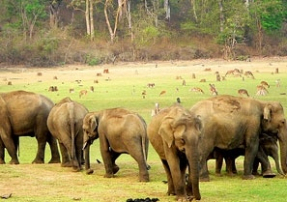

Slide 3
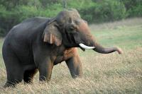

Slide 4
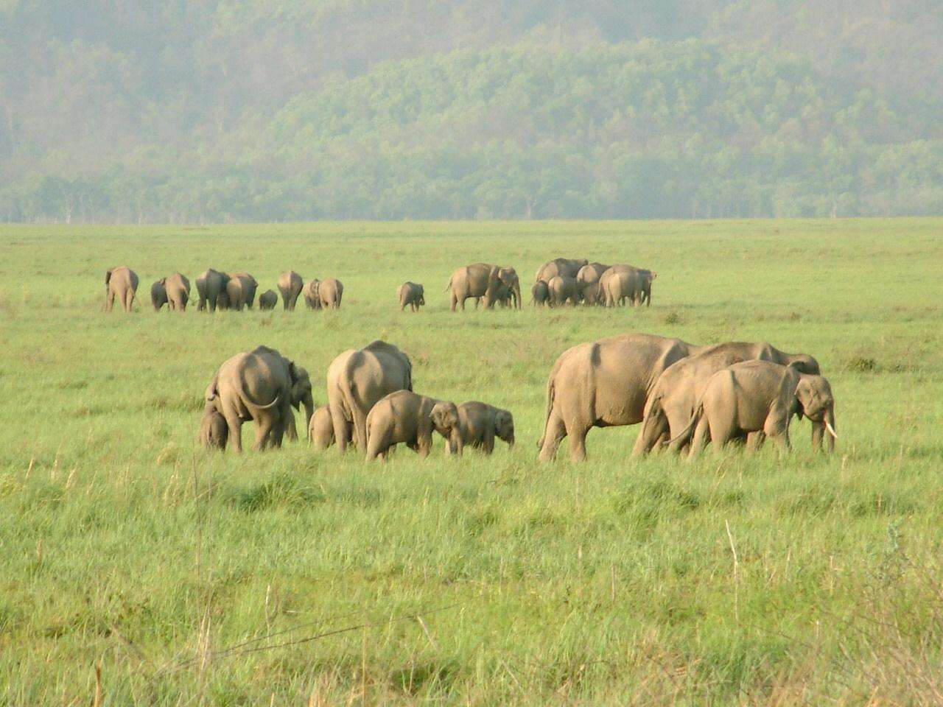

Slide 5
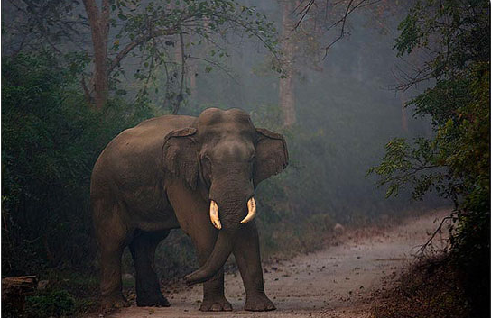

Slide 6
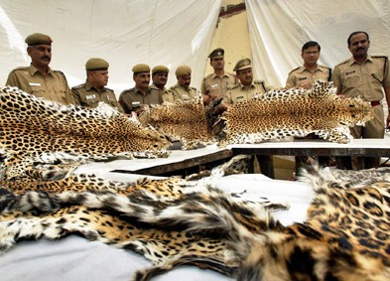
Poaching of leopard skins

Slide 7
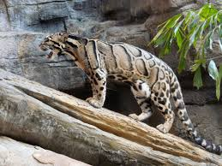

Slide 8
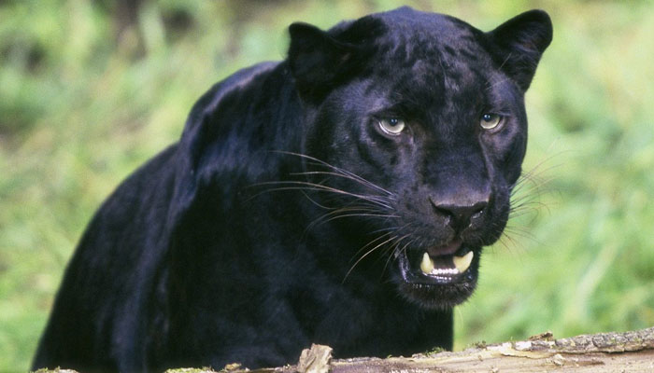
Panther

Slide 9
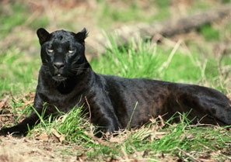
Black panther

Slide 10
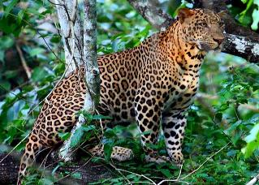
Leopard

Slide 11
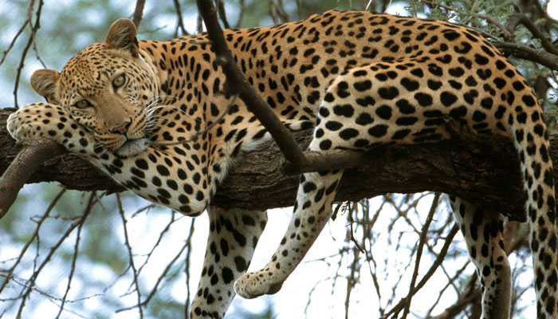

Slide 12
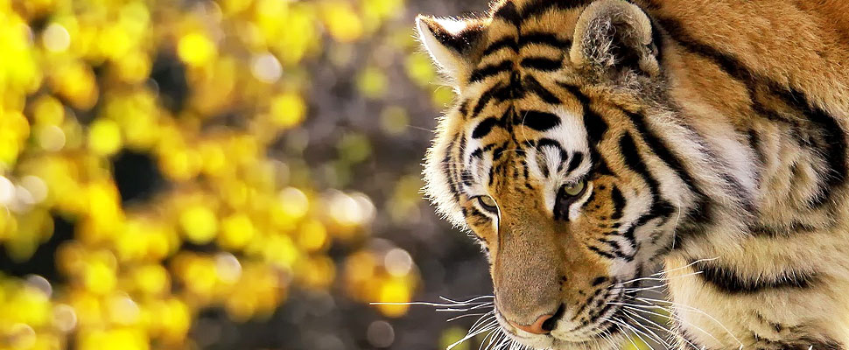

Slide 13
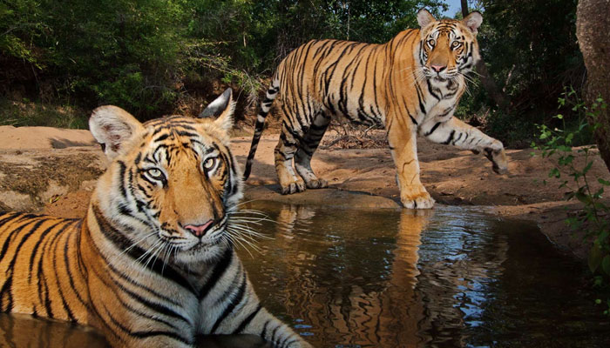

Slide 14
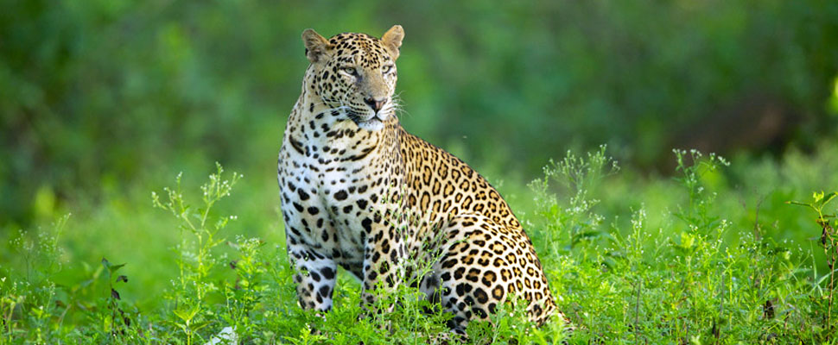

Slide 15
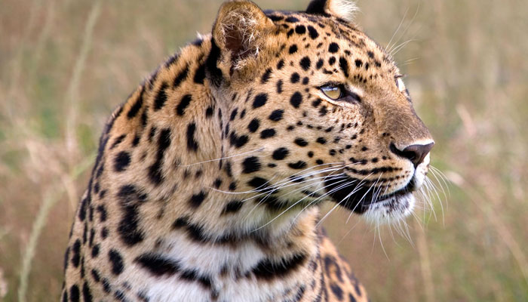

Slide 16
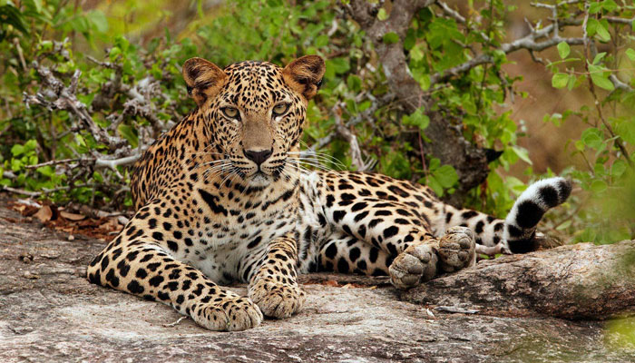

Slide 17
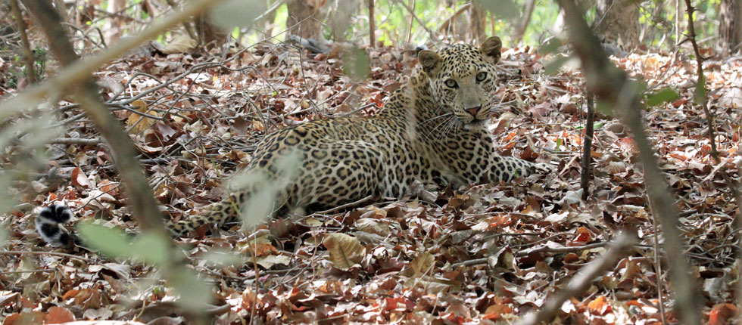

Slide 18
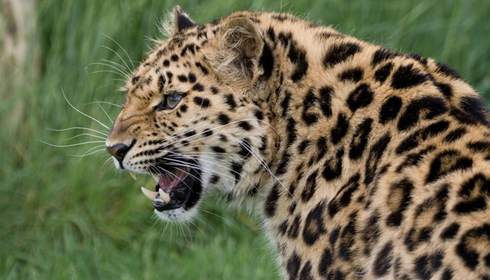

Slide 20
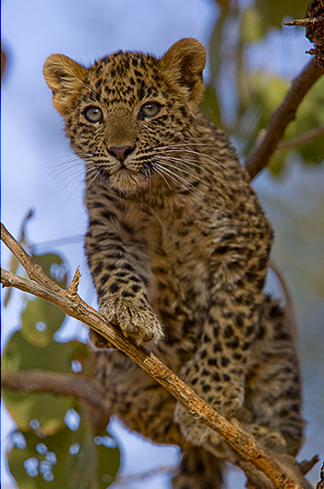
Leopard cub

Slide 21
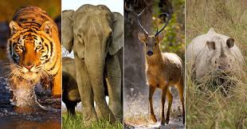

Slide 22


Slide 23
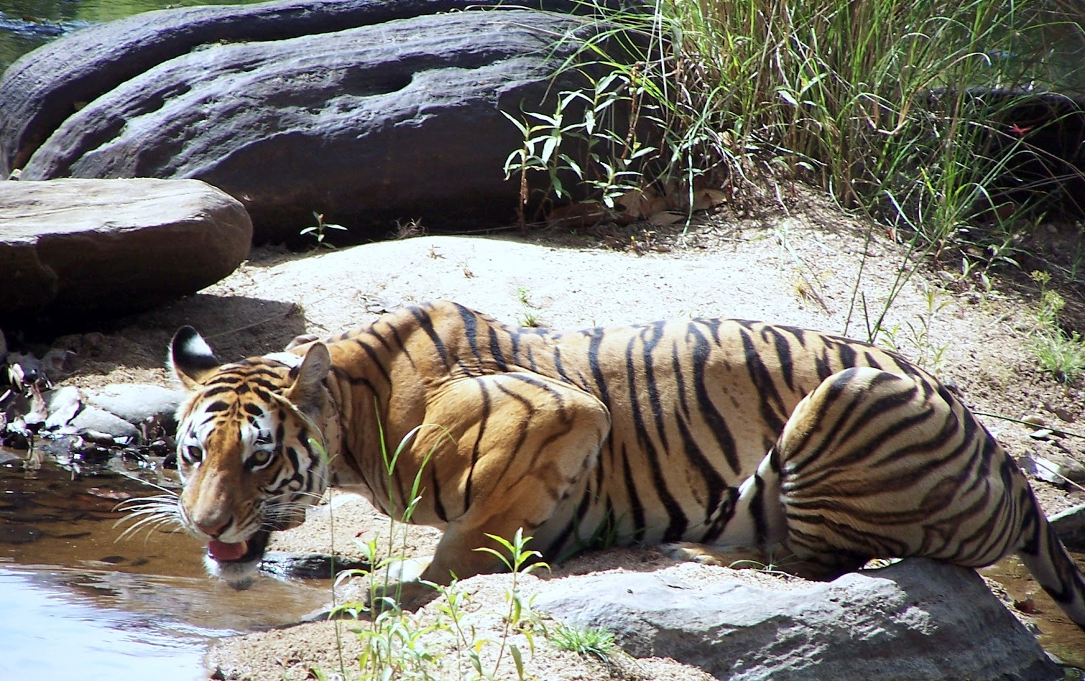

Slide 24


Slide 25


Slide 26


Slide 27


Slide 28
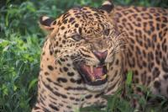

Slide 29


Slide 30
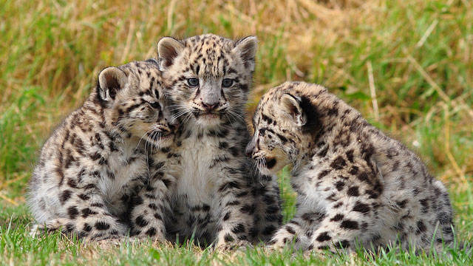

Slide 32


Slide 33
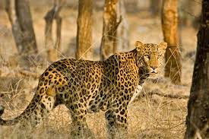

Slide 35


Slide 36
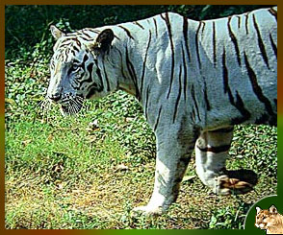
White Bengal Tiger

Slide 37


Slide 38
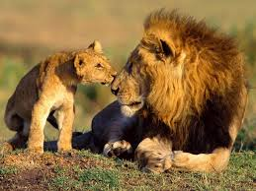

Slide 39


Slide 40


Slide 41
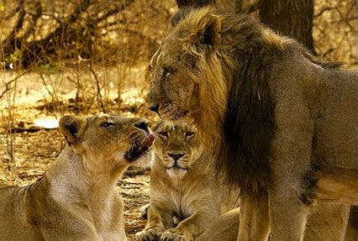

Slide 42


Slide 43


Slide 44
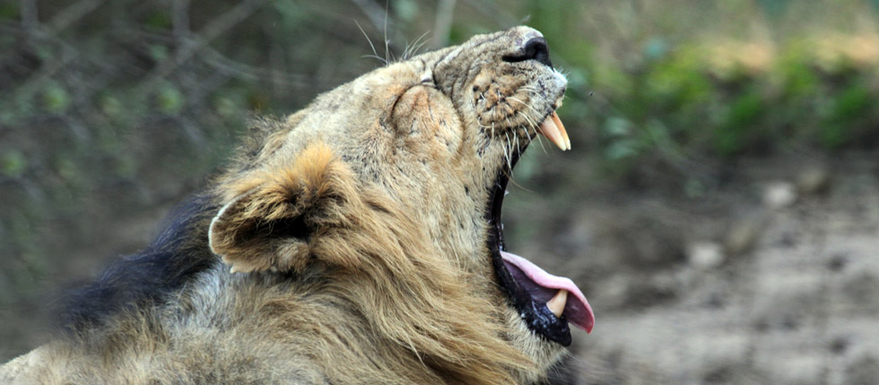

Slide 45


Slide 46


Slide 47
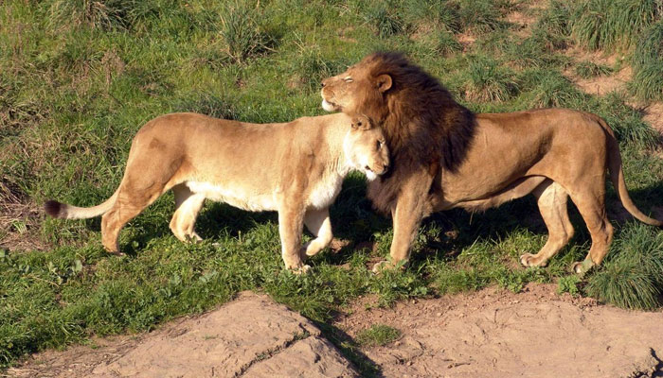

Slide 48


Slide 49


Slide 50
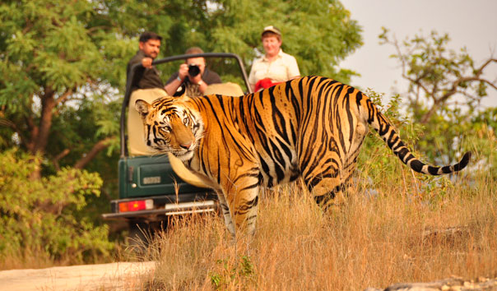

Slide 51


Slide 52
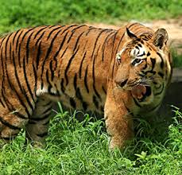

Slide 53
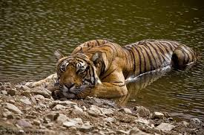

Slide 54
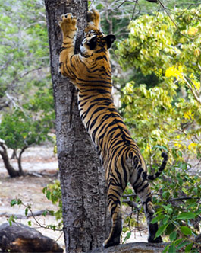

Slide 55
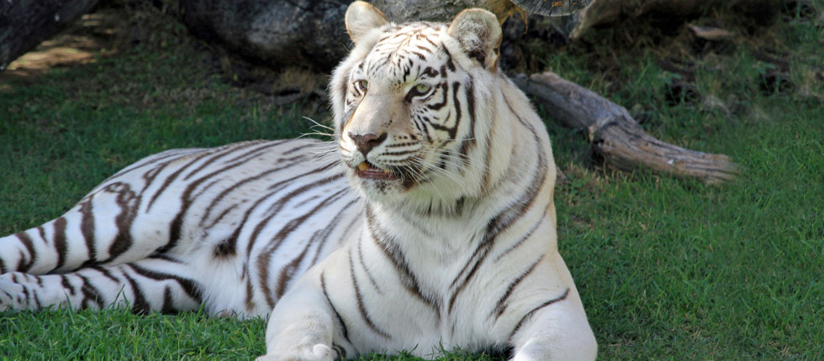
White Bengal Tiger

Slide 56


Slide 57
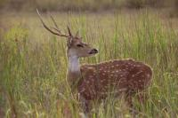

Slide 58
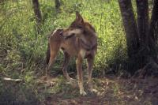

Slide 59
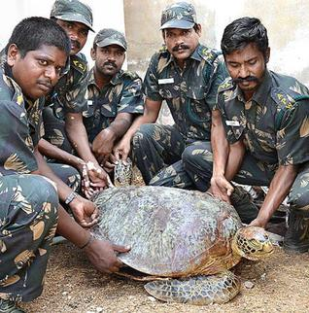
Rescued turtle

Slide 60
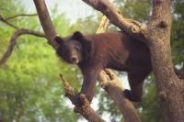
Himalayan black bear

Slide 61
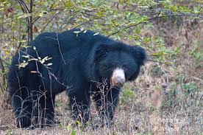

Slide 62
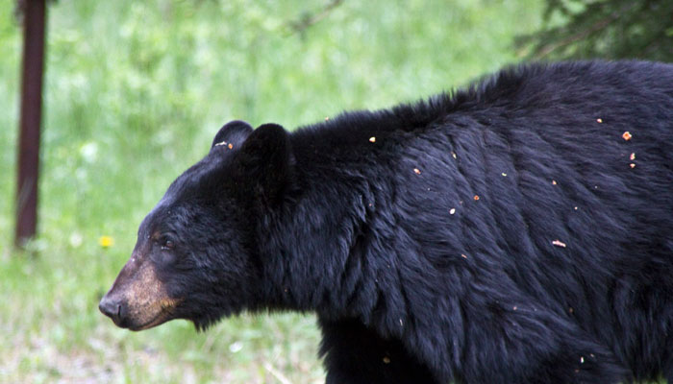

Slide 63
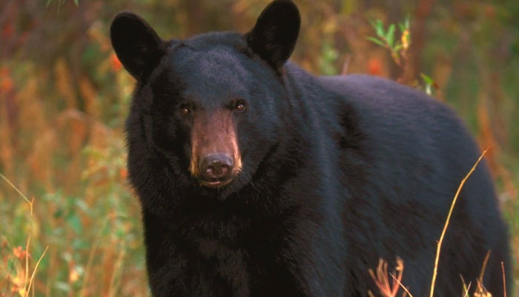

Slide 64
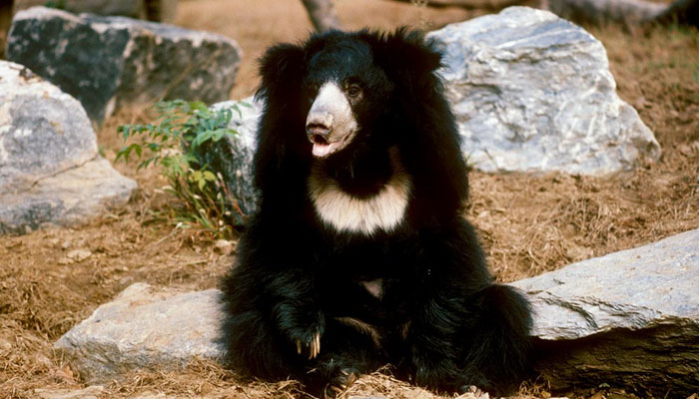
Sloth bear

Slide 65
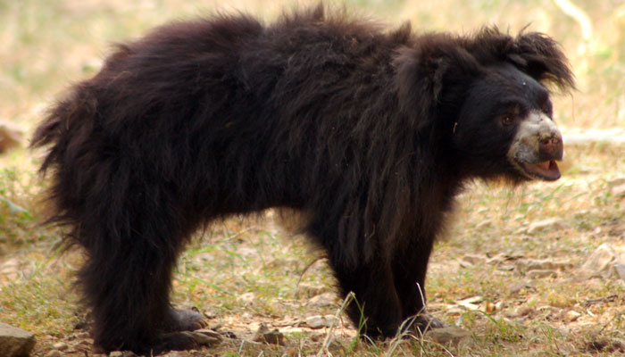
Sloth bear

Slide 66
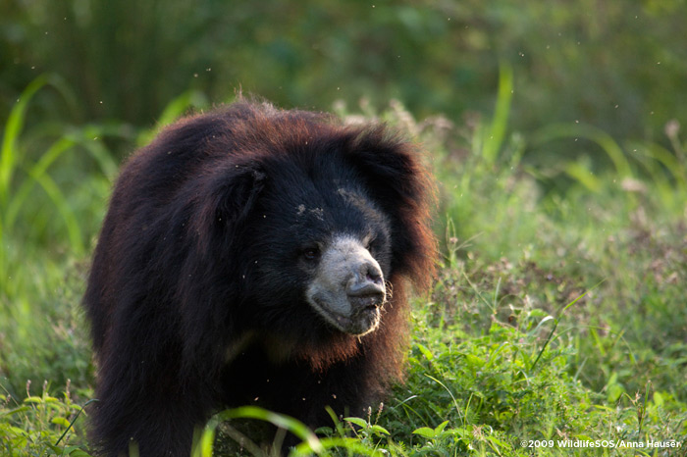

Slide 67
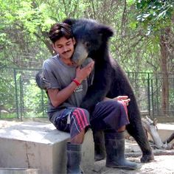
Rescued sloth bear

Slide 68
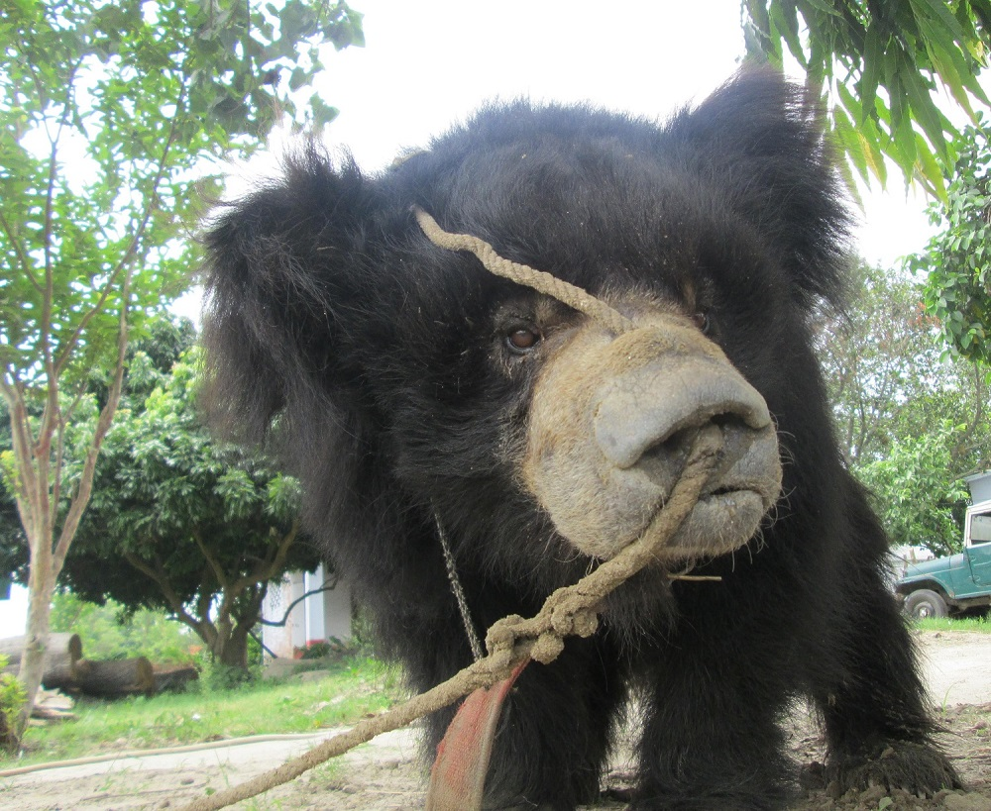
Rescued sloth bear

Slide 69
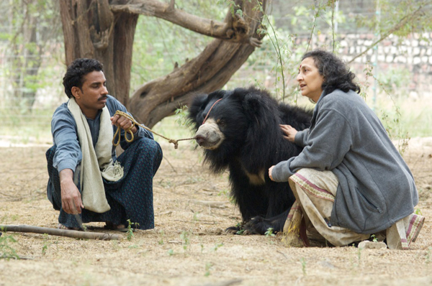
Kalandars abuse sloth bear

Slide 70
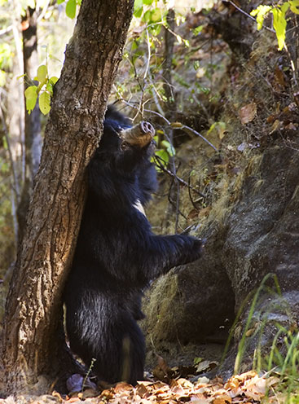
Sloth bear

Slide 71
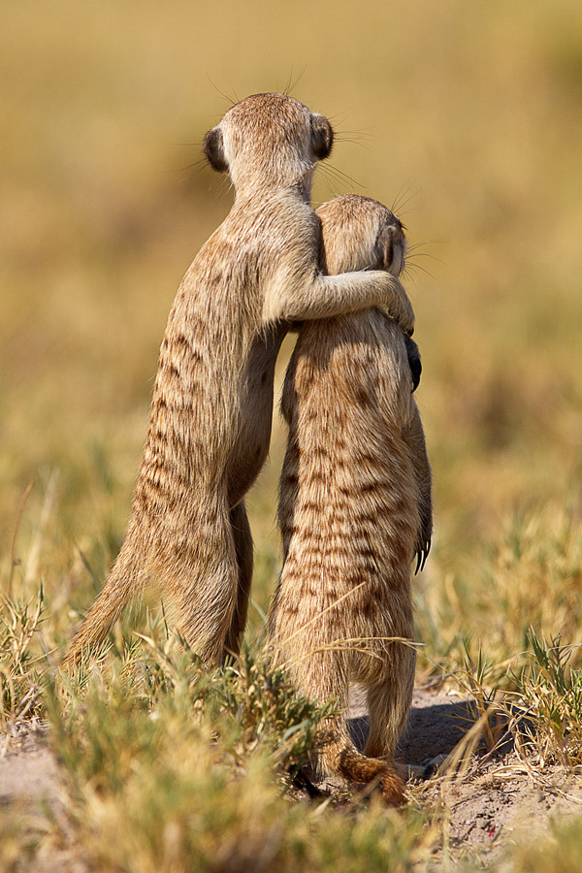

Slide 72
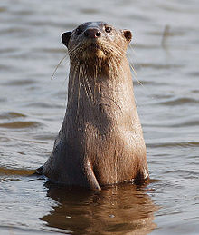
Otter

Slide 73
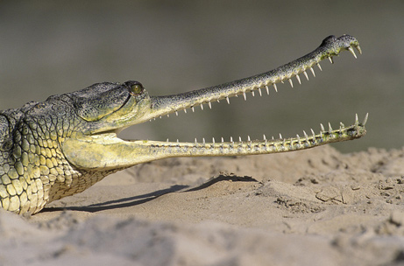
Gharial

Slide 74


Slide 75

Gharial

Slide 76


Slide 77


Slide 78


Slide 79


Slide 80


Slide 81


Slide 82

Crocodile

Slide 83


Slide 84


Slide 85


Slide 86


Slide 87


Slide 88


Slide 89

Mongoose

Slide 90

Grey wolf

Slide 91


Slide 92

Can anyone believe this?

Slide 93


Slide 94


Slide 95

King cobra

Slide 96


Slide 97

Cobra

Slide 98

Common cobra

Slide 99


Slide 100


Slide 101


Slide 102


Slide 103

Red mongoose

Slide 104

Mongoose

Slide 105

Mongoose

Slide 106


Slide 107


Slide 108


Slide 109

Mongoose

Slide 110


Slide 111

Mongoose

Slide 112


Slide 113

Black back antelopes

Slide 114


Slide 115

Blue sheep

Slide 116

Blue bull deer

Slide 117

Caribou deer

Slide 118

Chital deer

Slide 119

Chital deer

Slide 120

Indian shark

Slide 121


Slide 122

Ganga dolphin

Slide 123

Ganga dolphin

Slide 124

Ganga dolphin

Slide 125


Slide 126


Slide 127


Slide 128


Slide 129


Slide 130

Ganga river dolphin

Slide 131


Slide 132

Hare

Slide 133

River otter

Slide 134

Mongoose snake struggle

Slide 135

Jackal

Slide 136

Jackal

Slide 137

Jungle cat

Slide 138


Slide 139

Langur monkeys

Slide 140


Slide 141


Slide 142

Langur

Slide 143

Rhesus monkey

Slide 144

Mongoose

Slide 145

Nilgai

Slide 146

Otters

Slide 147


Slide 148


Slide 150

Sambar

Slide 151

Chameleon

Slide 152

Small mongoose

Slide 153

Slow lorison

Slide 154
Spotted deer

Slide 155

Squirrel

Slide 156
Wolf

Slide 157


Slide 158


Slide 159

Tibetan wild ass

Slide 160

Tibetan wolf

Slide 161

Wild ass

Slide 162

Wild dog

Slide 163


Slide 164


Slide 165


Slide 166


Slide 167


Slide 168

Red panda

Slide 169

Squirrel

Slide 170


Slide 171


Slide 172


Slide 173


Slide 174


Slide 175


Slide 176


Slide 177

Mallard duck

Slide 178


Slide 179


Slide 180


Slide 181


Slide 182


Slide 183

Secretary birds

Slide 184


Slide 185


Slide 186


Slide 187


Slide 188


Slide 189

Cranes

Slide 190


Slide 191


Slide 192


Slide 193


Slide 194


Slide 195

Toucan

Slide 196


Slide 197

Pelican

Slide 198


Slide 199

Cocatiel

Slide 200

Cranes

Slide 201


Slide 202


Slide 203


Slide 204

Vulture

Slide 205


Slide 206


Slide 207


Slide 208


Slide 209


Slide 210

Great horn bill

Slide 211


Slide 212

Peacocks

Slide 213


Slide 214

Saras crane

Slide 215


Slide 216


Slide 217

King fisher

Slide 218


Slide 219


Slide 220


Slide 221


Slide 222


Slide 223


Slide 224

Fox

Slide 225


Slide 226


Slide 227


Slide 228

Porcupine

Slide 229


Slide 230

Otter

Slide 231


Slide 232


Slide 233


Slide 234


Slide 235

Red scorpion

Slide 236


Slide 237


Slide 238


Slide 239

Wolf

Slide 240

Wolf cubs

Slide 241


Slide 242

Spotted deer

Slide 243

Baby mongoose

Slide 245
Otters

Slide 246

Wolf

Slide 247

Pangolin

Slide 248


Slide 251


Slide 253
Wild dog

Slide 254

Hyena

Slide 255

Hyena

Slide 256


Slide 257

Striped hyena

Slide 258

Wild donkeys in Rahasthan

Slide 259

Wild ass of desert

Slide 260


Slide 261


Slide 263


Slide 264

Wild horses

Slide 265

Wild horses

Slide 266

Wild buffaloes

Slide 267

Fox

Slide 268

Gaur

Slide 269

Wild ass of Rajasthan

Slide 270

Gir lions

Slide 271


Slide 272


Slide 273

Indian Rhino

Slide 274

White rhino

Slide 275


Slide 276

Brahmaputra valley rhino

Slide 277

Darjeeling black rhino

Slide 278


Slide 279

Black rhino

Slide 280


Slide 281

Mouse deer

Slide 282


Slide 283


Slide 284


Slide 285

Turtle

Slide 286


Slide 287


Slide 288


Slide 289

Lizard in the desert

Slide 290

Tibetan wolf

