Slide 1
Tribes of Africa
Part two
Tribes of Africa
Part two
This is the continuation of Part One to highlight various tribes of Africa, their clothes, jewelries, dances and other accoutrements.
It is for private viewing only.
AKC

Slide 2
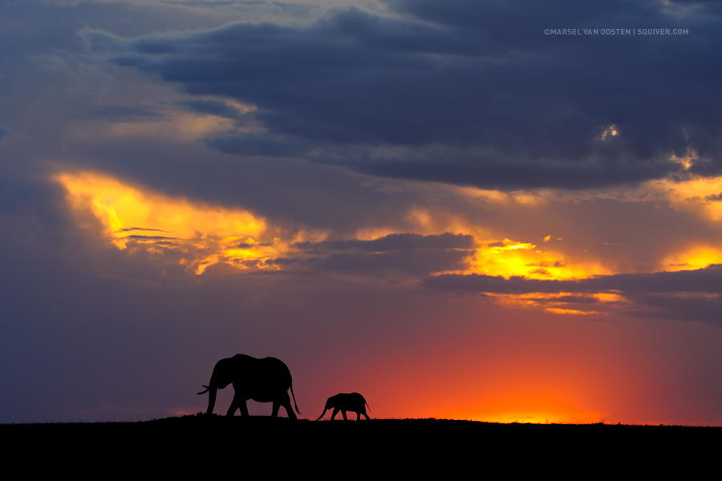
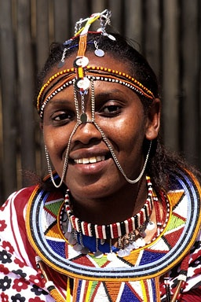

Slide 3
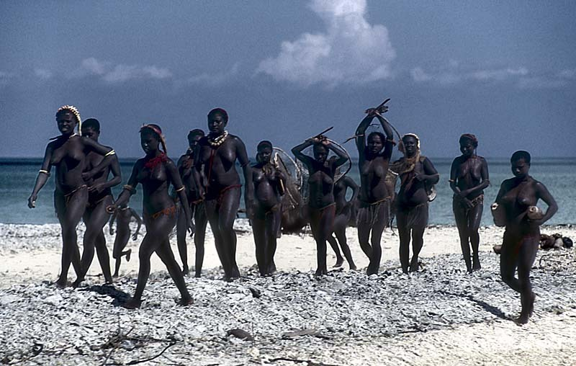
Jarawa tribe

Slide 4
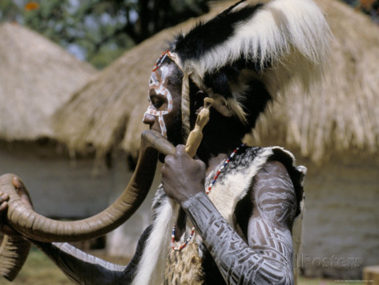
Kikuyu tribesman

Slide 5
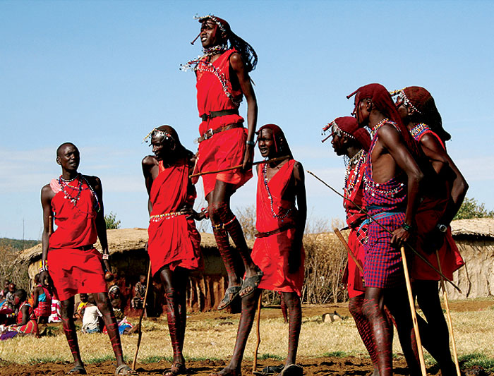
Masai jumpers

Slide 6
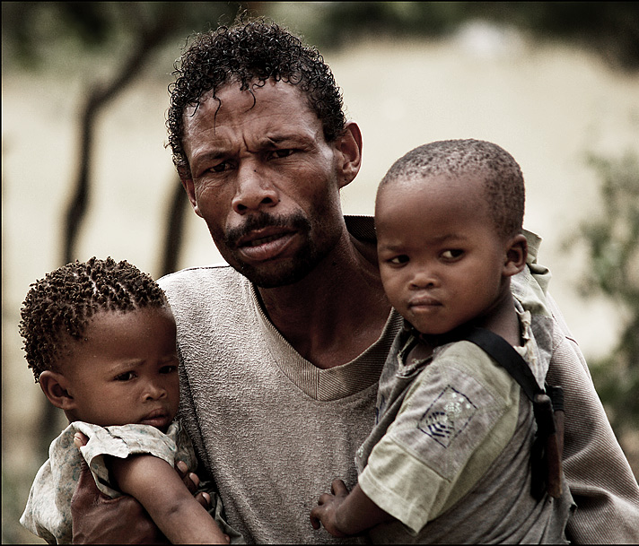
Khoi tribe

Slide 7
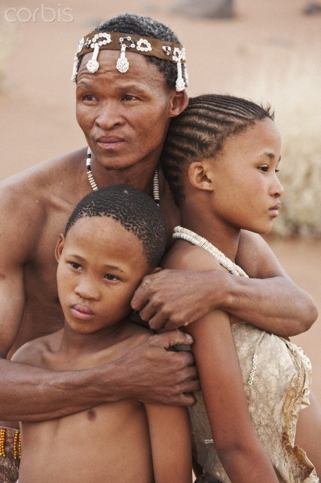
Khoi tribe

Slide 8
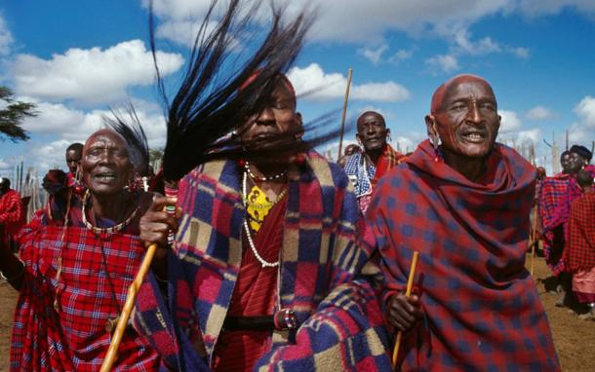

Slide 9
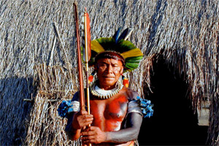

Slide 10
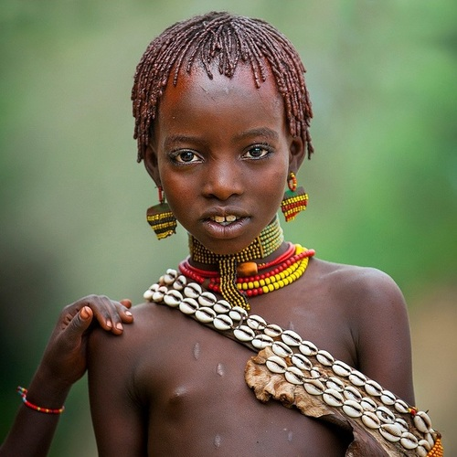

Slide 11
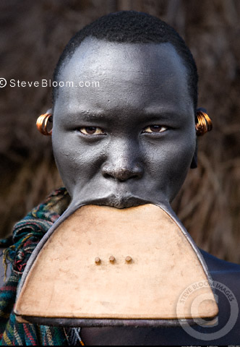

Slide 12
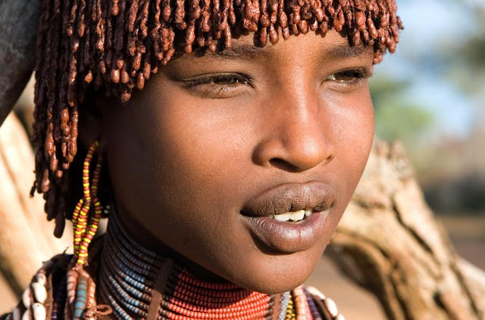

Slide 13
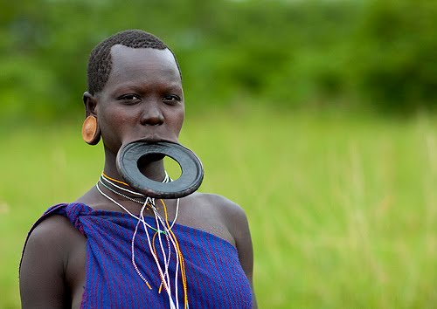

Slide 14
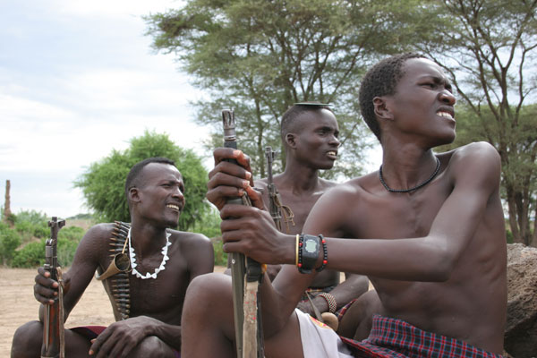
Locho tribesman

Slide 15
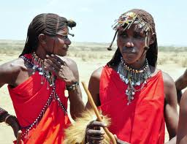
Masai

Slide 16
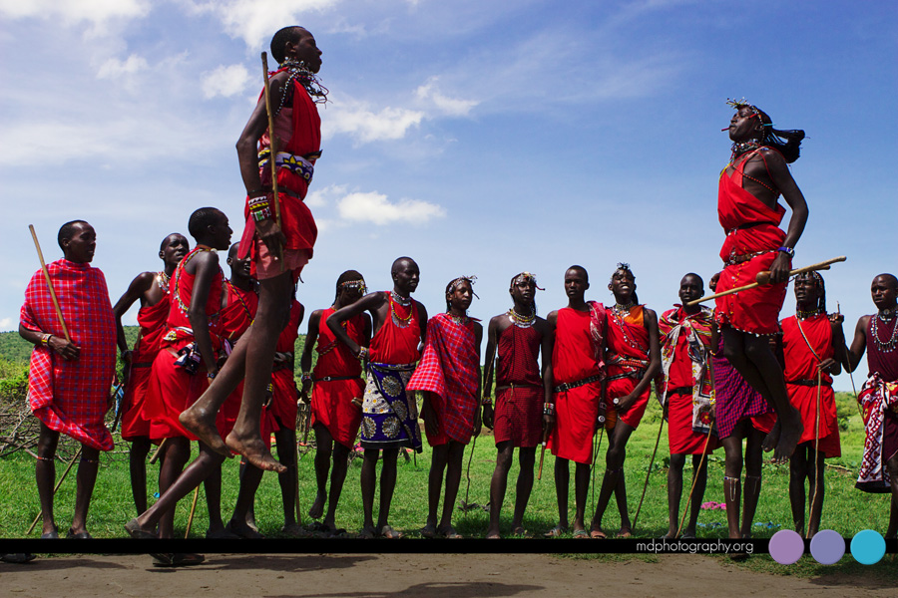
Masai dance

Slide 17
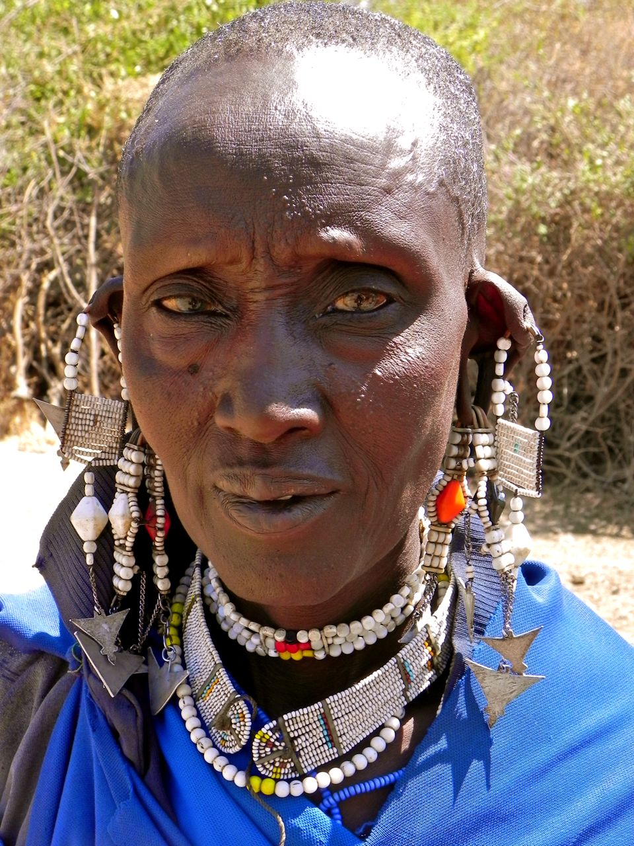
Masai

Slide 18
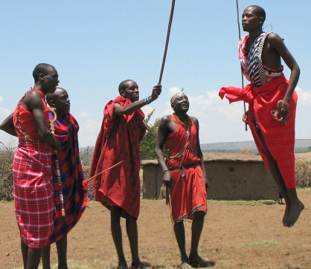
Masai

Slide 19
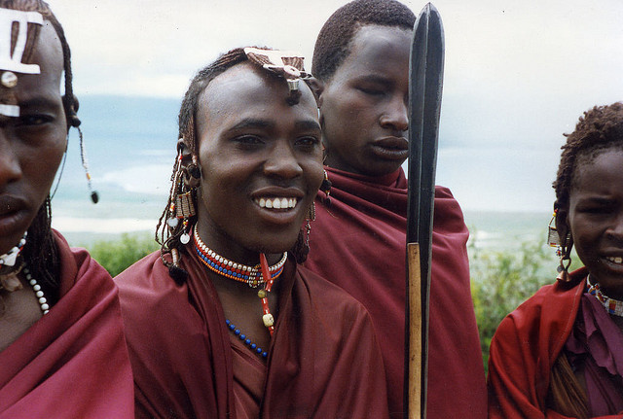
Masai from Tanzania

Slide 20
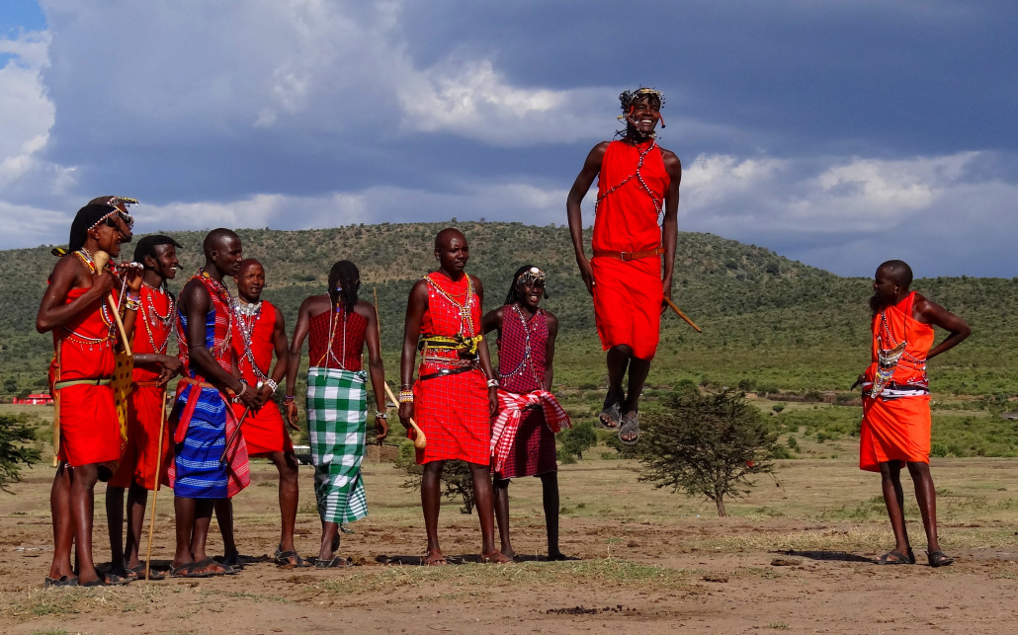
Masai in Tanzania

Slide 21
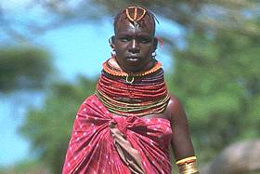
Masai woman

Slide 22
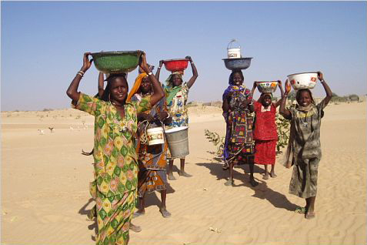
Mao women

Slide 23
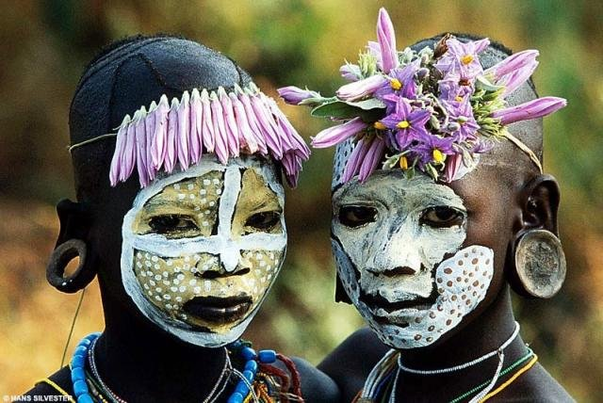

Slide 24
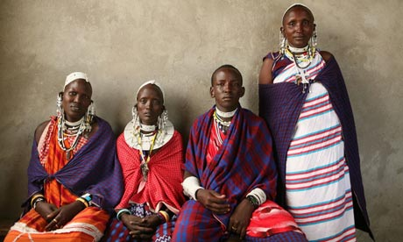
Masai women

Slide 25
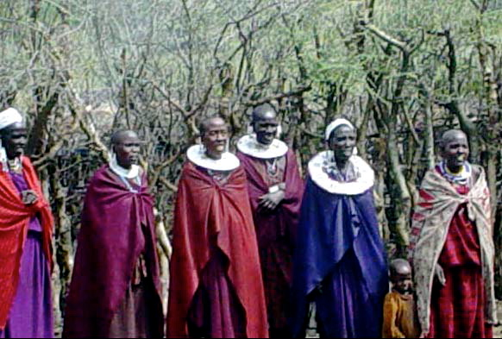
Masai women

Slide 26
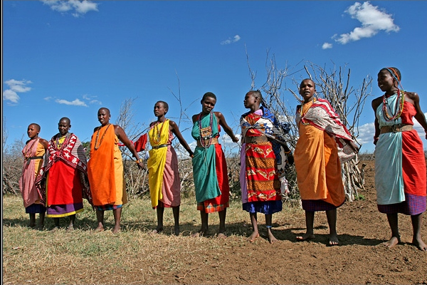
Masai dancers

Slide 27
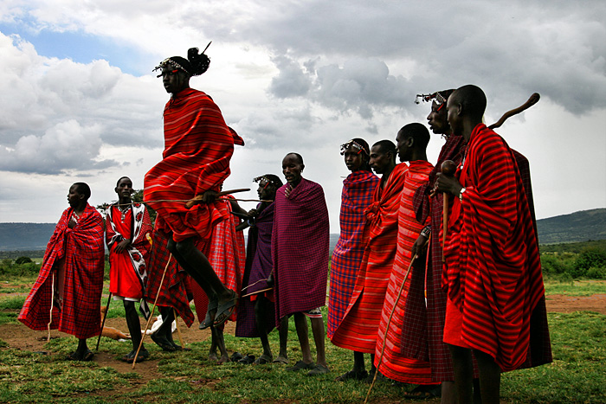
Masai

Slide 28
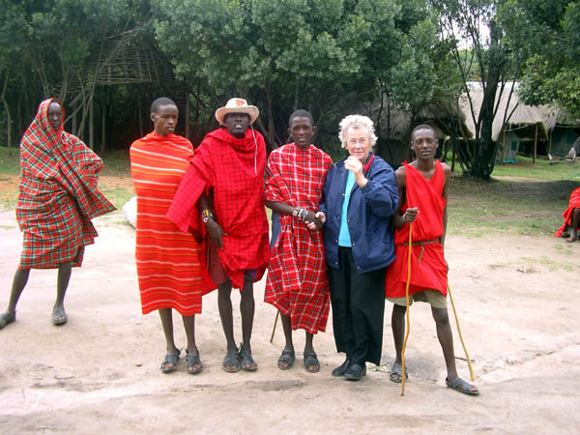
Masai tribesmen

Slide 29
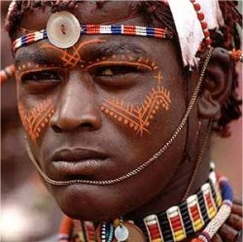
Masai warrior

Slide 30
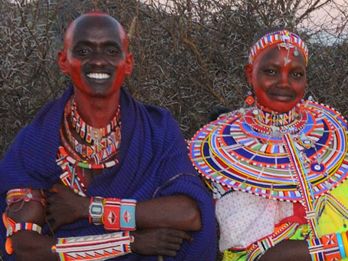
Masai wedding

Slide 31
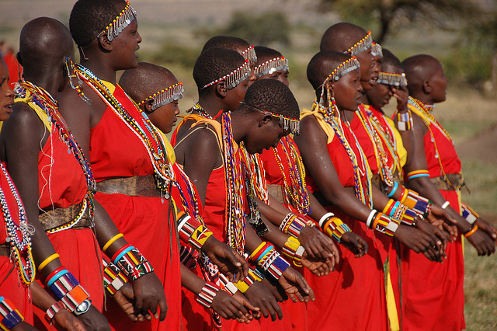
Masai women

Slide 32
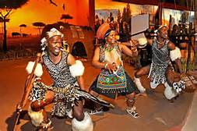
Matabele Xhosa

Slide 33
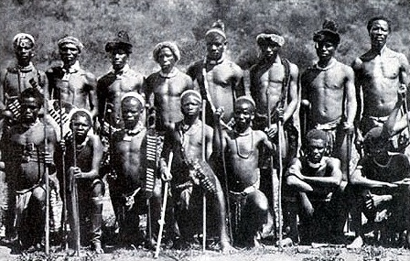
Matabele tribe

Slide 34
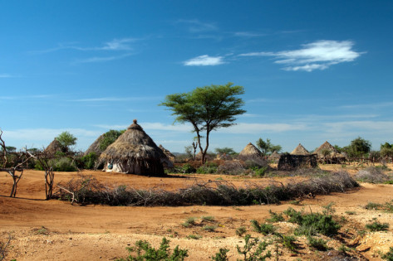

Slide 35
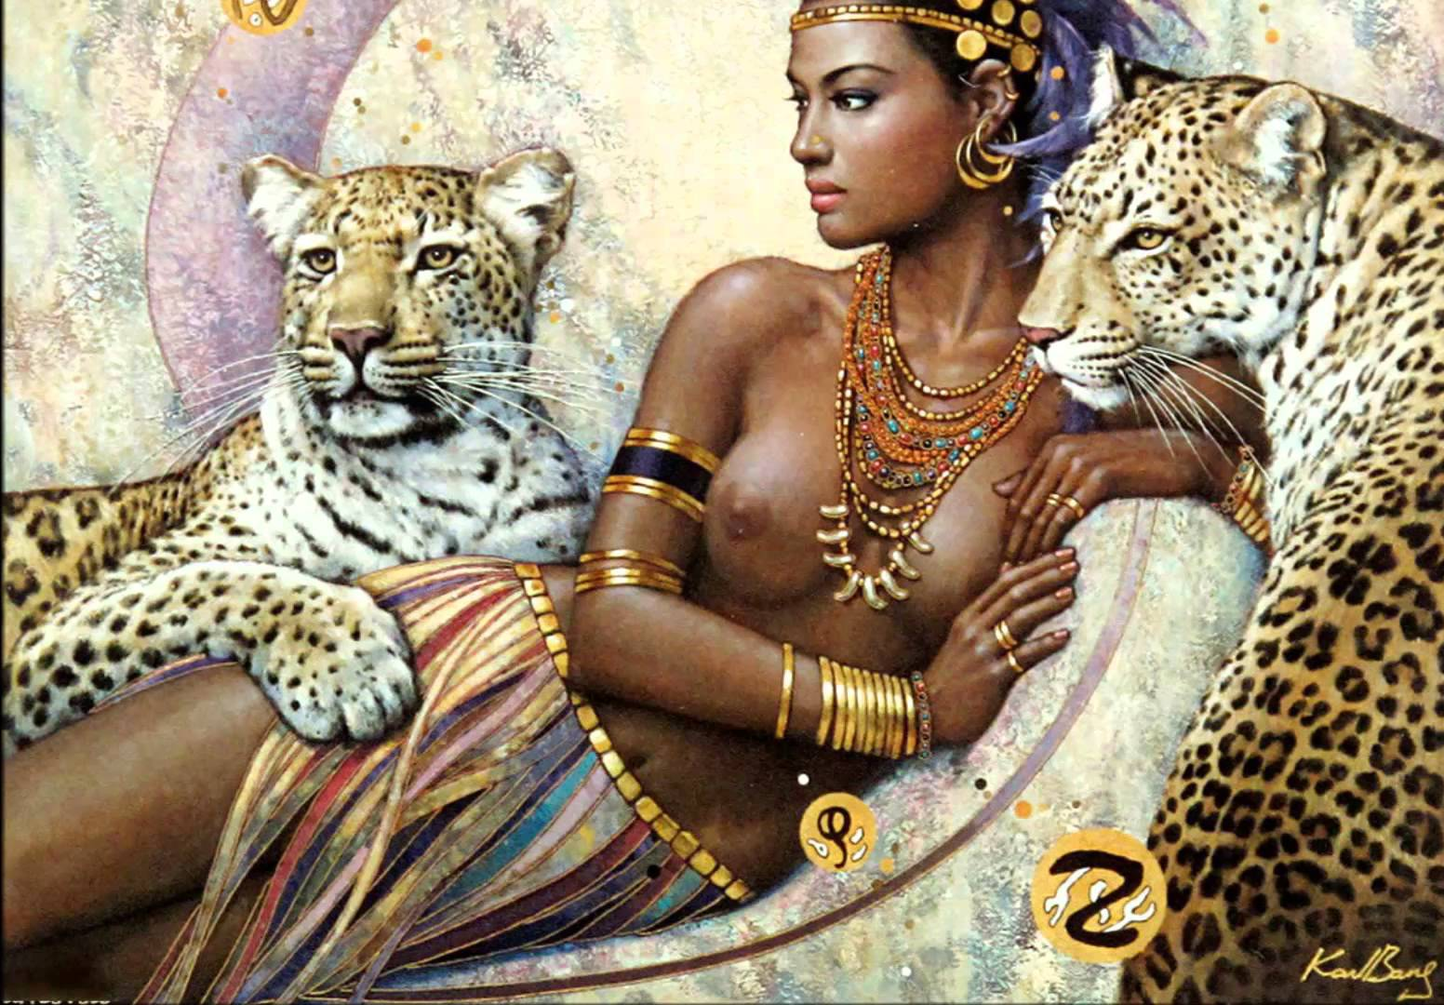

Slide 36
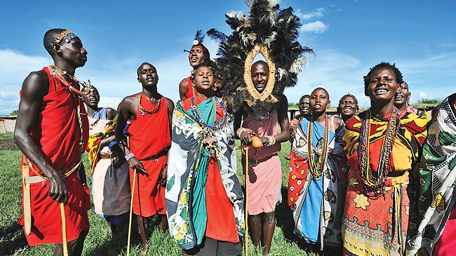

Slide 37
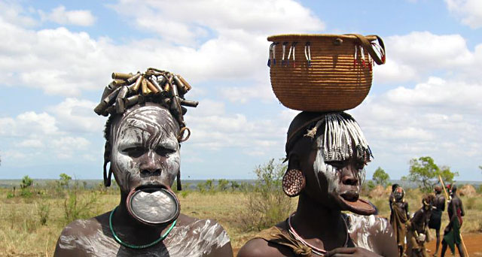
Mursi tribe of Ethiopia

Slide 38
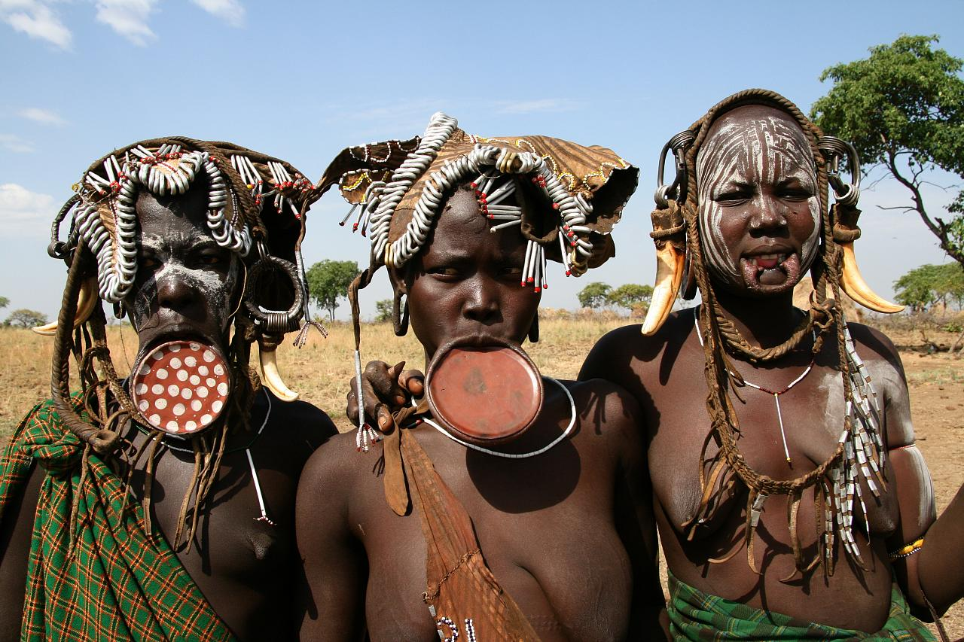
Mursi tribe

Slide 39
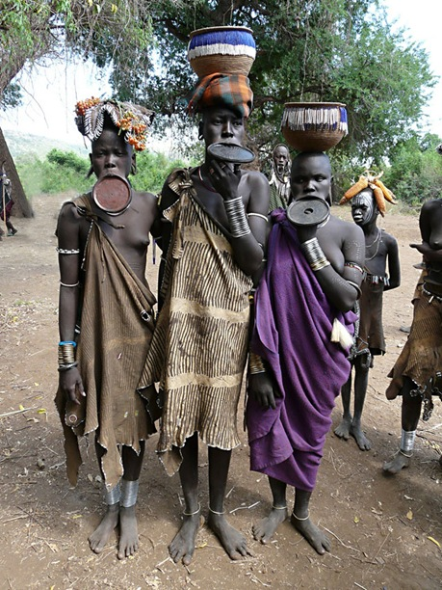
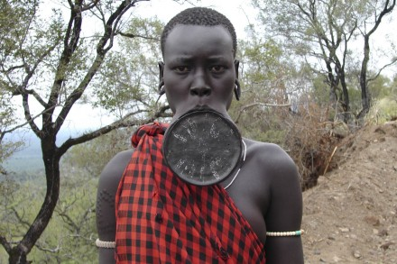
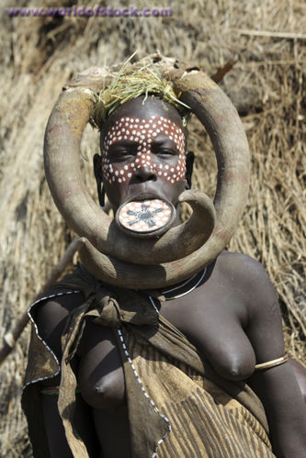
Mursi tribe of Ethiopia

Slide 40
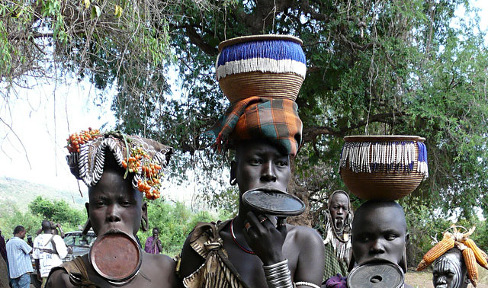
Mursi of Ethiopia

Slide 41
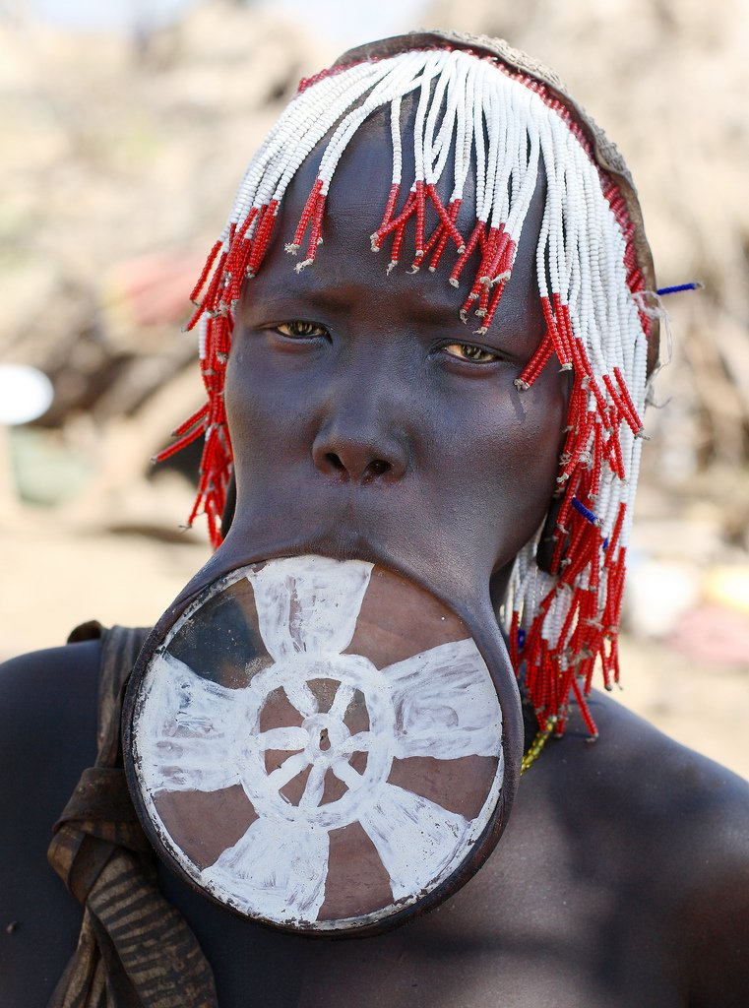
Mursi

Slide 42
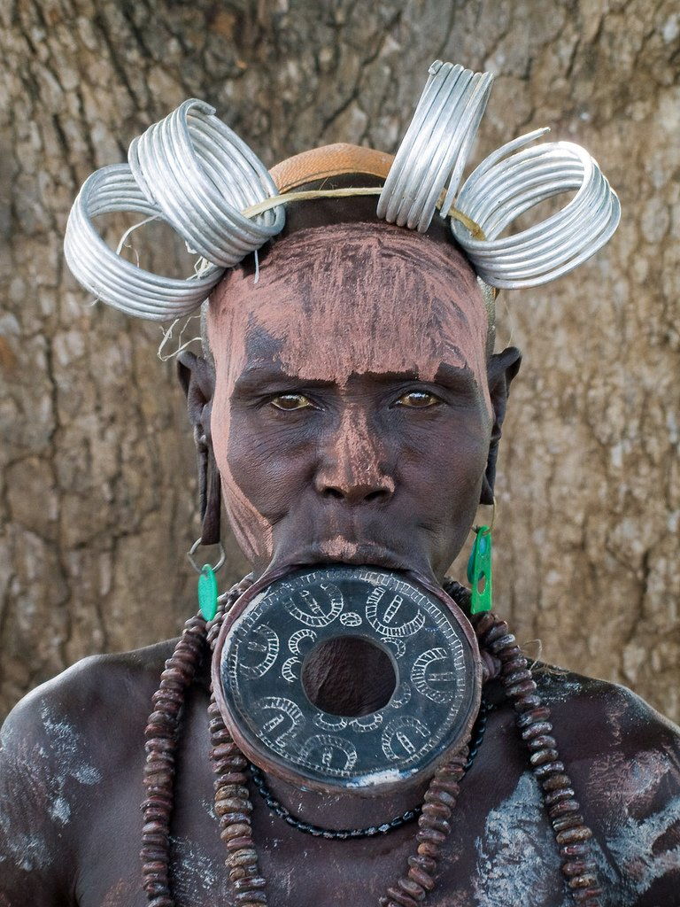
Mursi

Slide 43
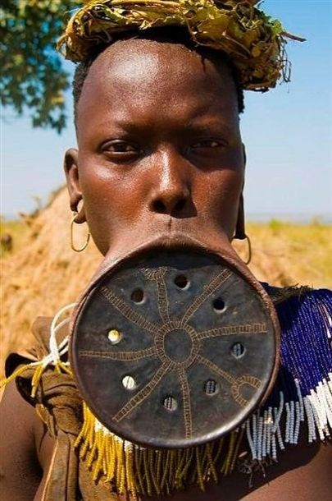
Mursi woman

Slide 44
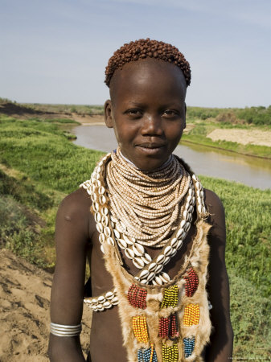

Slide 45
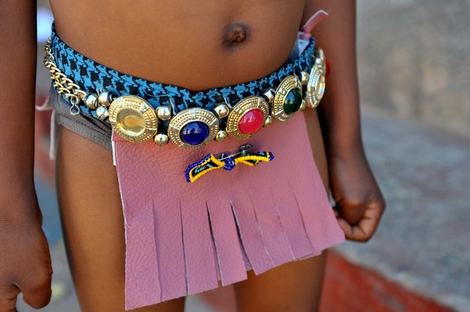
Ndebele girl

Slide 46
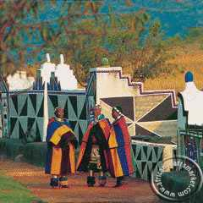
Ndebele women

Slide 47
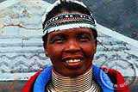
Ndebele rings

Slide 48
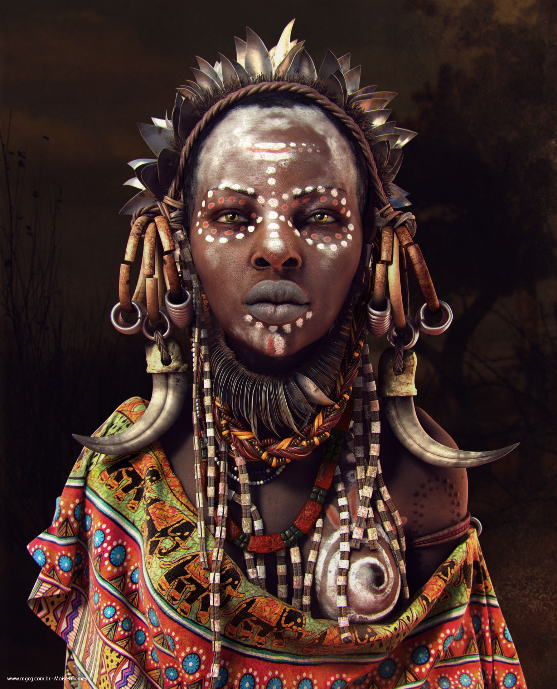

Slide 49

Fulani of Niger

Slide 50

Bushmen

Slide 51

Touareg woman

Slide 52


Slide 53

Omo river people

Slide 54


Slide 55


Slide 56


Slide 57


Slide 58


Slide 59

Ulu tribal dance
Zulu tribal dance

Slide 60

Fulani tribesmen

Slide 61

Masai woman

Slide 62

Pygmies

Slide 63

Pygmies dancing

Slide 64


Slide 65


Slide 66


Slide 67

Samburu woman

Slide 68

Samburu woman

Slide 69

Samburu men

Slide 70

Samburu men

Slide 71

San tribe

Slide 72

Shiluk tribe

Slide 73

Xhosa girls singing

Slide 74


Slide 75


Slide 76

Somali Afro

Slide 77

Somali girl

Slide 78

South Africa

Slide 79

Ndebele women of South Africa

Slide 80

Swaziland women

Slide 81

Xhosa family of South Africa

Slide 82

South Africa

Slide 83

South Africa tribe

Slide 84

Amboseli, Kenya

Slide 85

Zulu woman in South Africa

Slide 86

Surma tribe

Slide 87

Surma tribe

Slide 88

Surma tribe

Slide 89

Surma boys

Slide 90

Surma and Mursi tribes

Slide 91


Slide 92

Masai jumpers

Slide 93


Slide 94


Slide 95


Slide 96

Mursi woman

Slide 97


Slide 98


Slide 99

Namib bushman

Slide 100


Slide 101


Slide 102


Slide 103


Slide 104


Slide 105


Slide 106


Slide 107


Slide 108


Slide 109


Slide 110


Slide 111


Slide 112


Slide 113


Slide 114


Slide 115


Slide 116


Slide 117


Slide 118


Slide 119


Slide 120


Slide 121


Slide 122


Slide 123

Fulanis of Niger

Slide 124


Slide 125

Suri of Omo valley

Slide 126


Slide 127


Slide 128


Slide 129

Scarification

Slide 130


Slide 131


Slide 132


Slide 133


Slide 134


Slide 135


Slide 136

Bushman of Namib

Slide 137


Slide 138


Slide 139


Slide 140


Slide 141


Slide 142


Slide 143


Slide 144


Slide 145


Slide 146


Slide 147


Slide 148


Slide 149


Slide 150


Slide 151


Slide 152


Slide 153


Slide 154


Slide 155


Slide 156


Slide 157


Slide 158


Slide 159


Slide 160


Slide 161


Slide 162


Slide 163


Slide 164


Slide 165


Slide 166


Slide 167


Slide 168


Slide 169


Slide 170


Slide 171


Slide 172


Slide 173


Slide 174


Slide 175


Slide 176


Slide 177


Slide 178


Slide 179


Slide 180


Slide 181


Slide 182


Slide 183


Slide 184


Slide 185


Slide 186


Slide 187


Slide 188


Slide 189


Slide 190


Slide 191


Slide 192


Slide 193


Slide 194


Slide 195


Slide 196


Slide 197


Slide 198

Zulu clothes

Slide 199


Slide 200


Slide 201


Slide 202


Slide 203


Slide 204


Slide 205


Slide 206


Slide 207


Slide 208


Slide 209


Slide 210


Slide 211


Slide 212


Slide 213


Slide 214


Slide 215


Slide 216


Slide 217

Tribe of Tanzania

Slide 218

Tribe of Ethiopia

Slide 219


Slide 220

Touareg man

Slide 221


Slide 222


Slide 223


Slide 224


Slide 225


Slide 226


Slide 227


Slide 228


Slide 229


Slide 230

Turkana,Kenya people

Slide 231

Ndebele ladies

Slide 232

Uganda warrior

Slide 233


Slide 234


Slide 235


Slide 236


Slide 237


Slide 238

Warrior dance

Slide 239

Zulu wedding

Slide 240


Slide 241


Slide 242


Slide 243


Slide 245


Slide 246

Yombe tribe scarification

Slide 247

Young Zulu couple

Slide 248

Zulu warriors

Slide 249

Young Zulu women

Slide 250

Zulu girls

Slide 251

Fearsome Zulu warriors

Slide 252

Zulu tribe

Slide 253

A Zulu woman

