Slide 1
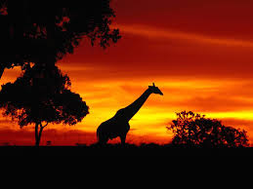
Tribes of Africa
Part three
The tribes of Africa is a mighty subject as there are so many tribes but many are represented here if not all to show the diversity and their ethnic differences, physique,costumes and jewelries. It is a continuation of Part two.
It is for your private viewing pleasure only.
AKC/ October 2015

Slide 2
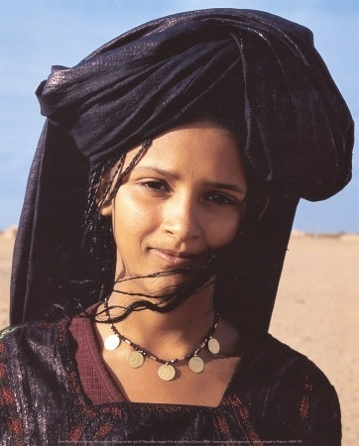
Berber girl of North Africa

Slide 3
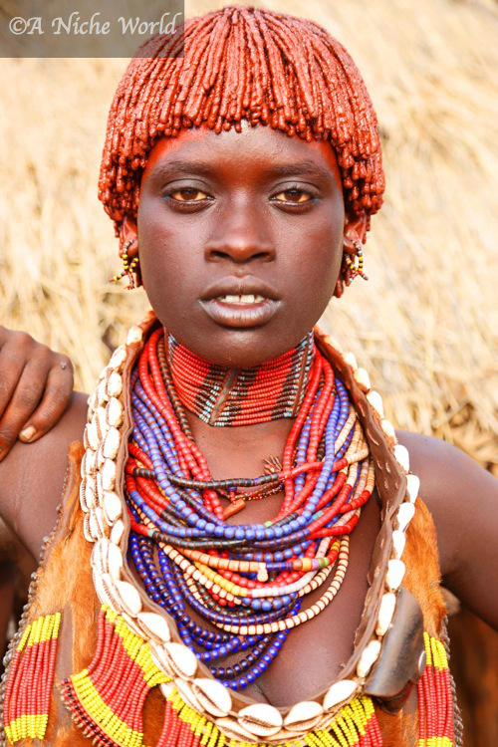
Benin

Slide 4
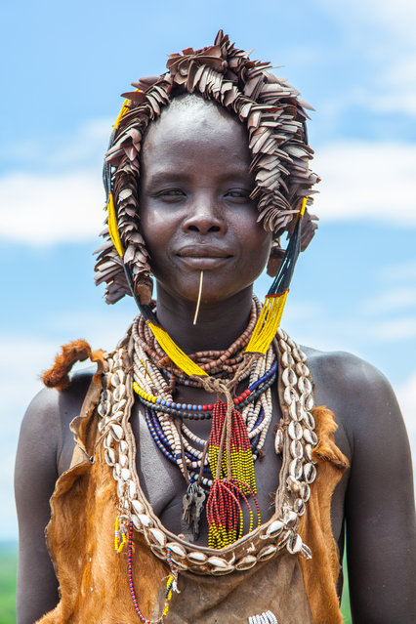

Slide 5
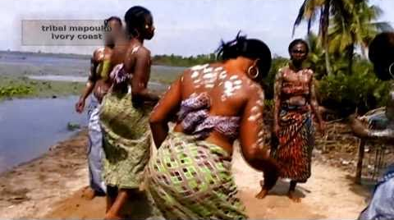

Slide 6
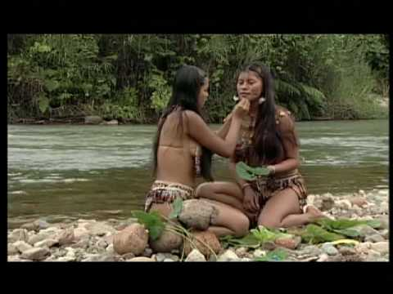

Slide 7
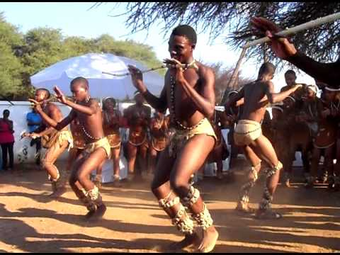

Slide 8
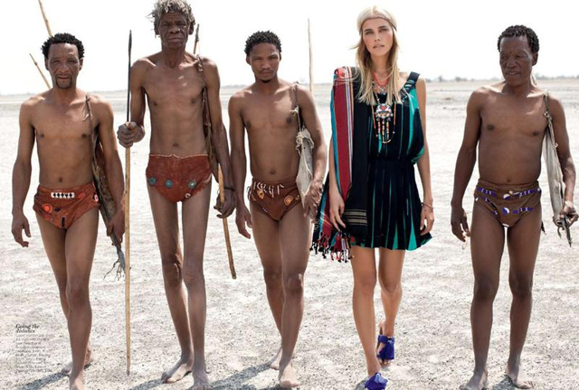
Hotentots

Slide 9
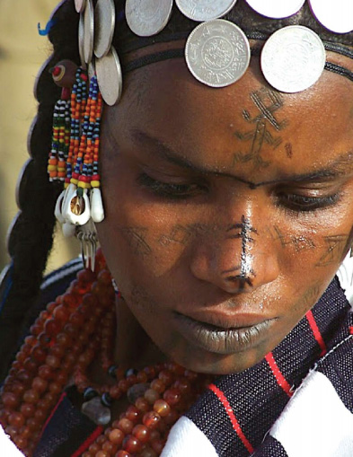

Slide 10
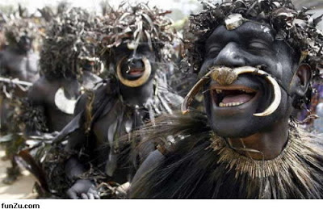

Slide 11
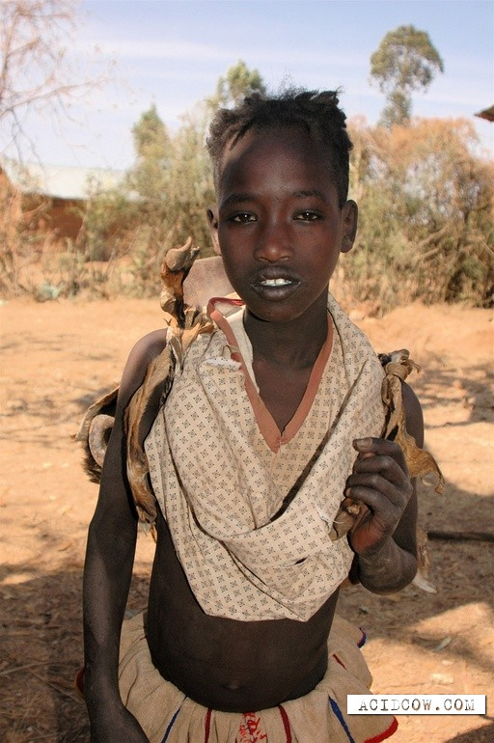

Slide 12
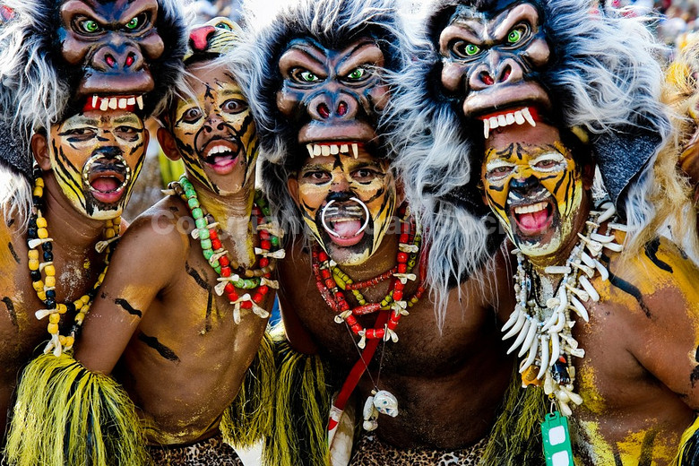
Ancient tribal masks

Slide 13
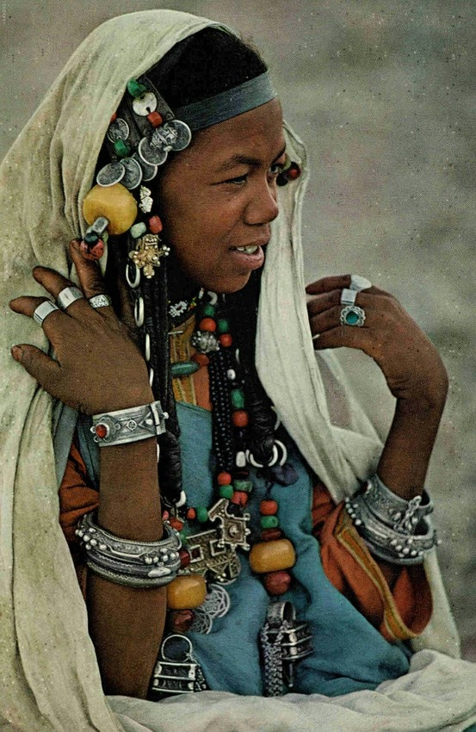

Slide 14
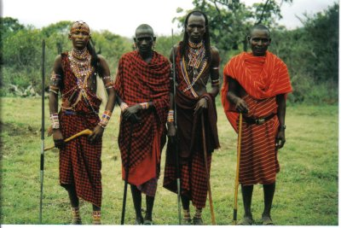
Masai warriors of Kenya

Slide 15
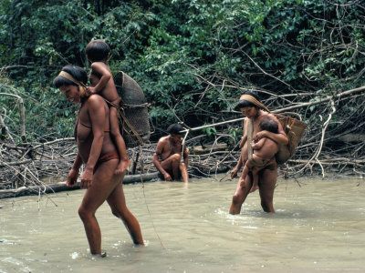

Slide 16
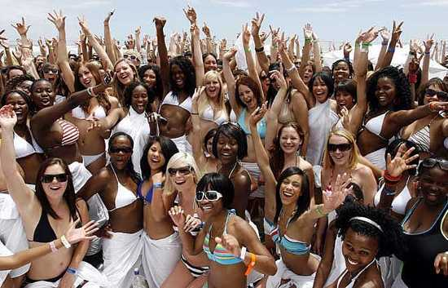
Diversity in African women

Slide 17
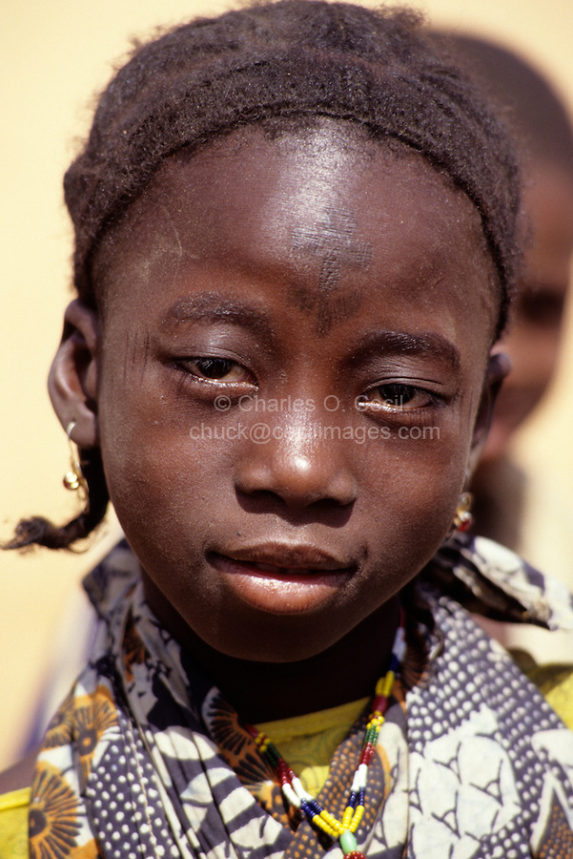
Fulani girl with tattoo

Slide 18
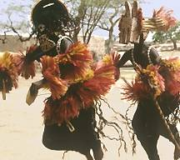

Slide 19
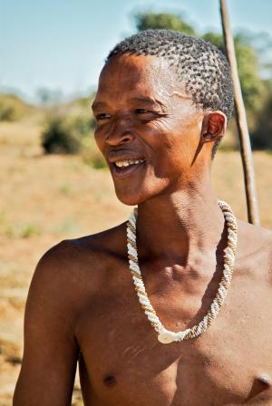
Bushman of Namibia

Slide 20
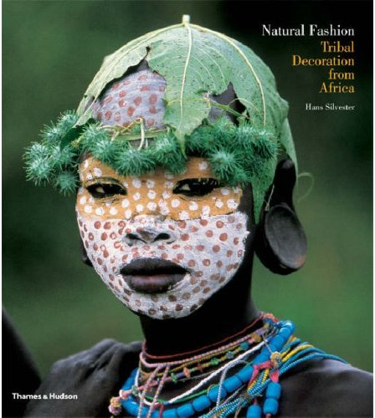

Slide 21
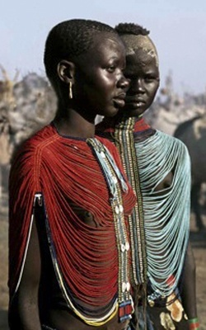

Slide 22
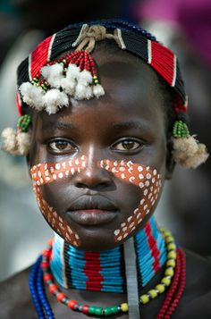

Slide 23
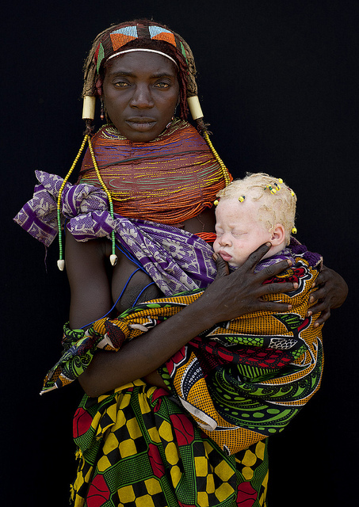
Woman with albino child

Slide 24
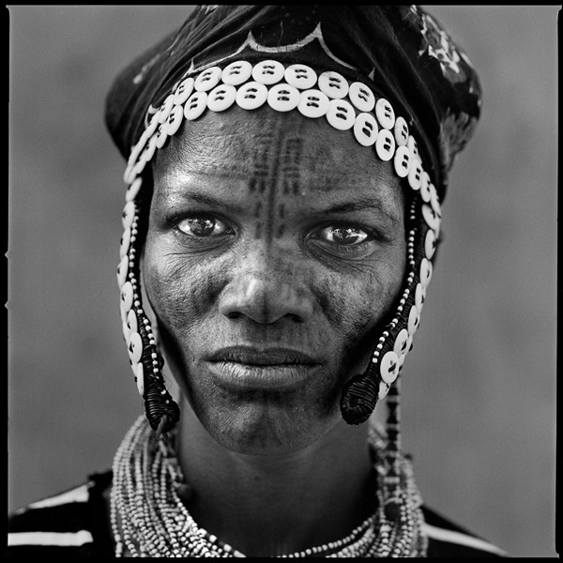

Slide 25
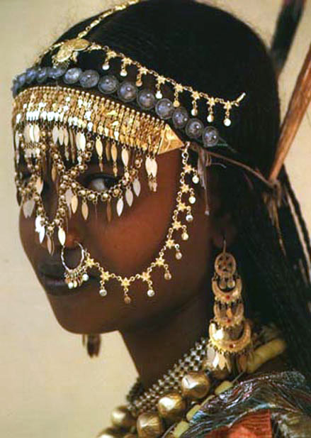
North African metal beads

Slide 26
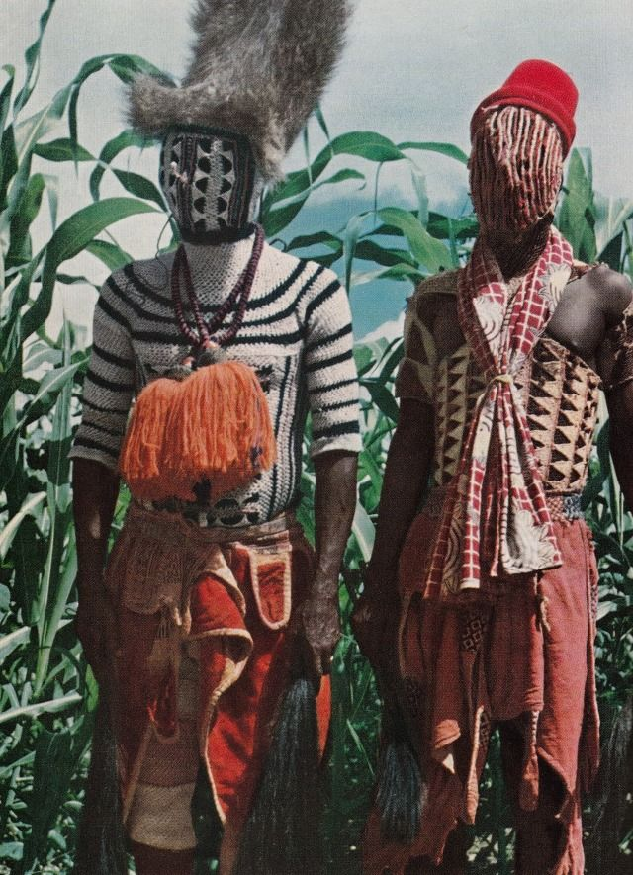

Slide 27
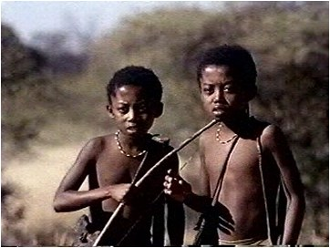

Slide 28
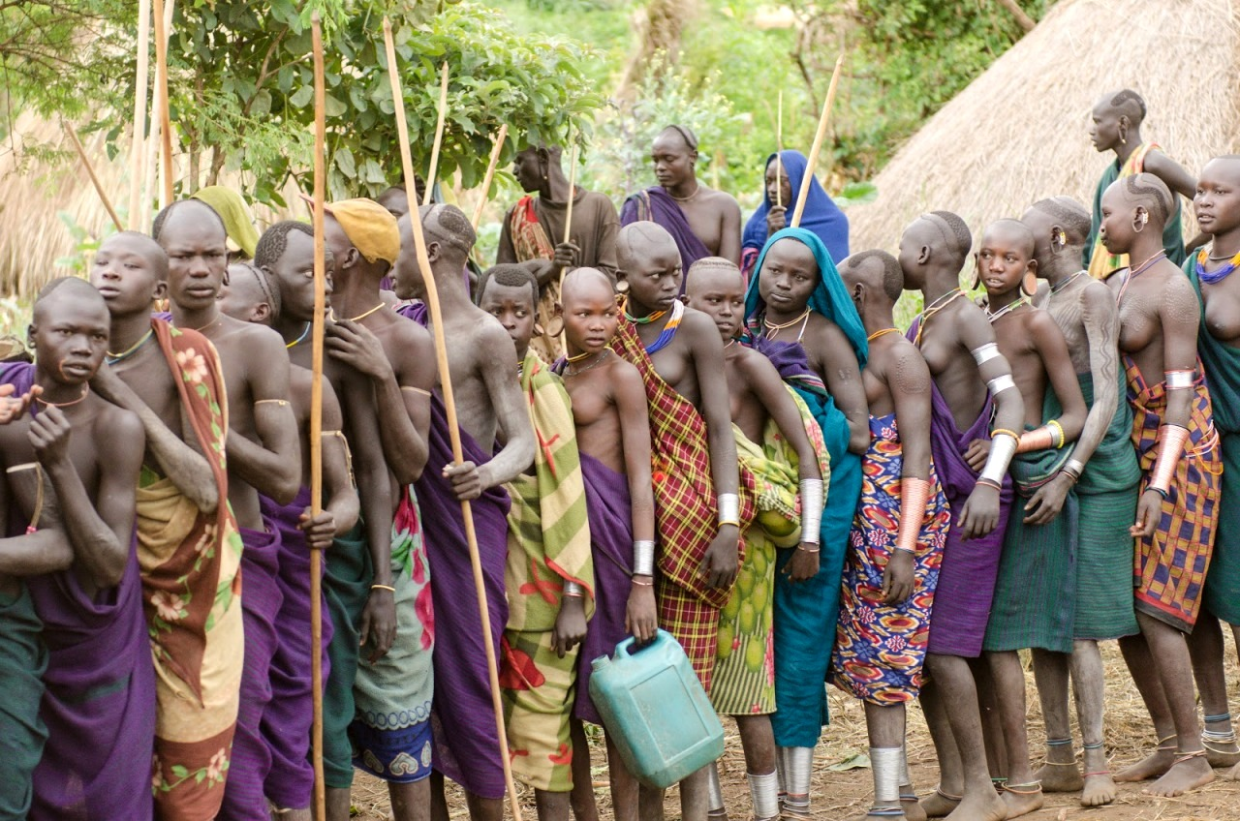
Surma

Slide 29
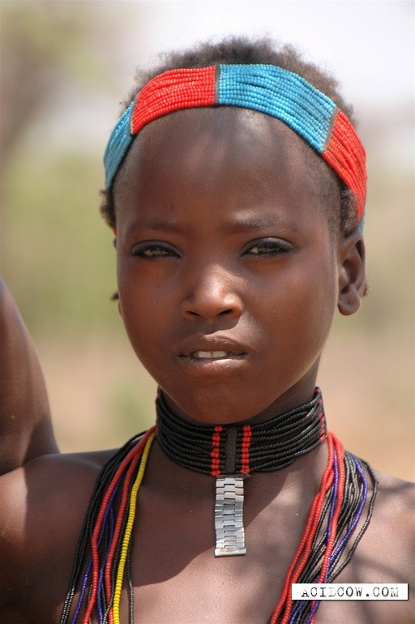

Slide 30
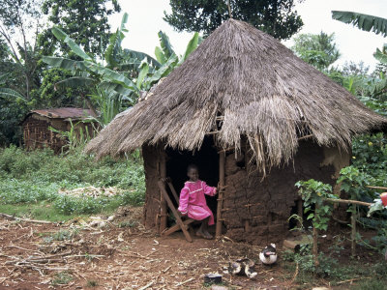

Slide 31
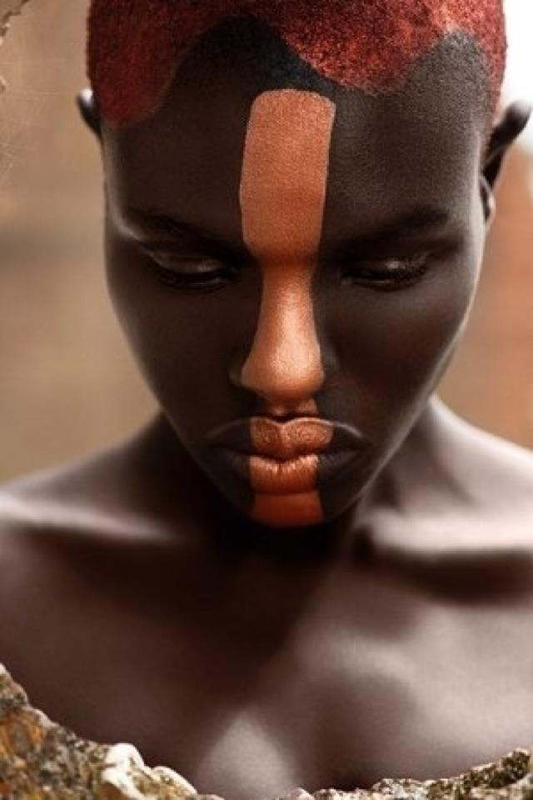

Slide 32
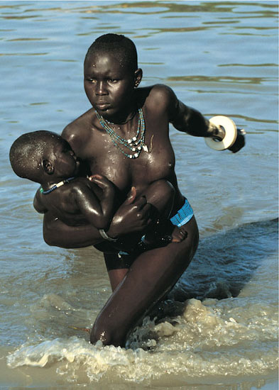

Slide 33
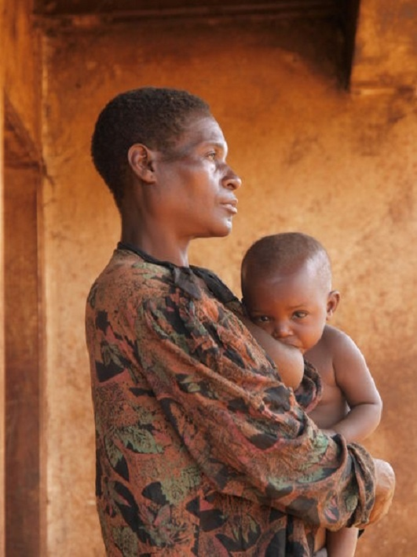

Slide 34
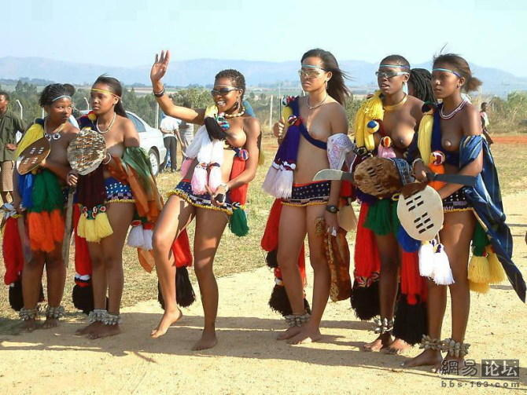

Slide 35
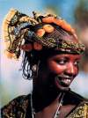

Slide 36
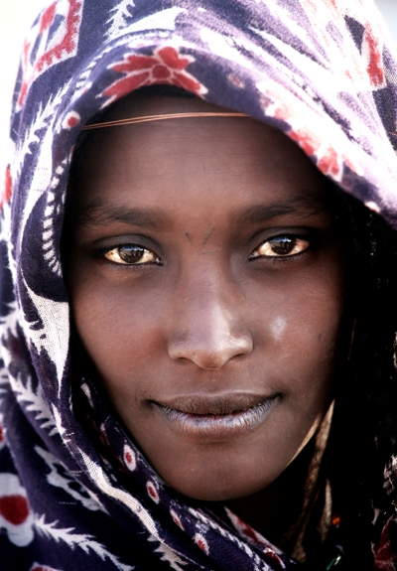
Woman from Afar region

Slide 37
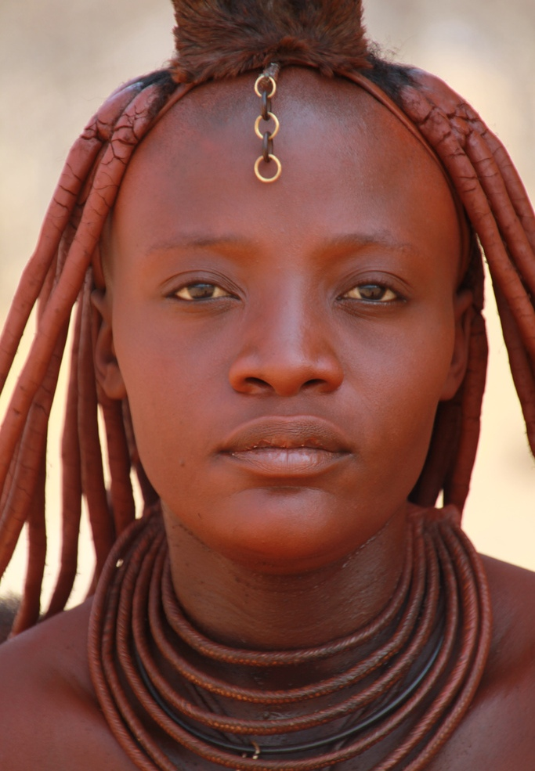
Himba woman

Slide 38
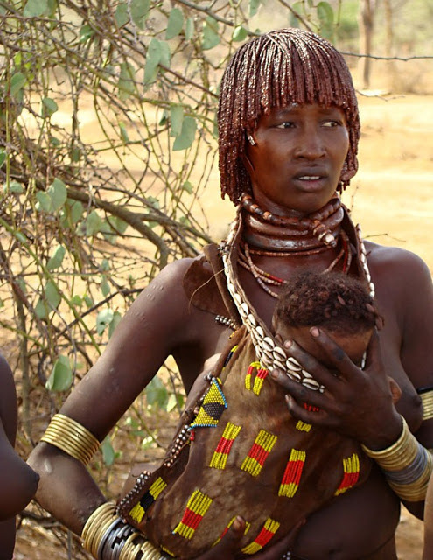

Slide 39
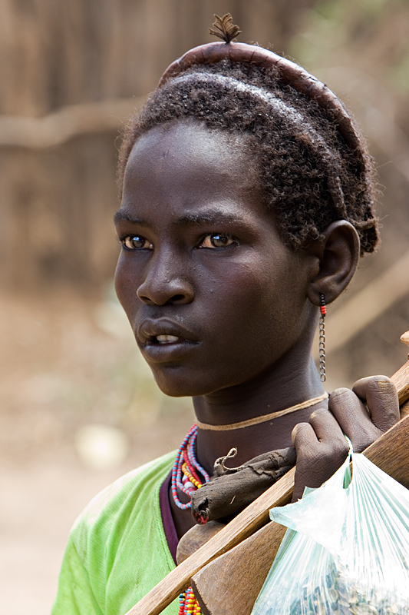
Boy from Dassanech tribe

Slide 40
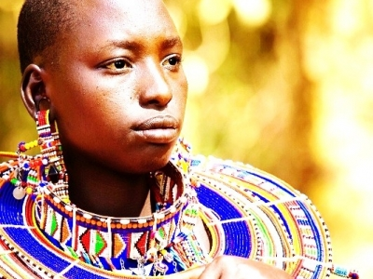

Slide 41
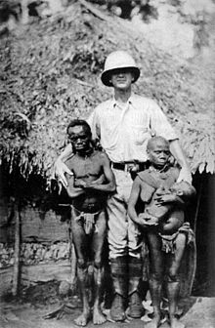
Pygmies of Central Africa

Slide 42
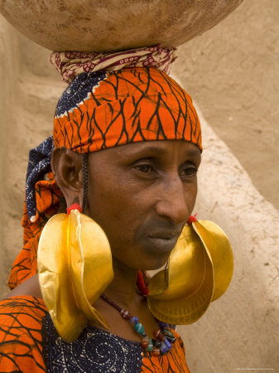
Fulani woman of West Africa

Slide 43
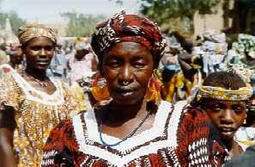

Slide 44
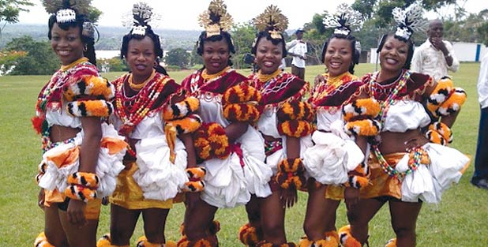
Obong dancers

Slide 45
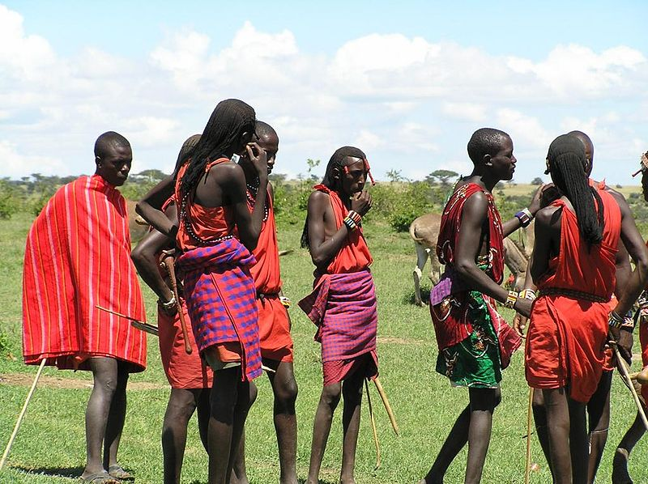
Masai tribe of East Africa

Slide 46
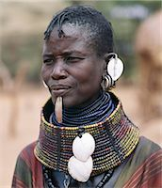

Slide 47
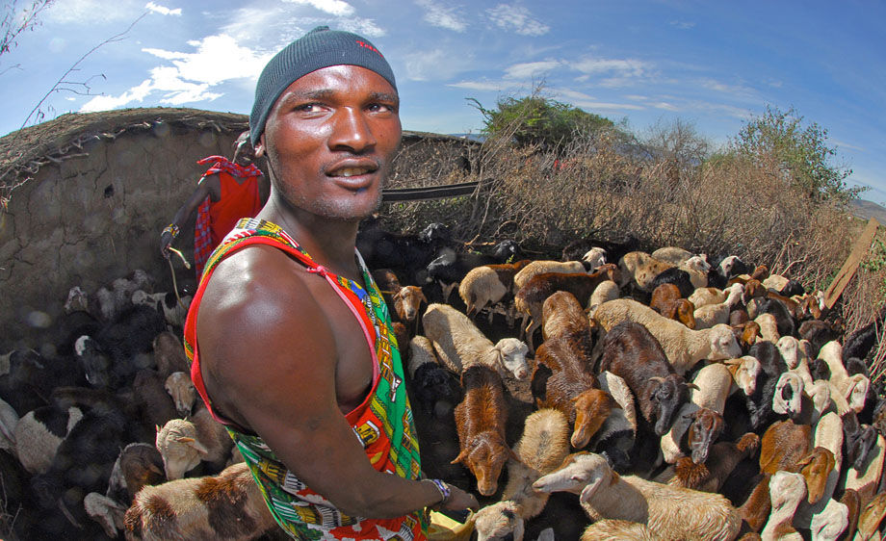

Slide 48
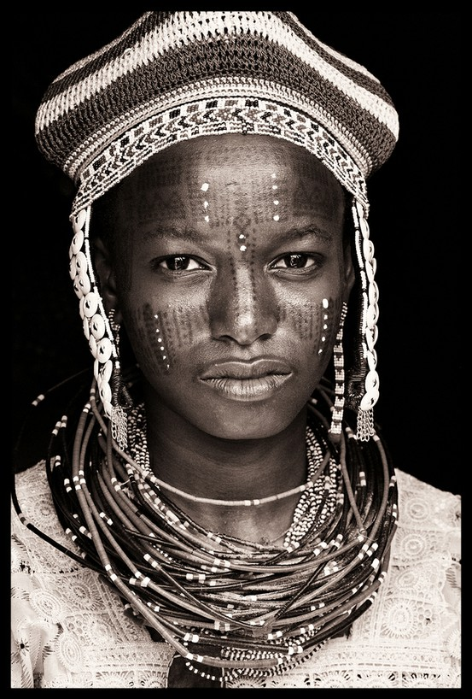

Slide 49
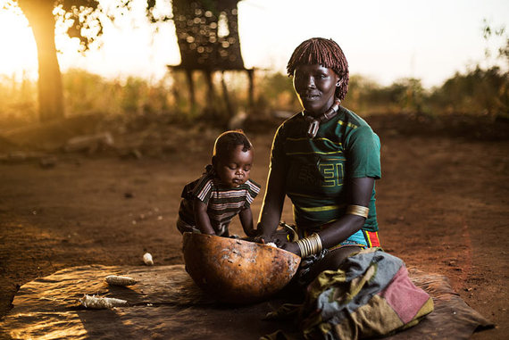

Slide 50
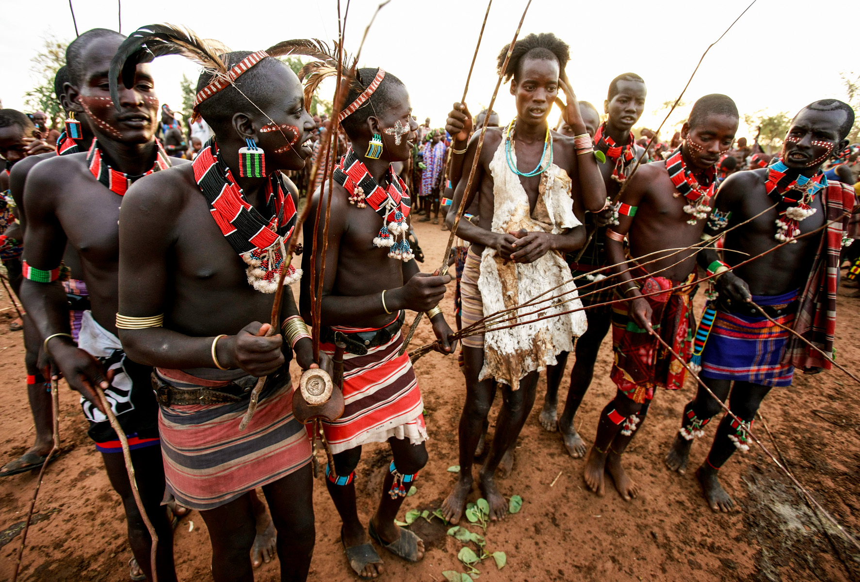
Beshadar in Ethiopia

Slide 51


Slide 52


Slide 53


Slide 54


Slide 55


Slide 56

Zulu dance in South Africa

Slide 57

Jarawa tribe

Slide 58

Jarawa tribe

Slide 59


Slide 60


Slide 61


Slide 62


Slide 63


Slide 64

Kara in Ethiopia

Slide 65

Masai hair braids

Slide 66


Slide 67


Slide 68

Dogon dancers of Mali

Slide 69


Slide 70


Slide 71


Slide 72

Kikuyu of Kenya

Slide 73


Slide 74


Slide 75

Fulani of Niger

Slide 76


Slide 77


Slide 78


Slide 79

Tribe of Omo valley,Ethiopia

Slide 80


Slide 81


Slide 82


Slide 83


Slide 84


Slide 85


Slide 86


Slide 87


Slide 88


Slide 89


Slide 90


Slide 91


Slide 92


Slide 93


Slide 94


Slide 95


Slide 96


Slide 97


Slide 98


Slide 99


Slide 101


Slide 102


Slide 103


Slide 104

Mursi tribe of Ethiopia

Slide 105


Slide 106


Slide 107


Slide 108

Afar girl from Danakil,Ethiopia

Slide 109

Afar girl

Slide 110

Afar tribe,Ethiopia

Slide 111

Afar girl

Slide 112

Afar woman

Slide 113


Slide 114

Swahili women

Slide 115


Slide 116


Slide 117


Slide 118


Slide 119

Blue eyed boy

Slide 120

Blue eyed boy of Waardenburg

Slide 121


Slide 122

Tribal art

Slide 123


Slide 124

Masai woman

Slide 125


Slide 126


Slide 127


Slide 128


Slide 129

Masai tribe

Slide 130


Slide 131


Slide 132


Slide 133

Tribal hair style

Slide 134

Tribal music of balafon

Slide 135

Hamer tribe

Slide 136

Hamer tribal group

Slide 137

Tribal scarification

Slide 138

Tribal tattoo

Slide 139


Slide 140


Slide 141


Slide 142


Slide 143


Slide 144


Slide 145


Slide 146


Slide 147


Slide 148


Slide 149


Slide 150


