Slide 1
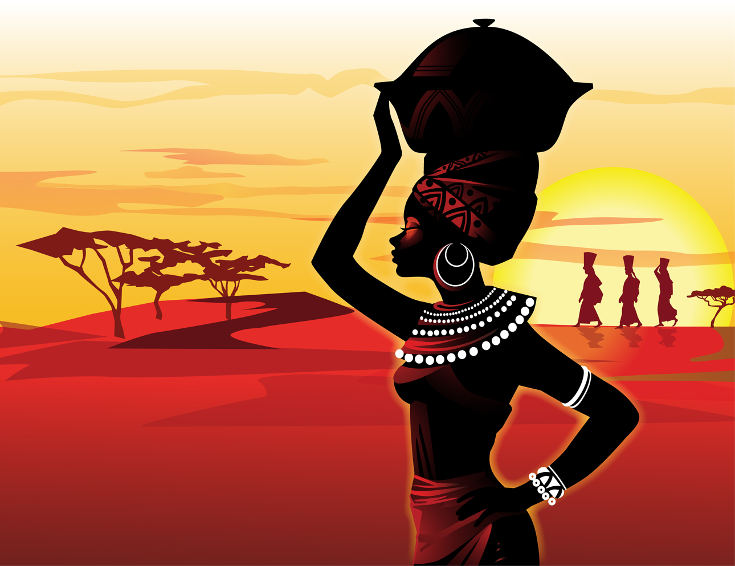
Tribes of Africa
Part One
Wonderful tribes of Africa in all its diversity,splendor and originality has no equal in the world . This should make you fall in love with Africa. It is presented in three parts for your private viewing only.
AKC – October 2015

Slide 2
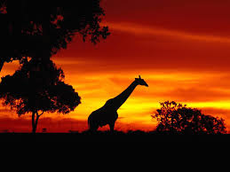
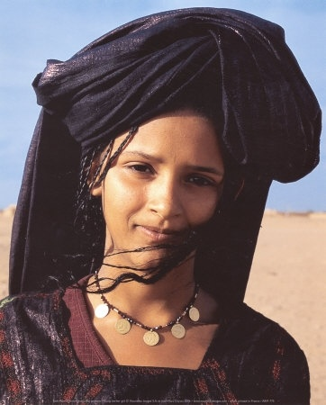
Berber girl of North Africa

Slide 3
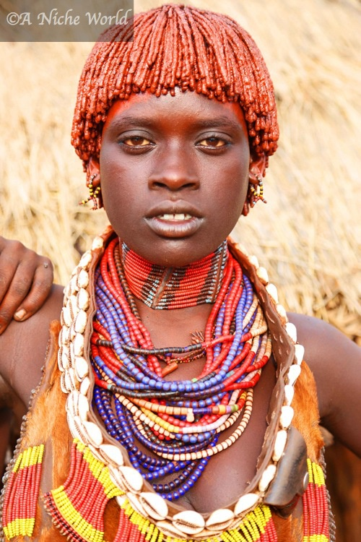
Benin

Slide 4
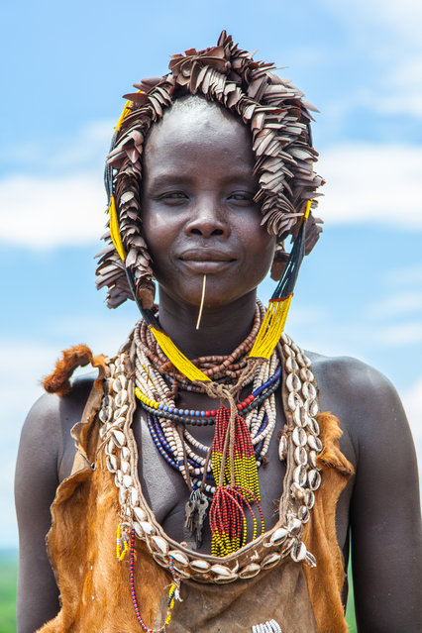

Slide 5
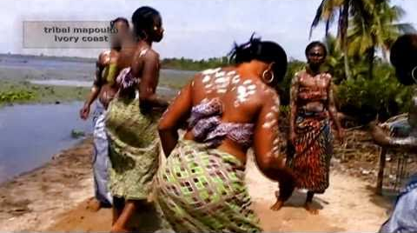

Slide 6
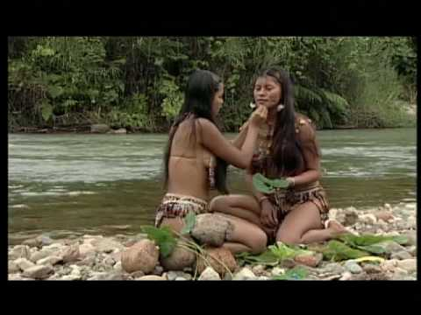

Slide 7
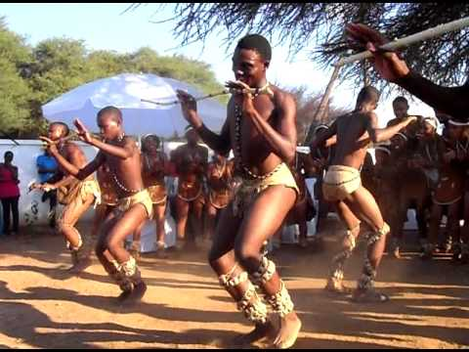

Slide 8
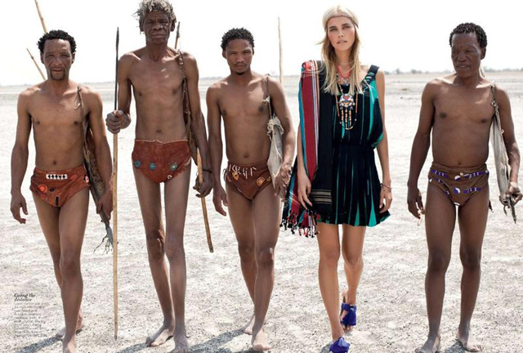
Hotentots

Slide 9
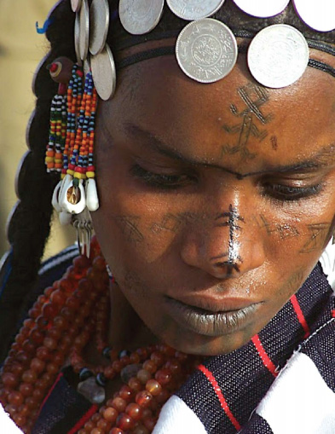

Slide 10
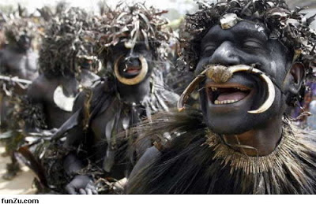

Slide 11
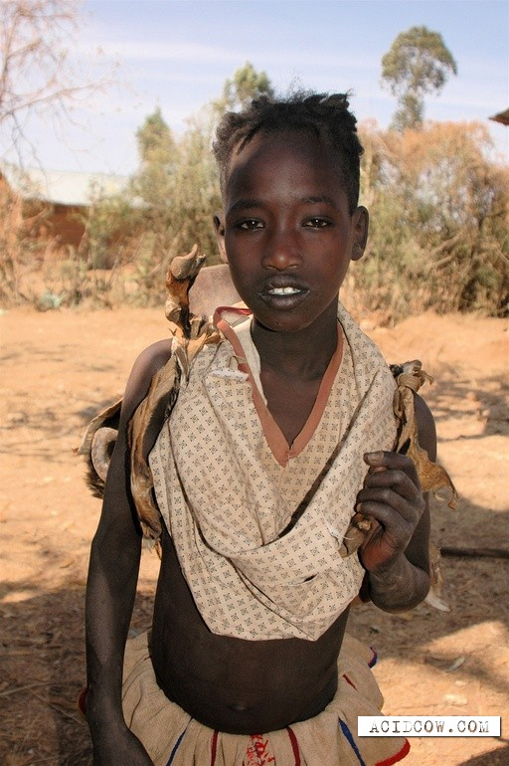

Slide 12
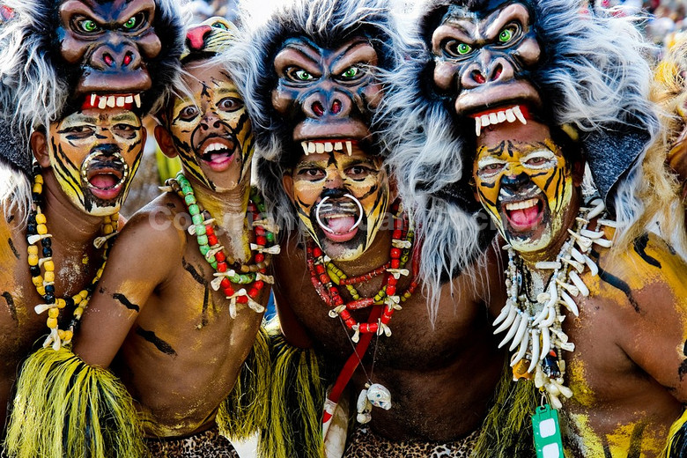
Ancient tribal masks

Slide 13
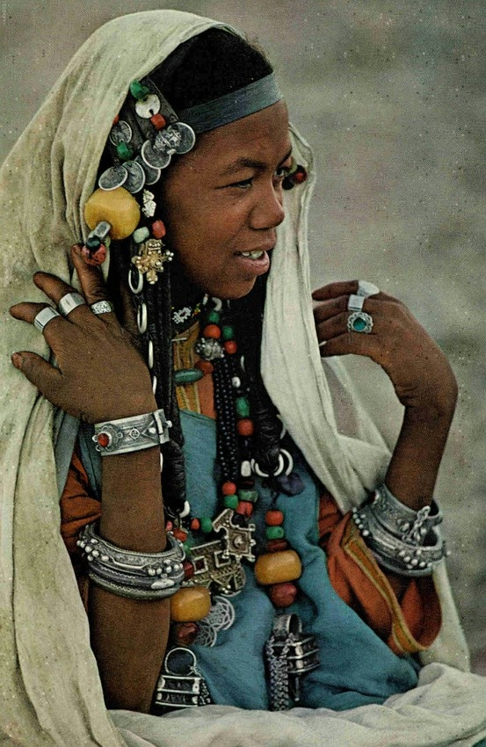

Slide 14
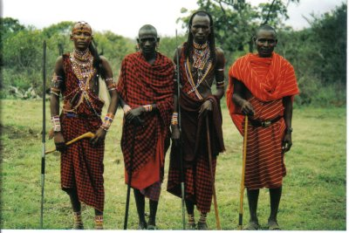
Masai warriors of Kenya

Slide 15
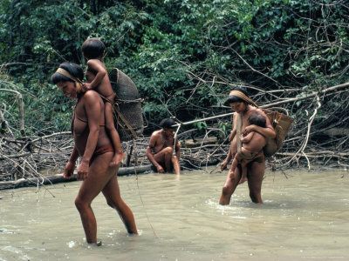

Slide 16
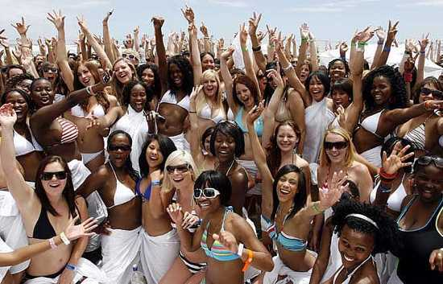
Diversity in African women

Slide 17
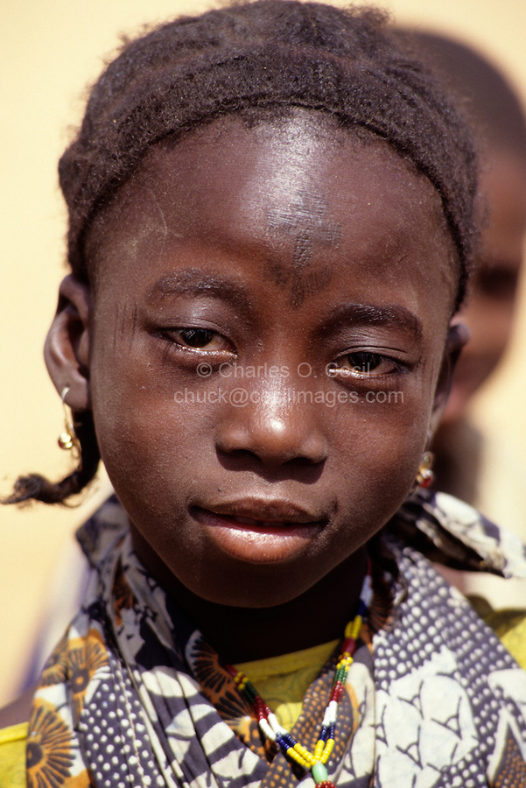
Fulani girl with tattoo

Slide 18
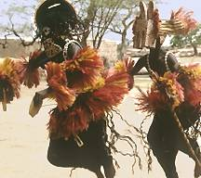

Slide 19
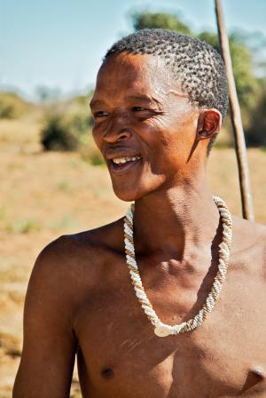
Bushman of Namibia

Slide 20
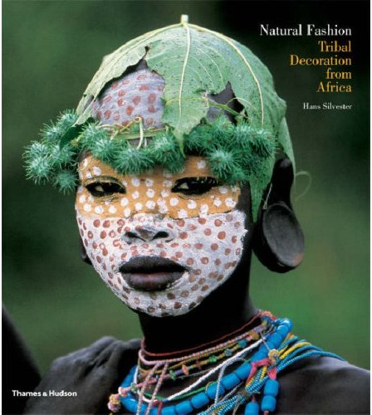

Slide 21
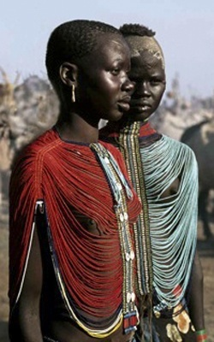

Slide 22
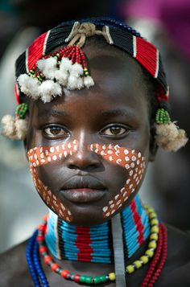

Slide 23
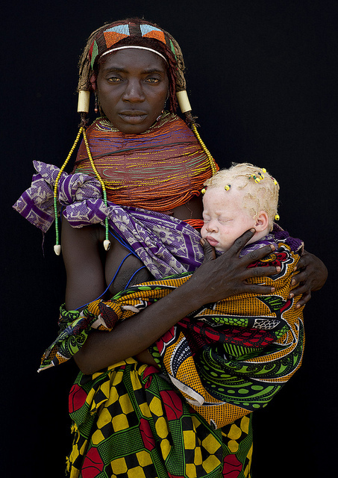
Woman with albino child

Slide 24
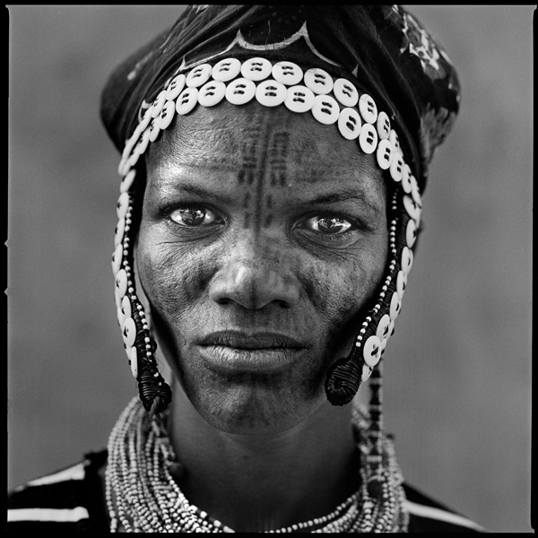

Slide 25
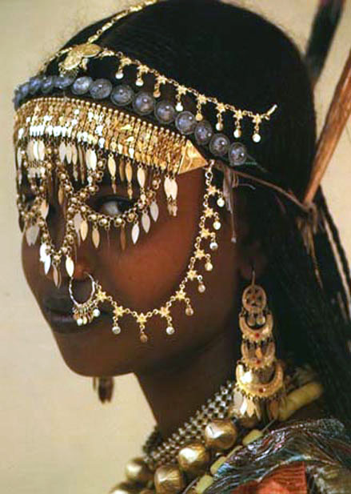
North African metal beads

Slide 26
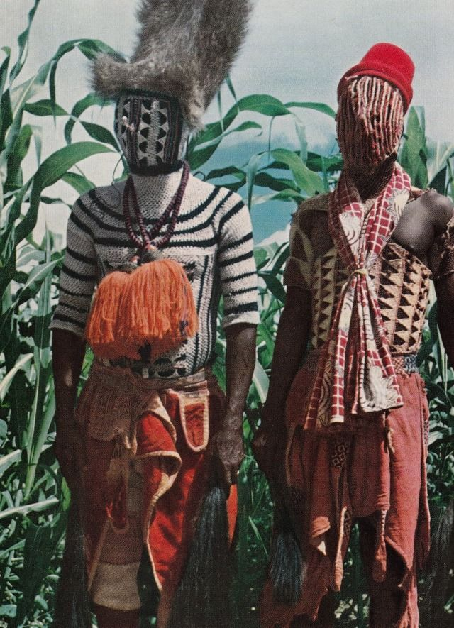

Slide 27
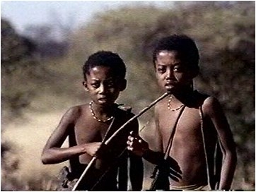

Slide 28
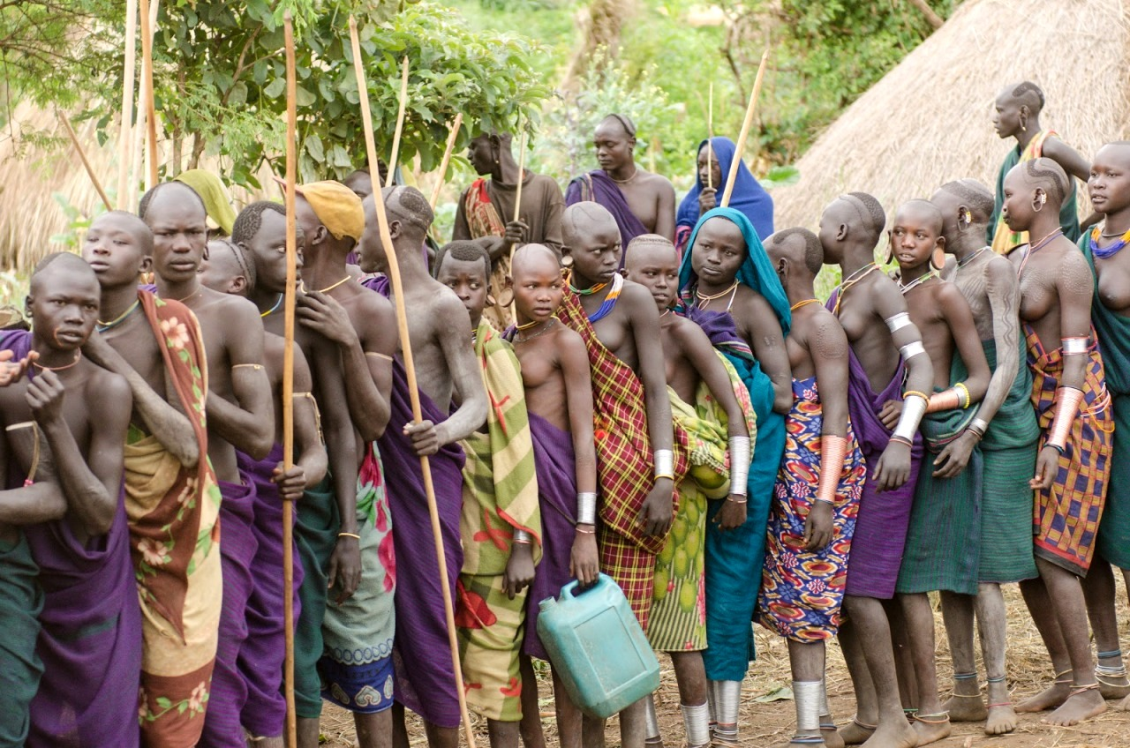
Surma

Slide 29
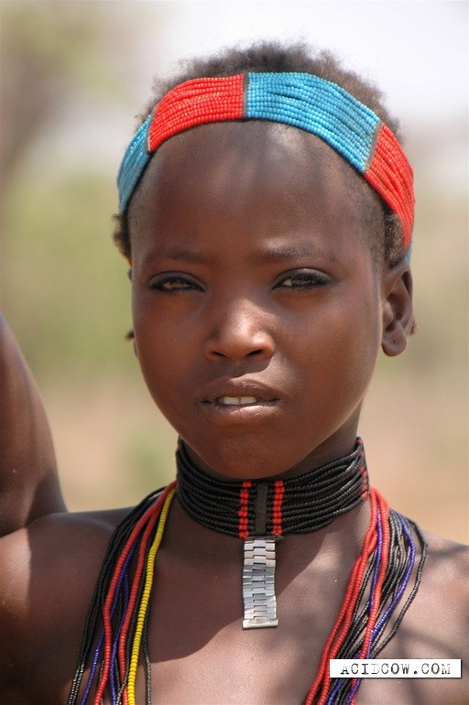

Slide 30
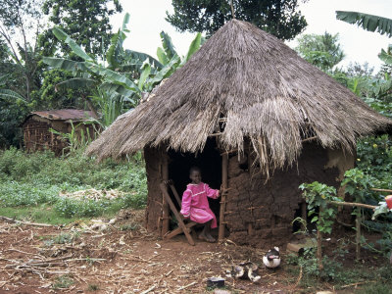

Slide 31
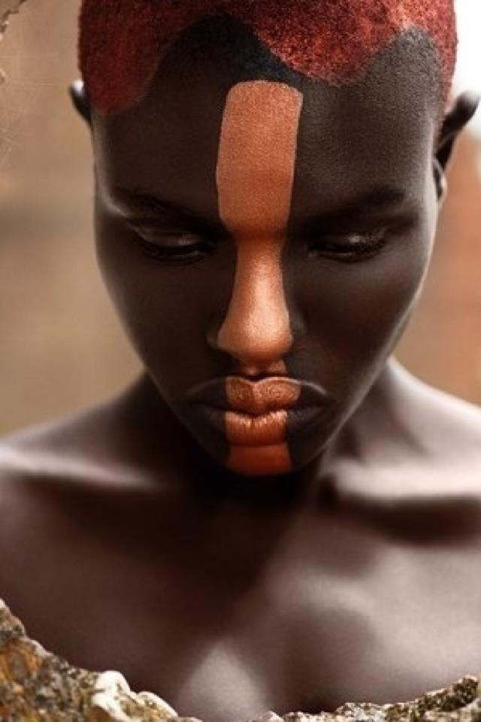

Slide 32
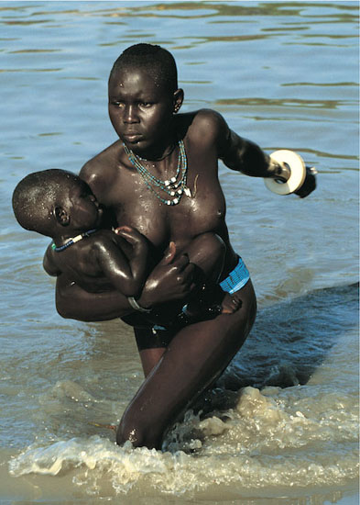

Slide 33
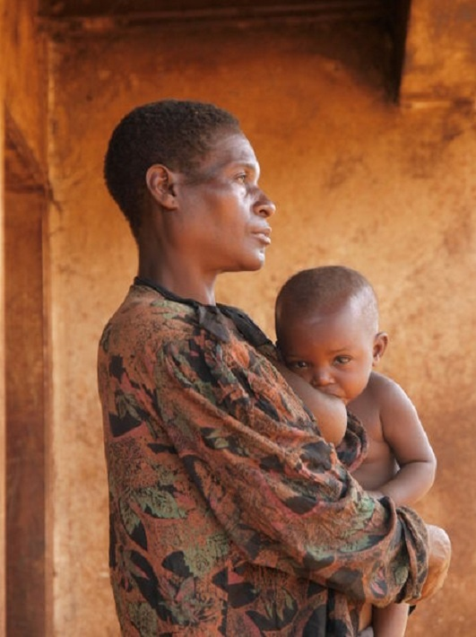

Slide 34
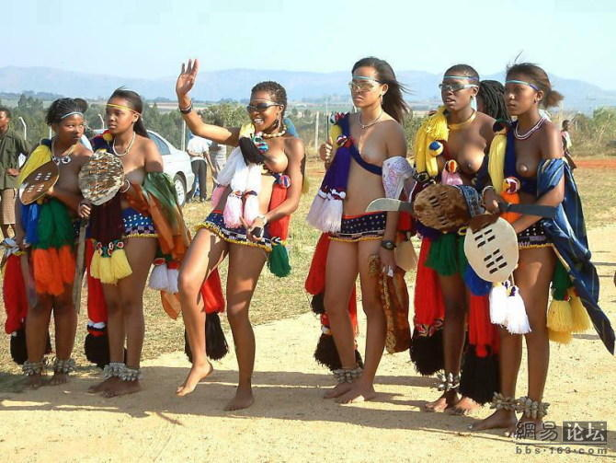

Slide 35
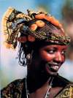

Slide 36
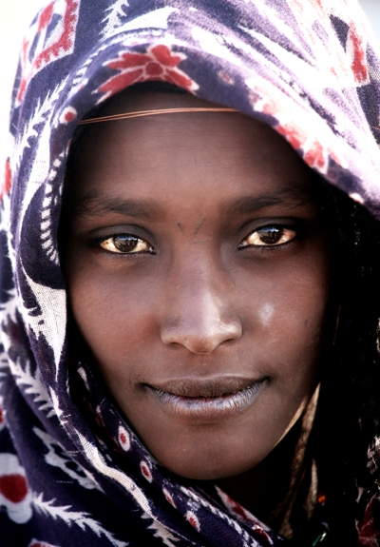
Woman from Afar region

Slide 37
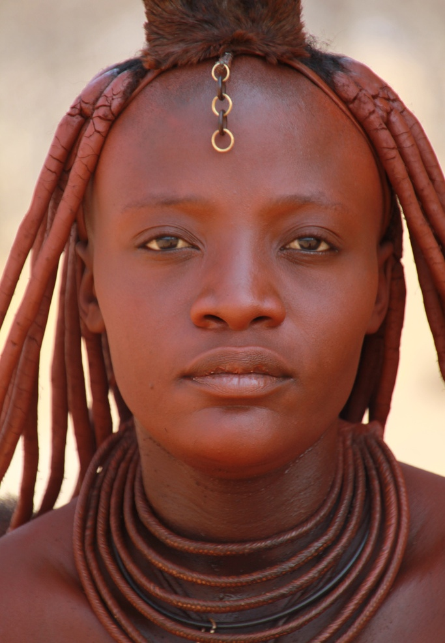
Himba woman

Slide 38
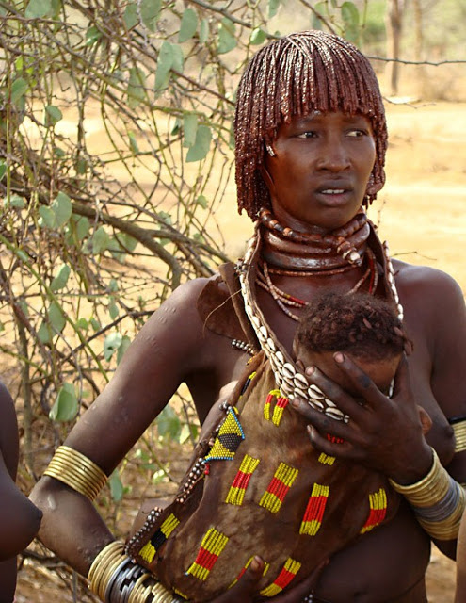

Slide 39
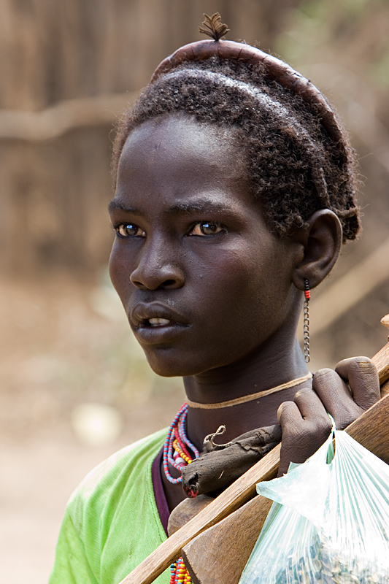
Boy from Dassanech tribe

Slide 40
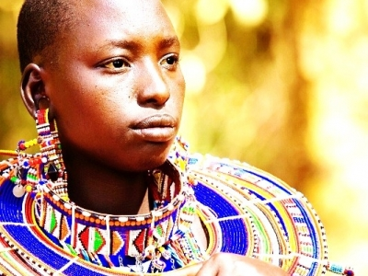

Slide 41
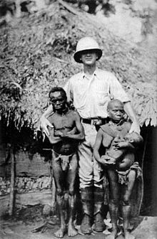
Pygmies of Central Africa

Slide 42
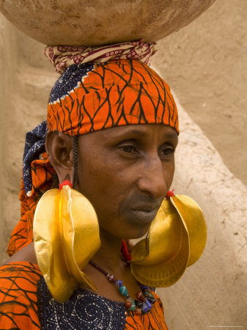
Fulani woman of West Africa

Slide 43
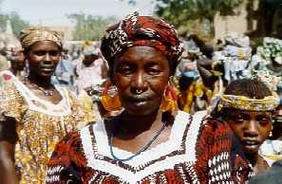

Slide 44
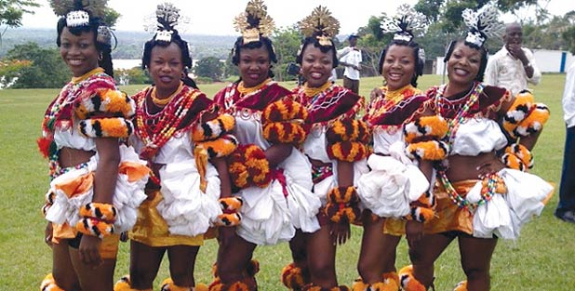
Obong dancers

Slide 45
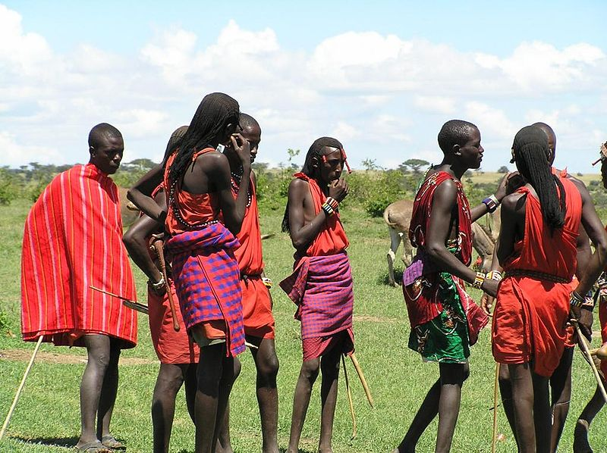
Masai tribe of East Africa

Slide 46
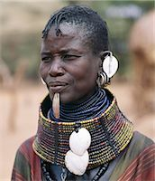

Slide 47
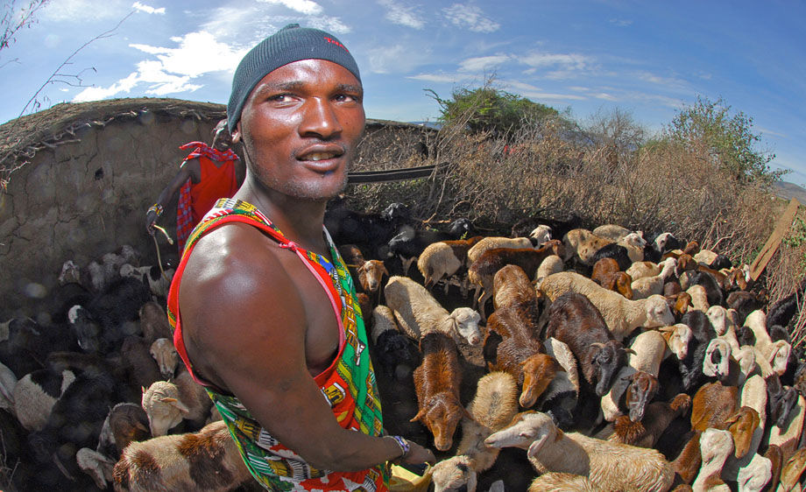

Slide 48
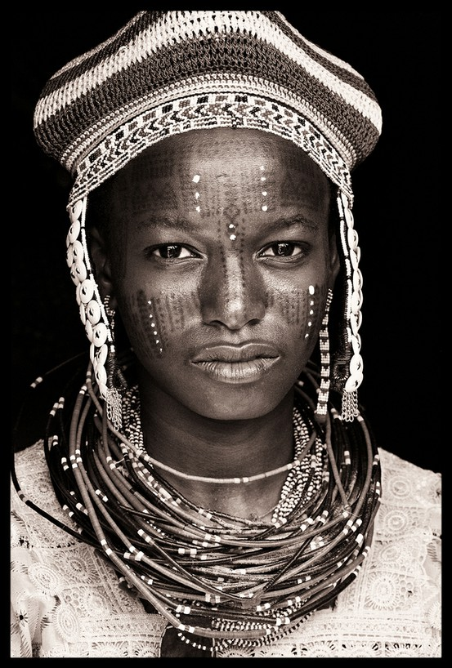

Slide 49
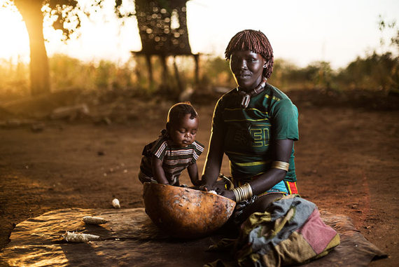

Slide 50

Beshadar in Ethiopia

Slide 51


Slide 52


Slide 53


Slide 54


Slide 55


Slide 56

Zulu dance in South Africa

Slide 57

Jarawa tribe

Slide 58

Jarawa tribe

Slide 59


Slide 60


Slide 61


Slide 62


Slide 63


Slide 64

Kara in Ethiopia

Slide 65

Masai hair braids

Slide 66


Slide 67


Slide 68

Dogon dancers of Mali

Slide 69


Slide 70


Slide 71


Slide 72

Kikuyu of Kenya

Slide 73


Slide 74


Slide 75

Fulani of Niger

Slide 76


Slide 77


Slide 78


Slide 79

Tribe of Omo valley,Ethiopia

Slide 80


Slide 81


Slide 82


Slide 83


Slide 84


Slide 85


Slide 86


Slide 87


Slide 88


Slide 89


Slide 90


Slide 91

Tribal scarification

Slide 92


Slide 93


Slide 94


Slide 95


Slide 96


Slide 97


Slide 98


Slide 99


Slide 101


Slide 102


Slide 103


Slide 104

Mursi tribe of Ethiopia

Slide 105


Slide 106


Slide 107


Slide 108

Afar girl from Danakil,Ethiopia

Slide 109

Afar girl

Slide 110

Afar tribe,Ethiopia

Slide 111

Afar girl

Slide 112

Afar woman

Slide 113


Slide 114

Swahili women

Slide 115


Slide 116


Slide 117


Slide 119

Blue eyed boy

Slide 120

Blue eyed boy of Waardenburg

Slide 121


Slide 122

Tribal art

Slide 123


Slide 124

Masai woman

Slide 125


Slide 126


Slide 127


Slide 128


Slide 129

Masai tribe

Slide 130


Slide 131


Slide 132


Slide 133

Tribal hair style

Slide 134

Tribal music of balafon

Slide 135

Hamer tribe

Slide 136

Hamer tribal group

Slide 137

Tribal scarification

Slide 138

Tribal tattoo

Slide 139


Slide 140


Slide 141


Slide 142


Slide 143


Slide 144


Slide 145


Slide 146


Slide 147


Slide 148


Slide 149


Slide 150


Slide 153


Slide 154


Slide 155


Slide 156

Zulus

Slide 157

Zunguzungu tribe

Slide 158

Tribal wedding

Slide 159


Slide 160

African wedding

Slide 161


Slide 162


Slide 163


Slide 164


Slide 165

Samburu tribe

Slide 166

Scarification process

Slide 167

Africans from south to north

Slide 168


Slide 169


Slide 170

Albino child

Slide 171


Slide 172

Masai warrior

Slide 173

Ameru tribe

Slide 175


Slide 176

Arbore tribe

Slide 177

Arbore elder

Slide 178


Slide 179


Slide 180


Slide 181


Slide 182


Slide 183


Slide 184

Ashanti tribe

Slide 185


Slide 186


Slide 187


Slide 188


Slide 189


Slide 190

Bantu tribe

Slide 191

Basotho tribe

Slide 192

Batwa of Burundi

Slide 193

Baule girl of gold coast

Slide 195

Benin

Slide 196

Dahomey tribe

Slide 197


Slide 198


Slide 199

Makoti lerato

Slide 200


Slide 201


Slide 202


Slide 203


Slide 204

Central African Republic

Slide 205


Slide 206


Slide 208


Slide 209


Slide 210

Daasanach girl

Slide 211


Slide 212


Slide 213

Daasanach huts

Slide 214


Slide 215


Slide 216

Masai in Masai Mara,Kenya

Slide 217


Slide 218

Dogon of Mali

Slide 219

Dogon dancers in Mali

Slide 220

Karo tribe near Omo river

Slide 221

Fertility dance

Slide 222


Slide 223

Ethiopian tribe

Slide 224

Suri tribe of Ethiopia

Slide 225

Scarification in Ethiopia

Slide 226


Slide 227


Slide 228


Slide 229


Slide 230

Fulani tribe

Slide 231


Slide 232


Slide 233


Slide 234


Slide 235


Slide 236
Fulani of Niger

Slide 237

Fulani woman

Slide 238


Slide 239

Ashanti of Ghana

Slide 240


Slide 241


Slide 242

Dogon dancers of Mali

Slide 243

Hima tribe of Angola

Slide 244

Himba woman

Slide 245

Himba woman

Slide 246

Himba girl

Slide 247

Himba people

Slide 248

Zulu tribe

Slide 249

Hostile tribe

Slide 250


Slide 251

Ubuntu of Bushman

Slide 252

Fulani

Slide 253


Slide 254


Slide 255

Tribal village in South Africa

