Slide 1
Wonderful world of orchids
All major groups of orchids are shown although not all the orchids in the group can be included due to limited space. However, it will give you a good idea of the wonderful orchids that are popular due to their aesthetic splendor and dazzling colors. It is for your personal viewing only.
Editor AKC.

Slide 2
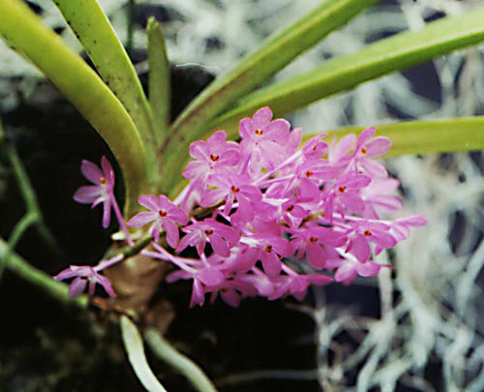
Ascocentrum Ampulaceum

Slide 3
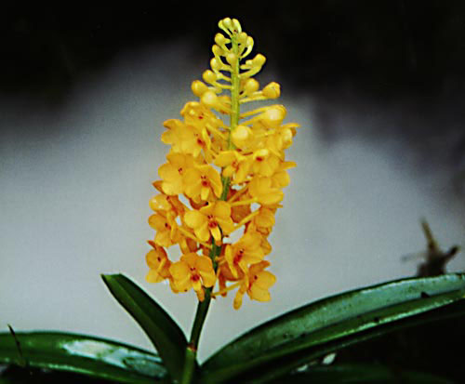
Ascocentrum garai

Slide 4
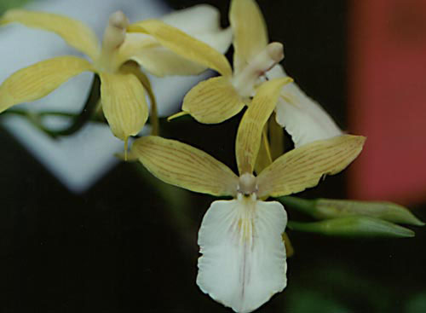
Aspepidendroides hybrid

Slide 5
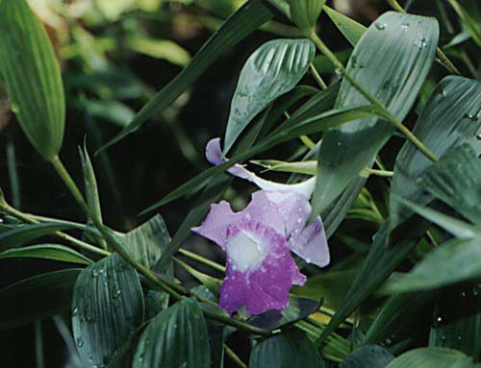
Bamboo orchid

Slide 6
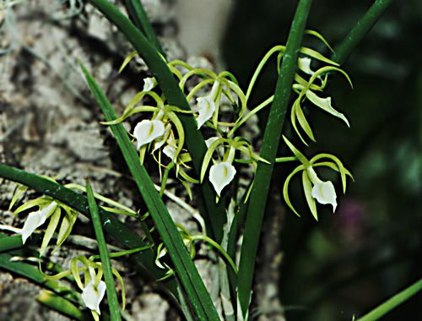
Brassavola cordata

Slide 7
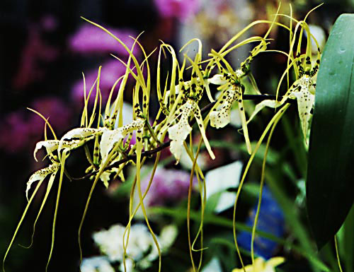
Brassia rex lance

Slide 8
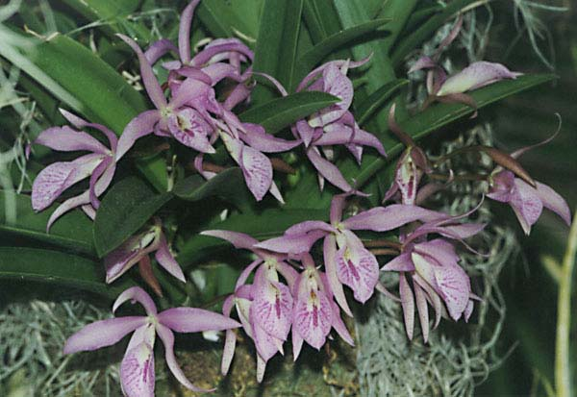
Brassocattleya mayayumi

Slide 9
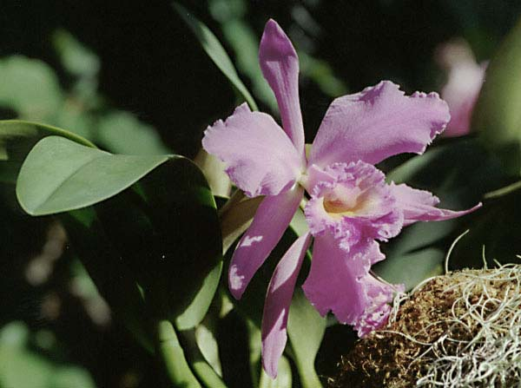
Brassocattleya willisharring

Slide 10
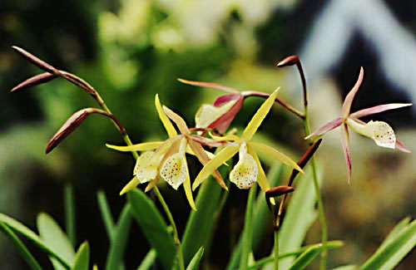
Brassolaelia yellowbird

Slide 11
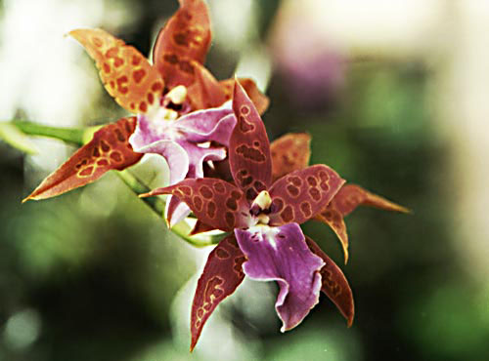
Beallara purple passion

Slide 12
Brassavola cordata

Slide 13
Brassia rex lance

Slide 14
Brasso cattleya mayumi

Slide 15
Brassocattleya willisharring

Slide 16
Brassolaelia yellowbird

Slide 17
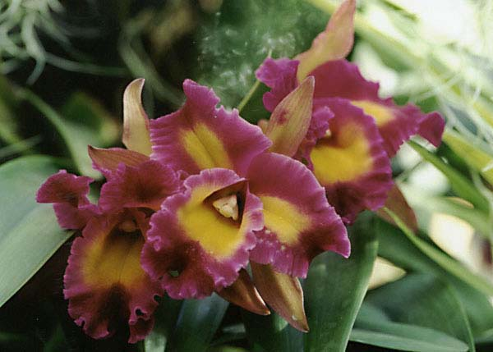
Brassolaelio cattleya borneo

Slide 18
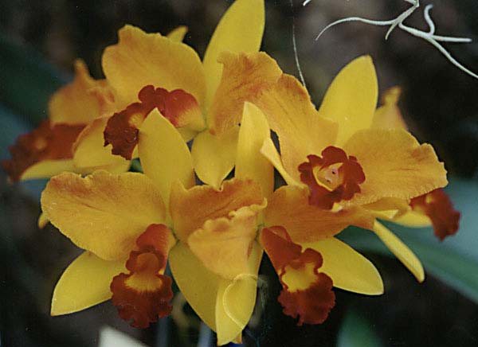
Brassolaelio cattleya kurt

Slide 19
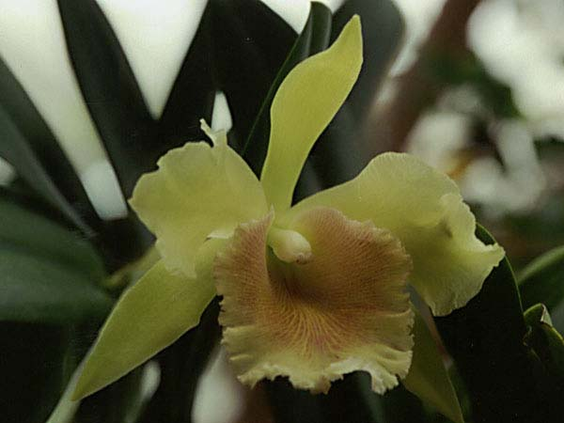
Brassolaelio cattleya ojaive

Slide 20
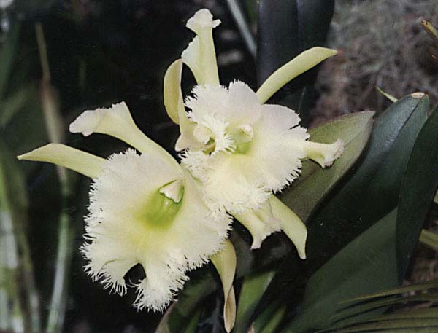
Brassocattleya riosgr

Slide 21
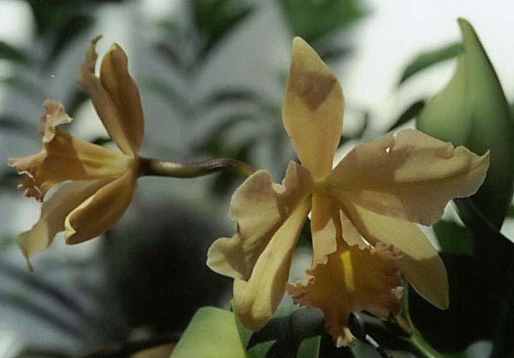
Brassocattleya copperglo

Slide 22
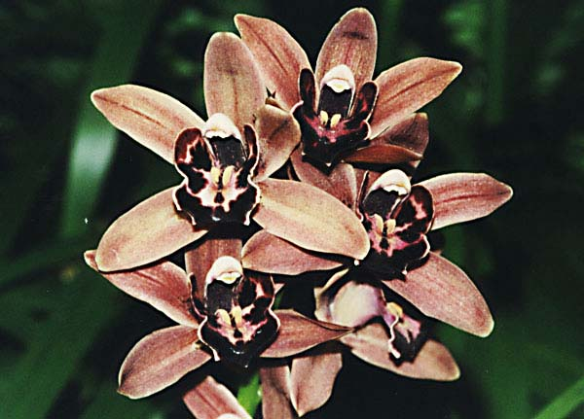
Brown bomber

Slide 23
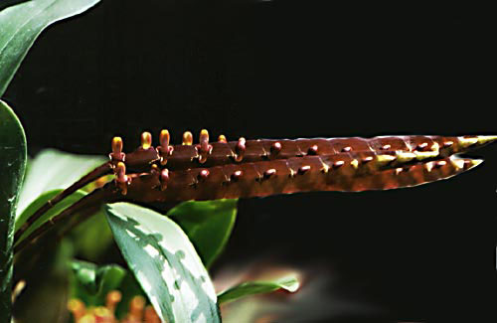
Bulbophyllum fulcatum

Slide 24
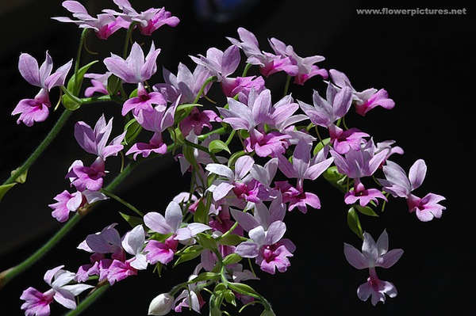
Calanthe

Slide 25
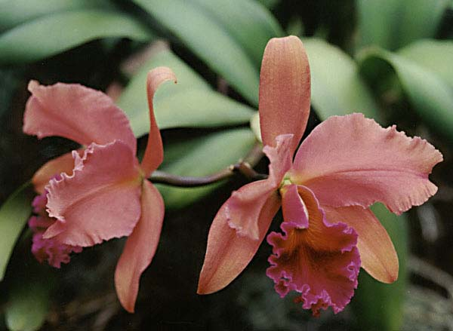
Cattleya 011

Slide 26
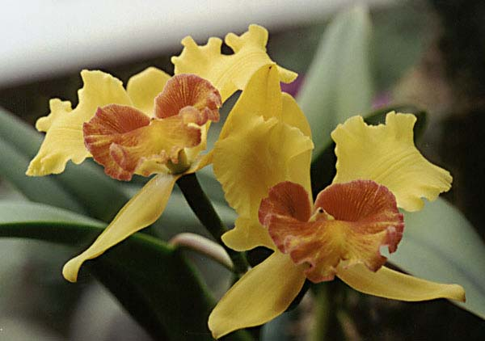
Cattleya 012

Slide 27
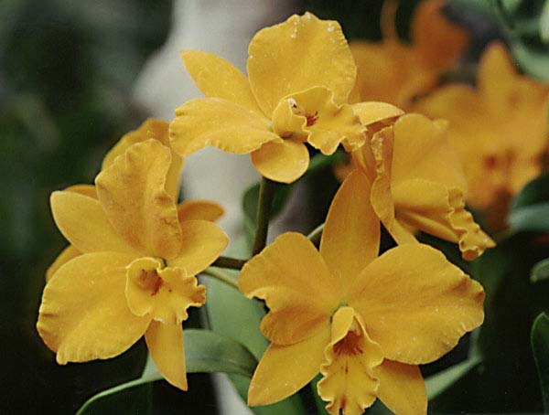
Cattleya 013

Slide 28
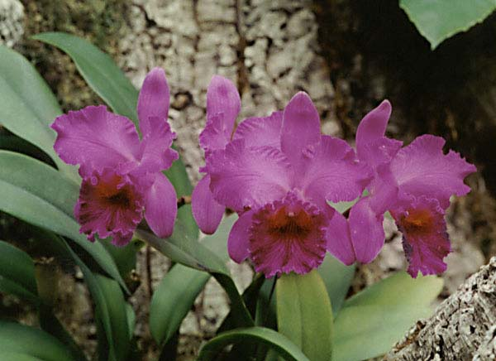
Cattleya 014

Slide 29
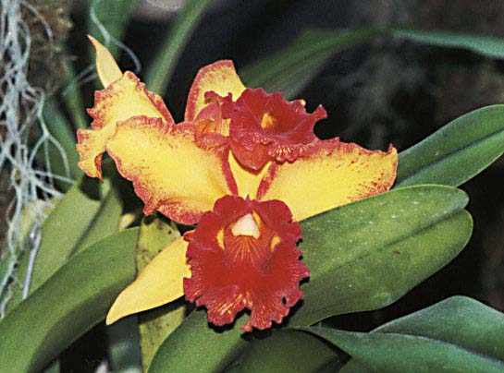
Cattleya 015

Slide 30
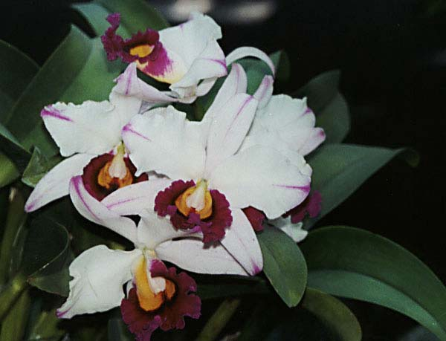
Cattleya 016

Slide 31
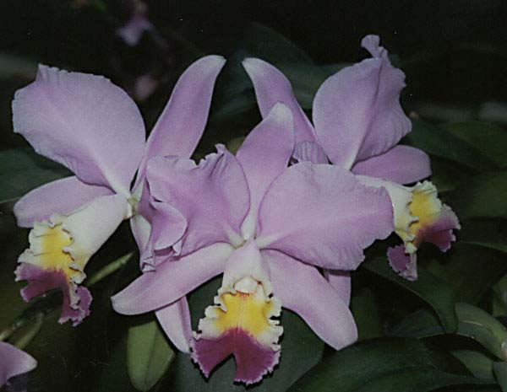
Cattleya 017

Slide 32
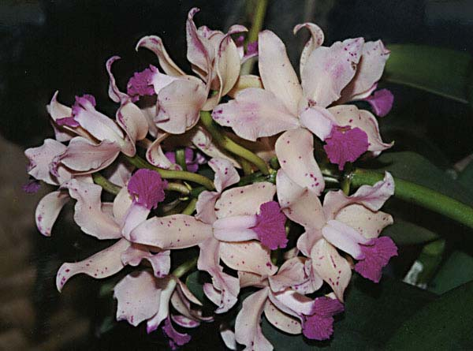
Cattleya amethysto glossa

Slide 33
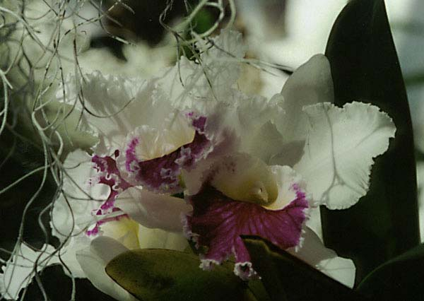
Cattleya astri

Slide 34
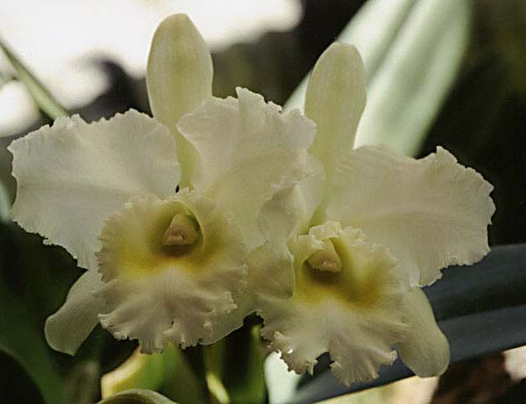
Cattleya bobbetts

Slide 35
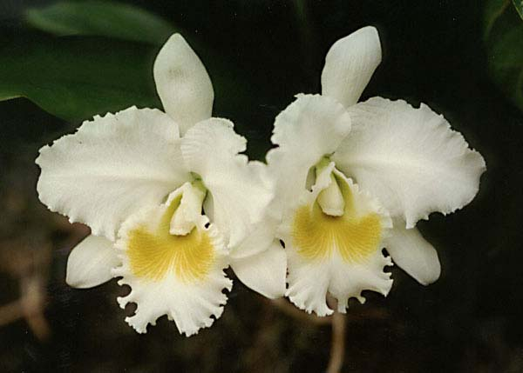
Cattleya carmela

Slide 36
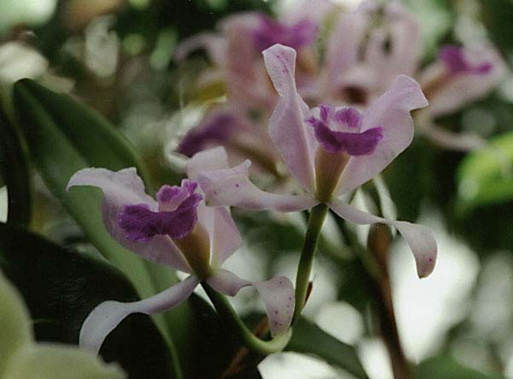
Cattleya chewelah

Slide 37
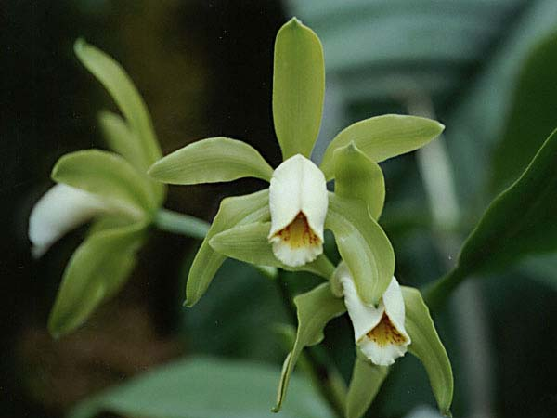
Cattleya forbesii

Slide 38
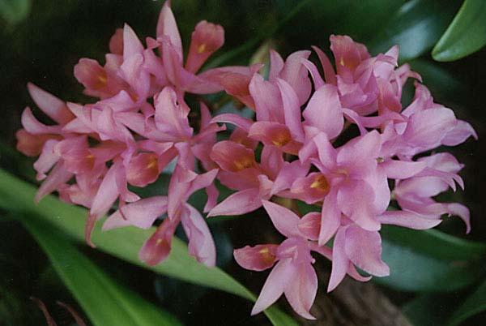
Cattleya guatamalensis

Slide 39
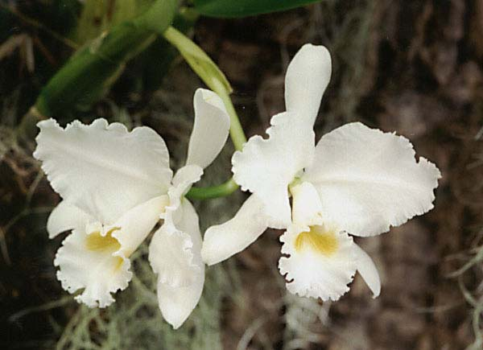
Cattleya hildabattle

Slide 40
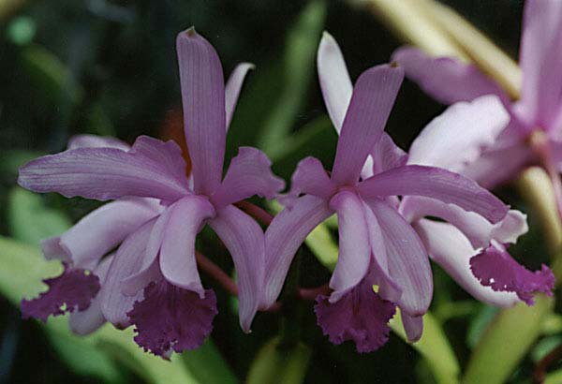
Cattleya intermedia

Slide 41
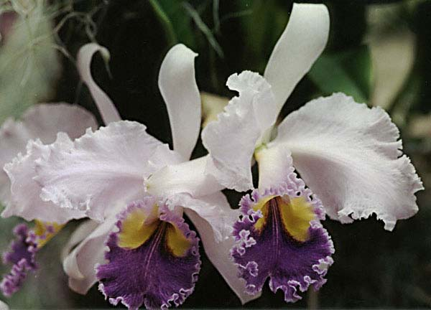
Cattleya jenico

Slide 42
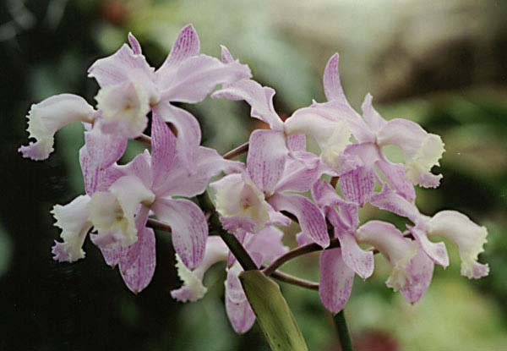
Cattleya loddigesii

Slide 43
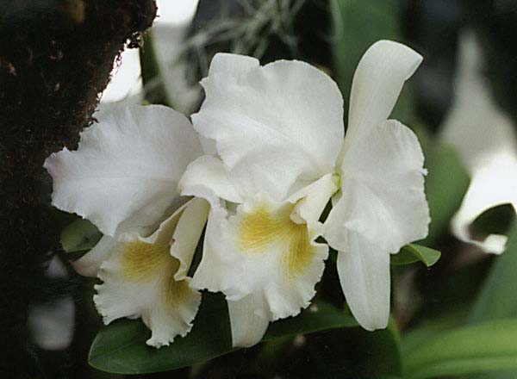
Cattleya losgatos

Slide 44
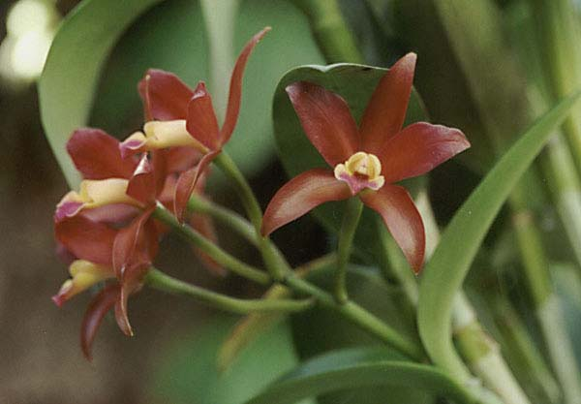
Cattleya valentineday

Slide 45
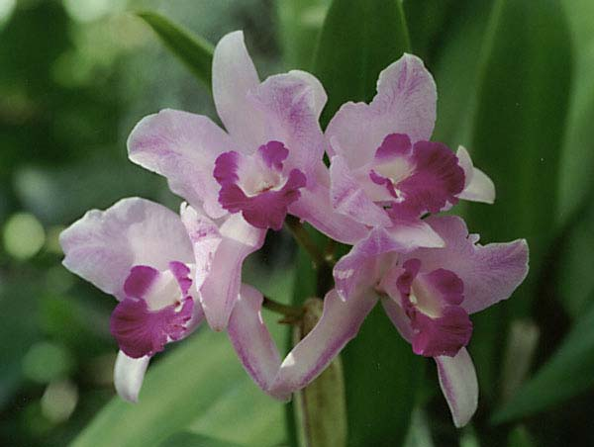
Cattleya zeno

Slide 46
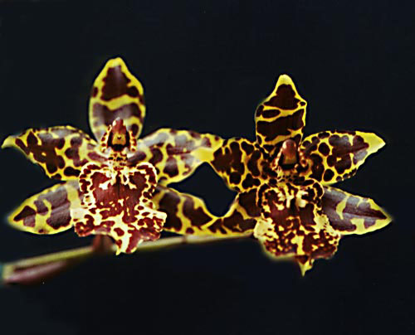
Colmanara wildcat carmela

Slide 47
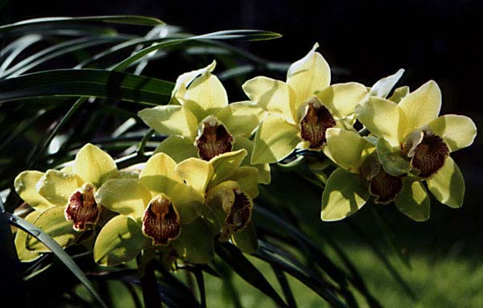
Cymbidium 001

Slide 48
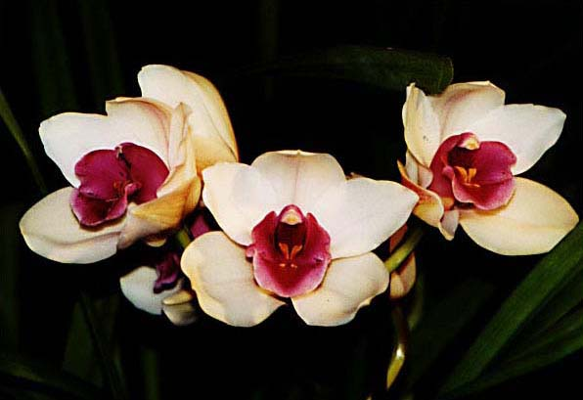
Cymbidium 012

Slide 49
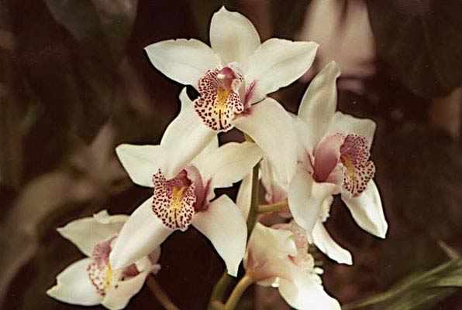
Cymbidium early palace

Slide 50
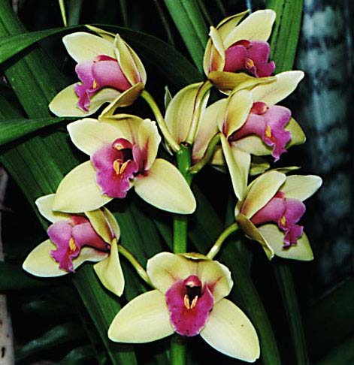
Cymbidium evening star

Slide 51
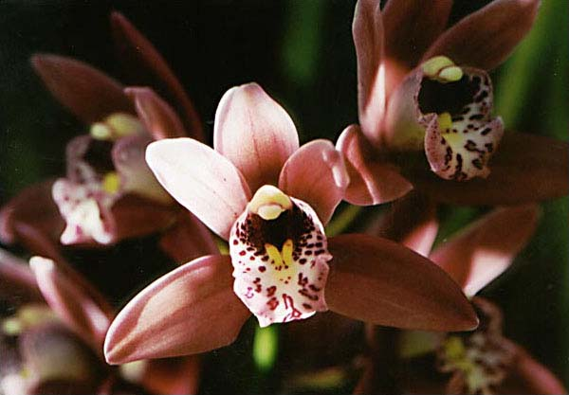
Cymbidium mainstem

Slide 52
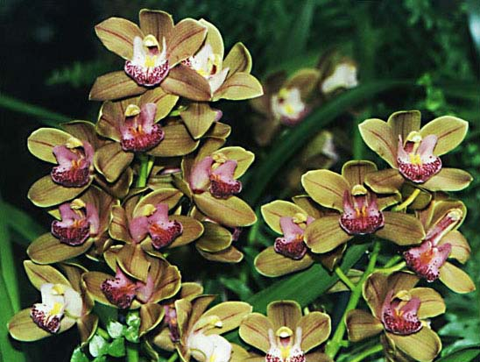
Cymbidium maluca

Slide 53
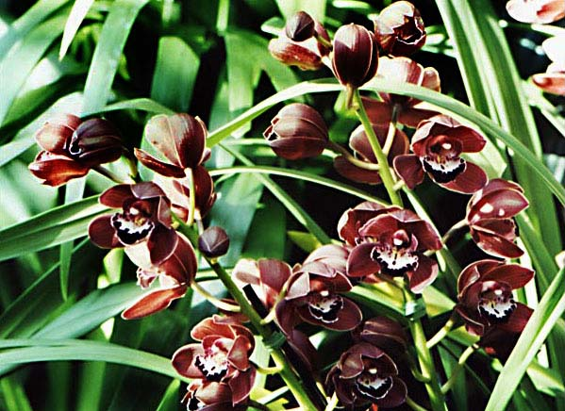
Cymbidium mini bacon

Slide 54
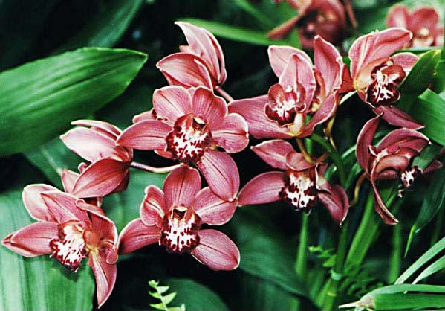
Cymbidium red beauty

Slide 55
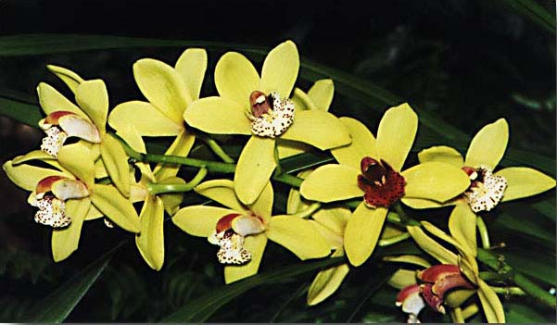
Cymbidium red black

Slide 56
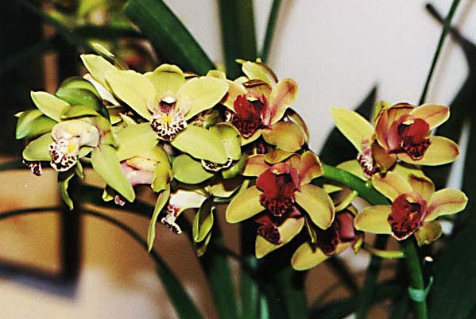
Cymbidium sylvia miller

Slide 57

Cymbidium tomthump

Slide 58

Cymbidium viamar tranquille

Slide 59

Cymbidium 3

Slide 60

Cyrtochilum macranthum

Slide 61

Delight

Slide 62

Dendrobium canaliculatum

Slide 63

Dendrobium cinderella

Slide 64

Dendrobium ekapol

Slide 65

Dendrobium friendship

Slide 66

Dendrobium hawaiian princess

Slide 67

Dendrobium johnsoniae

Slide 68

Dendrobium kingianum

Slide 69

Dendrobium kingianum 1

Slide 70

Dendrobium kingianum betty

Slide 71

Dendrobium kunico

Slide 72

Dendrobium noble

Slide 73

Dendrobium pohkiew

Slide 74

Dendrobium pugel flower

Slide 75

Dendrobium roytokunaga

Slide 76

Dendrobium sau paulo

Slide 77

Dendrobium thai 1

Slide 78

Dendrobium thai 2

Slide 79

Dendrobium thai 3

Slide 80

Dendrobium thai 6

Slide 81

Dendrobium thai 7

Slide 82

Dendrobium thai 8

Slide 83

Dendrobium thai 9

Slide 84

Dendrobium thai 10

Slide 85

Dendrobium thai 11

Slide 86

Dendrobium yuppadaewan

Slide 87

Dendrobium yukidaruma

Slide 88

Dendrochillum formosanum

Slide 89

Denham court

Slide 90

Dgmra flying high

Slide 91

Dorisia sunset

Slide 92

DSCN 4602

Slide 93

DSCN 4619

Slide 94

DSCN 4621

Slide 95

DSCN 4651

Slide 96

DSCN 4675

Slide 97

DSCN 4752

Slide 98

DSCN 4773

Slide 99

DSCN 4824

Slide 100

DSCN 5052

Slide 101

DSCN 5057

Slide 102

DSCN 5061

Slide 103

DSCN 5069

Slide 104

DSCN 5073

Slide 105

DSCN 5076

Slide 106

DSCN 5078
#UPLB joins 2015 Bañamos parade.

Slide 107

#UPLB joins 2015 Bañamos parade.
DSCN 5085

Slide 108

#UPLB joins 2015 Bañamos parade.
DSCN 5088

Slide 109

#UPLB joins 2015 Bañamos parade.
DSCN 5092

Slide 110

#UPLB joins 2015 Bañamos parade.
DSCN 5094

Slide 111

DSCN 5118
#UPLB joins 2015 Bañamos parade.

Slide 112

#UPLB joins 2015 Bañamos parade.
DSCN 5120

Slide 113

#UPLB joins 2015 Bañamos parade.
DSCN 5123

Slide 114

#UPLB joins 2015 Bañamos parade.
DSCN 5125

Slide 115

DSCN 5139
#UPLB joins 2015 Bañamos parade.

Slide 116

#UPLB joins 2015 Bañamos parade.
DSCN 5144

Slide 117

#UPLB joins 2015 Bañamos parade.
DSCN 5148

Slide 118

DSCN 5151

Slide 119

DSCN 5173

Slide 120

DSCN 5191

Slide 121

DSCN 5199

Slide 122

DSCN 5203

Slide 123

DSCN 5205

Slide 124

DSCN 5209

Slide 125

DSCN 5228

Slide 126

DSCN 5414

Slide 127

Encycordigera alba

Slide 128

Epidendrum

Slide 129

Epidendrum baguense

Slide 130

Epidendrum chlorops woodstr

Slide 131

Epidendrum conopseum

Slide 132

Epidendrum hokulea

Slide 133

Epidendrum ibaguense

Slide 134

Epidendrum plasticdoll

Slide 135

Epidendrum stanfordianum

Slide 136

Epidendrum 1

Slide 137

Epistanfordianum

Slide 138

Fame

Slide 139


Slide 140


Slide 141


Slide 142


Slide 143


Slide 144


Slide 145

Karawara redlava

Slide 146

Kefer mystacina

Slide 147

Laelio anceps

Slide 148

Laelio cattleya angel love

Slide 149

Laelio cattleya carolynreid

Slide 150

Laelio cattleya colorama

Slide 151

Laelio cattleya culminant

Slide 152

Laelio cattleya desert orange

Slide 153

Laelio cattleya drumbeat

Slide 154

Laelio cattleya eleanor hitch

Slide 155

Laelio cattleya emiliae

Slide 156

Laelio cattleya eva

Slide 157

Laelio cattleya firey treat

Slide 158

Laelio cattleya gold digger

Slide 159

Laelio cattleya grodkesgold

Slide 160

Laelio cattleya helenblorenc

Slide 161

Laelio cattleya intermediofl

Slide 162

Laelio cattleya ken battle

Slide 163

Laelio cattleya latulerie

Slide 164

Laelio cattleya lucy ingram

Slide 165

Laelio cattleya mischief

Slide 166

Laelio cattleya pinkie

Slide 167

Laelio cattleya st louis

Slide 168

Laelio cattleya sugarbowl

Slide 169

Leptotes bicolor

Slide 170

Ludicia discolor

Slide 171

Mclellanara pagan love song

Slide 172

Mary Bea

Slide 173

Masdevallia copper angel

Slide 174

Maxillaria tenuifolia

Slide 175

Oncidium 001

Slide 176

Paphiopedilum actaeus

Slide 177

Oncidium carnival

Slide 178

Oncidium divaricatum

Slide 179

Oncidium equitant

Slide 180

Oncidium golden sunset

Slide 181

Oncidiium gowerramsey

Slide 182

Oncidium GS

Slide 183

Oncidium maculatum

Slide 184

Oncidium sniffen

Slide 185

Oncidium pendicum

Slide 186

Oncidium sugarplum

Slide 187

Oncidium tigenum

Slide 188

Oncidium wilbur

Slide 189

Paphiopedilum almagavaert

Slide 190

Paphiopedilum ansom

Slide 191

P.armeniacum

Slide 192

P. arthurianum

Slide 193

P. aureum

Slide 194

P. bembridge

Slide 195

P. benson

Slide 196

P. blackflame

Slide 197

P. blackthorpe

Slide 198

P. ceres

Slide 199

P. charjan

Slide 200

P. copenhagen

Slide 201

P. fairdot

Slide 202

P. fairrieanum

Slide 203

P. fcpuddle

Slide 204

P. imperial jade

Slide 205

P. insigne

Slide 206

P. jenniferkalina

Slide 207

P. joanne

Slide 208

P. joeheadrick

Slide 209

P. meadowheights

Slide 210

P. micranthum

Slide 211

P. spicerianum

Slide 212

P. stwithin

Slide 213

Pha. 011

Slide 214

Pha. 012

Slide 215

Pha. 013

Slide 216

Pha. 014

Slide 217

Pha. 015

Slide 218

Pha. 016

Slide 219

Pha. 017

Slide 220

Pha. bradley

Slide 221

Pha. brother fancyfree

Slide 222

Pha. brother isabel

Slide 223

Pha. brotherpassat

Slide 224

Pha. carmela

Slide 225

Pha. Carolina 2

Slide 226

Pha. cassandra

Slide 227

Pha. dendi

Slide 228

Pha. fairycharm

Slide 229

Pha. hampshire

Slide 230

Pha. hausermann

Slide 231

Pha. ris

Slide 232

Pha. tinyfill

Slide 233

Pha. tsj

Slide 234

Phaius

Slide 235

Phragmipidium besseae

Slide 236

Phrag. donwimber

Slide 237

Phrag. ericyoung

Slide 238

Phrag. praying mantis

Slide 239

Phrag. sedenii

Slide 240

Renanthera matutina

Slide 241

Rhynohostylus gigantea

Slide 242

Rodriguezia minus

Slide 243

Schom superbien

Slide 244

Sobralia decoro

Slide 245

Sohomburgkia undulata

Slide 246

Sophrolaelia cattleya tiny titan

Slide 247

Sophro. goldco

Slide 248

Sophro. lipsty

Slide 249

Sophro. sutter

Slide 250

Sparkle

Slide 251

Vanda

Slide 252

Vanda 11

Slide 253

Vanda 2

Slide 254

Vanda 4

Slide 255

Vanda 5

Slide 256

Vanda 6

Slide 257

Vanda 7

Slide 258

Vanda 8

Slide 259

Vanda 9

Slide 260

Vanda 10

Slide 261

Vanda 11

Slide 262

Vanda 12

Slide 263

Vanda 13

Slide 264

Vanda 14

Slide 265

Vanda 15

Slide 266

Vanda 16

Slide 267

Vanda 18

Slide 268

Vanda 19

Slide 269

Vanda 20

Slide 270

Vanda thai 1

Slide 271

Vanda thai 2

Slide 272

Vanda thai 3

Slide 273

Vanda thai 4

Slide 274

Vanda thai 5

Slide 275

Vanda thai 6

Slide 276

Vanda thai 8

Slide 277

Vanda thai 9

Slide 278

Vanda thai 10

Slide 279

Vanda thai 12

Slide 280

Vanda thai 13

Slide 281

Wilsonara oxaca

Slide 282

Zygopelatum alexis linder

Slide 283

Vietnamese cattleya 1

Slide 284

VN cattleya 2

Slide 285

VN cattleya 3

Slide 286

VN cattleya 4

Slide 287

VN cattleya 5

Slide 288

VN cattleya 6

Slide 289

VN cattleya 7

Slide 290

VN cattleya 8

Slide 291

VN cattleya 9

Slide 292

VN cattleya 10

Slide 293

VN cattleya 11

Slide 294

VN cattleya 12

Slide 295

VN cattleya 13

Slide 296

VN cattleya 14

Slide 297

VN cattleya 15

Slide 298

VN cattleya 16

Slide 299

VN cattleya 17

Slide 300

VN cattleya 18

Slide 301

VN cattleya 19

Slide 302

VN cattleya 20

