Slide 1
The desert city of Jaisalmer in Rajasthan , India is the gateway to the great Thar desert. The Architecture of this old city reflects the climate and the need for cooler buildings with thick walls and stone grill windows. The stone masonry and design reached its zenith here.
The massive forts and richly decorated palaces show the martial nature of Rajasthan and the creativity of its people who love color. The rich art of Rajasthan is seen everywhere in palaces and forts. People of Rajasthan wear very colorful clothes where women are pretty and adorn themselves with jewelry.
This presentation is for personal viewing only.
AKC
Desert city of Jaisalmer

Slide 2
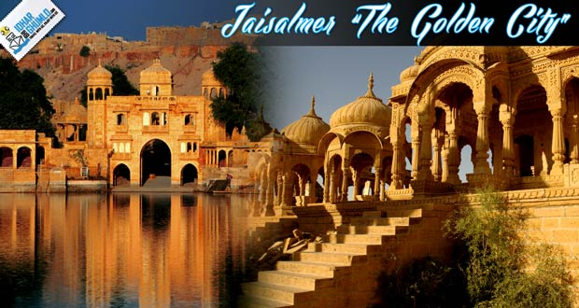

Slide 3
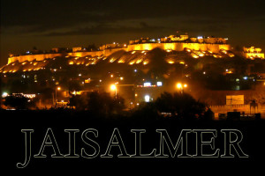

Slide 4
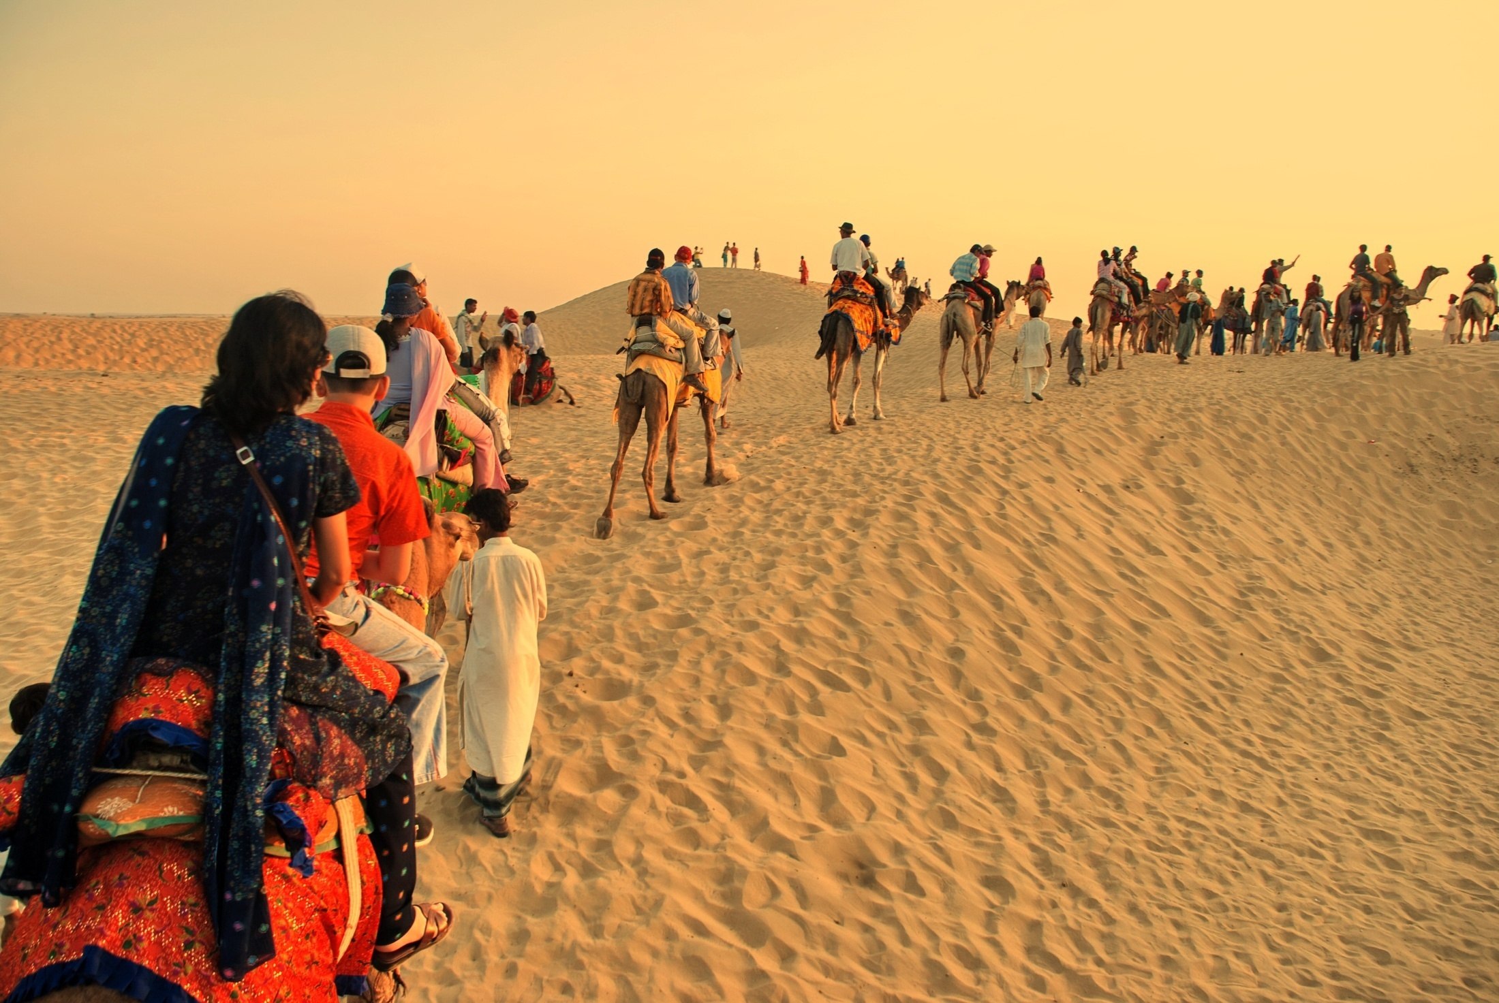

Slide 5
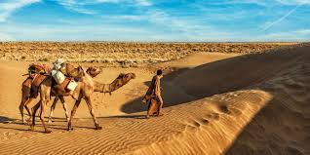

Slide 6
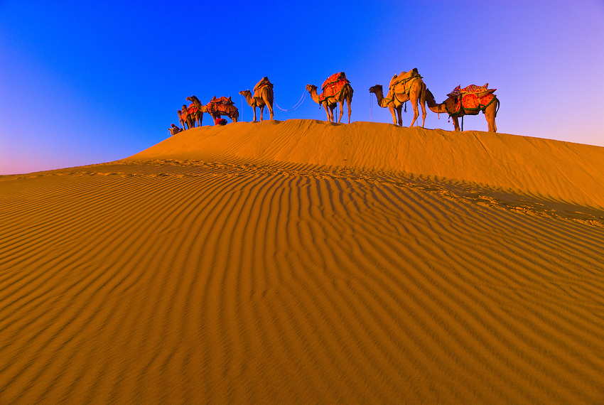

Slide 7
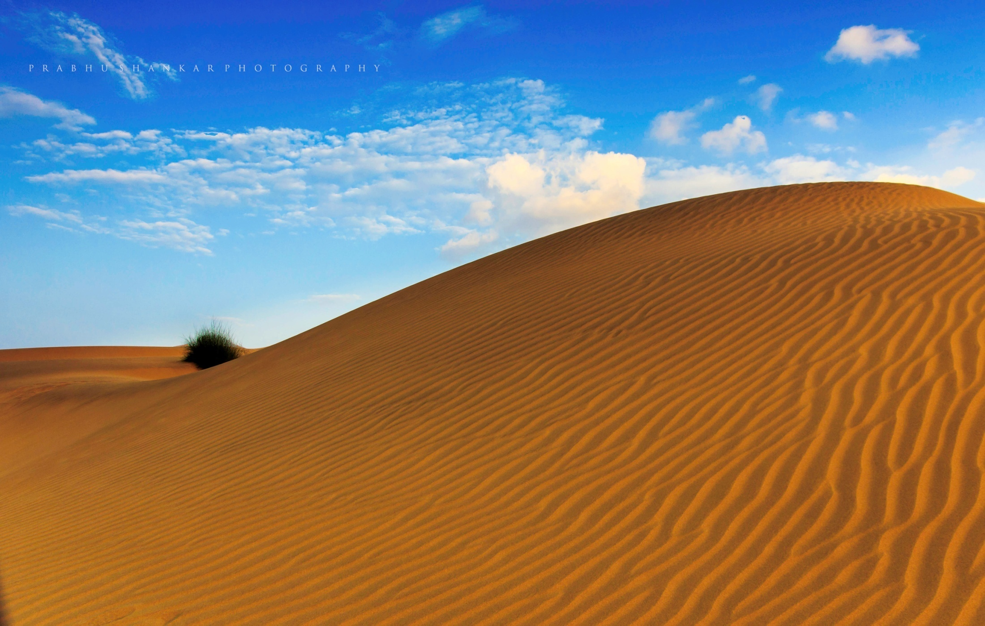

Slide 8
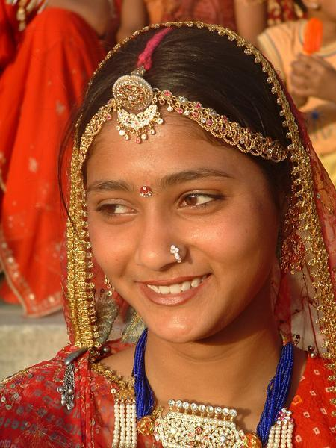

Slide 9
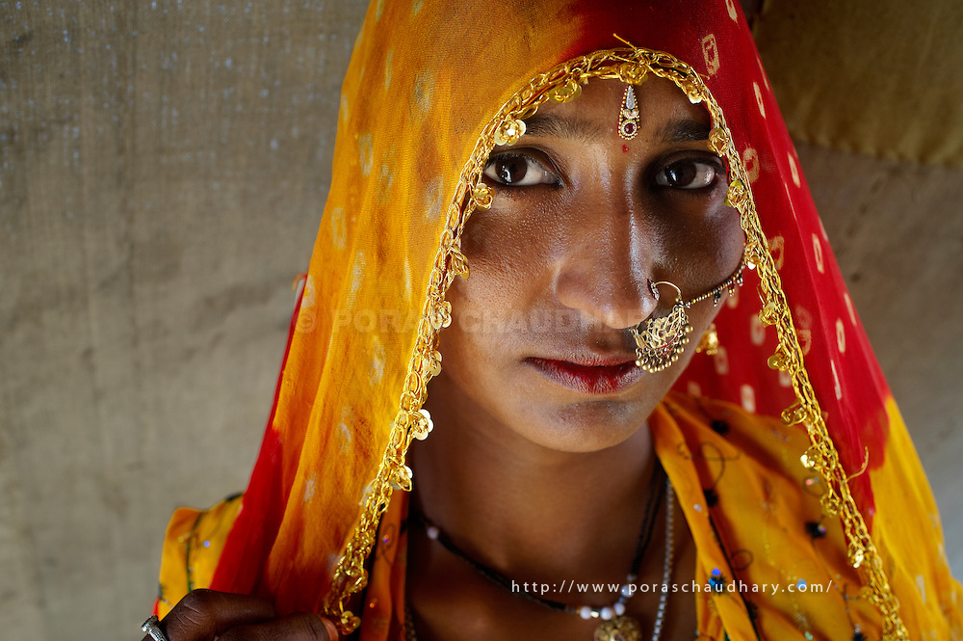

Slide 10
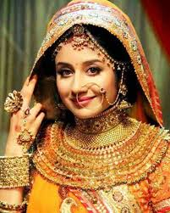

Slide 11
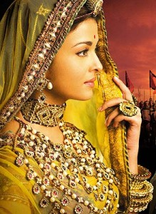
Jodha Bai came from Rajasthan

Slide 12
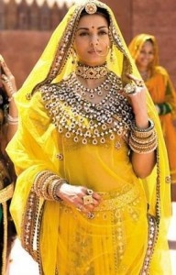

Slide 13
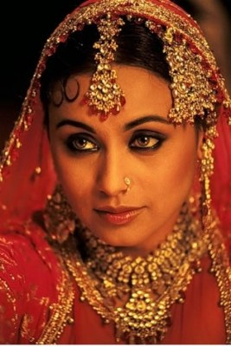

Slide 14
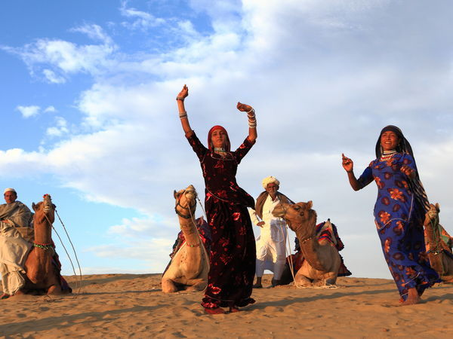
Dancers of Rajasthan

Slide 15
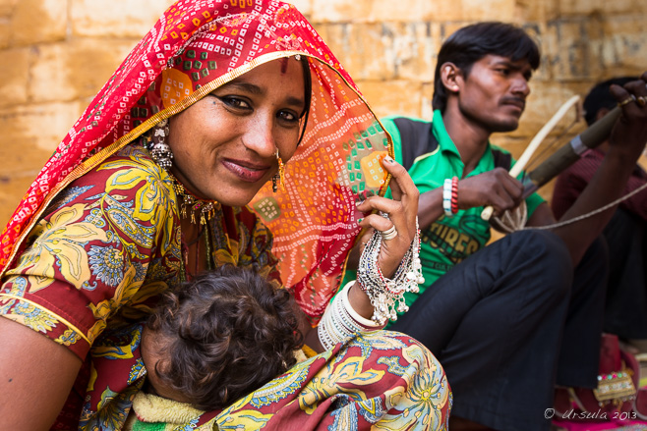
Gypsy woman

Slide 16
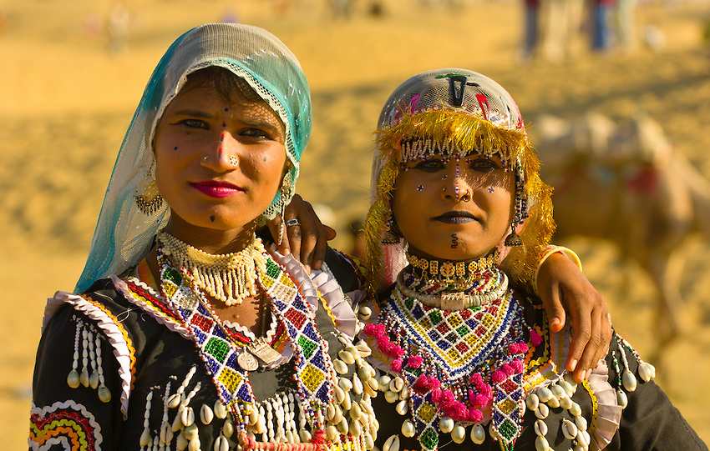

Slide 17
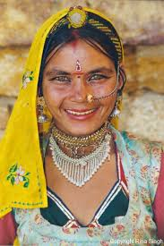

Slide 18
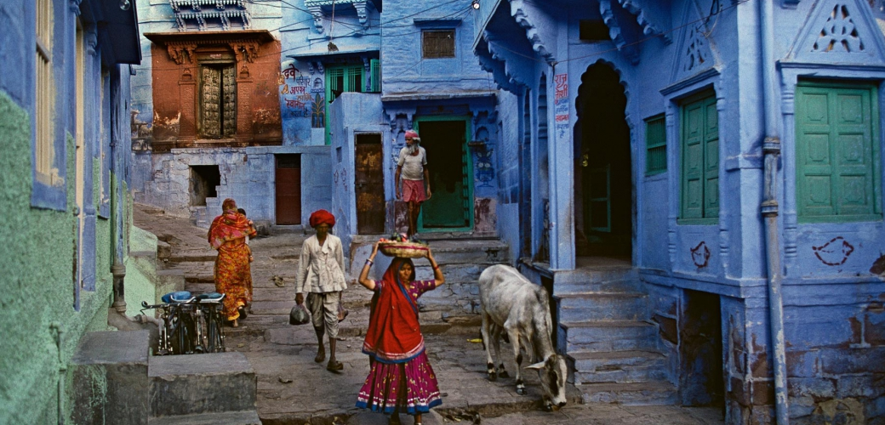

Slide 19
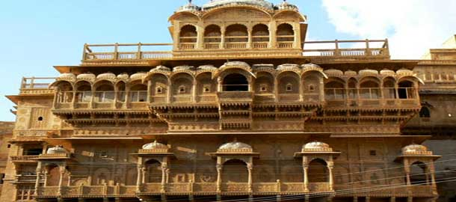
Raj Mahal in Jaisalmer

Slide 20
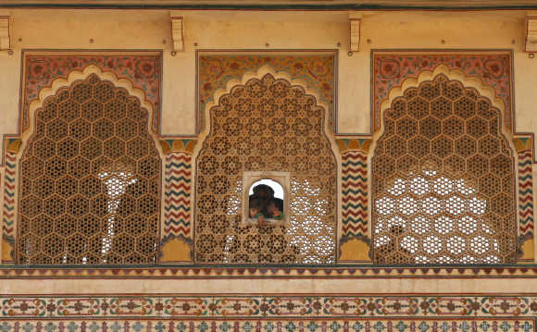
Raj Mahal in Jaisalmer

Slide 21
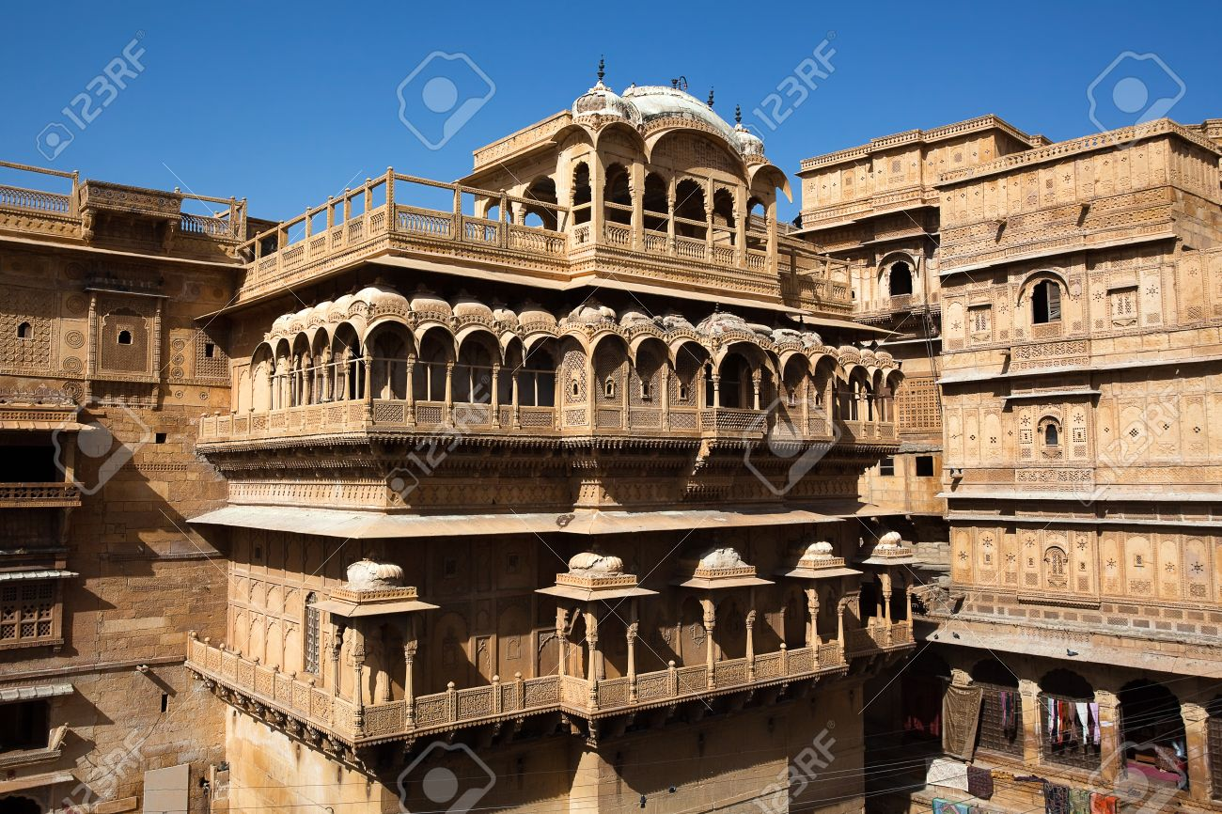
Raj Mahal

Slide 22
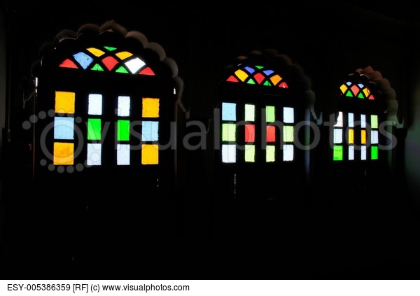
Stain glass windows of Raj Mahal

Slide 23
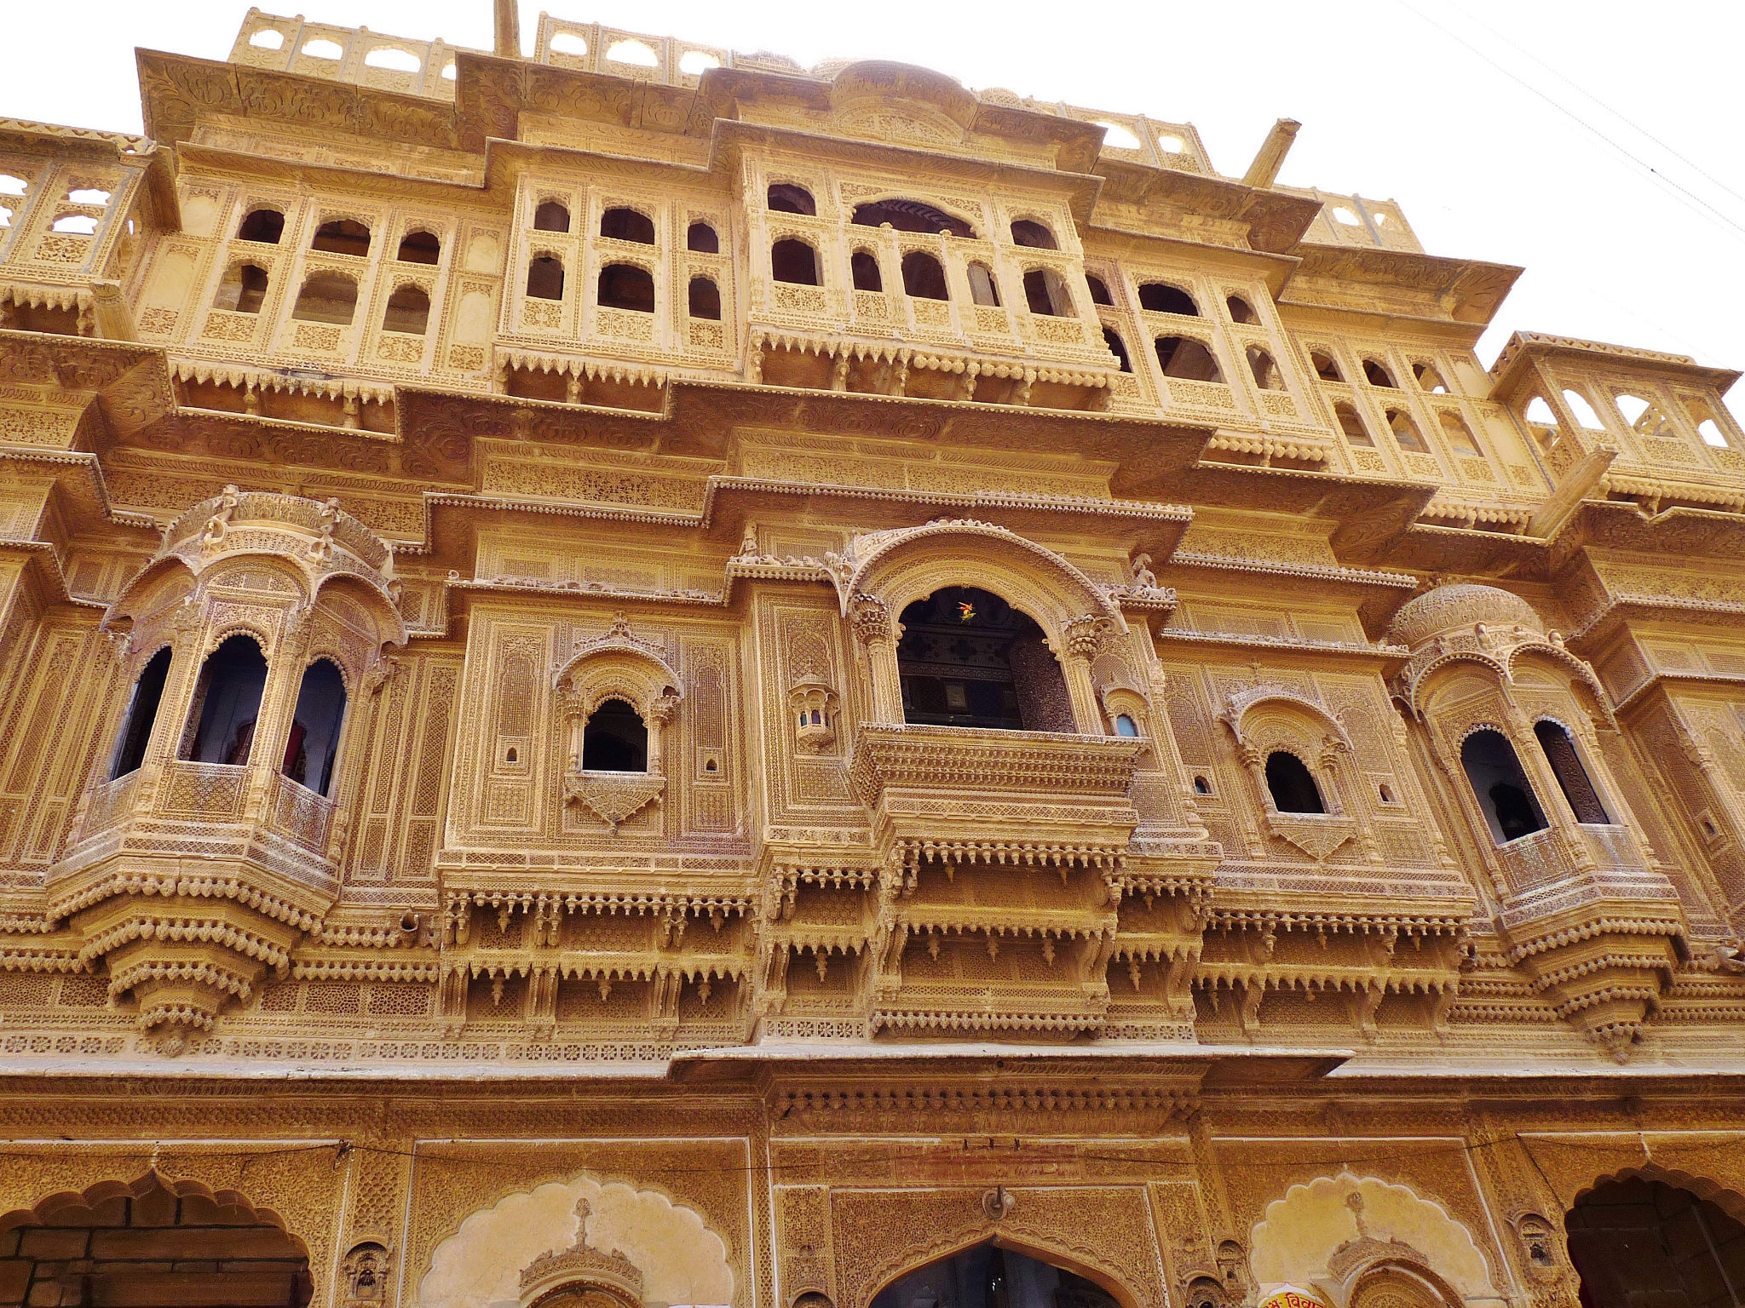
Suryagarh palace

Slide 24
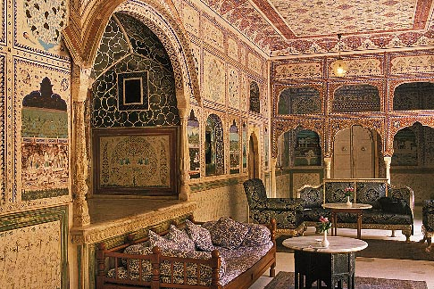
Samode Mahal palace

Slide 25
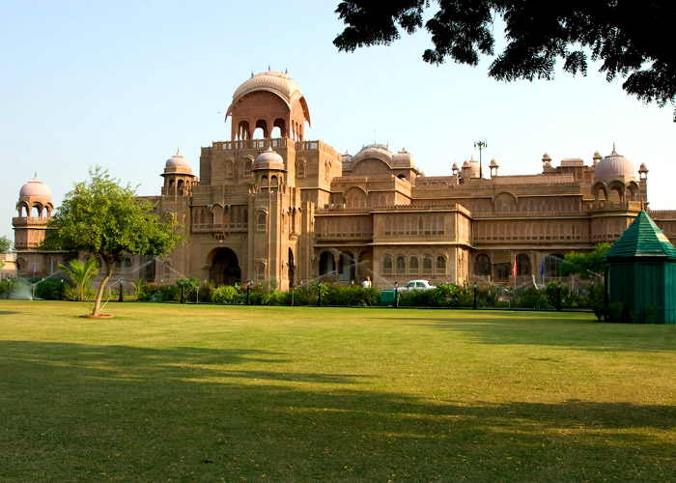

Slide 26
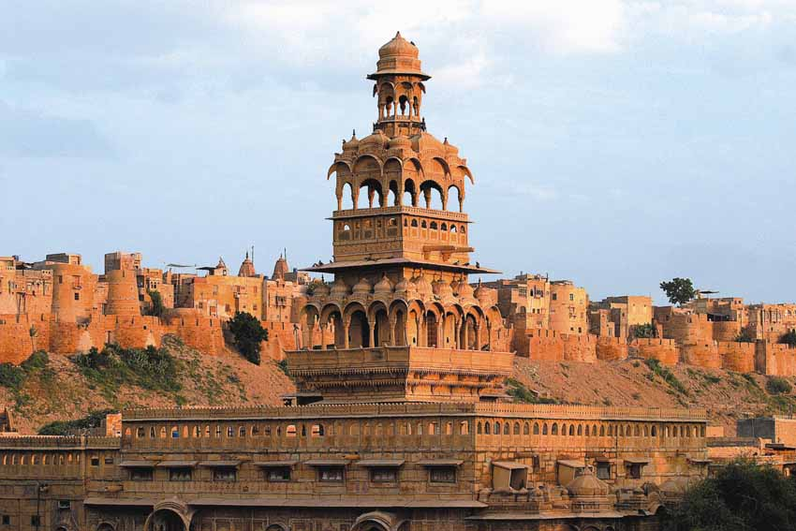

Slide 27
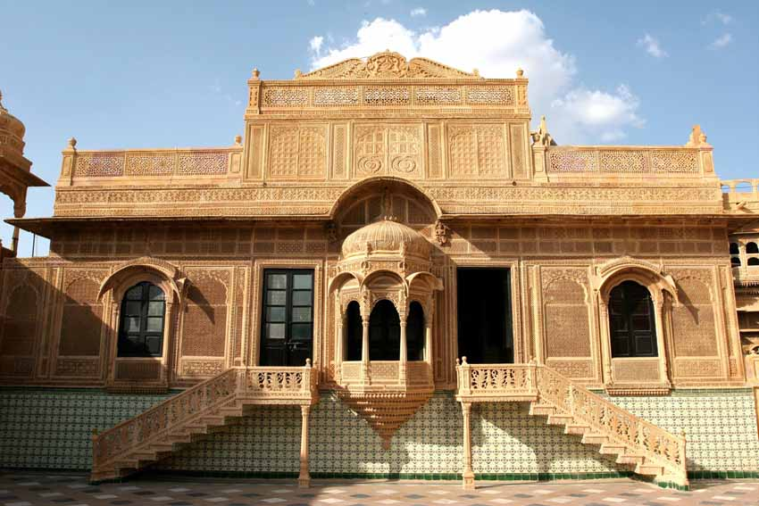

Slide 28
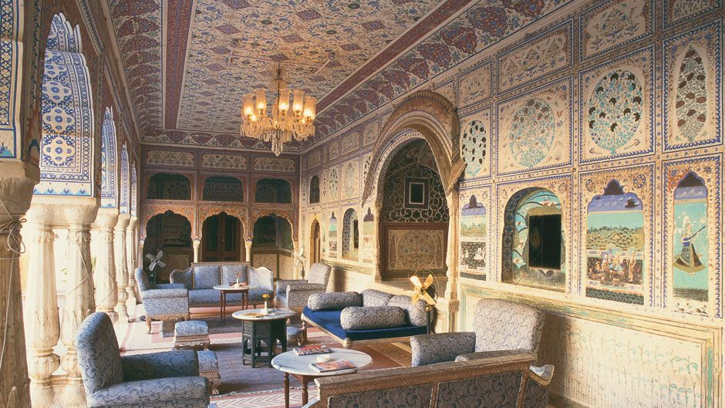
Samode Mahal palace

Slide 29
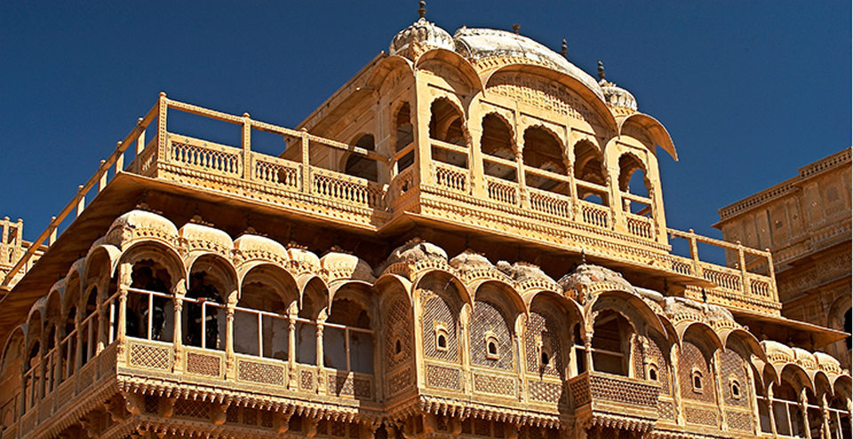

Slide 30
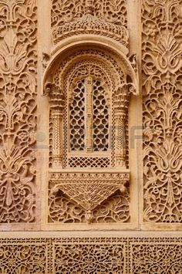
Ornate windows

Slide 31
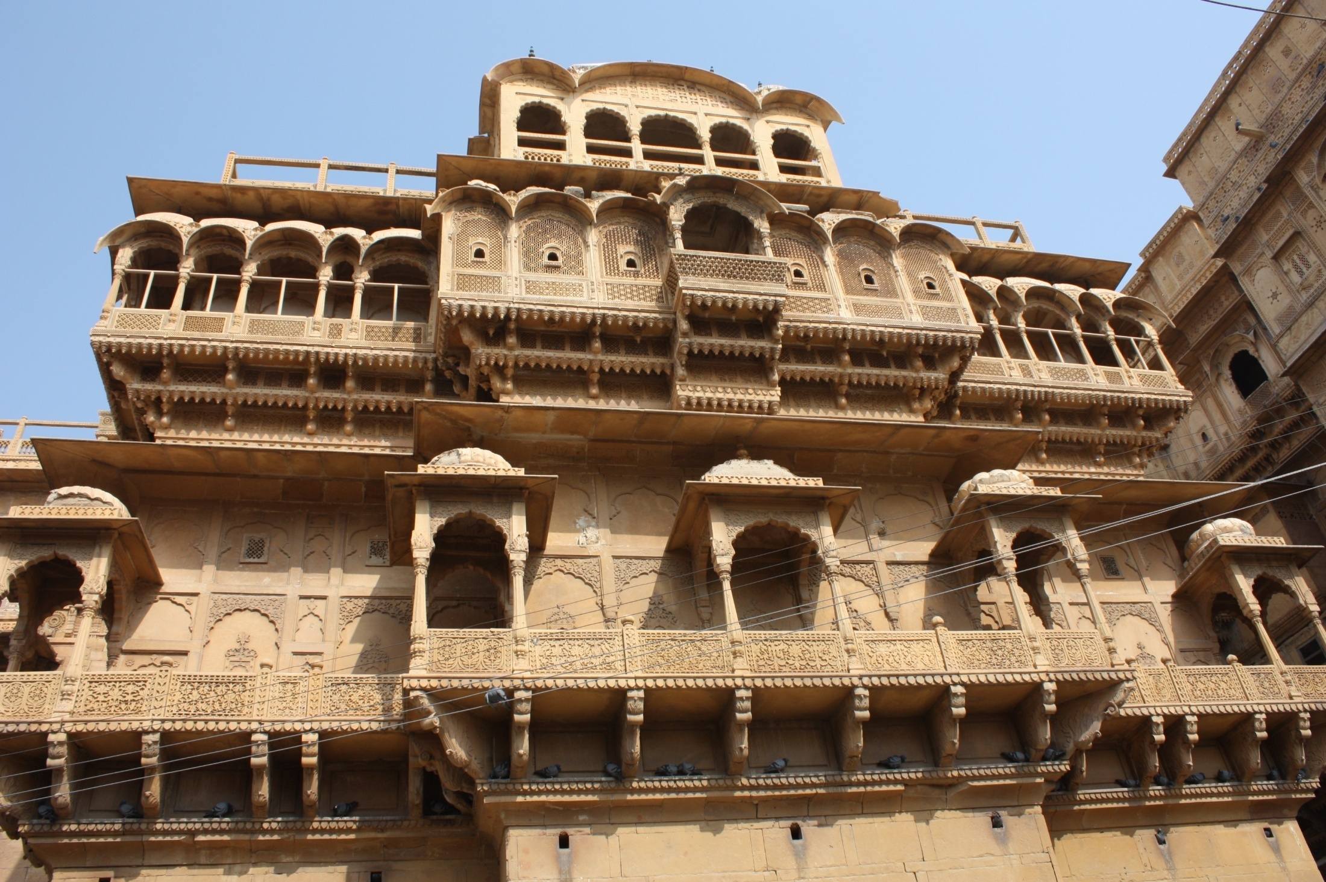

Slide 32
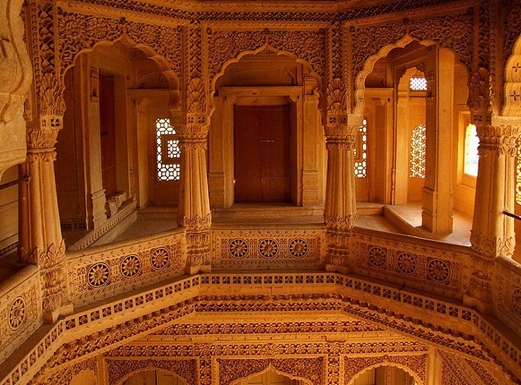

Slide 33
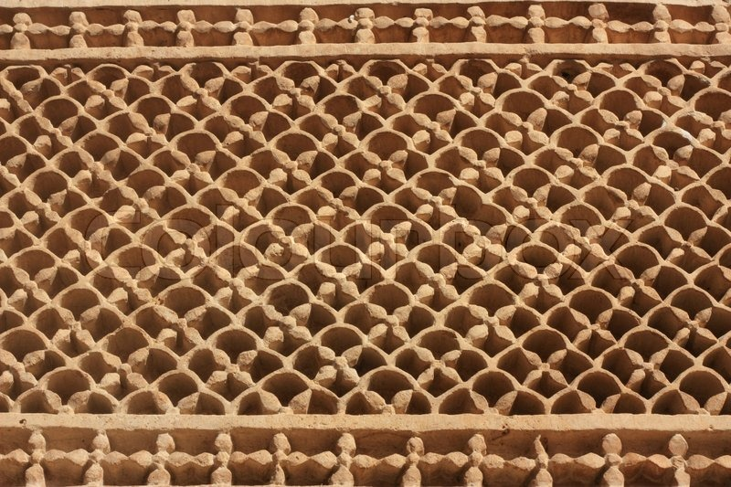
Jaisalmer fort stone grills

Slide 34
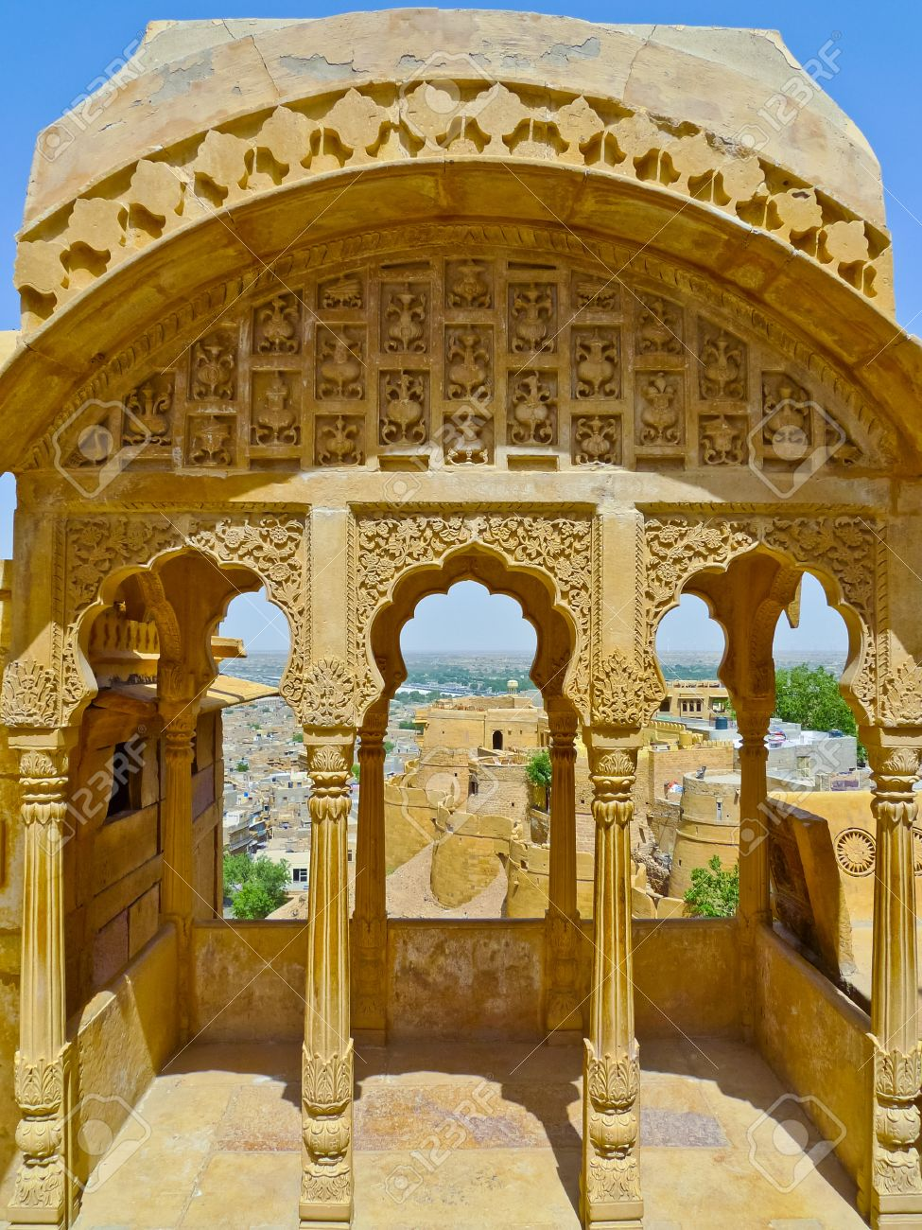
View from palace balcony

Slide 35
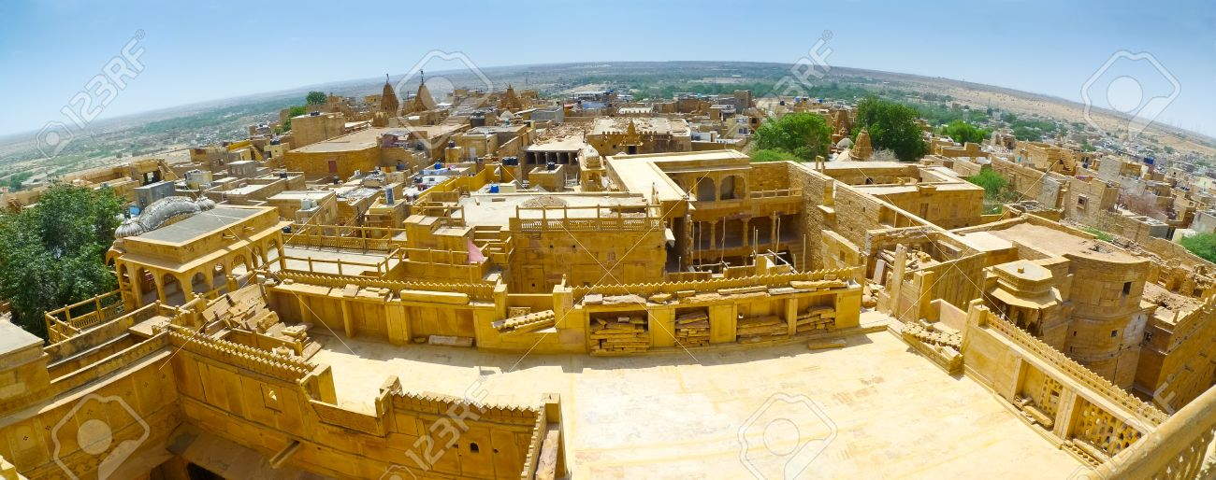
View of Jaisalmer from roof top balcony

Slide 36
Raj Mahal

Slide 37
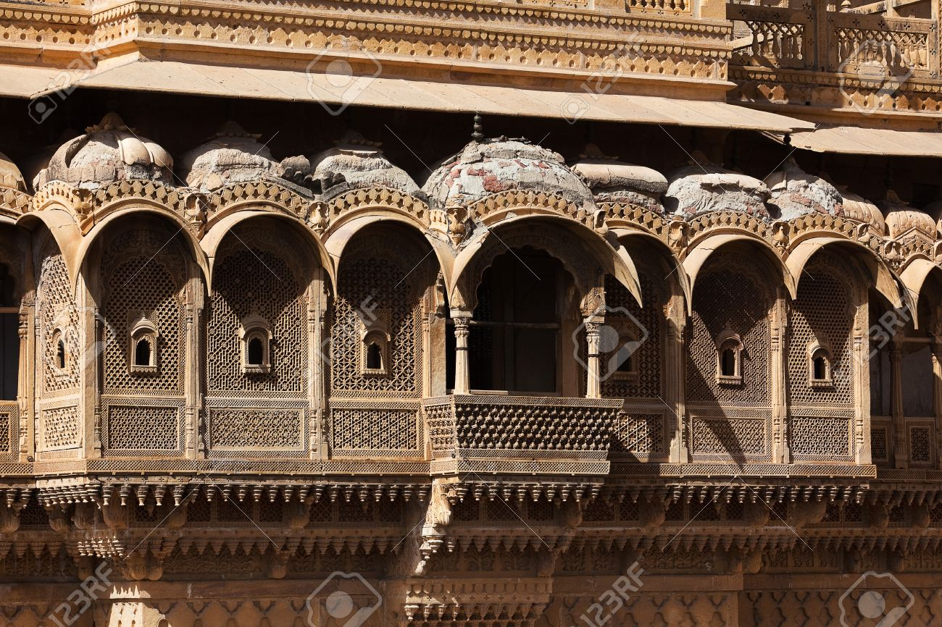
Raj Mahal balcony

Slide 38
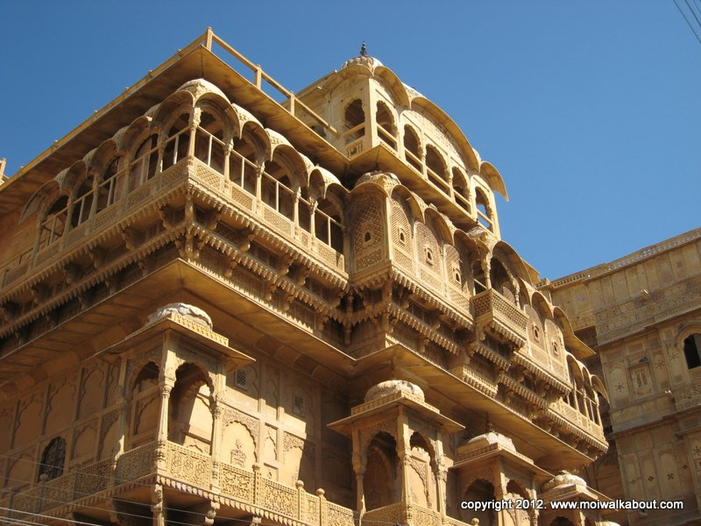

Slide 39
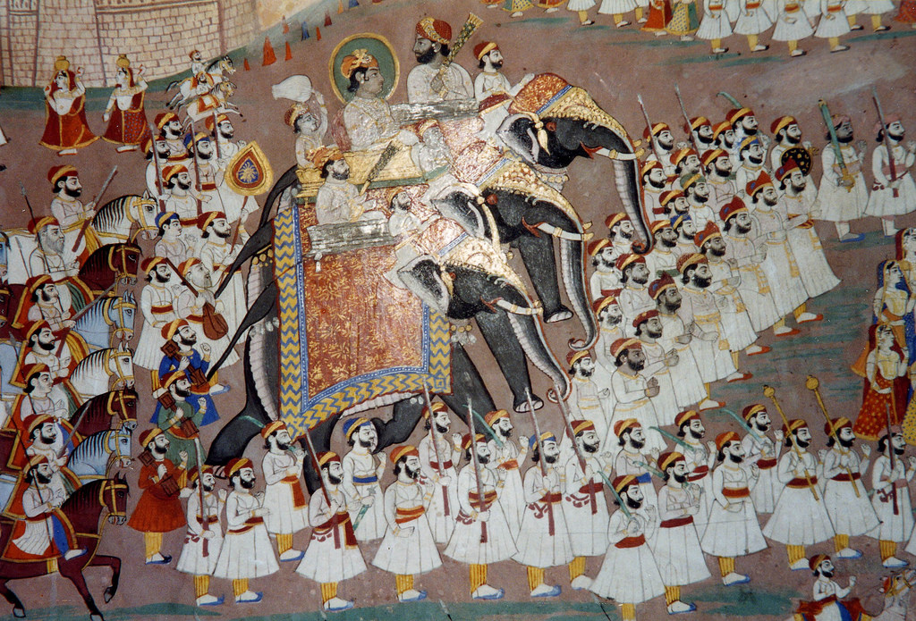
Mural painting inside palace

Slide 40
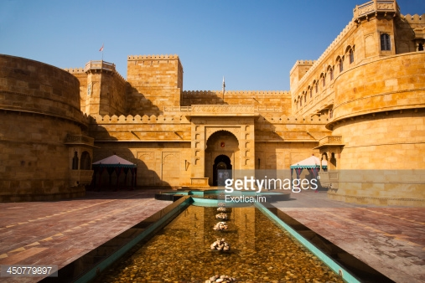

Slide 41
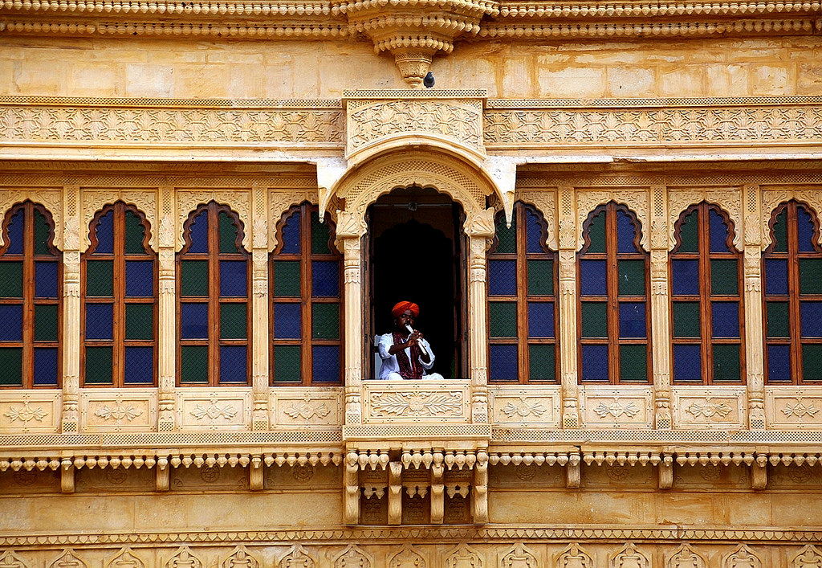

Slide 42
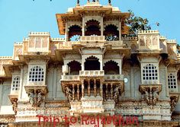

Slide 43
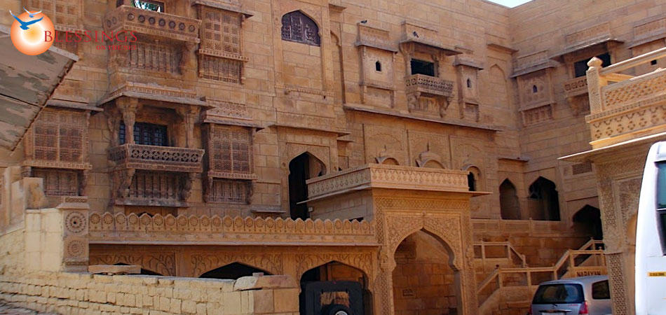

Slide 44
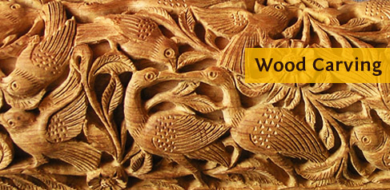
Bahadur garh wood carving

Slide 45
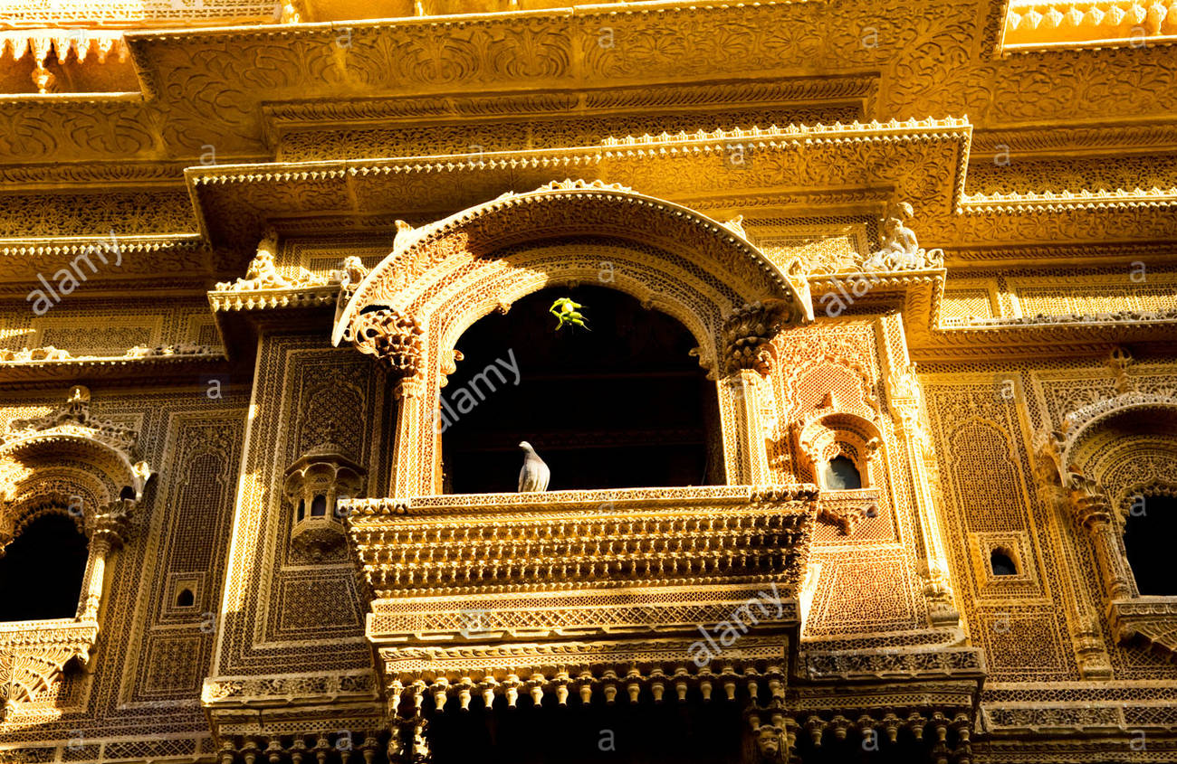

Slide 46
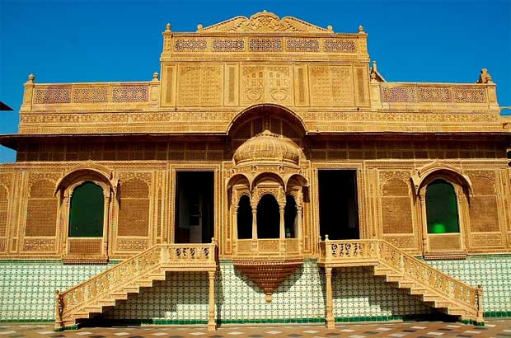
Mandir palace

Slide 47
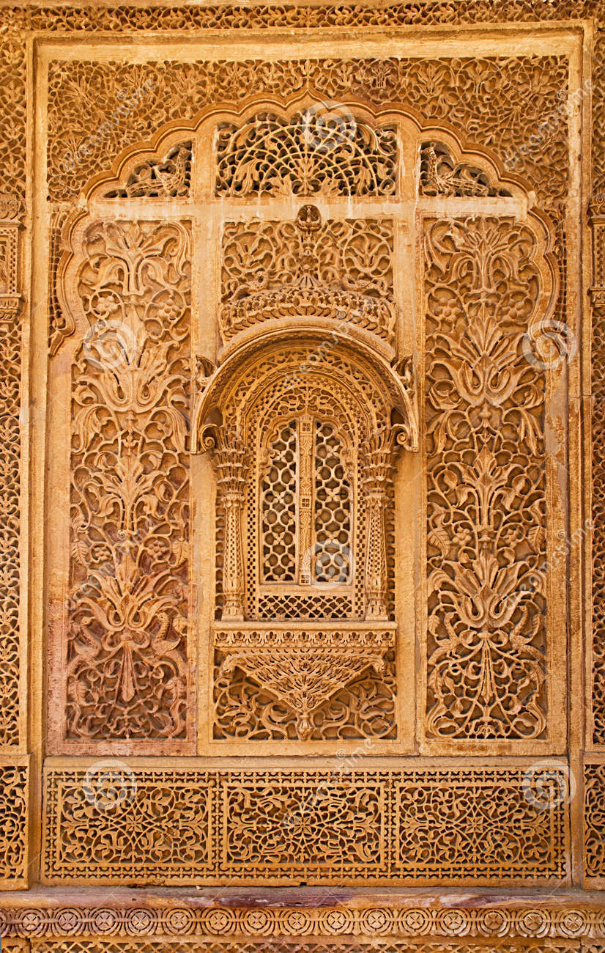
Carved window of Mandir palace

Slide 48
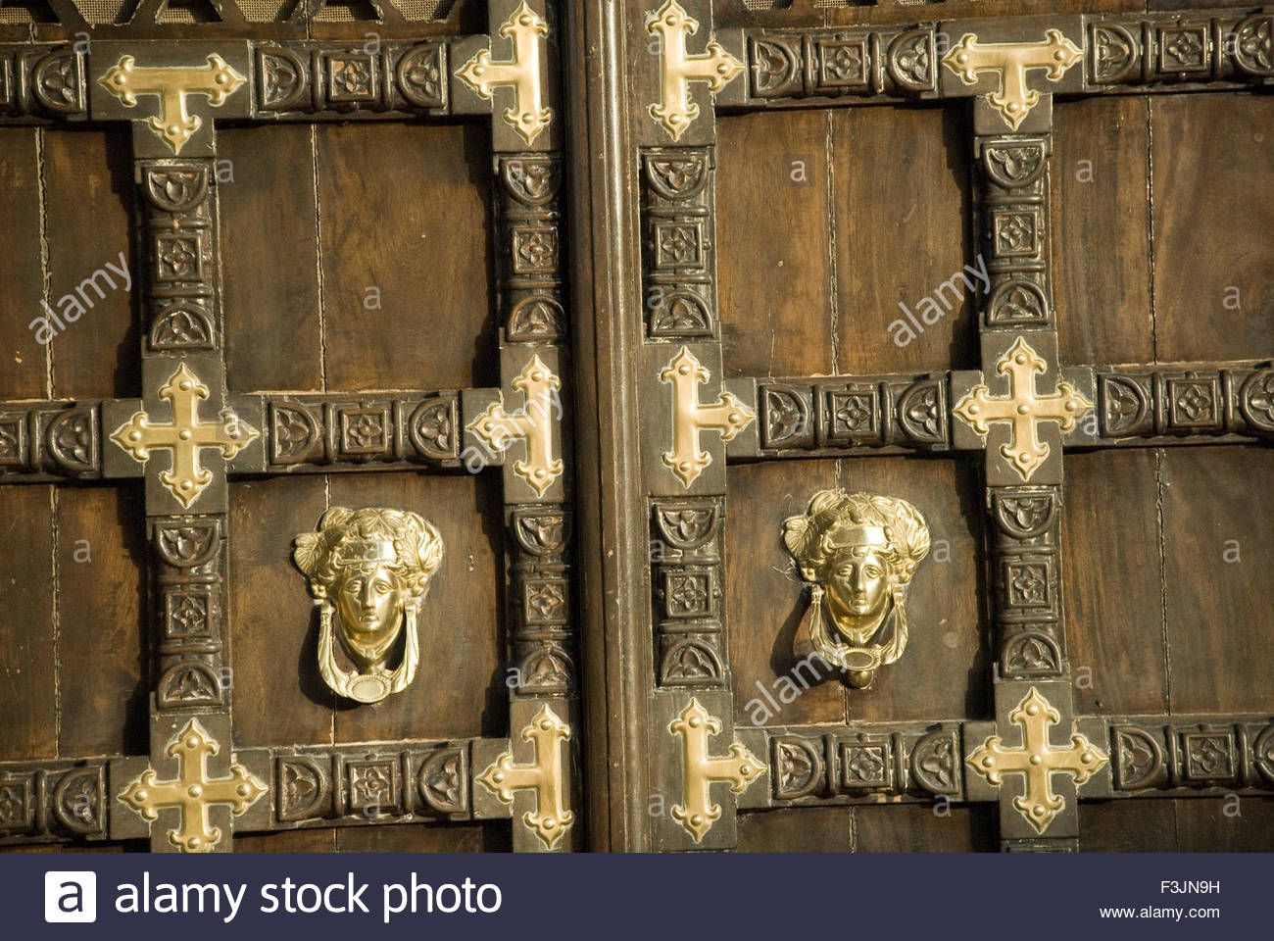
Door of city palace

Slide 49
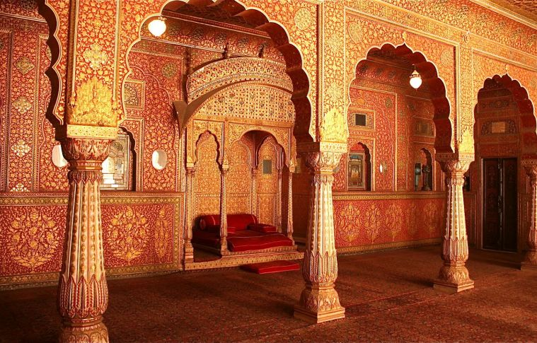

Slide 50
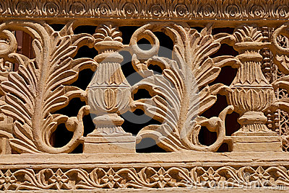
Mandir palace

Slide 51
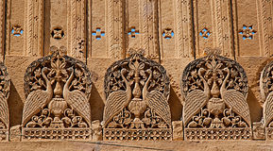
Exterior of Mandir palace

Slide 52
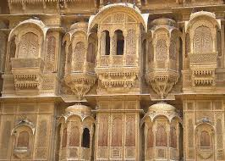

Slide 53


Slide 54

Suryagarh palace

Slide 55

Jaisalmer fort

Slide 56

Gorband palace

Slide 57

Haveli of Jaisalmer

Slide 58


Slide 59


Slide 60

Himmatgarh palace

Slide 61

Jawahar Niwas palace

Slide 62

Mandir palace

Slide 63

Hotel Shahi palace

Slide 64

Hotel SriNath palace

Slide 65


Slide 66


Slide 67


Slide 68


Slide 69


Slide 70


Slide 71


Slide 72


Slide 73


Slide 74


Slide 75

Jaisalmer palace

Slide 76

Jaisalmer fort

Slide 77

Jaisalmer fort

Slide 78

Jaisalmer palace

Slide 79


Slide 80

Jaisalmer barabagh

Slide 81

Jaisalmer fort

Slide 82


Slide 83

Jaisalmer palace inside

Slide 84

Patwon ki haveli

Slide 85


Slide 86

Jawahar palace

Slide 87


Slide 88

Maharaja palace

Slide 89

Maharaja palace

Slide 90

Lobby ,Maharaja palace

Slide 91

Court yard,Maharaja palace

Slide 92


Slide 93

Mandir palace

Slide 94

Mandir palace

Slide 95

Mandir palace

Slide 96

Mandir palace

Slide 97

Mandir palace

Slide 98

Mandir palace

Slide 99

Old town palace inside the fort

Slide 100


Slide 101

Palace inside the fort

Slide 102

Palace inside fort

Slide 103

Maharaja palace

Slide 104


Slide 105


Slide 106


Slide 107

Raj Mahal palace

Slide 108

Hands at the entrance Raj Mahal palace

Slide 109


Slide 110

Royal palace

Slide 111

SriNath palace

Slide 112


Slide 113


Slide 114

Raj Mahal

Slide 115


Slide 116

JodhPur fort

Slide 117

Interior of JunaGarh fort

Slide 118

Laxmi Niwas Bikaner

Slide 119
Samode Mahal palace

Slide 120

Puppets of Rajasthan

Slide 121


Slide 122


