Slide 1
Native American art and craft
There are numerous tribes of Native Americans
who have very distinct styles of their own art and craft. It is not possible to showcase them all so a very selected few are presented here for your private enjoyment. Their incredible skills
in art and craft are self evident and need no explanation. They lived in harmony with the nature and got their inspirations from it .
Amal K.Chatterjee/October 2015

Slide 2
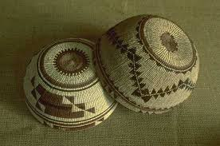

Slide 3
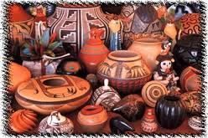

Slide 4
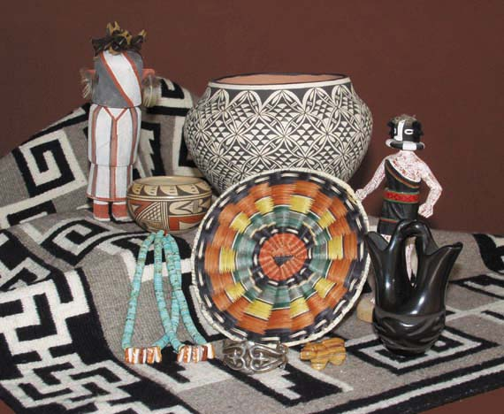

Slide 5
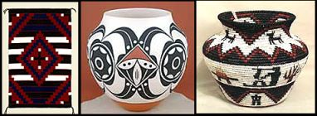

Slide 6
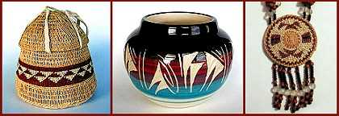

Slide 7
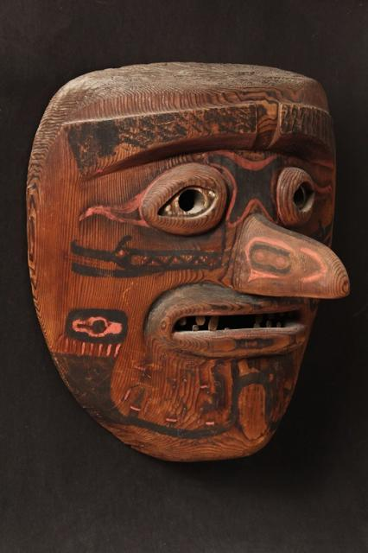

Slide 8
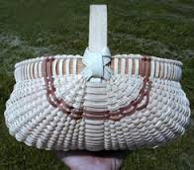

Slide 9
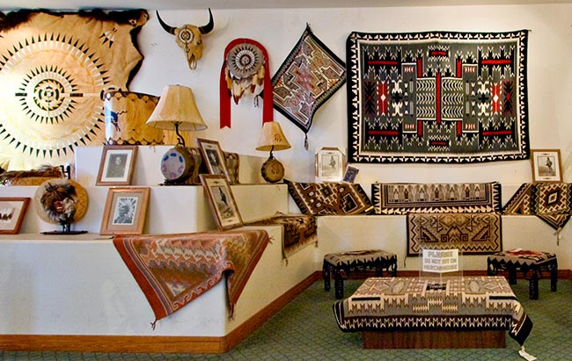

Slide 10
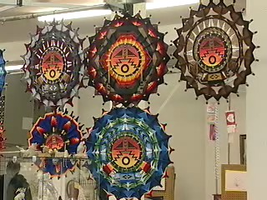

Slide 11
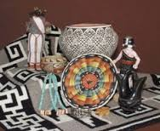

Slide 12
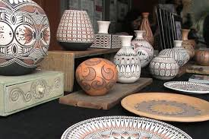

Slide 13
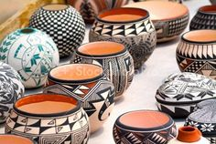

Slide 14


Slide 15
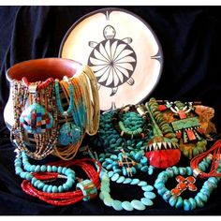

Slide 16
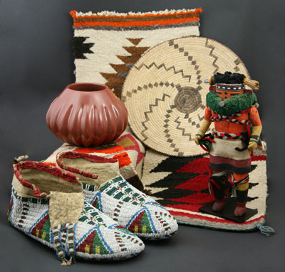

Slide 17
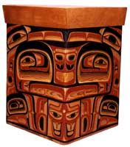

Slide 18
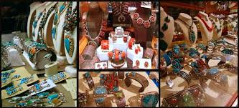

Slide 19
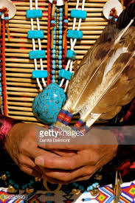

Slide 20
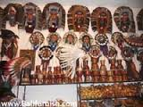

Slide 21
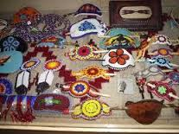

Slide 22
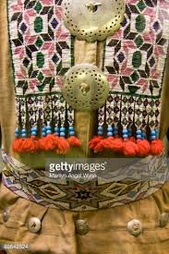

Slide 23
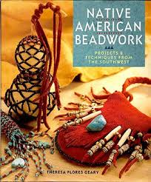

Slide 24
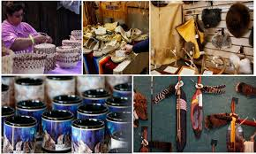

Slide 26
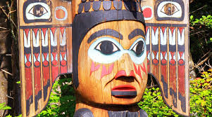

Slide 27
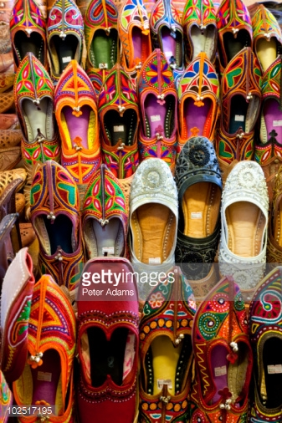

Slide 28
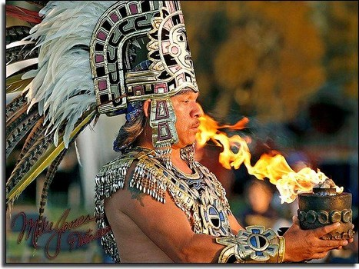

Slide 29
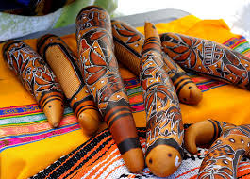

Slide 30
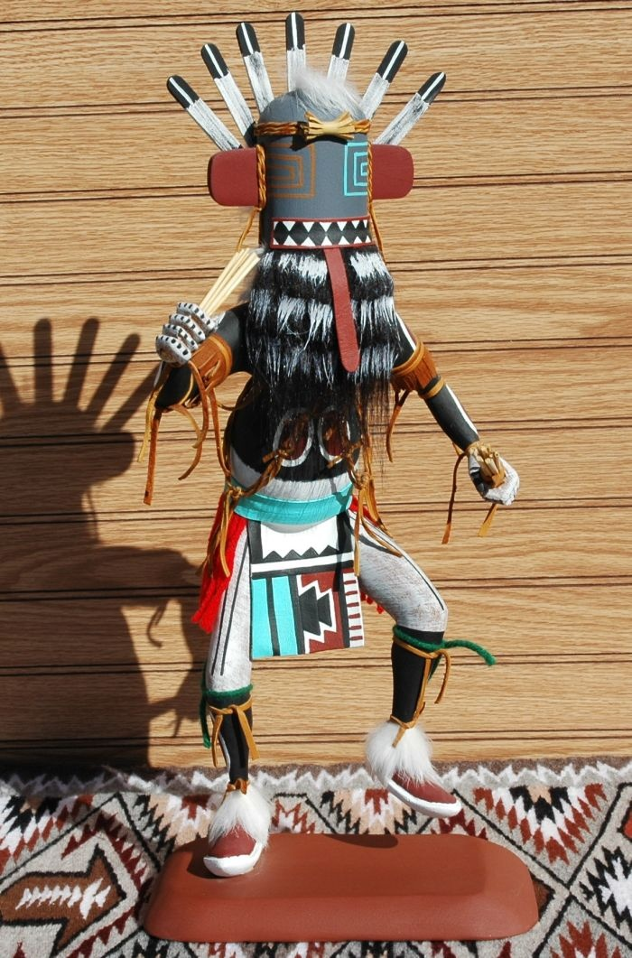

Slide 31
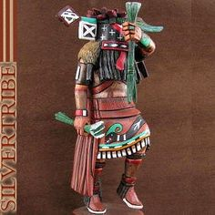

Slide 32
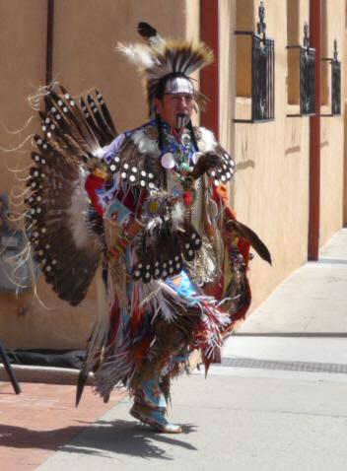

Slide 33
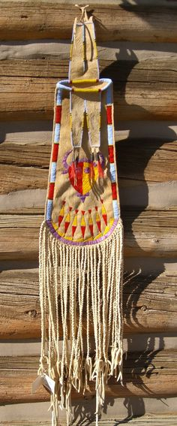

Slide 34
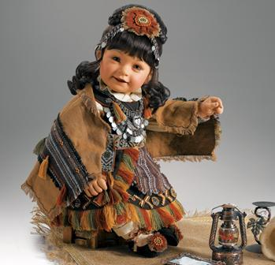

Slide 35
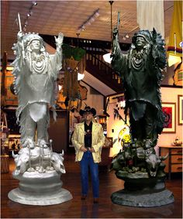

Slide 36
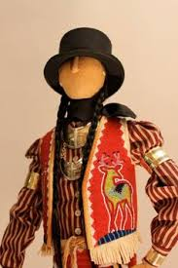

Slide 37
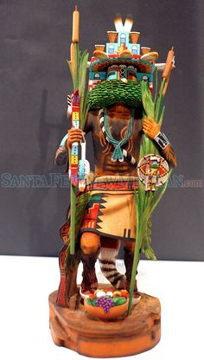

Slide 38
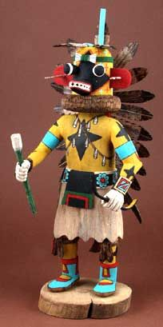

Slide 39
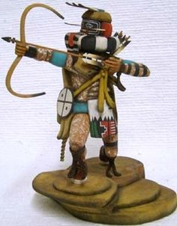

Slide 40
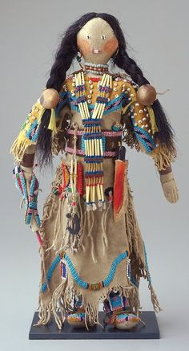

Slide 41
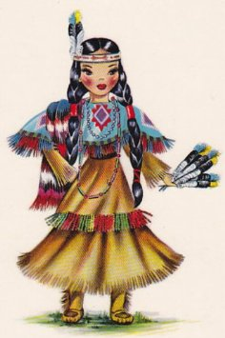

Slide 42
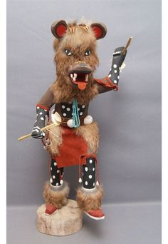

Slide 43
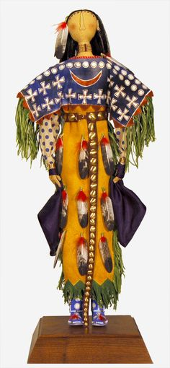

Slide 44
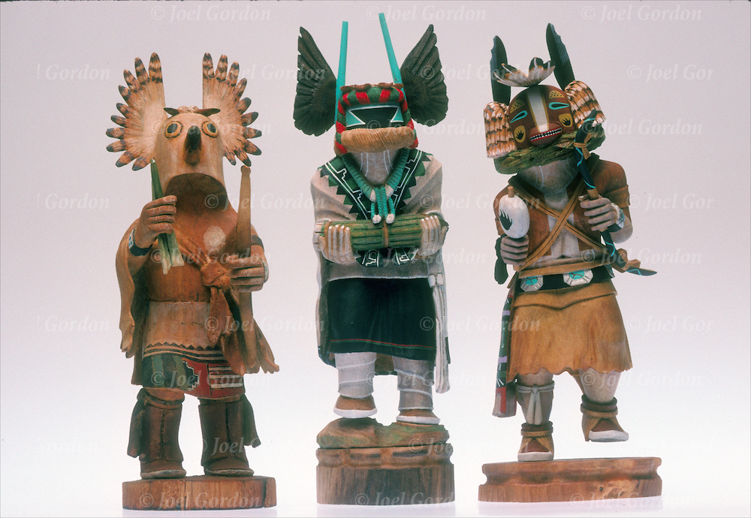

Slide 45
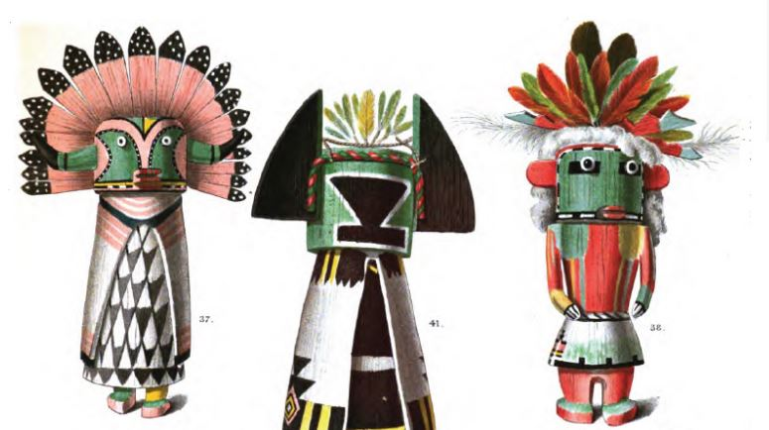

Slide 46
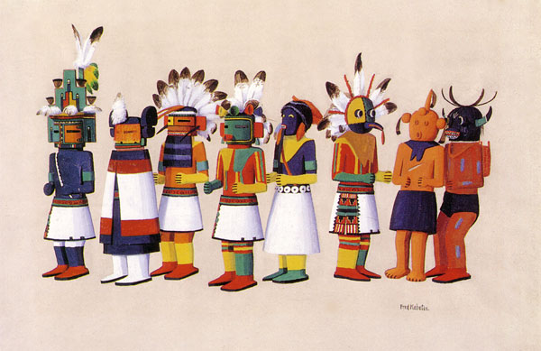

Slide 47
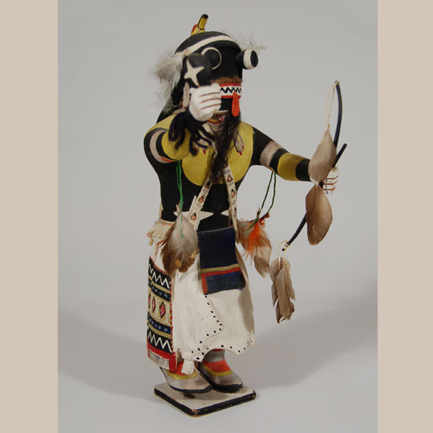

Slide 48
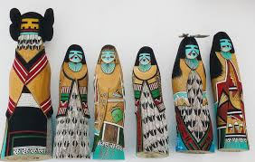

Slide 49
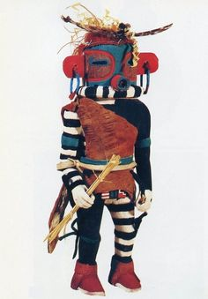

Slide 50
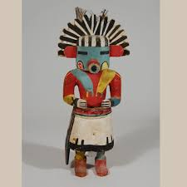

Slide 51
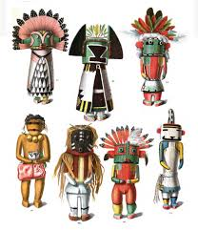

Slide 52
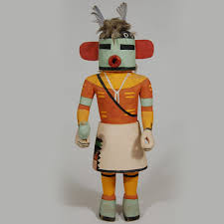

Slide 53
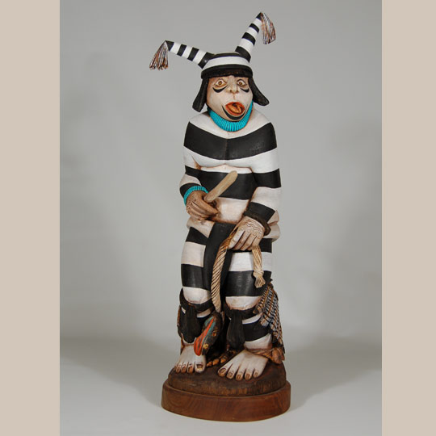

Slide 55


Slide 56


Slide 57


Slide 58


Slide 59


Slide 61


Slide 62


Slide 63


Slide 64


Slide 65


Slide 66


Slide 67


Slide 68


Slide 69


Slide 70


Slide 71


Slide 72


Slide 73


Slide 74


Slide 75


Slide 76


Slide 78


Slide 79


Slide 80


Slide 81


Slide 82


Slide 83


Slide 84


Slide 85


Slide 86


Slide 87


Slide 88


Slide 89


Slide 90


Slide 91


Slide 92


Slide 93


Slide 94


Slide 95


Slide 96


Slide 97


Slide 98


Slide 99


Slide 100


Slide 101


Slide 102


Slide 103


Slide 104


Slide 105


Slide 106


Slide 107


Slide 108


Slide 109


Slide 110


Slide 111


Slide 112


Slide 113


Slide 114


Slide 115


Slide 116


Slide 117


Slide 118


Slide 119


Slide 120


Slide 121


Slide 122


Slide 123


Slide 124


Slide 125


Slide 126


Slide 127


Slide 128


Slide 129


Slide 130


Slide 131


Slide 132


Slide 133


Slide 135


Slide 136


Slide 137


Slide 138


Slide 139


Slide 140


Slide 141


Slide 142


Slide 143


Slide 144


Slide 145


Slide 146


Slide 147


Slide 148


Slide 149


Slide 150


Slide 151


Slide 152


Slide 154


Slide 156


Slide 157


Slide 158


Slide 159


Slide 160


Slide 161


Slide 163


Slide 164


Slide 165


Slide 166


Slide 167


Slide 168


Slide 169


Slide 170


Slide 171


Slide 172


Slide 173


Slide 175


Slide 176


Slide 177


Slide 178


Slide 179


Slide 181


Slide 182


Slide 183


Slide 184


Slide 185


Slide 186


Slide 187


Slide 190


Slide 191


Slide 192


Slide 193


Slide 194


Slide 195


Slide 196


Slide 197

Apache

Slide 198

Apache

Slide 199

Zuni pottery maker

Slide 200

Cherokee bead work

Slide 201

Cherokee vest

Slide 202

Cherokee pin cushion

Slide 203

Cherokee bead work

Slide 204

Cherokee tobacco bag

Slide 205

Cherokee moccasins

Slide 206

Cherokee basket

Slide 207

Cherokee wood carver

Slide 208

Apache

Slide 209

Hopi woman

Slide 210

Hopi woman making pottery

Slide 211

Lacota sioux

Slide 212

Lacota Sioux dance dress

Slide 213

Lacota Siouxs leggings

Slide 214

Lacota Sioux beaded moccasins

Slide 215

Lacota Sioux pipe

Slide 216

Sioux beadwork blanket

Slide 217

Sioux saddle blanket

Slide 218


Slide 219

Navajo sand painting

Slide 220

Navajo sand painting

Slide 221

Navajo sand painting

Slide 222

Navajo blanket making

Slide 223

Navajo flute player

Slide 224

Navajo blanket patterns

Slide 225

Navajo blanket

Slide 226

Navajo basket

Slide 227

Santo Domingo woman

Slide 228

Zuni women

Slide 229

Navajo painting

Slide 230

Navajo painting

Slide 231


Slide 232


Slide 233


Slide 234


Slide 235


Slide 236


Slide 237


Slide 238


Slide 239


Slide 240


Slide 241


Slide 242


Slide 243


Slide 244


Slide 245


Slide 246


Slide 247


Slide 248


Slide 249


Slide 250


Slide 251


Slide 252


Slide 253


Slide 254


Slide 255


Slide 256


Slide 257


Slide 258


Slide 259


Slide 260


Slide 261


Slide 262


Slide 263


Slide 264


Slide 265


Slide 266


Slide 267


Slide 268


Slide 269


Slide 270


Slide 271


Slide 272


Slide 273


Slide 274


Slide 275


Slide 276


Slide 277


Slide 278


Slide 279


Slide 280


Slide 281


Slide 282


Slide 283


Slide 285


Slide 286


Slide 287


Slide 288


Slide 289


Slide 290


Slide 291


Slide 292


Slide 293


Slide 295


Slide 296


Slide 298


Slide 299


Slide 300


Slide 301

Santo Domingo pottery

Slide 303


Slide 304


Slide 305


Slide 306


Slide 307


Slide 308


Slide 309


Slide 310


Slide 311


Slide 312


Slide 313


Slide 314


Slide 315


Slide 316


Slide 317


Slide 318


Slide 319


Slide 320


Slide 321


Slide 322


Slide 323


Slide 324


Slide 325


Slide 326


Slide 327


Slide 329


Slide 330


Slide 331


Slide 332

Santo Domingo

Slide 333


Slide 334


Slide 335


Slide 336


Slide 337


Slide 338


Slide 339


Slide 341


Slide 342


Slide 343


Slide 344


Slide 345


Slide 347


Slide 348

Hopi

Slide 349


Slide 350


Slide 351


Slide 352

Santo Domingo pottery

Slide 353


Slide 354


Slide 355


Slide 356

South West

Slide 357


Slide 358


Slide 359


Slide 360


Slide 361


Slide 362


Slide 363


Slide 364


Slide 365


Slide 366


Slide 367


Slide 368


Slide 369


Slide 370


Slide 371


Slide 372


Slide 373


Slide 374


Slide 375


Slide 376


Slide 377


Slide 378


Slide 379


Slide 380


Slide 381


Slide 382

Cherokee mask

Slide 383


Slide 384


Slide 385


Slide 386


Slide 387


Slide 388


Slide 389


