Slide 1
Nalanda
The second University in the world
Founded in 413-455 AD

Slide 2
World’s first university was established in Takshashila in 700 BC , now in Pakistan and was destroyed by the Huns of Central Asia around 500 AD but this theory of destruction is contested by many historians.
niversity
It enrolled 10500 students from as far as Syria, Babylon, Greece and China studying 68 subjects . It flourished from 700 BC to 500 AD.The stupa in the next slides proves that Buddhist theology was taught there as in Nalanda but the decline of Takshashila is still shrouded in mystery.
AKC/December 2015

Slide 3
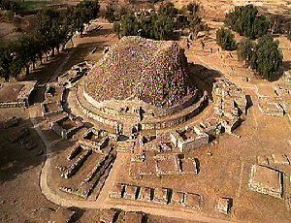
Ruins of Takshashila University

Slide 4
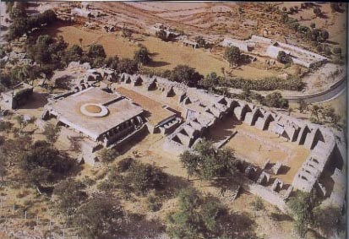
A monastery ruin in Takshashila

Slide 5
The second university in the world
The second university at Nalanda was established in 413-455 AD using the model of Takshashila where theology, grammar, metaphysics, astrology, medicine, philosophy, economics, art,military science etc. were taught. It functioned as the premier center of learning from 500 to 1300 AD when it was totally destroyed by Moslem invader Bakhtiar Khilji from Turkey. It had 300 lecture halls , an observatory and a massive library that surpassed that of Karnak in Egypt. Chinese traveler Hiuen Tsiang wrote that there were more than 10000 students and over 200 teachers teaching there. Khilji destroyed Nalanda in order to root out Buddhism.
It was Hiuen Tsiang’s written records that led to the discovery of Nalanda ruins in Bihar.

Slide 6
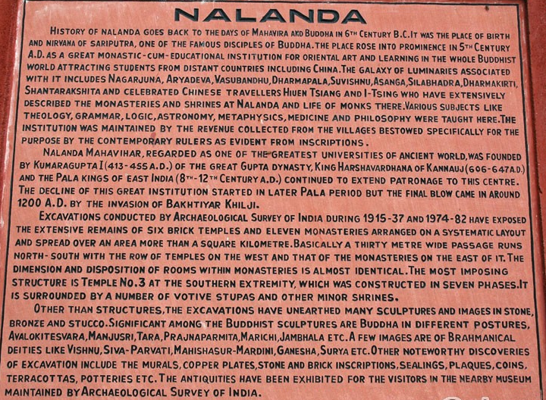

Slide 7
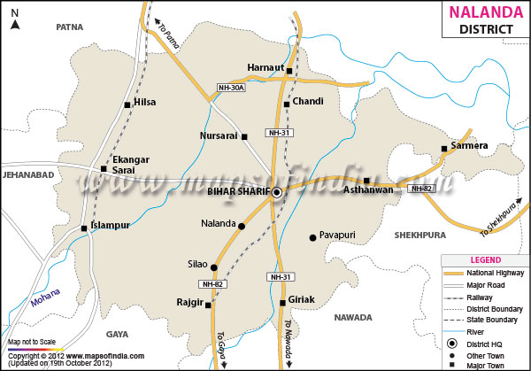
Bihar

Slide 8

Administration building

Slide 9
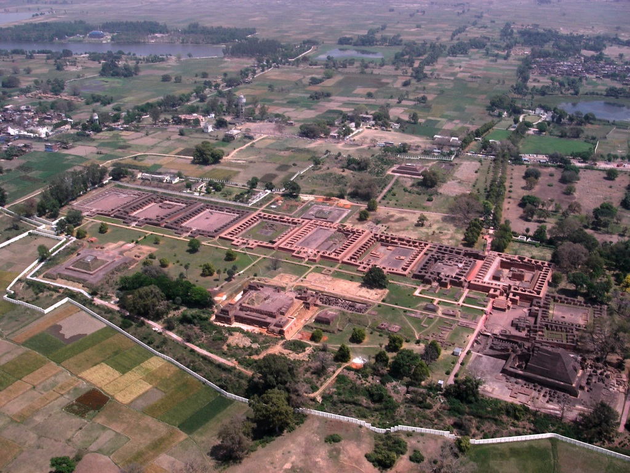
Dormitories and dining halls for students
Aerial view of Nalanda ruins

Slide 10
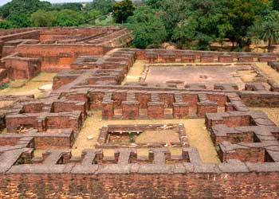
Dining table surrounded by rooms

Slide 11
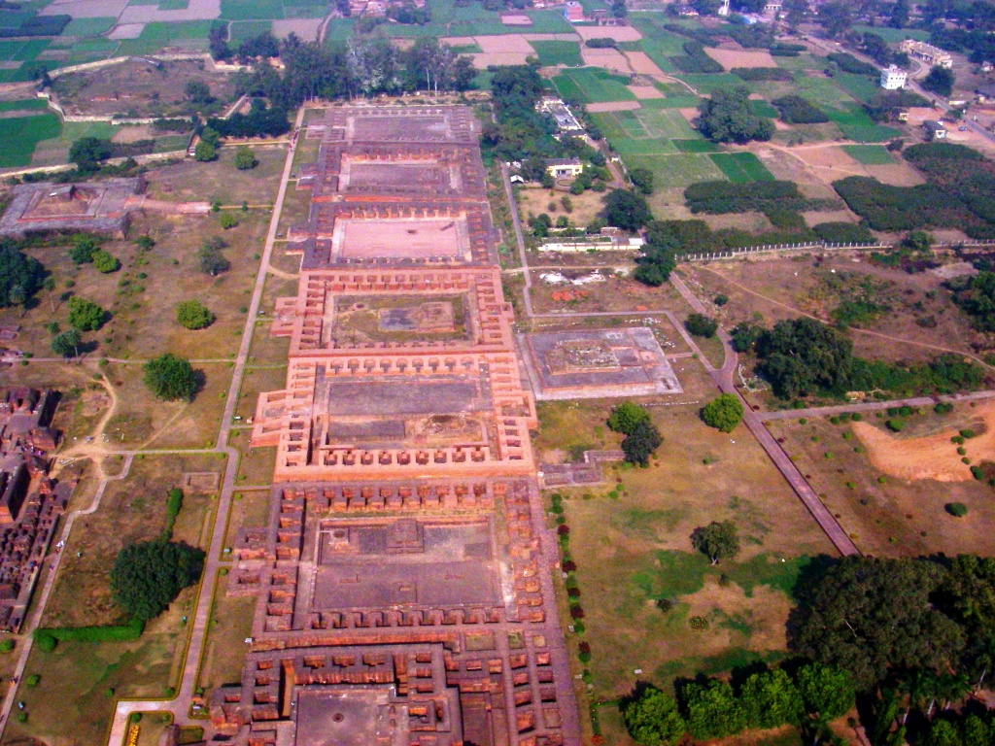
Dormitories with outside toilets

Slide 12
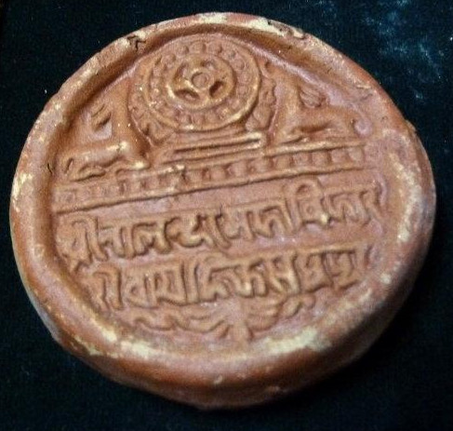
Seal of Nalanda

Slide 13
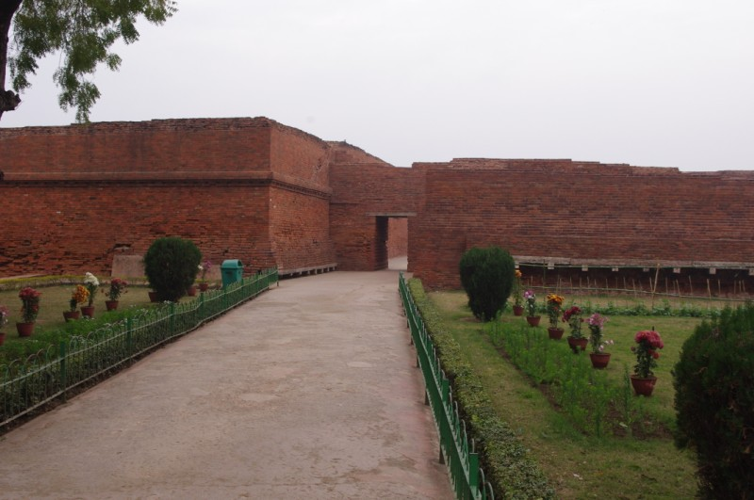
Entrance to Nalanda

Slide 14
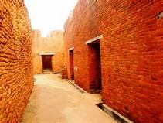
Passageway to offices

Slide 15
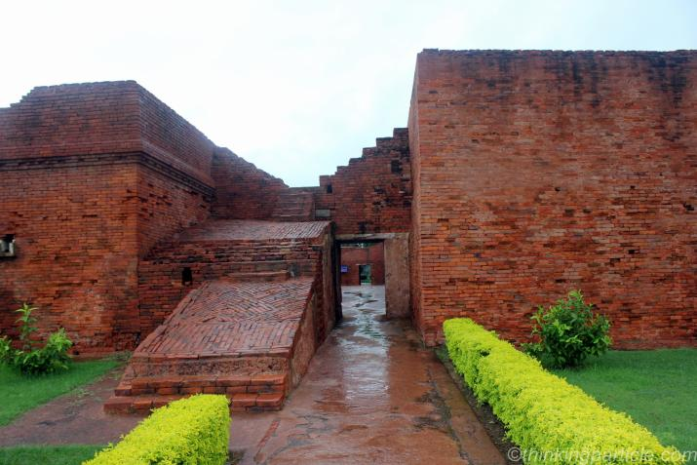

Slide 16
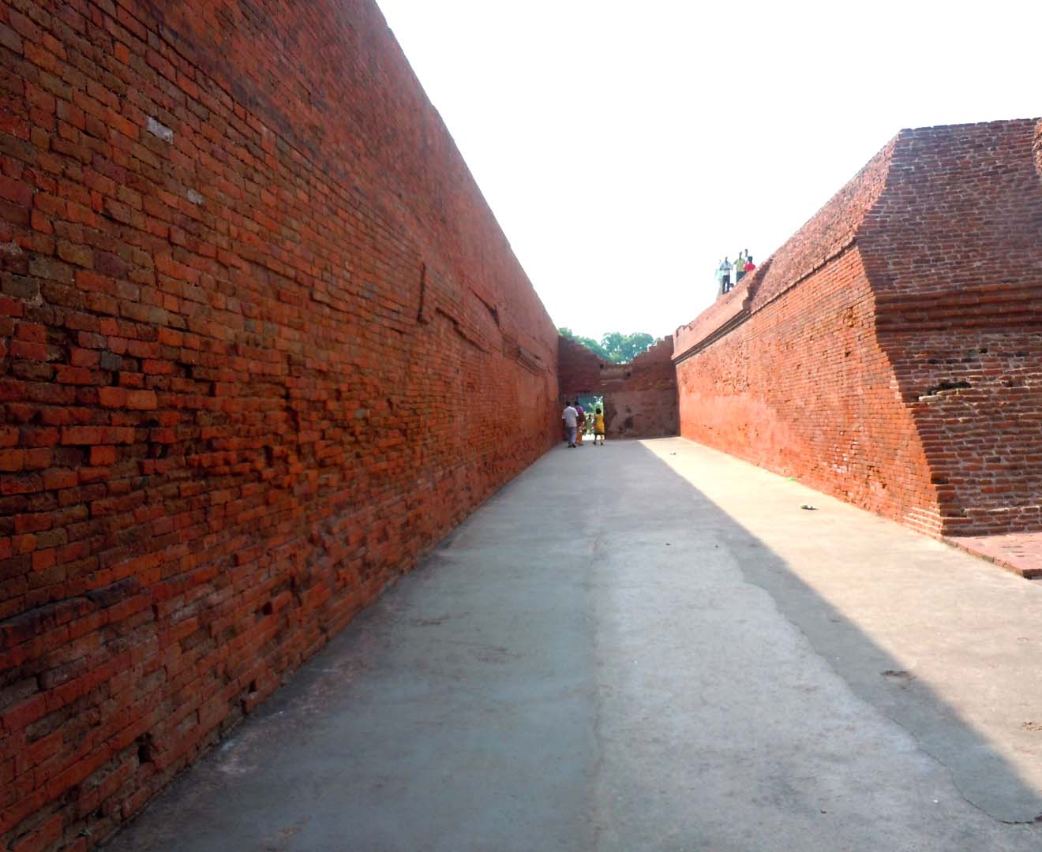

Slide 17
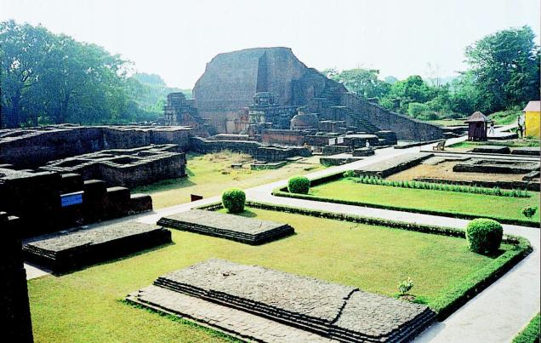

Slide 18
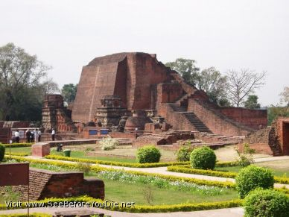

Slide 19
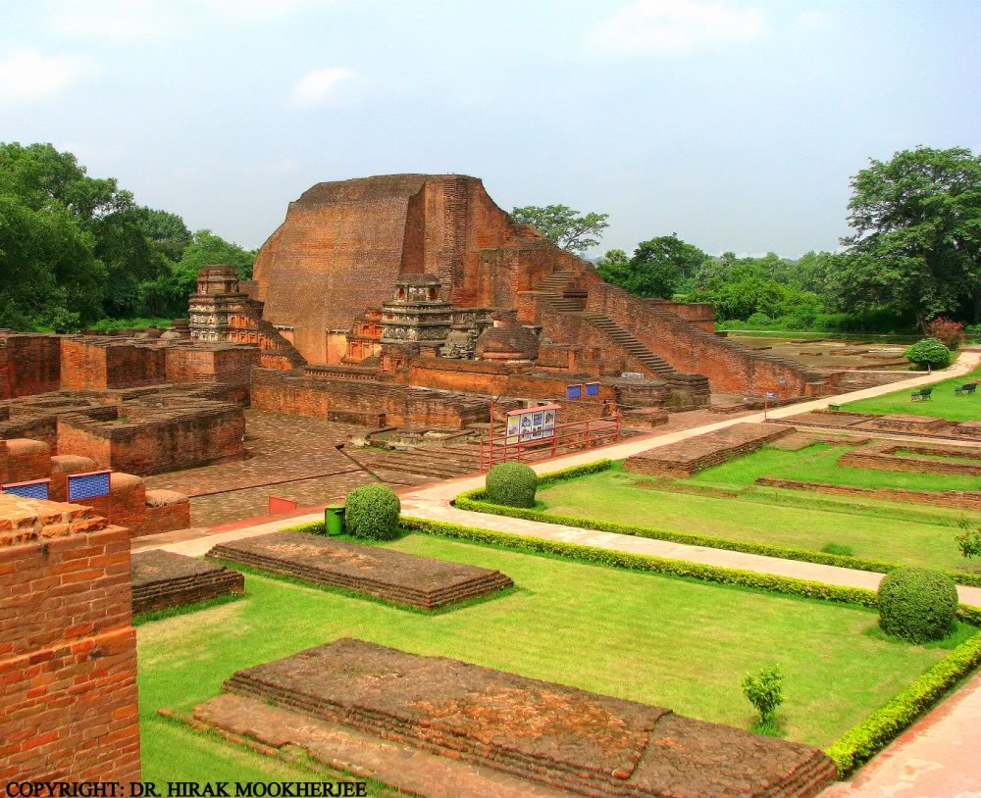

Slide 20
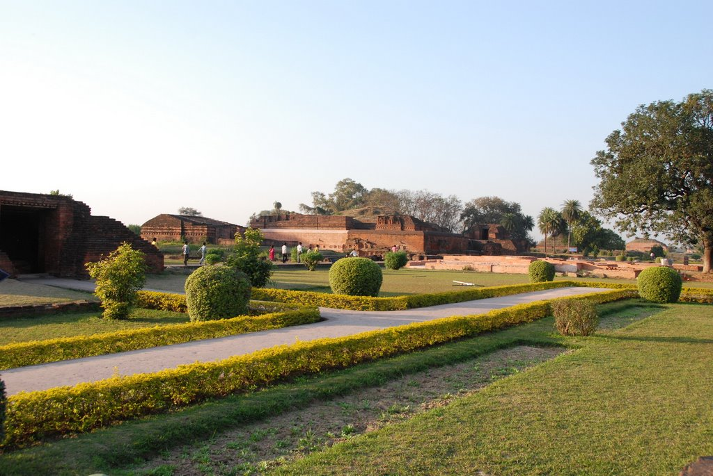

Slide 21
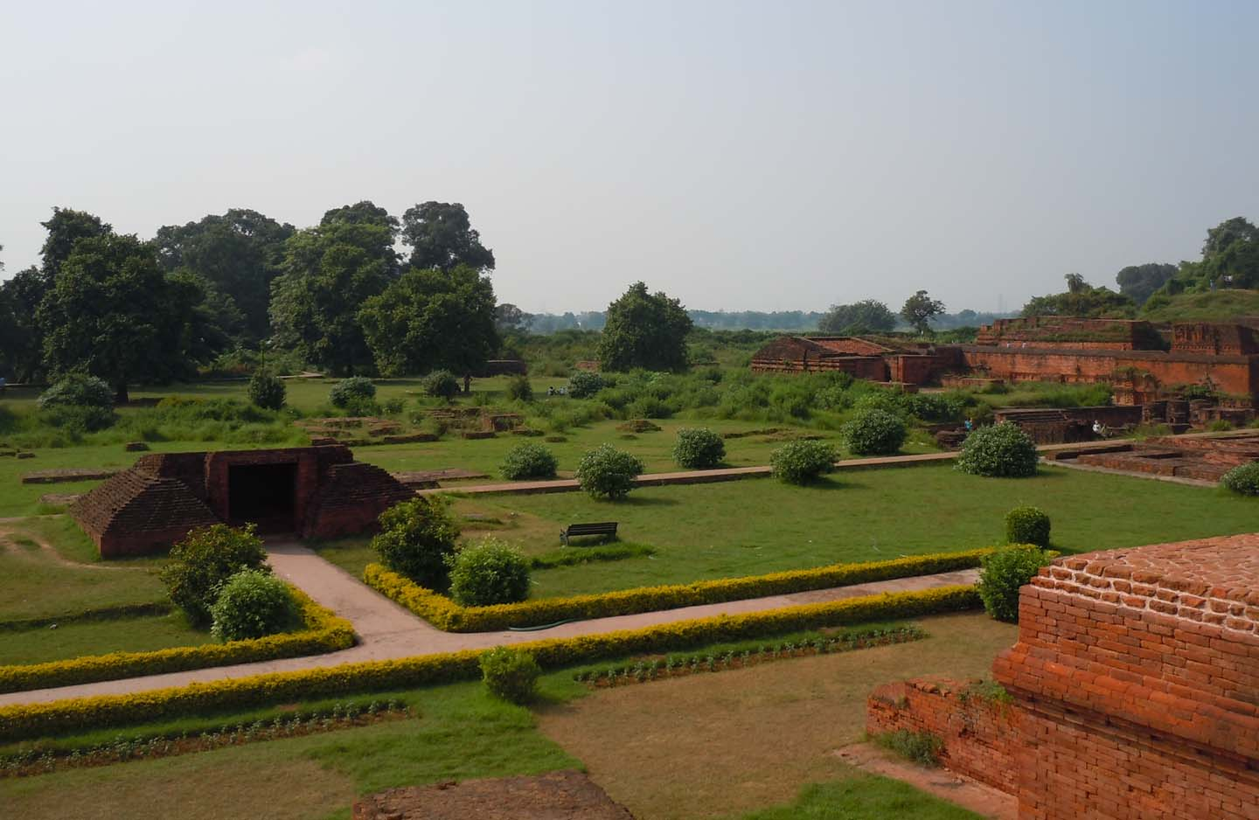

Slide 22
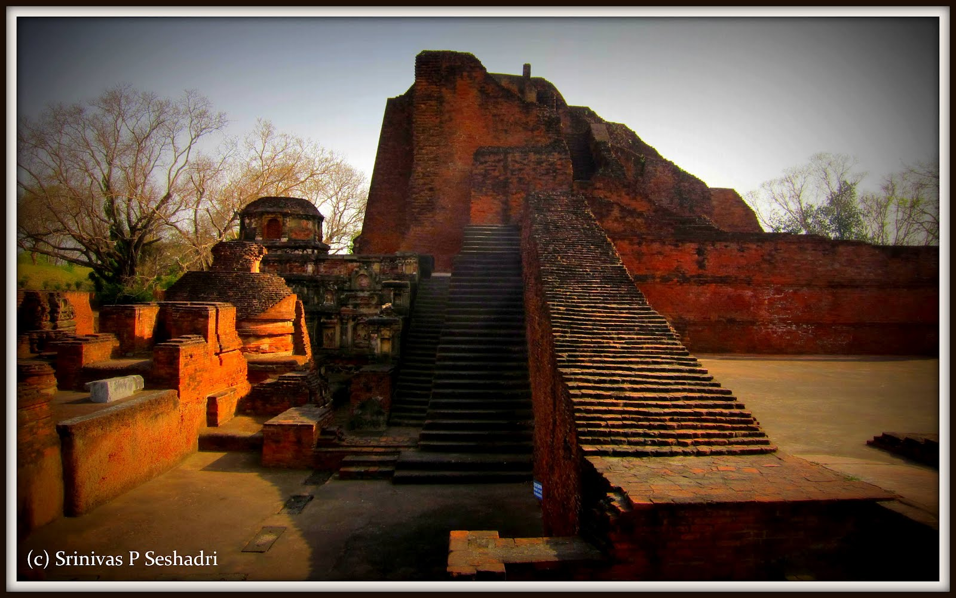

Slide 23
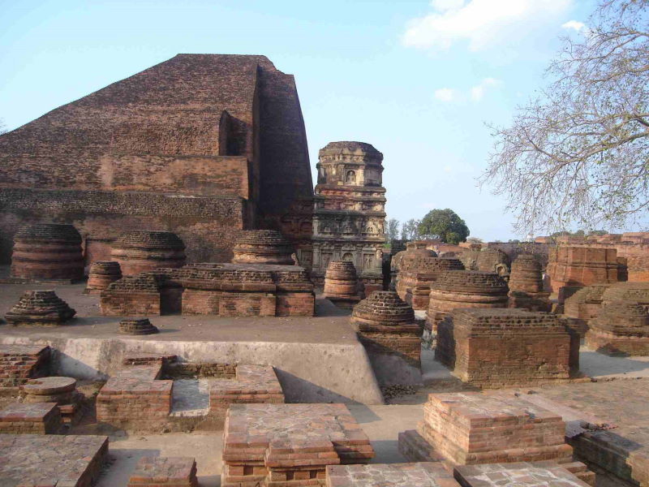

Slide 24
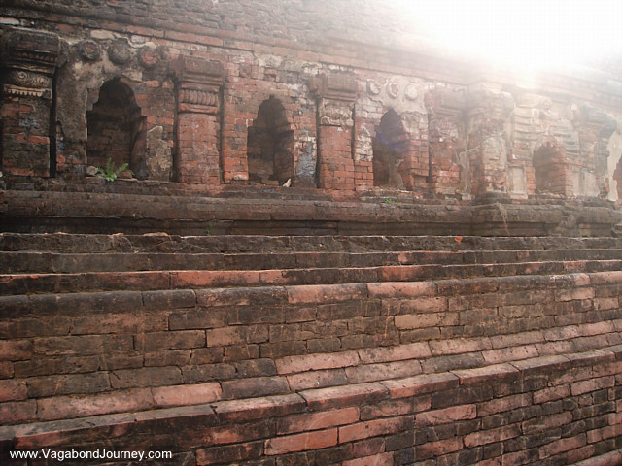
Outerface of Stupa

Slide 25
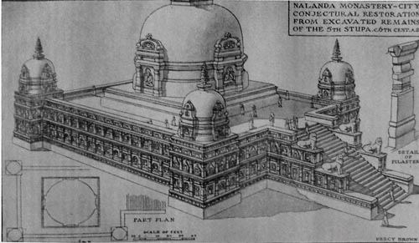

Slide 26
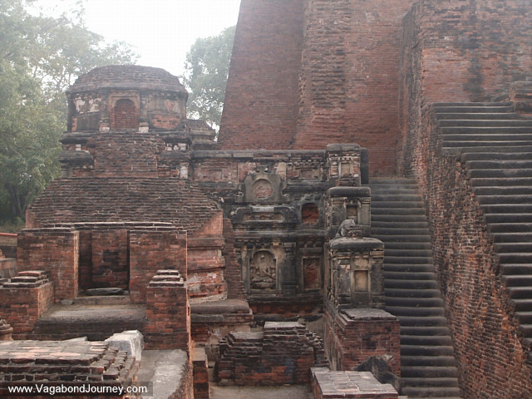

Slide 27
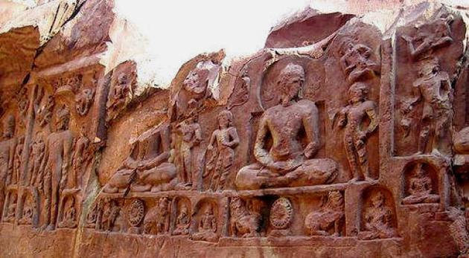

Slide 29
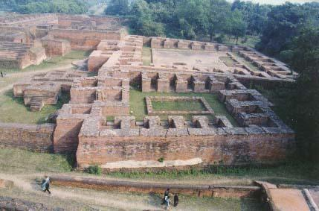
Dormitory and dining area

Slide 30
A tower with niches for Buddha statues

Slide 31
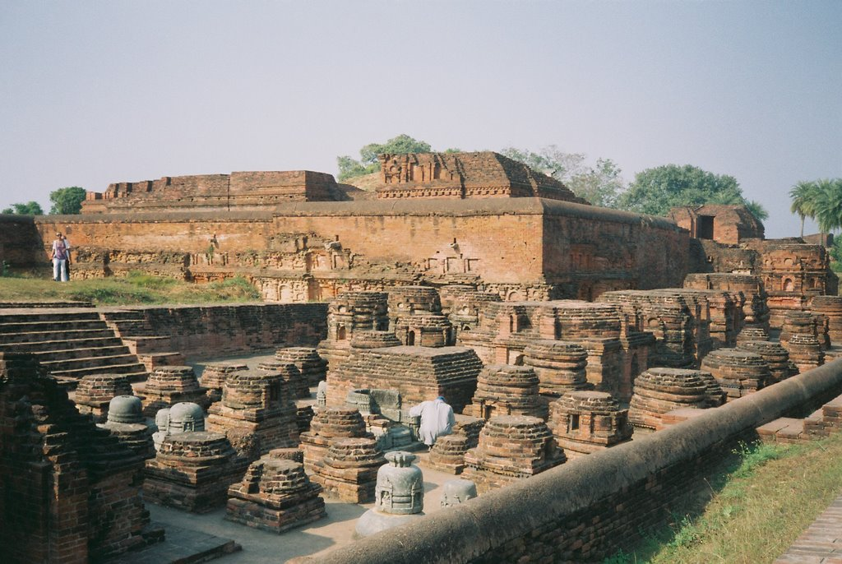
Prayer and meditation area

Slide 32
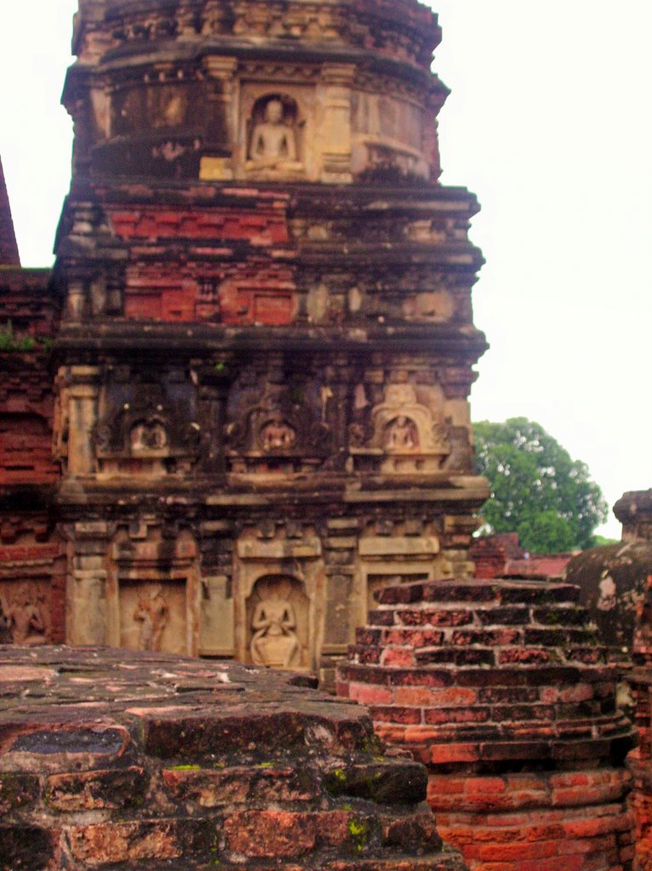
University landmark tower

Slide 33
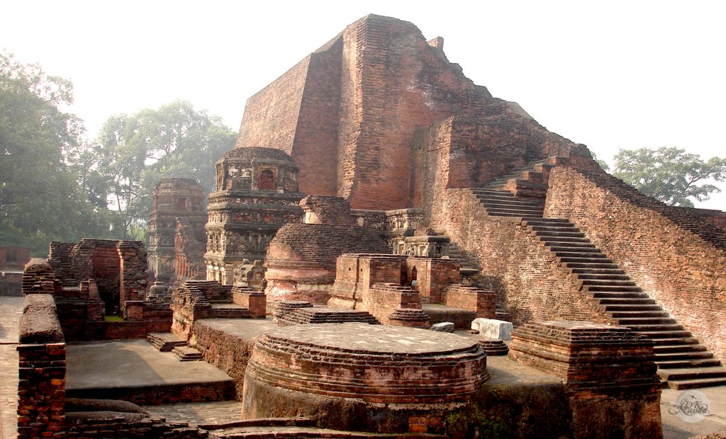

Slide 34
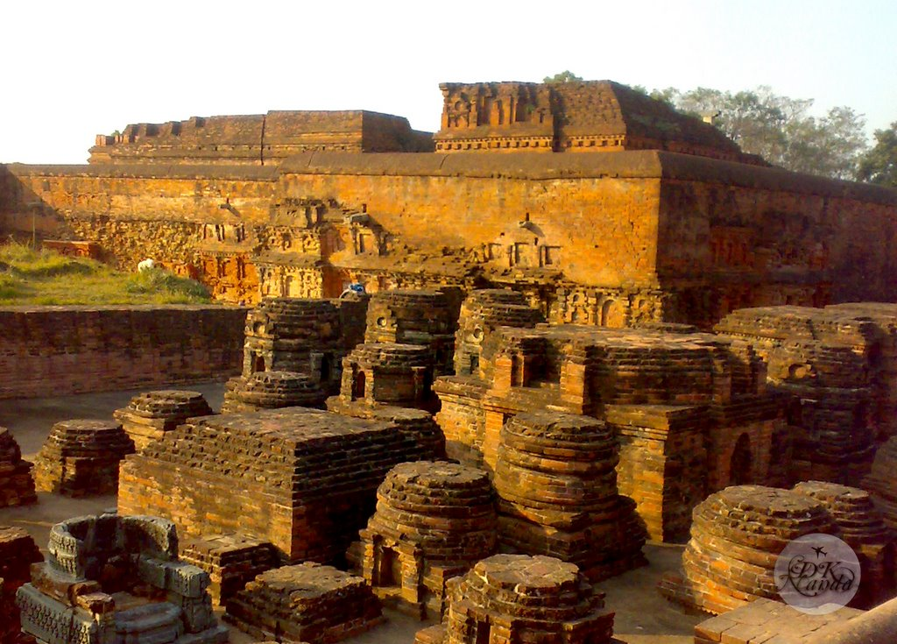

Slide 35
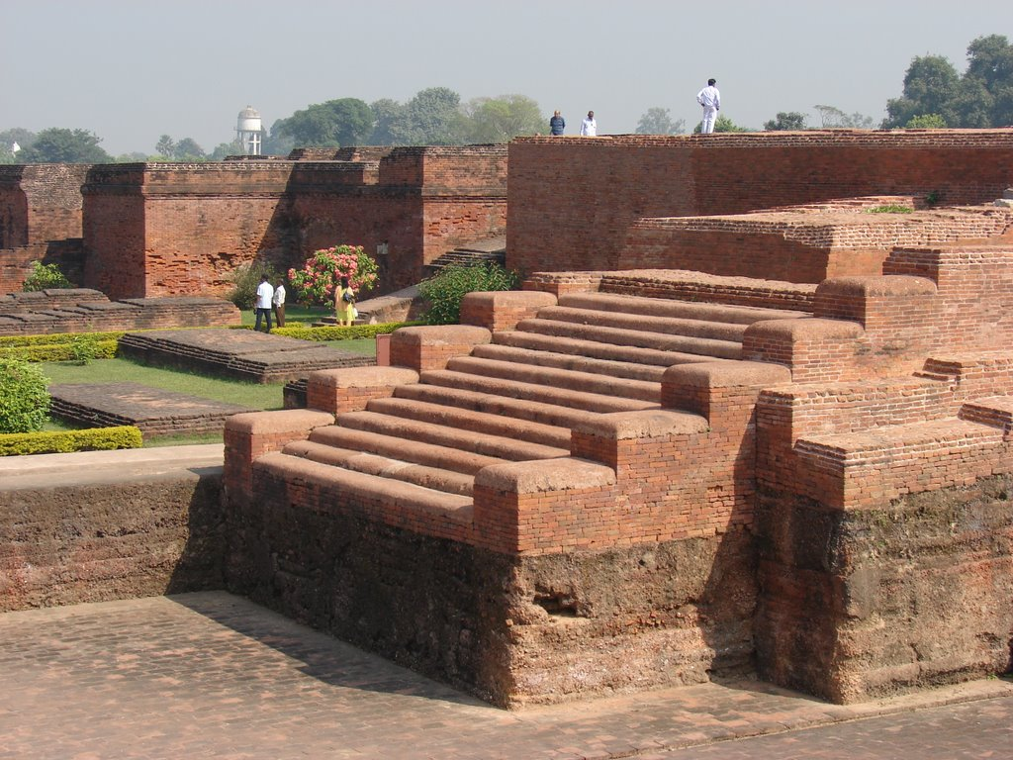

Slide 36
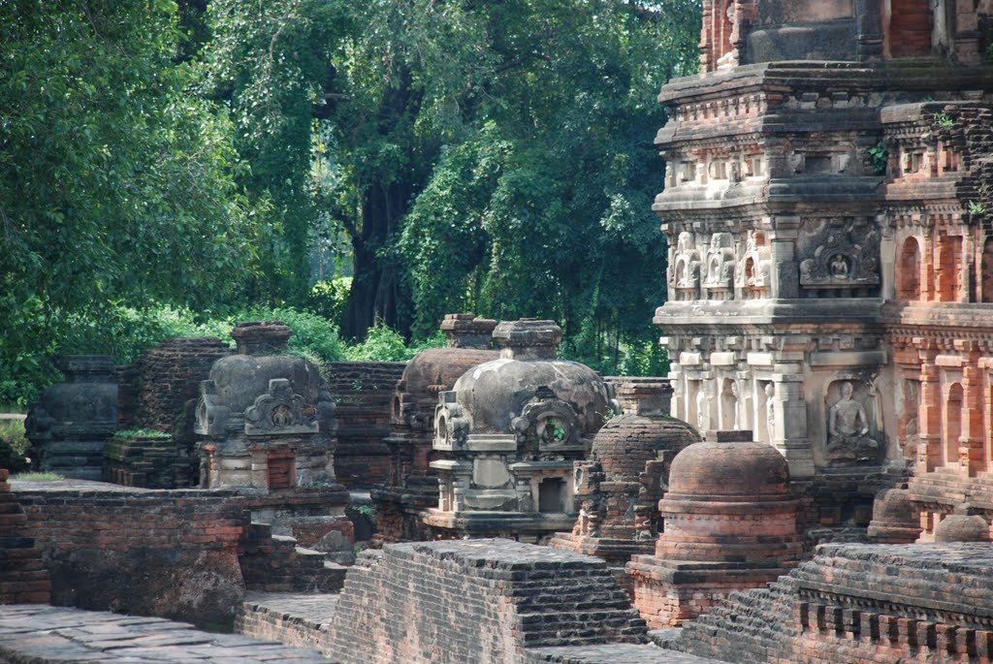

Slide 37
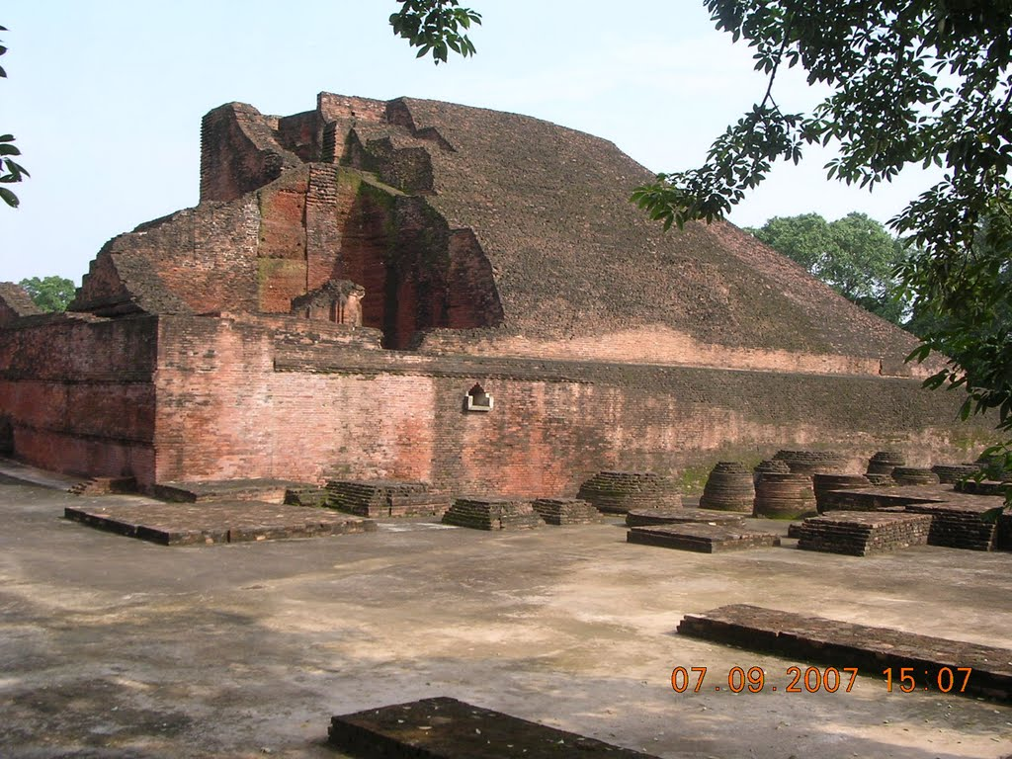

Slide 38
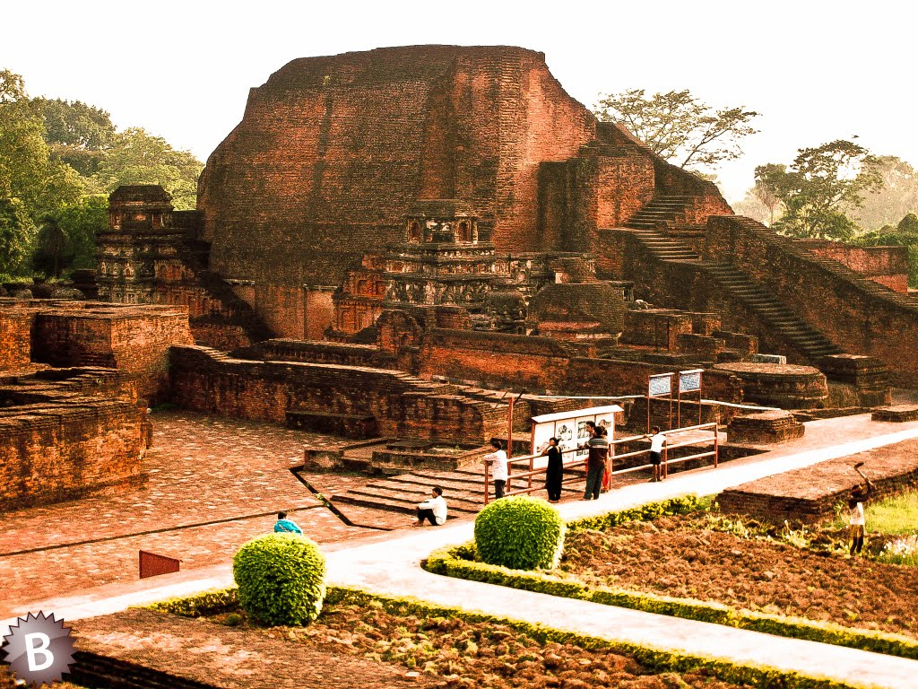

Slide 39
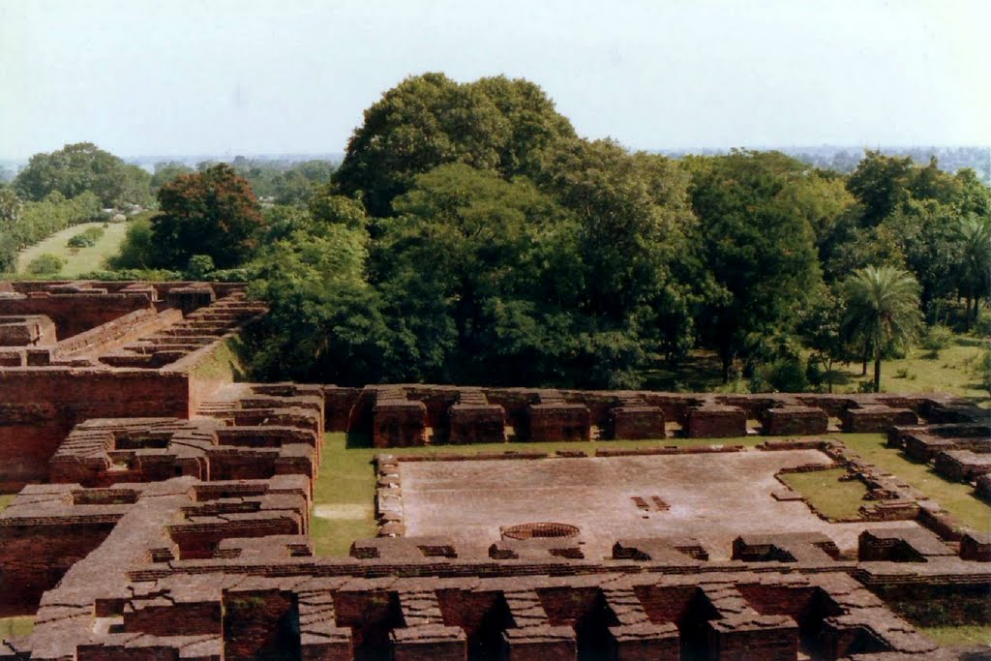

Slide 40
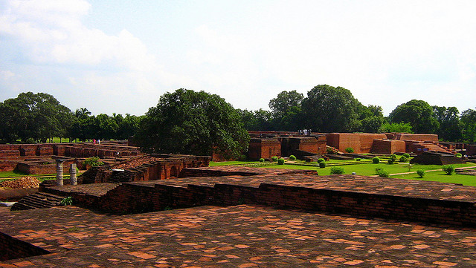

Slide 41
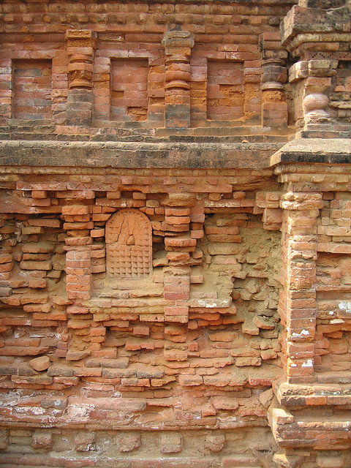

Slide 42
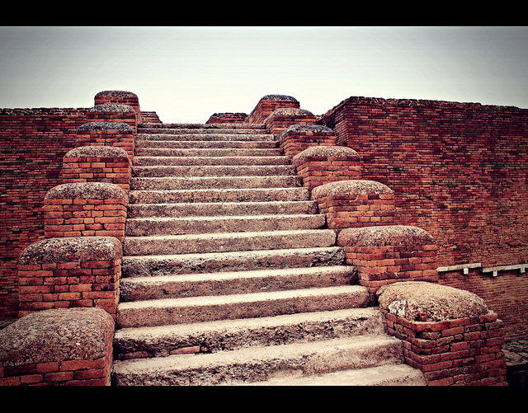

Slide 43
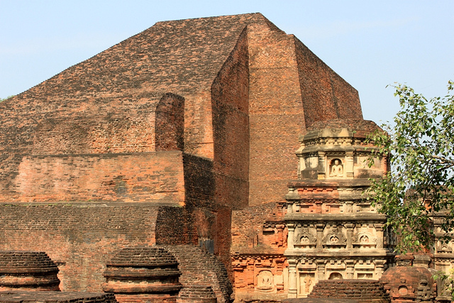

Slide 44
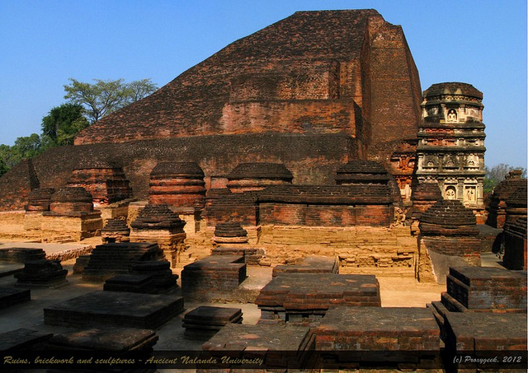

Slide 45
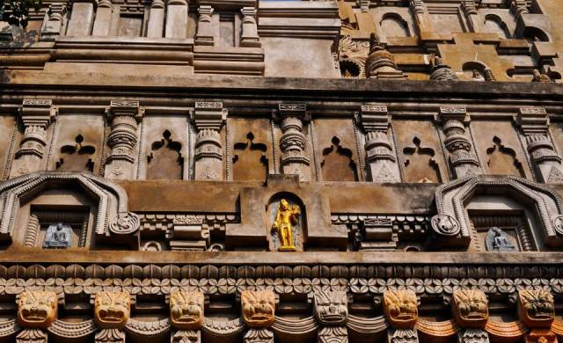

Slide 46
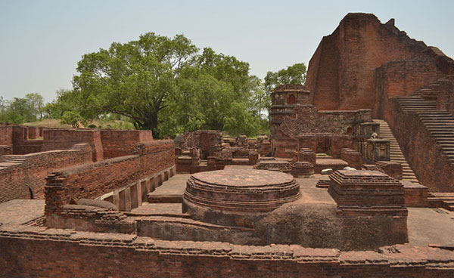
Planary hall

Slide 47
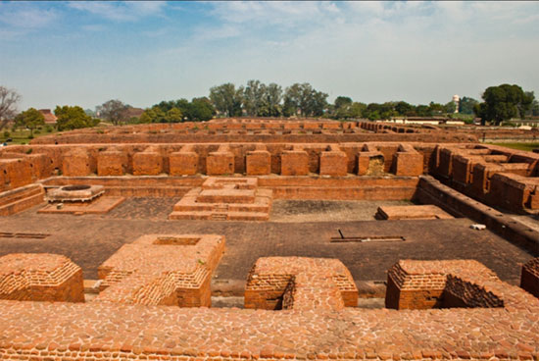

Slide 48
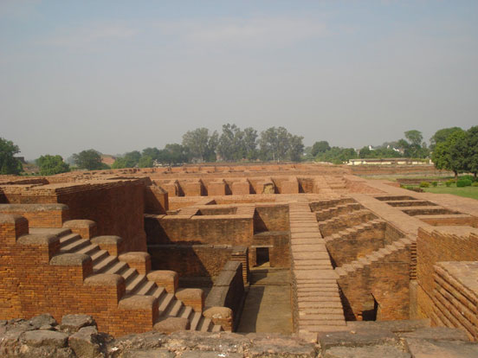

Slide 50
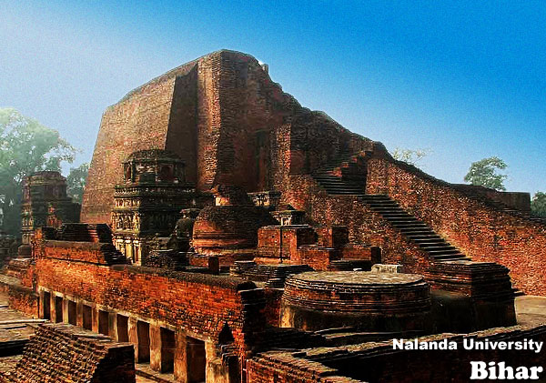

Slide 51
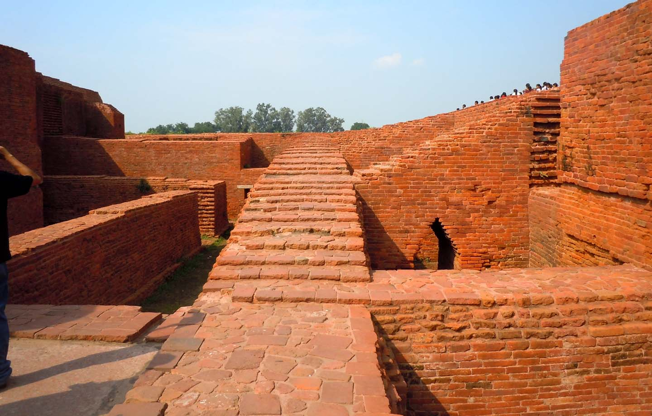

Slide 52
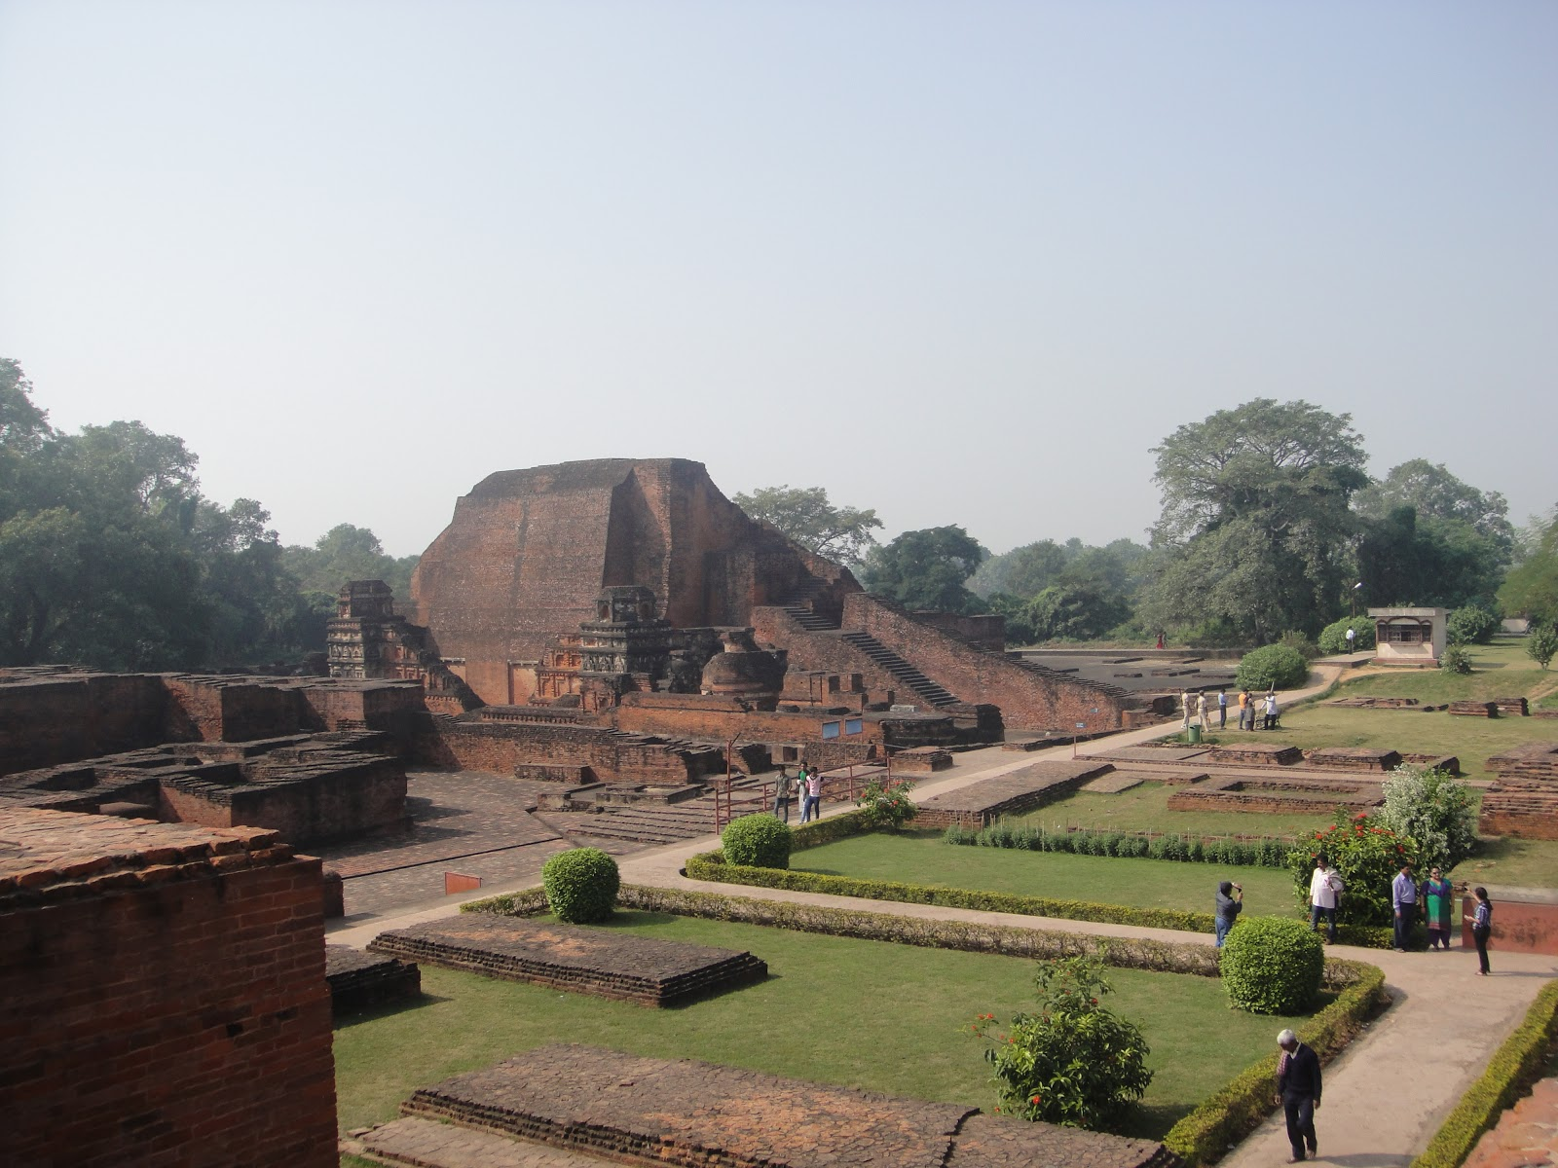

Slide 53
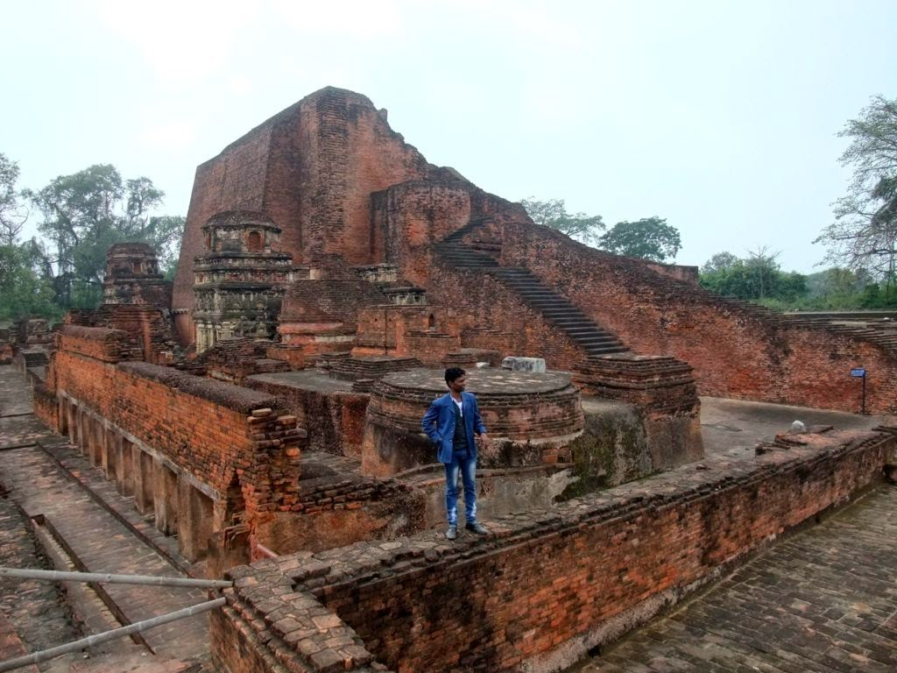

Slide 54
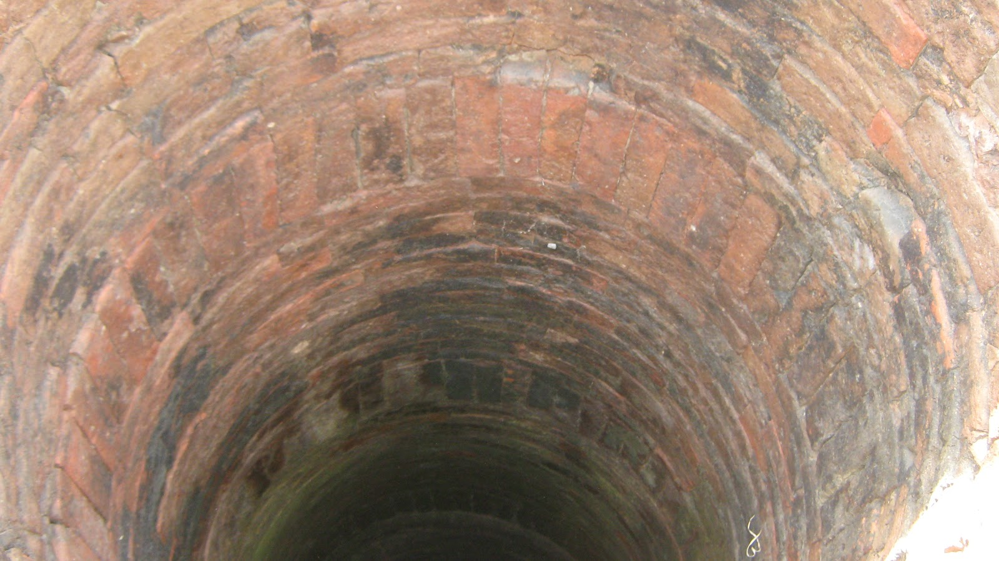
Deep well

Slide 55
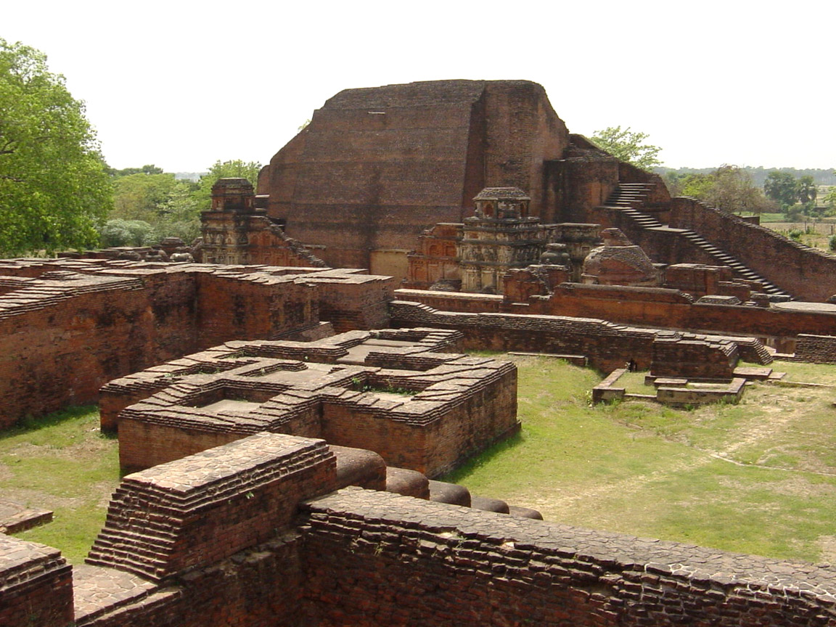

Slide 56
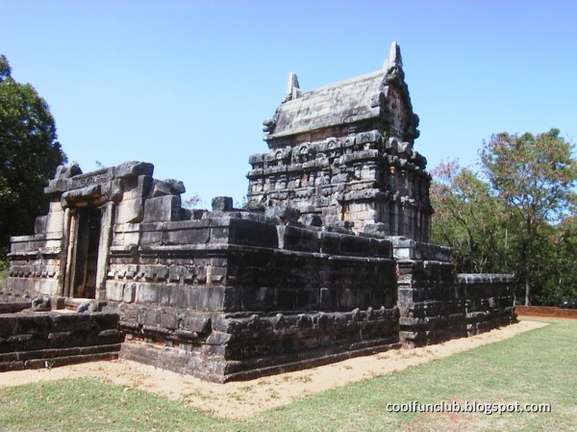

Slide 57
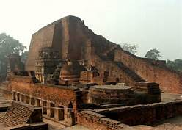

Slide 58


Slide 59


Slide 60


Slide 61

Rice granary through dark doors

Slide 62


Slide 63


Slide 64


Slide 65


Slide 66


Slide 68


Slide 69


Slide 70


Slide 71


Slide 72

Monks at prayer

Slide 73


Slide 74


Slide 75


Slide 76


Slide 77


Slide 78


Slide 79


Slide 80


Slide 81


Slide 82


Slide 83


Slide 85


Slide 86

Buddha statuary surrounding the stupas

Slide 87


Slide 88


Slide 89


Slide 90


Slide 91


Slide 92


Slide 93

Outer wall of the campus

Slide 94


Slide 95


Slide 96


Slide 97


Slide 98


Slide 99


Slide 100

Dining area

Slide 101


Slide 102


Slide 103


Slide 104


Slide 105


Slide 106


Slide 107


Slide 108


Slide 109

One of the 7 gates entry to campus

Slide 110


Slide 111


Slide 112


Slide 113


Slide 114


Slide 115


Slide 117


Slide 123


Slide 124

`Conceptual view of the new Nalanda university

Slide 125


Slide 126


Slide 127

New Nalanda University campus

Slide 128


Slide 129


Slide 130


