Slide 1
Maha Kumbha Mela
The biggest and the largest religious fair on the planet takes place in Allahabad every 12th year at the confluence of Ganga and Yamuna river where millions of pilgrims bathe to get Nirvana that frees the soul from the cycle of birth and death. To attain Nirvana is close to the heart of every Hindu .

Slide 2
Editors note :
This powerpoint is presented here for your private viewing pleasure only.
AKC
Jan. 2017

Slide 3

Bathing starts with prayers

Slide 4
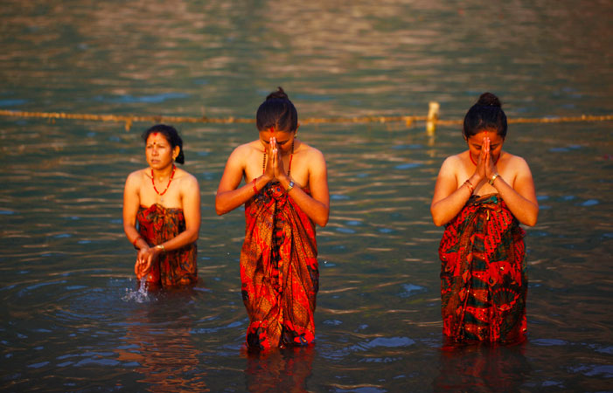

Slide 5
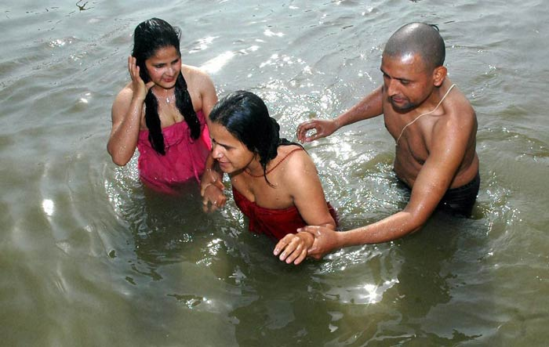
They shave their heads as a personal offering

Slide 6
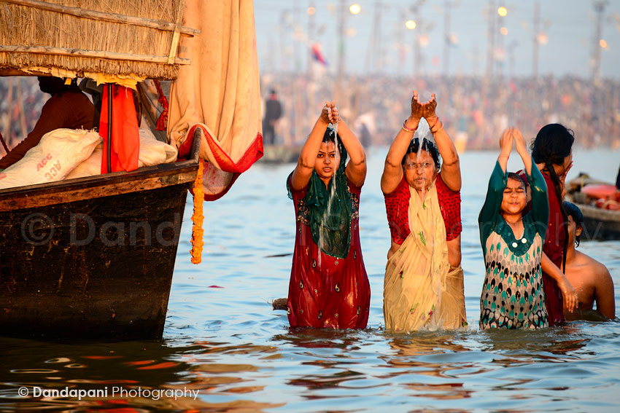

Slide 7
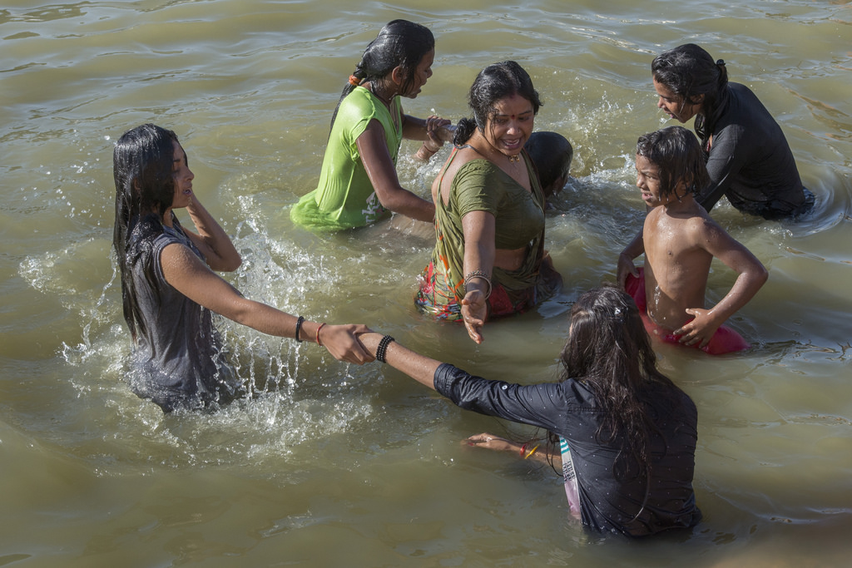

Slide 8
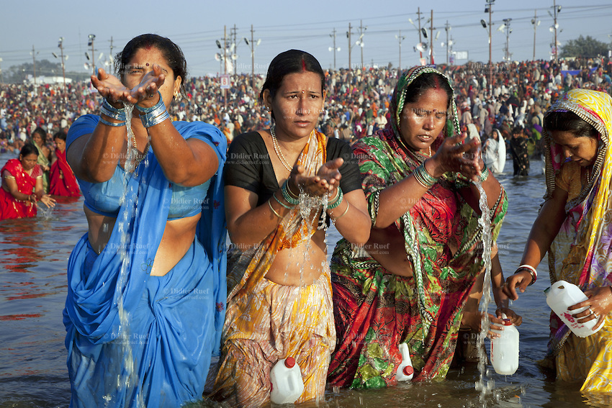

Slide 9
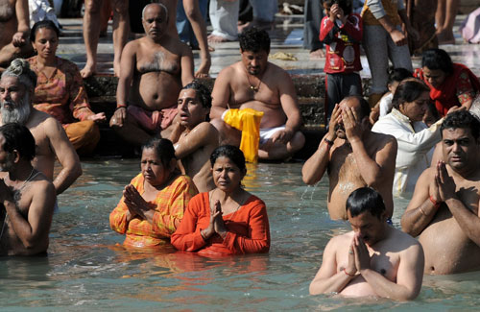

Slide 10
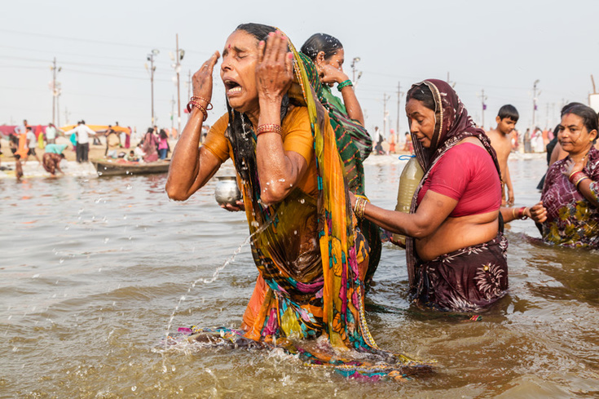
Some get emotional

Slide 11
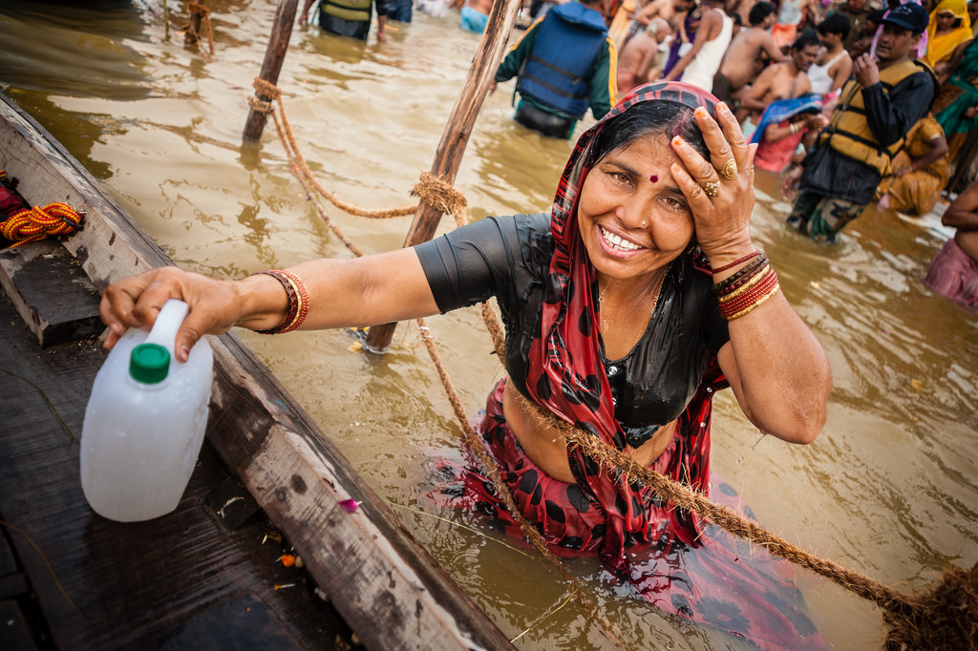
They bring Ganga water home because it is holy

Slide 12
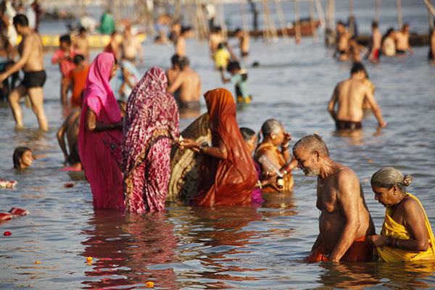

Slide 13
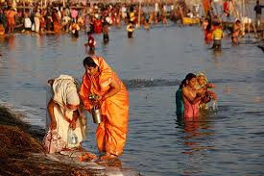

Slide 14
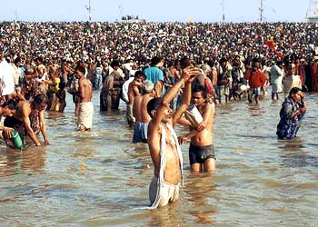
Prayers are offered to the Sun God

Slide 15
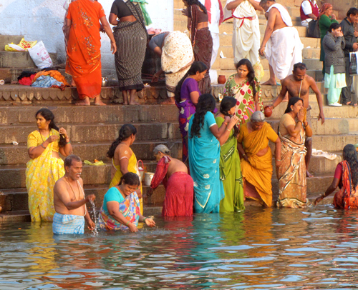

Slide 16
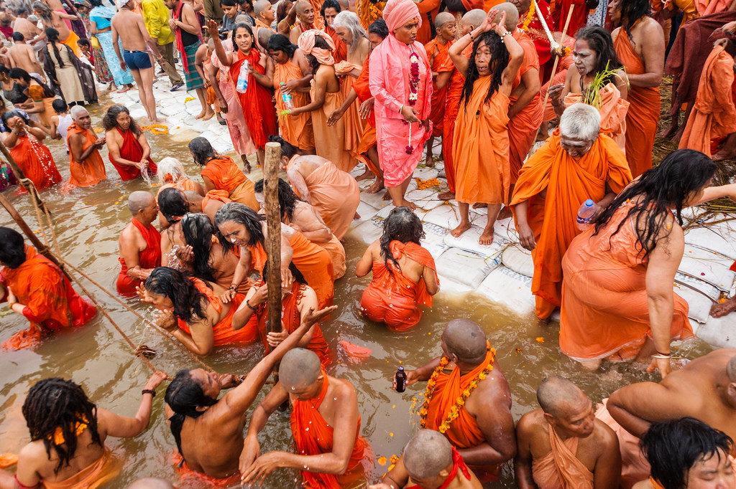
Female holy sadhus attend in large numbers

Slide 17
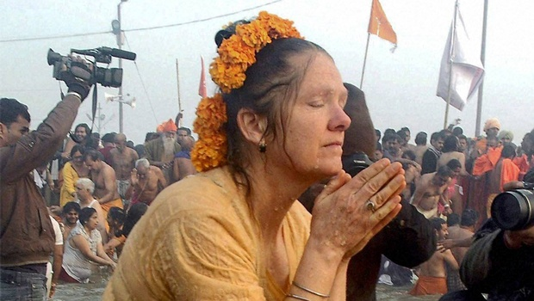
Many foreigners enjoy the fair

Slide 18
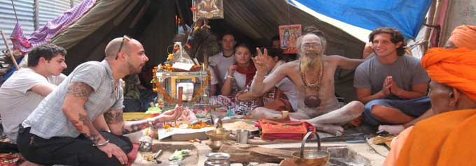
Followers of Krishna Consciousness attend the fair in large numbers

Slide 19
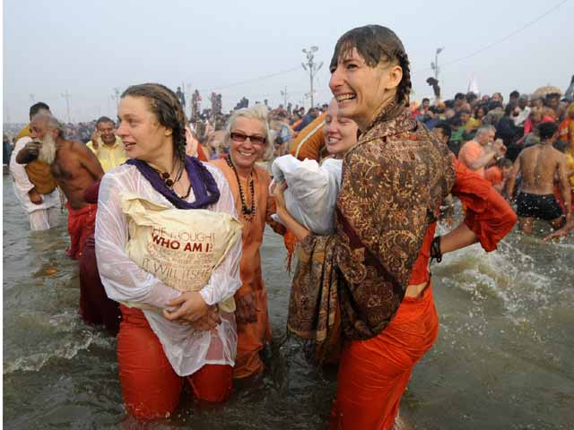

Slide 20
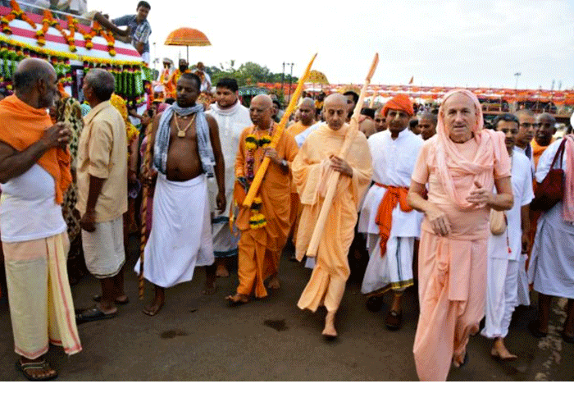

Slide 21
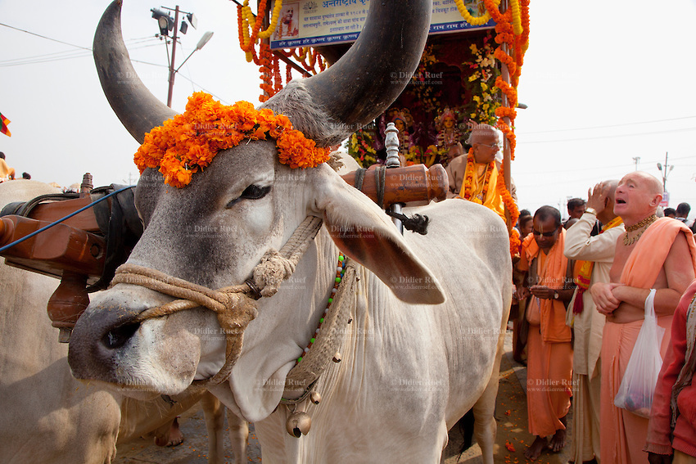

Slide 22
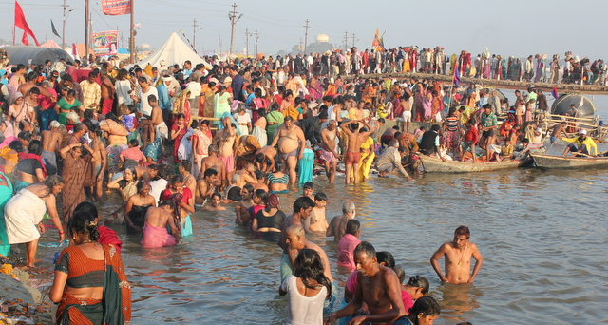
Hindus bathe in Sangam joyously

Slide 23
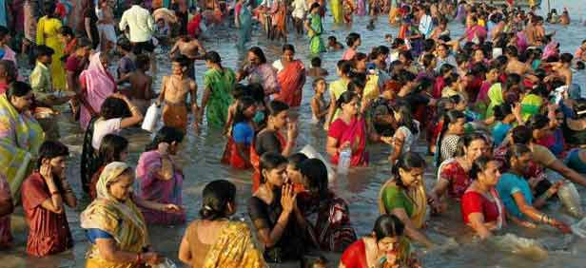
This event comes only once every 12th year.

Slide 24
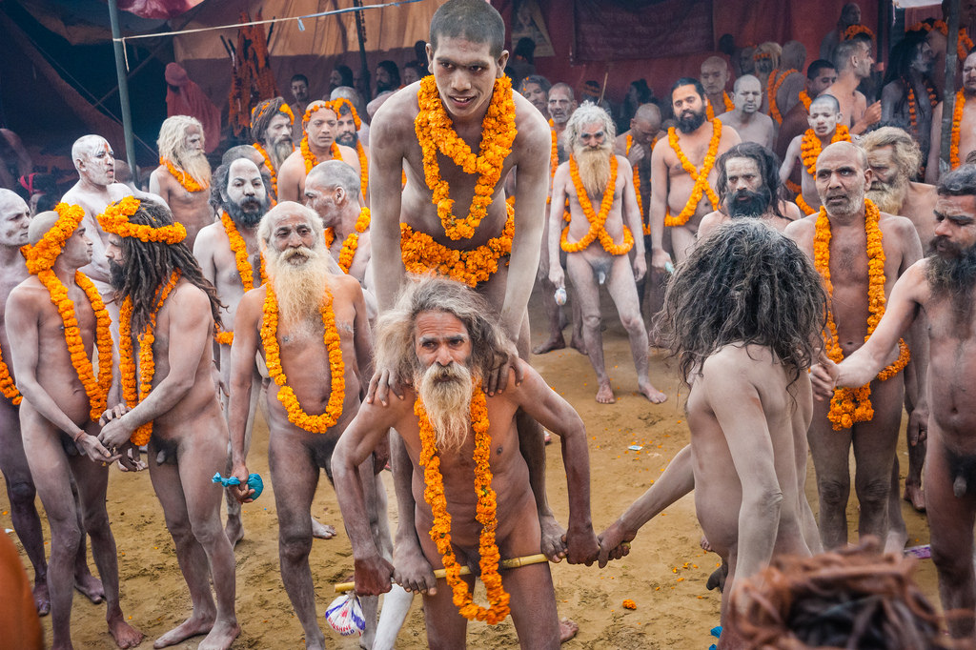
Naked sadhus called Nagas come in large numbers

Slide 25
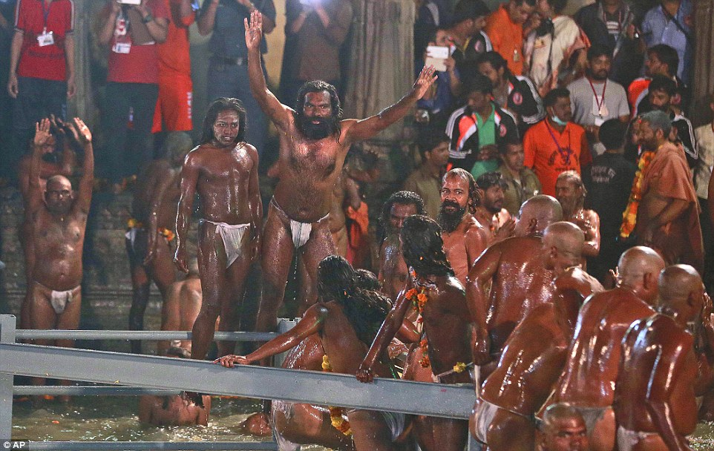
New initiates to ascetic life come to take vows

Slide 26
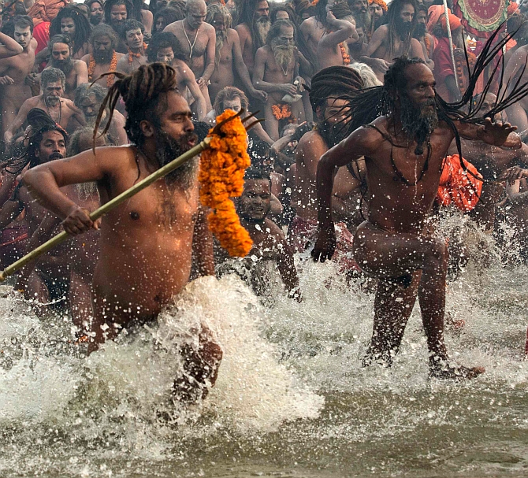
Naga sadhus enjoying bathing in Ganga

Slide 27
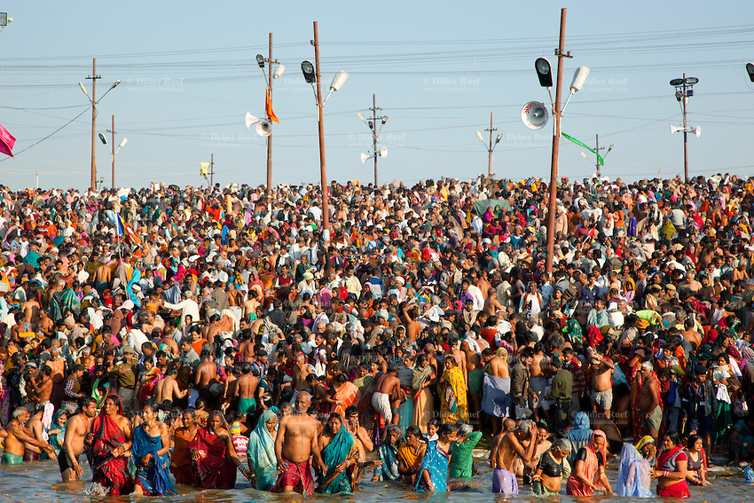
More than 10 million pilgrims attend the fair.

Slide 28
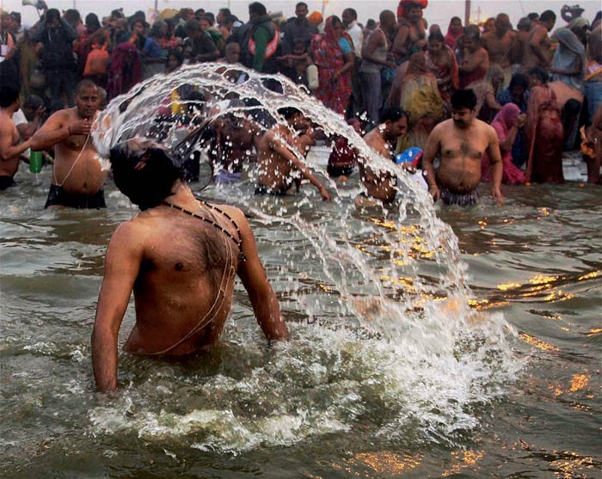

Slide 29
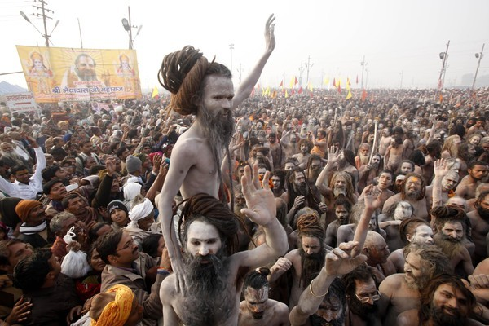

Slide 30
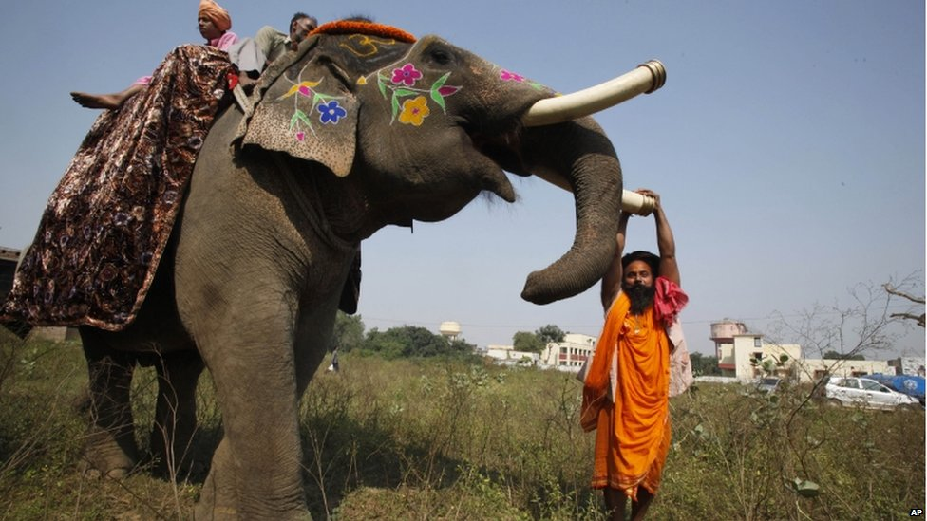

Slide 31
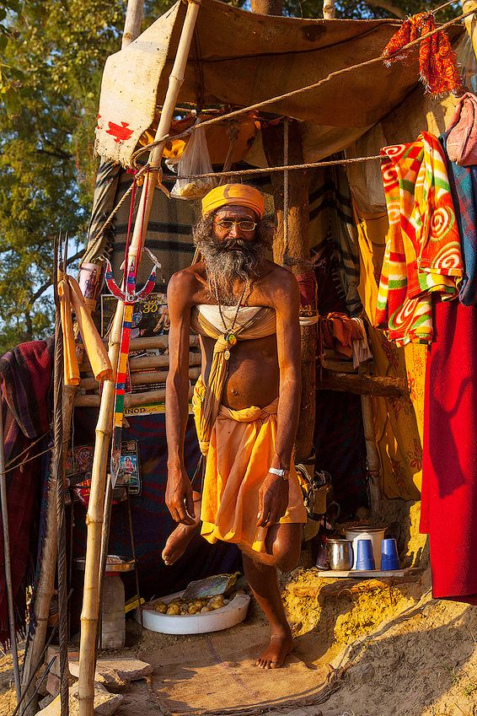
Standing on one leg for life is the extreme penitence for some sadhus

Slide 32
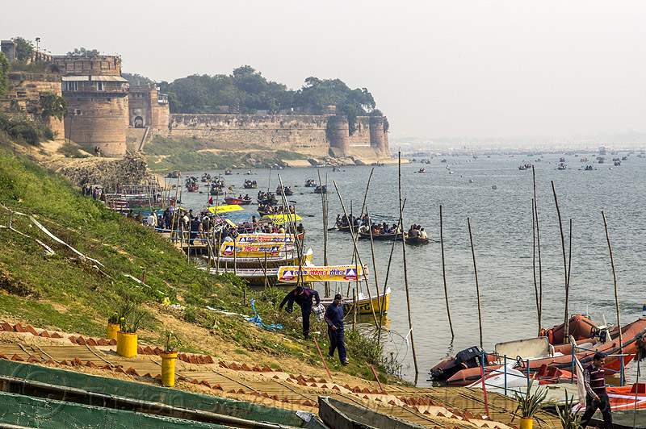
Allahabad fort at the confluence called Sangam

Slide 33
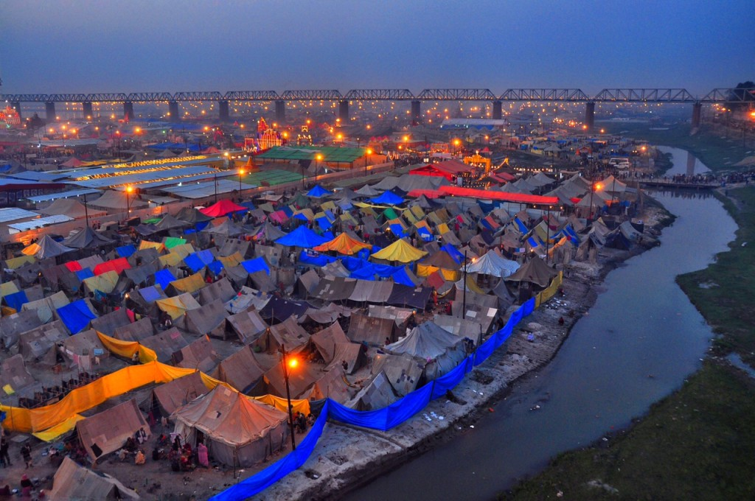
A massive tent city is put up by the government with all facilities

Slide 34
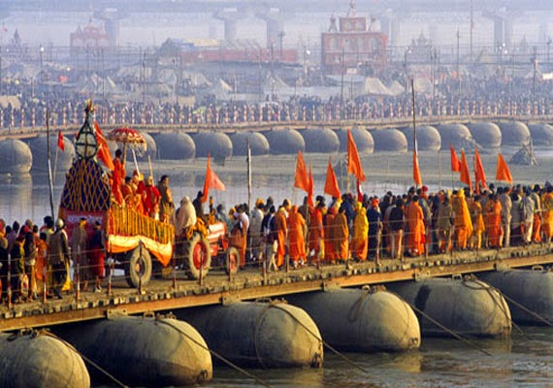
Scores of pontoon bridges are built

Slide 35
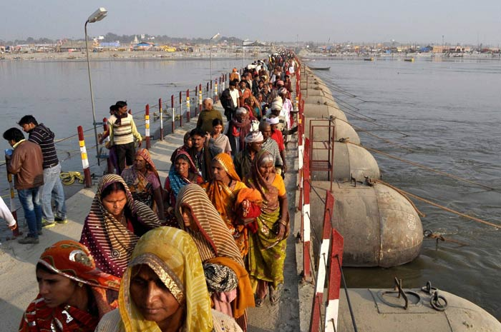

Slide 36
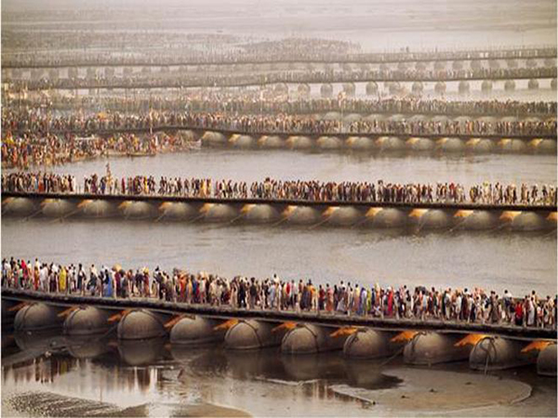
The scale of facilities is mind boggling.

Slide 37
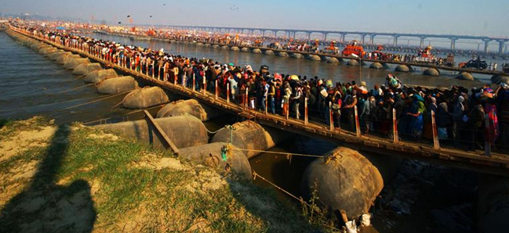

Slide 38
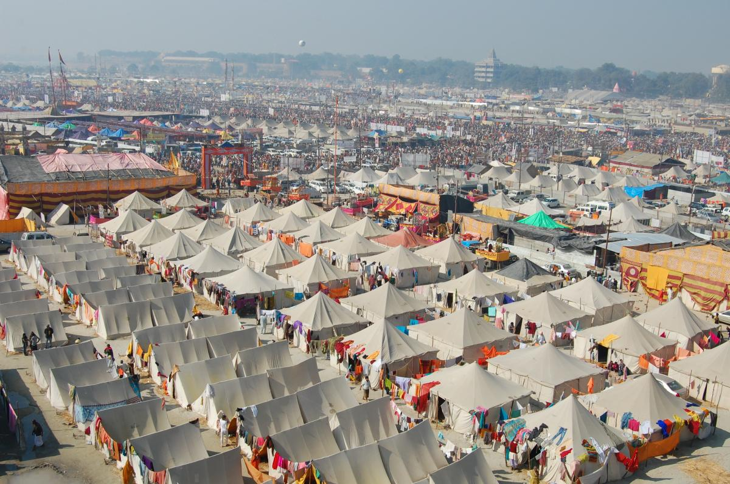
The tent city has hospitals, feeding centers and good sanitary facilities

Slide 39
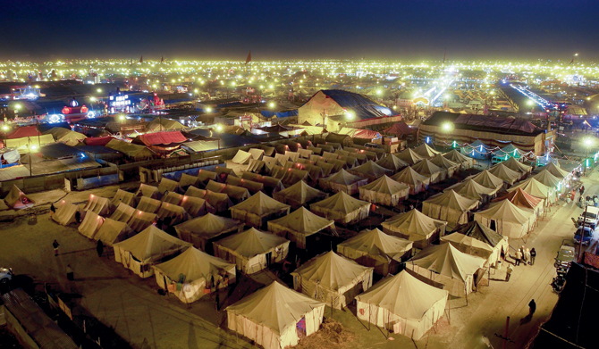

Slide 40
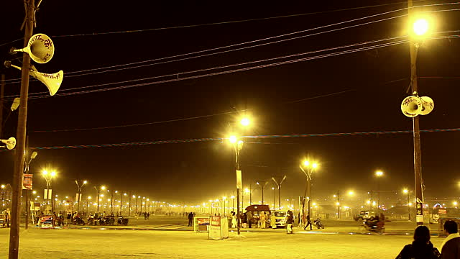
Night becomes day at the fair grounds

Slide 41
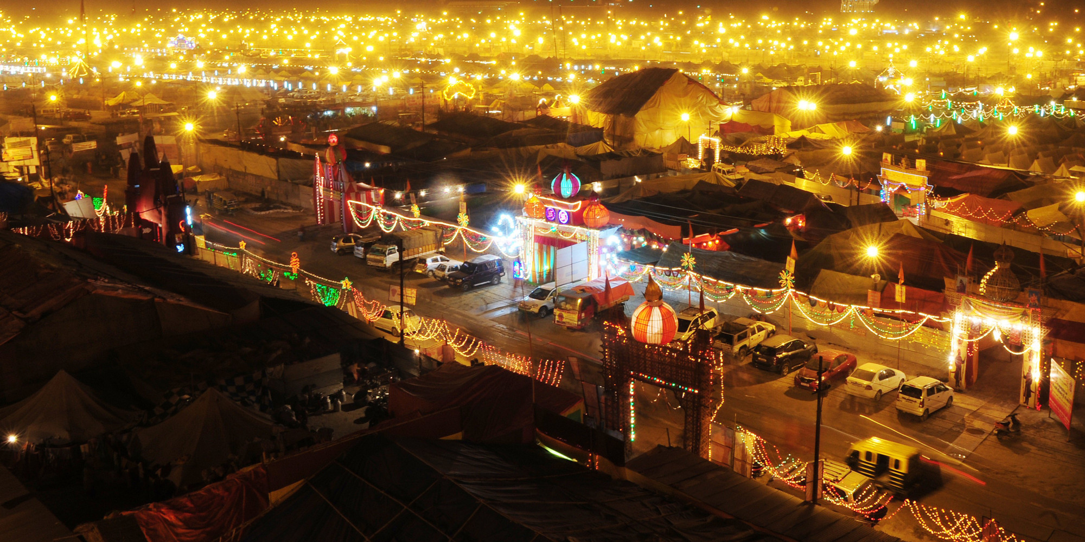
Free electricity and potable water is provided by the government

Slide 42
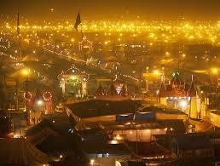

Slide 43
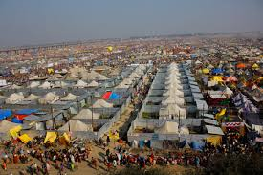

Slide 45
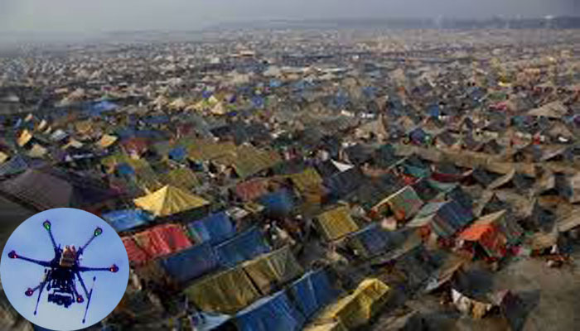
Drones keep an eye on security

Slide 46
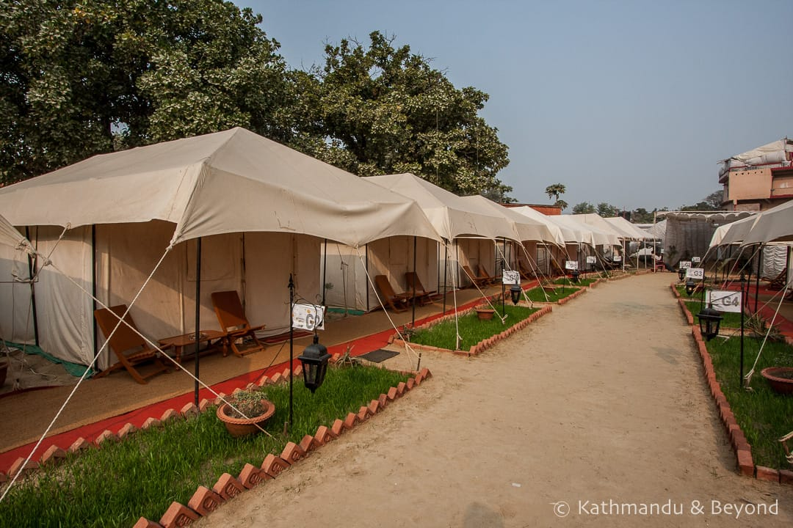

Slide 47
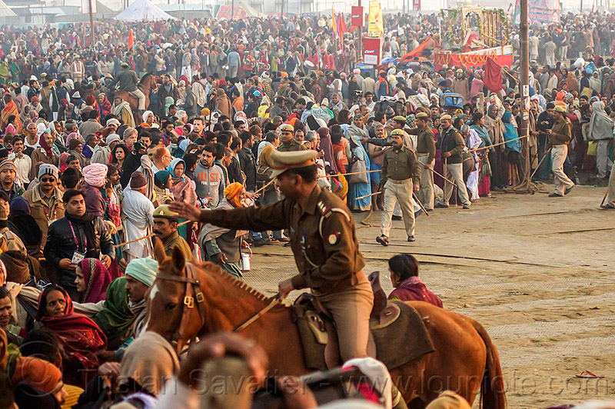

Slide 48
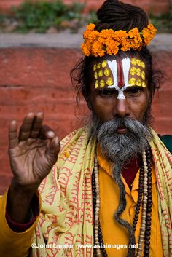

Slide 50
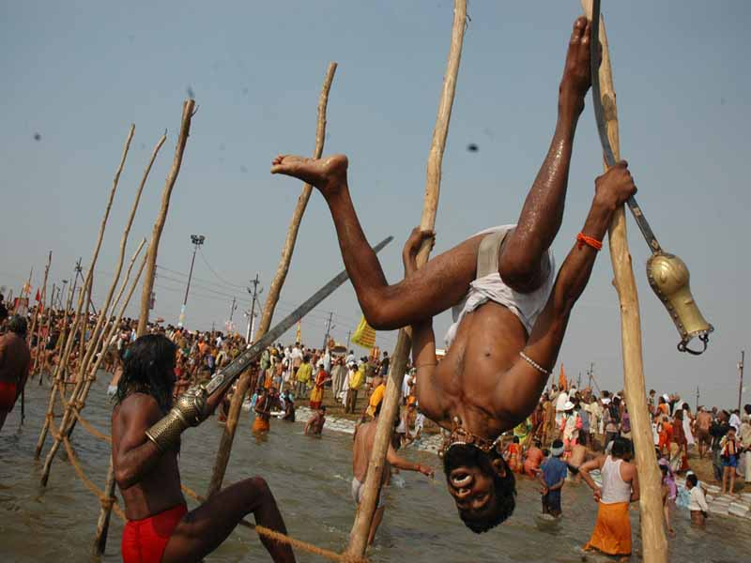

Slide 51
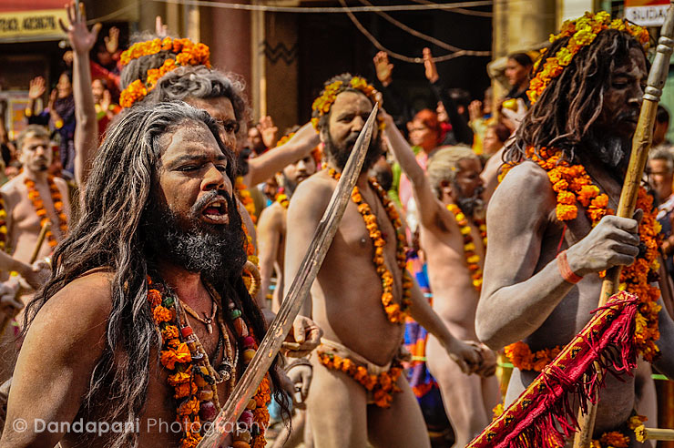

Slide 52
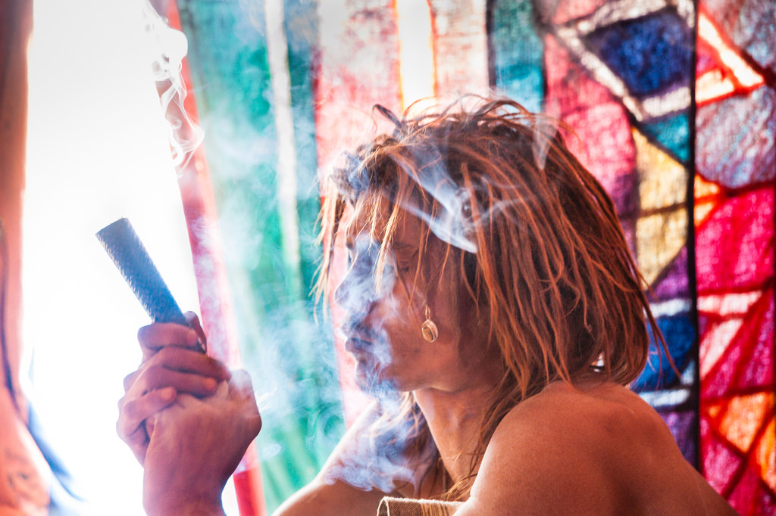
Sadhus enjoying smoking pot

Slide 53
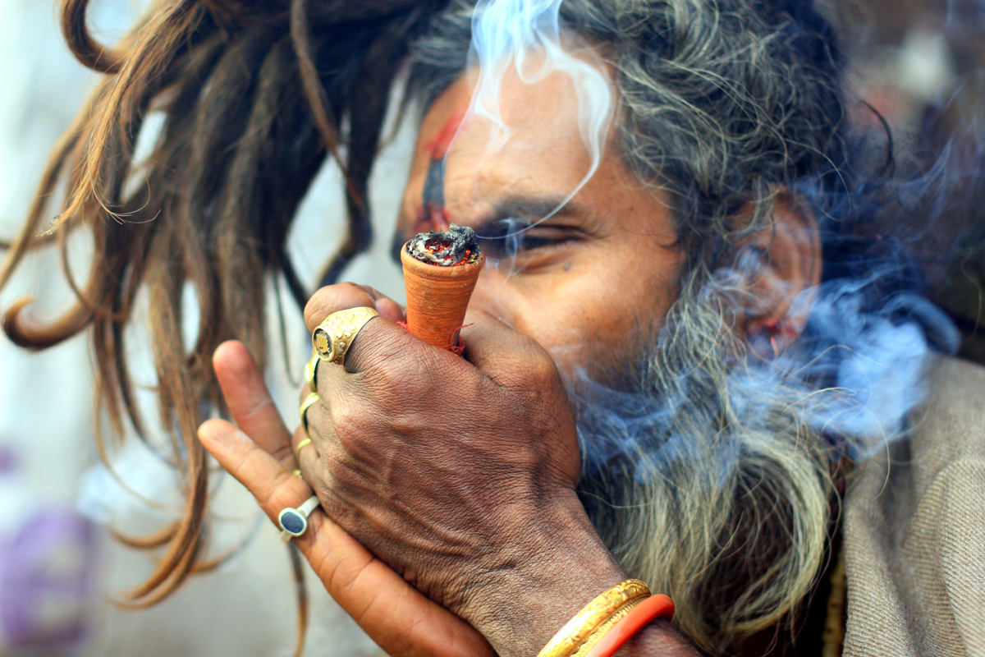

Slide 54
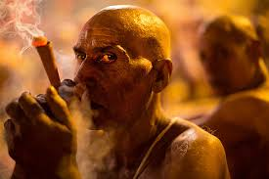

Slide 55
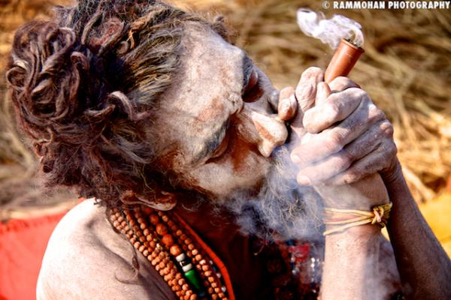
Contrary to popular belief, pot smoking is a social taboo

Slide 56


Slide 57

A vegetable market to supply the pilgrims

Slide 58


Slide 59


Slide 60


Slide 61

Elephant rides are for the tourists

Slide 62

Long haired Naga sadhus with the initiates

Slide 63

Here they take the vow to become Nagas

Slide 64


Slide 65


Slide 67


Slide 68


Slide 69


Slide 70

Female sadhus some foreign also come in large numbers

Slide 71


Slide 72


Slide 73


Slide 75


Slide 76

Sadhu reading scriptures

Slide 77

A sadhu showing off his matted hair

Slide 78


Slide 79

Free food is offered to pilgrims everyday

Slide 80

Food preparation for the pilgrims

Slide 81


Slide 83


Slide 84


Slide 85


Slide 86

Early morning bathing rituals

Slide 87


Slide 88


Slide 89


Slide 90


Slide 91


Slide 92

Call for prayers by blowing the conch

Slide 93


Slide 94


Slide 95

Pilgrims are fed everyday

Slide 96


Slide 97


Slide 99


Slide 100


Slide 101


Slide 102


Slide 104

Evening prayers called Aarti

Slide 105


Slide 106
The end

