Slide 1
Khajuraho
A world heritage site

Slide 2
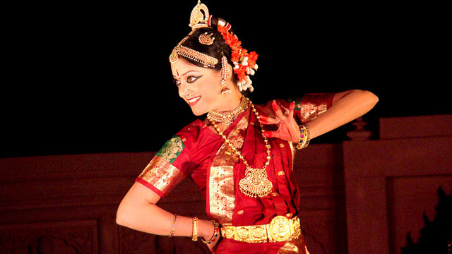
Welcome to Khajuraho

Slide 3
Editor’s note
Khajuraho temples are a world renowned site in India that have survived the ravages of time and Islamic destruction but alas not in their entirety. Still what remains dazzles your eyes and fills you with wonder. The erotic sculptures are an integral part of the temple complex and should be understood in the context of Hindu philosophy prevalent at ancient times when people expressed their sexuality freely as found in Khajuraho. India has regressed since then . In 1838 a British army captain, TS Burt, employed by the Asiatic Society in Kolkata , came upon information that led him to the rediscovery of the complex of temples in the jungle in Khajuraho. We were fortunate to visit Khajuraho.
It is for your private use only.
AKC/December 2015
.

Slide 4
Most Khajuraho temples were built between 950 and 1050 CE by the Chandela dynasty. Historical records note that the Khajuraho temple site had 85 temples by 12th century, spread over 20 square kilometers. Of these, only about 20 temples have survived, spread over 6 square kilometers. Of the various surviving temples, the largest and most famous Kandaria Mahadeva temple is decorated with a profusion of sculptures with intricate details, symbolism and expressiveness of ancient Indian art. It was built in the reign of King Ganda from 1017-1029 CE. The temple inscriptions suggest many of the currently surviving temples were complete between 970 to 1030 CE, with few more temples completed in decades thereafter. Central India was seized by Delhi Sultanate in 13th century. Under Muslim rule, some temples were destroyed and the rest left in neglect. Ruins of some old temples are still visible.
^{5]}

Slide 5
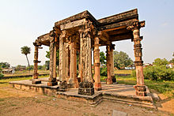
Ruins of temples after the Moslem attacks

Slide 6
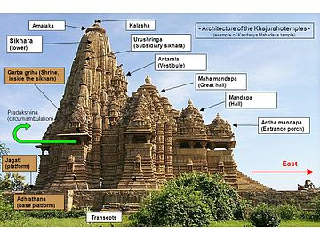
Architecture of temples at Khajuraho

Slide 7
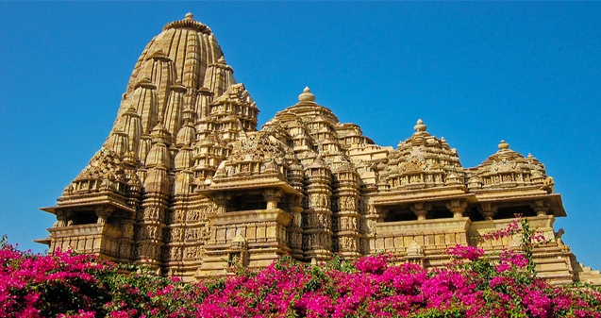

Slide 8
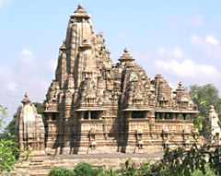

Slide 9
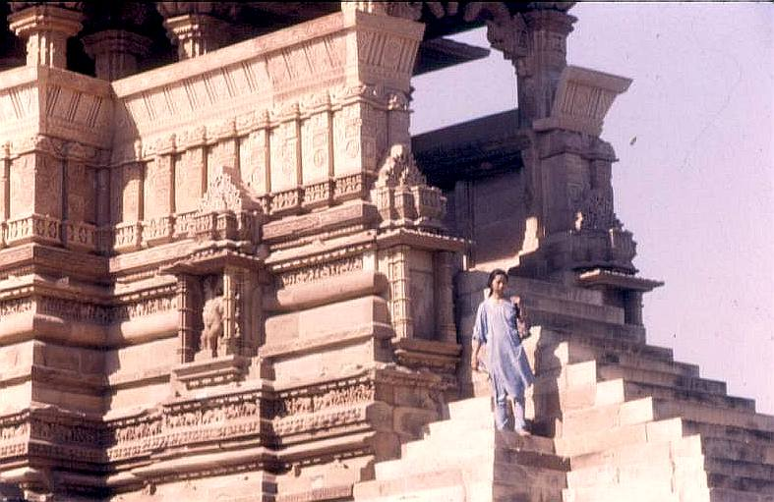
Tipin in Khajuraho

Slide 10
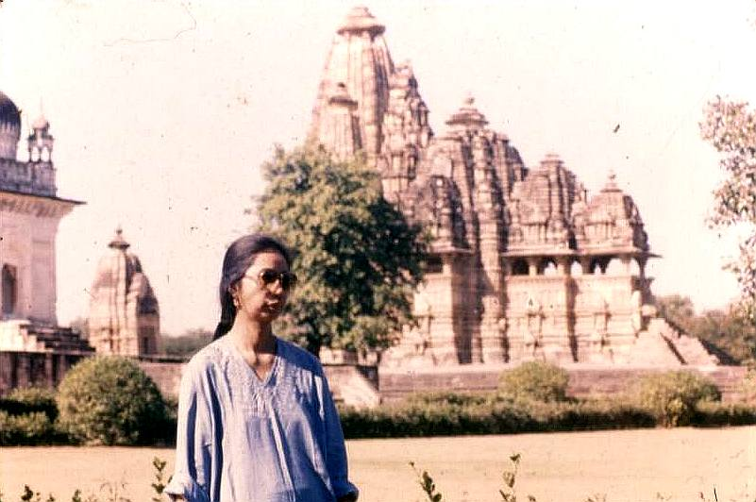

Slide 11
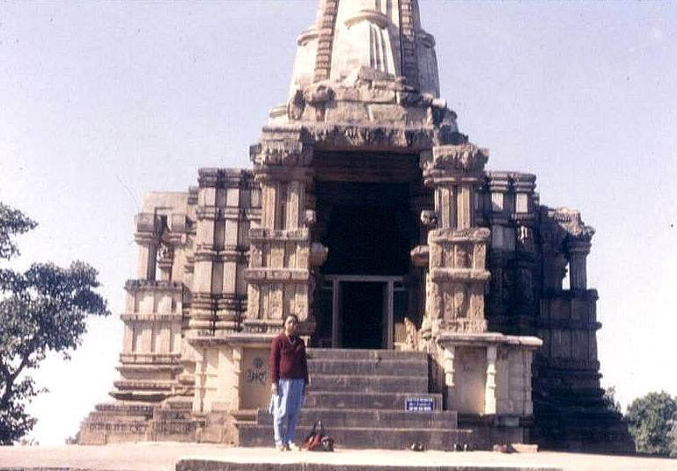

Slide 12
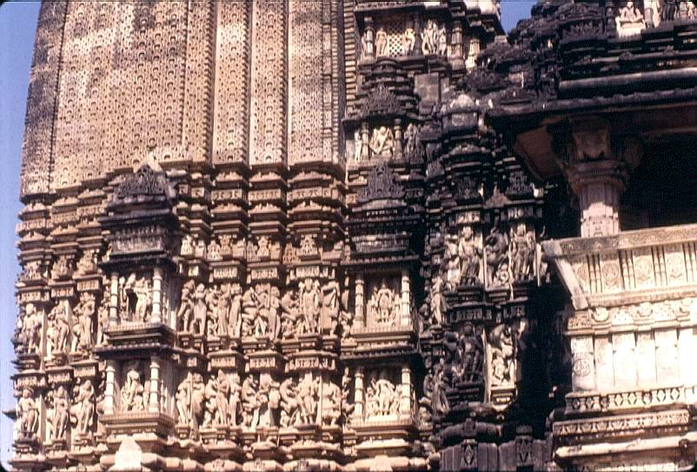

Slide 13
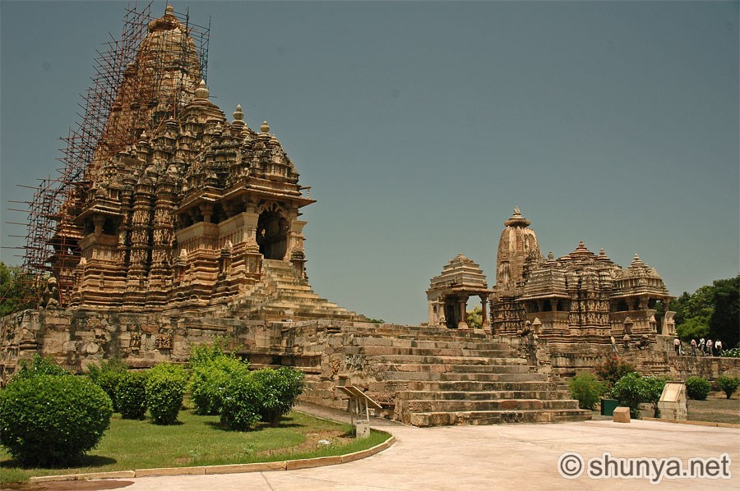

Slide 14
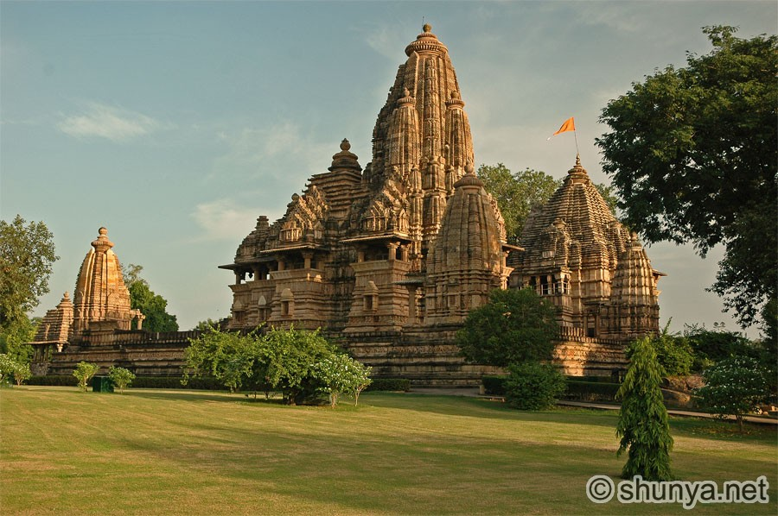

Slide 15
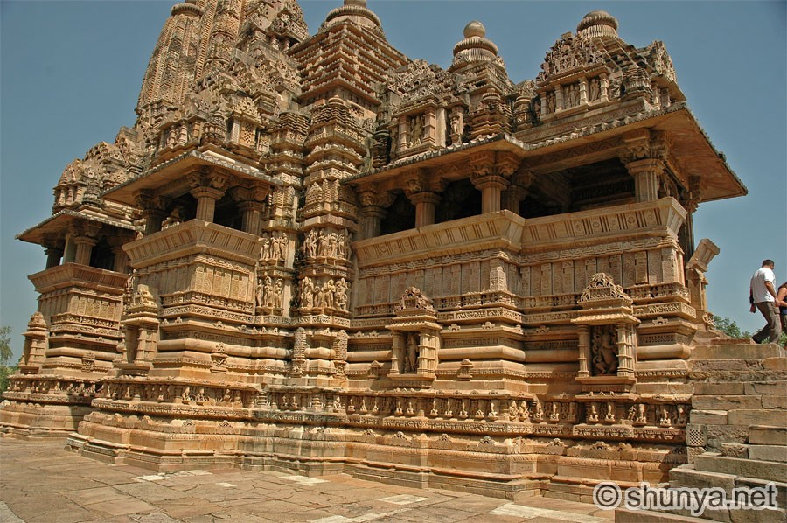

Slide 16
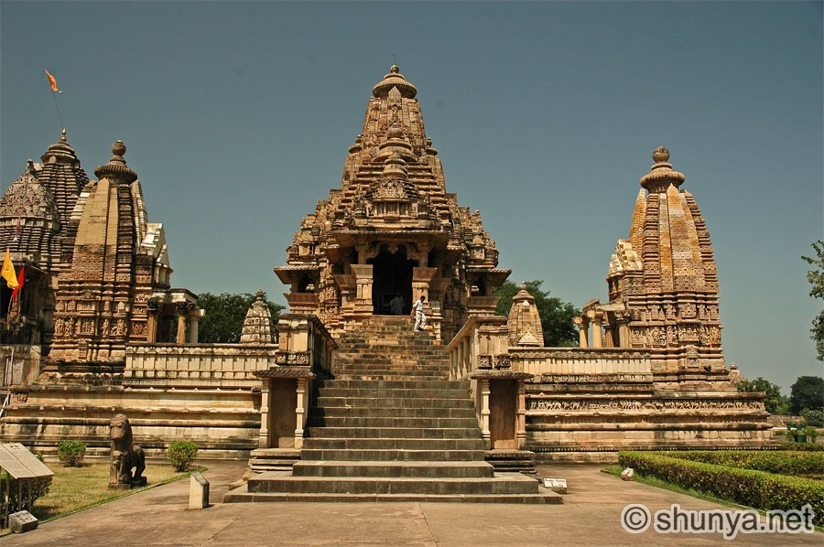

Slide 17
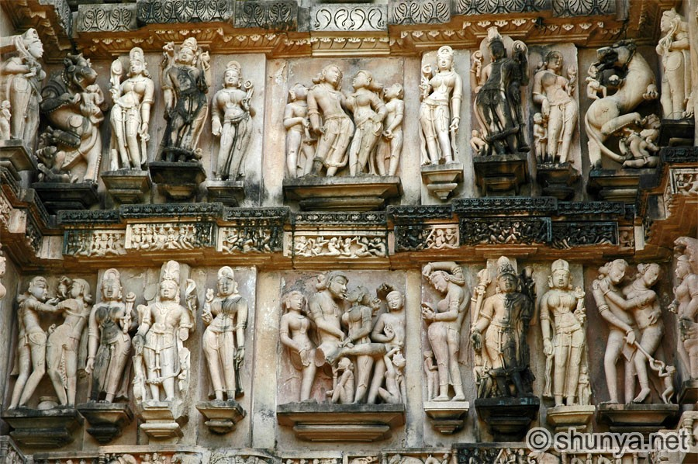

Slide 18
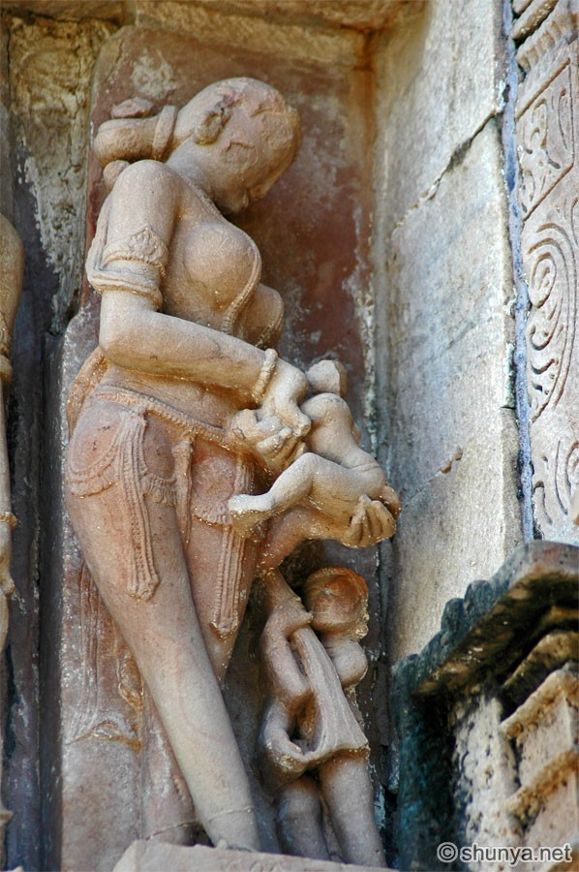

Slide 19
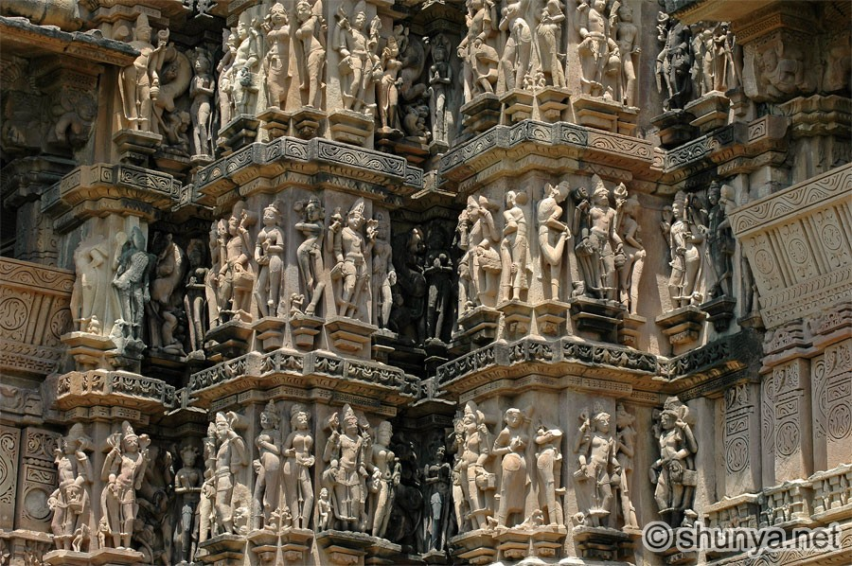

Slide 20
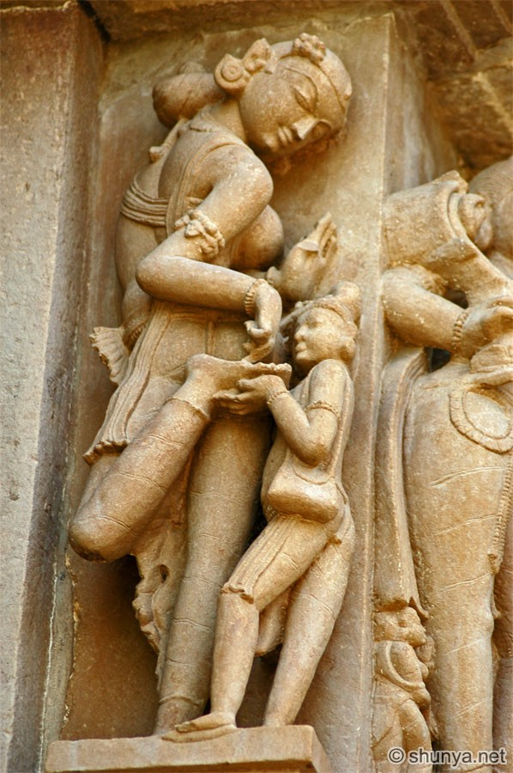

Slide 21
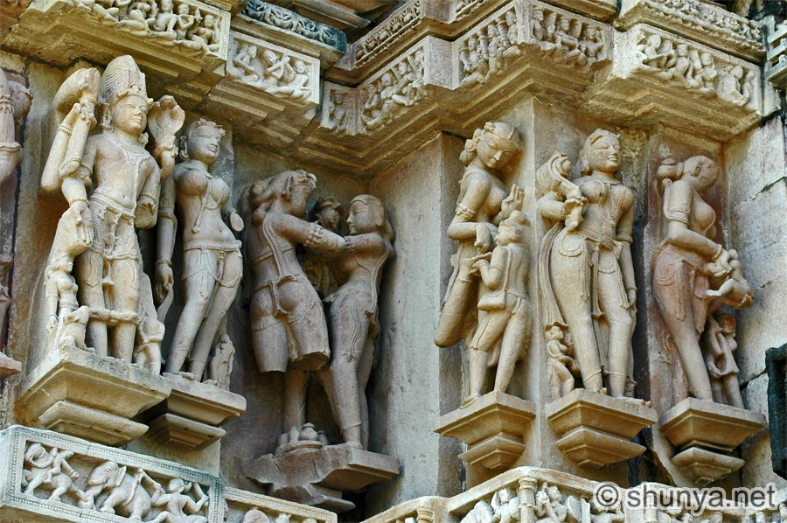

Slide 22
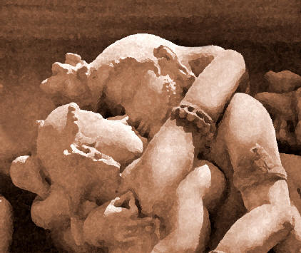

Slide 23
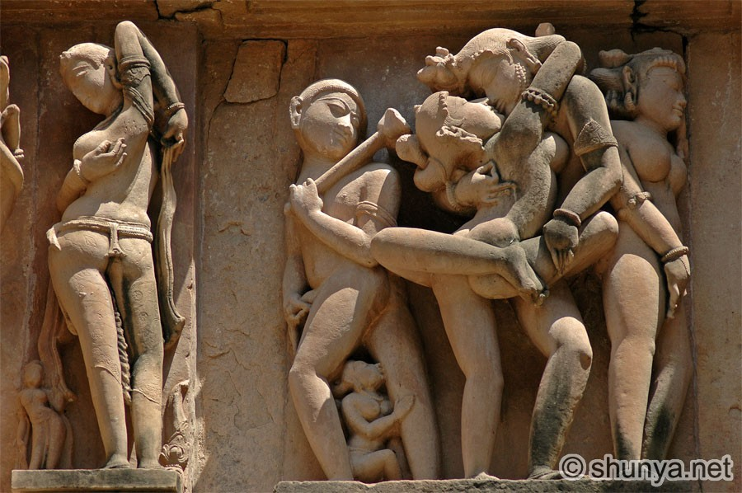

Slide 24
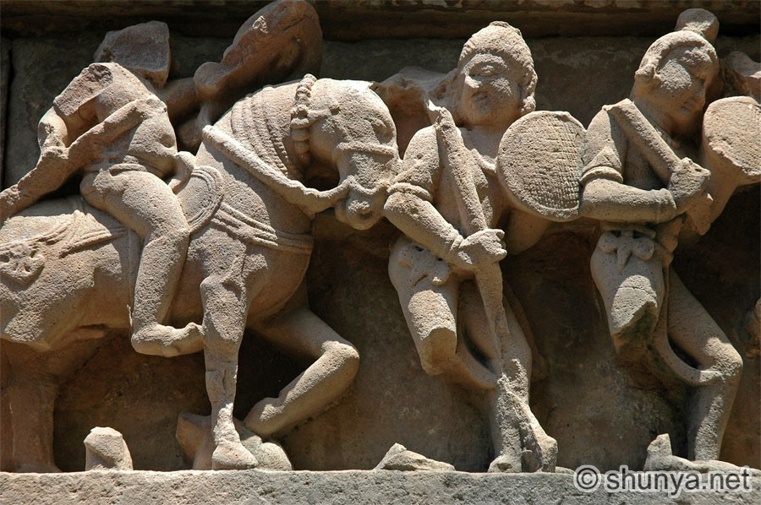

Slide 25
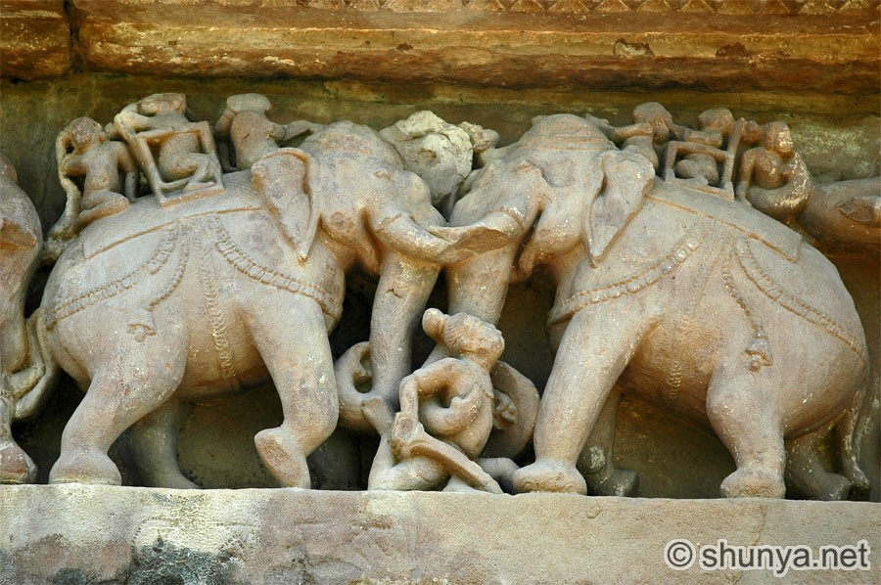

Slide 26
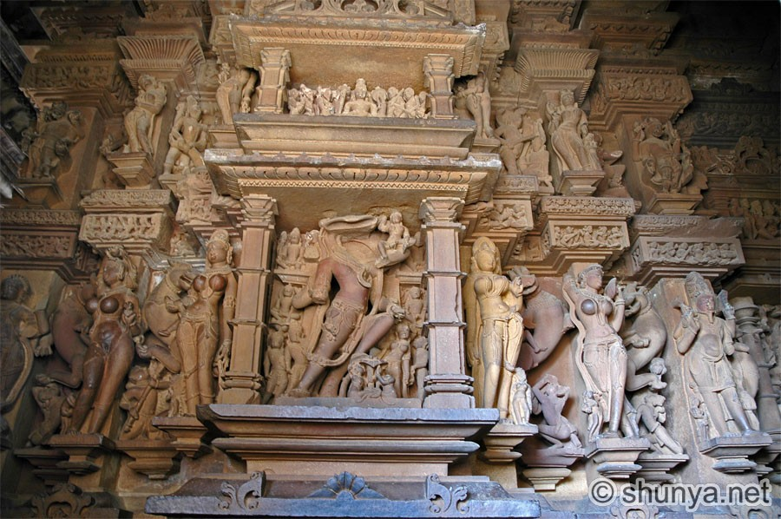

Slide 27
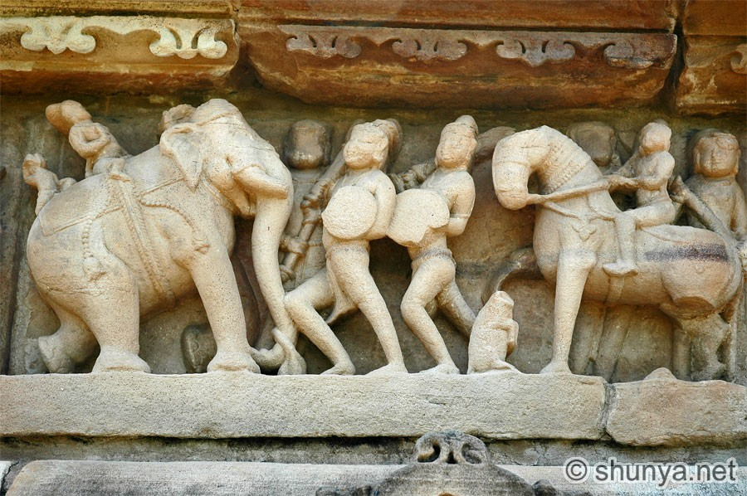

Slide 28
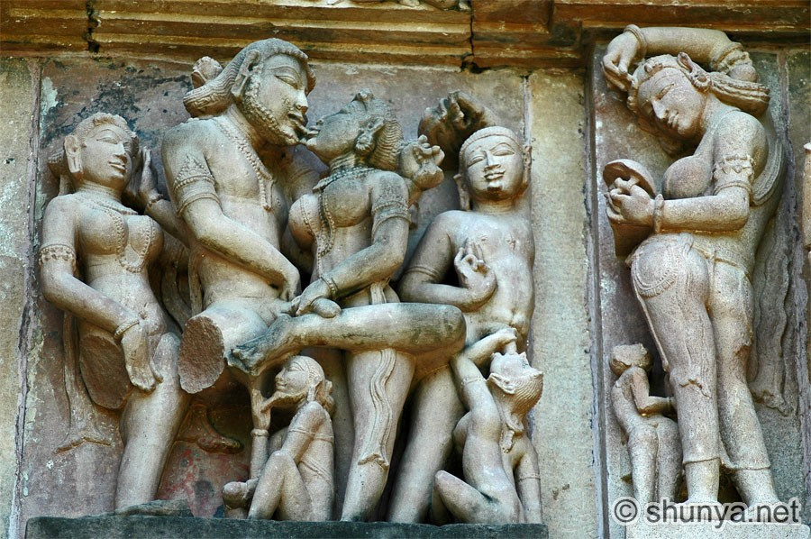

Slide 29
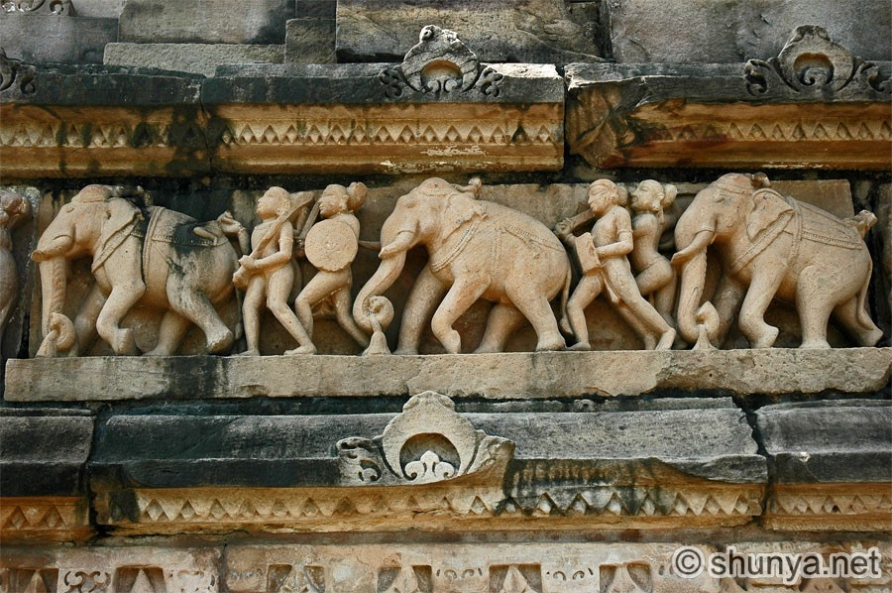

Slide 30
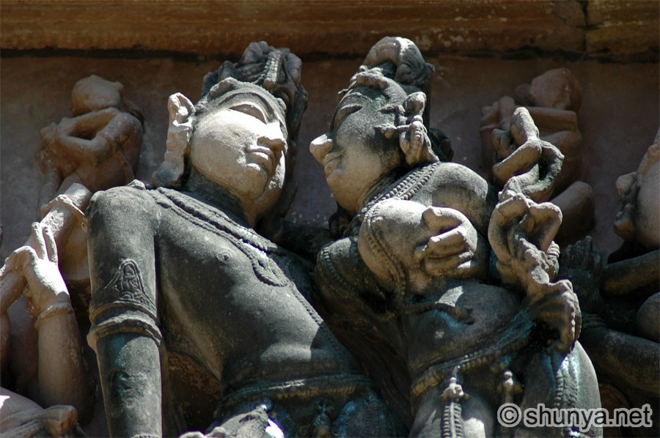

Slide 31
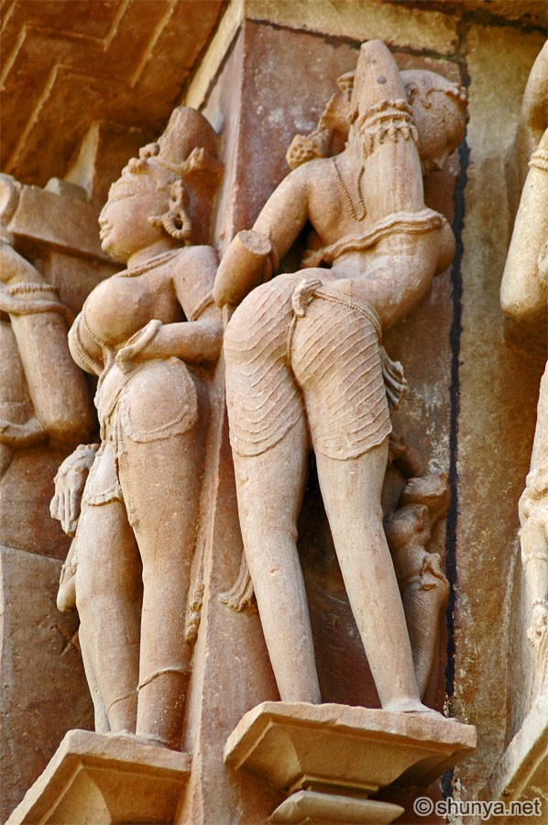

Slide 32
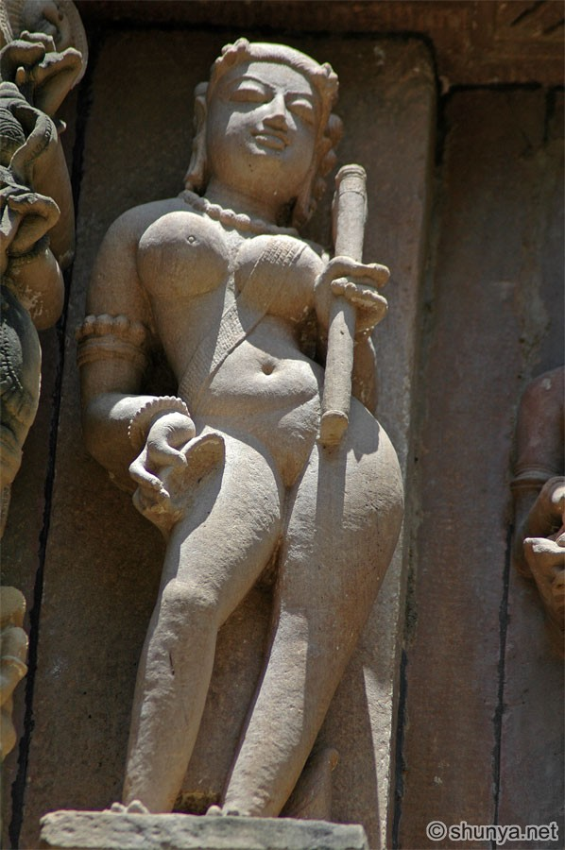

Slide 33
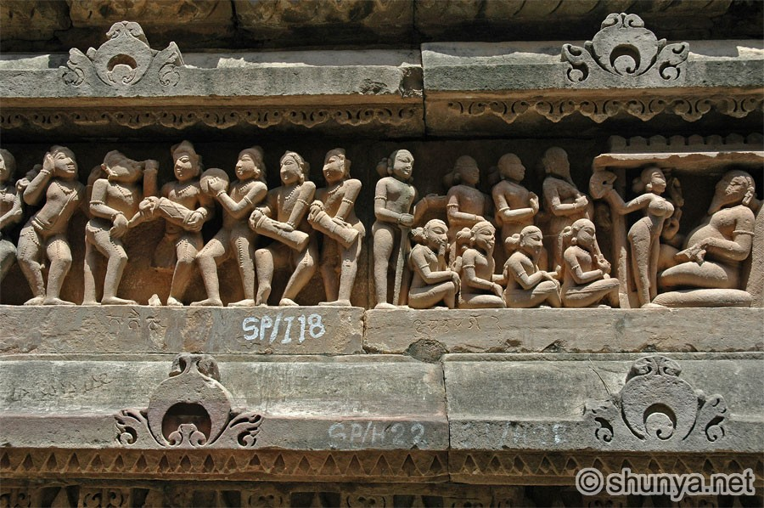

Slide 34
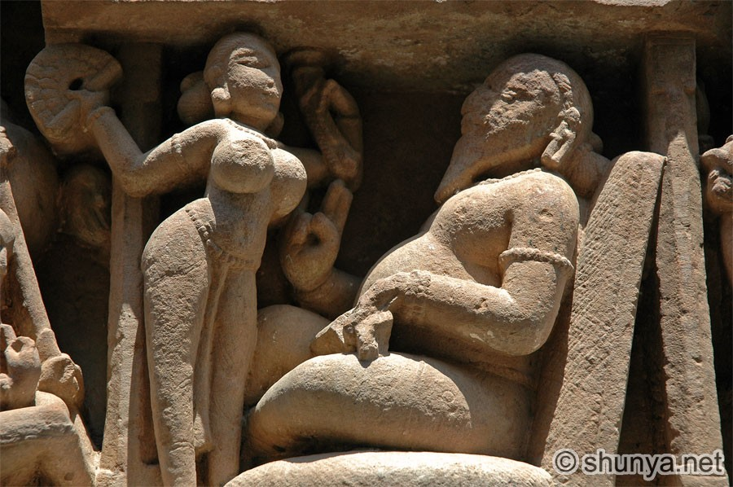

Slide 35
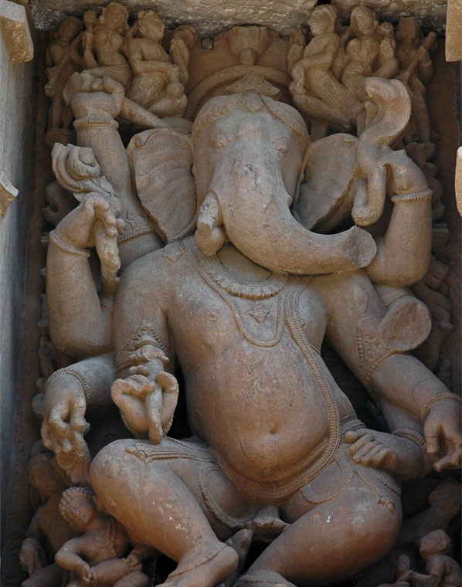

Slide 36
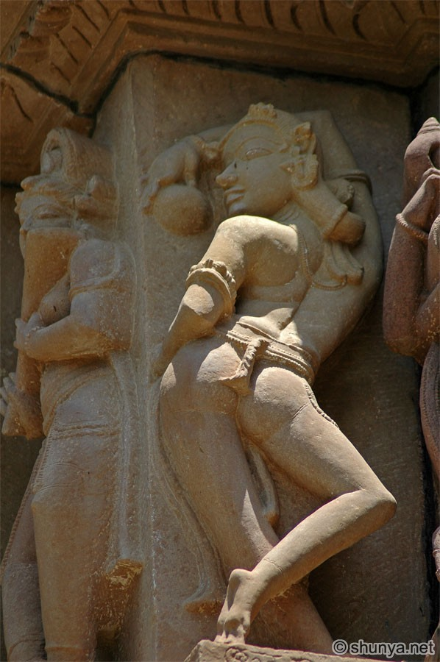

Slide 37
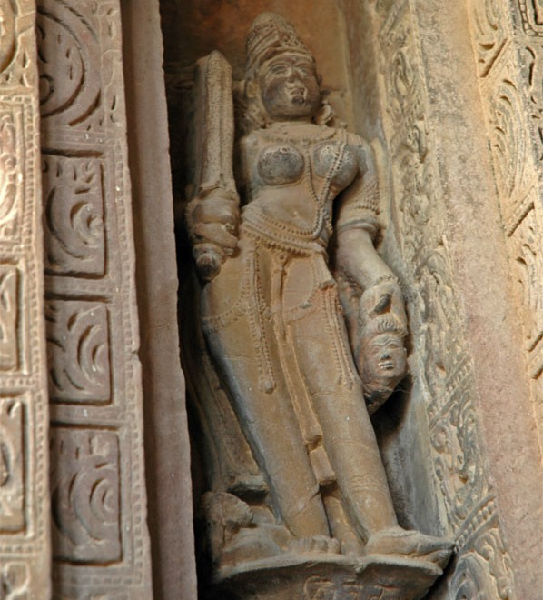

Slide 38
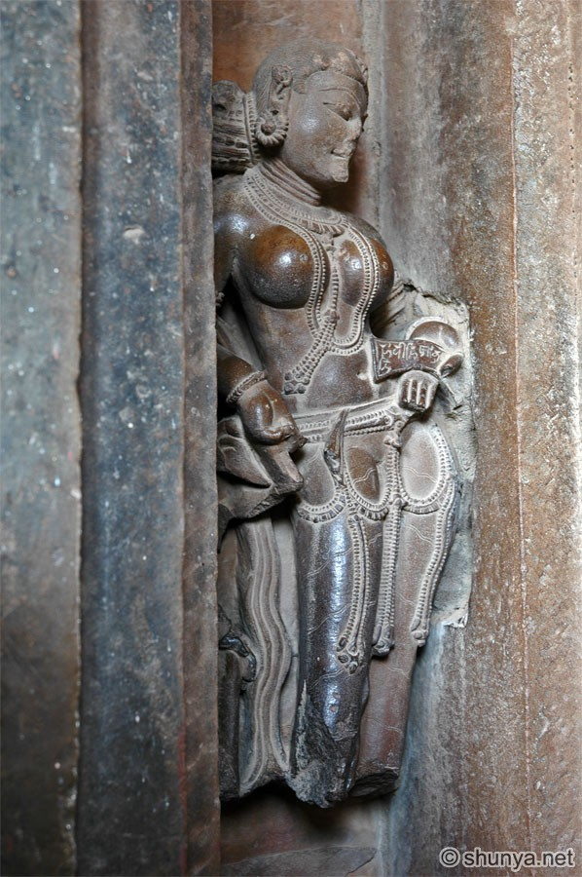

Slide 39
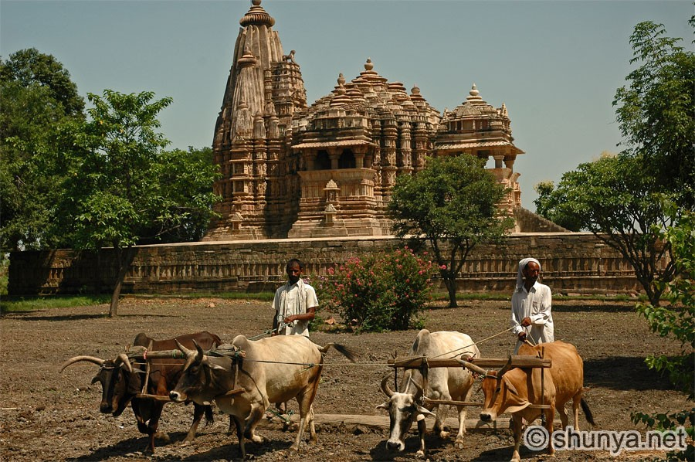

Slide 45
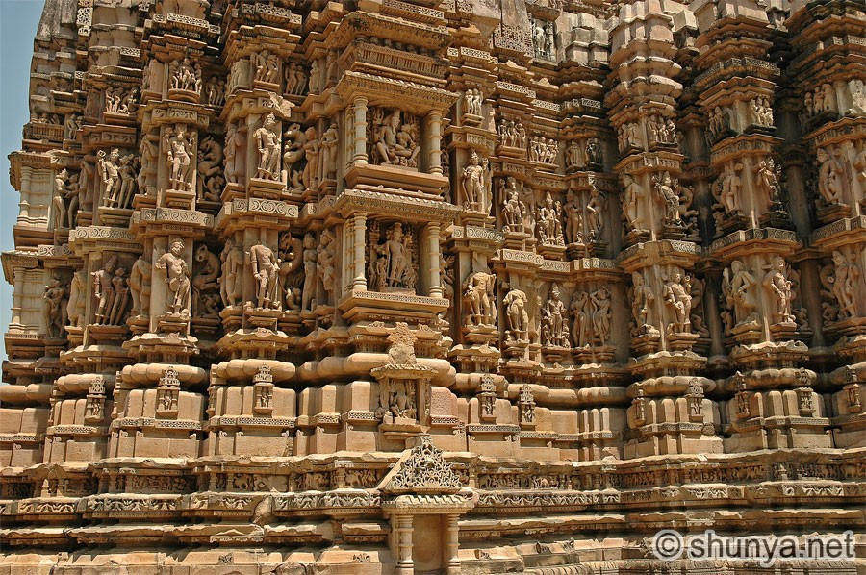

Slide 46
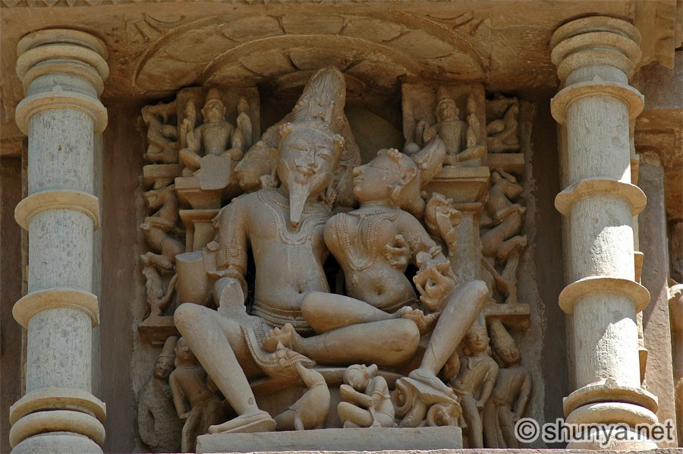

Slide 47
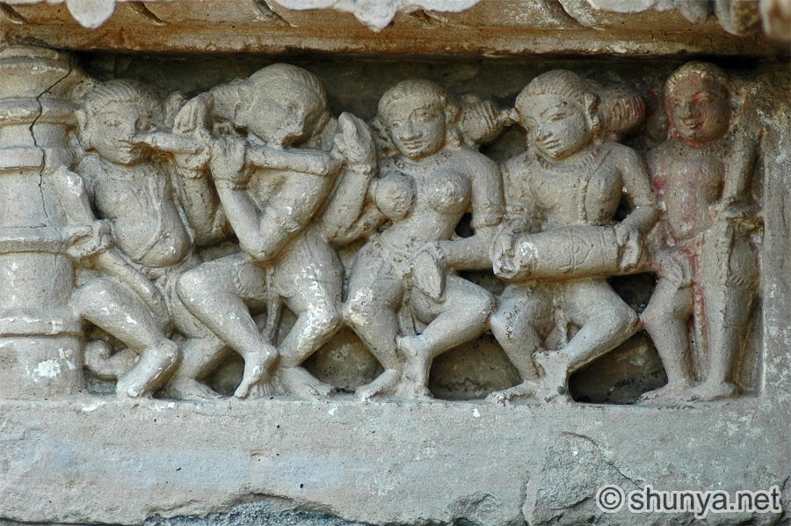

Slide 48
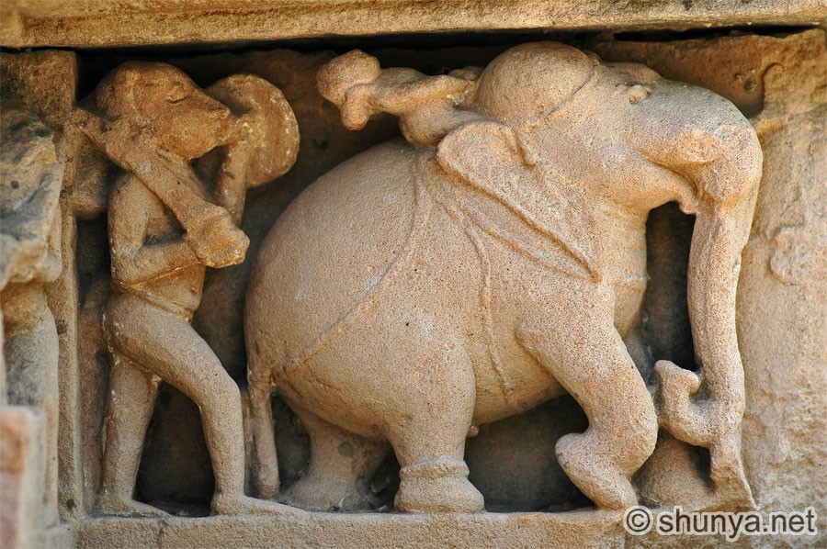

Slide 49
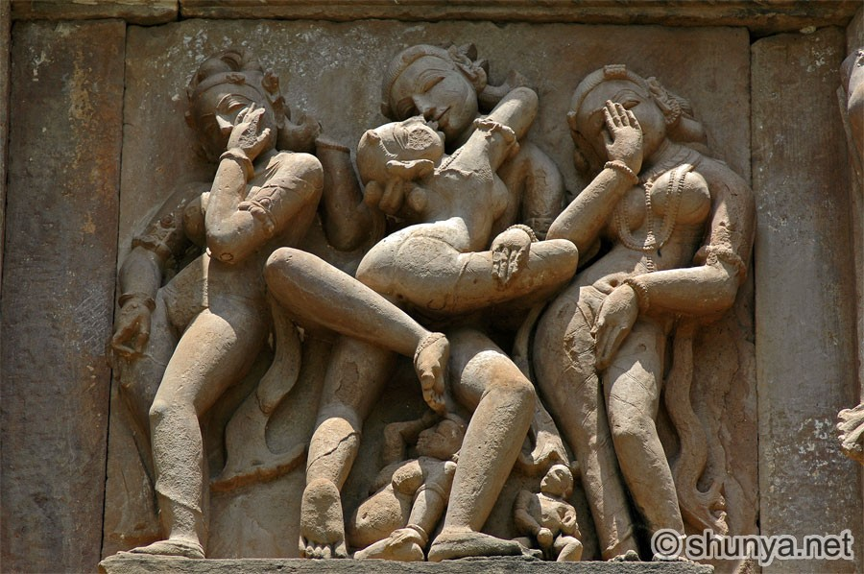

Slide 50
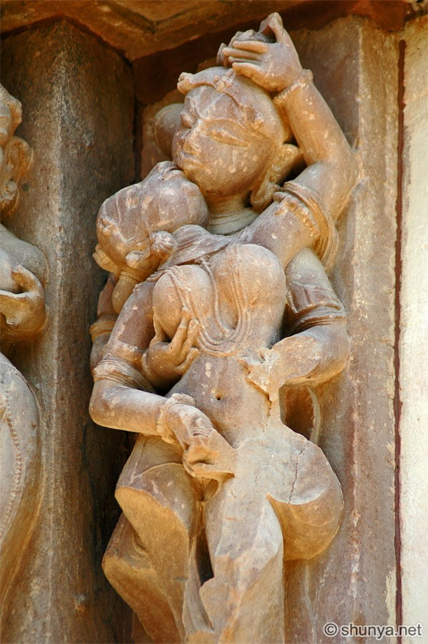

Slide 51
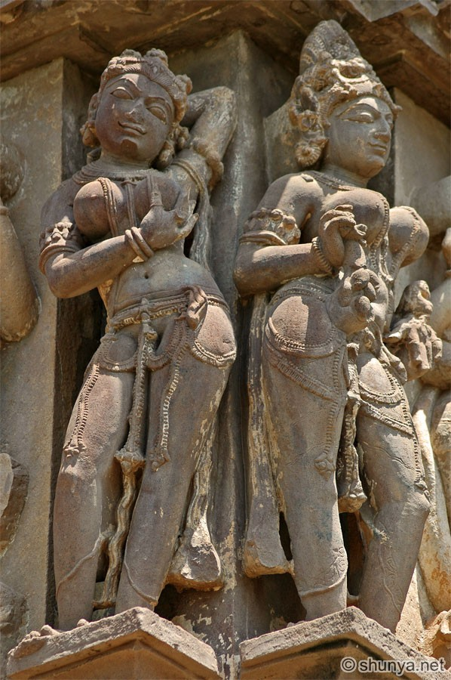

Slide 52
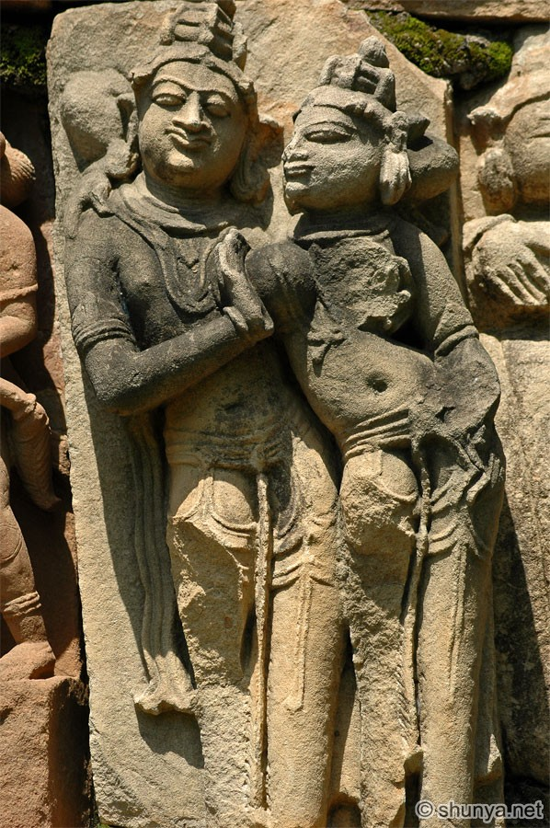

Slide 53
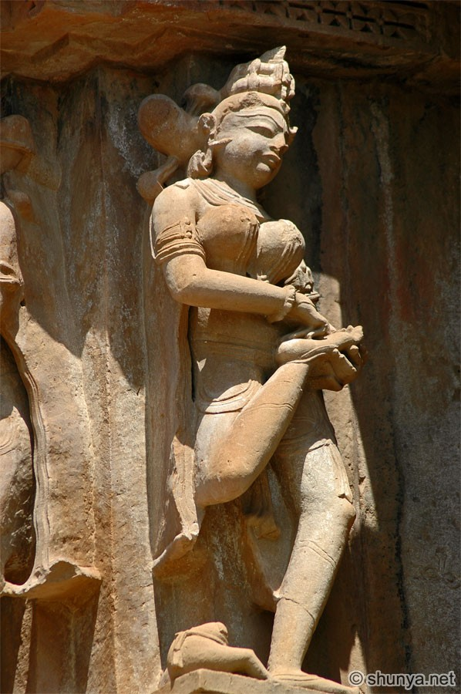

Slide 54
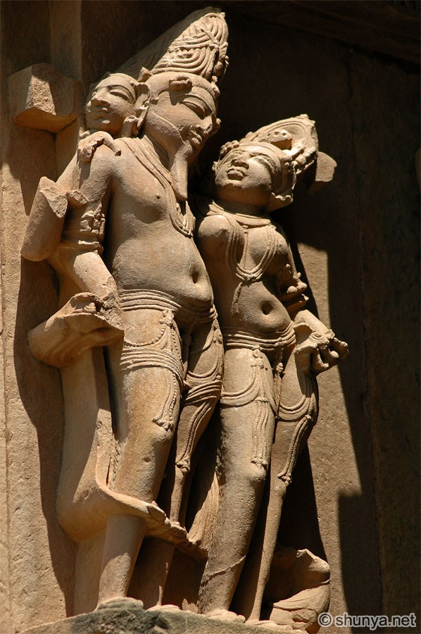

Slide 55
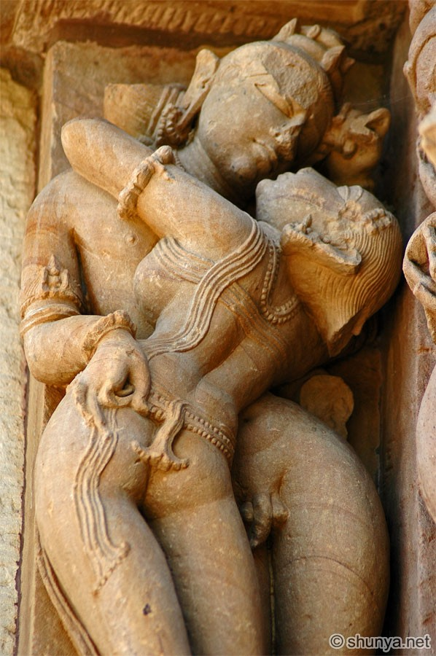

Slide 56
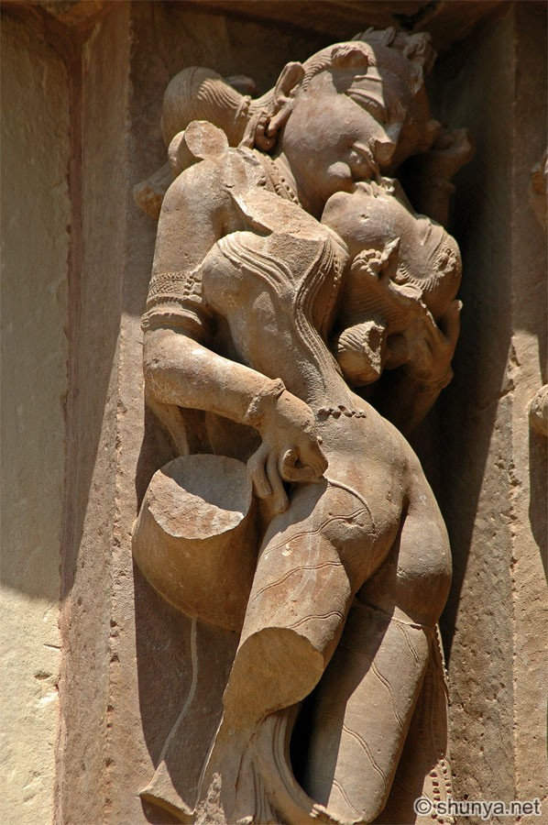

Slide 57
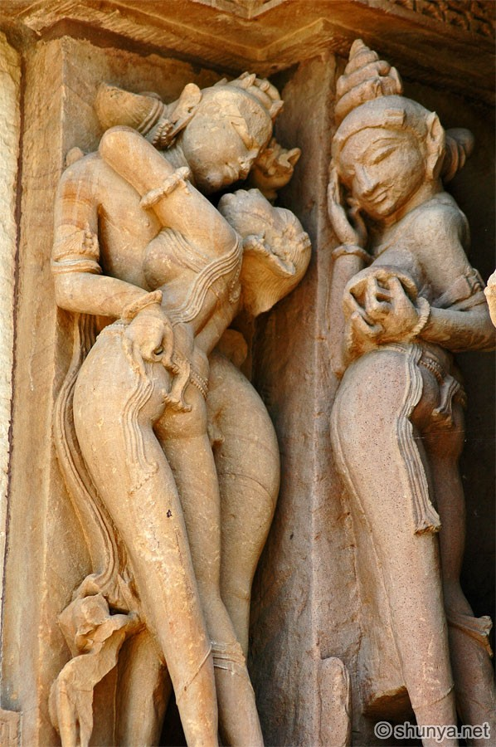

Slide 58
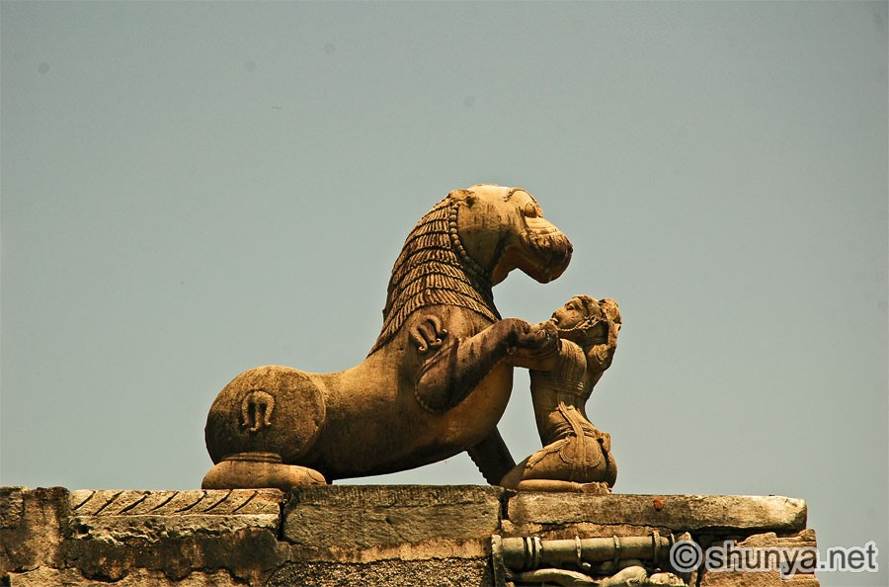

Slide 59


Slide 60


Slide 61


Slide 62


Slide 63


Slide 64


Slide 65


Slide 66


Slide 67


Slide 68


Slide 69


Slide 70


Slide 71


Slide 72


Slide 73


Slide 74


Slide 75


Slide 76


Slide 77


Slide 78


Slide 79


Slide 80


Slide 81


Slide 82


Slide 83


Slide 84


Slide 85


Slide 89


Slide 112


Slide 113


Slide 114


Slide 115


Slide 116


Slide 117


Slide 118


Slide 119


Slide 130


Slide 131


Slide 132


Slide 133


Slide 134


Slide 135


Slide 136


Slide 137


Slide 138


Slide 139


Slide 143


Slide 144


Slide 145


Slide 146


Slide 147


Slide 148


Slide 149


Slide 150


Slide 151


Slide 152


Slide 153


Slide 154


Slide 155


Slide 156


Slide 157


Slide 158


Slide 159


Slide 163


Slide 164


Slide 165


Slide 166
Chitragupta temple

Slide 177


Slide 179


Slide 181


Slide 182


Slide 183
Devi Jagadambini temple

Slide 185


Slide 190


Slide 194


Slide 195

Duladeo temple

Slide 196


Slide 197


Slide 198


Slide 205


Slide 206


Slide 207


Slide 208


Slide 209


Slide 210


Slide 211


Slide 212


Slide 213


Slide 214


Slide 215


Slide 216


Slide 217


Slide 218


Slide 219


Slide 220


Slide 221


Slide 222
Kandaria Mahadeo temple

Slide 223


Slide 226


Slide 228


Slide 241


Slide 242


Slide 243


Slide 244


Slide 245


Slide 246


Slide 248


Slide 249


Slide 250


Slide 251


Slide 252


Slide 253


Slide 254


Slide 255


Slide 256


Slide 257


Slide 258


Slide 259


Slide 260


Slide 261


Slide 262


Slide 263


Slide 264


Slide 265


Slide 266


Slide 267


Slide 268


Slide 269


Slide 270


Slide 271


Slide 272


Slide 273


Slide 274


Slide 275


Slide 276


Slide 277


Slide 278


Slide 279


Slide 280


Slide 281


Slide 282
Lakhsman temple

Slide 283
Lakhsman temple

Slide 291

Parshvanath temple

Slide 292


Slide 296

Vamana temple

Slide 297
VishwaNath temple

Slide 298


Slide 299


Slide 300


Slide 301


Slide 303

The end

