Slide 1
Kanchipuram silk sarees
Part Two

Slide 2
Kanchipuram
Editor’s note
Kanchipuram silk sarees are truly the jewels of the South where silk weaving is as ancient as the country itself. The variety and colors dazzle the eyes and cater to every desire of a beautiful woman in making herself more alluring.
It is famous all over the world for it’s workmanship and design just like the silk sarees of Benares. It is presented here for your visual pleasure.
AKC/November 2015

Slide 3
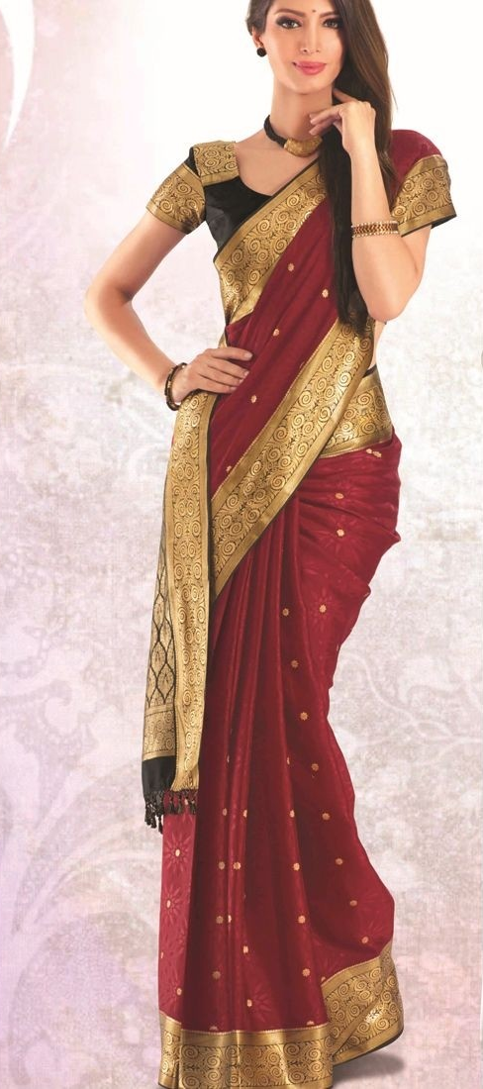
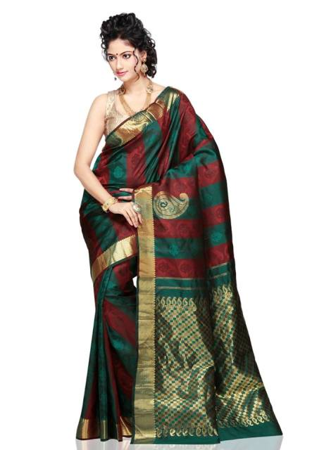

Slide 4
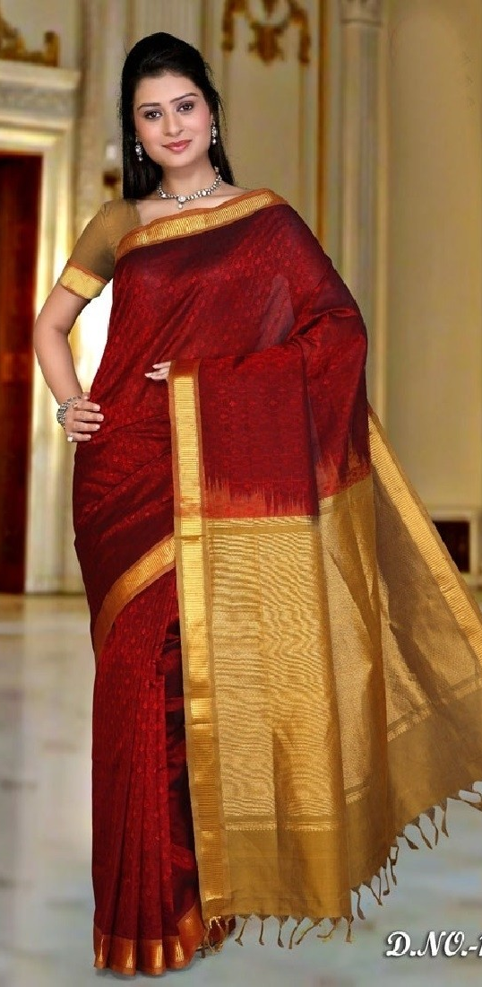
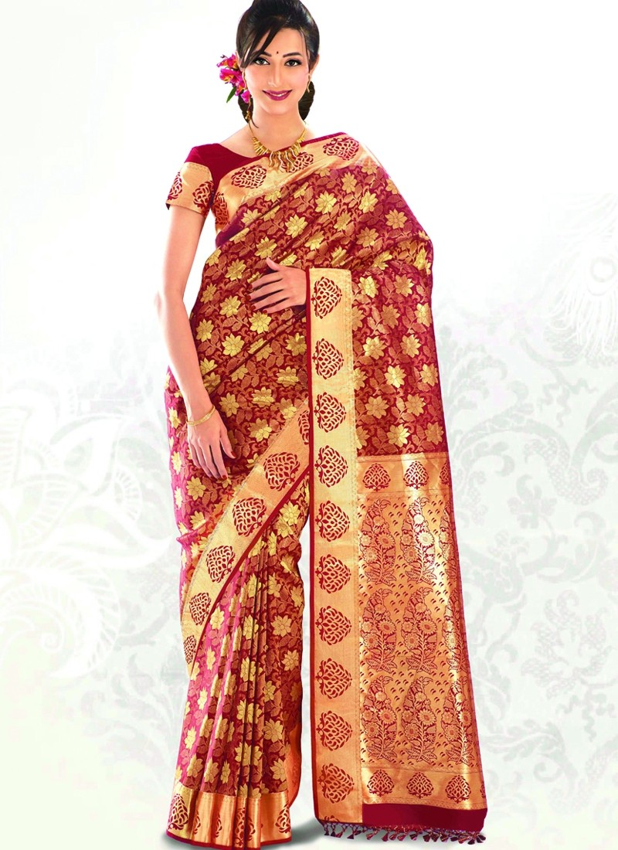

Slide 5
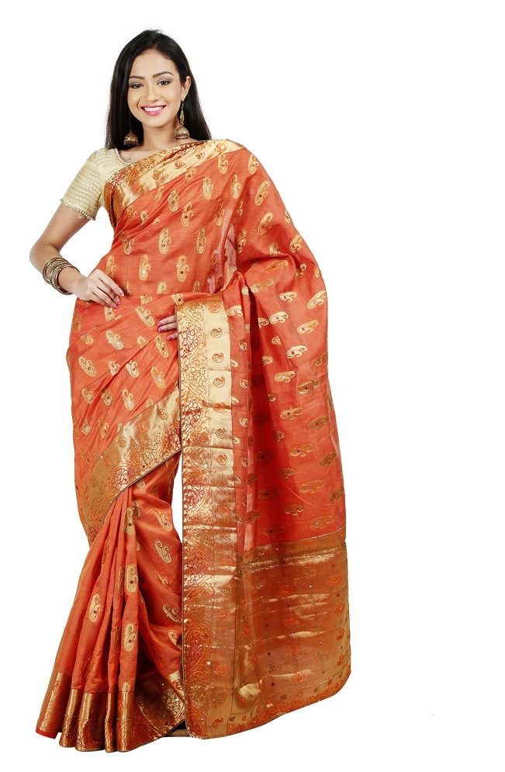
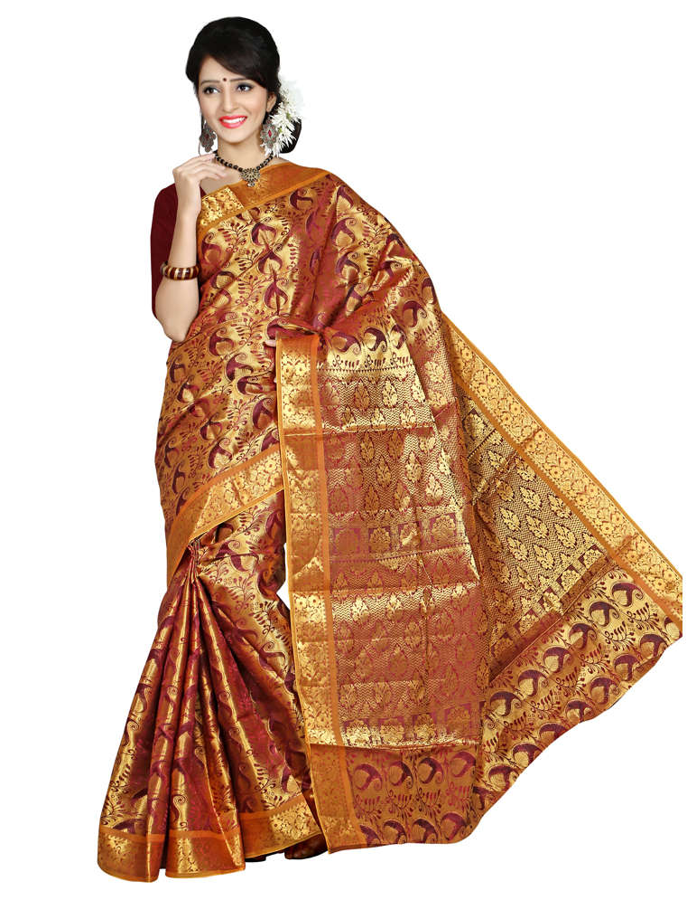

Slide 6
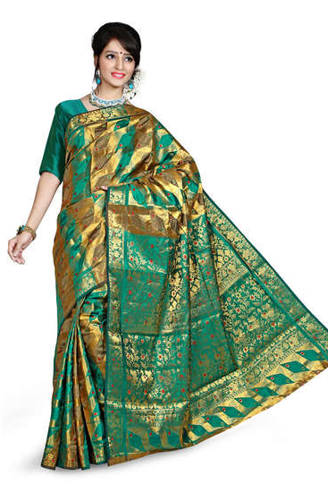
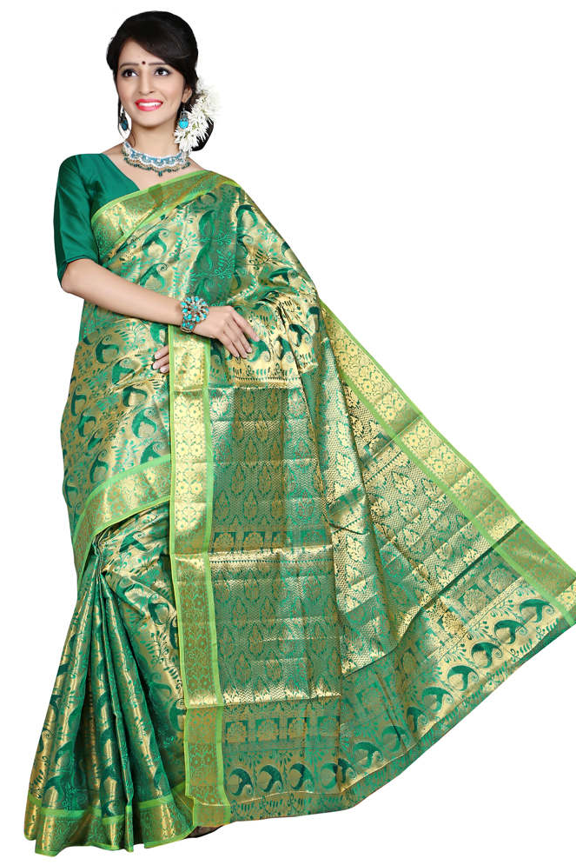

Slide 7
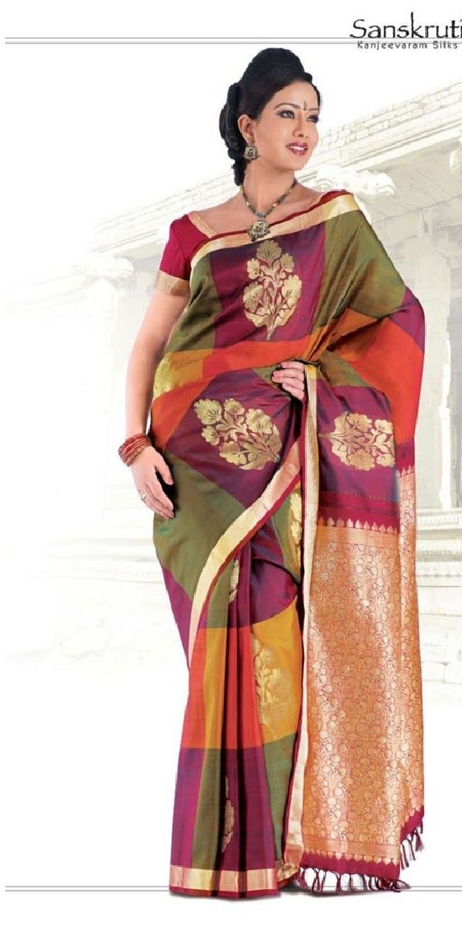
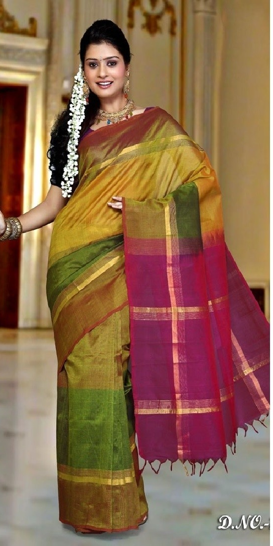

Slide 8
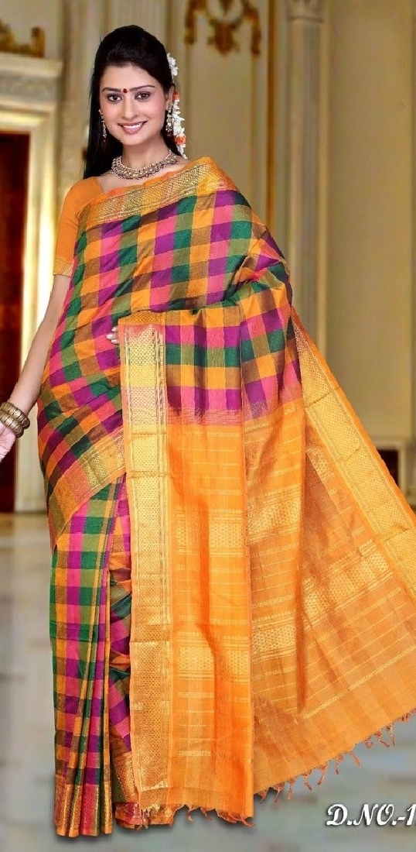
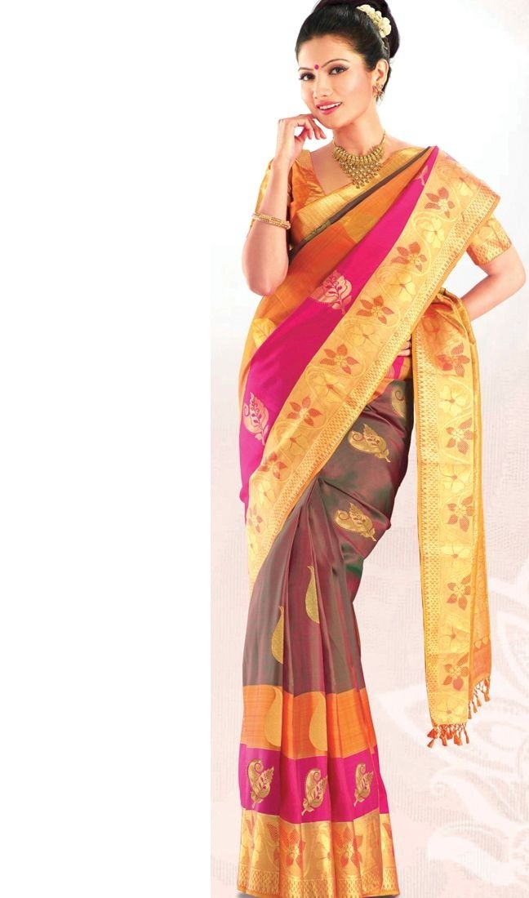

Slide 9
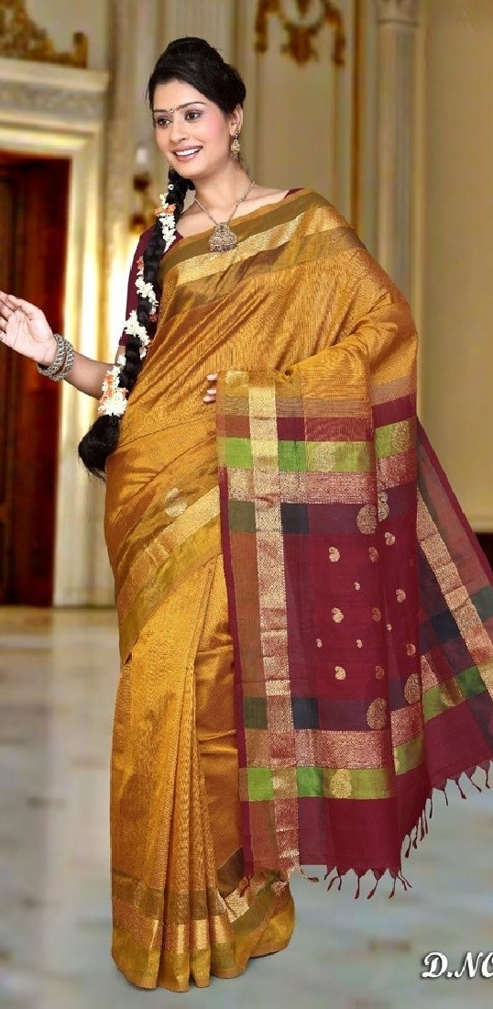
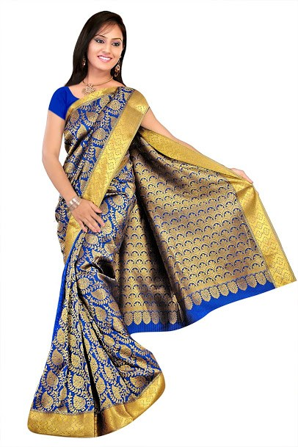

Slide 10
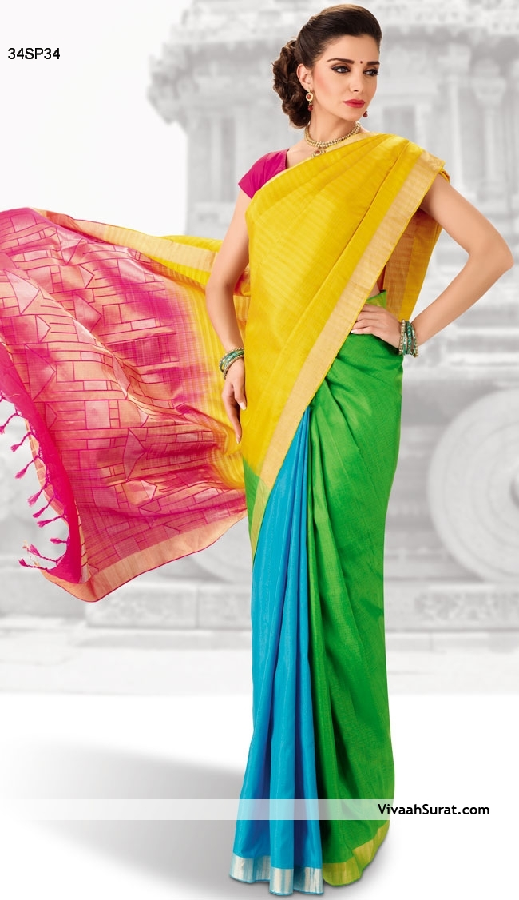
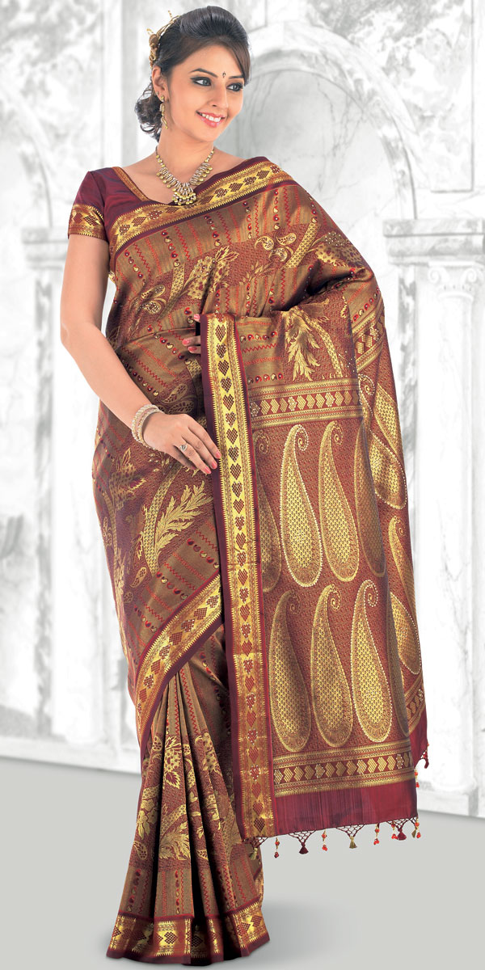

Slide 11
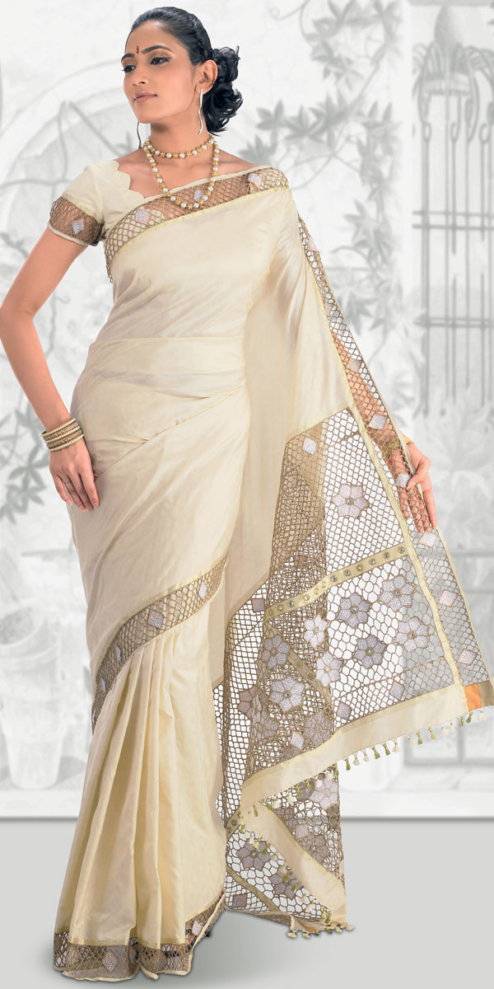
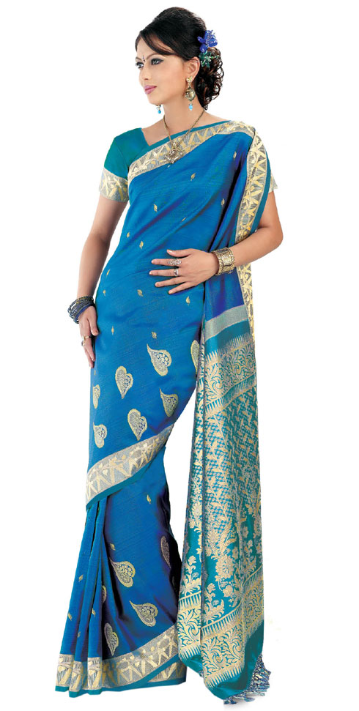

Slide 12
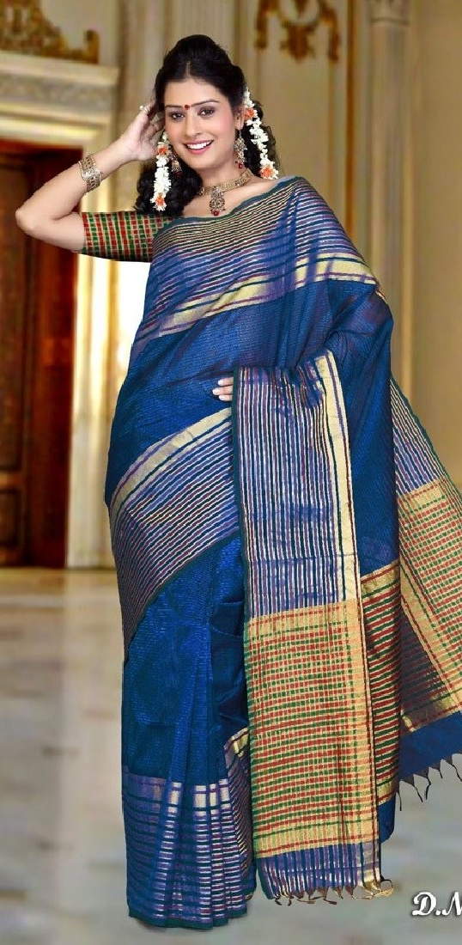
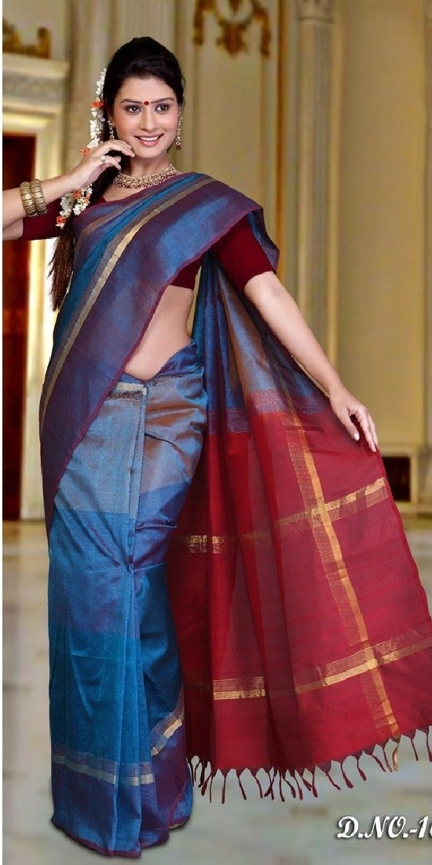

Slide 13
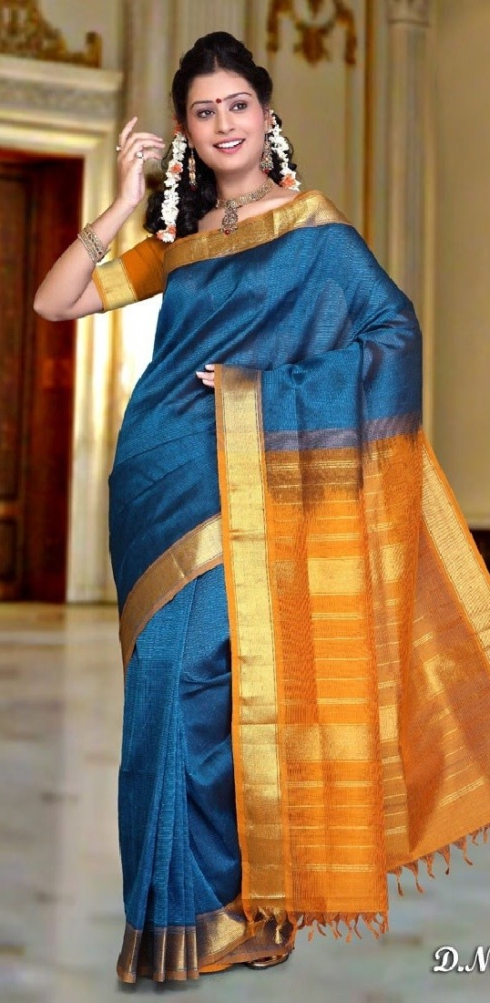
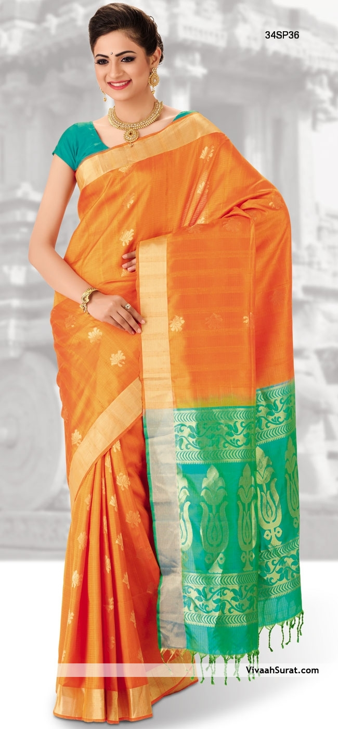

Slide 14
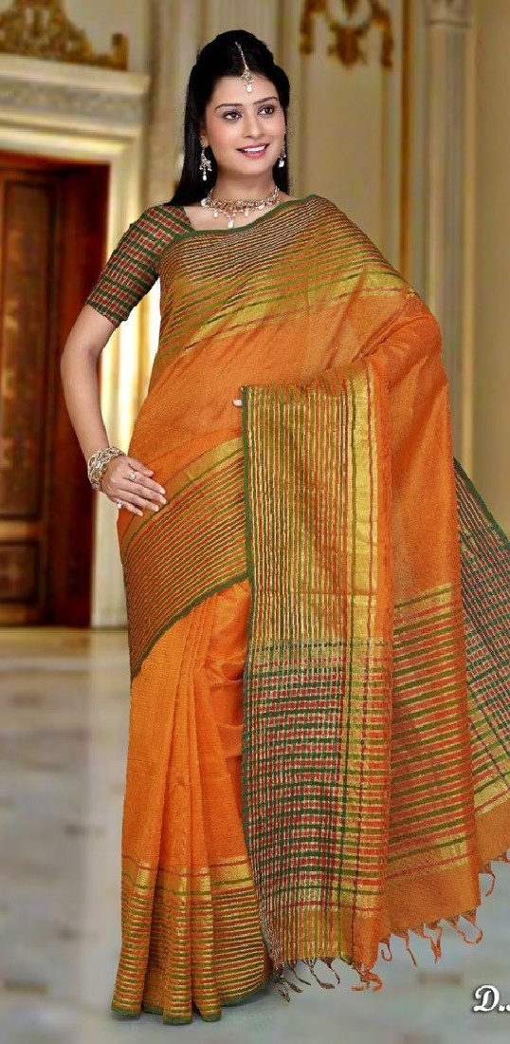
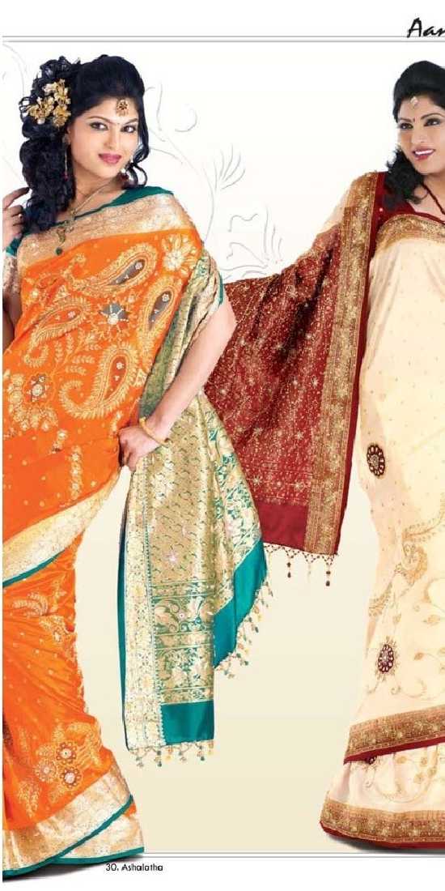

Slide 15
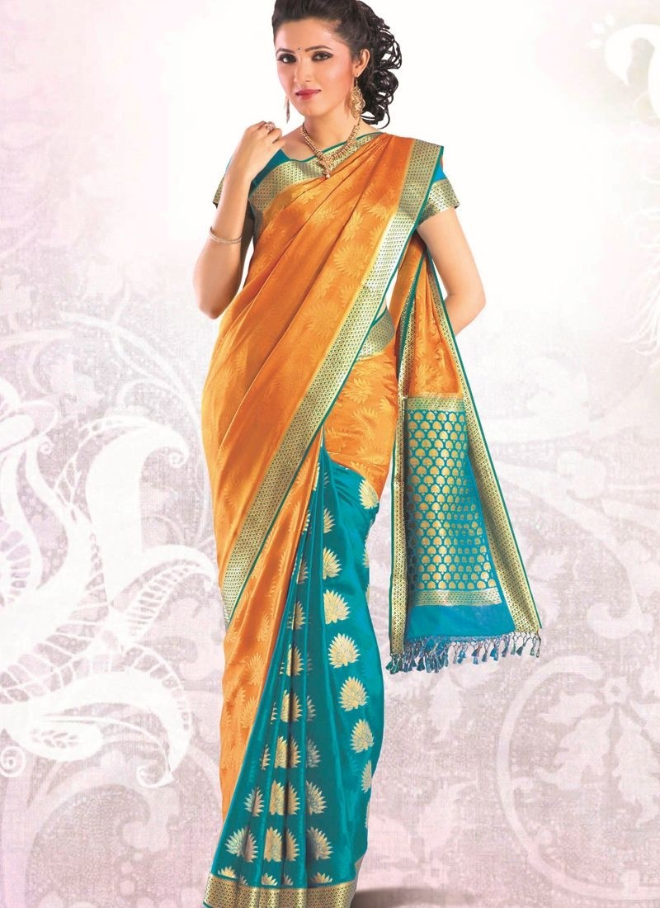

Slide 16
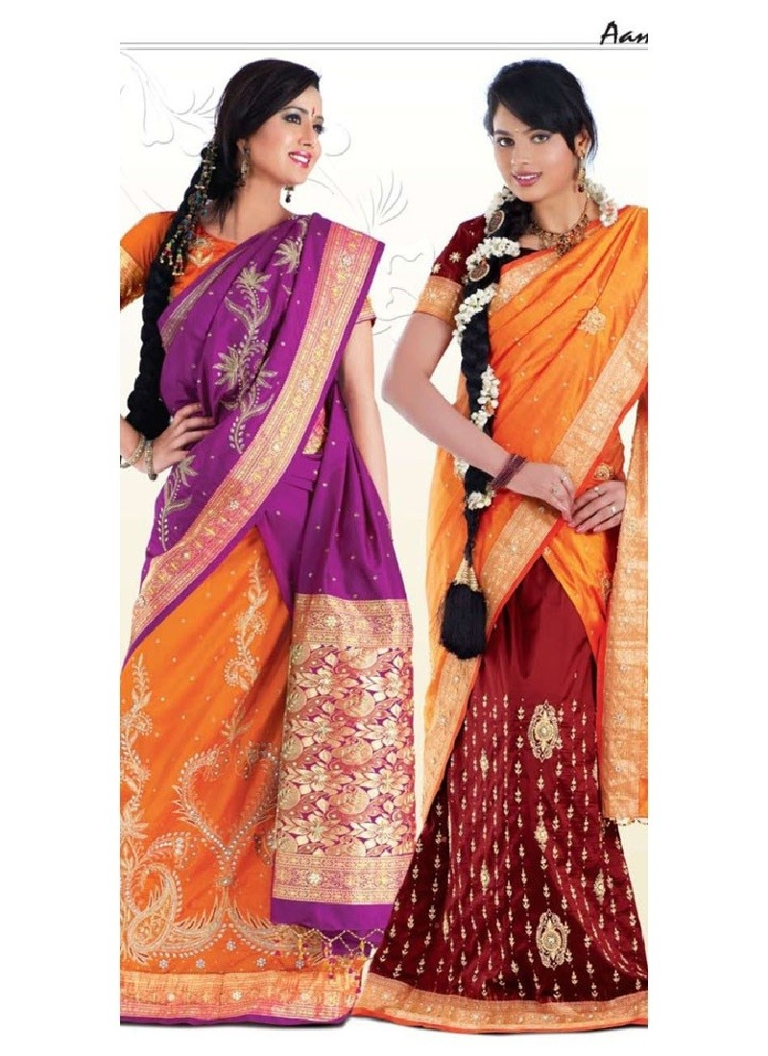

Slide 17
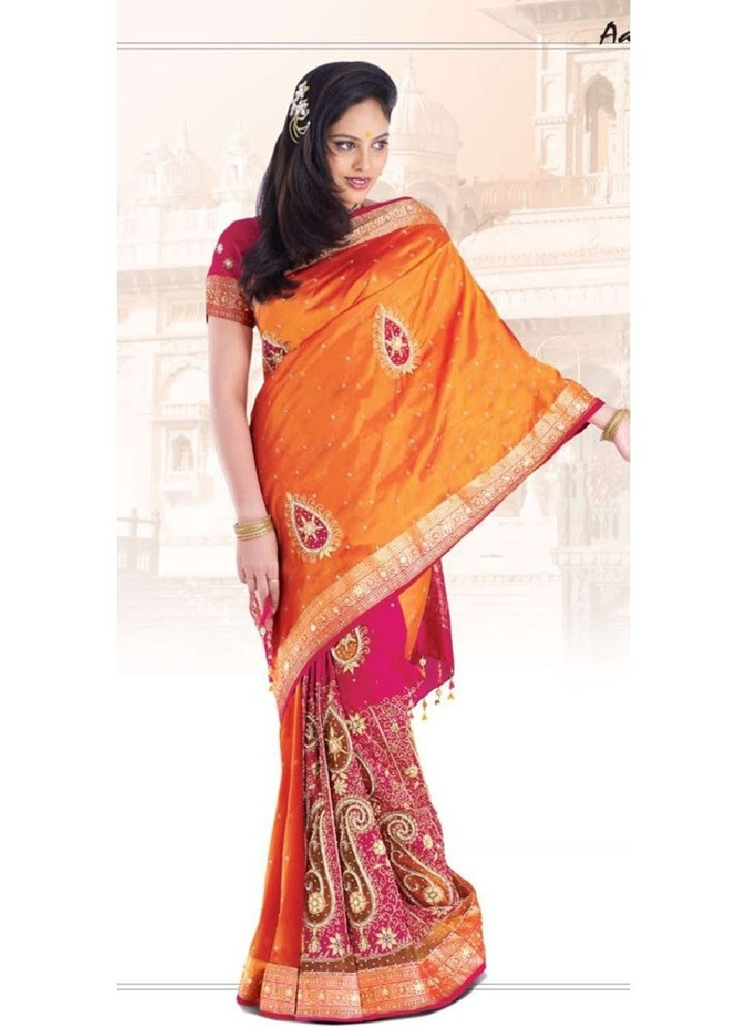

Slide 18
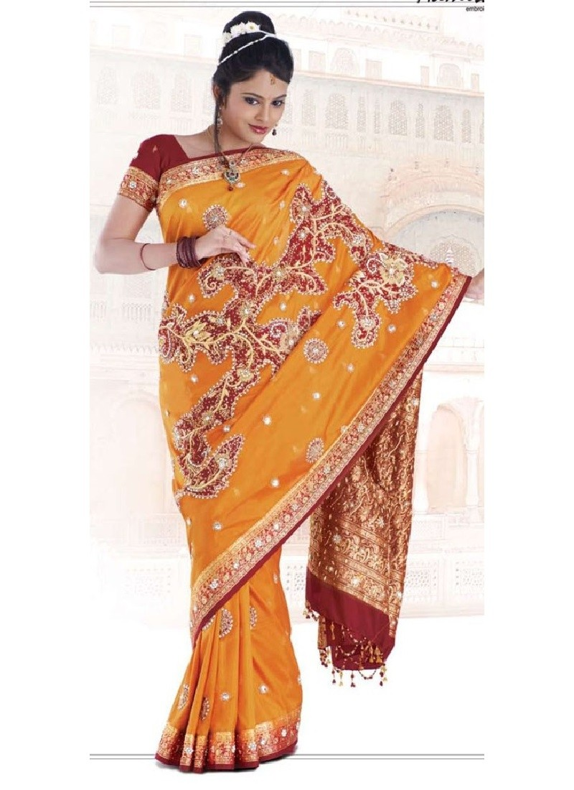

Slide 19
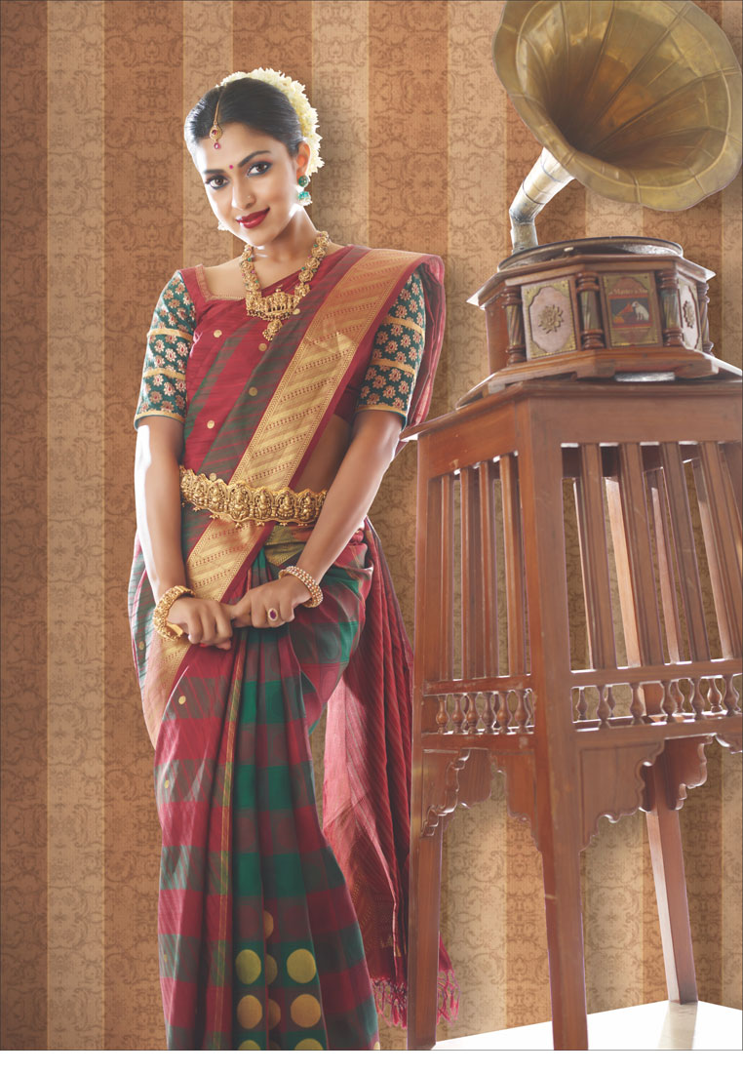

Slide 20
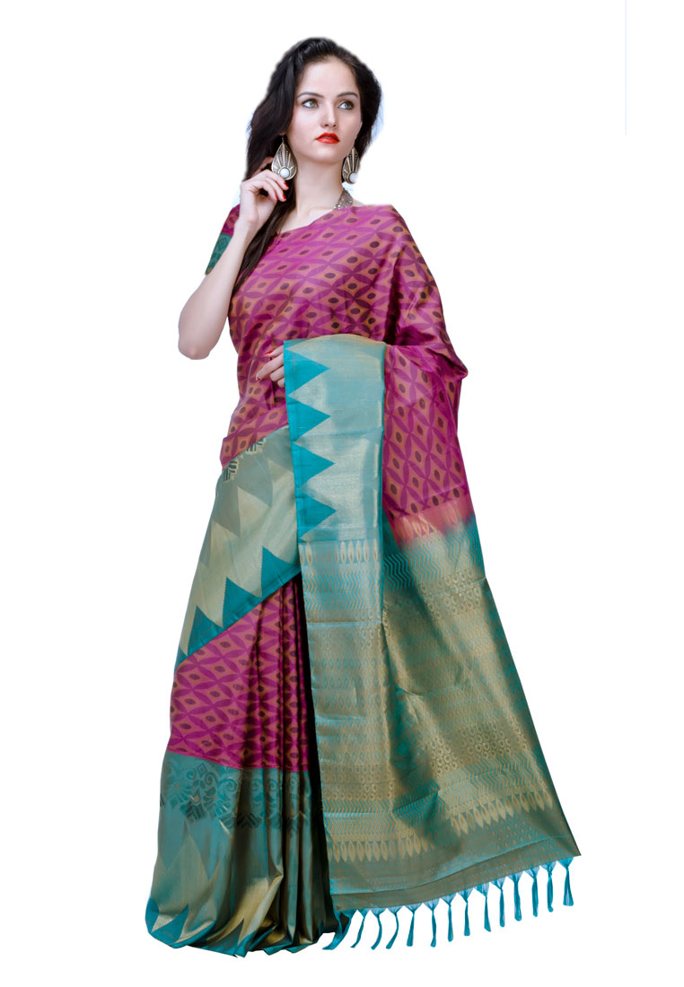

Slide 21
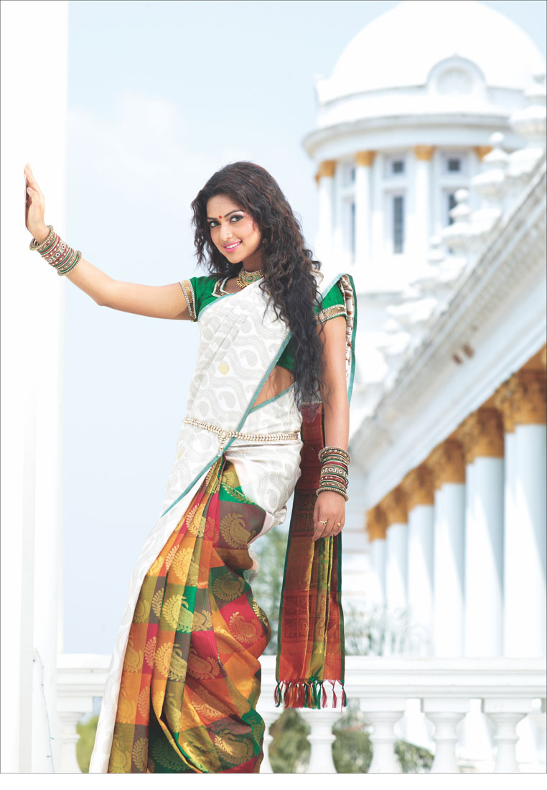

Slide 22
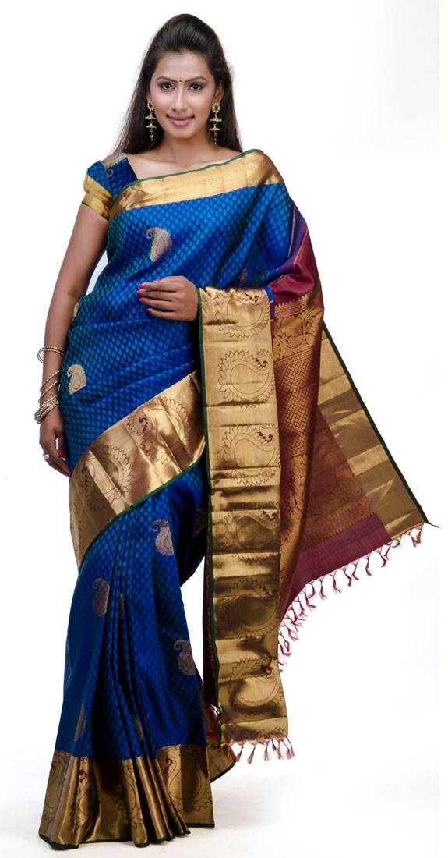
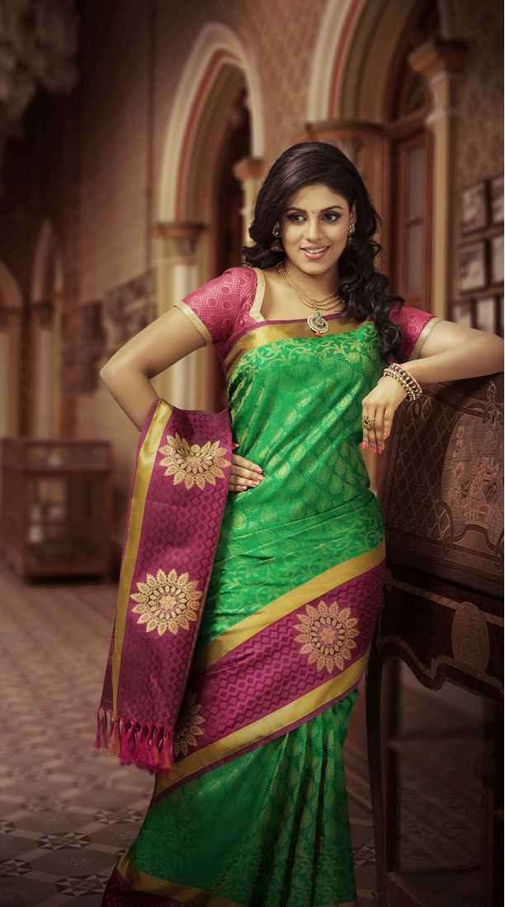

Slide 23
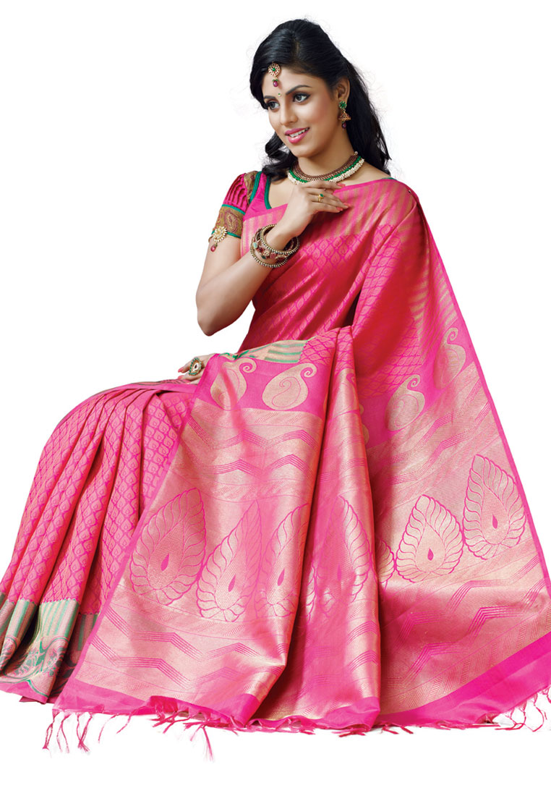

Slide 24
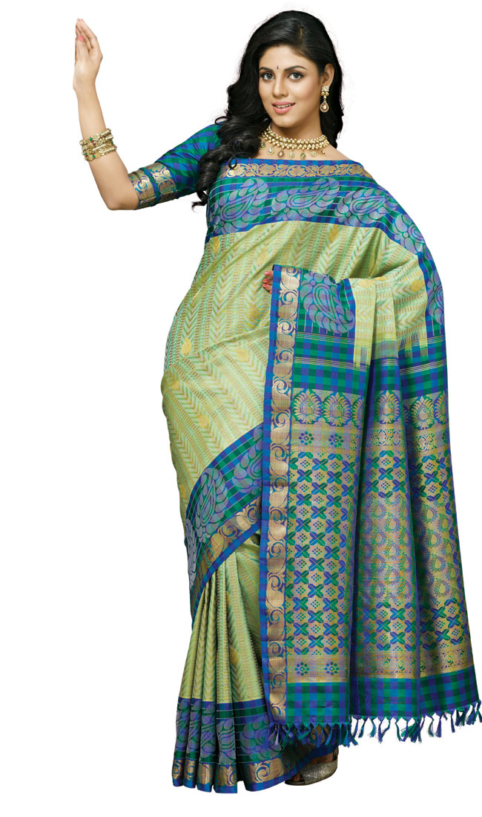
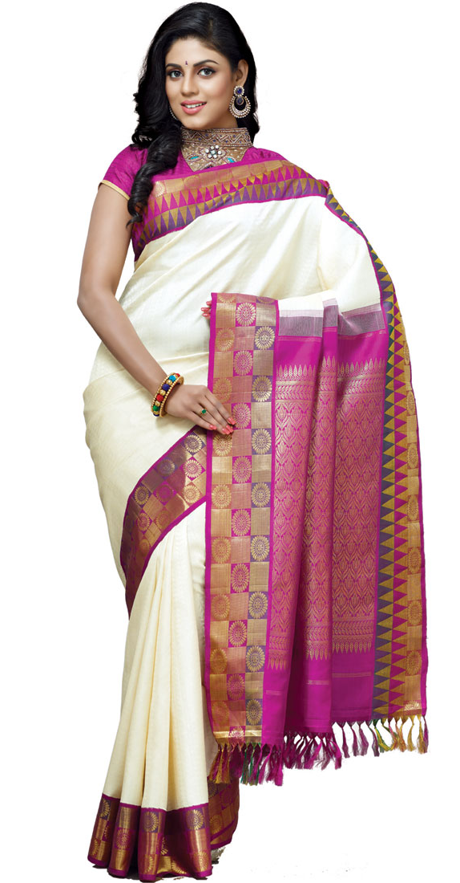

Slide 25
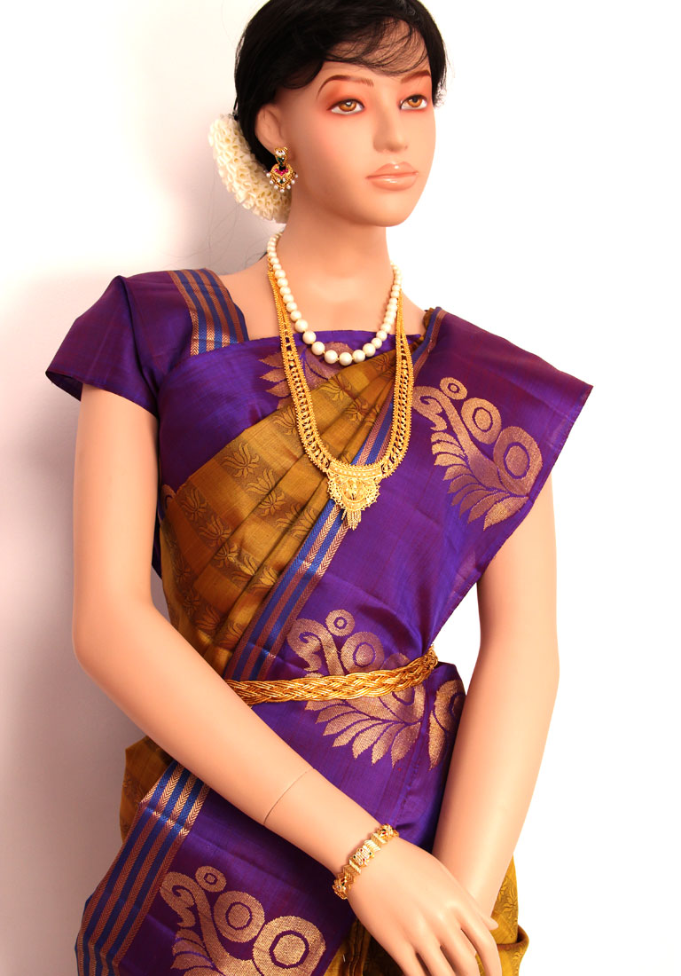

Slide 26
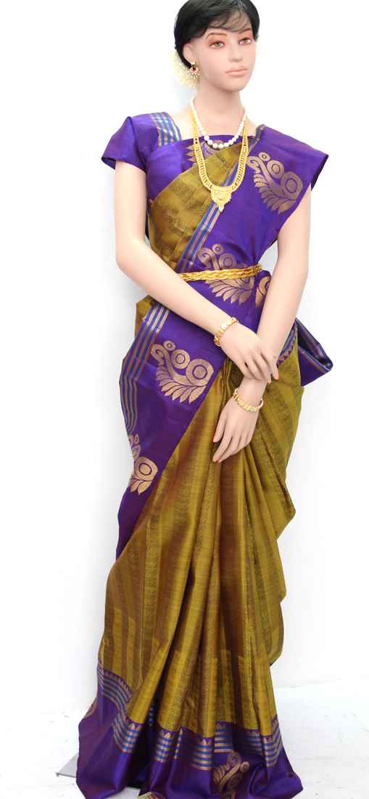
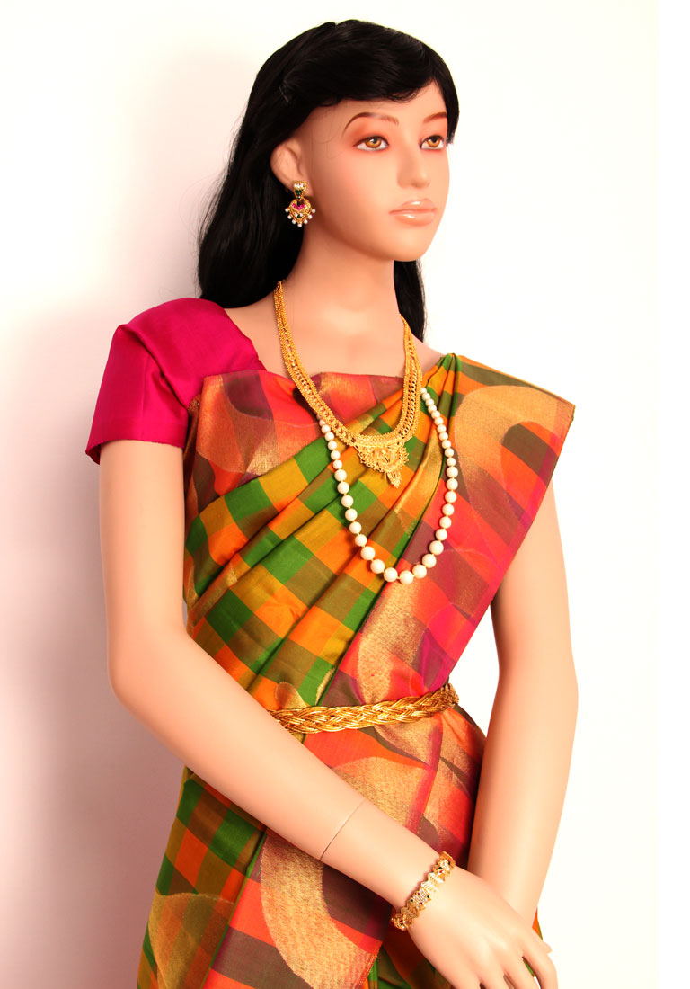

Slide 27
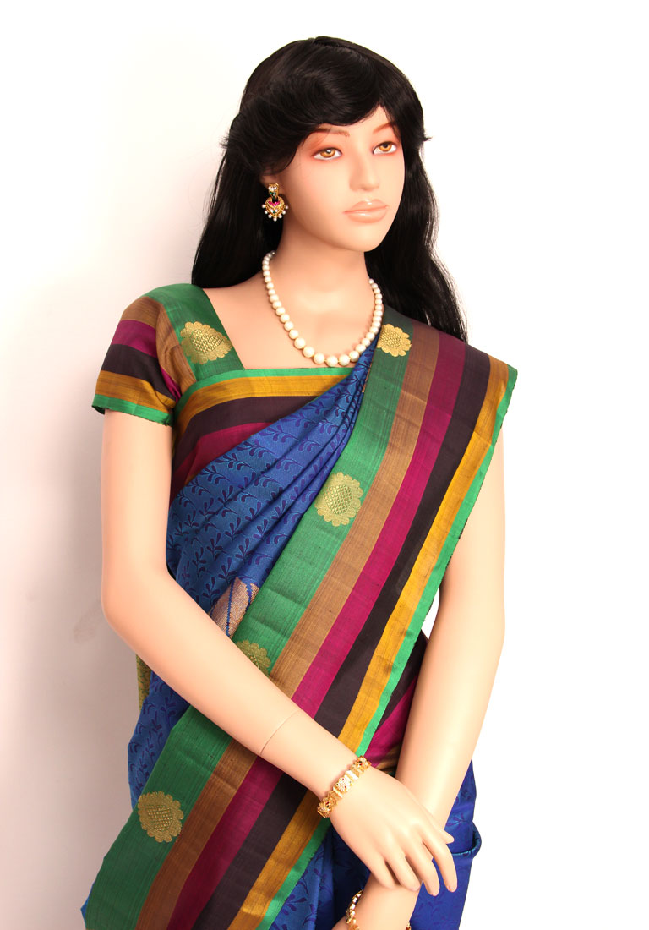
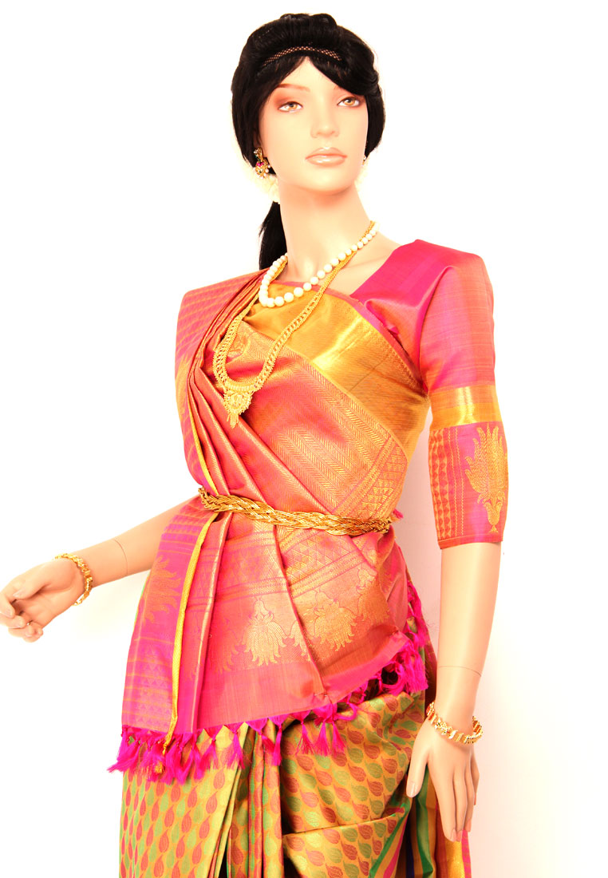

Slide 28
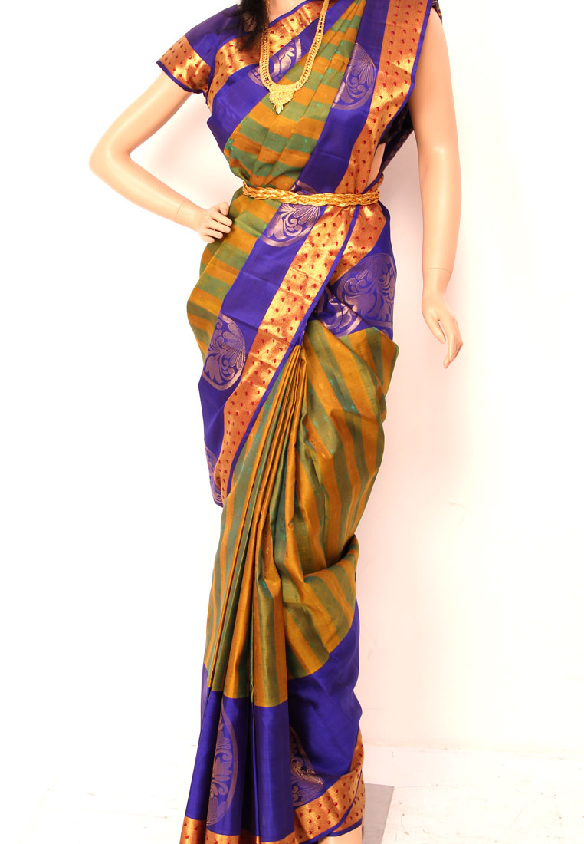
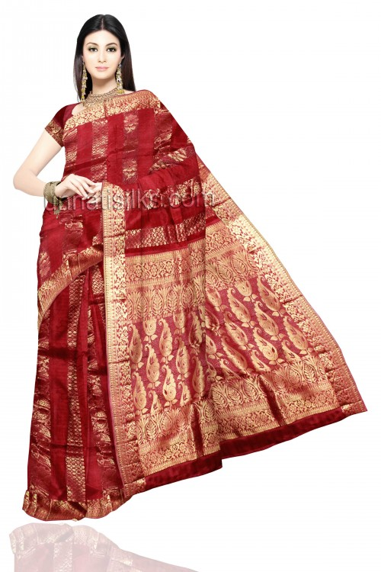

Slide 29
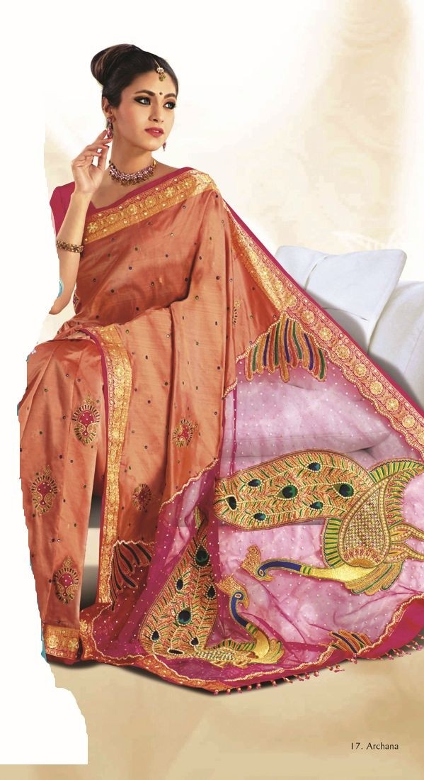
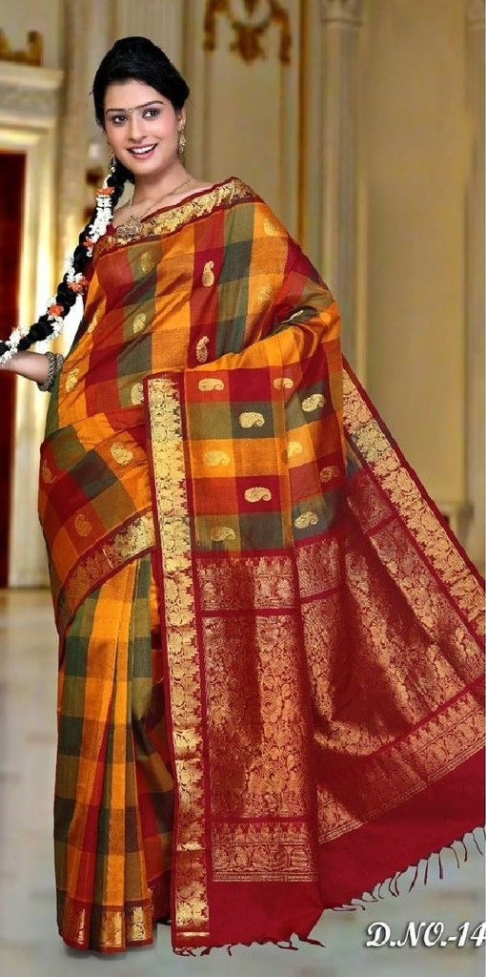

Slide 30
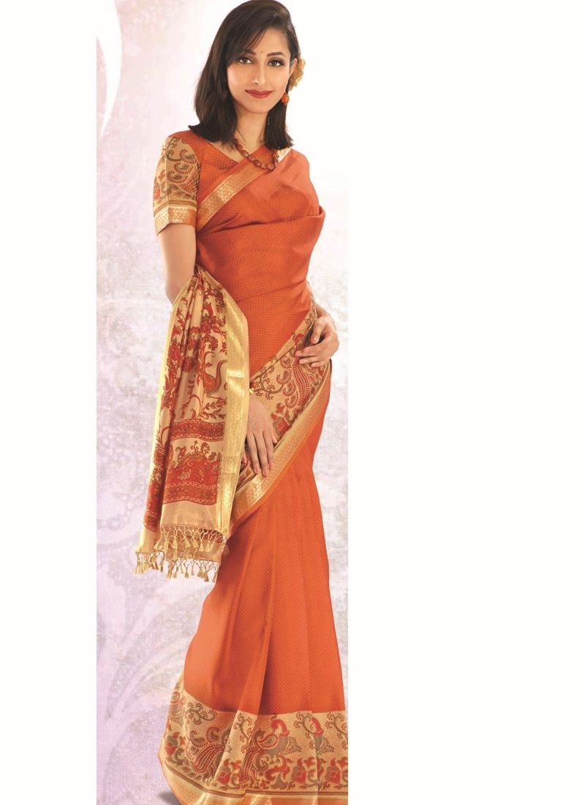


Slide 31
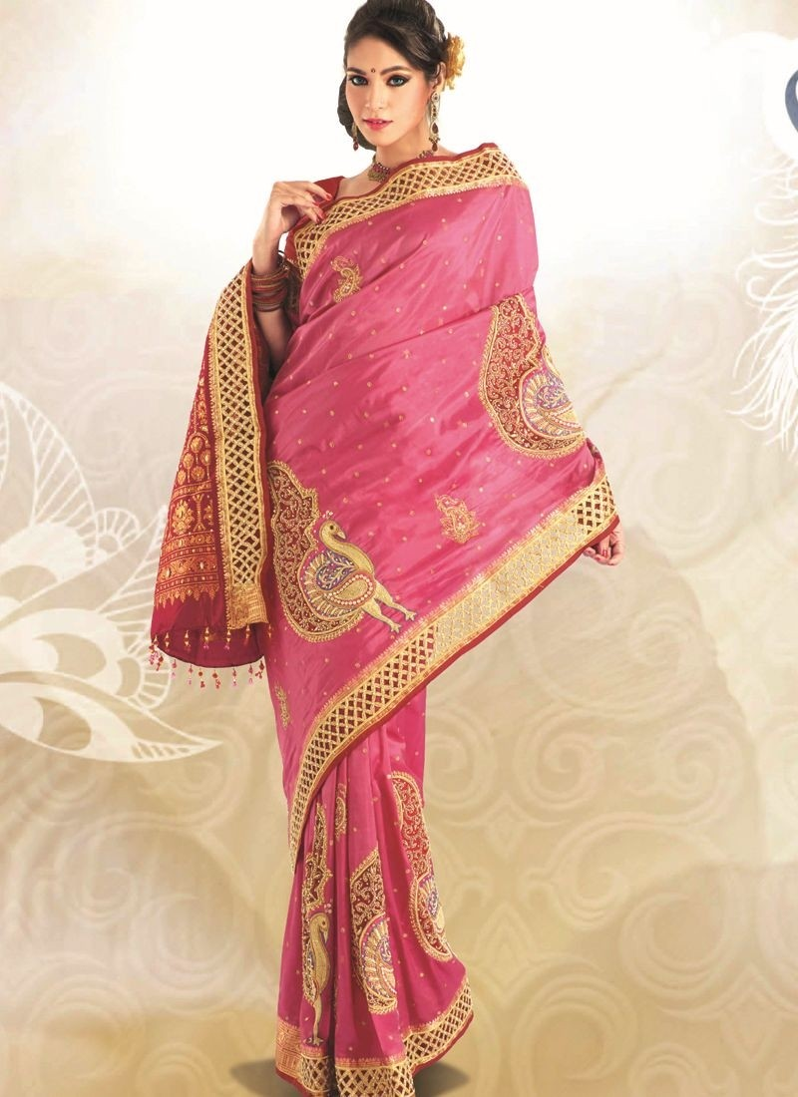
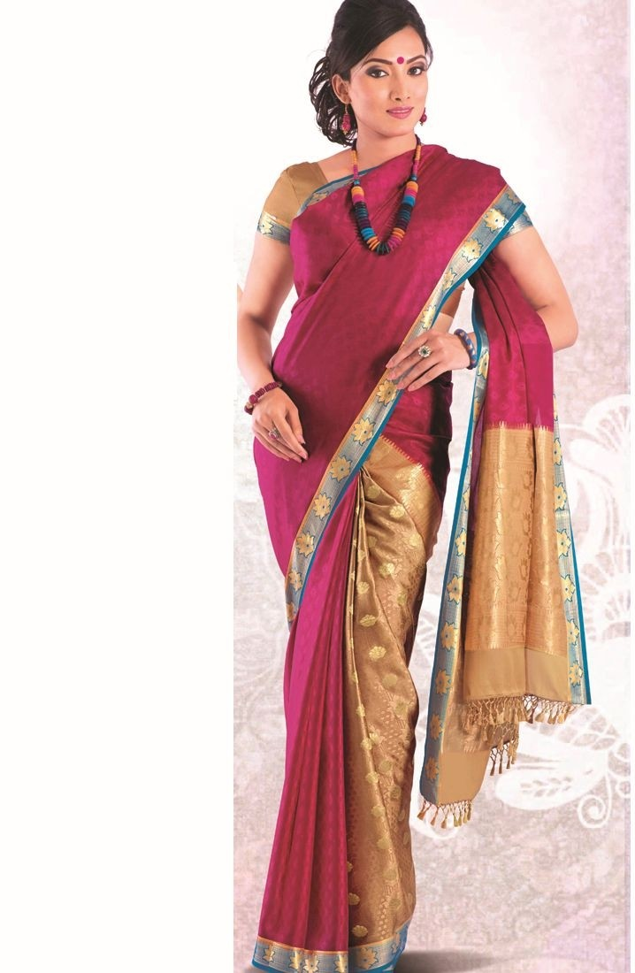

Slide 32
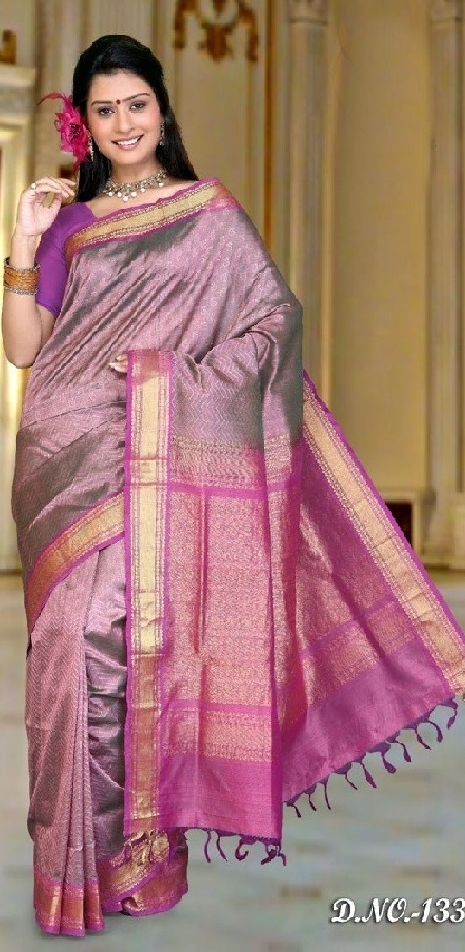
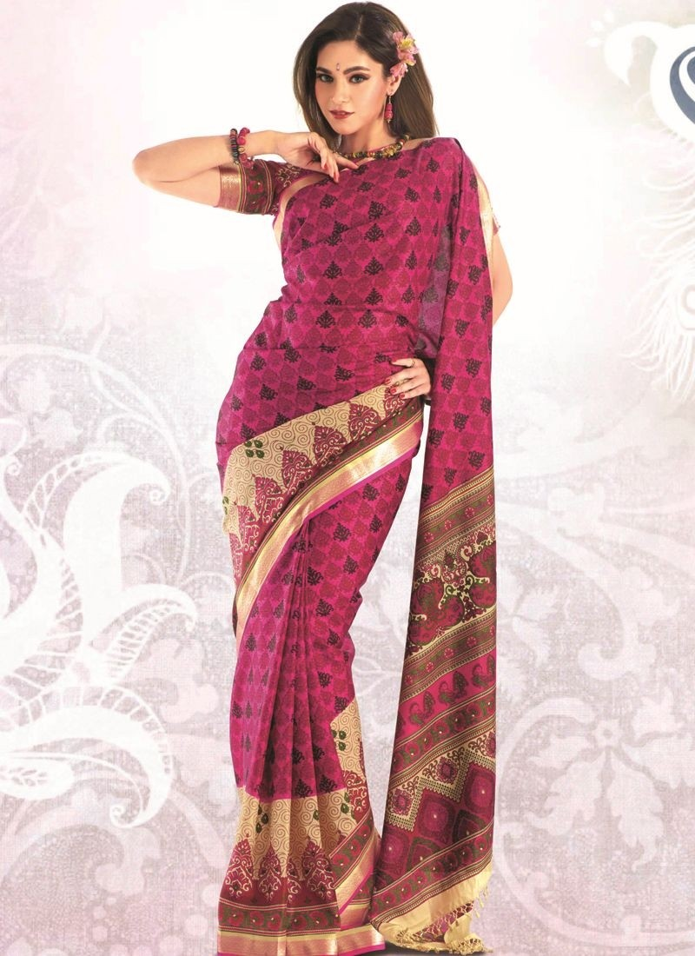

Slide 33


Slide 34


Slide 35


Slide 36



Slide 37



Slide 38



Slide 39



Slide 40



Slide 41



Slide 42



Slide 43



Slide 44


Slide 45



Slide 46



Slide 47



Slide 48



Slide 49



Slide 50



Slide 51



Slide 52


Slide 53



Slide 54


Slide 55


Slide 56


Slide 57



Slide 58


Slide 59



Slide 60



Slide 61



Slide 62



Slide 63



Slide 64



Slide 65



Slide 66


Slide 67



Slide 68



Slide 69



Slide 70



Slide 71


Slide 72



Slide 73



Slide 74



Slide 75



Slide 76



Slide 77



Slide 78



Slide 79



Slide 80


Slide 81




Slide 82



Slide 83



Slide 84


Slide 85



Slide 86


Slide 87



Slide 88


Slide 89


Slide 90



Slide 91


Slide 92



Slide 93



Slide 94


Slide 95



Slide 96


Slide 97


Slide 98


Slide 99



Slide 100



Slide 101



