Slide 1
Kanchipuram silk sarees
Part One

Slide 2
Kanchipuram
Editor’s note
Kanchipuram silk sarees are truly the jewels of the South where silk weaving is as ancient as the country itself. The variety and colors dazzle the eyes and cater to every desire of a beautiful woman in making herself more alluring.
It is famous all over the world for it’s workmanship and design just like the silk sarees of Benares. It is presented here for your visual pleasure.
AKC/November 2015

Slide 3
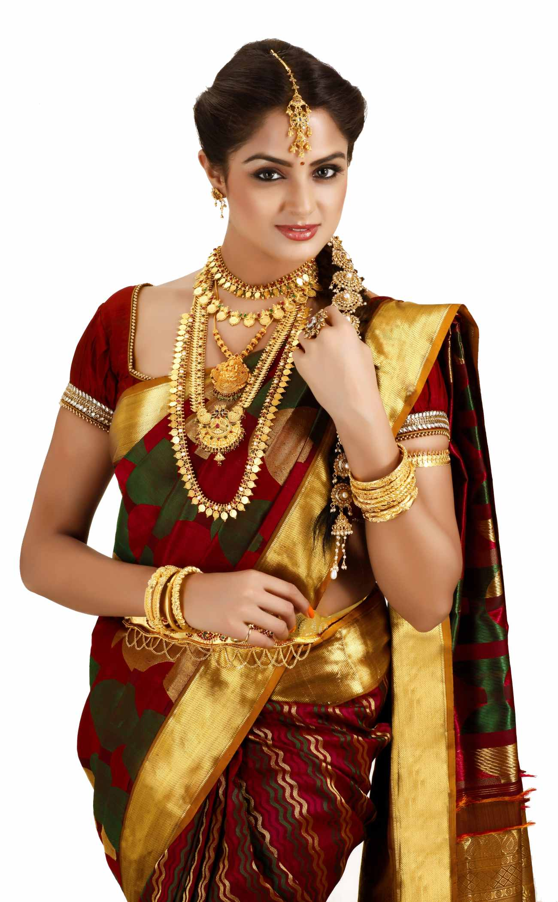

Slide 4
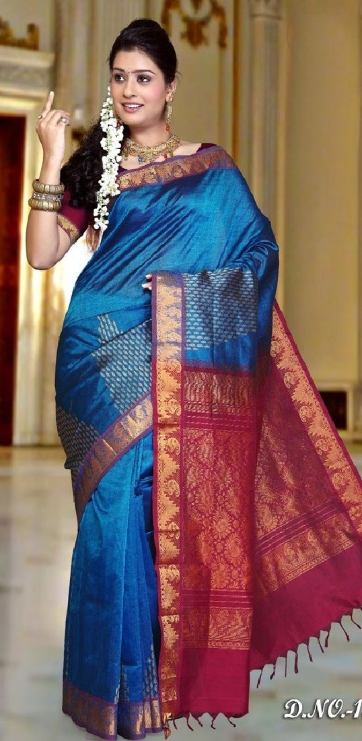
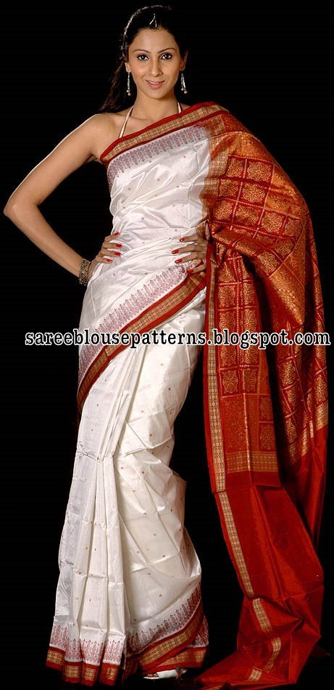
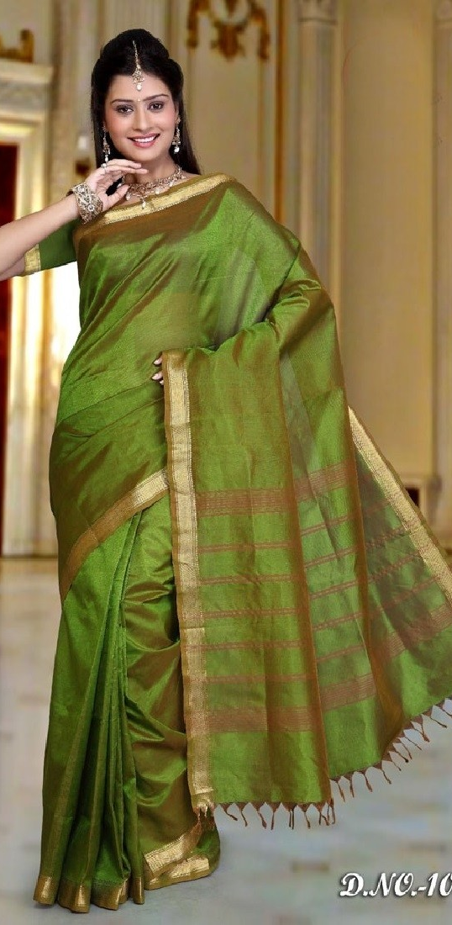

Slide 5
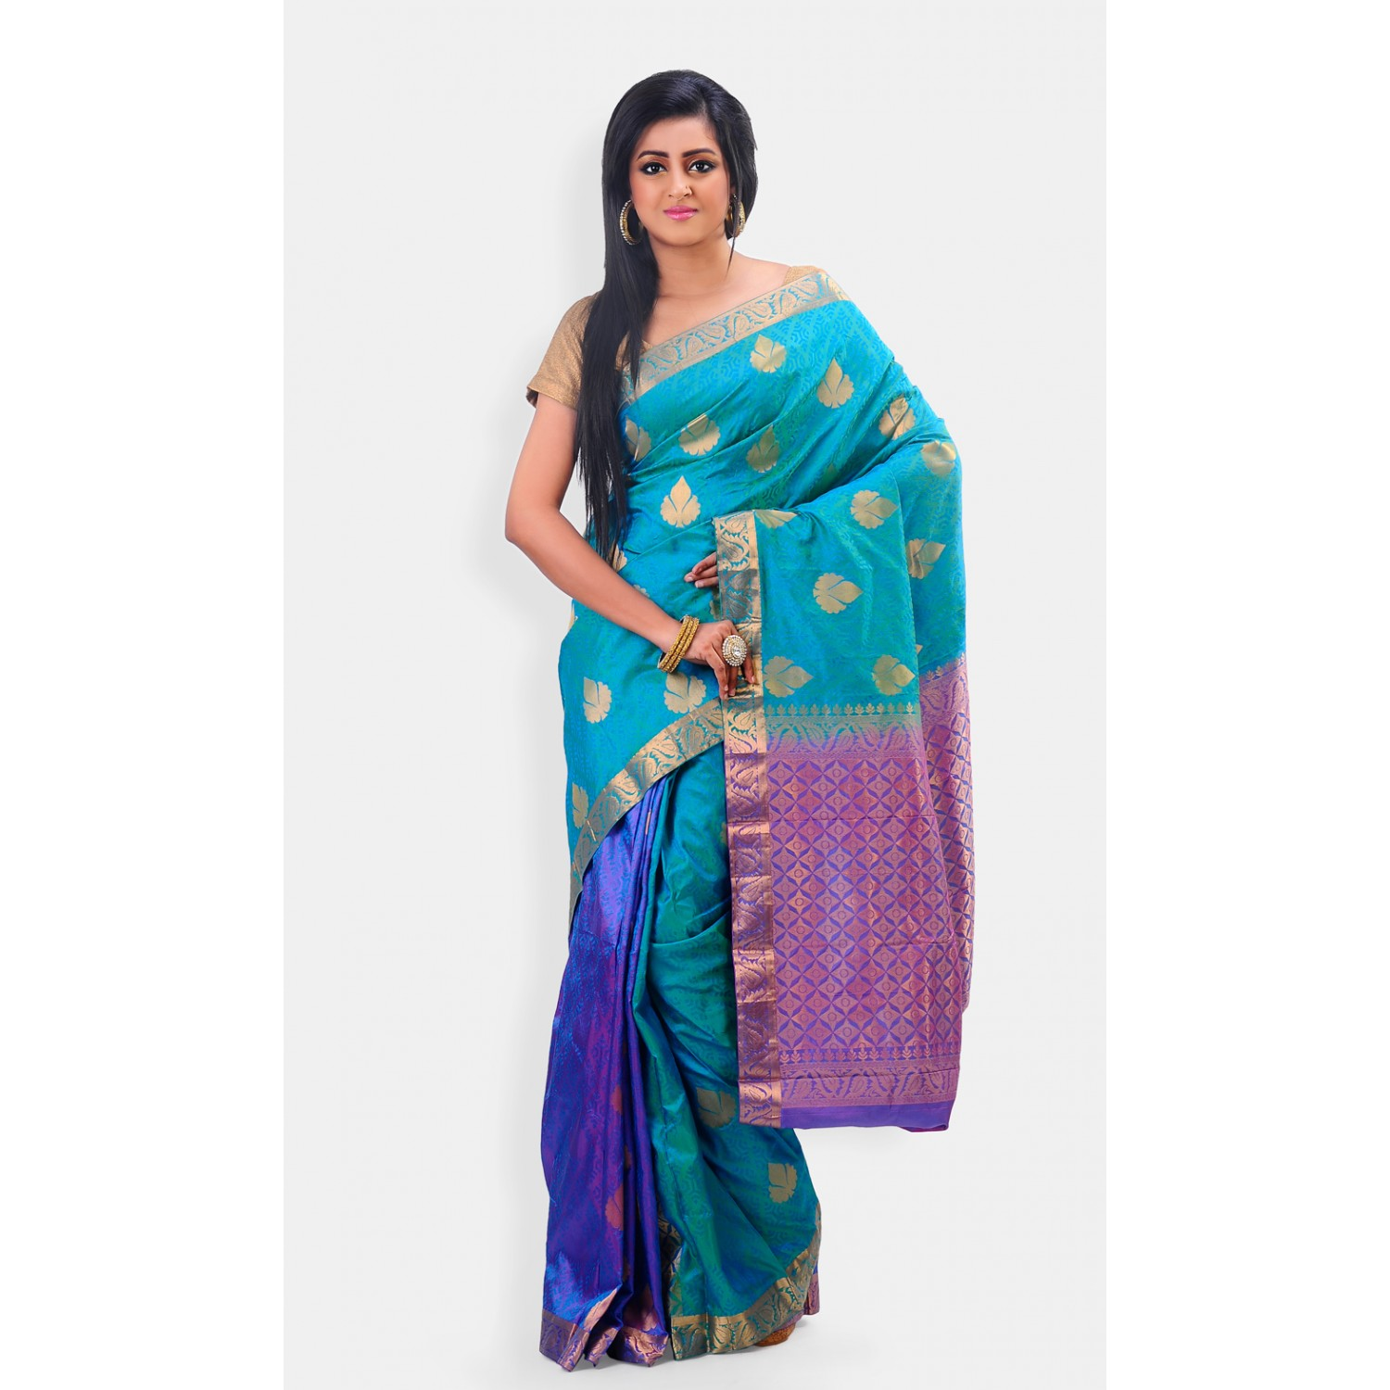

Slide 6
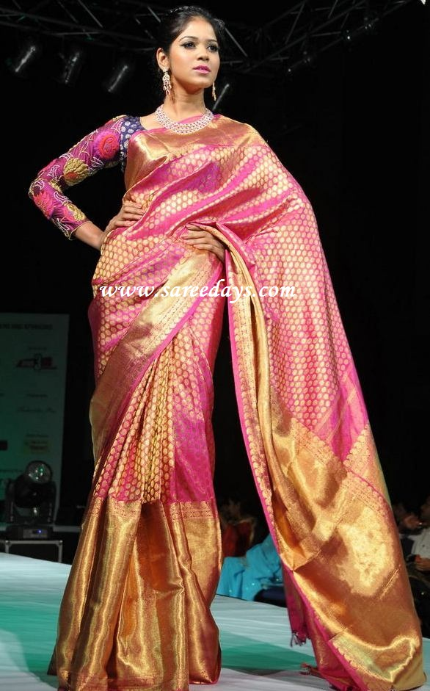
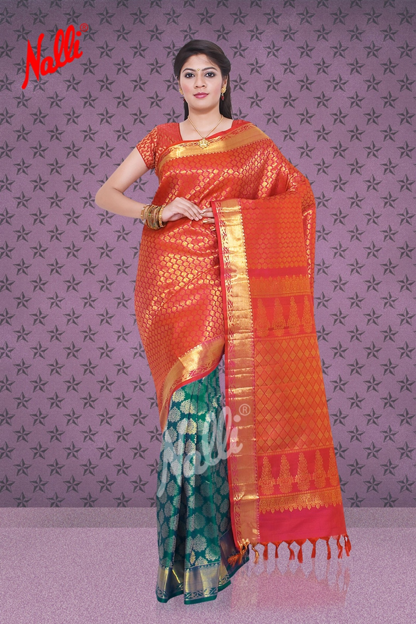

Slide 7


Slide 8
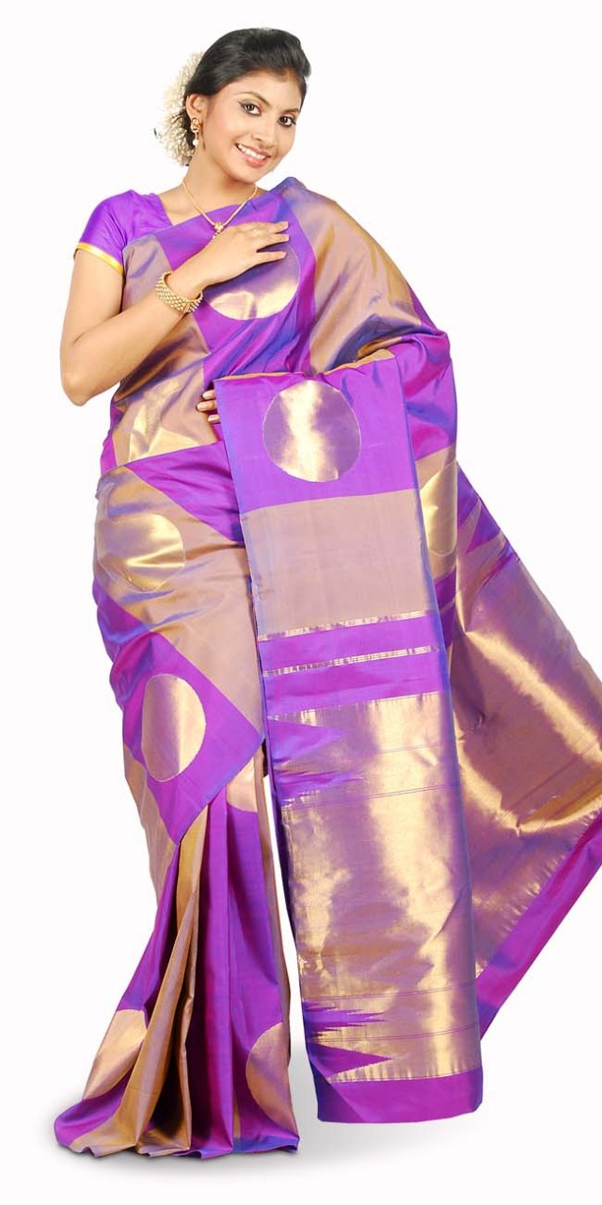
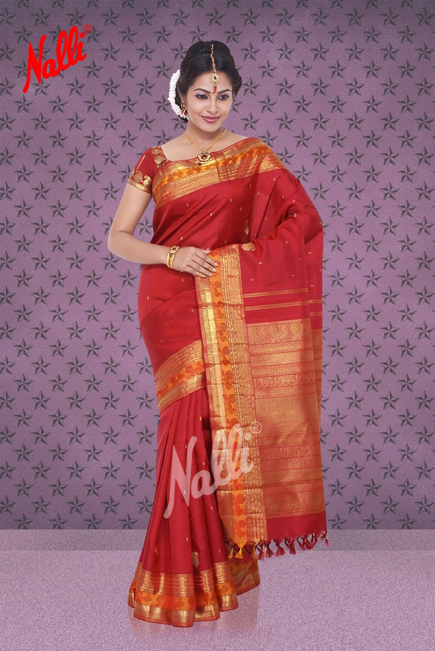

Slide 9
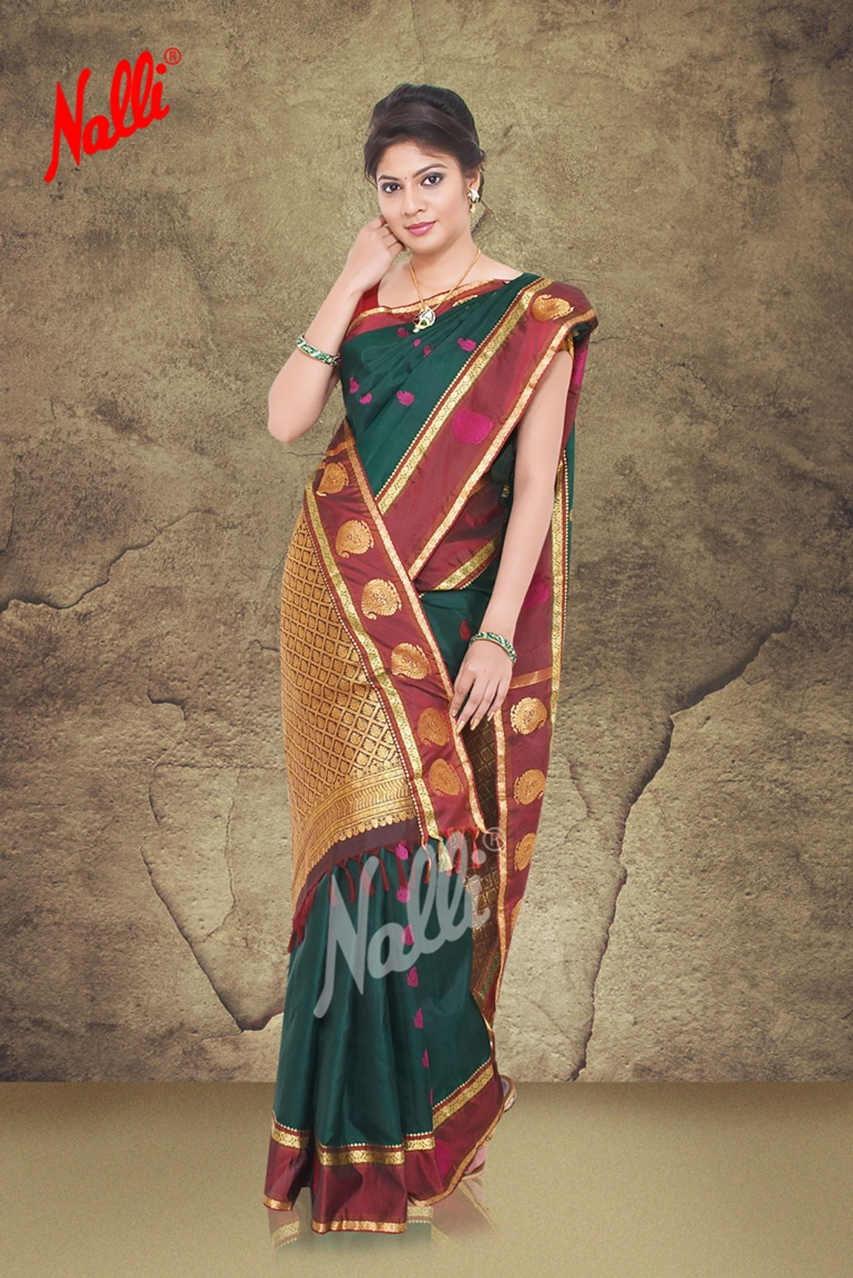
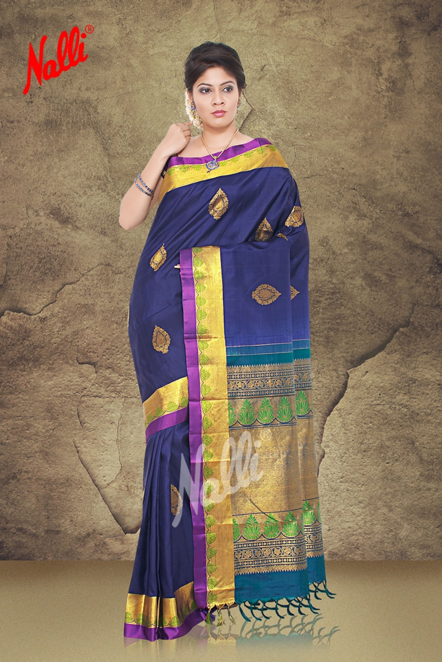

Slide 10
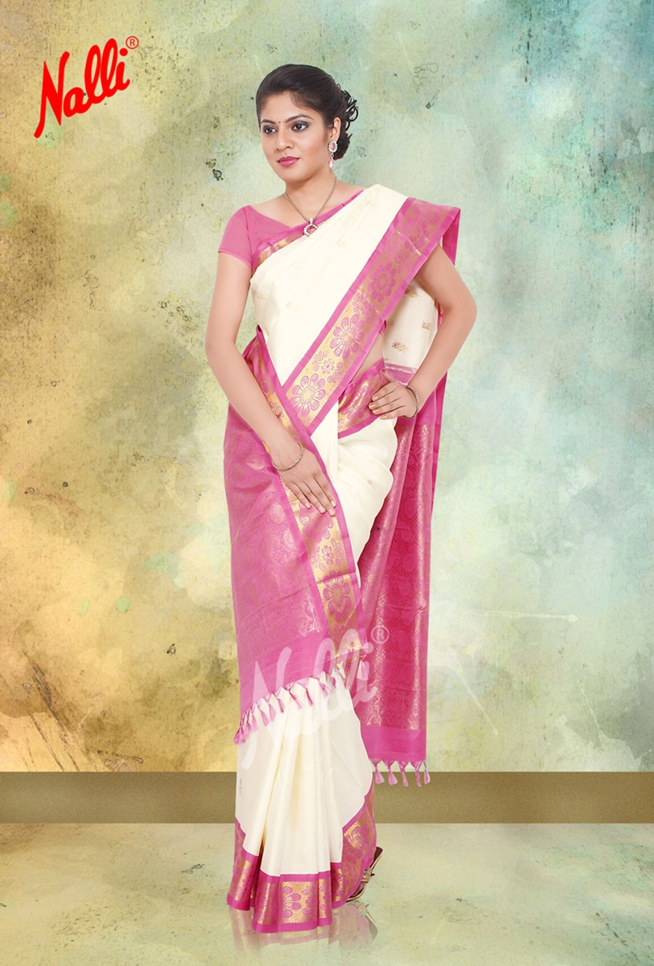
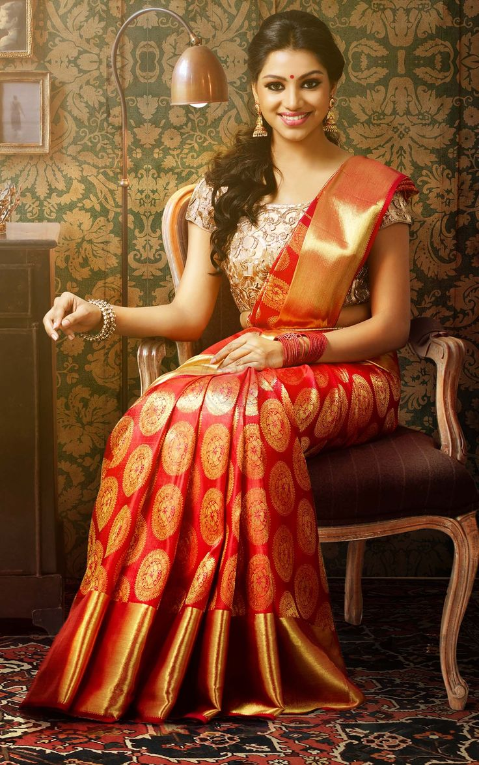

Slide 11
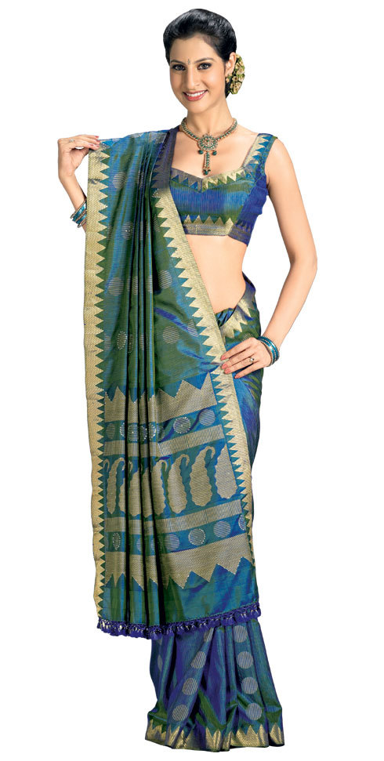
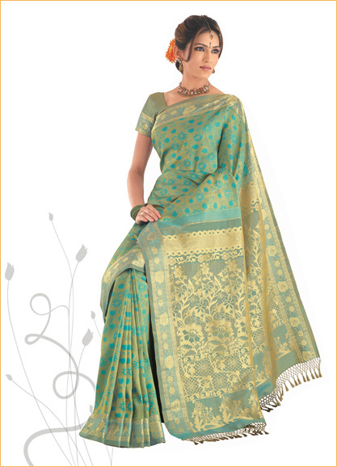

Slide 12
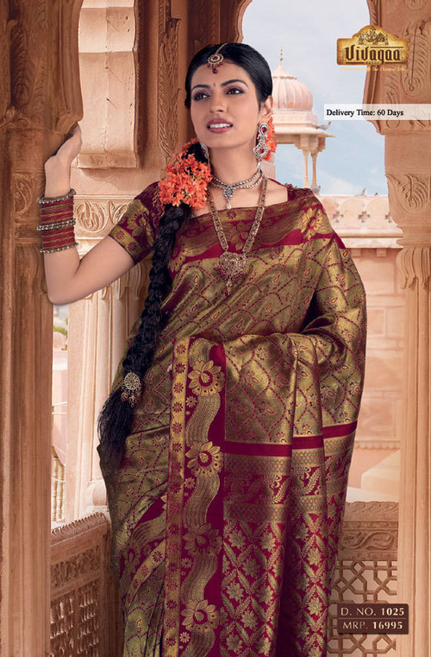

Slide 13
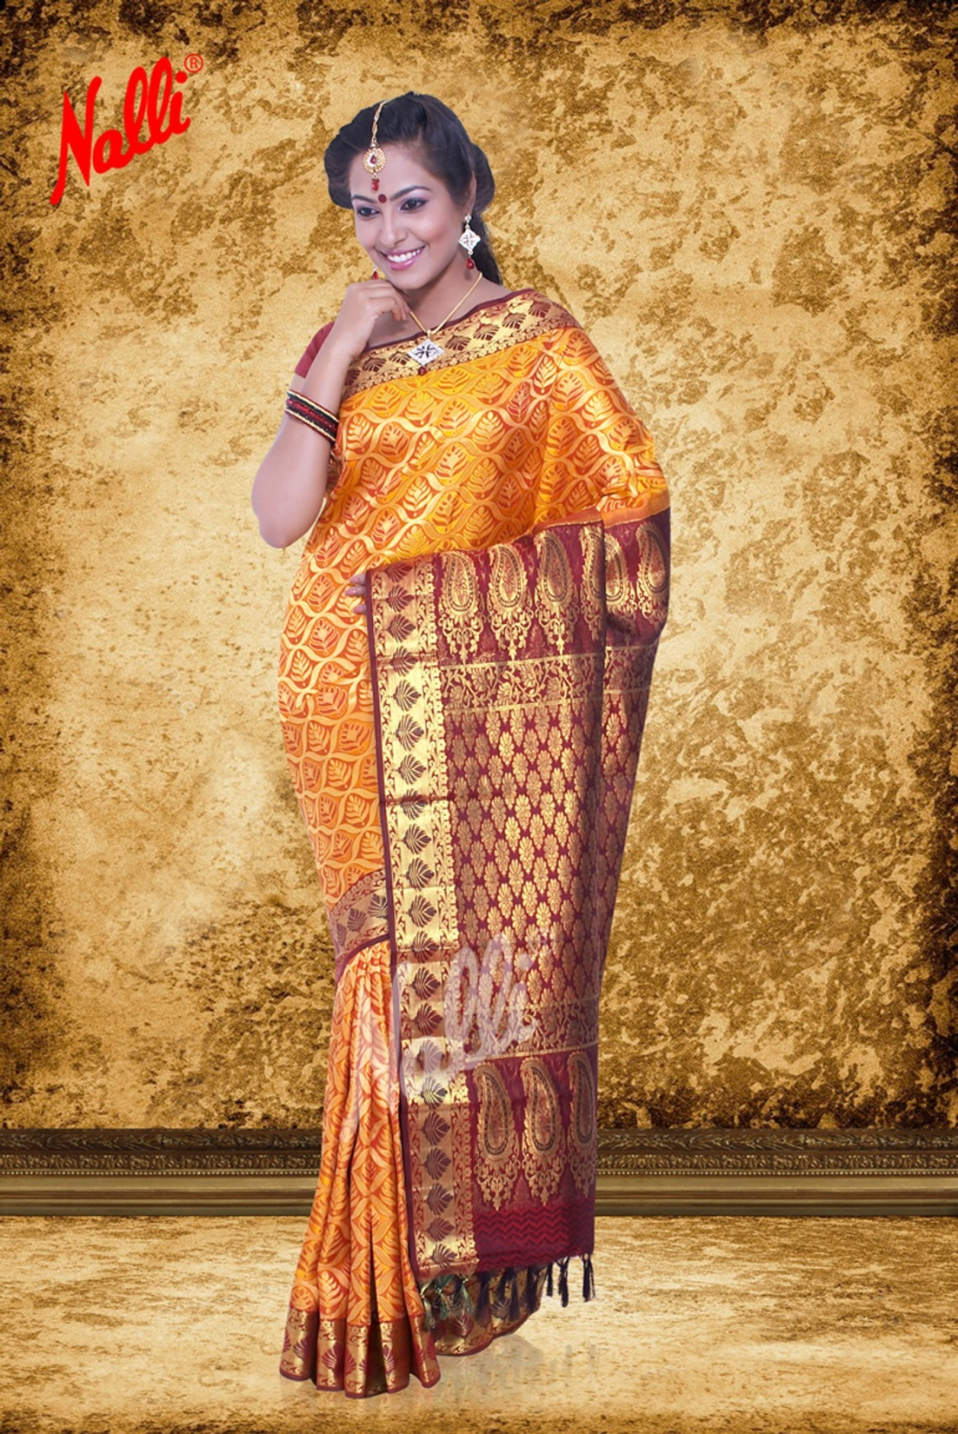
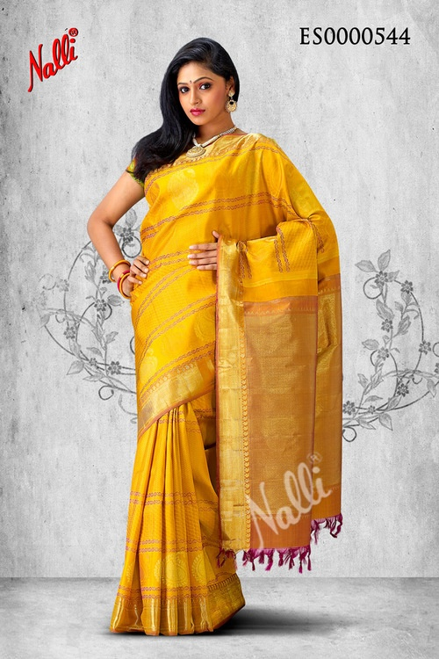

Slide 14
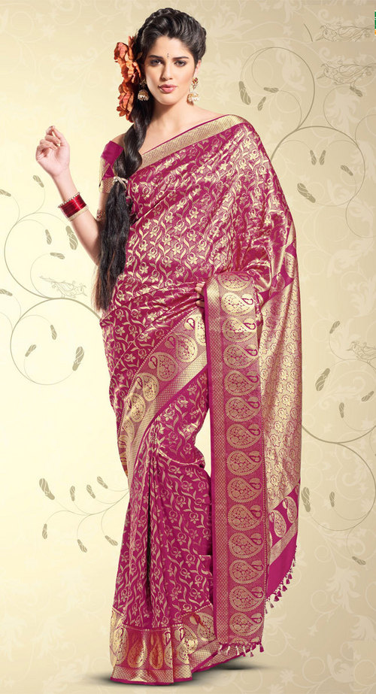
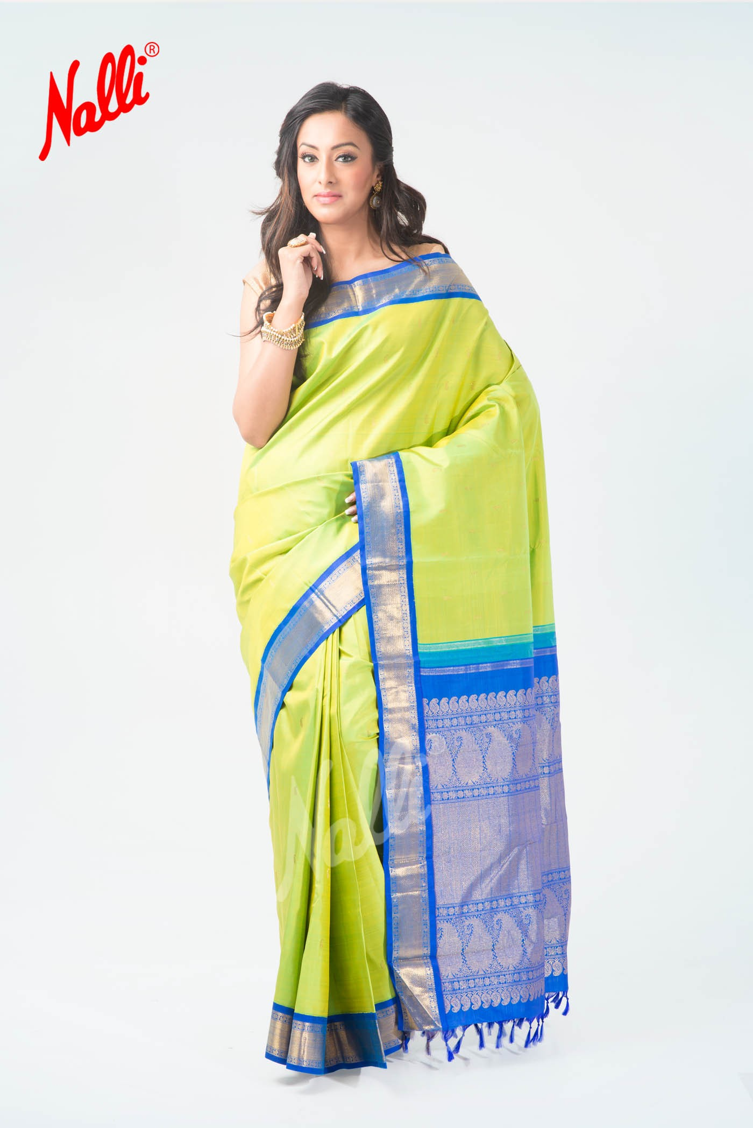

Slide 15
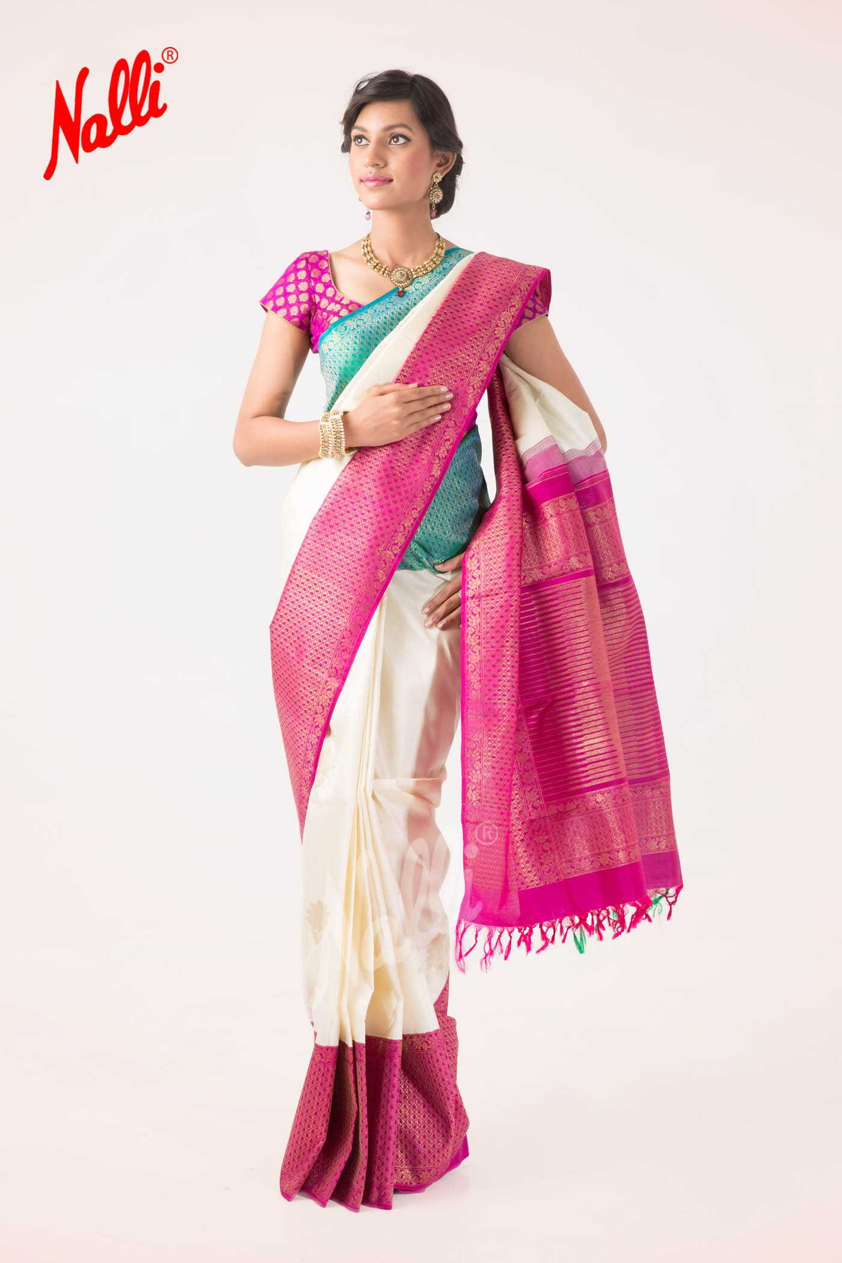
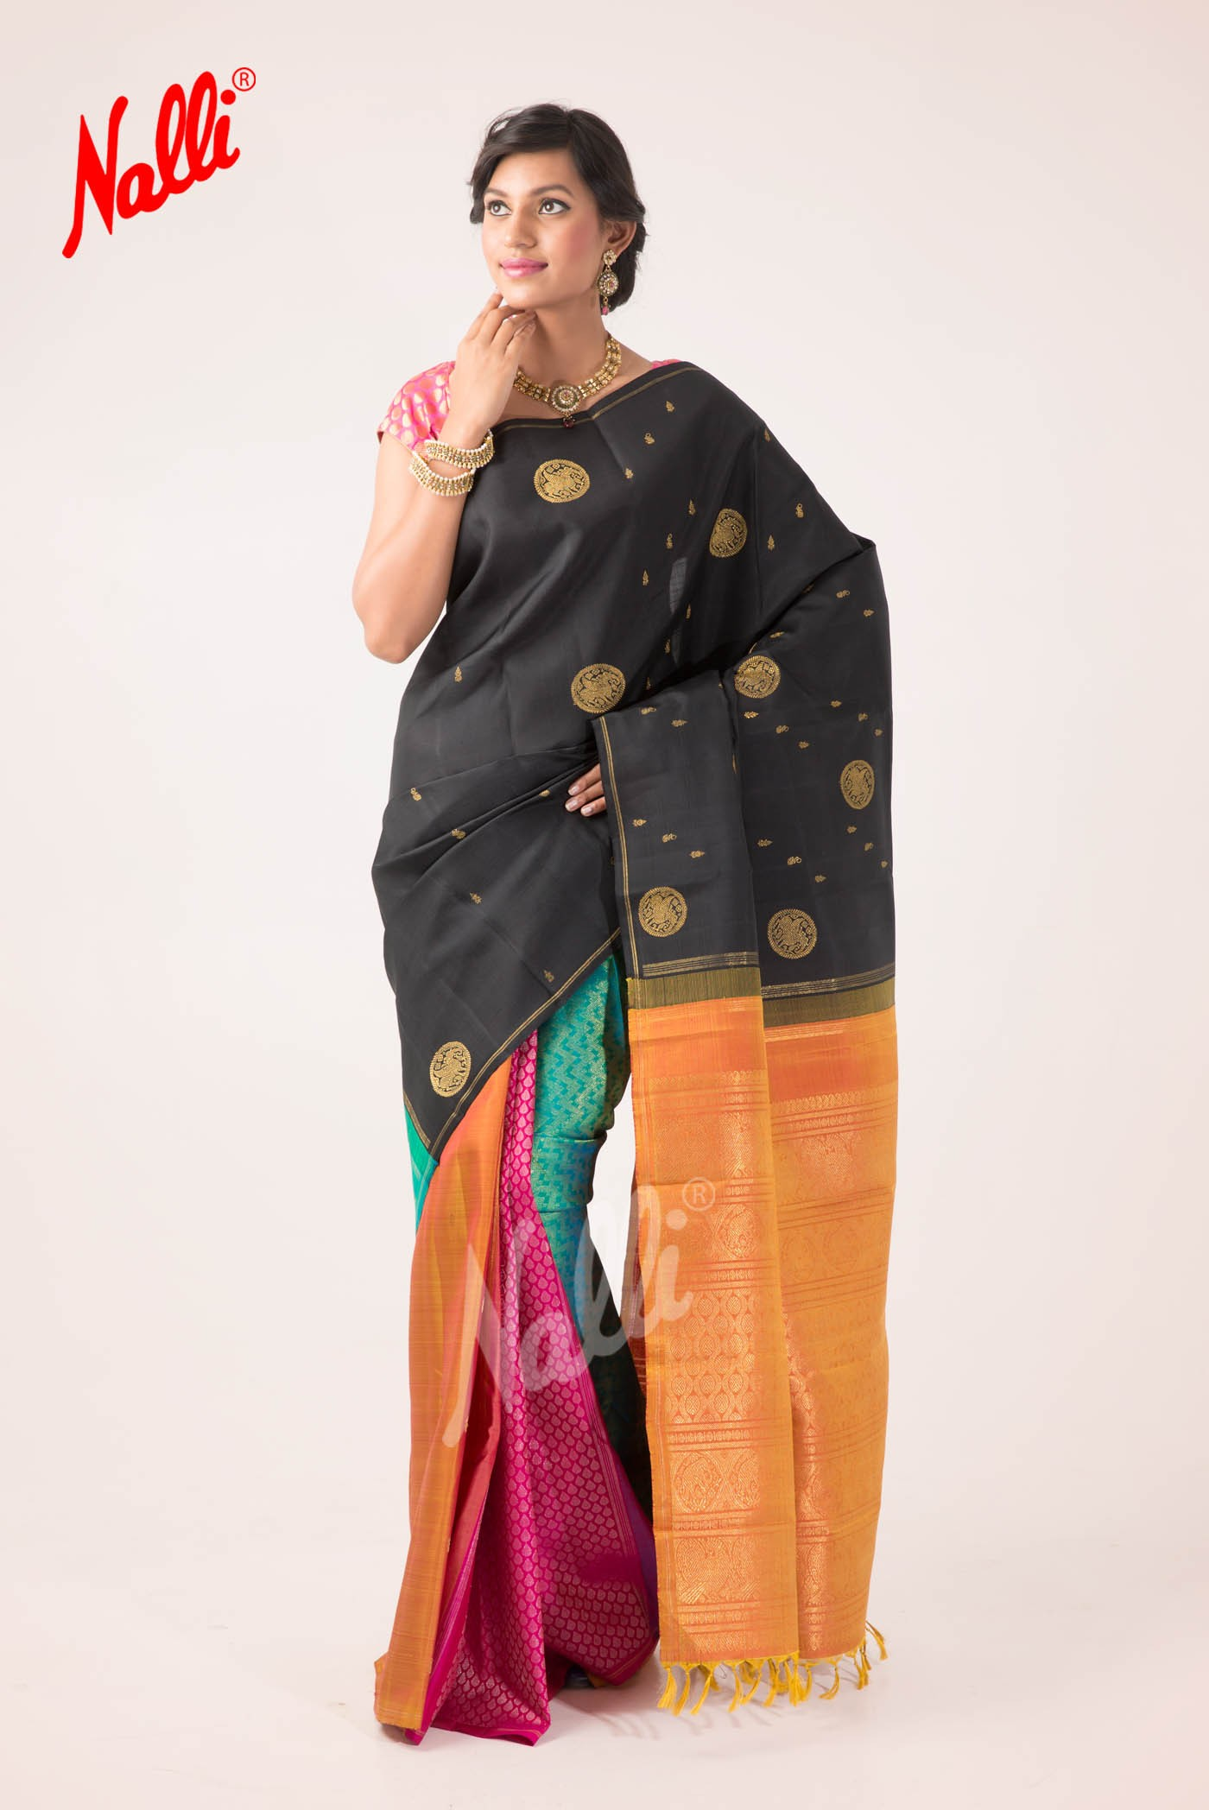

Slide 16
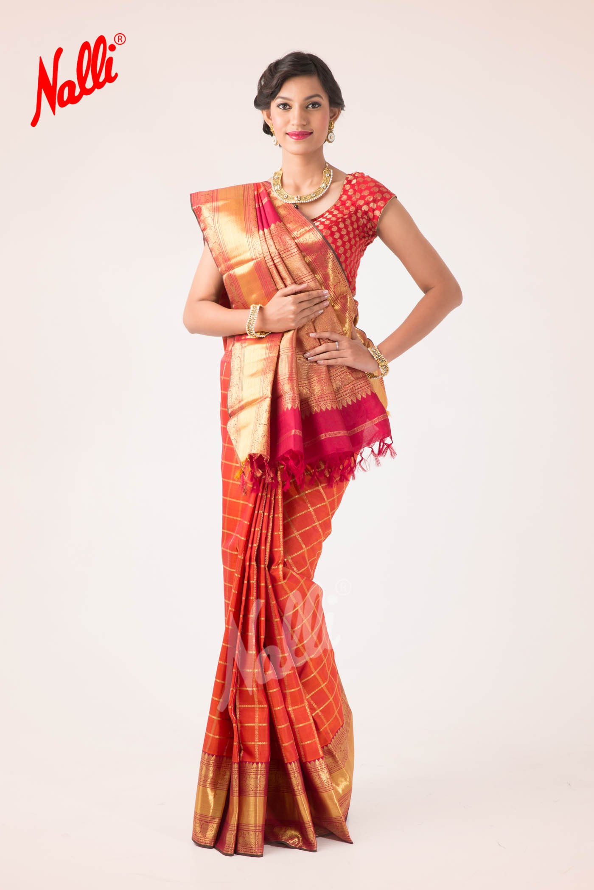
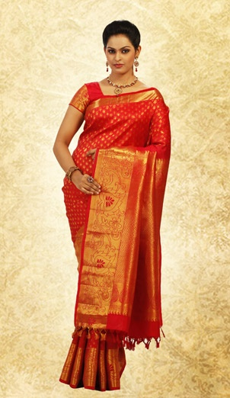

Slide 17
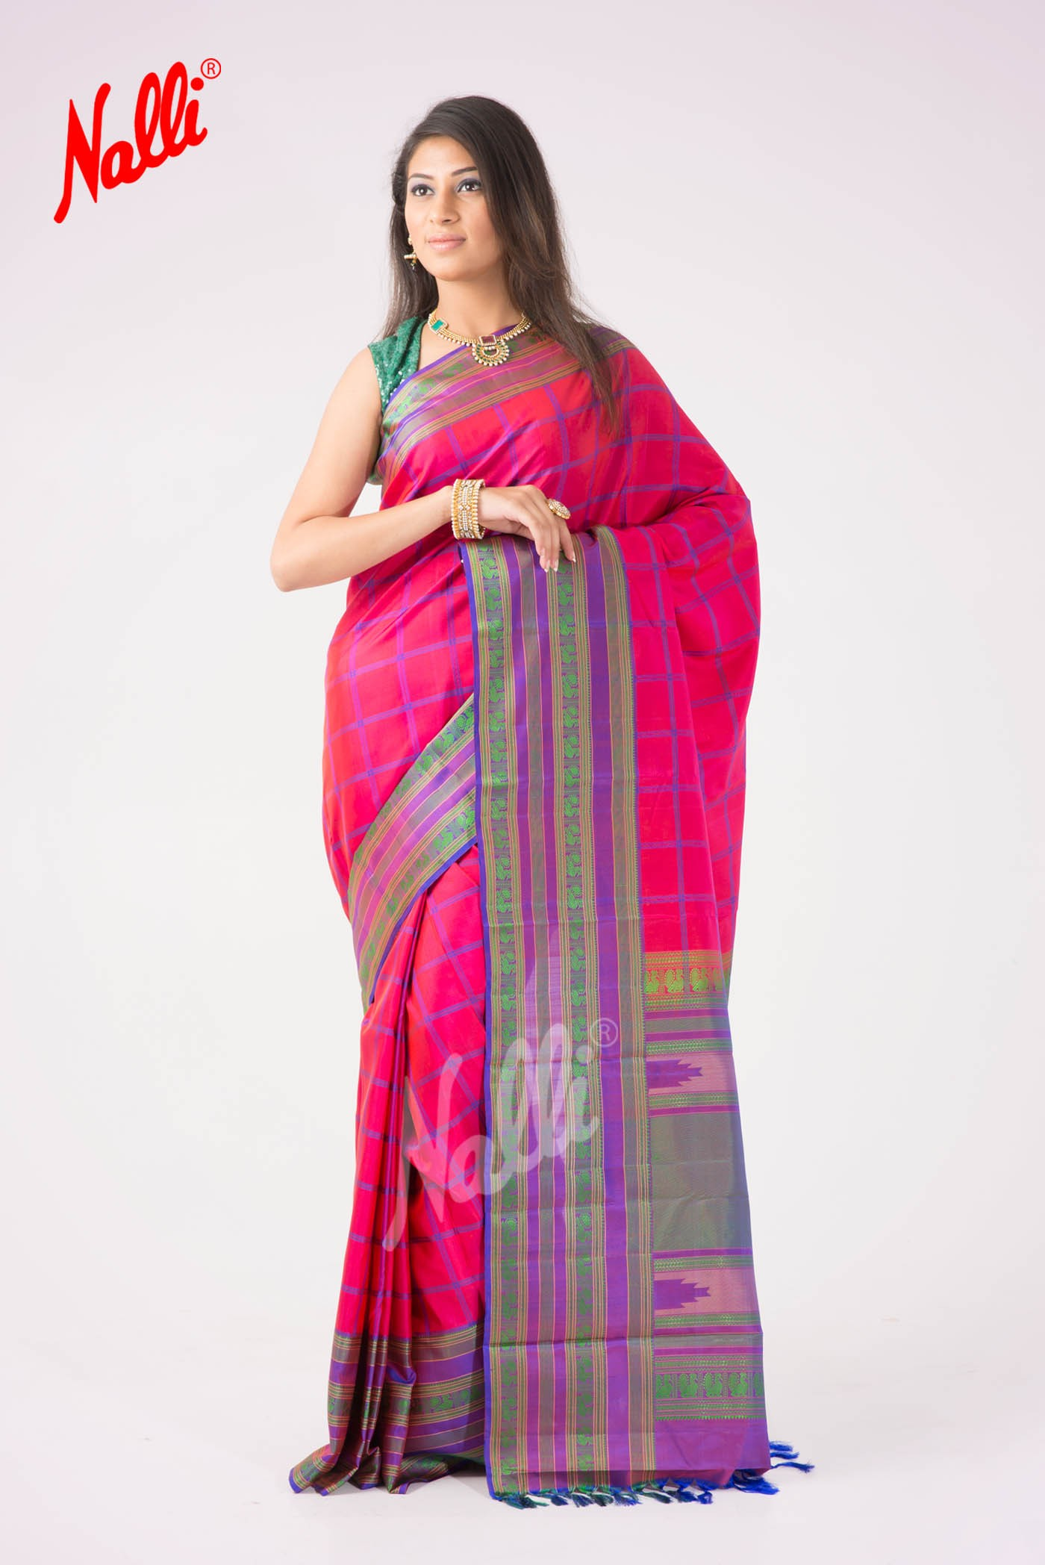
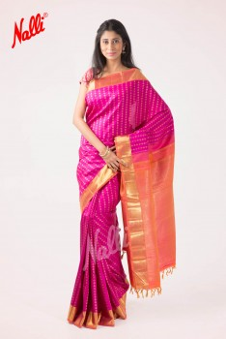

Slide 18
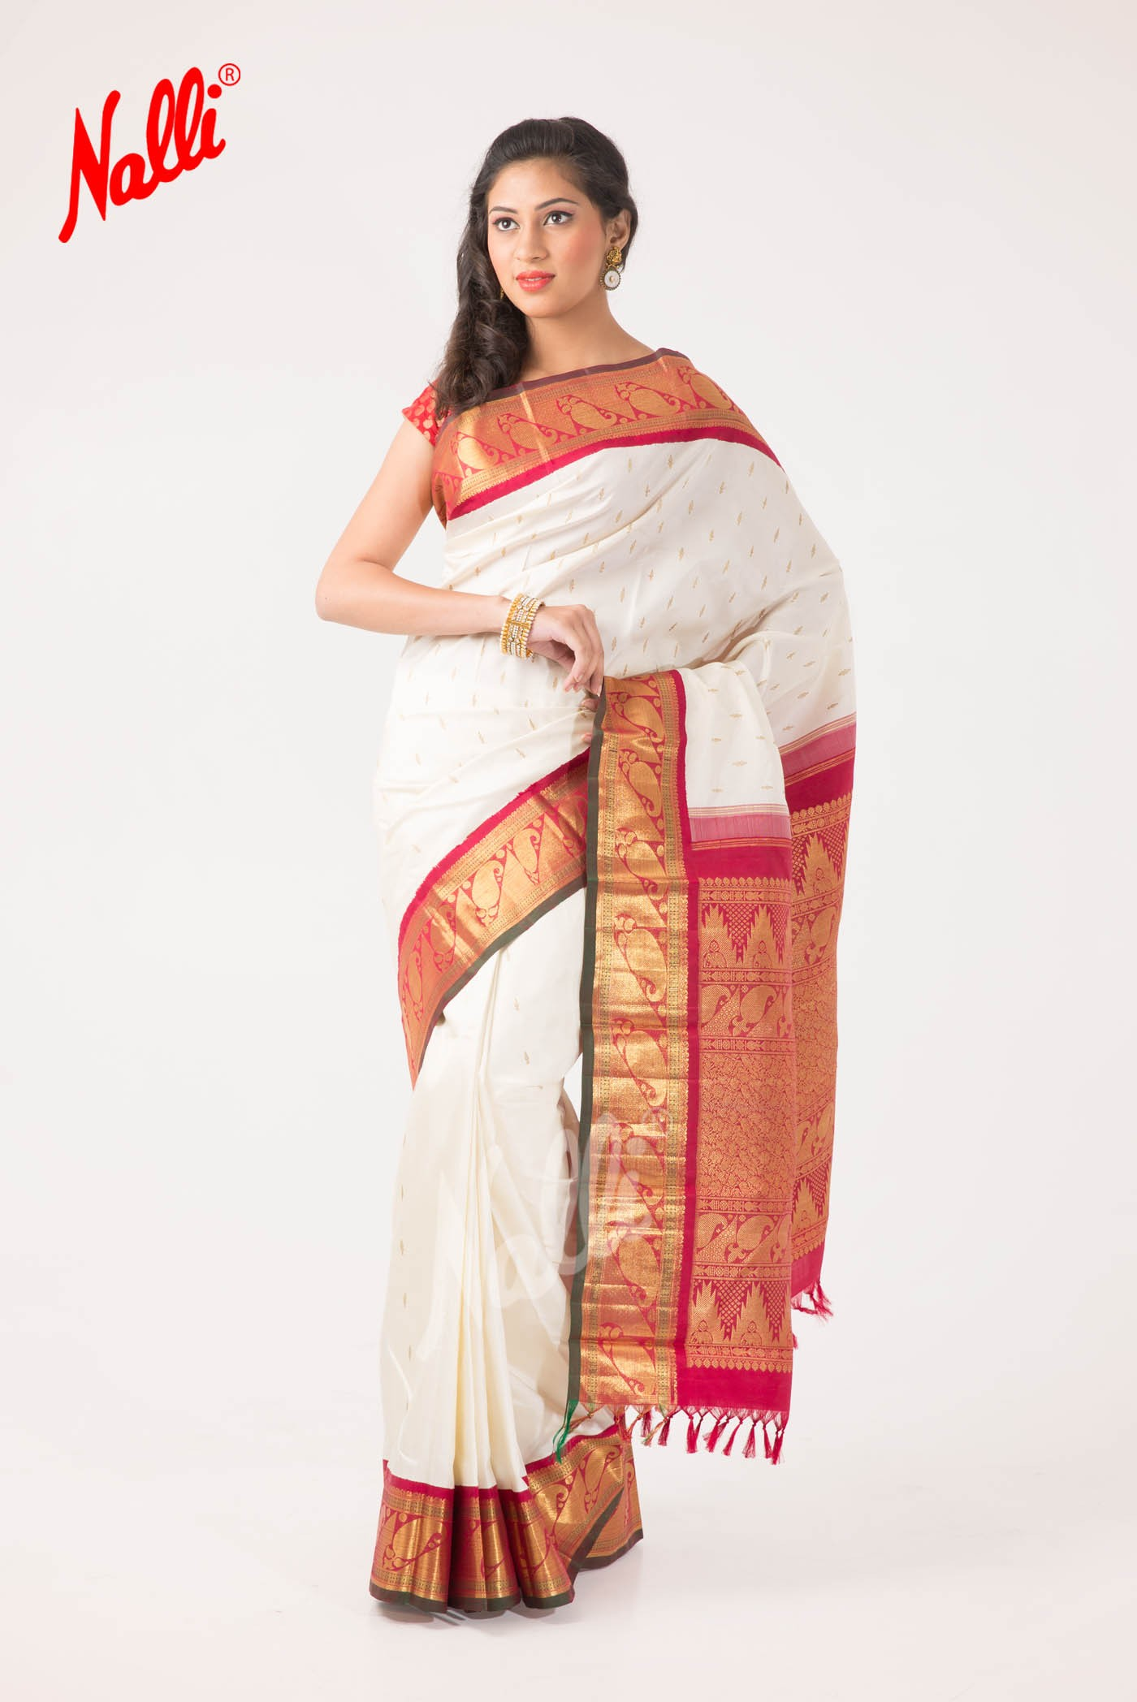
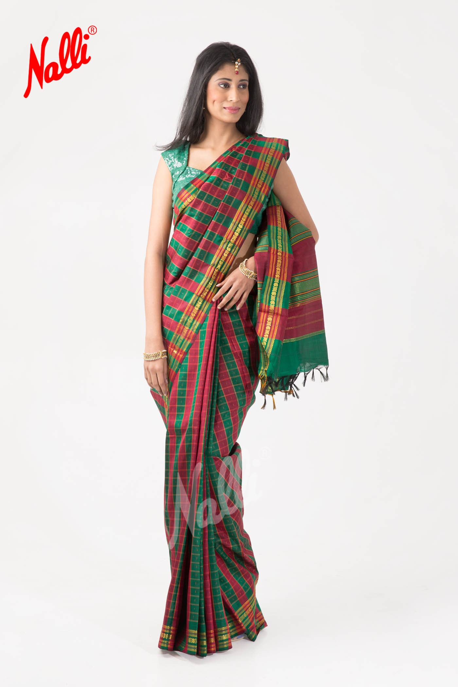

Slide 19
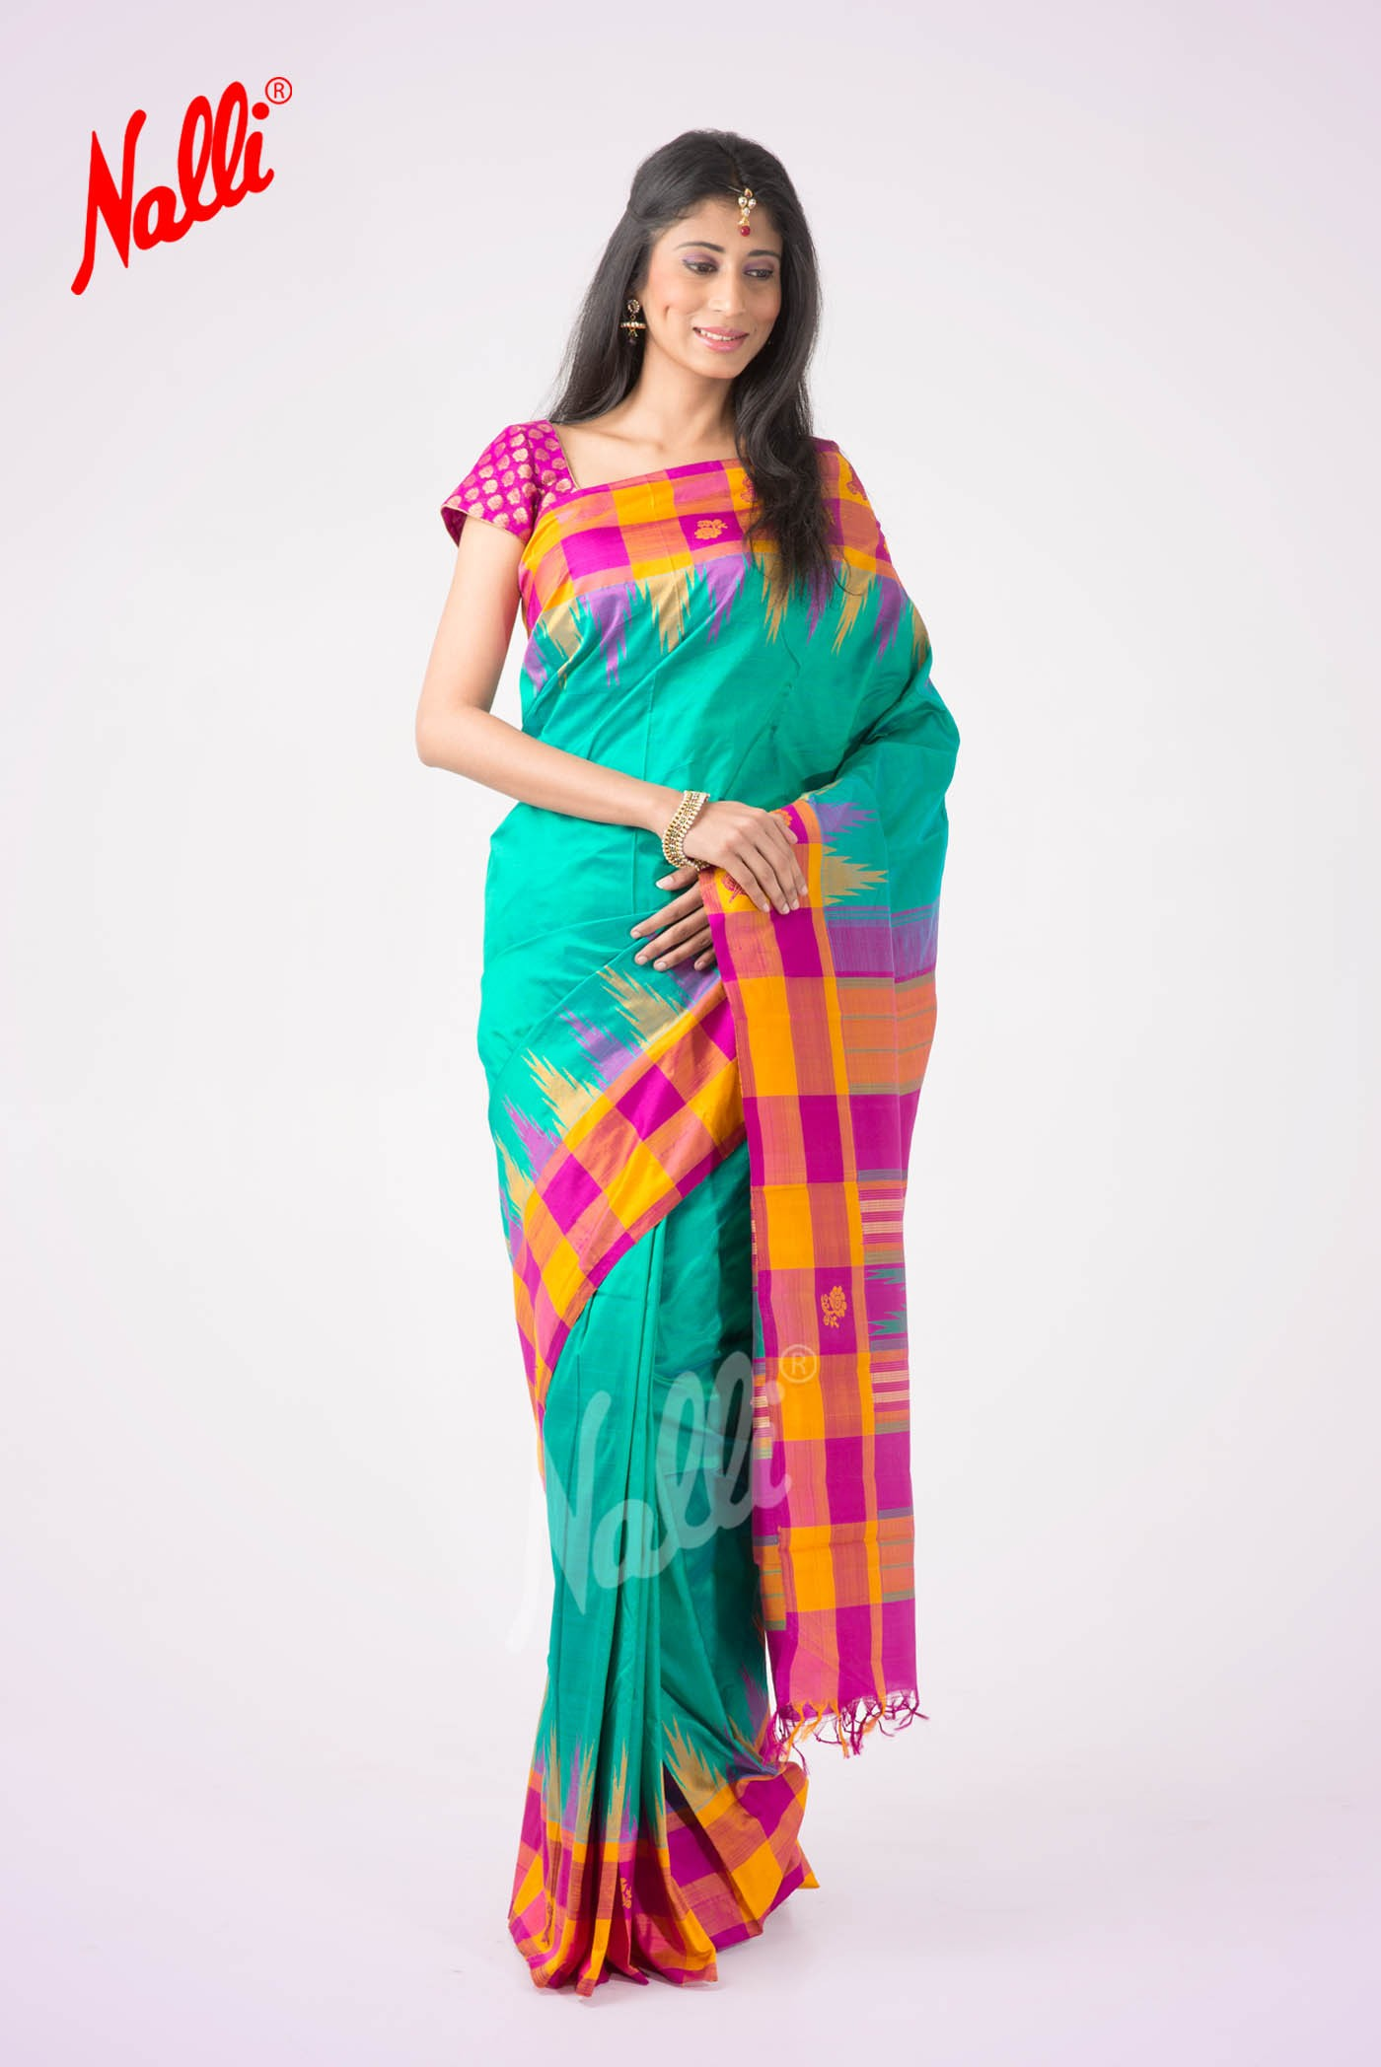
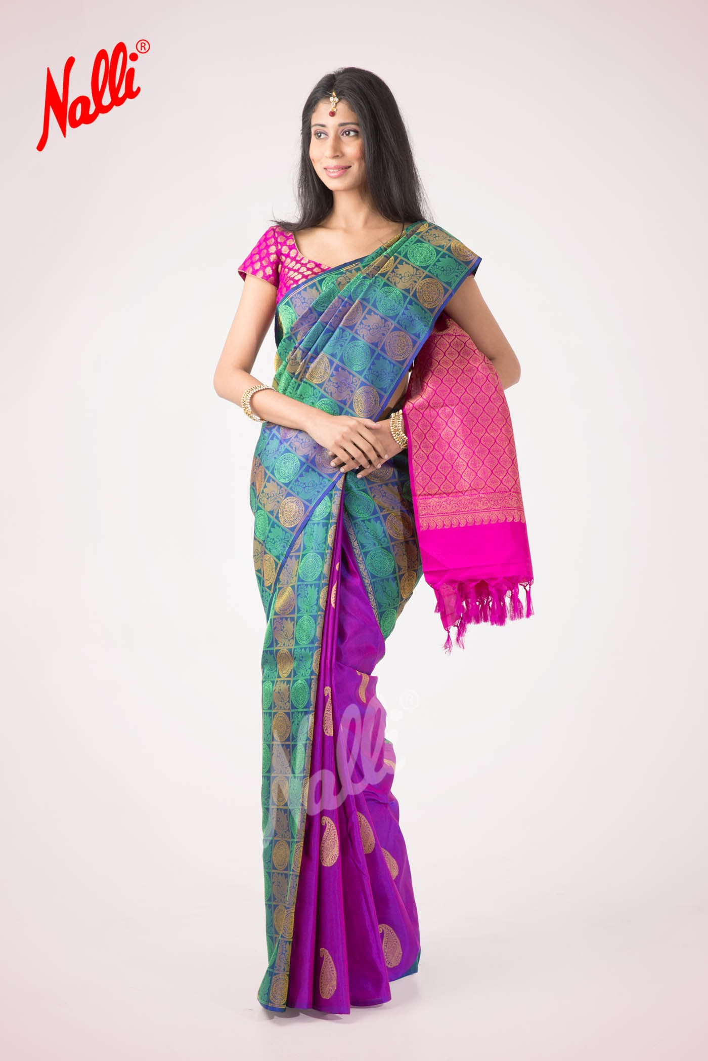

Slide 20
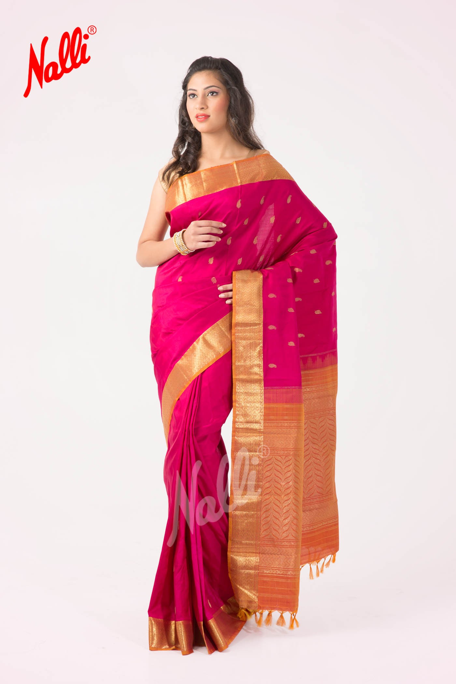
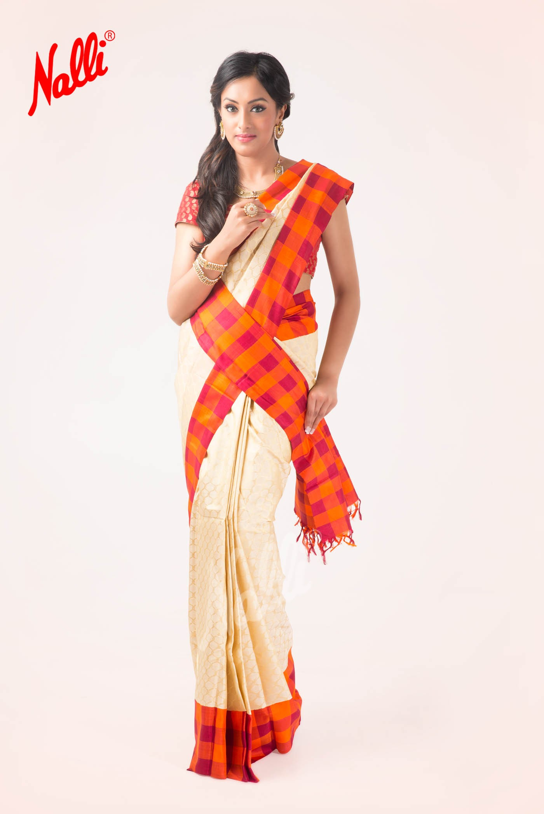

Slide 21
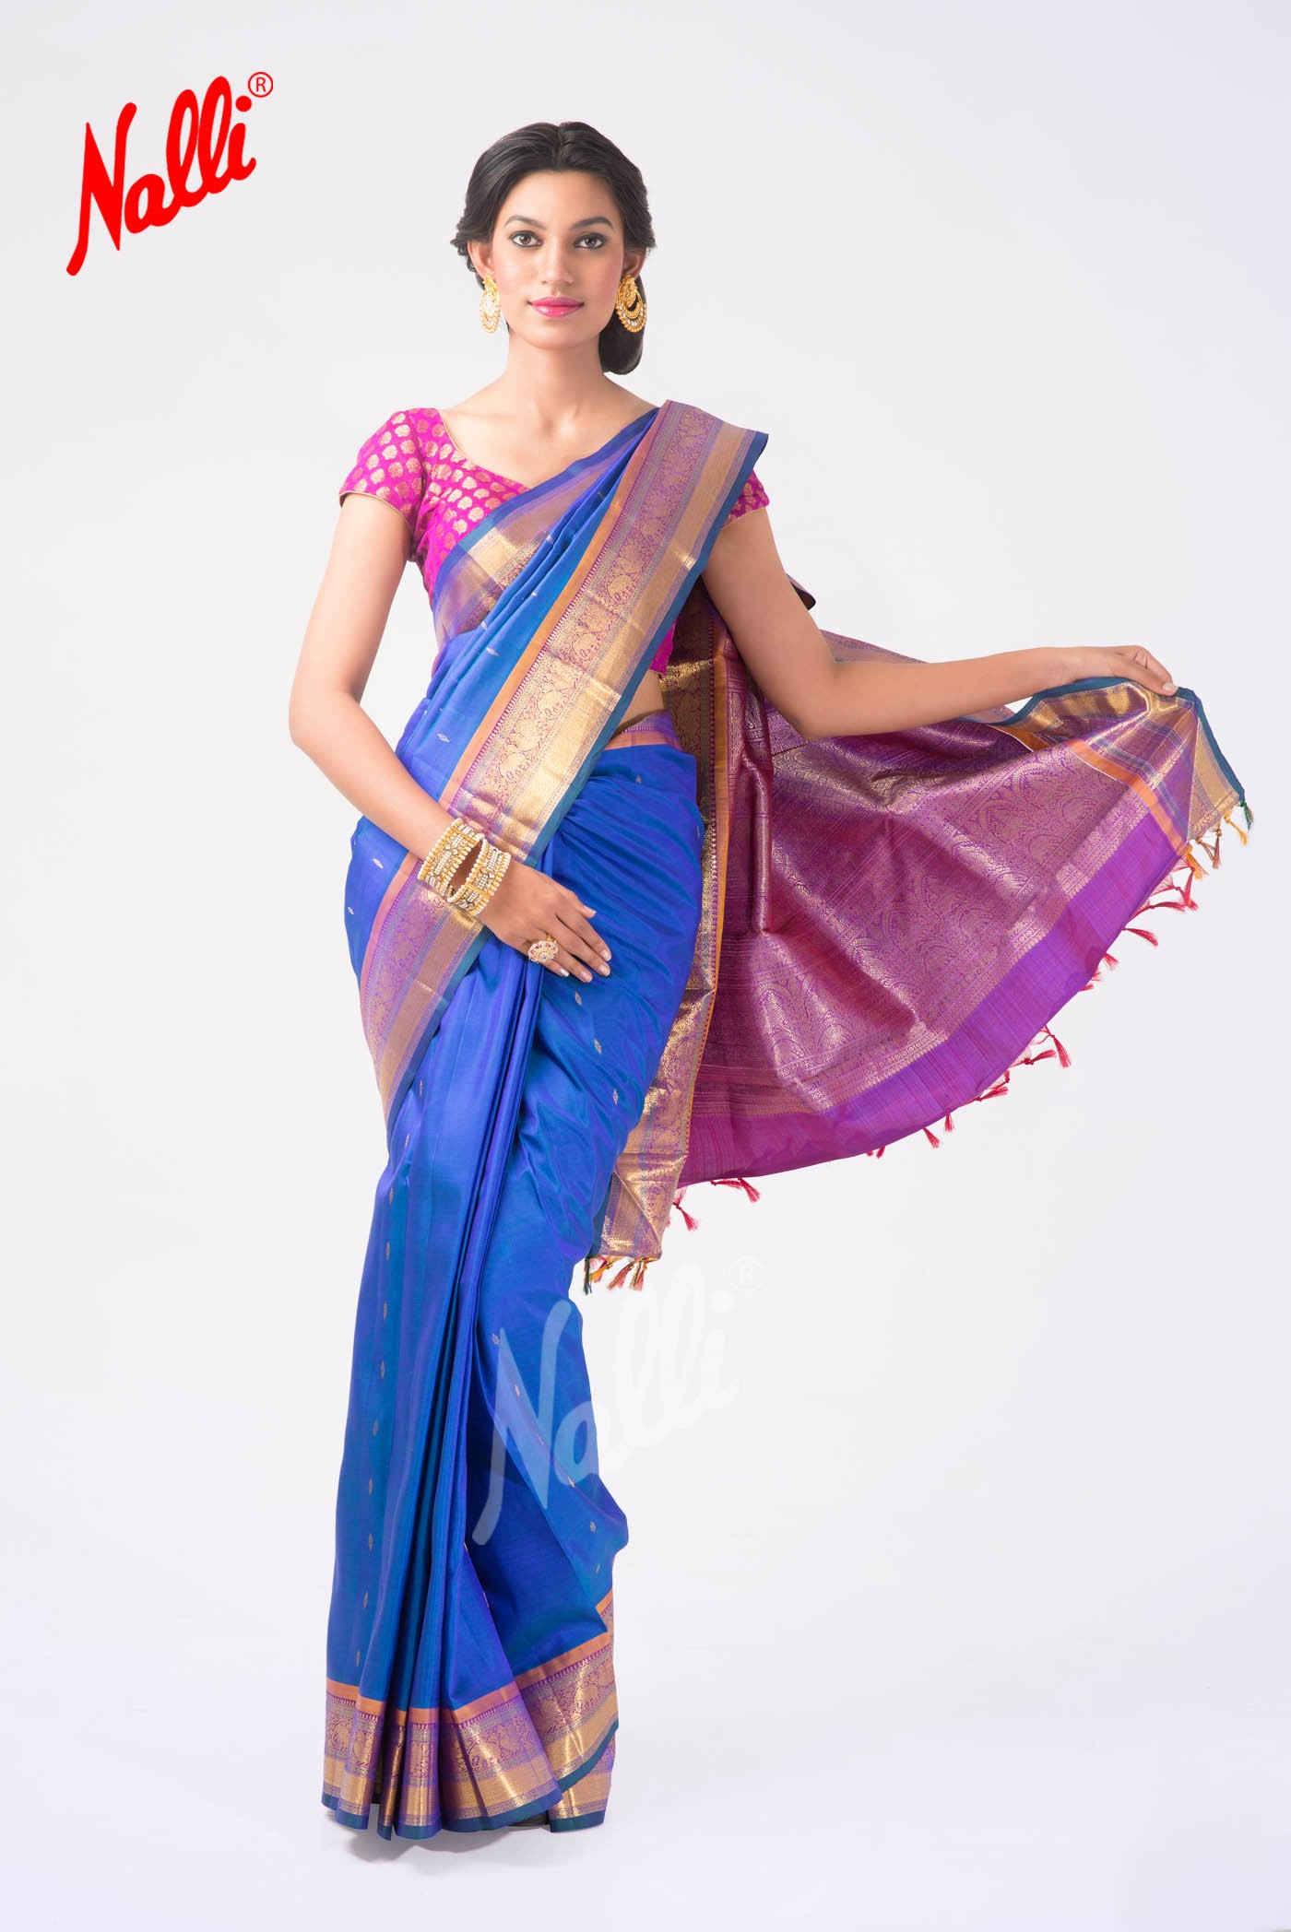
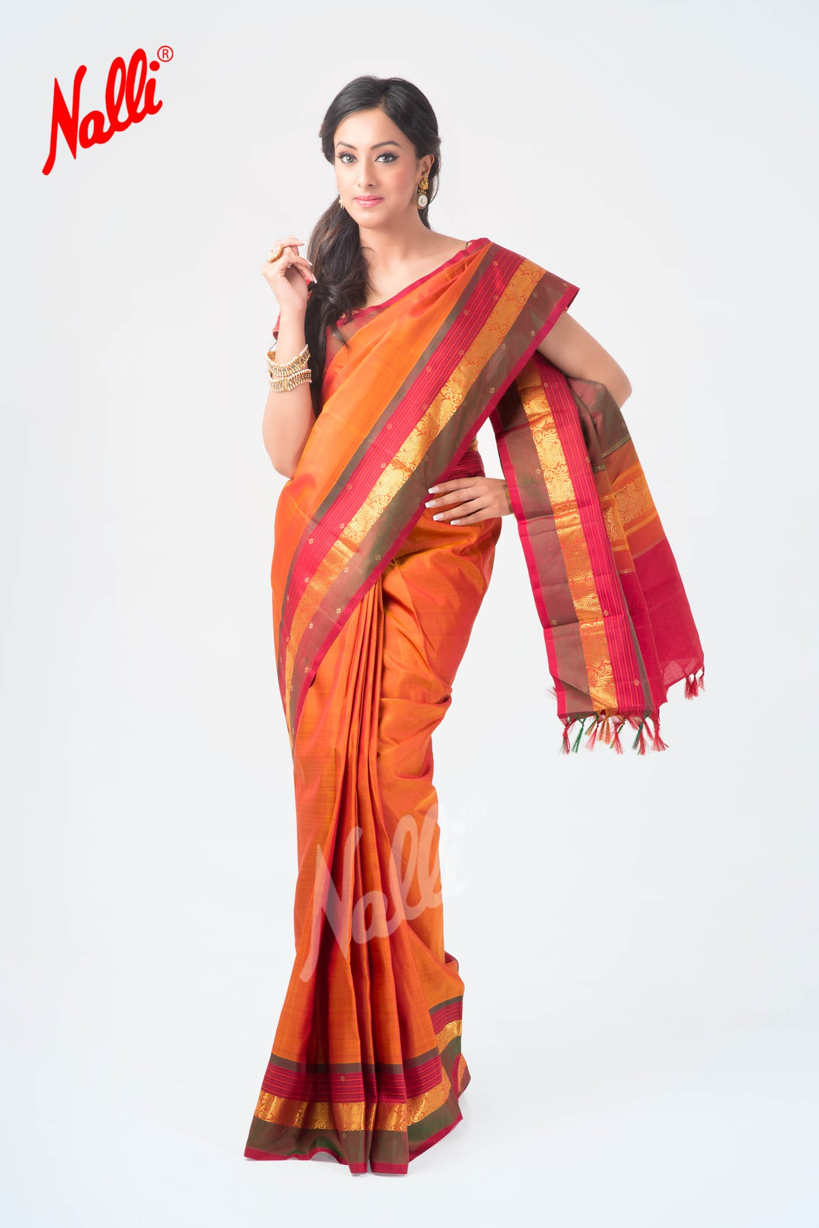

Slide 22
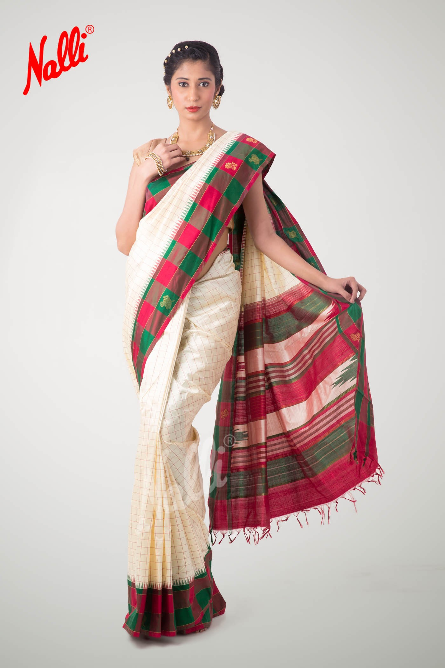
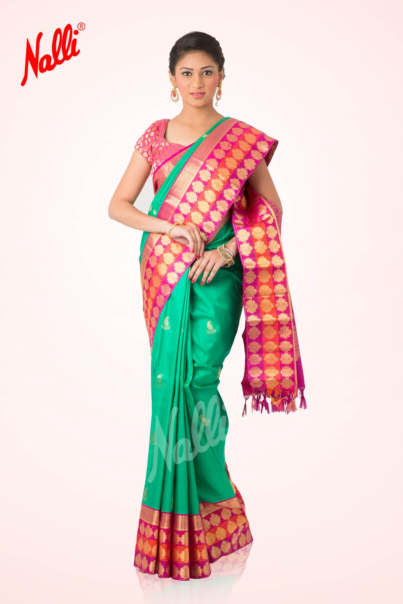

Slide 23
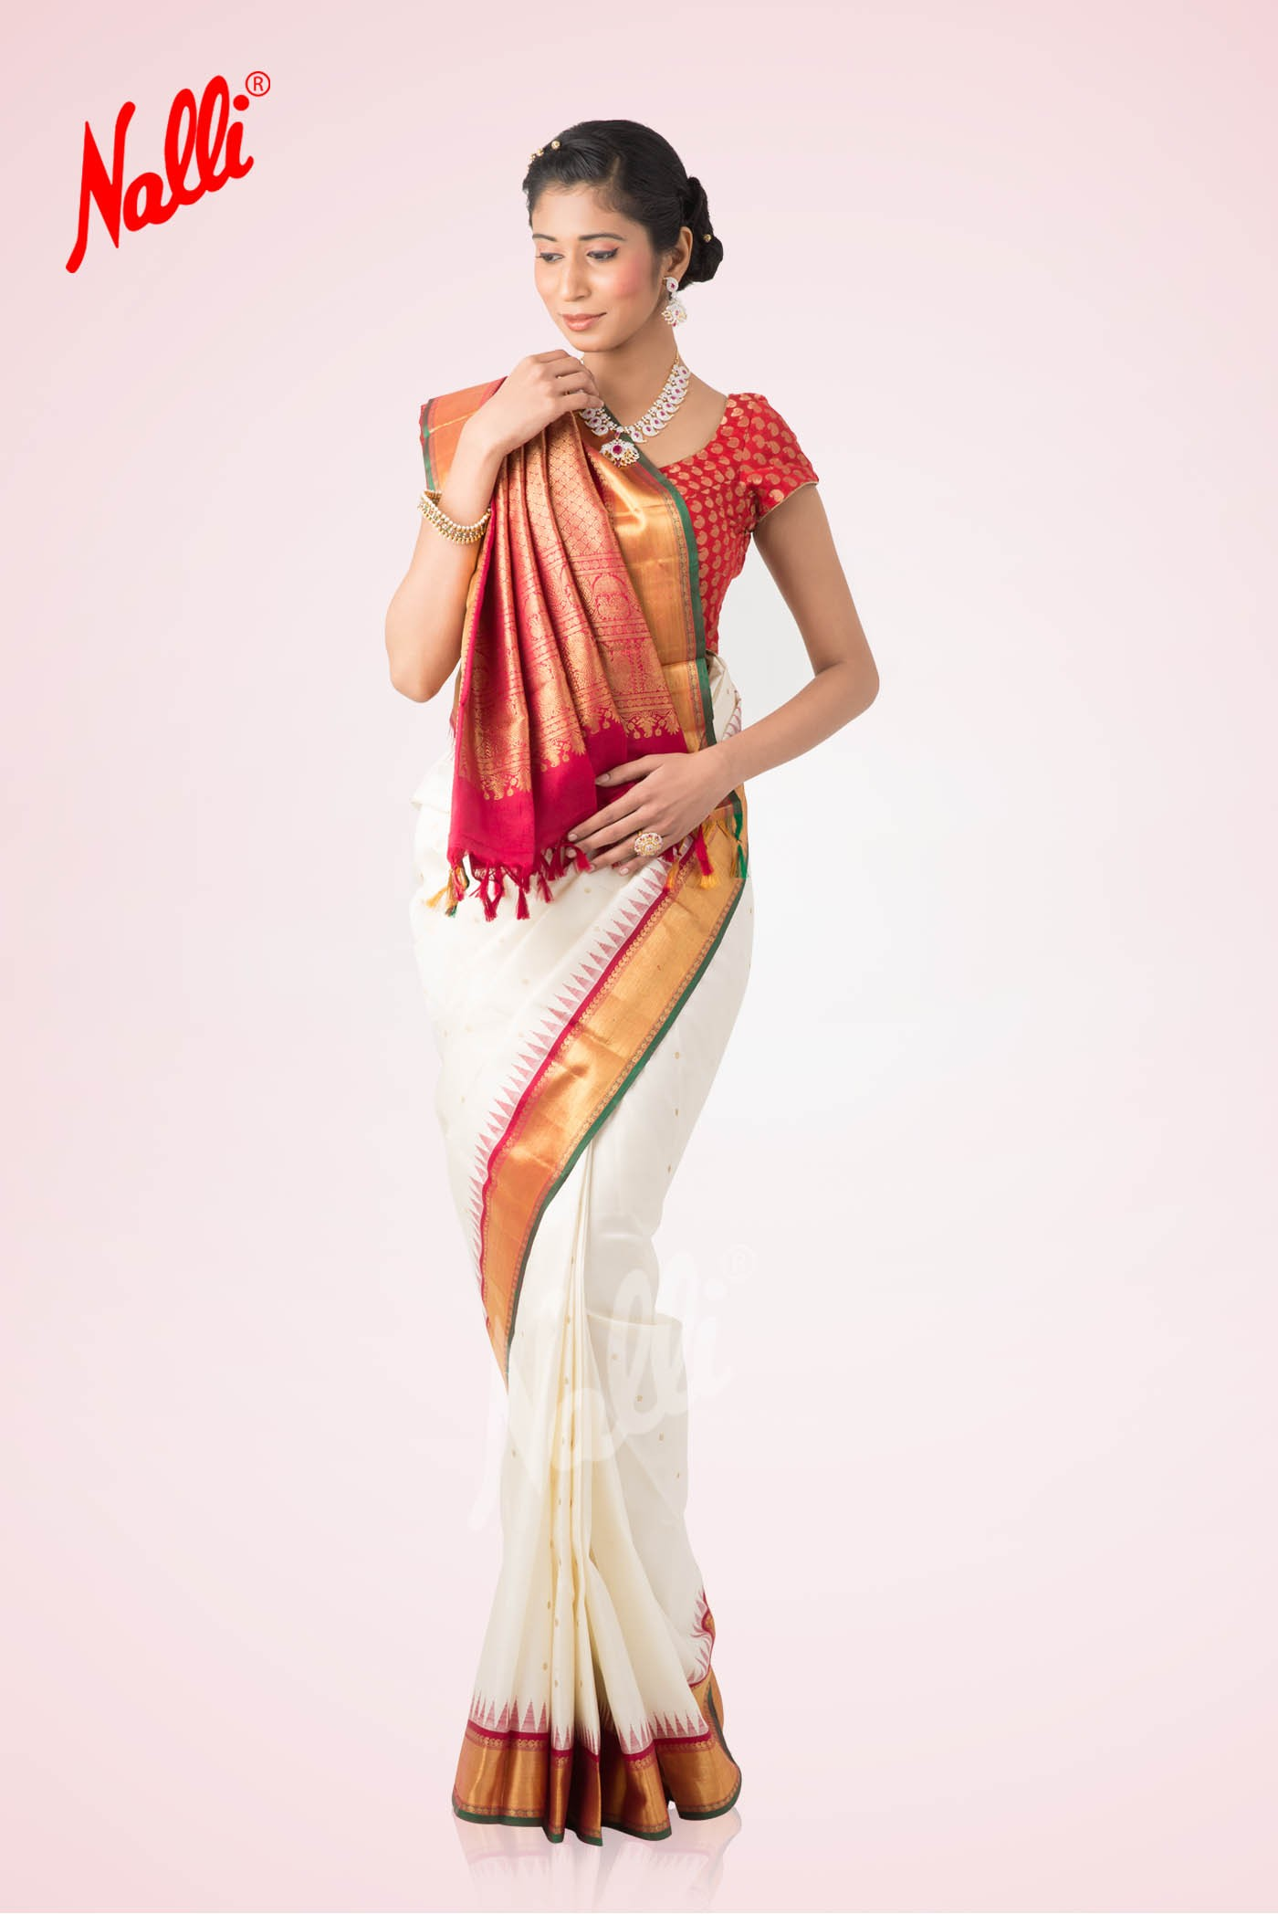
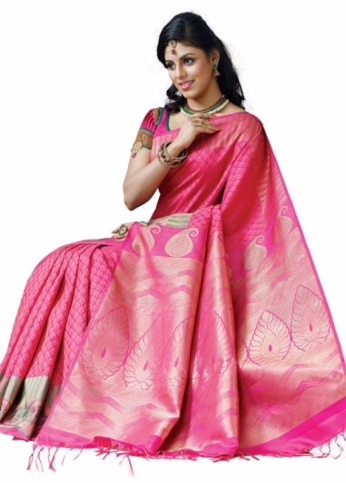

Slide 24
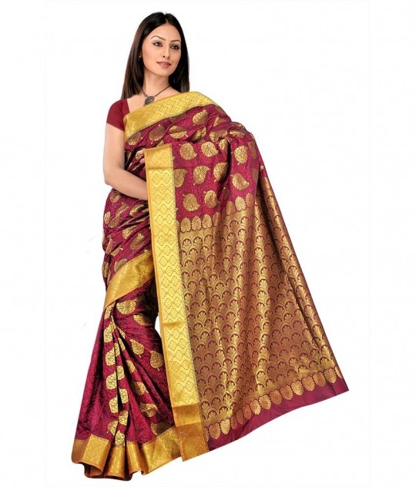

Slide 25
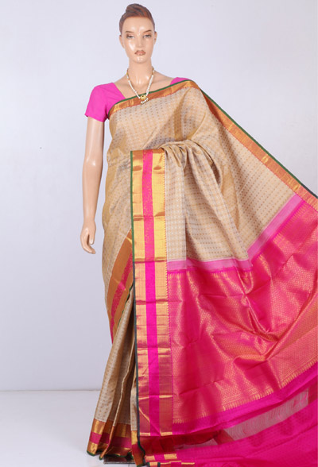
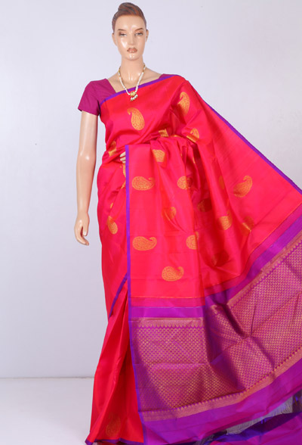

Slide 26
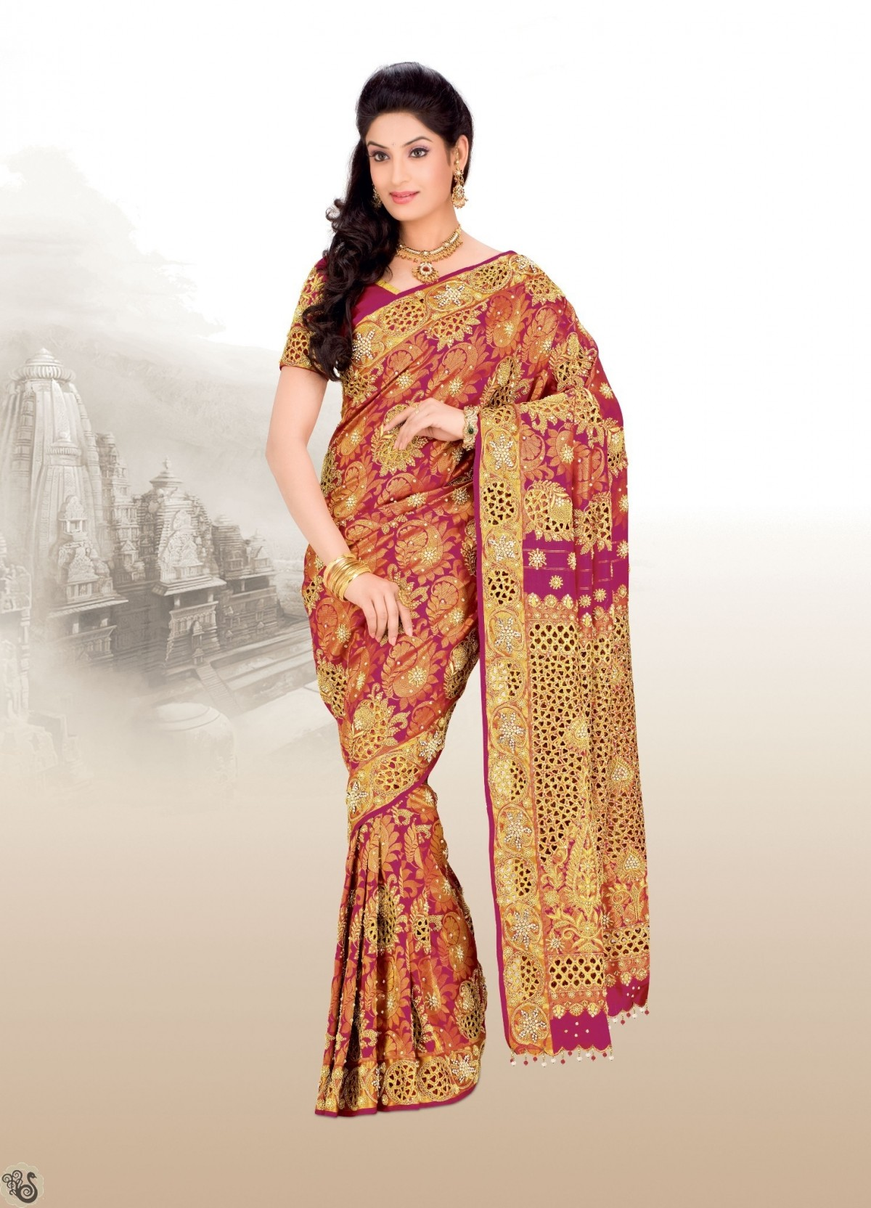

Slide 27
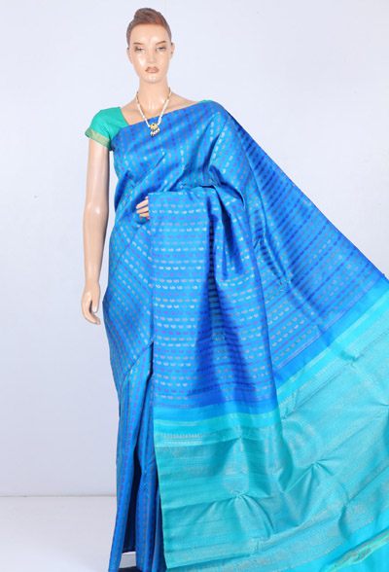
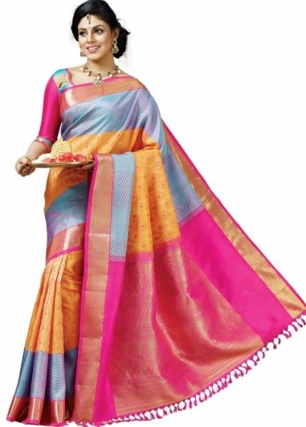

Slide 28
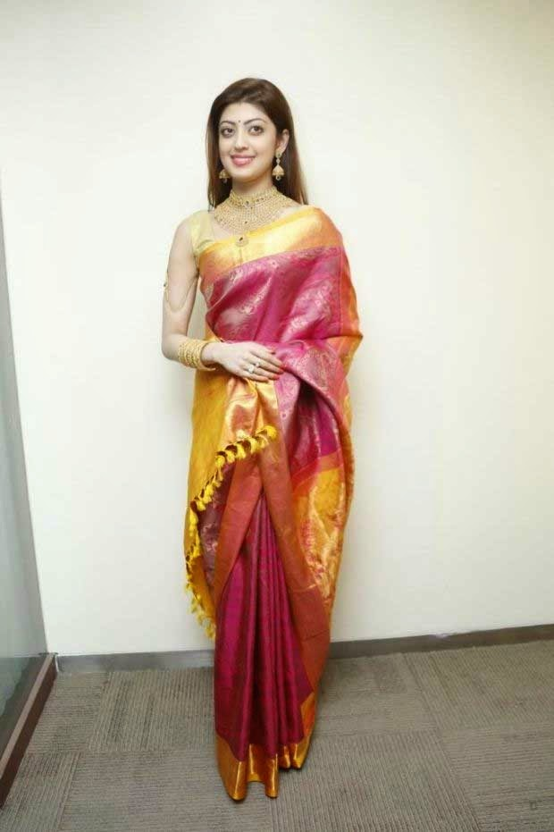


Slide 29
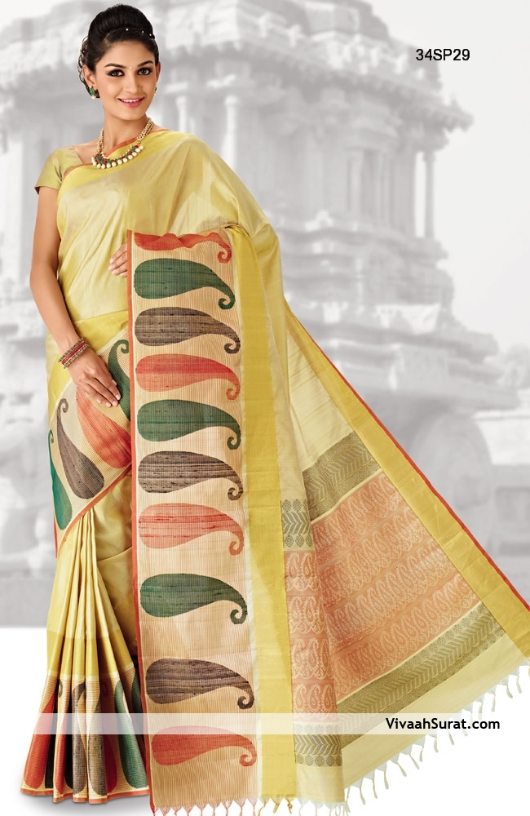
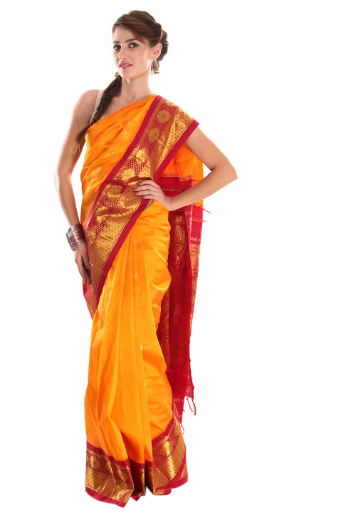

Slide 30
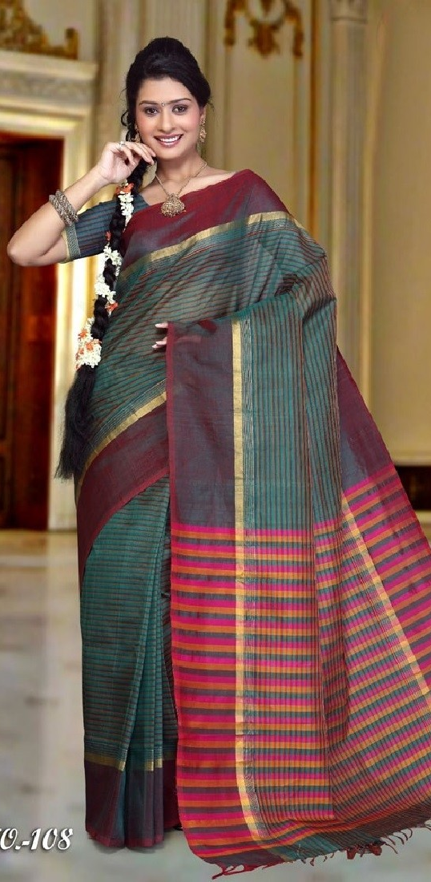
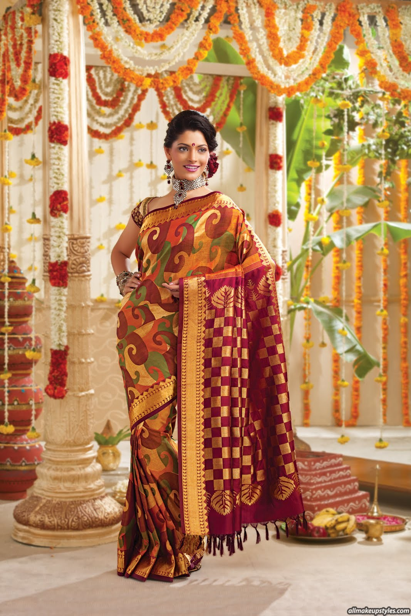

Slide 31
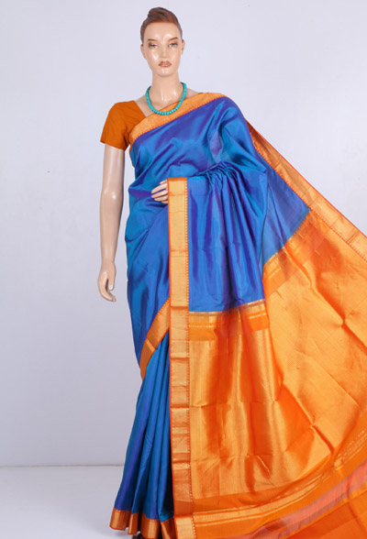


Slide 32



Slide 33


Slide 34


Slide 35



Slide 36



Slide 37



Slide 38



Slide 39


Slide 40



Slide 41



Slide 42


Slide 43



Slide 44



Slide 45



Slide 46



Slide 47



Slide 48



Slide 49



Slide 50




Slide 51




Slide 52




Slide 53



Slide 54


Slide 55


Slide 56


Slide 57


Slide 58



Slide 59


Slide 60



Slide 61



Slide 62




Slide 63



Slide 64



Slide 65


Slide 66




Slide 67


Slide 68


Slide 69




Slide 70



Slide 71




Slide 72




Slide 73


Slide 74


Slide 75


Slide 76


Slide 77


Slide 78


Slide 79


Slide 80


Slide 81



Slide 82



Slide 83



Slide 84



Slide 85




Slide 86


Slide 88




Slide 89


Slide 90




Slide 91



Slide 92



Slide 93




Slide 94


Slide 95



Slide 96



Slide 97



Slide 98


Slide 99


Slide 100


Slide 101


