Slide 1
Journey through Cambodia
Presented by
Amal K.Chatterjee

Slide 2
Editor’s note
Cambodia was once ravaged by the rule of the Khmer Rouge that took over two million lives of peaceful Buddhist Cambodians and destroyed its ancient heritage sites like Angkor Wat among many others.
Now Cambodia is slowly emerging as a developing nation and trying to heal its wounds. It is also restoring the damage to its ancient heritage sites in a painfully slow process but many countries are helping them in this effort.
It is for your private viewing pleasure only.
AKC/November 2015

Slide 3
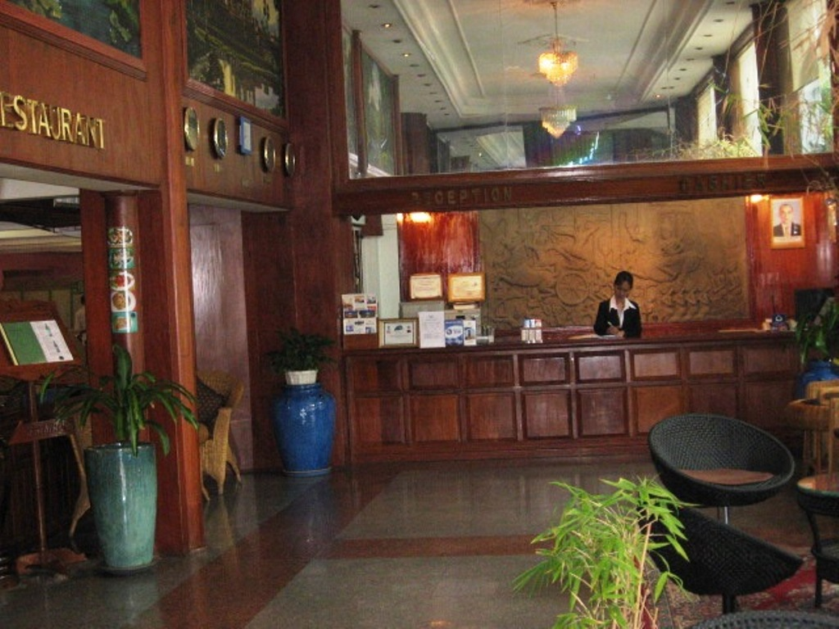
At first we stayed at the Princess hotel in Phnom Penh

Slide 4
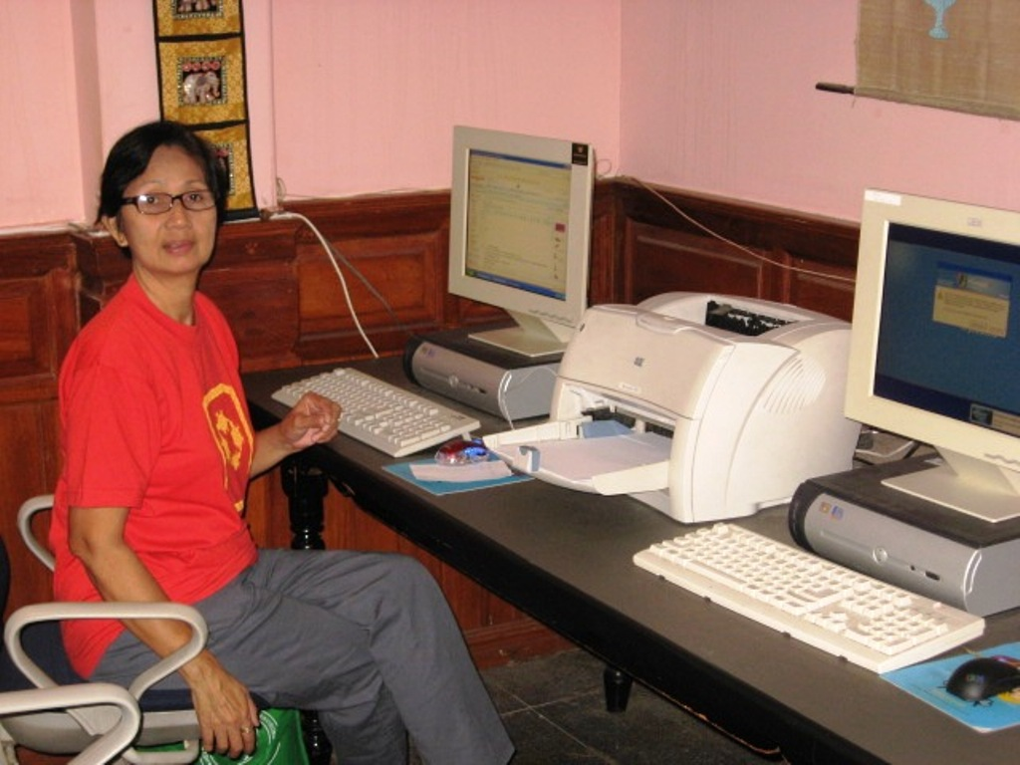
Where Tipin was soon into the internet

Slide 5
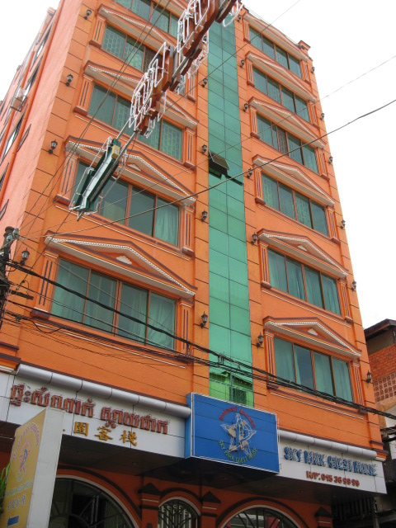
But we soon found this hotel downtown

Slide 6
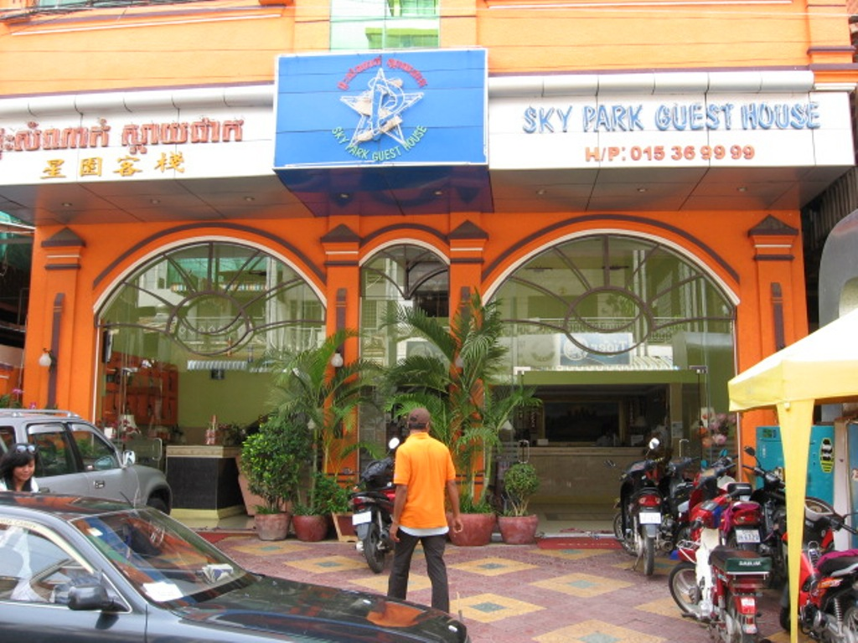
Called Sky Park guest house

Slide 7
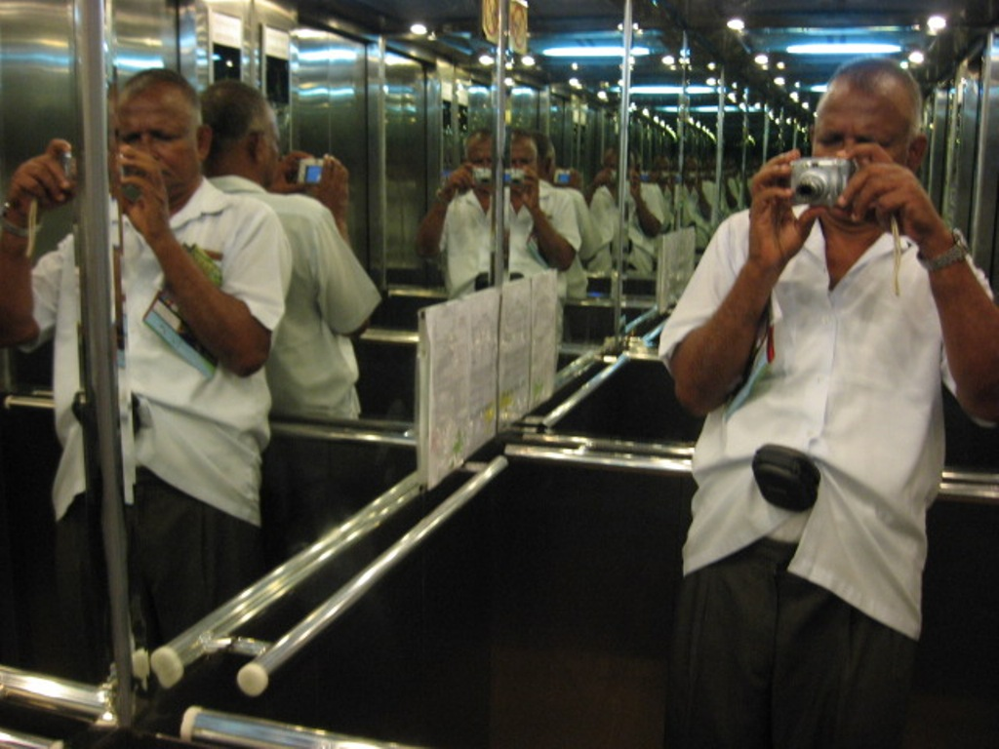
The reflection in the elevator was interesting

Slide 8
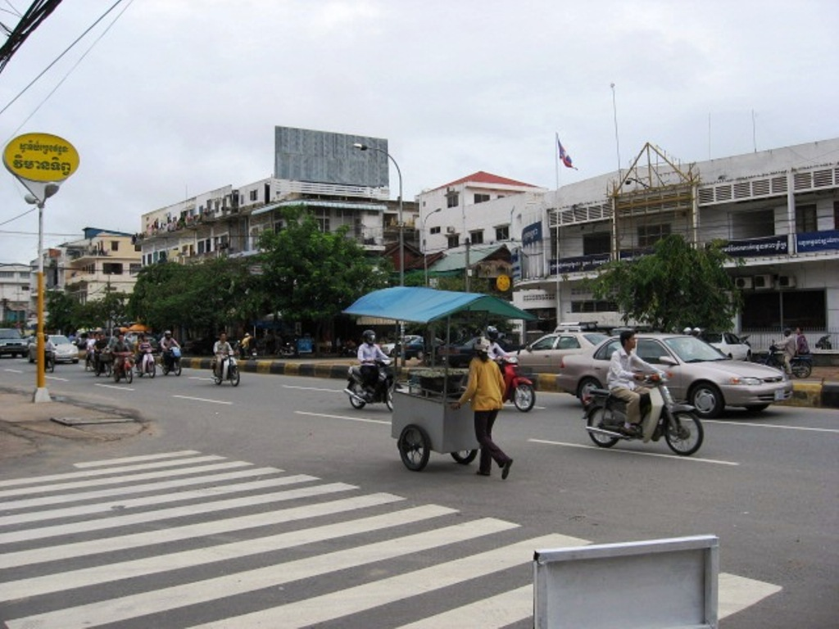
Streets of Phnom Penh

Slide 9
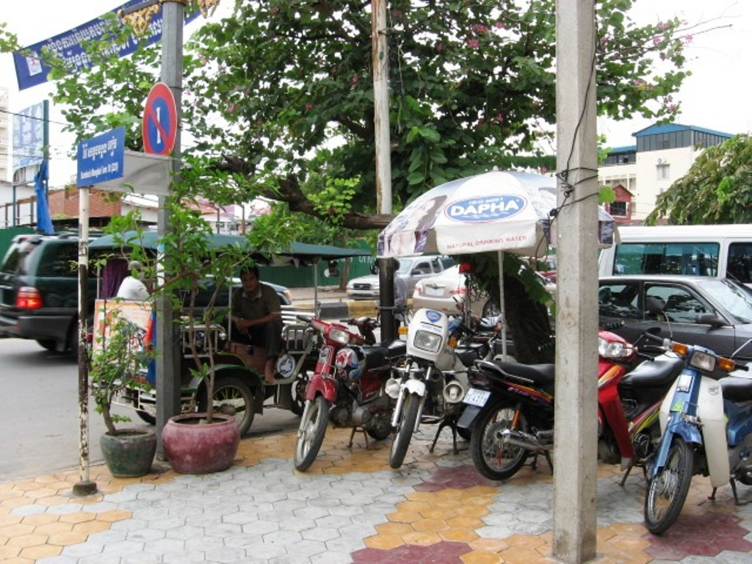
Where tuk tuks are the mode of transport

Slide 10
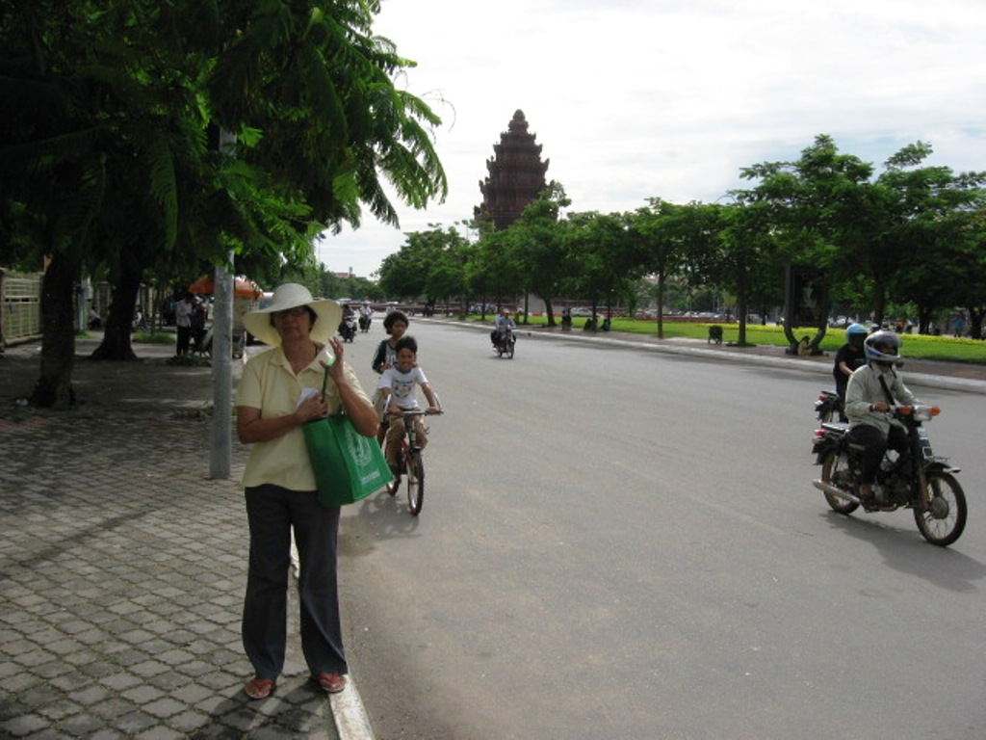
Independence monument in the background

Slide 11
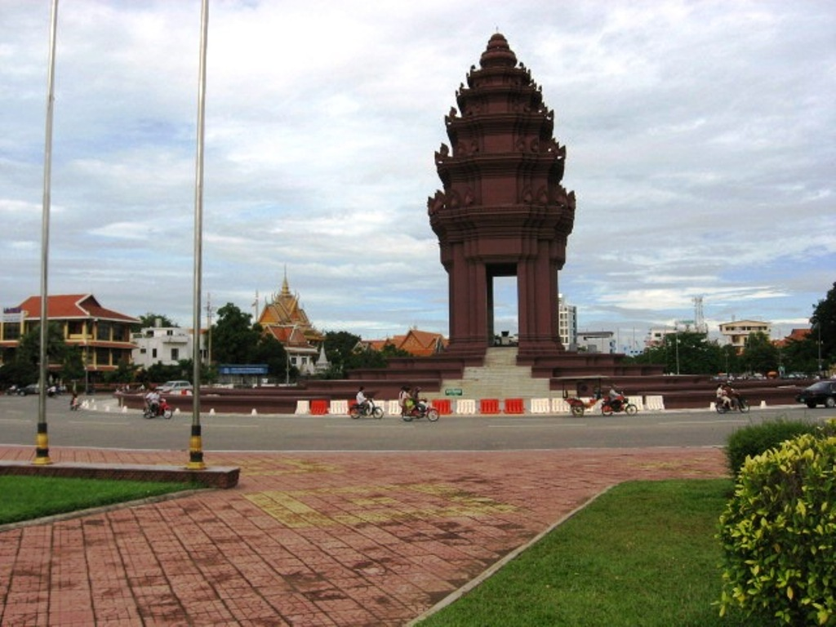
Closer view of the Independence monument

Slide 12
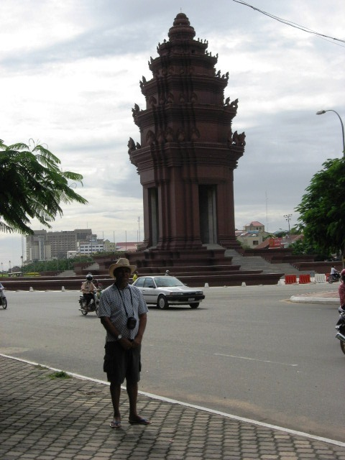
It is massive

Slide 13
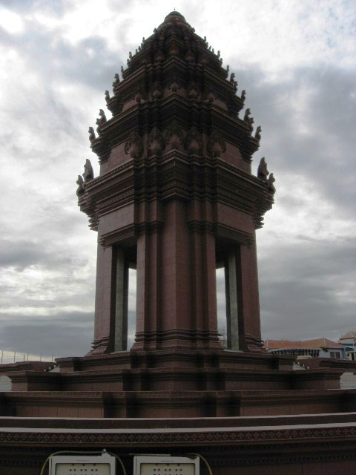
And very Angkorian in design

Slide 14
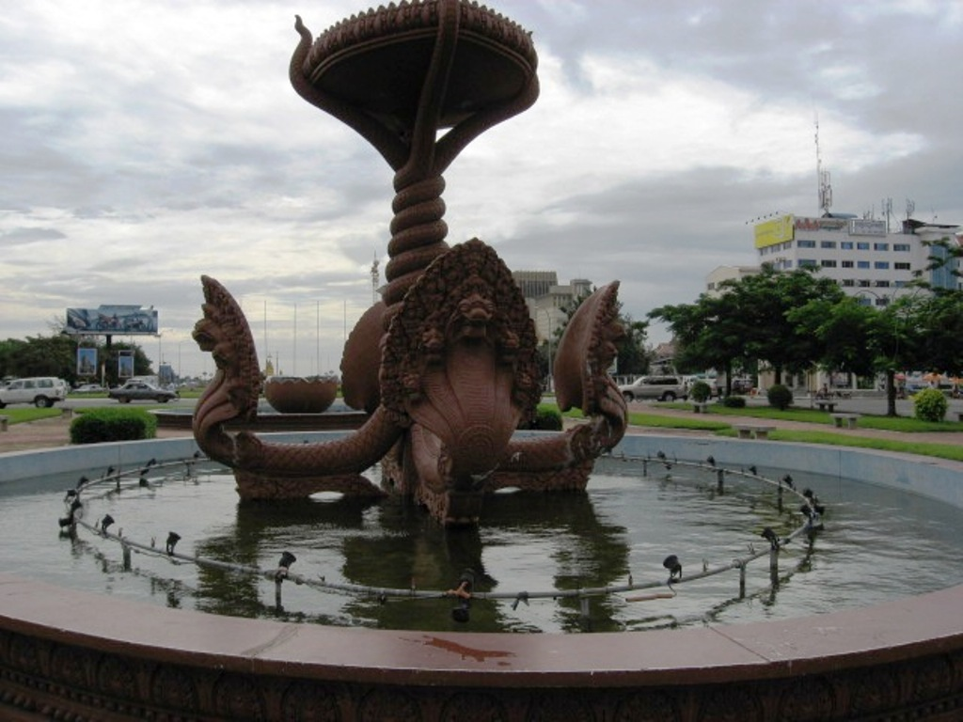
Another monument with snakes that we will see everywhere

Slide 15
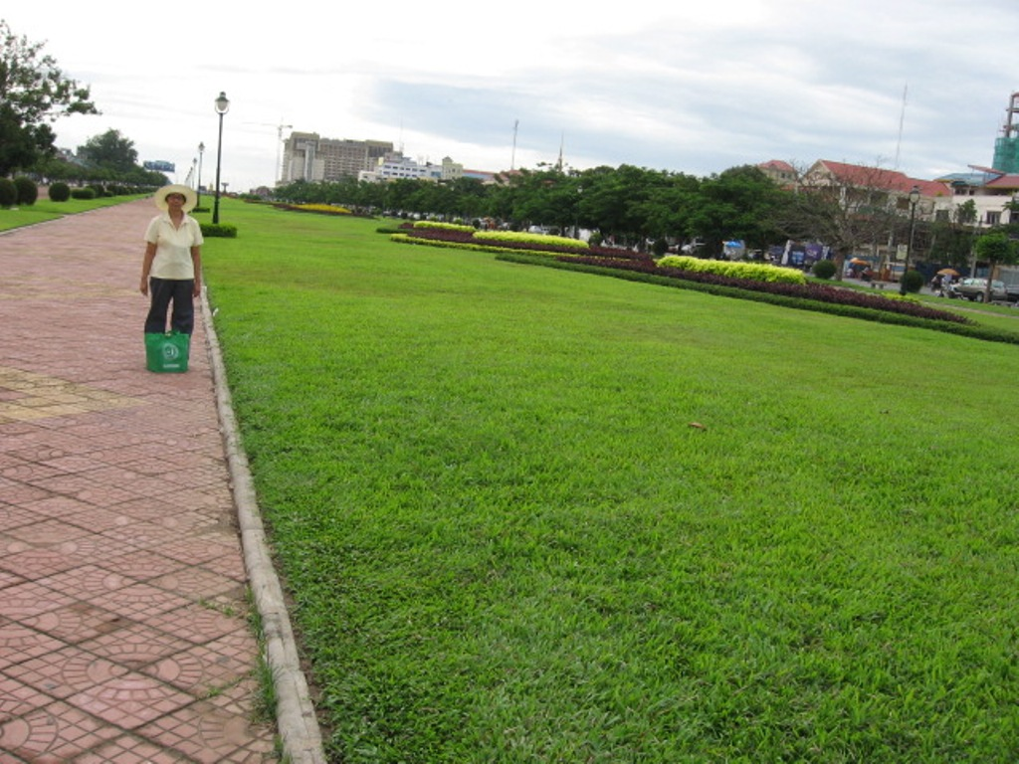
Part of Phnom Penh is green and well kept

Slide 16
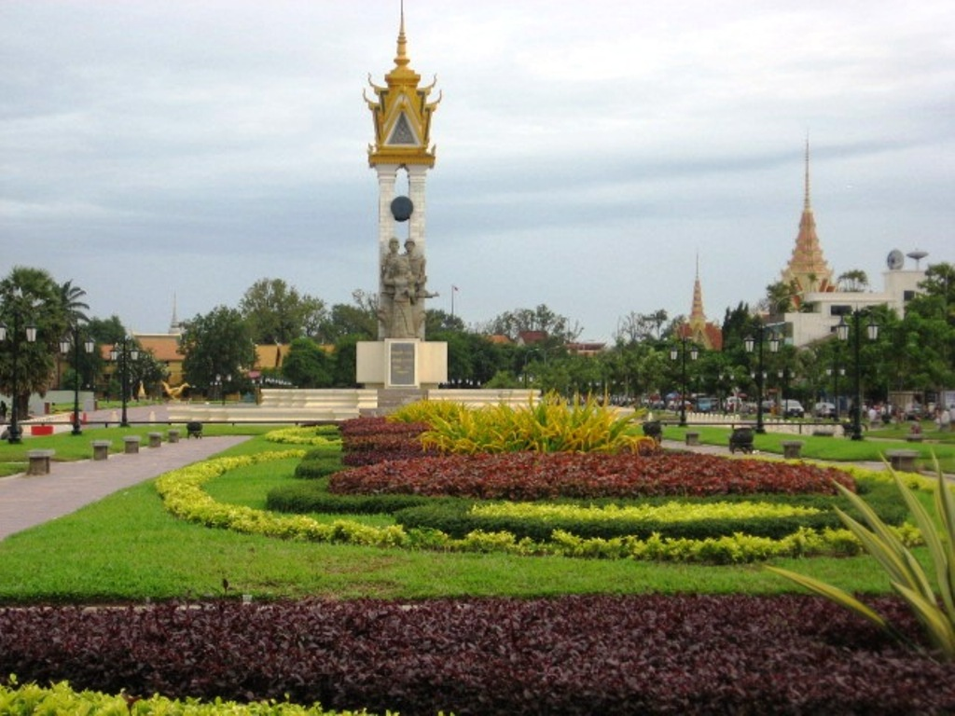
Liberation monument to honor the Vietnamese help

Slide 17
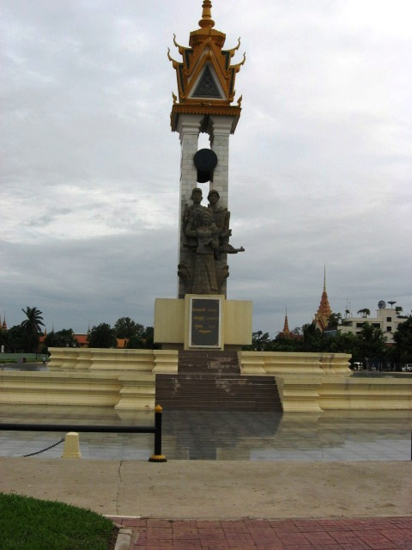
A closer look

Slide 18
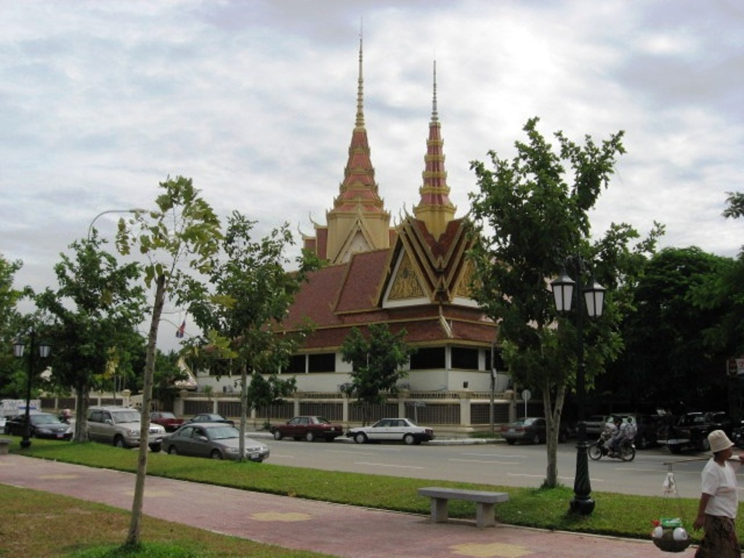
Phnom Penh is full of Wats or Buddhist temples

Slide 19
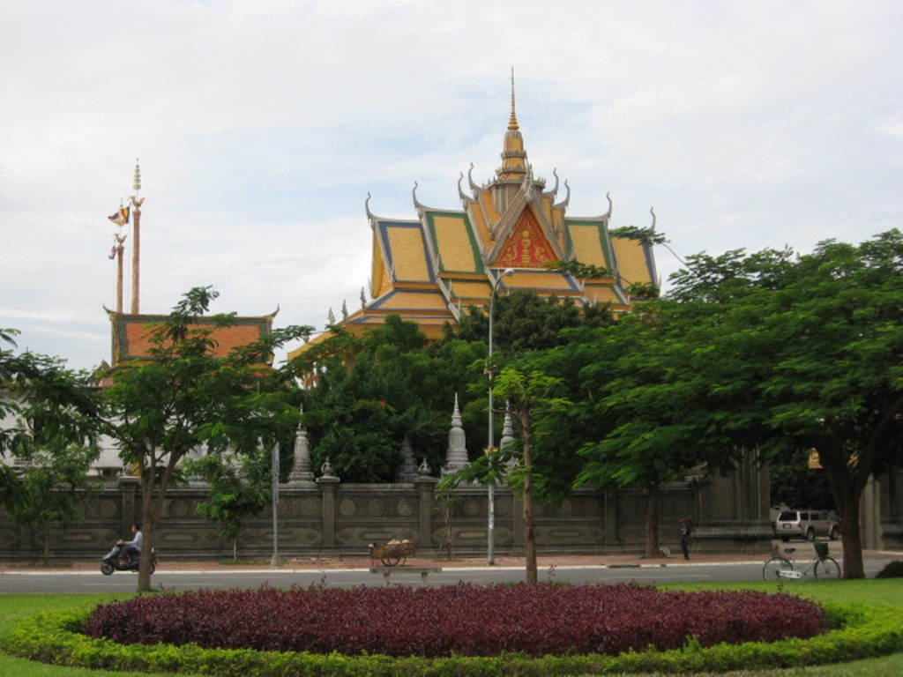
Reminding you that you are in a Buddhist country

Slide 20
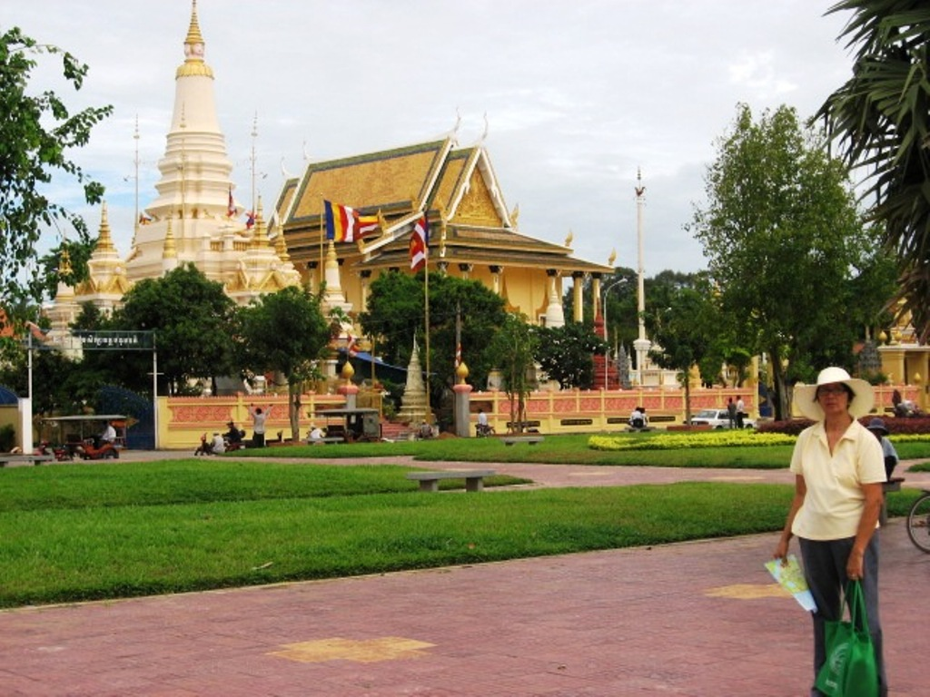
A wat often contains a relic of Buddha

Slide 21
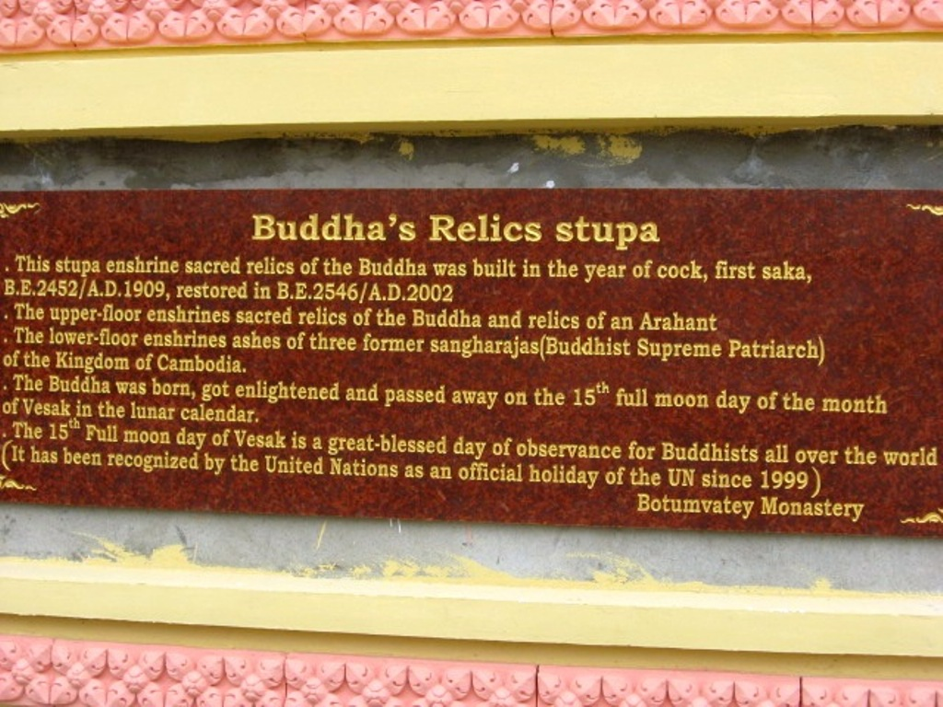
As is evident from this plaque

Slide 22
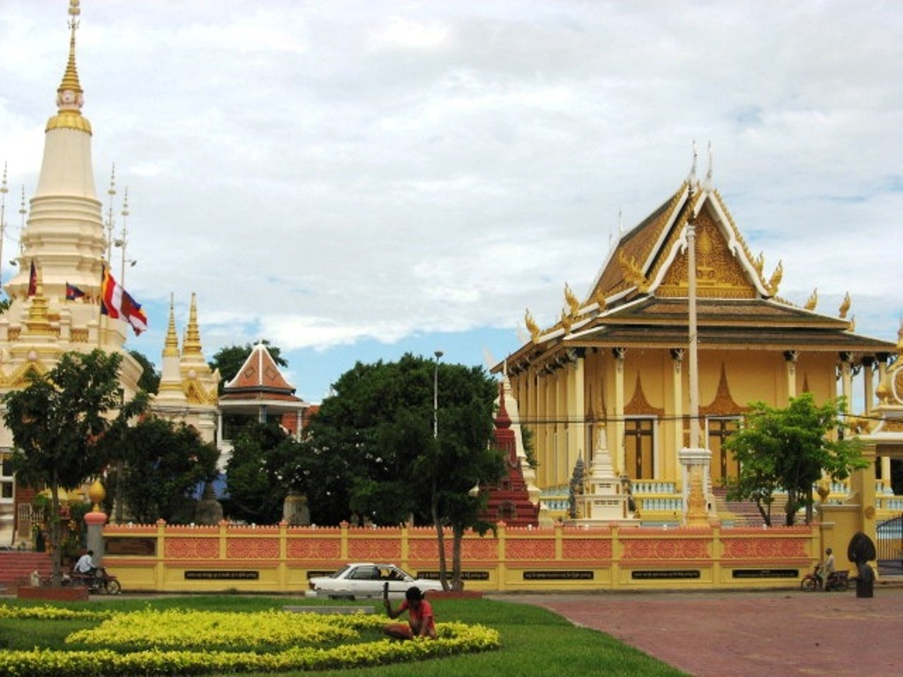
They are very elaborate in design
Notes:
Another wat with elaborate style

Slide 23
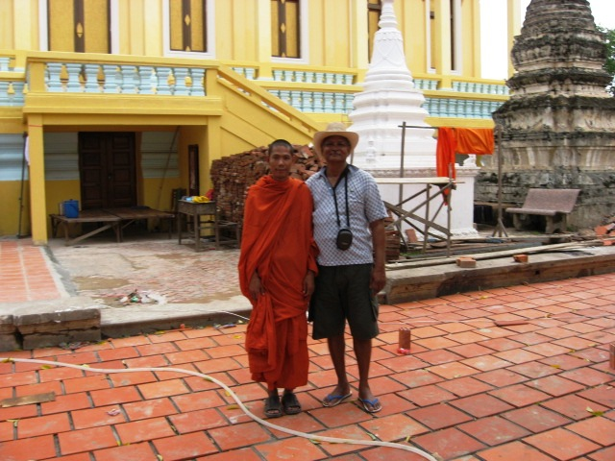
With a friendly monk

Slide 24
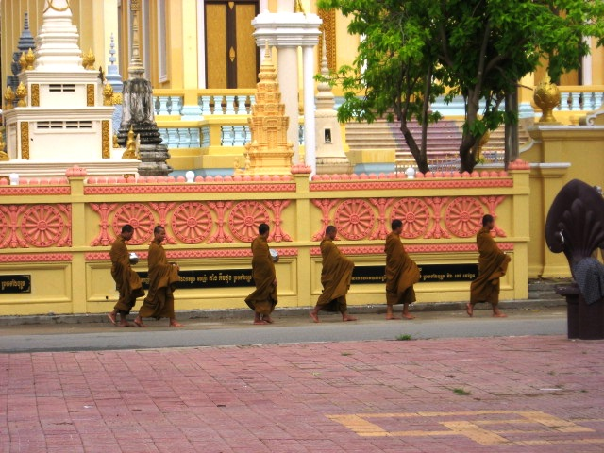
They go early in the morning to collect alms

Slide 25
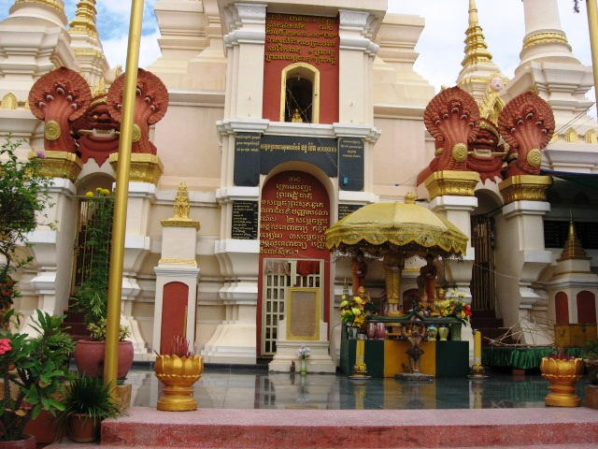
Inside a Wat in Phnom Penh

Slide 26
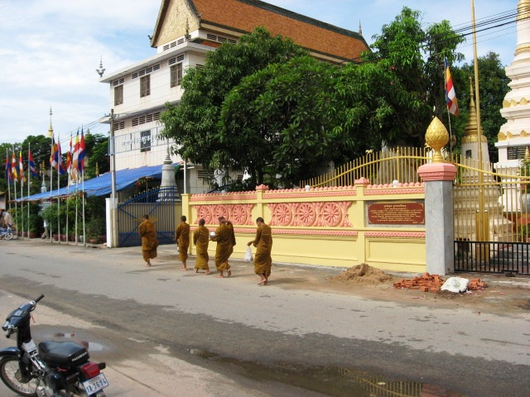
It is a predominantly Buddhist country

Slide 27
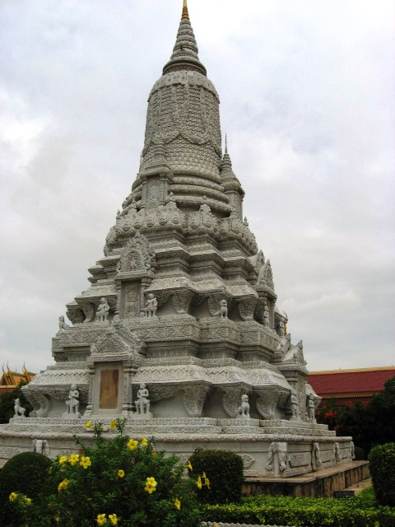
A stupa

Slide 28
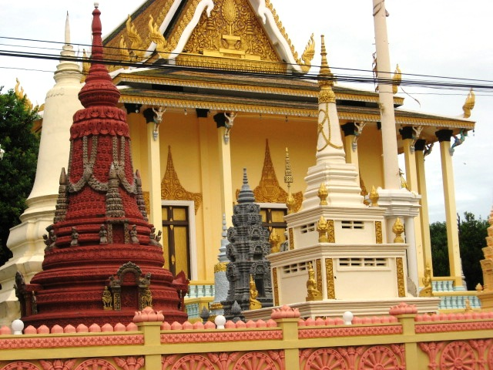
A wat may contain many stupas

Slide 29
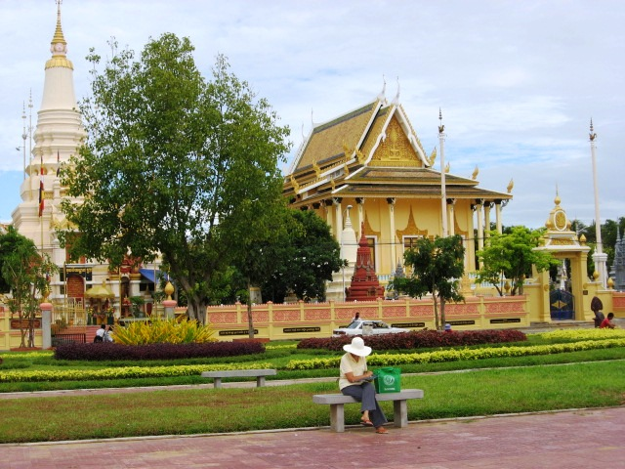
Tipin awaits in front of a Wat

Slide 30
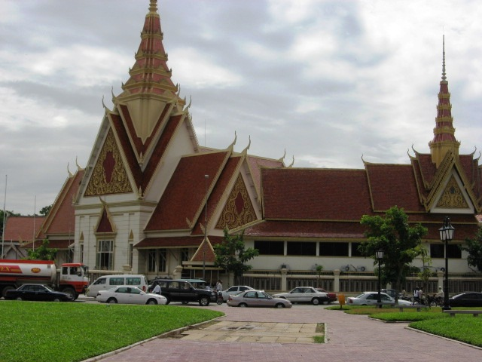
The National museum in Phnom Penh

Slide 31
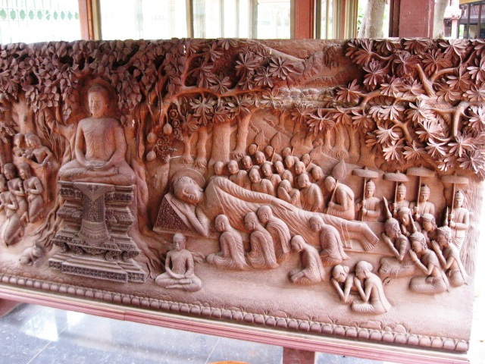
Stone carvings of Buddha in meditation, Museum

Slide 32
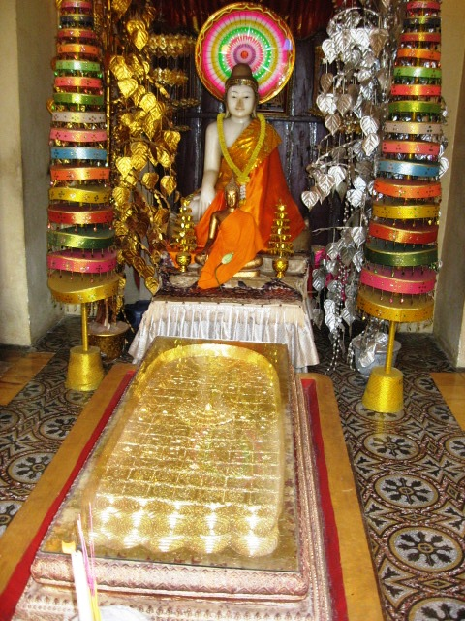
Buddha’s footprint

Slide 33
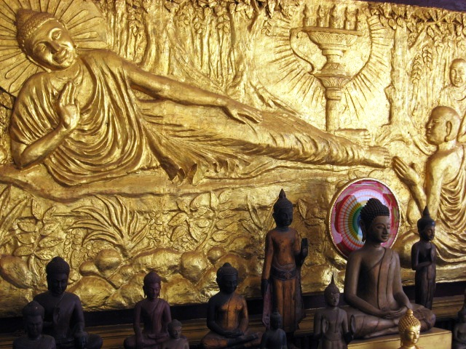
Reclining Buddha

Slide 34
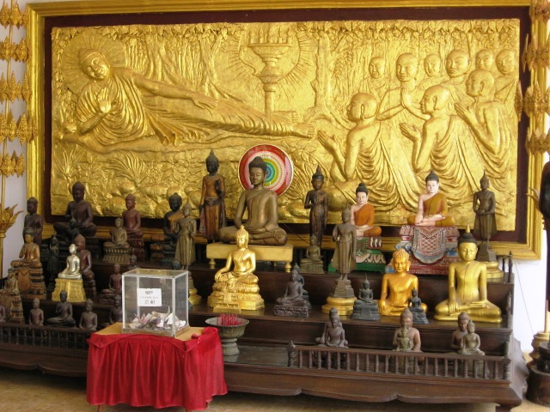
Another view of reclining Buddha

Slide 35
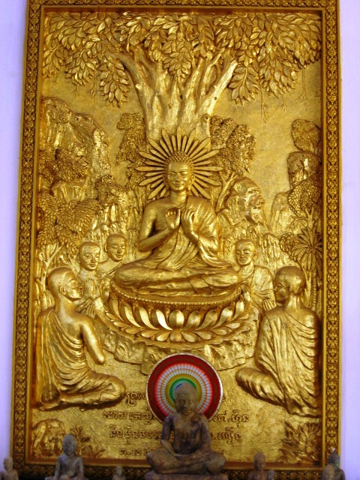
Sitting Buddha

Slide 36
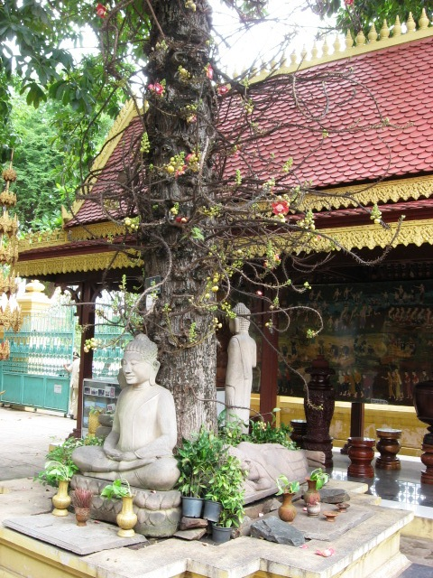
A small grotto

Slide 37
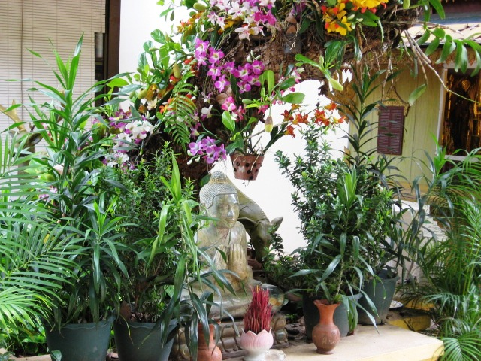
Orchids in a grotto

Slide 38
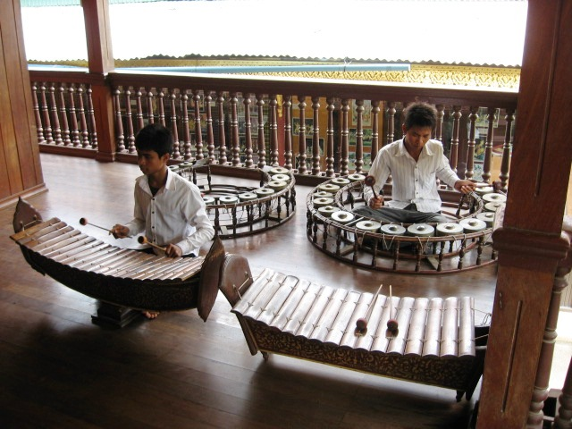
Traditional musicians

Slide 39
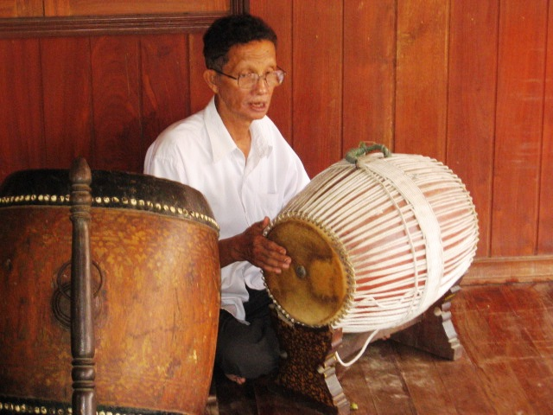
Traditional drums

Slide 40
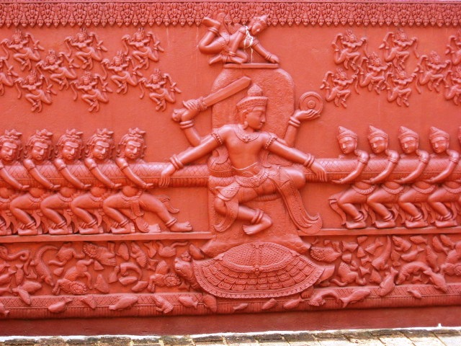
A carving depicting the churning of the sea for amrita

Slide 41
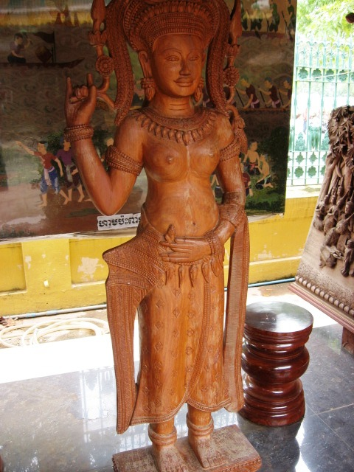
Apsaras or celestial nymphs

Slide 42
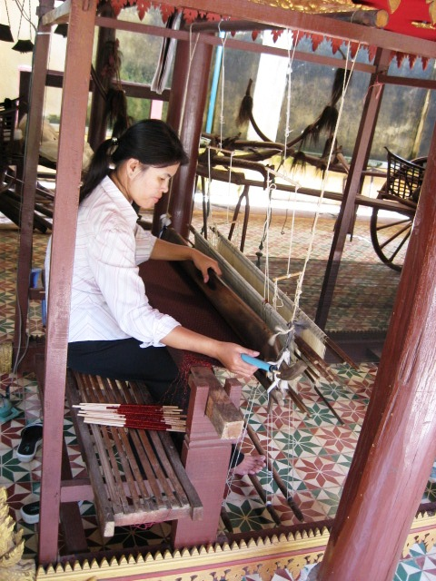
A weaver

Slide 43
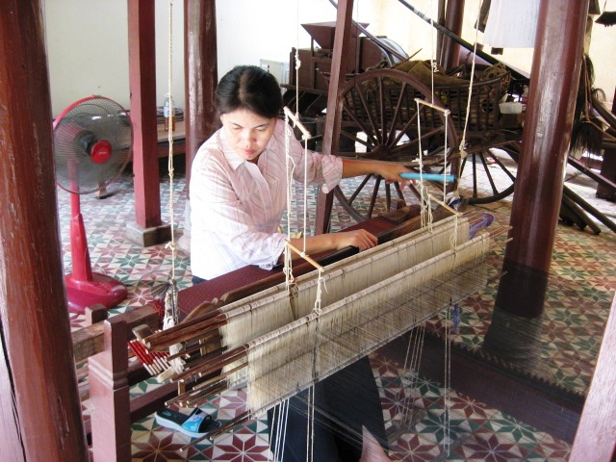
She makes beautiful clothes

Slide 44
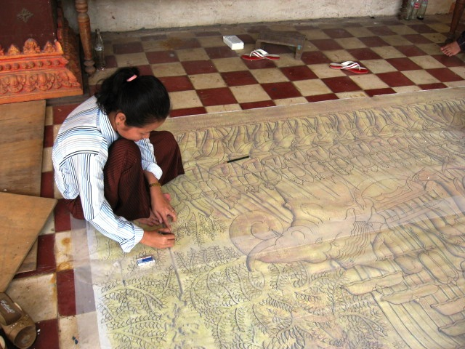
An artist at work

Slide 45
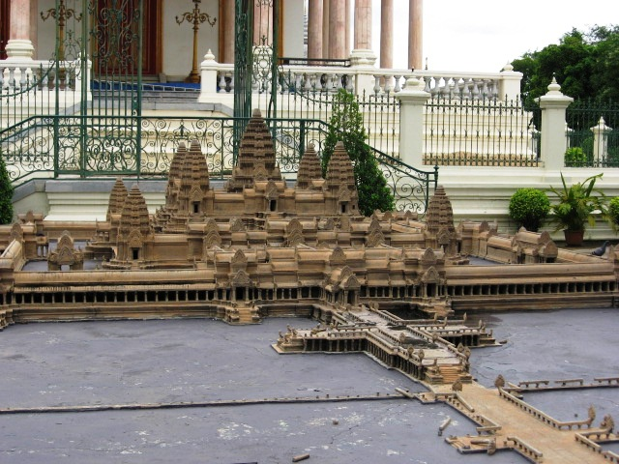
A model of Angkor Wat

Slide 46
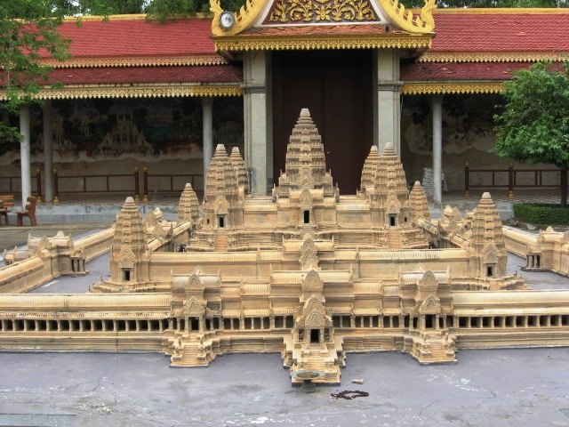
A model of Angkor Wat

Slide 47
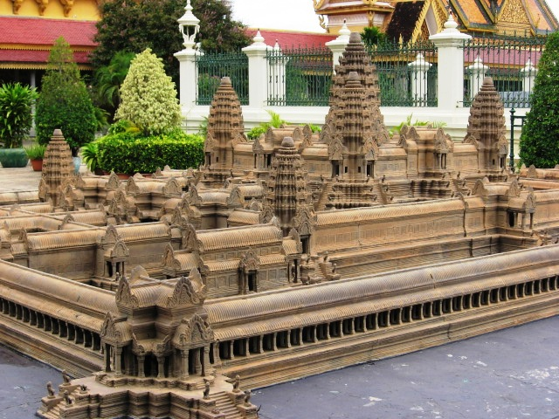
Seen from another angle

Slide 48
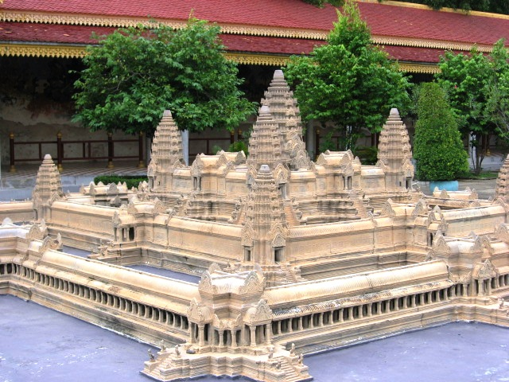
Another view of Angkor Wat

Slide 49
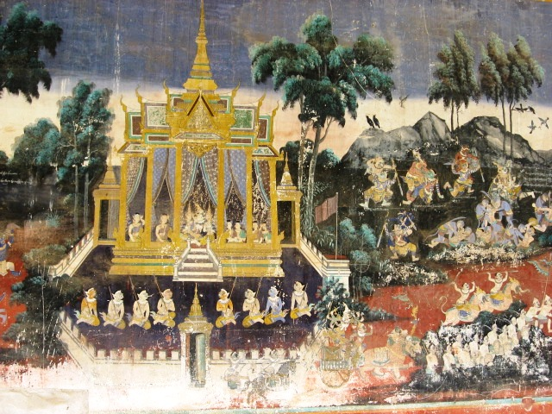
All wats have galleries depicting life of Buddha

Slide 50
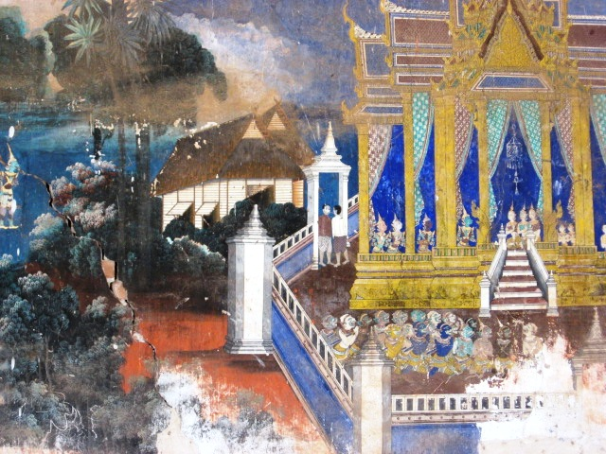
Gallery art

Slide 51
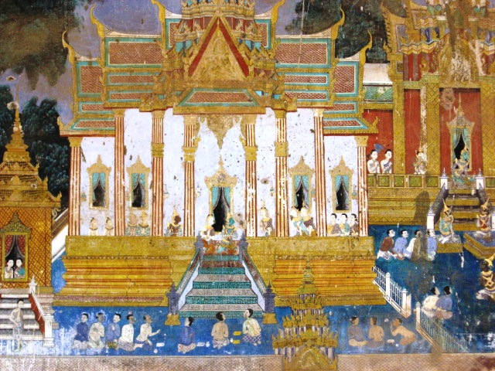
Gallery art in the wats

Slide 52
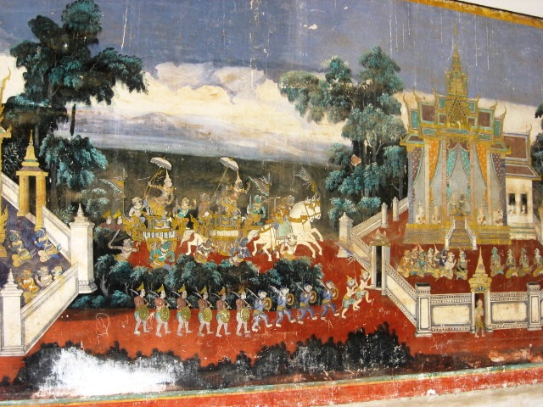
These paintings are in bad shape and need restoration

Slide 53

Because they are exposed to the elements

Slide 54

Like sunlight

Slide 55

And moisture

Slide 56

There are hundreds of them

Slide 57

Gold elephants

Slide 58

Silver elephants

Slide 59

Rural homes on stilts

Slide 60

Models of rural homes

Slide 61

Models of rural homes

Slide 62

Inside rural homes

Slide 63

Tipin in front of the Royal palace in Phnom Penh

Slide 64

Royal palace in Phnom Penh

Slide 65

Royal Palace at night

Slide 66

Royal palace grounds

Slide 67

Royal palace gate in Phnom Penh

Slide 68

Royal palace grounds

Slide 69

Pagodas inside the palace grounds

Slide 70

And the anxious guard

Slide 71

A stupa

Slide 72

Royal procession

Slide 73

Royal procession

Slide 74


Slide 75


Slide 76


Slide 77


Slide 78


Slide 79


Slide 80


Slide 81

The Brahmins

Slide 82

Dolls in the museum in royal dresses

Slide 83


Slide 84


Slide 85

Royal palanquin

Slide 86


Slide 87


Slide 88


Slide 89

Tipin and her reflection

Slide 90

Fireworks

Slide 91


Slide 92


Slide 93

The national museum

Slide 94

Tipin in front of National Museum in Phnom Penh

Slide 95

Kids playing near museum

Slide 96

Kids playing near museum

Slide 97

Elephant for ride near Wat Phnom

Slide 98

Monkey at Wat Phnom

Slide 99

Painting of Apsara dancers

Slide 100

Apsara painting

Slide 101

Traditional musician

