Slide 1

Joseph Mallord William Turner
1775 - 1851
Turner is the best landscape painter of Western painting. Whereas he had been at his beginnings an academic painter, Turner was slowly but unstoppably evolving towards a free, atmospheric style, sometimes even outlining the abstraction, which was misunderstood and rejected by the same critics who had admired him for decades

Slide 2
Editor’s note
I bring to you the most outstanding paintings of Turner
to show you what an incredible artist he was and what an impact he had on art itself. This is not the whole collection but only the fraction but you will understand why the world loves Turner. Note the slides 50 to 55 where the same scene changes color.
This is for your private viewing only.
AKC
September 2015

Slide 3
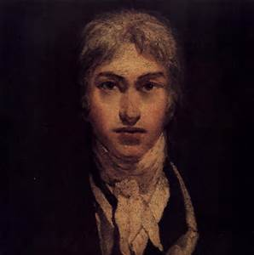
Self portrait

Slide 4
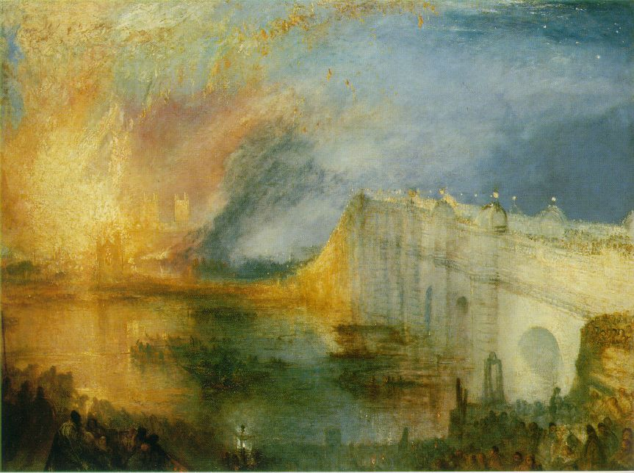
Burning

Slide 5
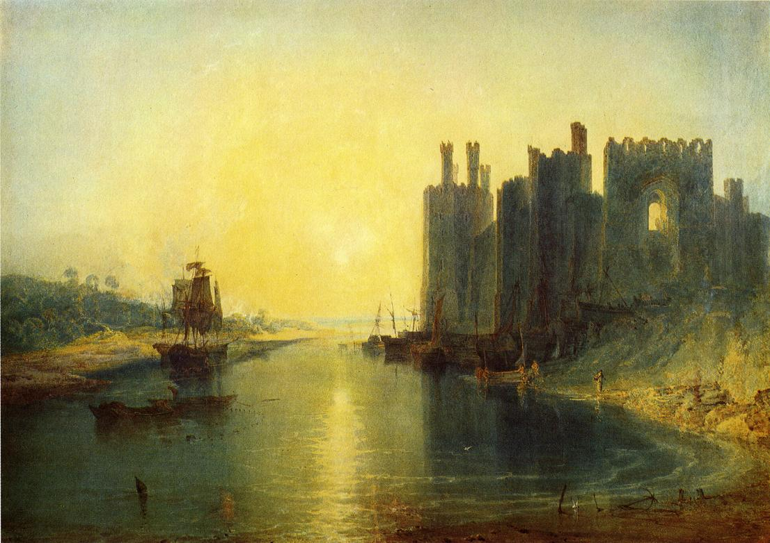
Caernarvon castle

Slide 6
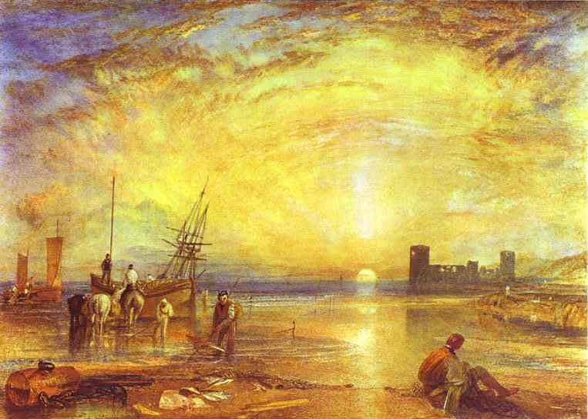
Flint castle

Slide 7
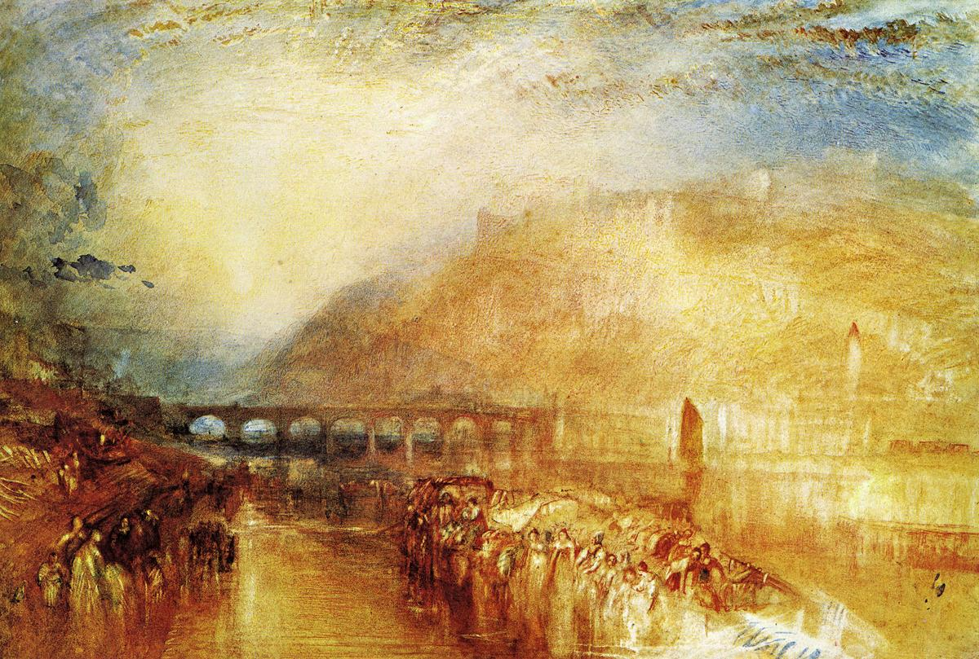
Heidelburg

Slide 8
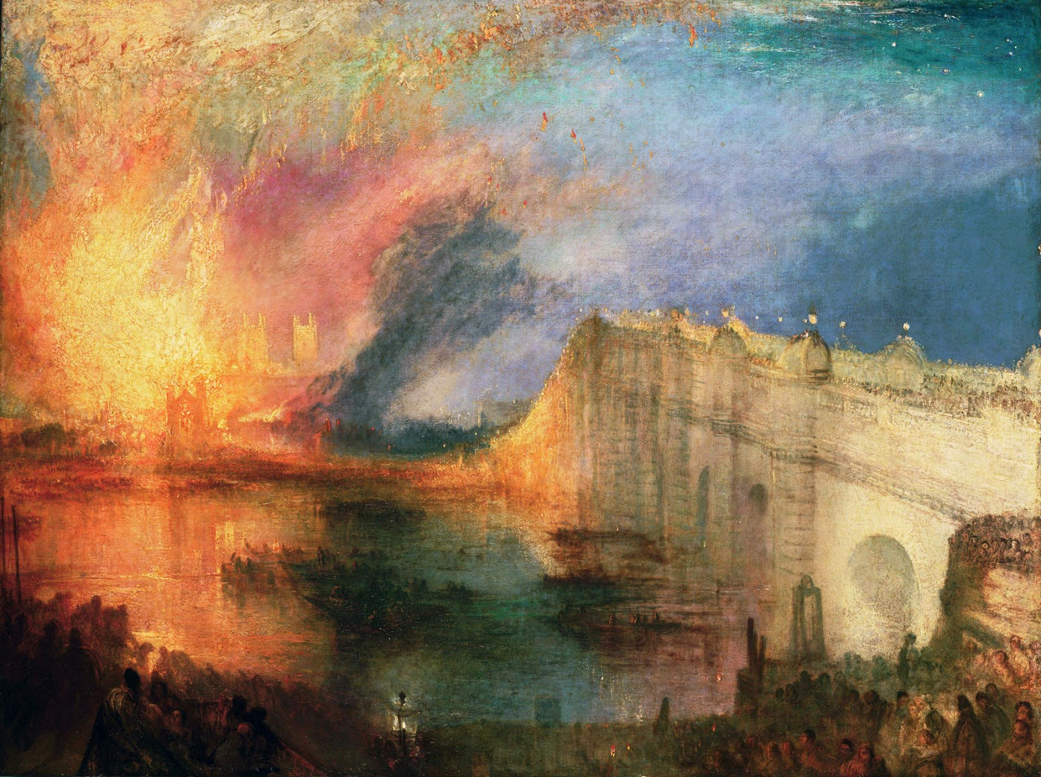
Burning of the house of lords and commons

Slide 9
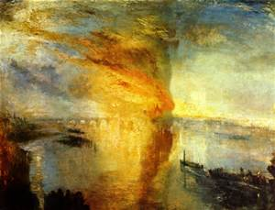

Slide 10
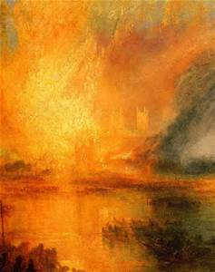

Slide 11
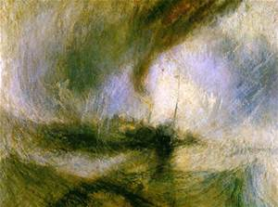

Slide 12
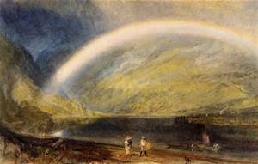

Slide 13
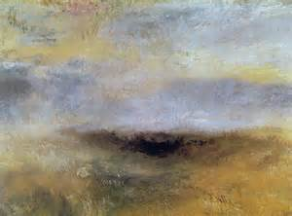

Slide 14
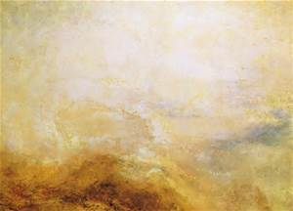

Slide 15
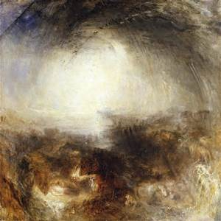

Slide 16
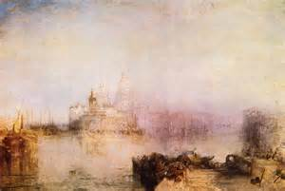

Slide 17
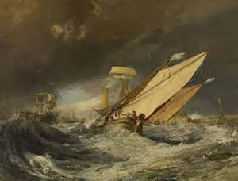

Slide 18
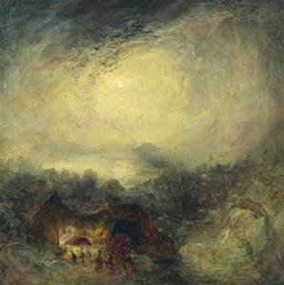

Slide 19
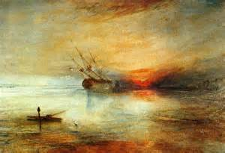

Slide 20
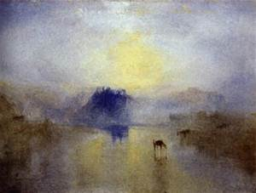

Slide 21
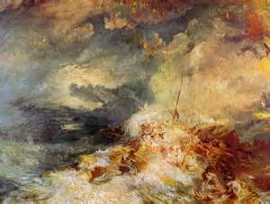

Slide 22
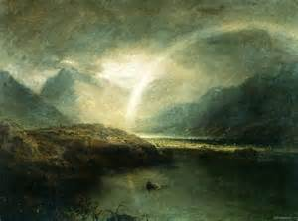

Slide 23
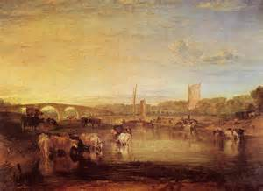

Slide 24
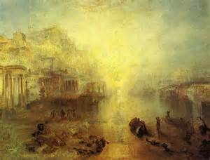

Slide 25
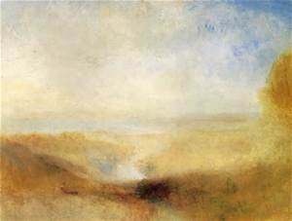

Slide 26
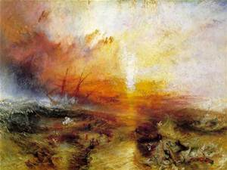

Slide 27
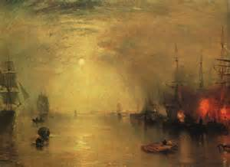

Slide 28
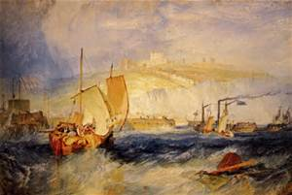

Slide 29
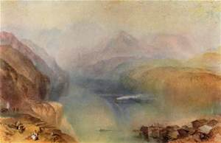

Slide 30
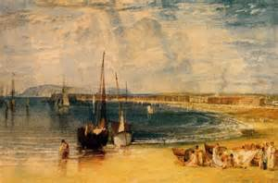

Slide 31
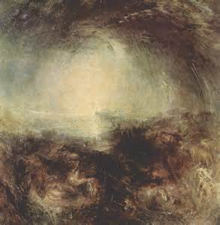

Slide 32
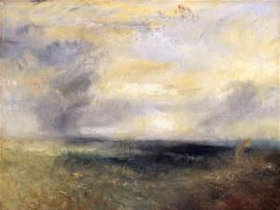

Slide 33
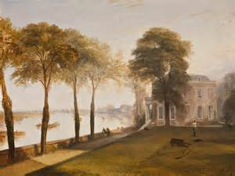

Slide 34
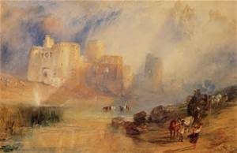

Slide 35
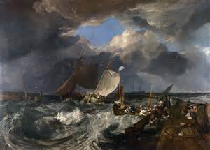

Slide 36
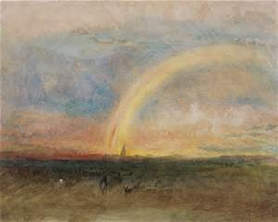

Slide 37
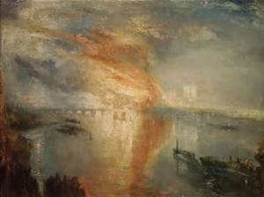

Slide 38
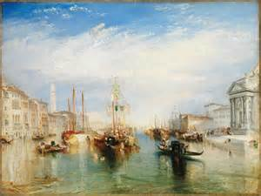

Slide 39
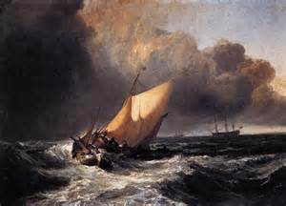

Slide 40
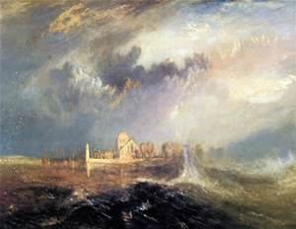

Slide 41
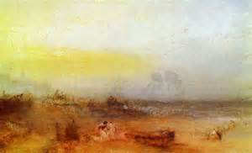

Slide 42
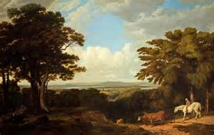

Slide 43
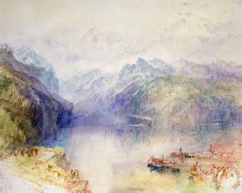

Slide 44
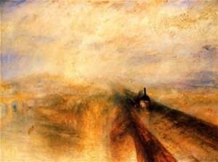

Slide 45
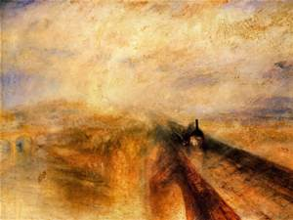

Slide 46
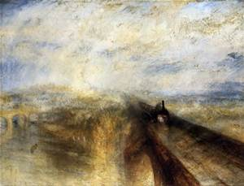

Slide 47
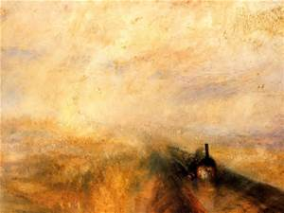

Slide 48
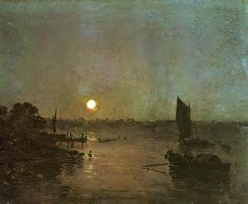

Slide 49
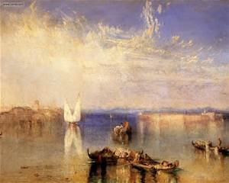

Slide 50
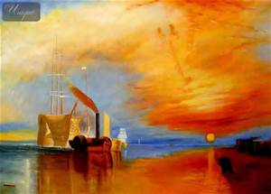

Slide 51
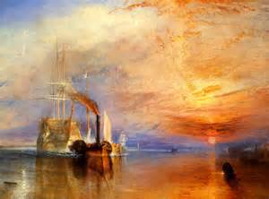

Slide 52
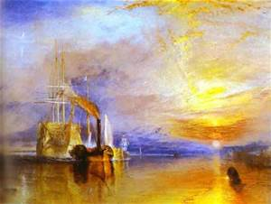

Slide 53


Slide 54


Slide 55


Slide 56


Slide 57


Slide 58


Slide 59


Slide 60


Slide 61


Slide 62


Slide 63


Slide 64


Slide 65


Slide 66


Slide 67


Slide 68


Slide 69


Slide 70


Slide 71


Slide 72


Slide 73


Slide 74


Slide 75


Slide 76


Slide 77


Slide 78


Slide 79


Slide 80


Slide 81


Slide 82


Slide 83


Slide 84


Slide 85


Slide 86


Slide 87


Slide 88


Slide 89


Slide 90


Slide 91


Slide 92


Slide 93


Slide 94


Slide 95


Slide 96


Slide 97


Slide 98


Slide 99


Slide 100


Slide 101


Slide 102


Slide 103


Slide 104


Slide 105


Slide 106


Slide 107


Slide 108


Slide 109

Morning after the deluge

Slide 110

Coalsby moonlight

Slide 111

Wreckers coast of Northumberland

