Slide 1
Islamic art, craft and architecture
Islamic art, craft and architecture has a profound legacy in the world history and shows creativity in it’s most amazing ways. It is very unique and is guided by the rules of Islam .
The presentation is a small glimpse into the world of Islamic art in it’s numerous forms and is for your private viewing only.
AKC/November 2015

Slide 2
Paintings of the Mughal era in India

Slide 3
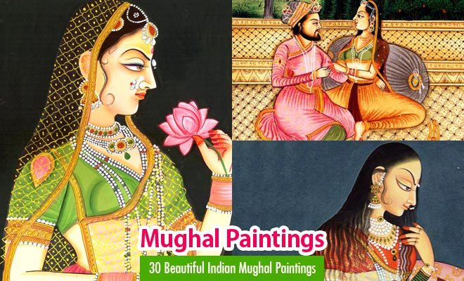

Slide 4
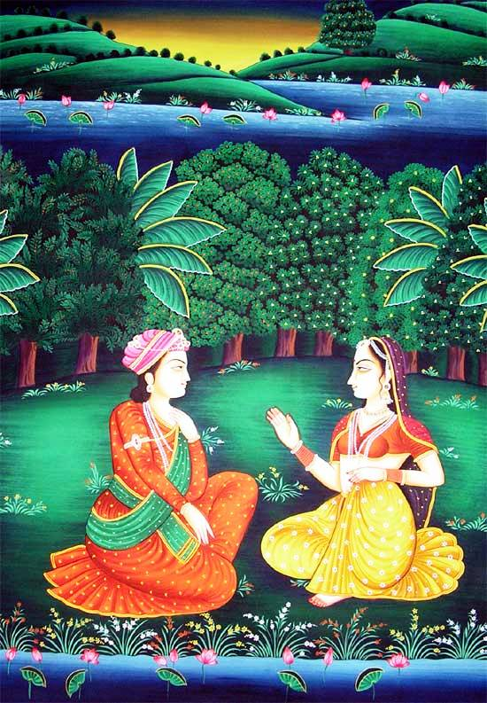

Slide 5
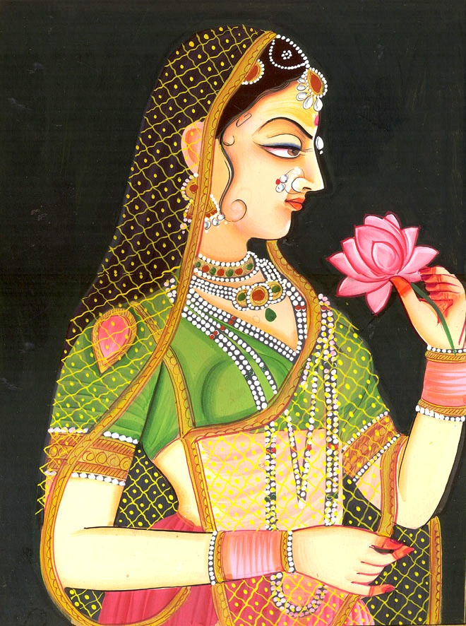

Slide 6
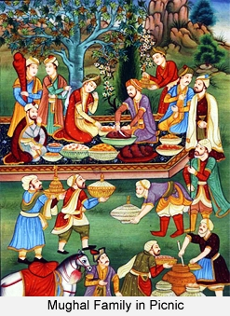

Slide 7
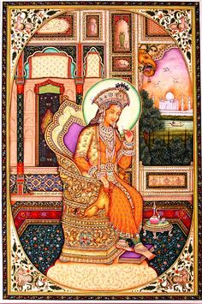

Slide 8
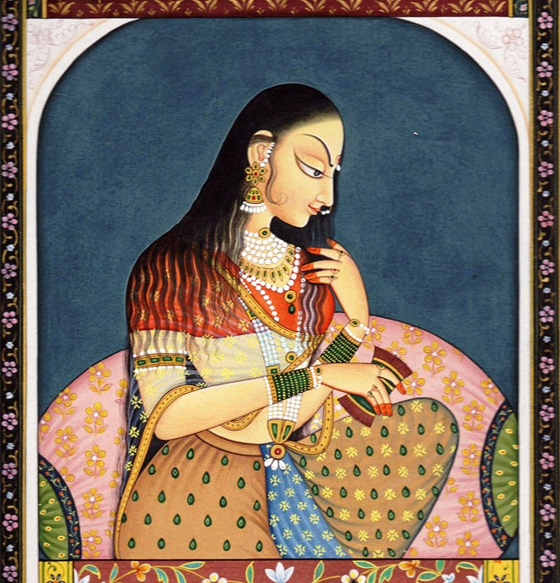

Slide 9
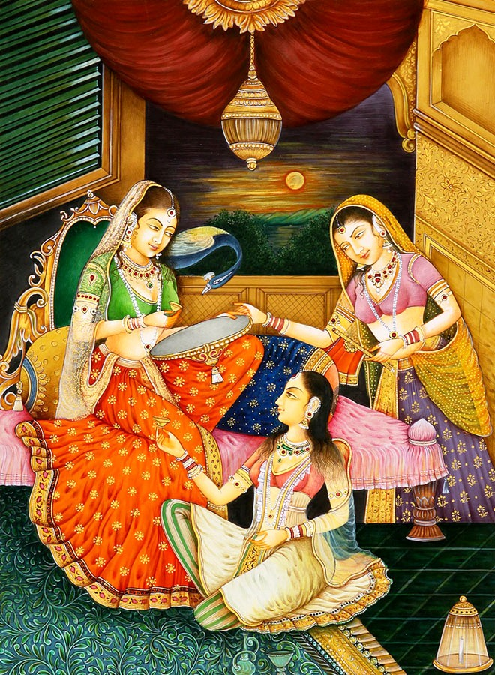

Slide 10
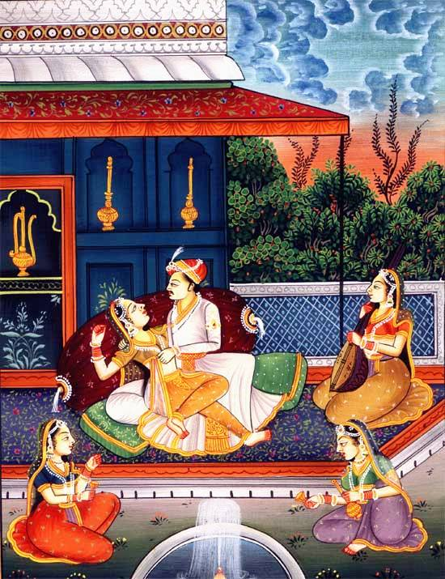

Slide 11
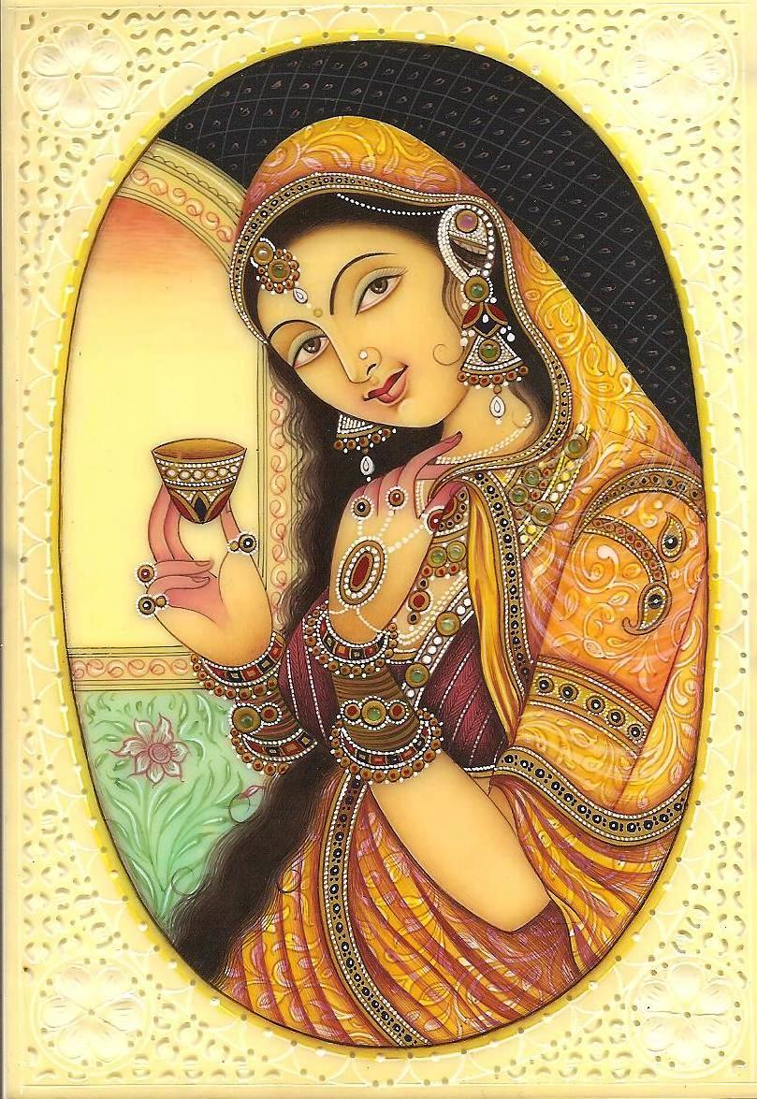

Slide 12
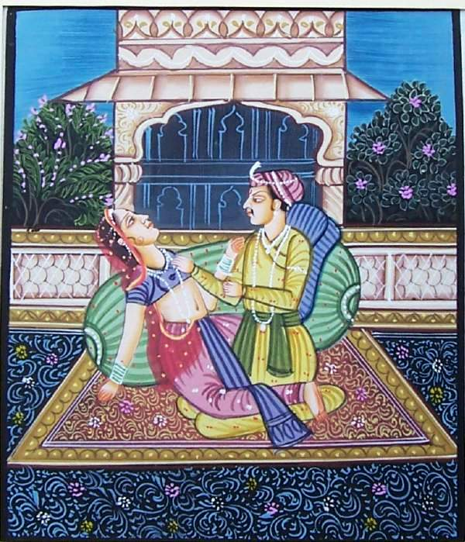

Slide 13
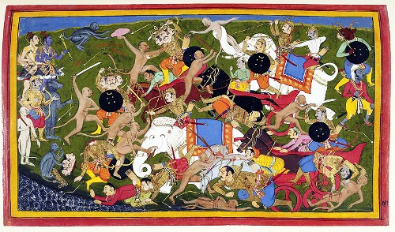

Slide 14
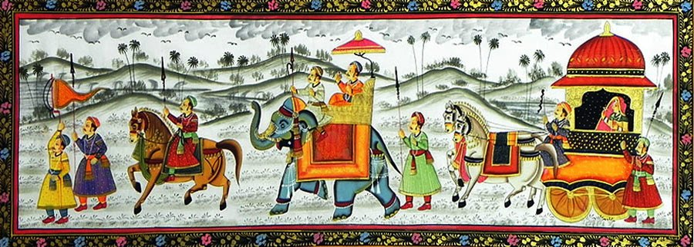

Slide 15
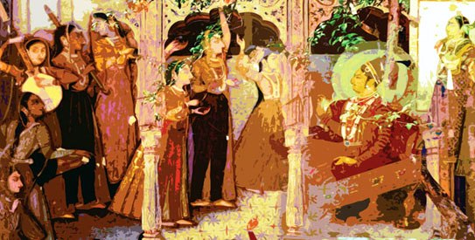

Slide 16
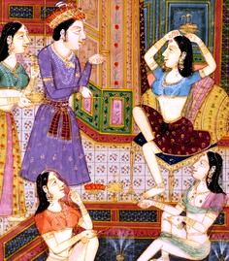

Slide 17
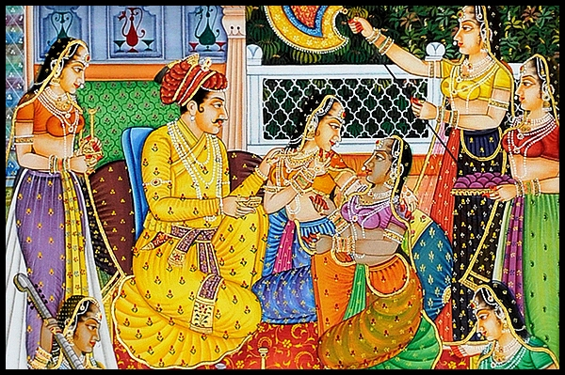

Slide 18
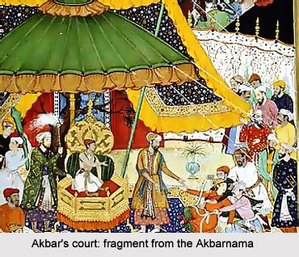

Slide 19
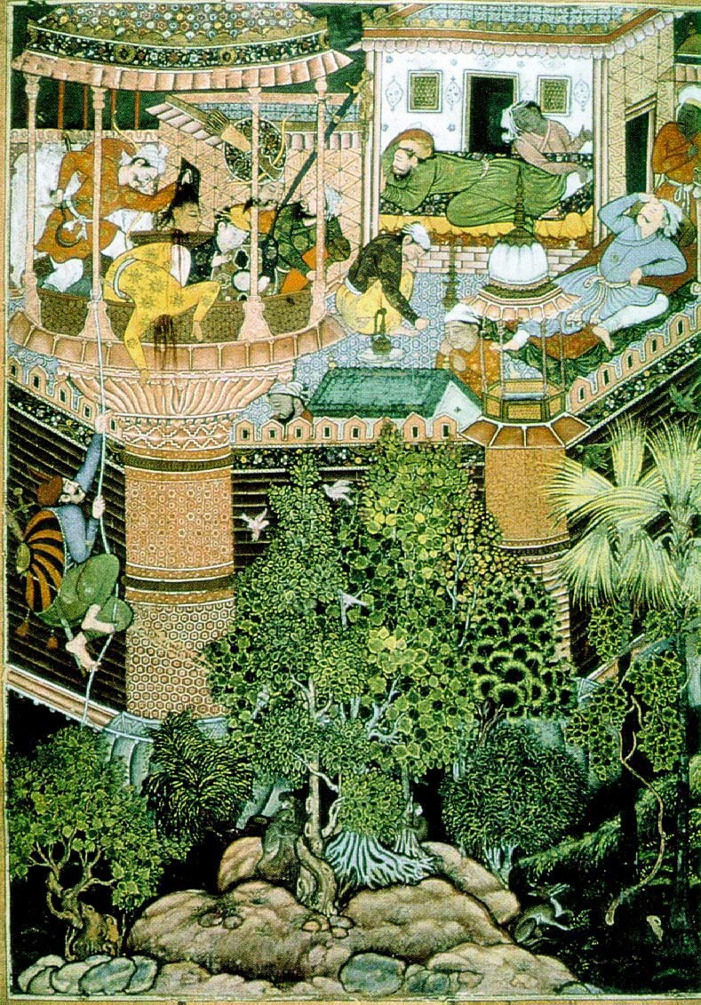

Slide 20
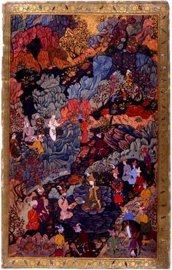

Slide 21
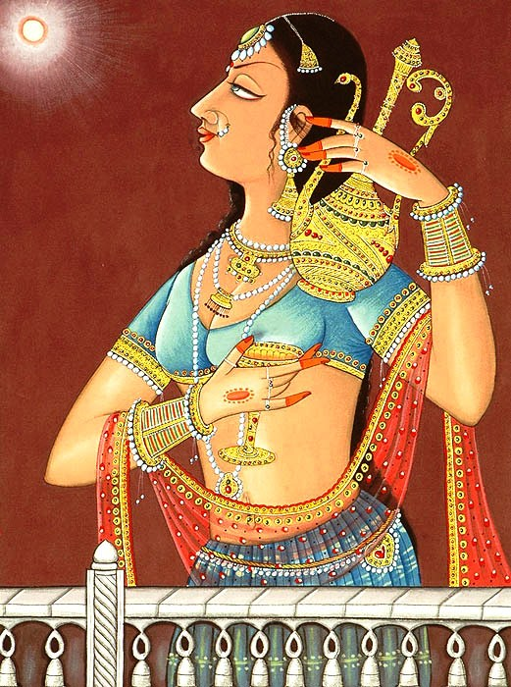

Slide 22
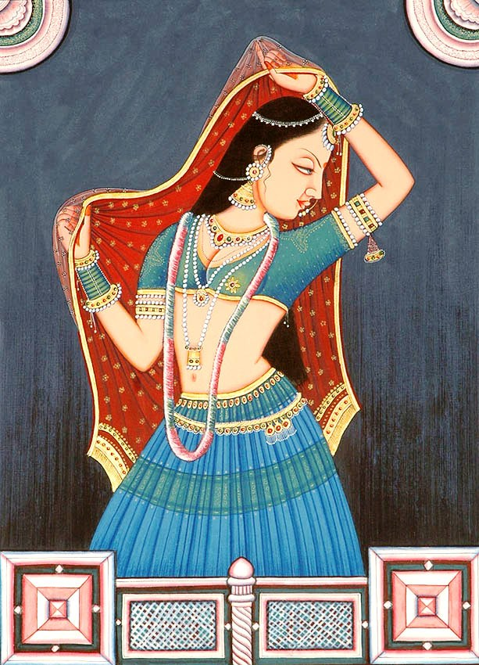

Slide 23
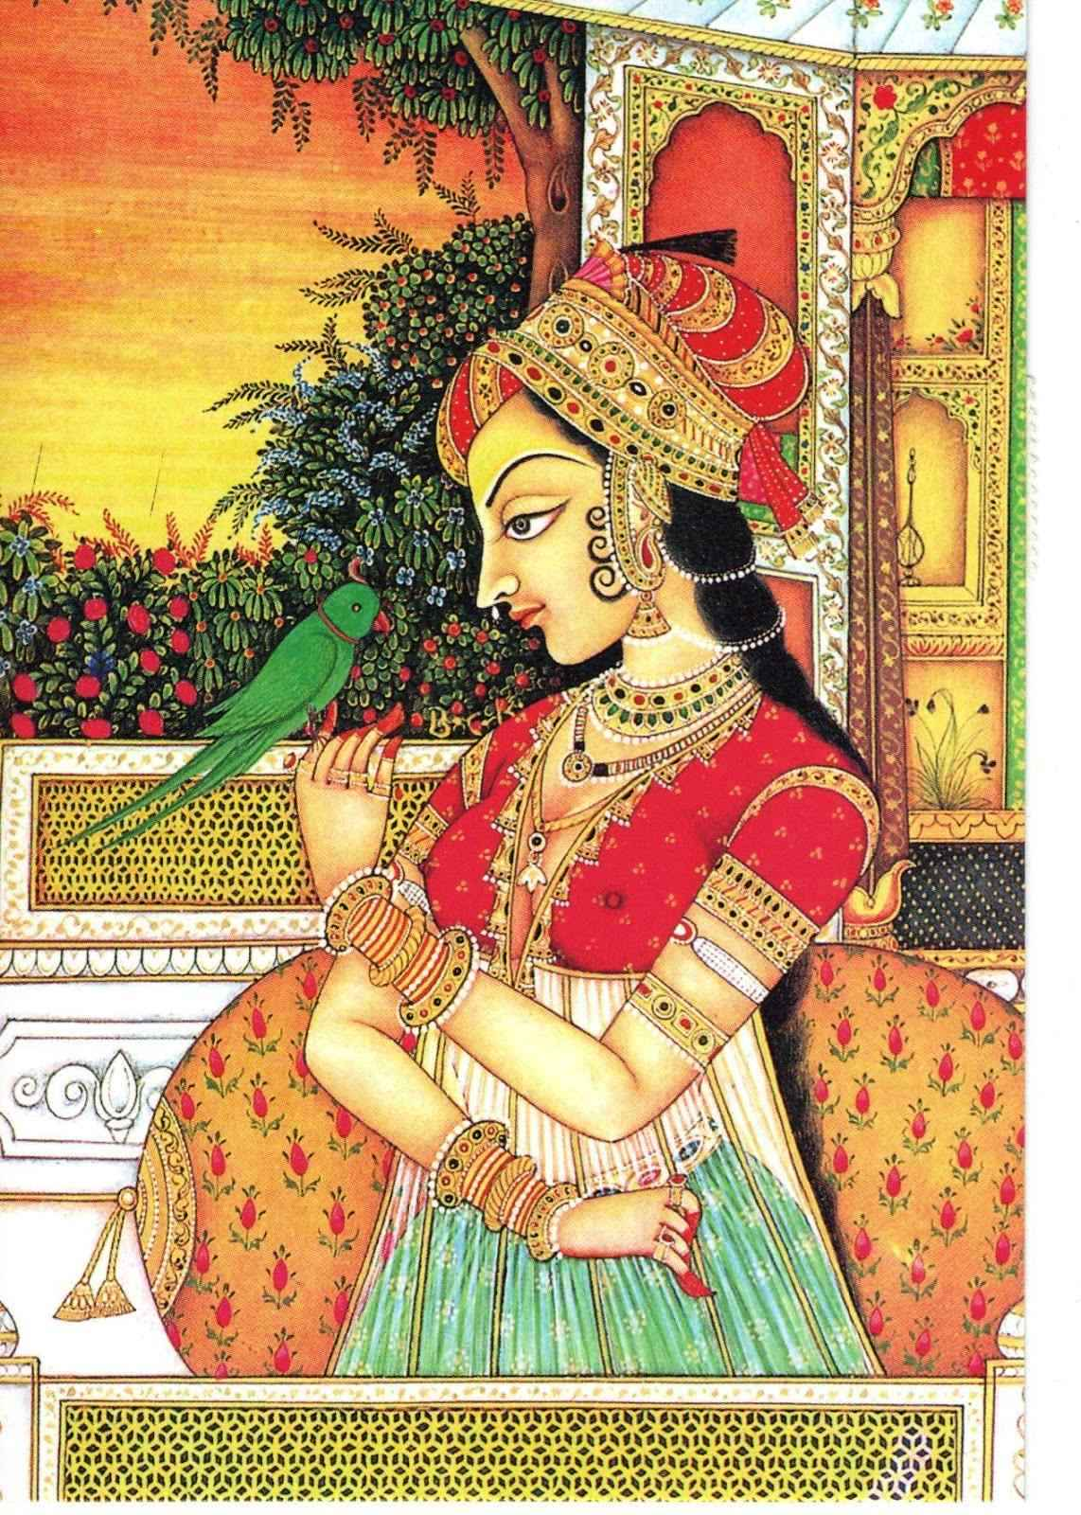

Slide 24
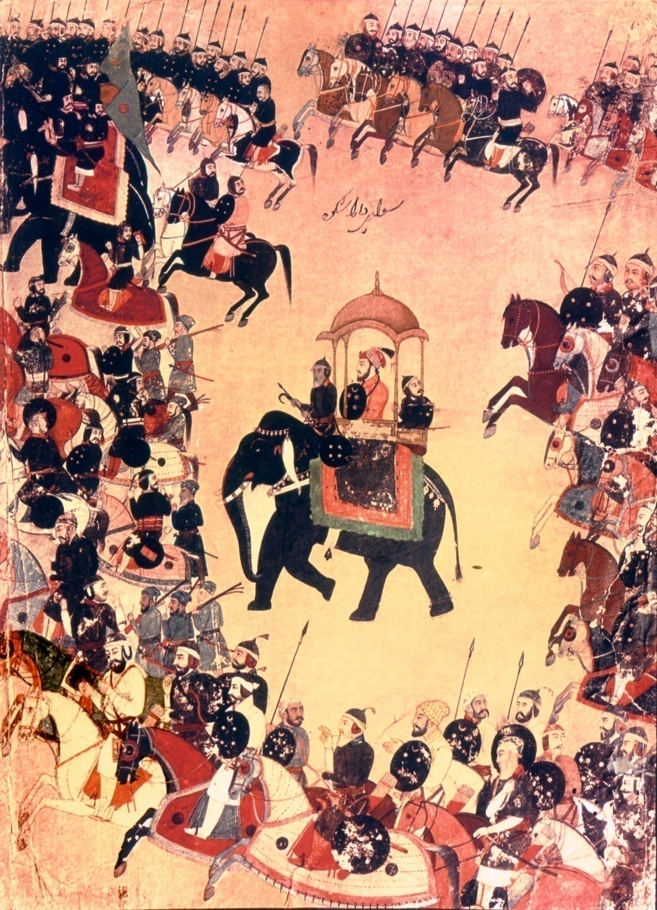

Slide 25
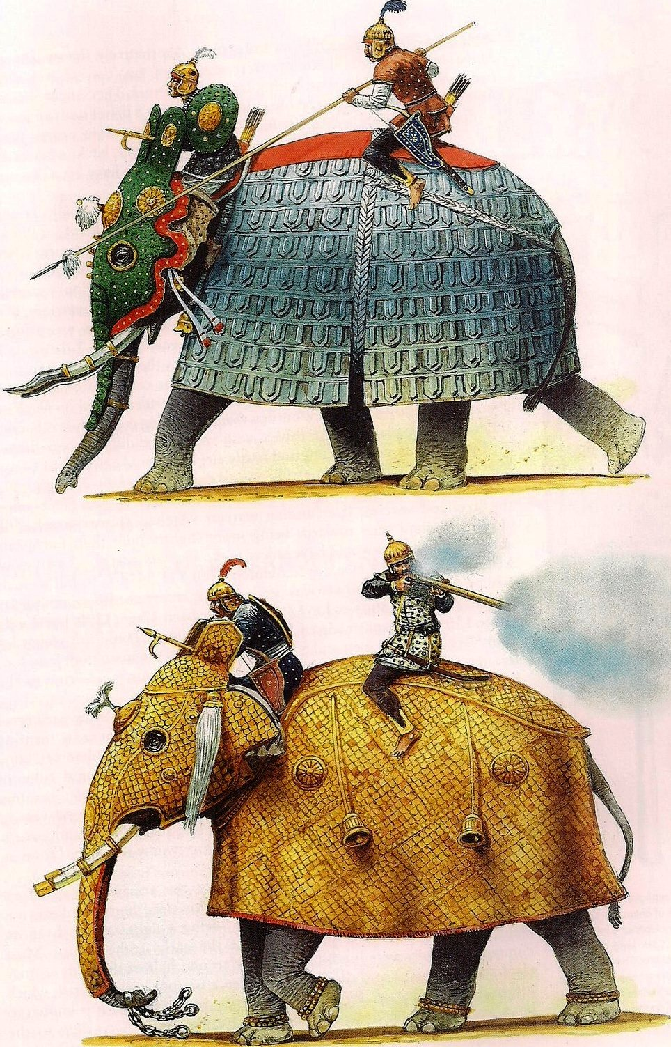

Slide 26
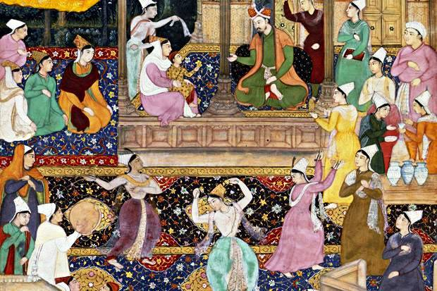

Slide 27
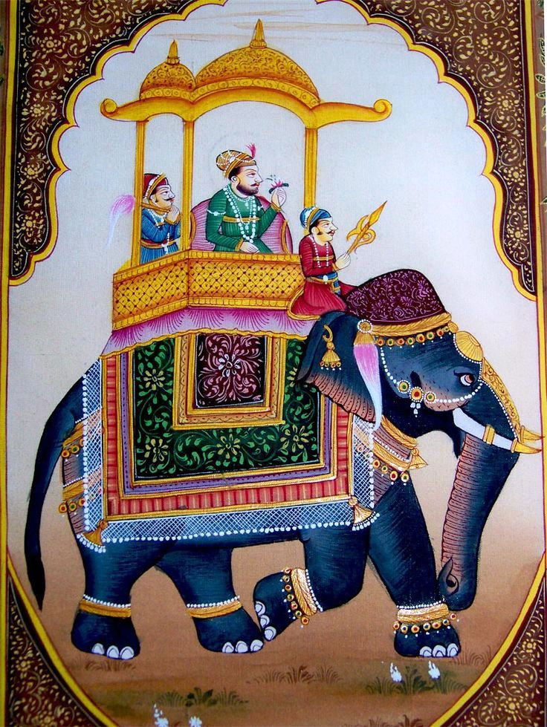

Slide 28
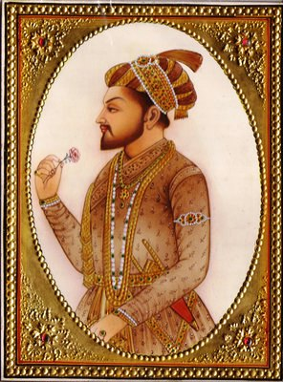

Slide 29
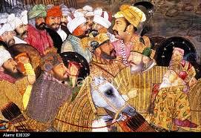

Slide 30
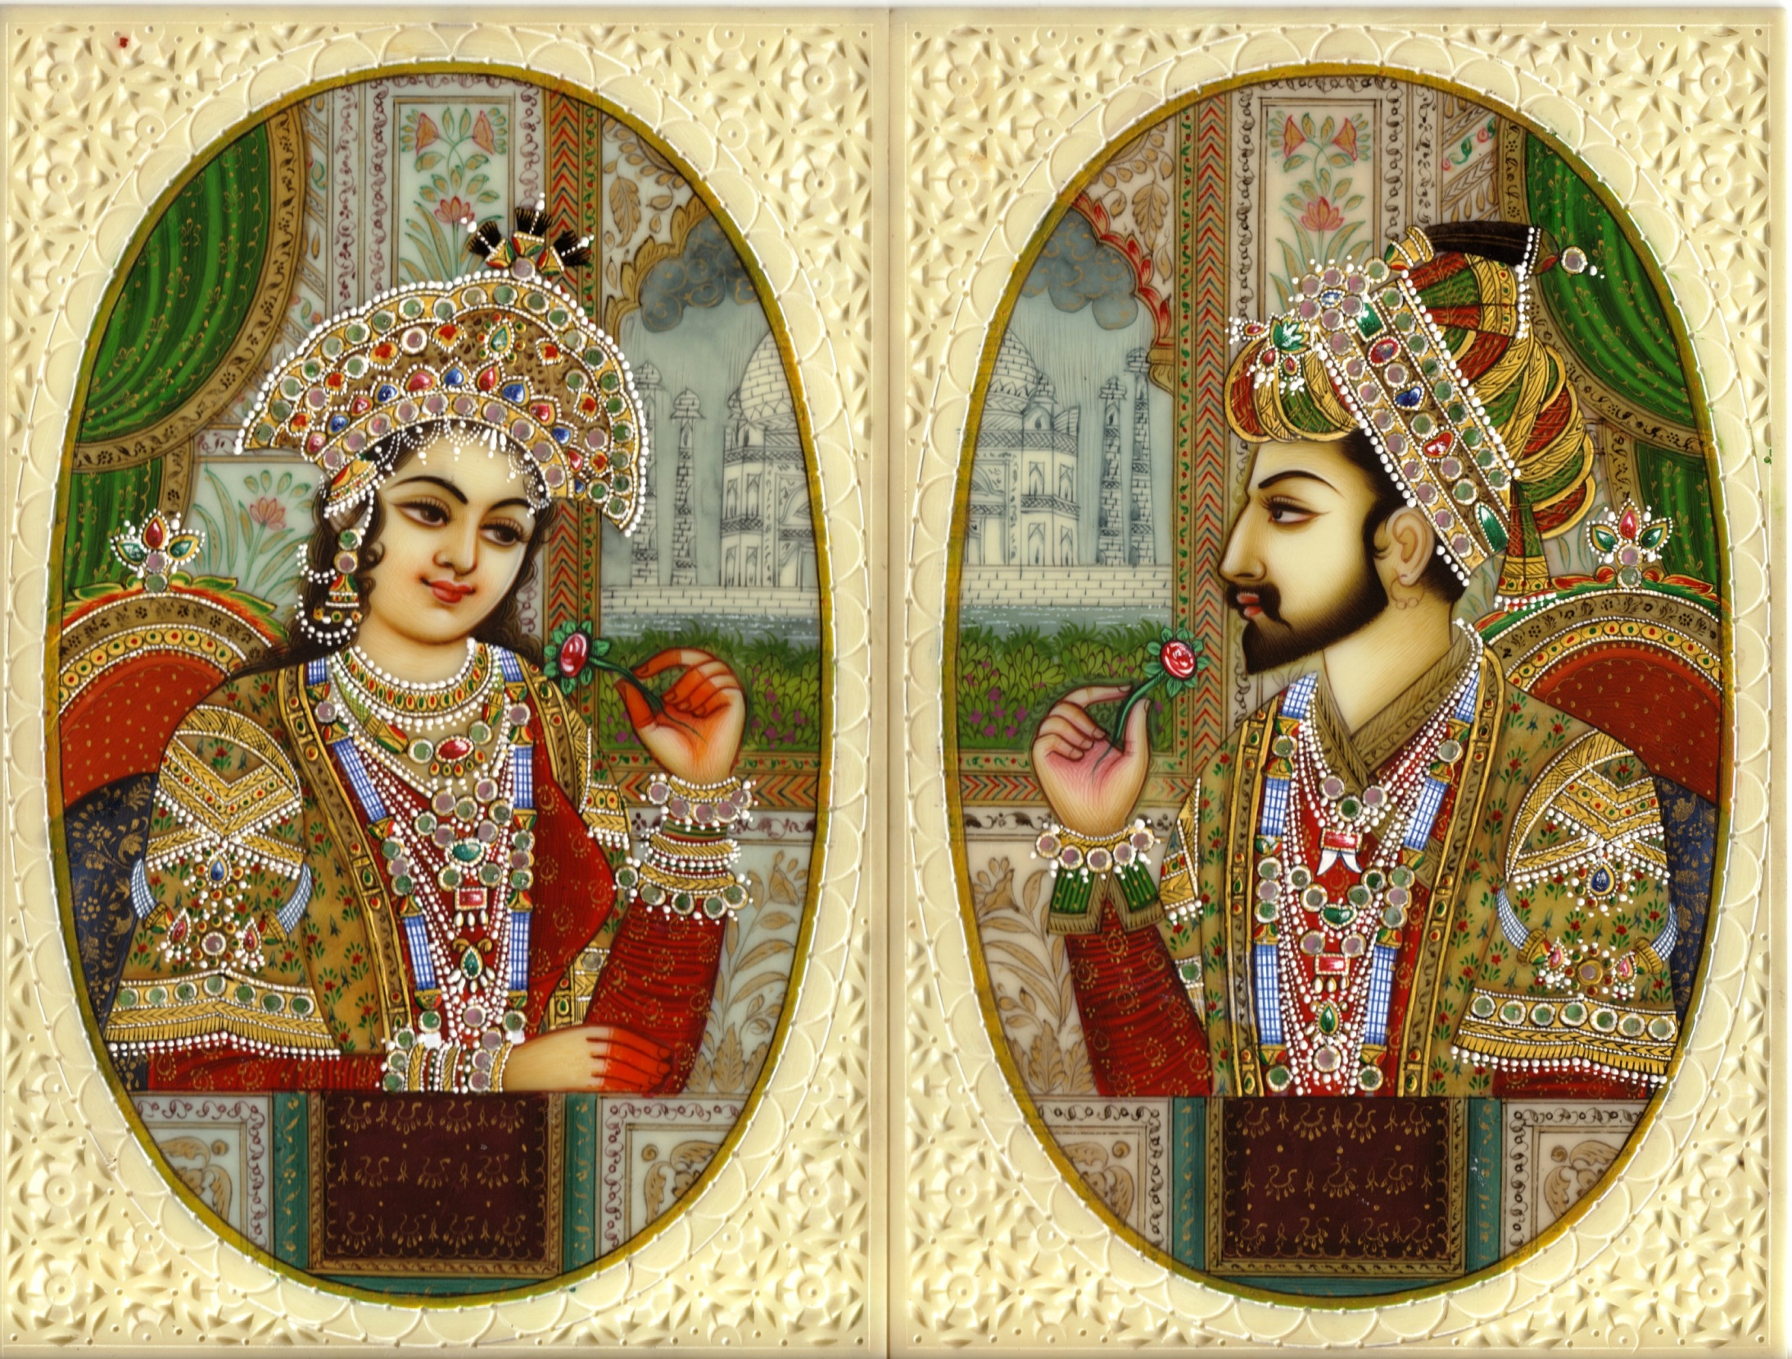

Slide 31
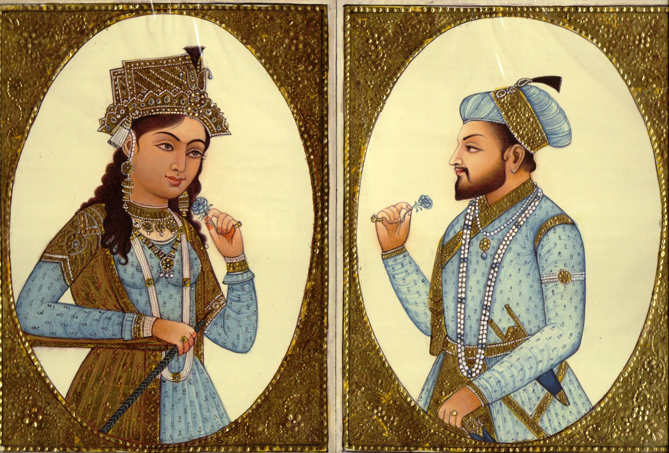

Slide 32
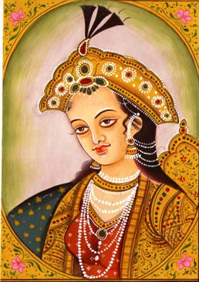

Slide 33
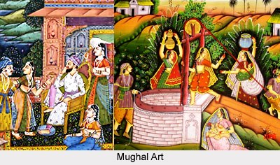

Slide 34
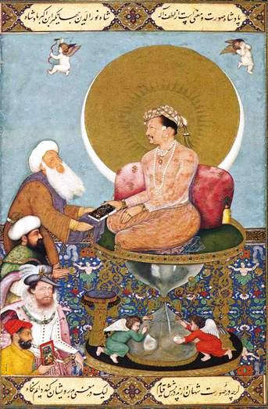

Slide 35
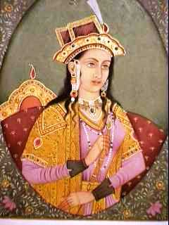

Slide 36
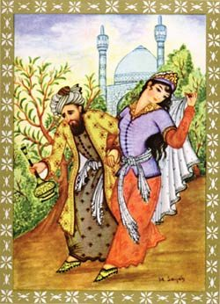

Slide 37
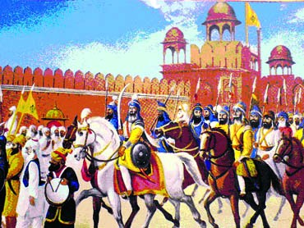

Slide 38
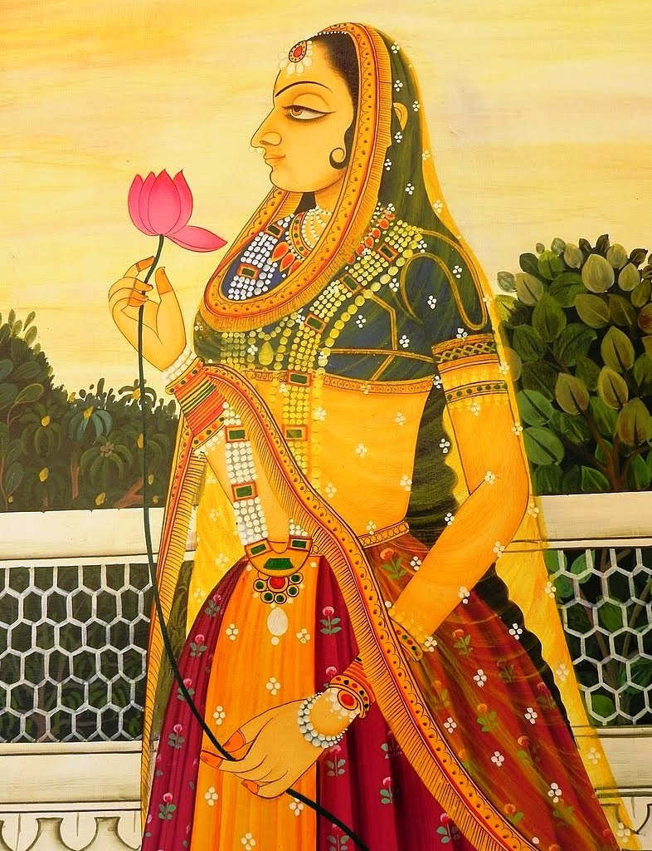

Slide 39
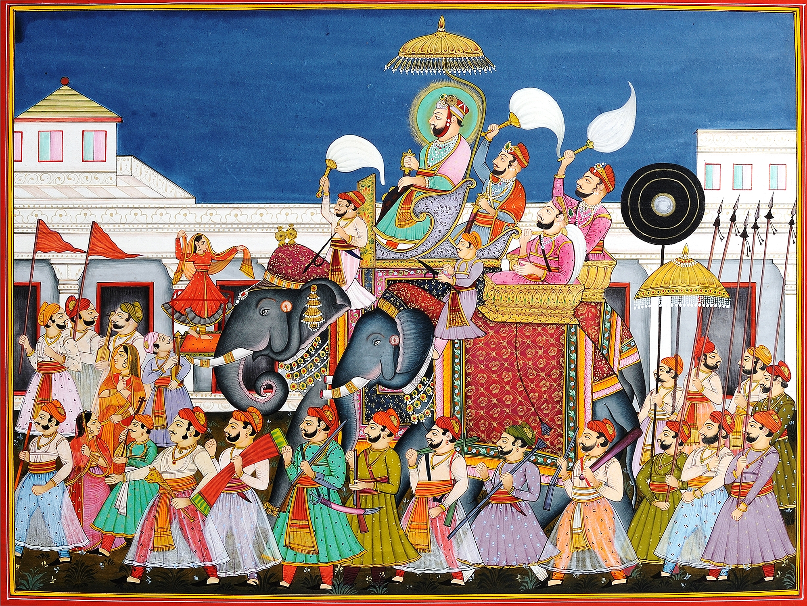

Slide 40
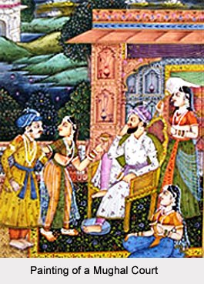

Slide 41
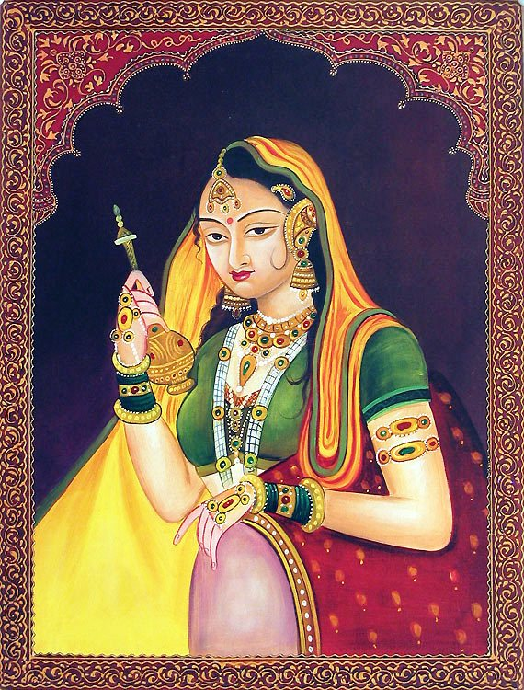

Slide 43
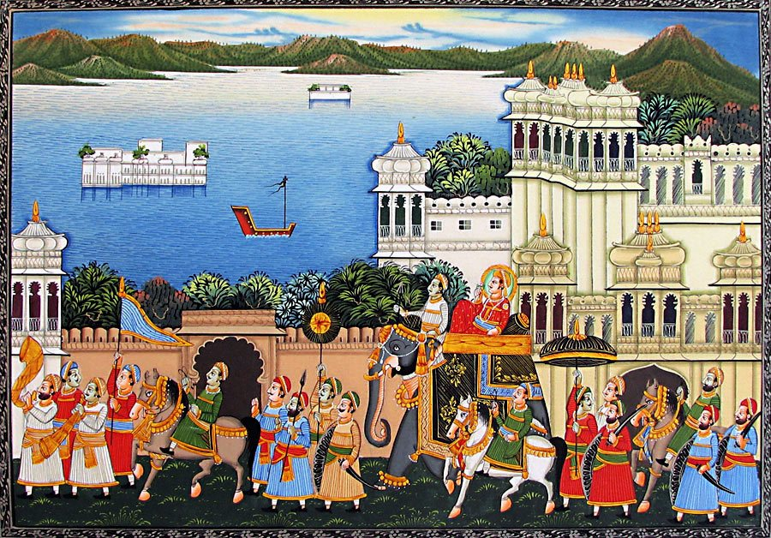

Slide 44
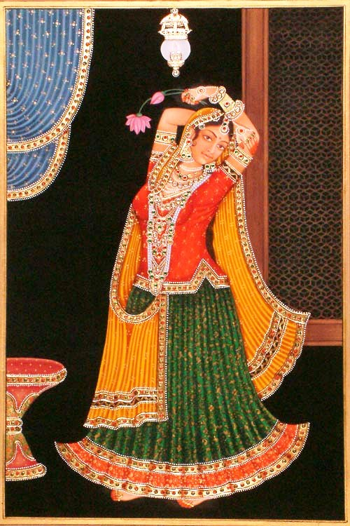
Nautch girl

Slide 45
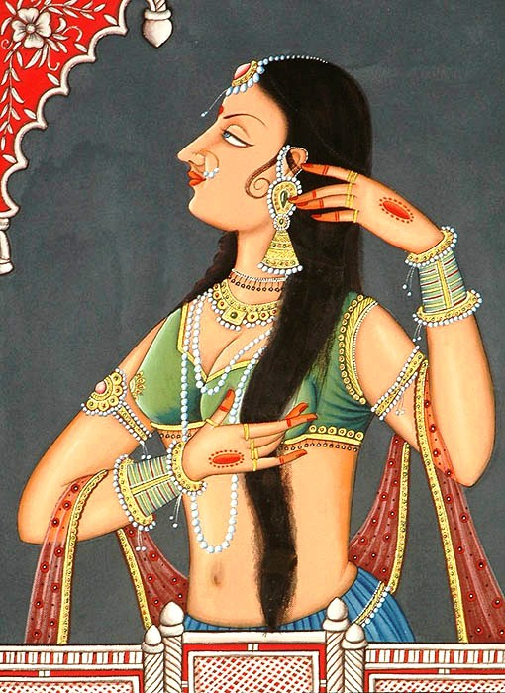

Slide 46
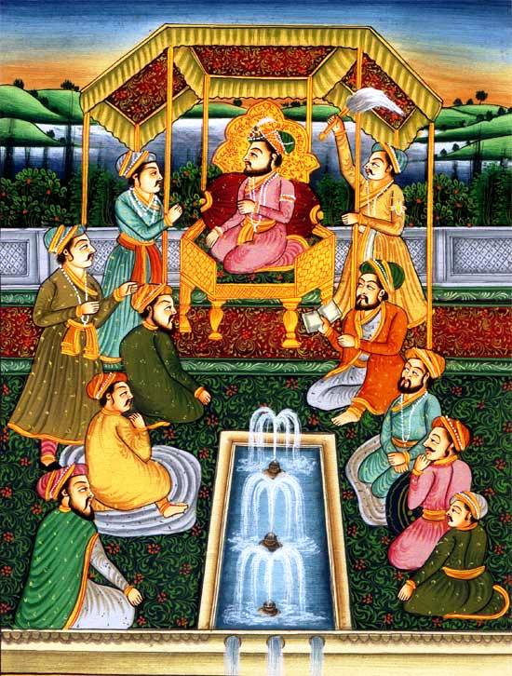

Slide 47
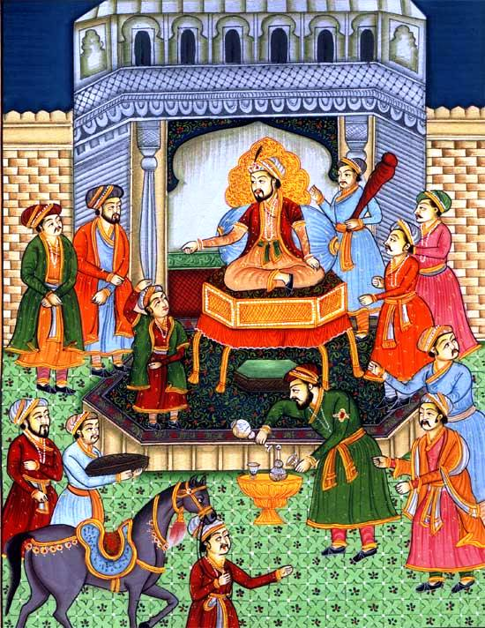

Slide 48
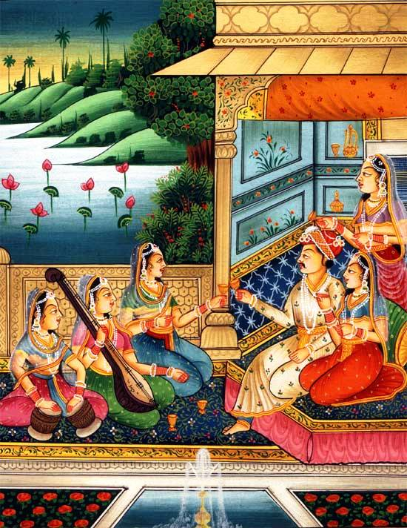

Slide 49
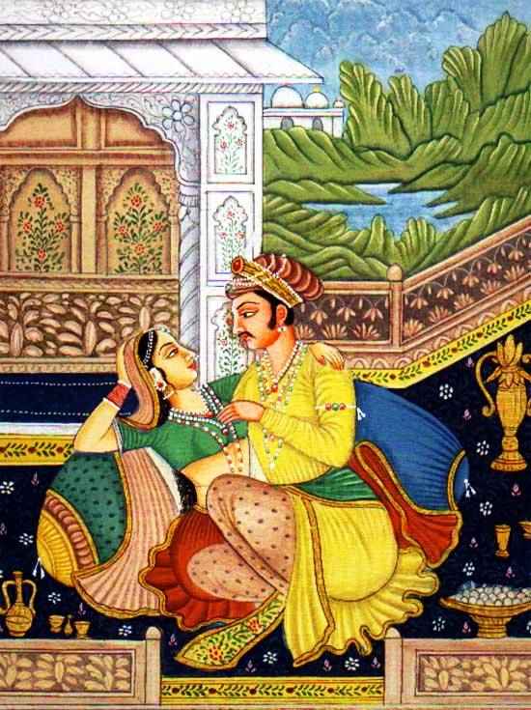

Slide 50
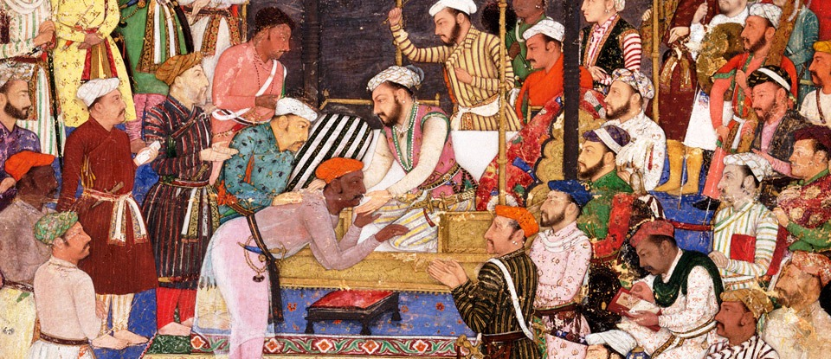

Slide 52
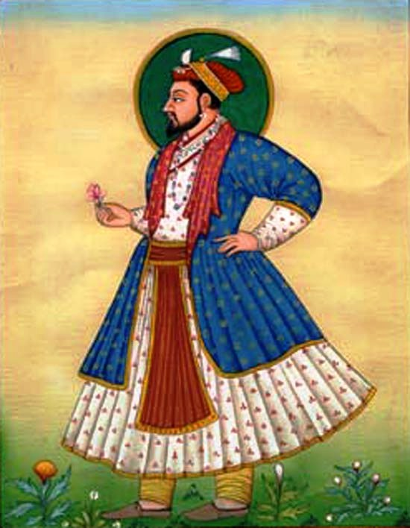
Shah Jahan

Slide 53
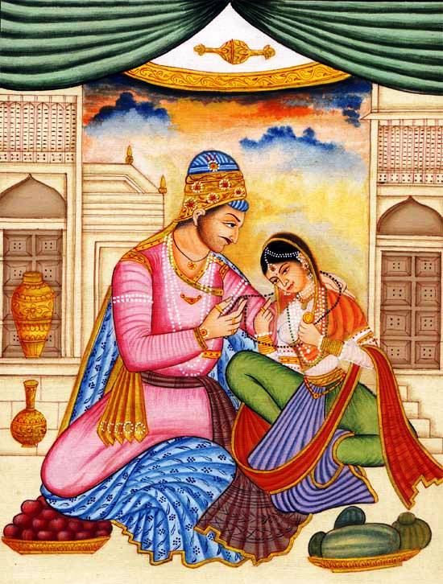

Slide 54
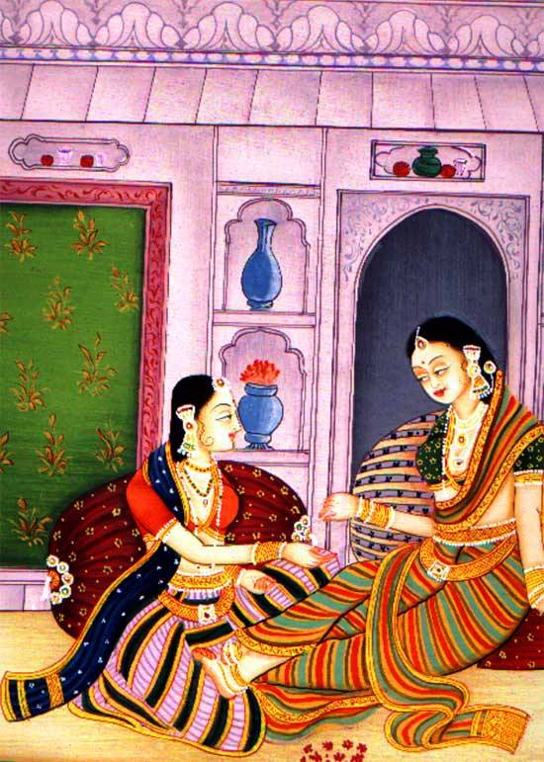

Slide 55


Slide 56


Slide 57


Slide 58


Slide 59


Slide 60


Slide 61


Slide 62


Slide 64
Islamic architecture and mosque decorations

Slide 65


Slide 66


Slide 67

Shiraj, Iran

Slide 68


Slide 69

Raya Banda, Indonesia

Slide 70

Suleimania mosque, Istambul

Slide 71


Slide 72


Slide 73

Tiles

Slide 74


Slide 75


Slide 76


Slide 77


Slide 78


Slide 79

Craftsman at work

Slide 80


Slide 81


Slide 82


Slide 83


Slide 84

Medina Azahara,Cordova, Spain

Slide 85
Islamic craft at it’s finest
The pottery, silk print, stone carved vessels, metal craft etc. dazzle the world with their beauty. The ceramic tiles that decorate their mosques are unique. The arabesque patterns using geometry have infinite variants as shown elsewhere.

Slide 86

Cordova, Spain

Slide 87


Slide 88


Slide 89


Slide 90


Slide 91


Slide 92

Fatimid crystal

Slide 93


Slide 94


Slide 95

Ceramics, Ottoman empire

Slide 96

Ottoman pottery

Slide 97


Slide 98


Slide 99

Ottoman plate

Slide 100


Slide 101

Ancient Islamic art

Slide 102


Slide 103


Slide 104


Slide 105


Slide 106

Patterns

Slide 107


Slide 108


Slide 109


Slide 110


Slide 111


Slide 112


Slide 113


Slide 114


Slide 115


Slide 116


Slide 117

Alhambra ,Granada,Spain

Slide 118


Slide 119


Slide 120


Slide 121


Slide 122


Slide 123


Slide 124

Alhambra, Granada,Spain

Slide 125


Slide 126


Slide 127


Slide 128

Calligraphy art

Slide 129


Slide 130

Hagia in Augustuspolis

Slide 131

Taj Mahal, Agra,India

Slide 132


Slide 133

Samara, Iraq

Slide 134


Slide 135

Abbasid period, Samara,Iraq

Slide 136

Golden dome of Al Aqsa mosque, Jerusalem

Slide 137

Abu Dhabi grand mosque

Slide 138

Al Jaferia palace, Spain

Slide 139


Slide 140


Slide 141


Slide 142


Slide 143

Al Sharif mosque

Slide 144


Slide 145

Museum of Islamic art, Doha

Slide 146


Slide 147

Doha museum

Slide 148

Faisal mosque, Pakistan

Slide 149


Slide 150

Samarkand, Uzbekistan

Slide 151


Slide 152

Istambul,Turkey

Slide 153

Dome of the rock, Jerusalem

Slide 154

Blue mosque, Istambul

Slide 155


Slide 156

Mohd.Ali mosque, Lion

Slide 157


Slide 158


Slide 159

Modern Islamic architecture

Slide 160


Slide 161

Hui mosque,Ningxia,China

Slide 162


Slide 163


Slide 164


Slide 165

Itmadudaula mausoleum, Agra

Slide 166


Slide 167


Slide 168


Slide 169

Doha museum of Islamic art

Slide 170

Islamic center in America

Slide 171

Al Aqsa mosque, Jerusalem

Slide 172

Islamic center in Toledo ,USA

Slide 173

Mosque, Djenne, Mali

Slide 174

Timbuktu , Mali

Slide 175


Slide 176


Slide 177


Slide 178


Slide 179


Slide 180


Slide 181

Persian arch

Slide 182

Darb I Imam, Isfahan,Iran

Slide 183

Qutub minar, Delhi

Slide 184


Slide 185


Slide 186


Slide 187


Slide 188


Slide 189


Slide 190


Slide 191


Slide 192


Slide 193


Slide 194


Slide 195


Slide 196


Slide 197


Slide 198


Slide 199


Slide 200


Slide 201

Girih tiles

Slide 202


Slide 203


Slide 204


Slide 205


Slide 206


Slide 207


Slide 208

Grand post office,Algiers

Slide 209


Slide 210

Alhambra,Granada,Spain

Slide 211


Slide 212


Slide 213


Slide 214


Slide 215


Slide 216


Slide 217


Slide 218


Slide 219


Slide 220


Slide 221


Slide 222


Slide 223


Slide 224


Slide 225


Slide 226


Slide 227


Slide 228


Slide 229


Slide 230


Slide 231


Slide 232


Slide 233


Slide 234


Slide 235


Slide 236


Slide 237


Slide 238

Morocco

Slide 239


Slide 240


Slide 241


Slide 242


Slide 243


Slide 244


Slide 245


Slide 246


Slide 247


Slide 248


Slide 249


Slide 250


Slide 251


Slide 252


Slide 253


Slide 254


Slide 255


Slide 256


Slide 257


Slide 258


Slide 259

Stone screen

Slide 260


Slide 261


Slide 262


Slide 263


Slide 264


Slide 265


Slide 266


Slide 267


Slide 268


Slide 269


Slide 270


Slide 271


Slide 272


Slide 273


Slide 274


Slide 275


Slide 276


Slide 277


Slide 278


Slide 279


Slide 280


Slide 281


Slide 282


Slide 283


Slide 284


Slide 286


Slide 287


Slide 288


Slide 289


Slide 290


Slide 291


Slide 292

Isfahan, Iran

Slide 293

Isfahan Imam mosque

Slide 294


Slide 295


Slide 296


Slide 297


Slide 298


Slide 299

Jam, Afghanistan

Slide 300


Slide 301


Slide 303


Slide 304


Slide 305


Slide 306


Slide 307


Slide 308


Slide 309


Slide 310


Slide 311


Slide 312


Slide 313


Slide 314


Slide 315


Slide 316


Slide 317


Slide 318


Slide 319

Isfahan, Iran

Slide 320


Slide 321


Slide 322


Slide 323


Slide 324


Slide 325


Slide 326

Isphahan, Iran

Slide 327


Slide 328


Slide 329


Slide 330

Turkish mosque, Johanesburg

Slide 331

Khomeini mosque, Isfahan,Iran

Slide 332


Slide 333


Slide 334


Slide 335


Slide 336


Slide 337

La Mesquita de Cordoba, Spain

Slide 338


Slide 339


Slide 340

Morocco

Slide 341


Slide 342

Qutub Minar, Delhi

Slide 343

Multan

Slide 344


Slide 345

Nejameddin Kubra mausoleum

Slide 346

Ottoman period mosque

Slide 347


Slide 348

Shah mosque, Isfahan, Iran

Slide 349

Egypt

Slide 350

Qutub minar,Delhi

Slide 351

Quatar museum

Slide 352

Cordoba, Spain

Slide 353

Rabat, Morocco

Slide 354

Musamman burj, Red Fort, Agra

Slide 355

Salah al deen

Slide 356


Slide 357

Selimiye mosque dome

Slide 358


Slide 359

Shah mosque, Isfahan, Iran

Slide 360

Sheikh Latif Allah mosque, Isfahan

Slide 361


Slide 362


Slide 363

Dome of Suleimania mosque

Slide 364

Tabriz mosque

Slide 365

Taj Mahal, India

Slide 366


Slide 367


Slide 368


Slide 369


Slide 370


Slide 371


Slide 372


Slide 373


Slide 374


Slide 375


Slide 376


Slide 377

Turkey

Slide 378


Slide 380


Slide 381

Waleed, Petra, Jordan

Slide 382


