Slide 1
Handloom silk sarees of Benares
Part one

Slide 2
Editor’s note
The handmade silk sarees of Benares are fabled for their originality, brilliance in color and exquisite details . Although the demands of modern life has made many women go for Shalwar Kurta or even Western clothes that has a profound effect on the silk industry , the Benares silk saree still occupies a special place in the heart of all women. No two sarees are made alike . The superb craftsmanship and attention to details make these sarees unique and very special.
I have presented a very small sample of this great art in silk for your private viewing pleasure only.
AKC/November 2015

Slide 3
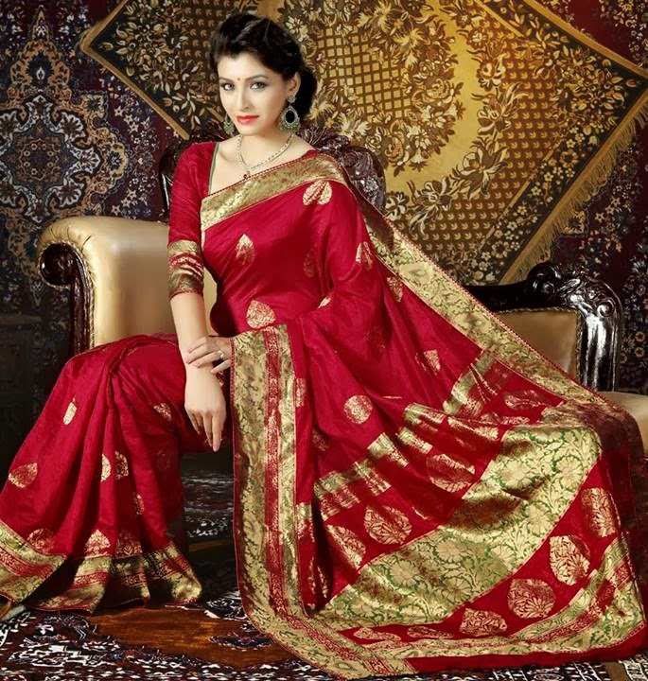

Slide 4
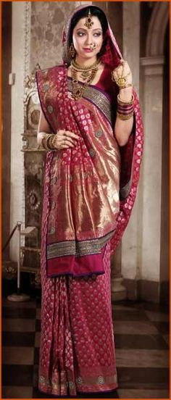
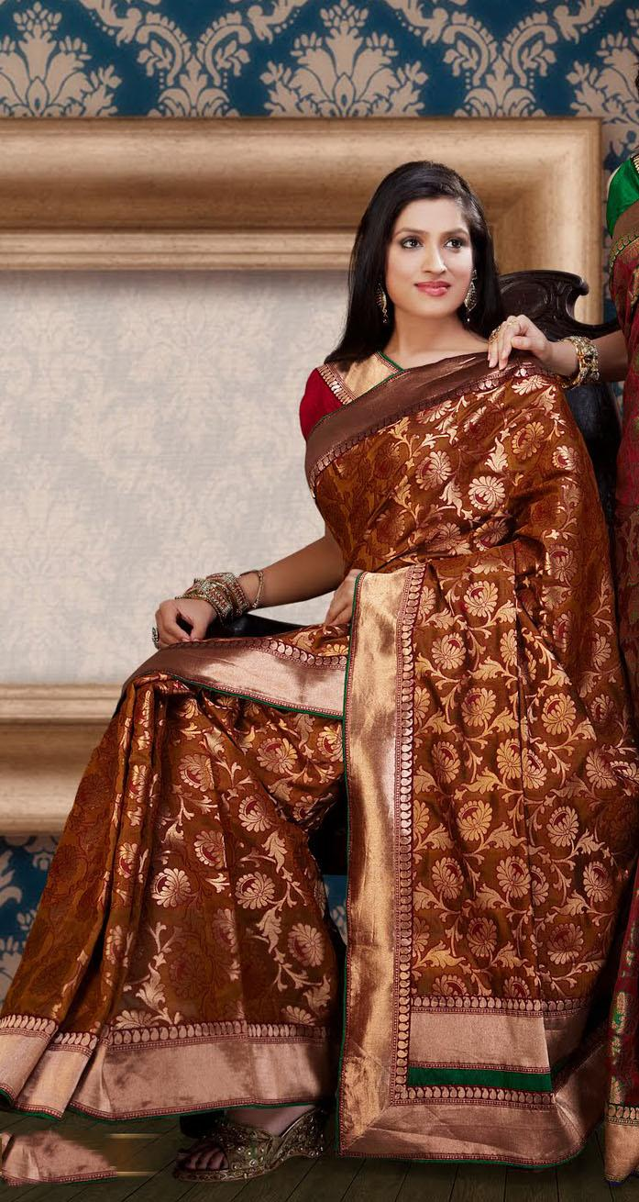
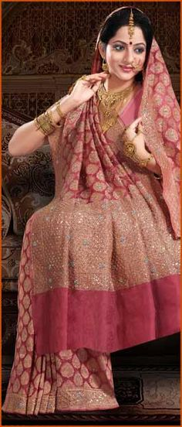

Slide 5
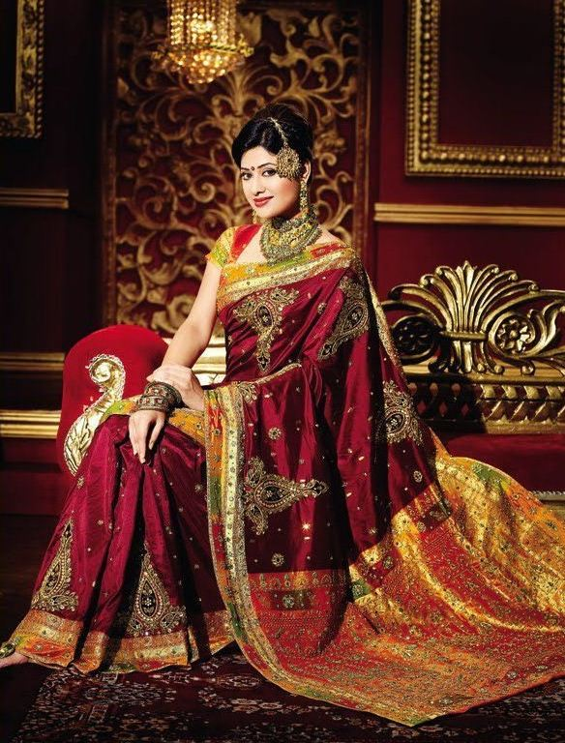

Slide 6
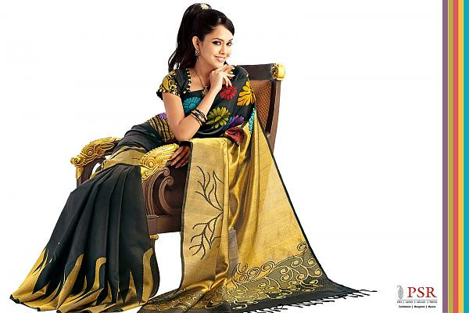

Slide 7
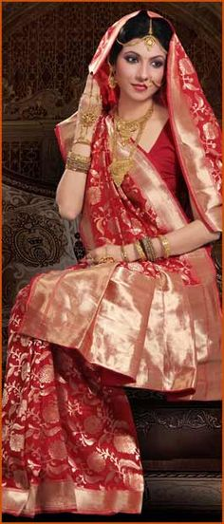
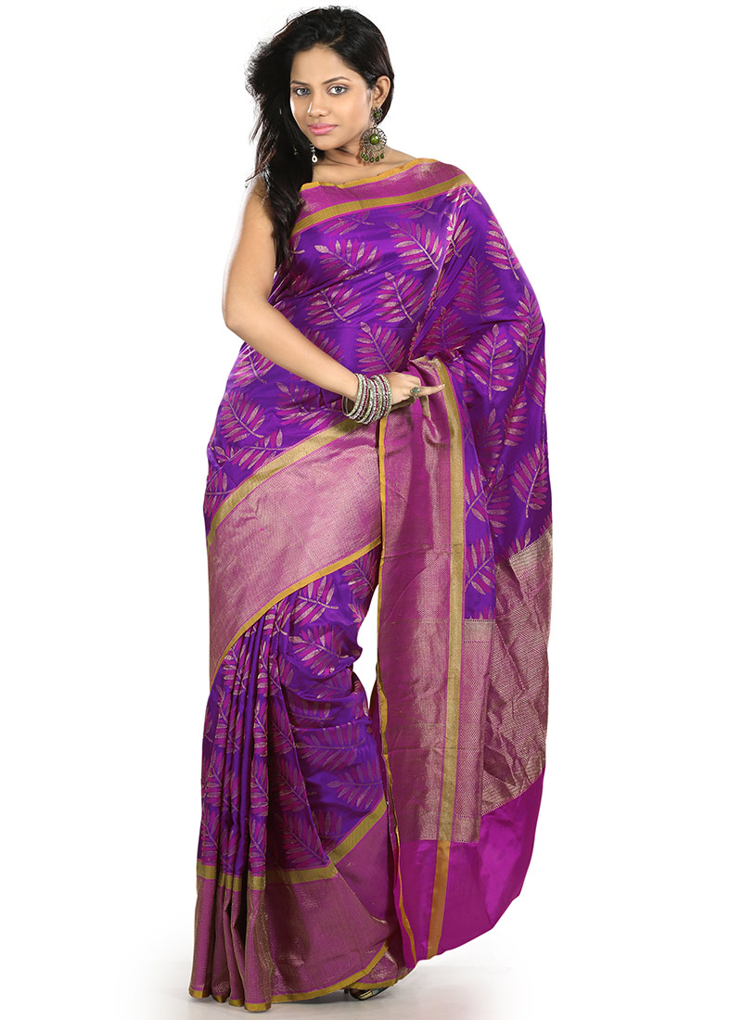

Slide 8
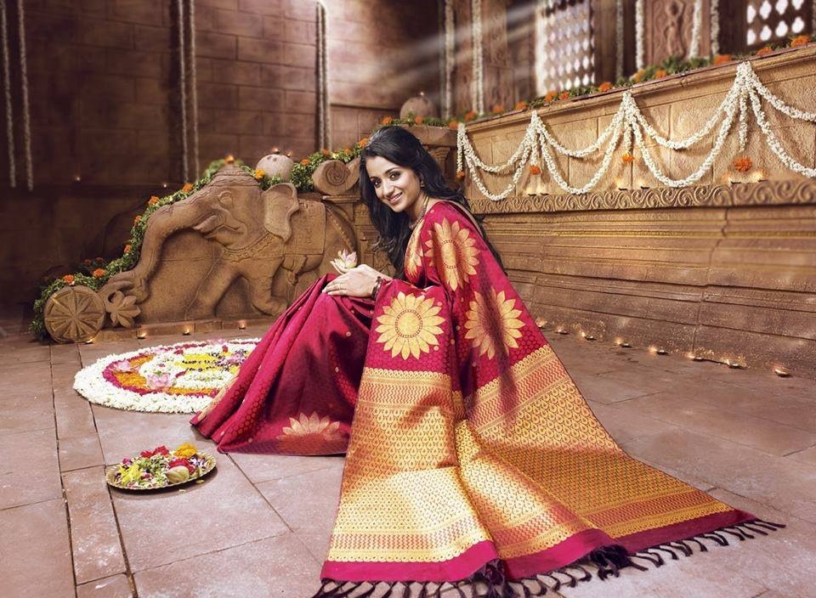

Slide 9
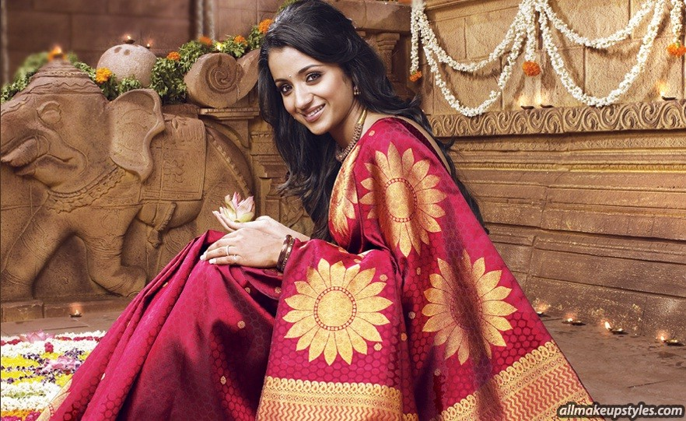

Slide 10
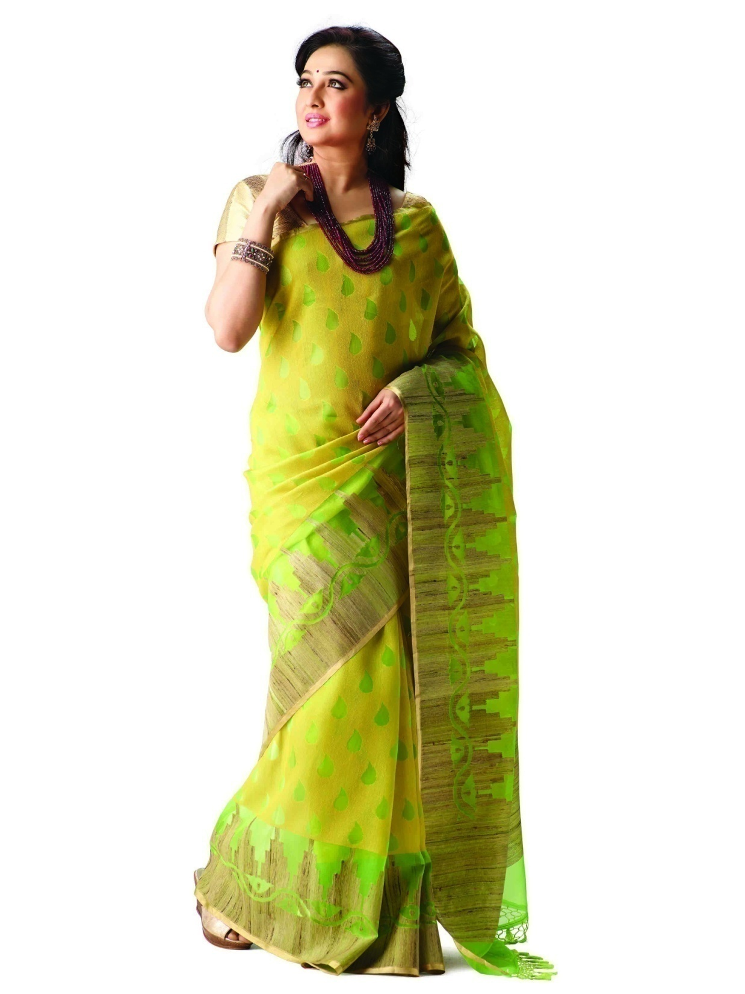

Slide 11
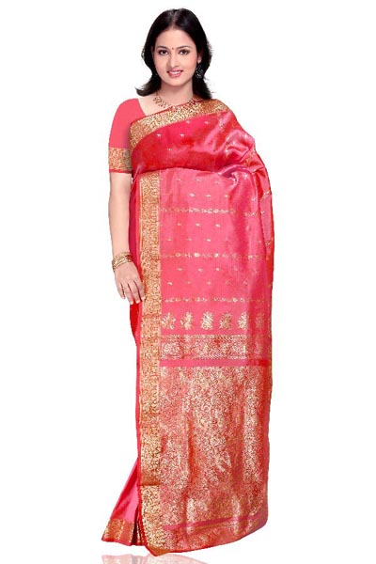

Slide 12
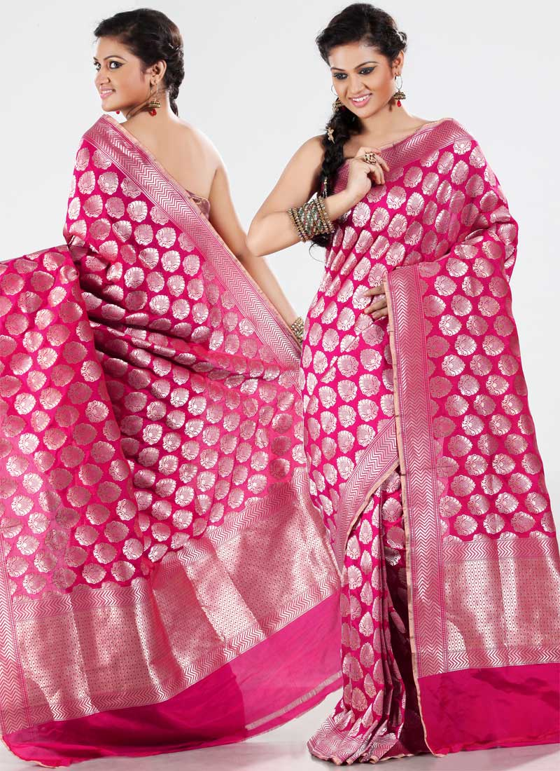

Slide 13


Slide 14
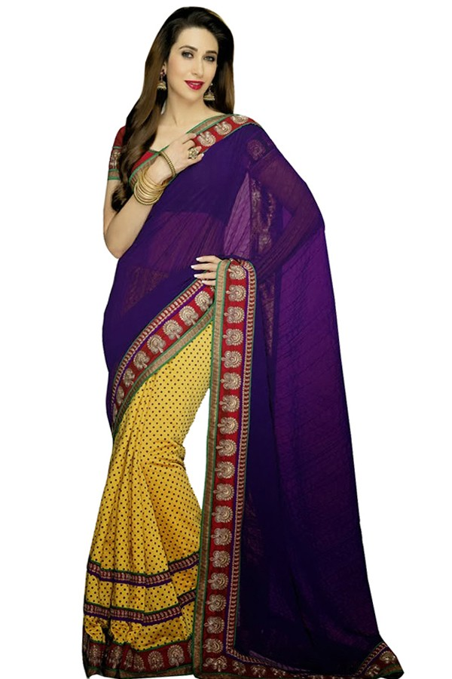

Slide 15
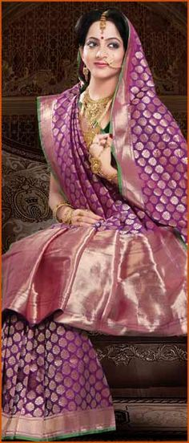

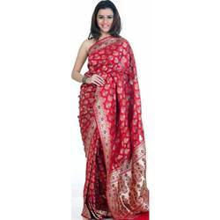

Slide 16


Slide 17


Slide 18


Slide 19


Slide 20


Slide 22
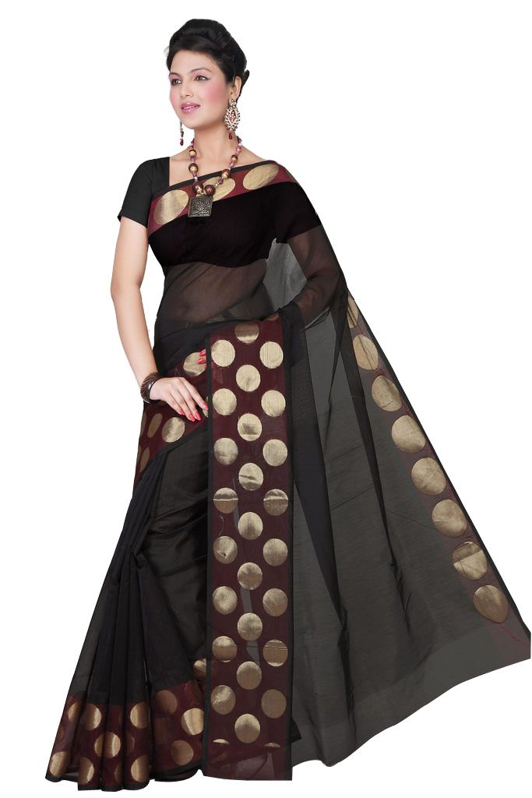

Slide 23
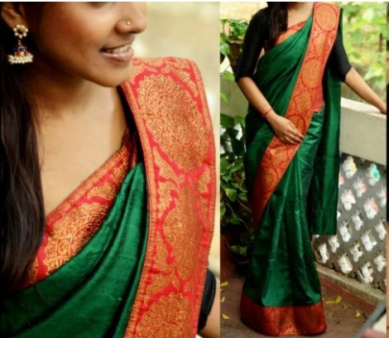

Slide 24
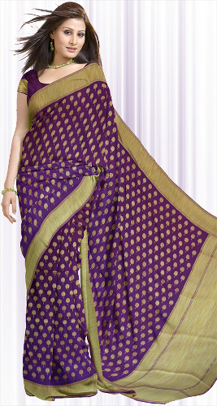
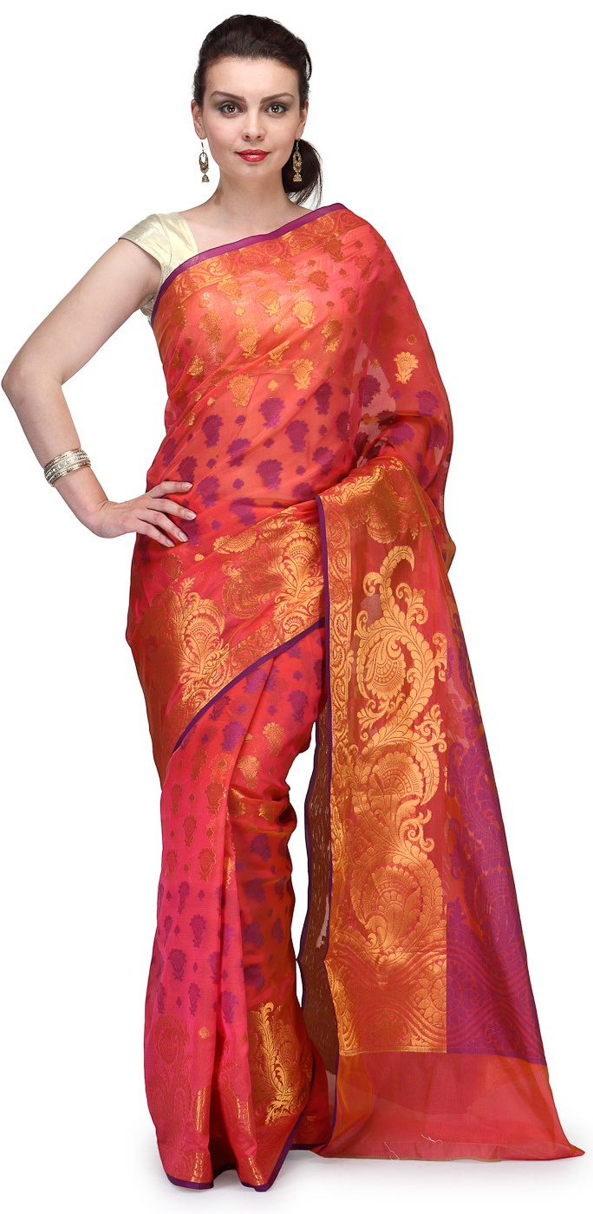
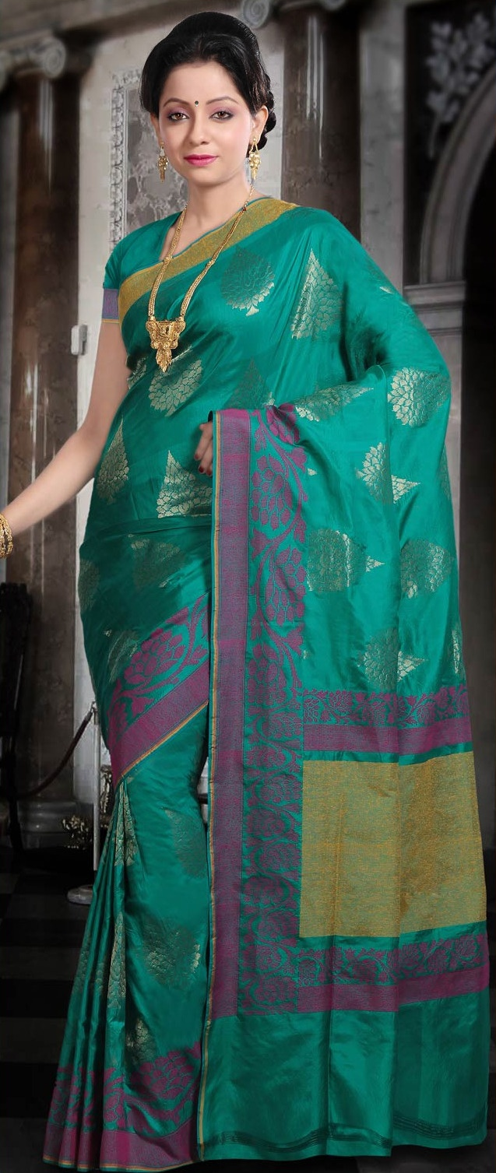

Slide 25
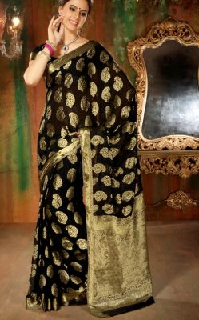

Slide 26
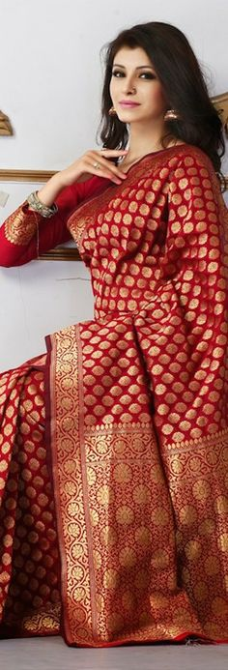
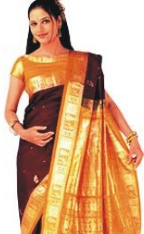
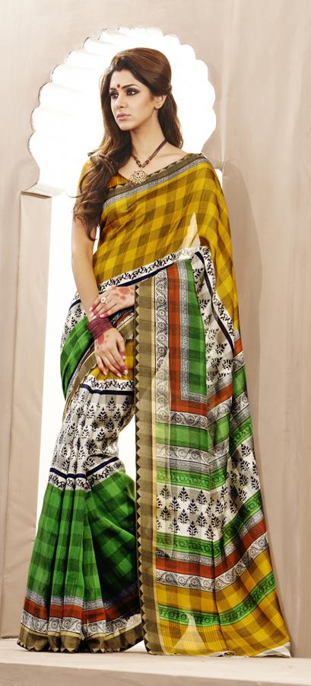

Slide 27
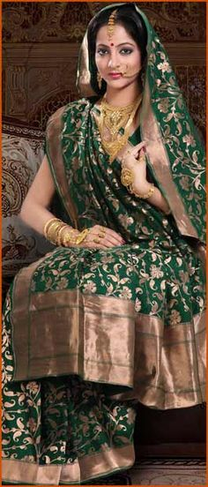

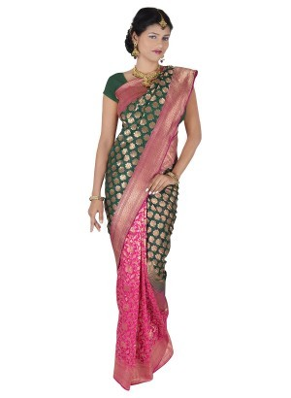

Slide 28


Slide 29
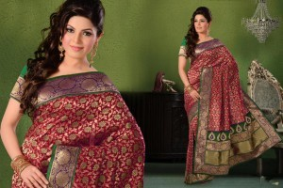

Slide 30
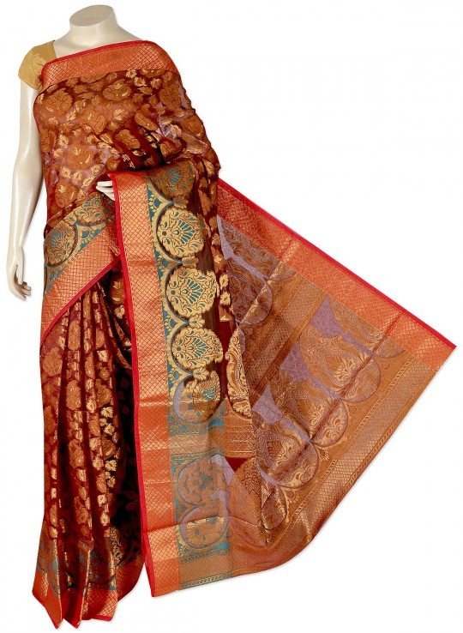

Slide 32
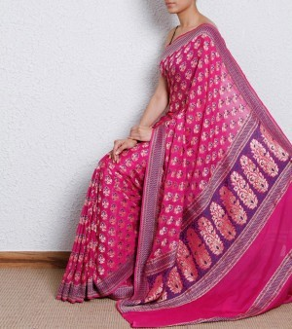

Slide 33
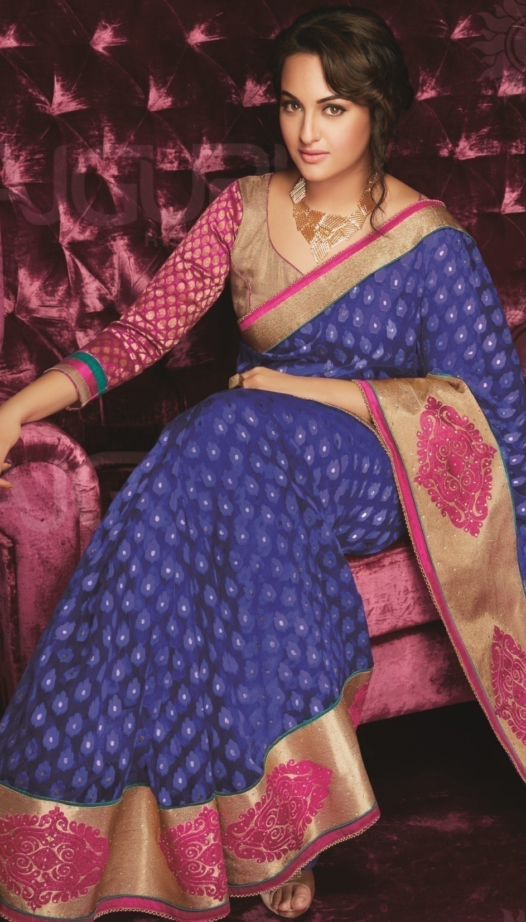

Slide 34
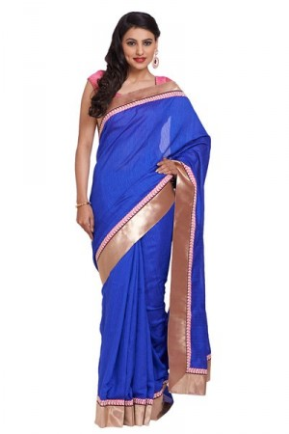
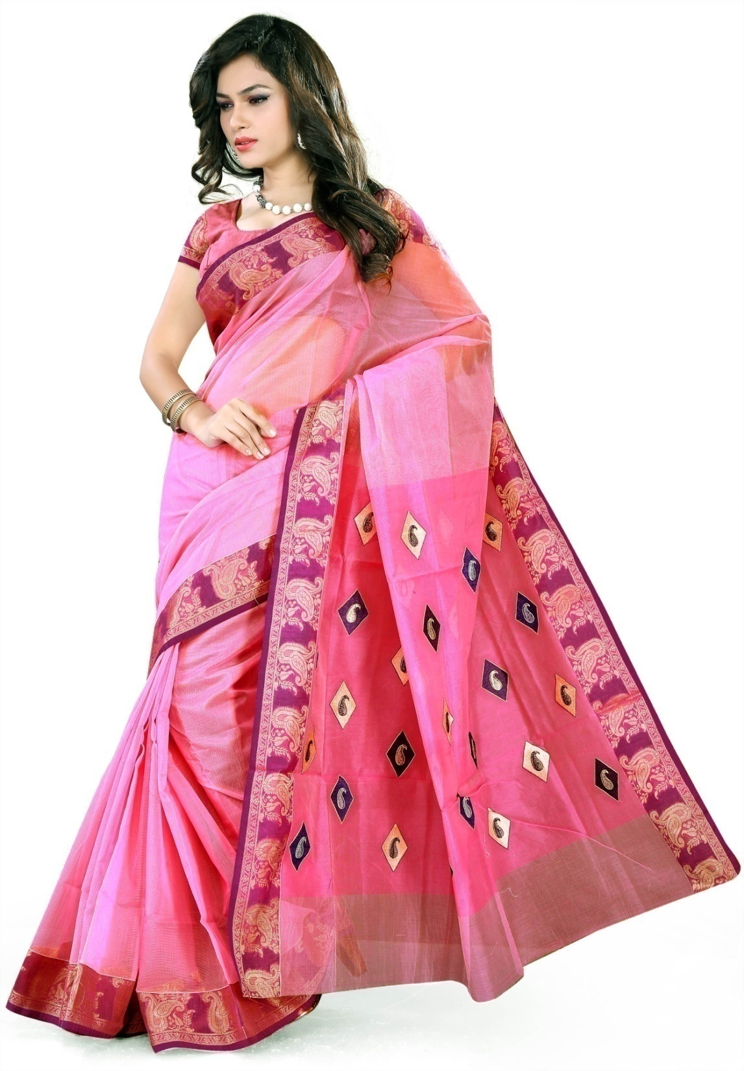

Slide 35
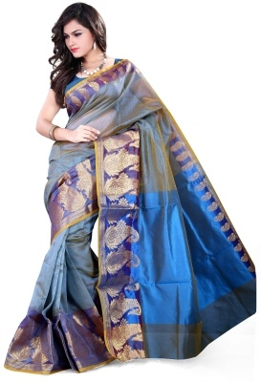
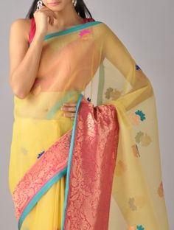

Slide 36
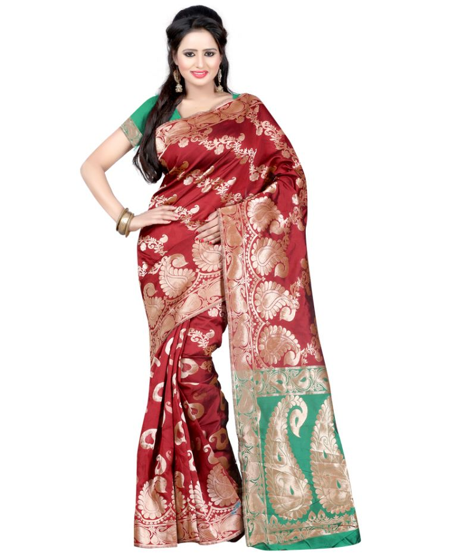

Slide 37
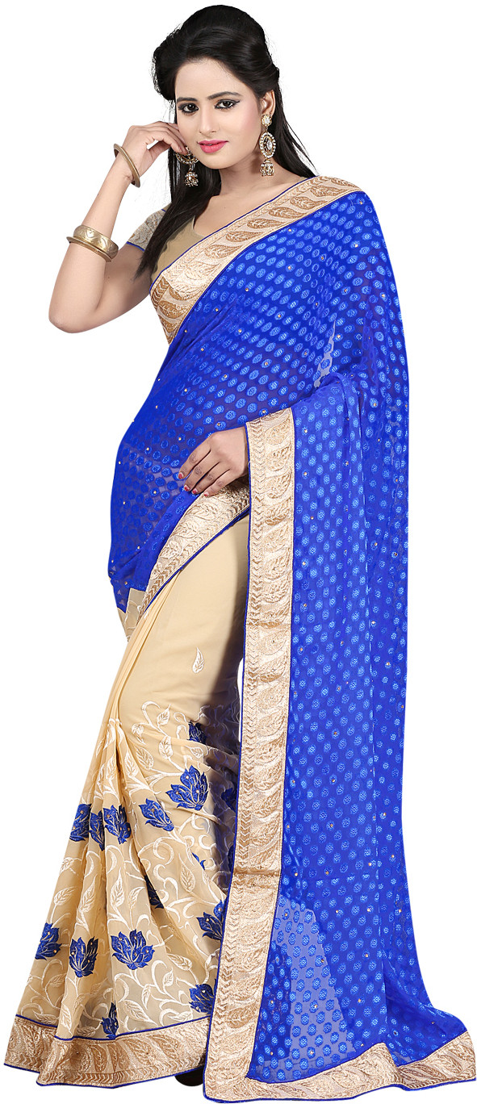
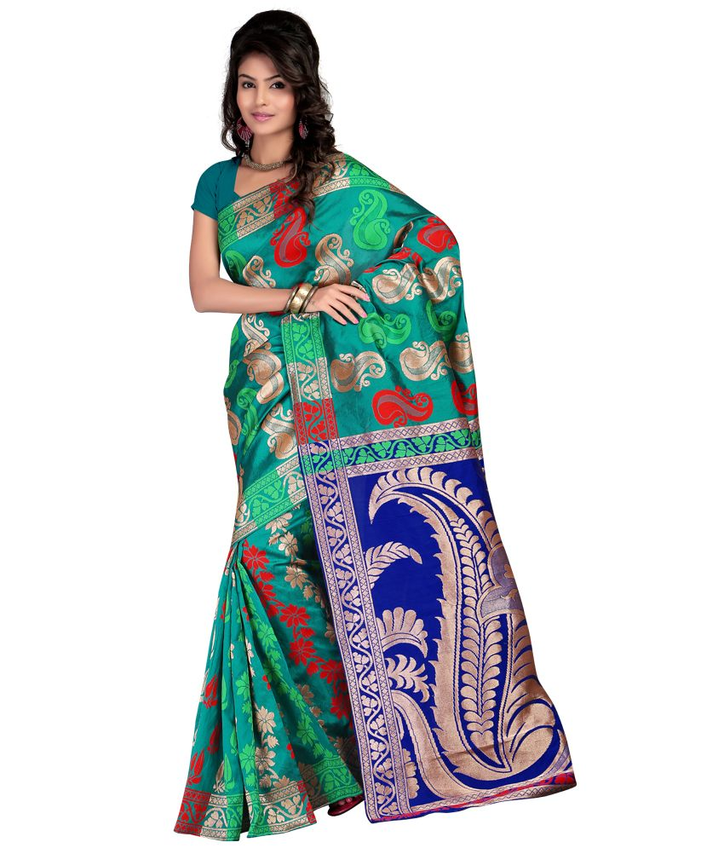

Slide 38
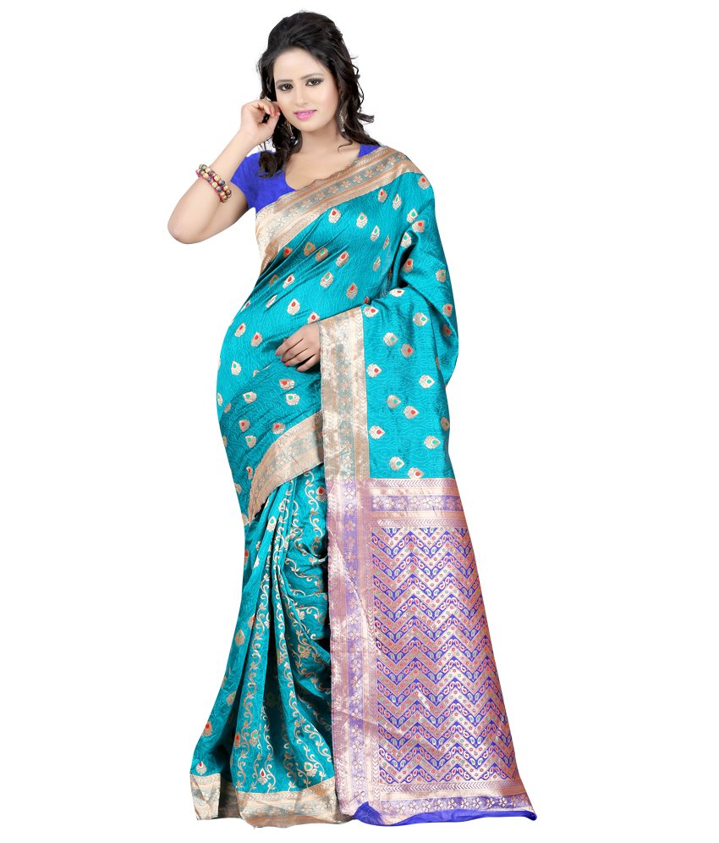

Slide 39


Slide 40
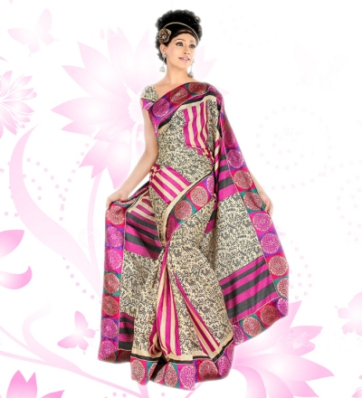

Slide 41
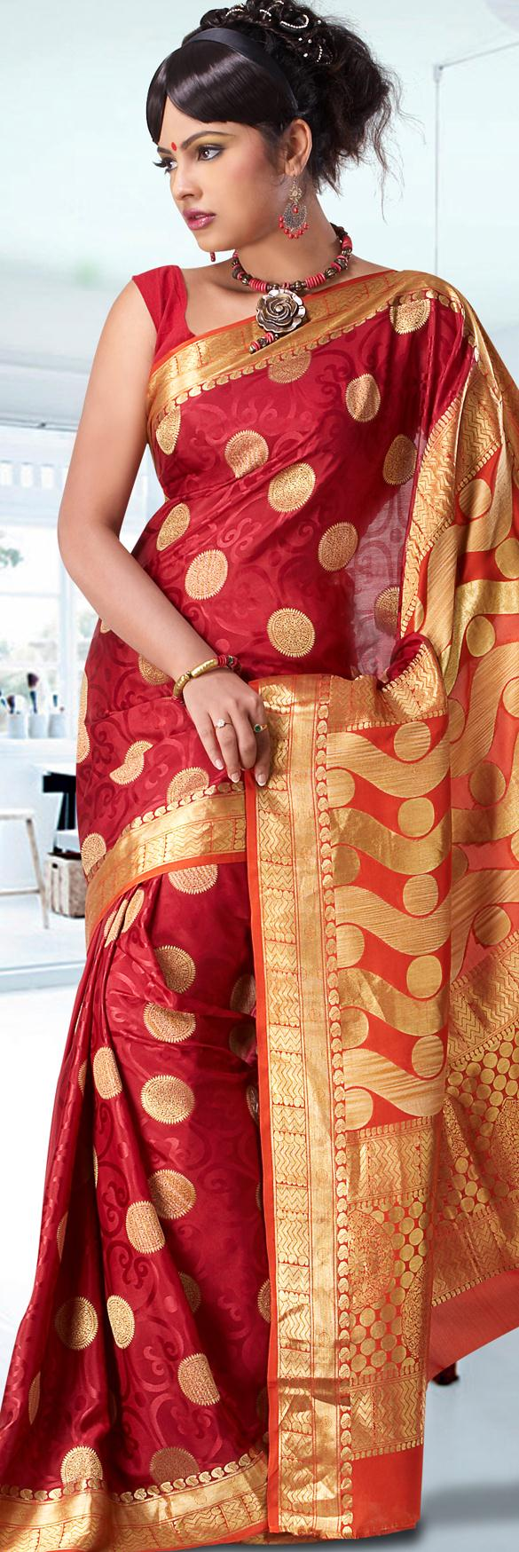
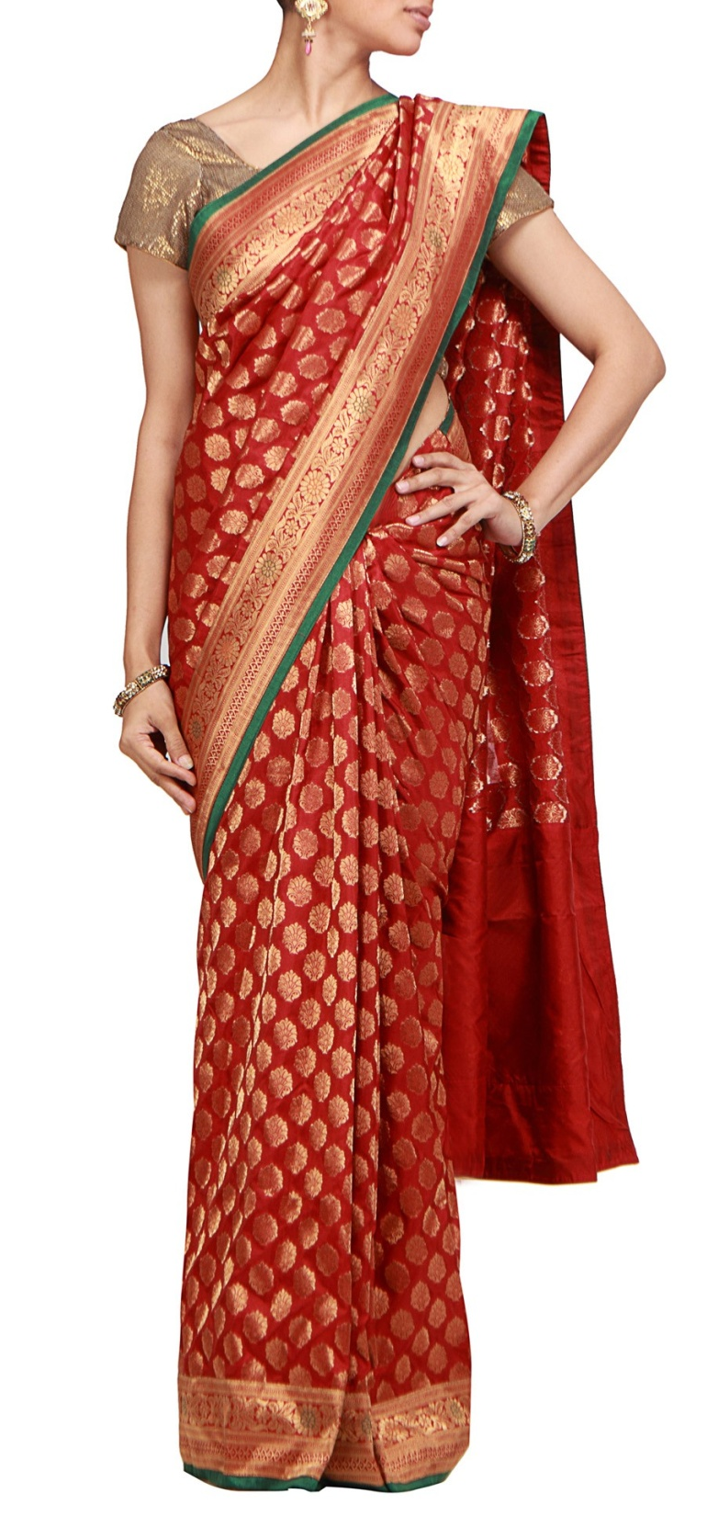
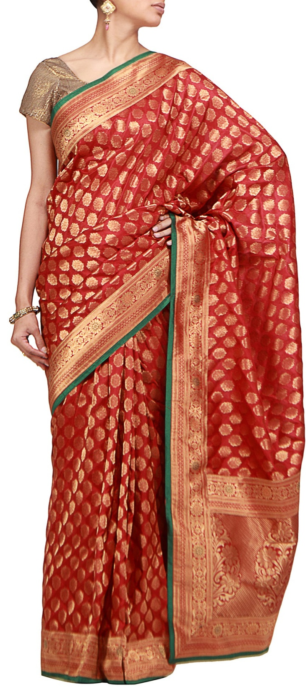

Slide 42


Slide 43
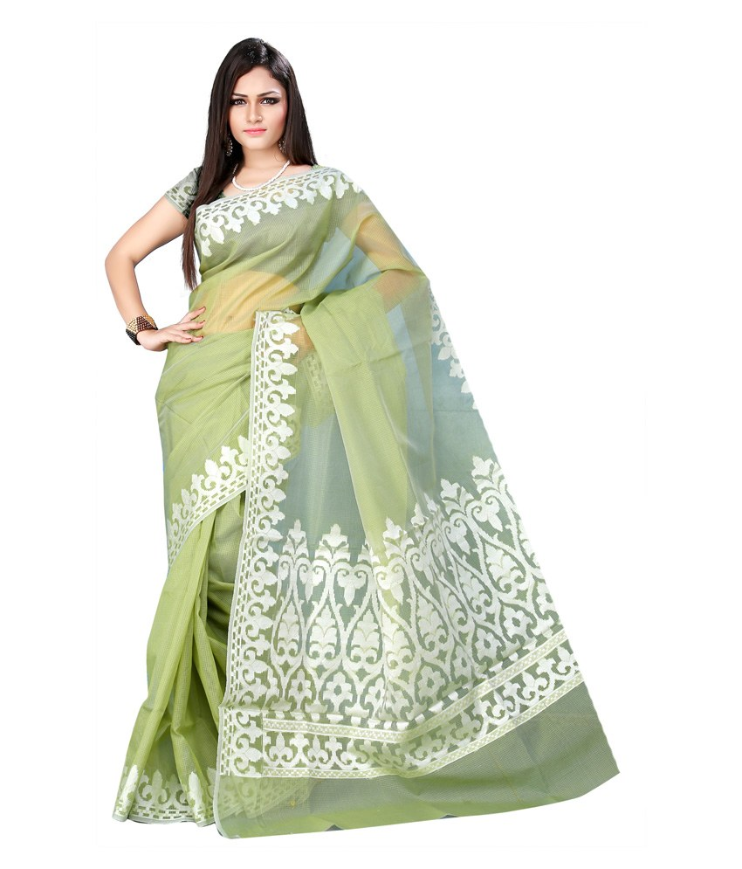

Slide 44


Slide 45
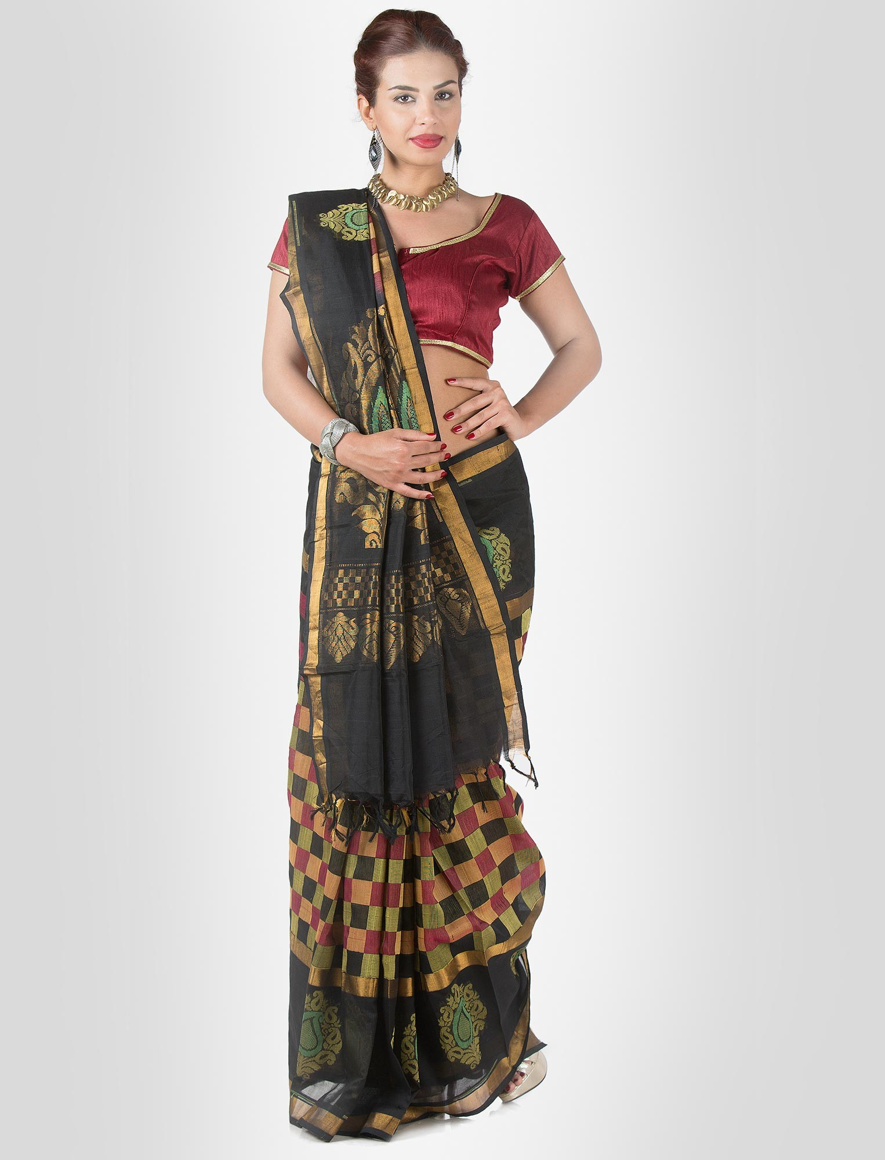

Slide 46
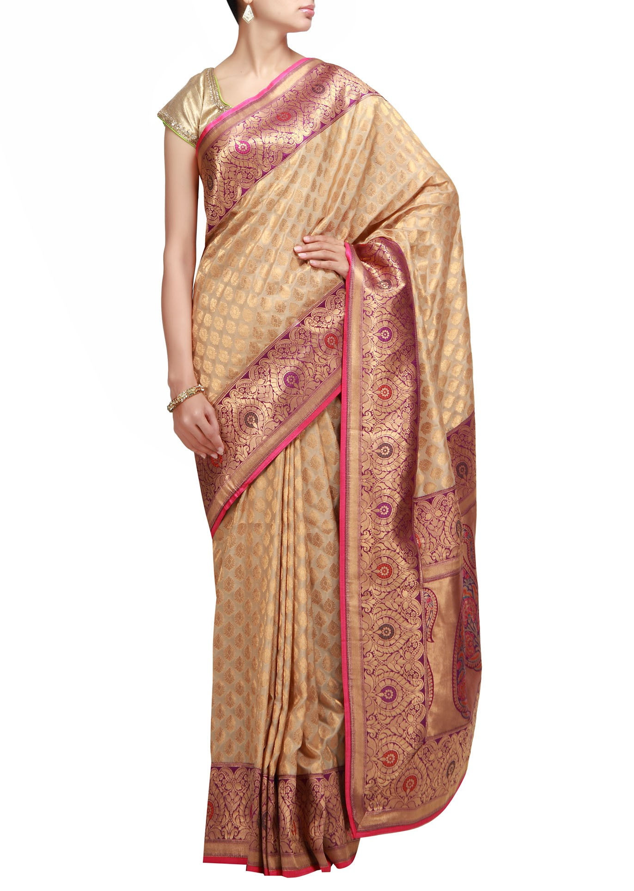

Slide 47
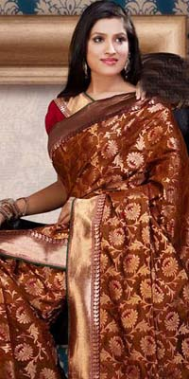

Slide 48
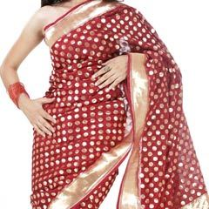

Slide 49


Slide 50
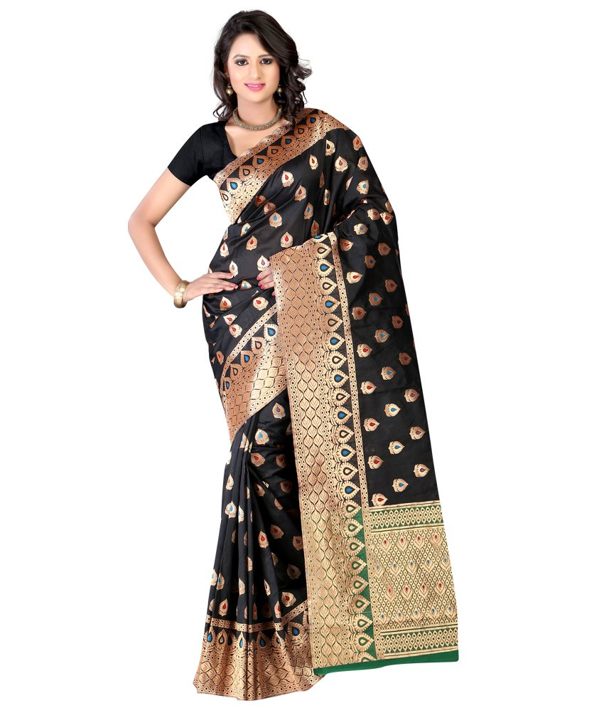

Slide 51
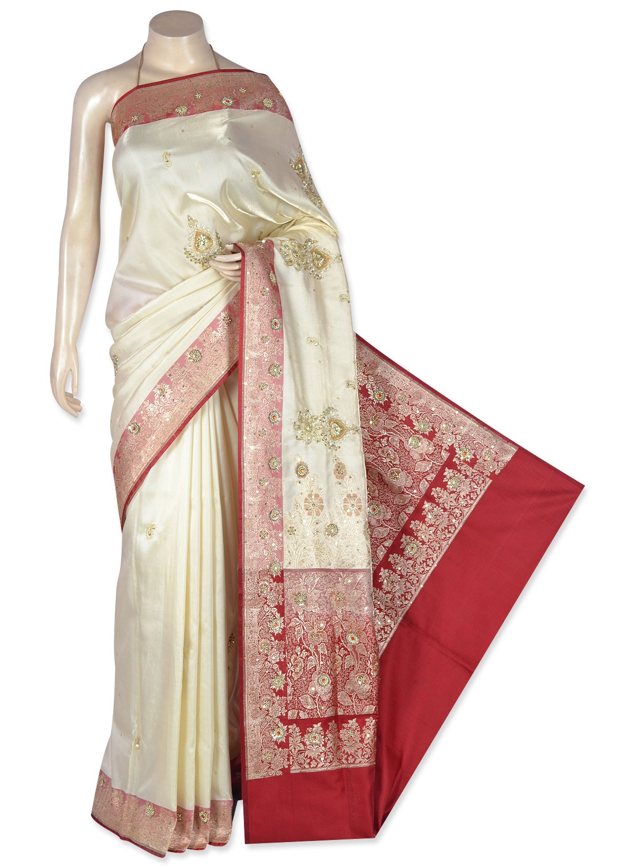


Slide 52


Slide 53


Slide 54



Slide 55


Slide 56


Slide 57


Slide 58


Slide 59


Slide 60


Slide 61


Slide 62


Slide 63


Slide 64


Slide 65


Slide 66


Slide 67


Slide 68



Slide 69


Slide 70



Slide 71


Slide 72


Slide 73


Slide 74


Slide 75


Slide 76



Slide 77




Slide 78


Slide 79


Slide 80


Slide 81


Slide 82


Slide 83


Slide 84



Slide 85



Slide 86


Slide 87


Slide 88


Slide 89



Slide 90



Slide 91


Slide 92


Slide 93


Slide 94



Slide 95


Slide 96



Slide 97


Slide 98


Slide 99


Slide 100


Slide 101



Slide 102


Slide 103


Slide 104


Slide 105


Slide 106


Slide 107


Slide 110


Slide 111


Slide 112



Slide 113




Slide 114



Slide 115


Slide 116


Slide 117


Slide 118


Slide 119


Slide 120


Slide 121


Slide 122


Slide 123


Slide 124




Slide 125


Slide 126


Slide 127



Slide 128


Slide 129



Slide 130




Slide 131




Slide 132


Slide 133


Slide 134


Slide 135


Slide 136



Slide 137



Slide 138



Slide 139




Slide 140


Slide 141




Slide 142


Slide 143


Slide 144


Slide 145



Slide 146



Slide 147


Slide 148


Slide 149



Slide 150


