Slide 1
Famous glass wares
Part One
Among the famous glass wares Baccarat, Steuben, Carnival ,Bohemian and many others come to mind.
Here the finest examples of cut glass, art glass and crystal glass wares are presented for your private enjoyment in three parts.
AKC/December 2015

Slide 2
Fenton glass ware

Slide 3
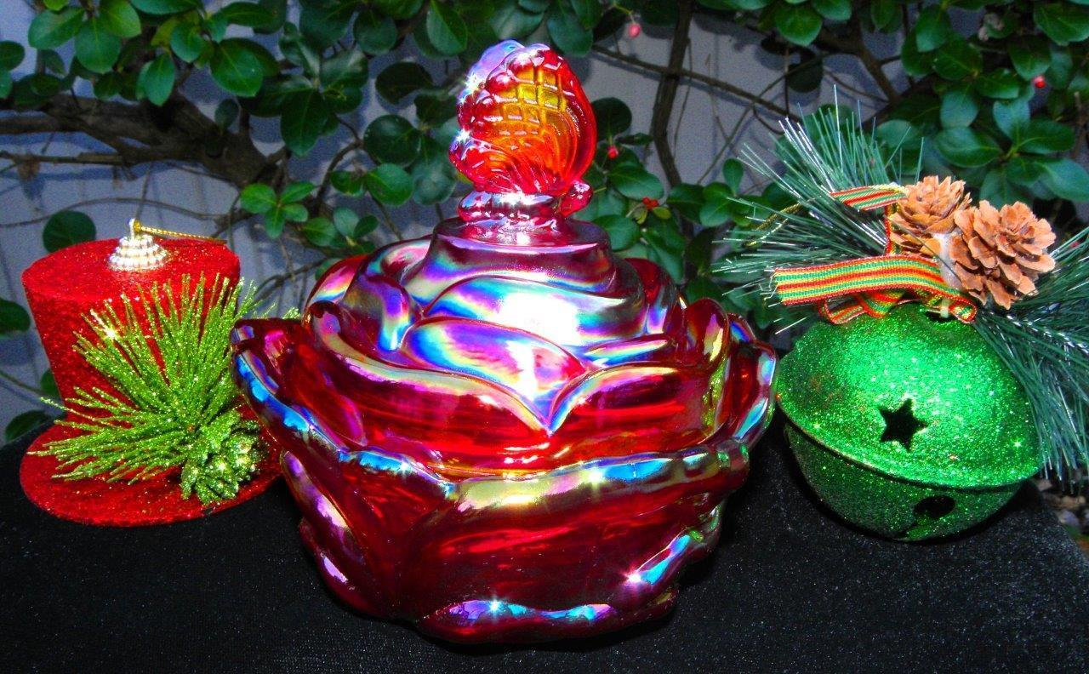

Slide 4
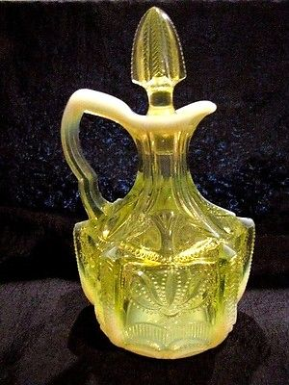

Slide 5
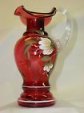

Slide 6
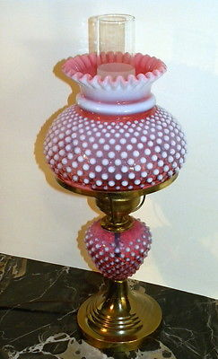

Slide 7
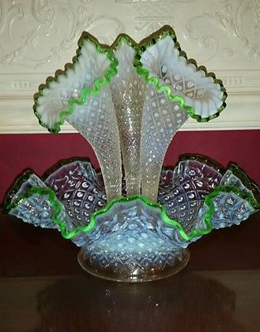

Slide 8
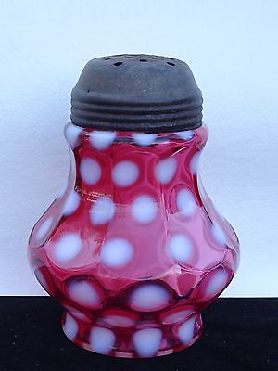

Slide 9
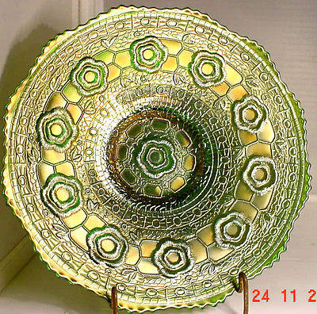

Slide 10
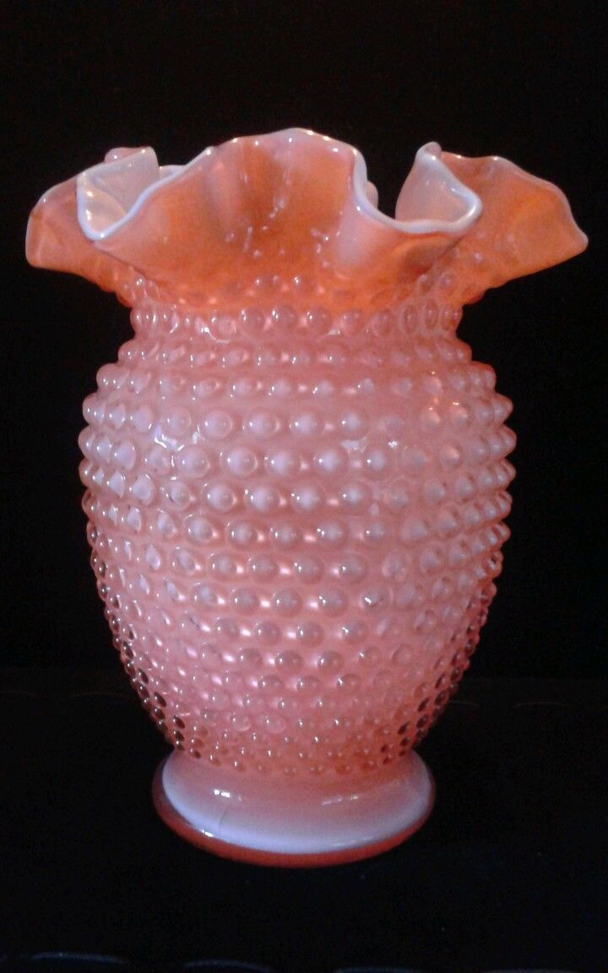
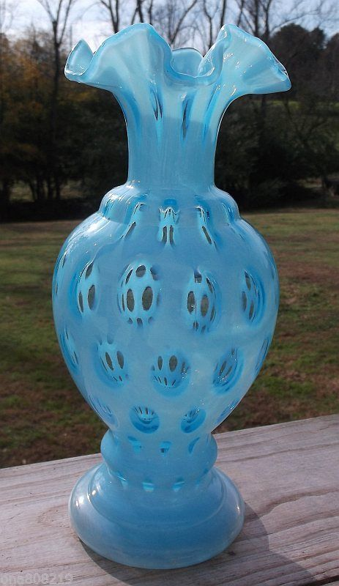

Slide 11
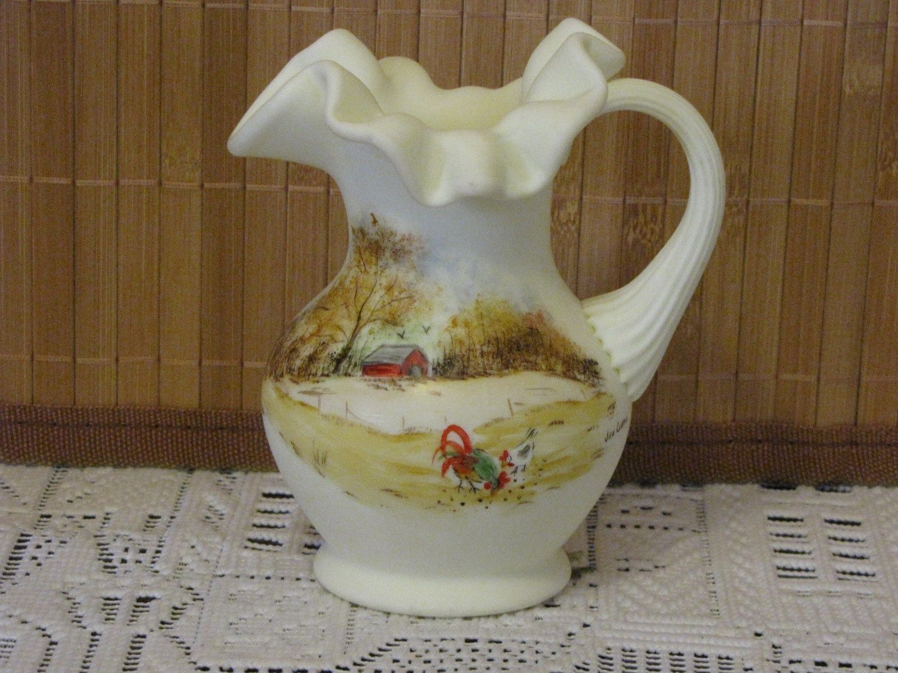

Slide 12
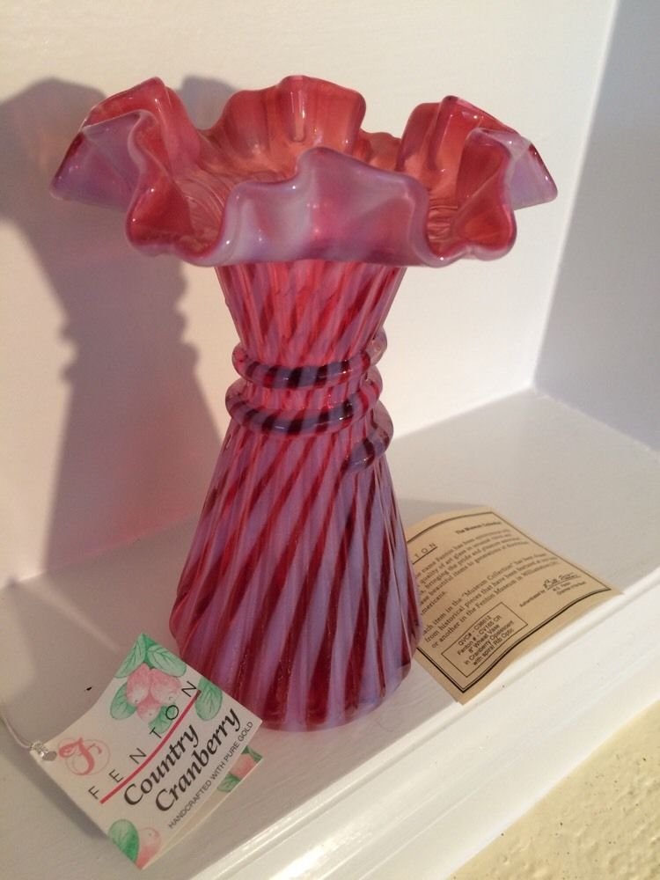

Slide 13
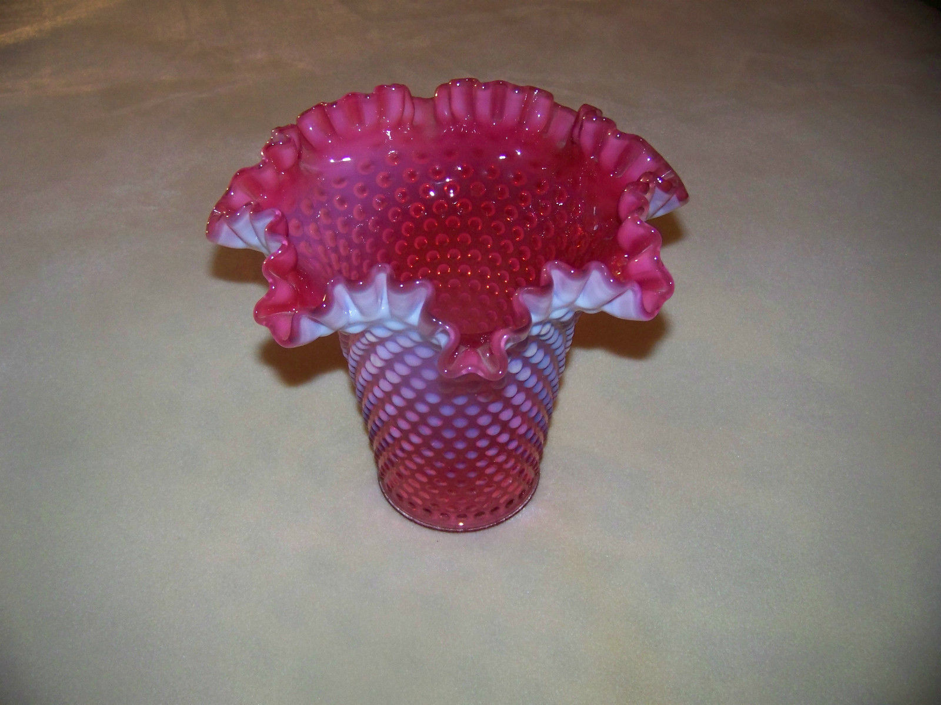

Slide 14
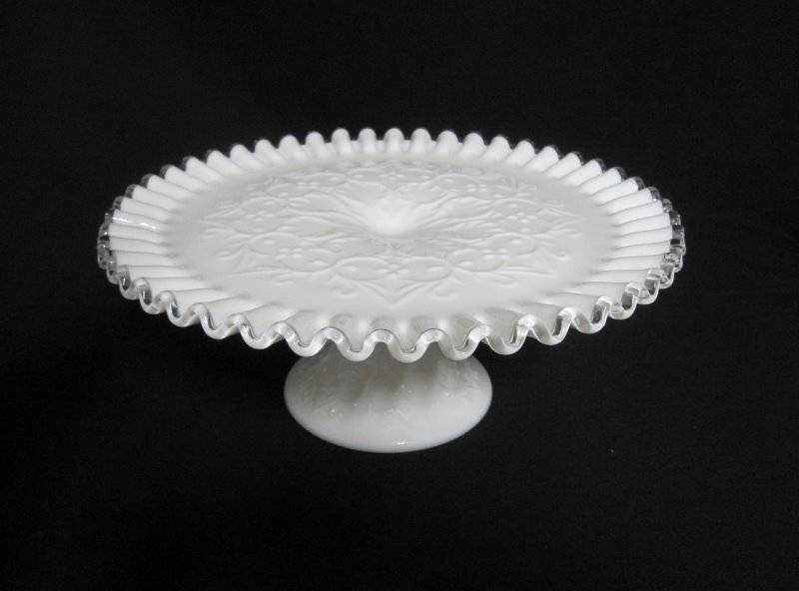

Slide 15
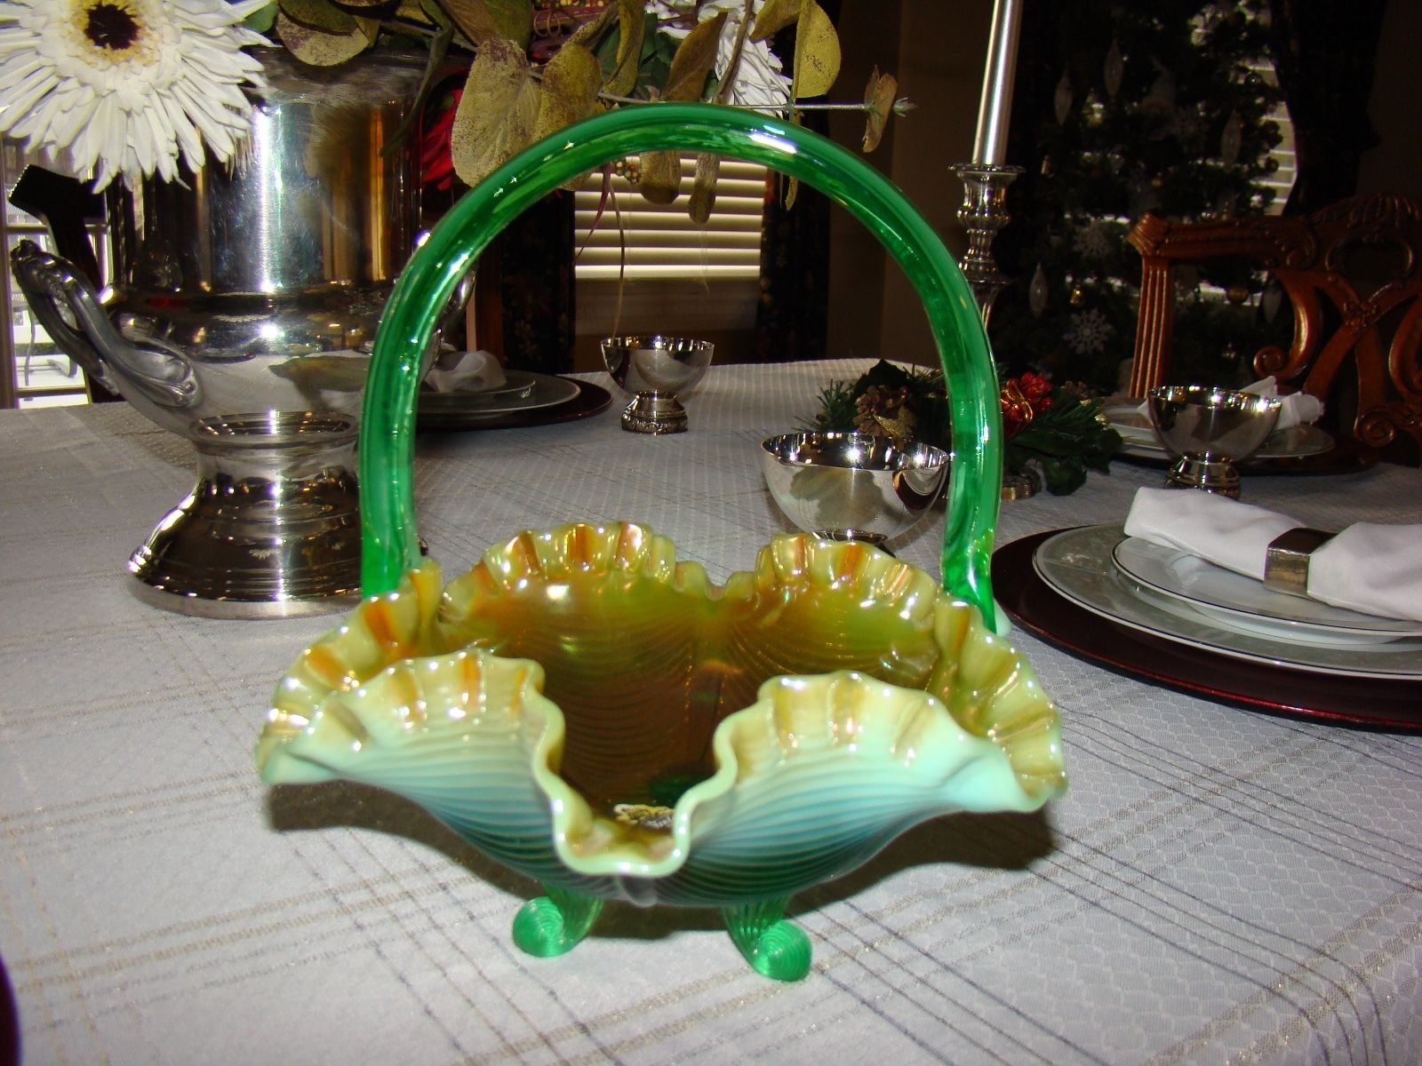

Slide 16
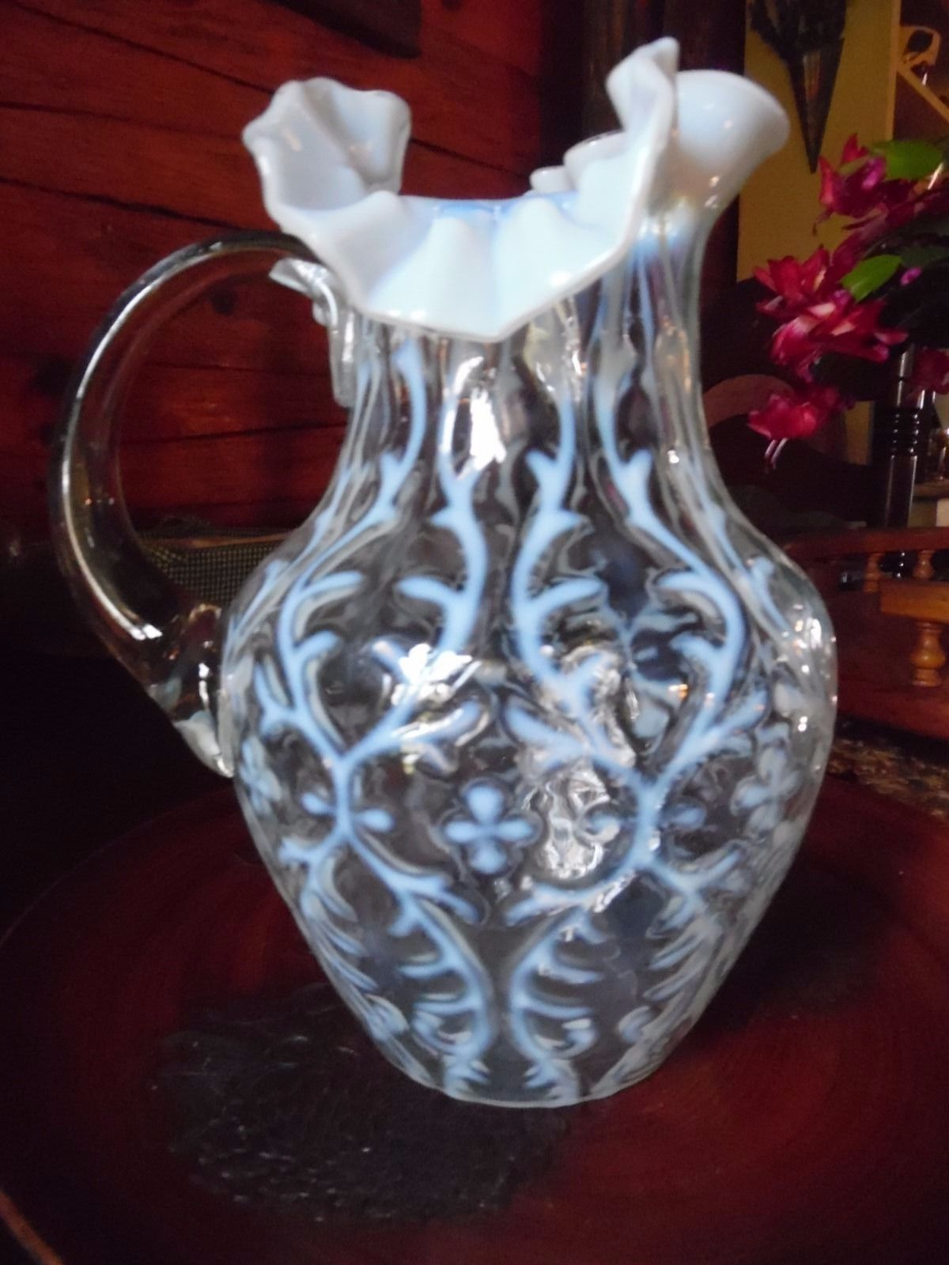

Slide 17
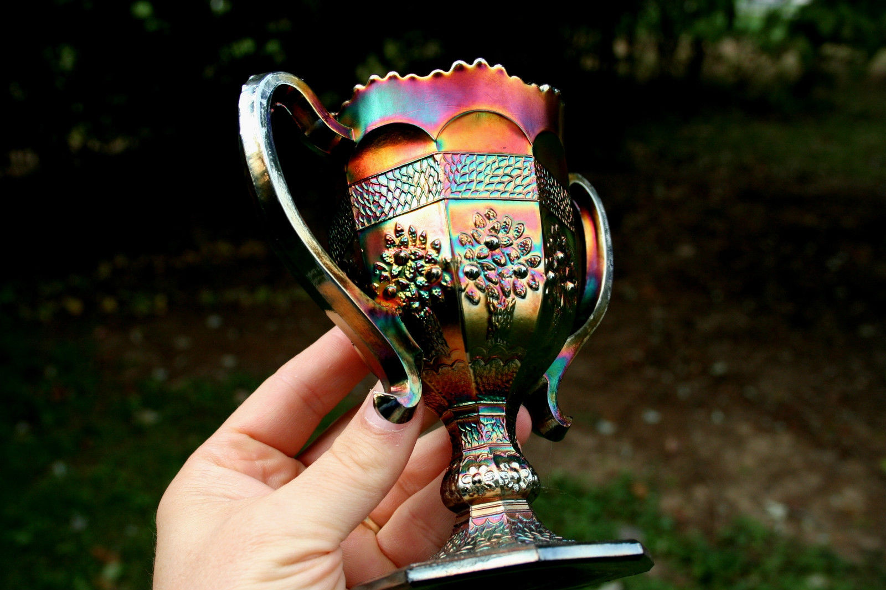

Slide 18
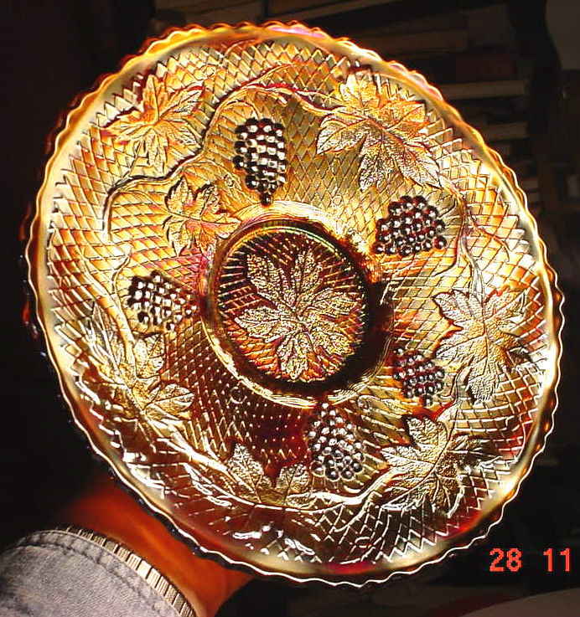

Slide 19
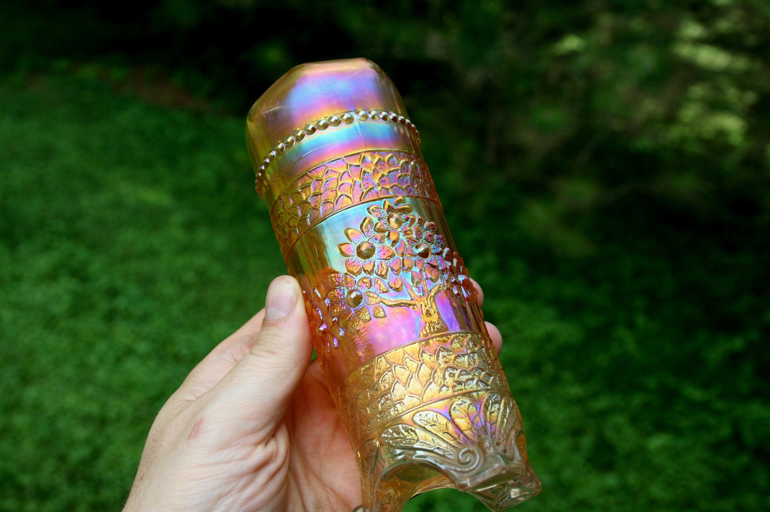

Slide 20
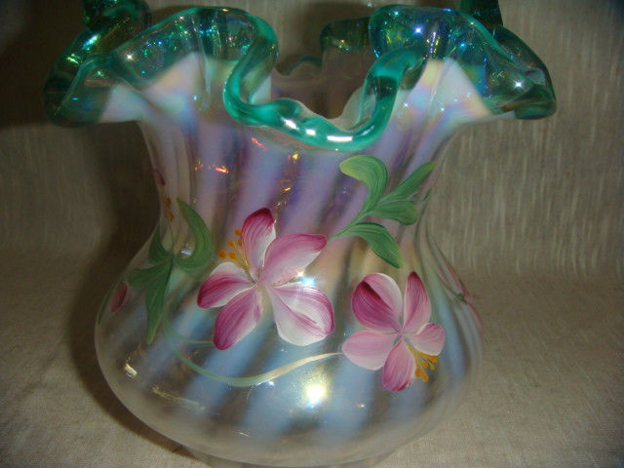

Slide 21
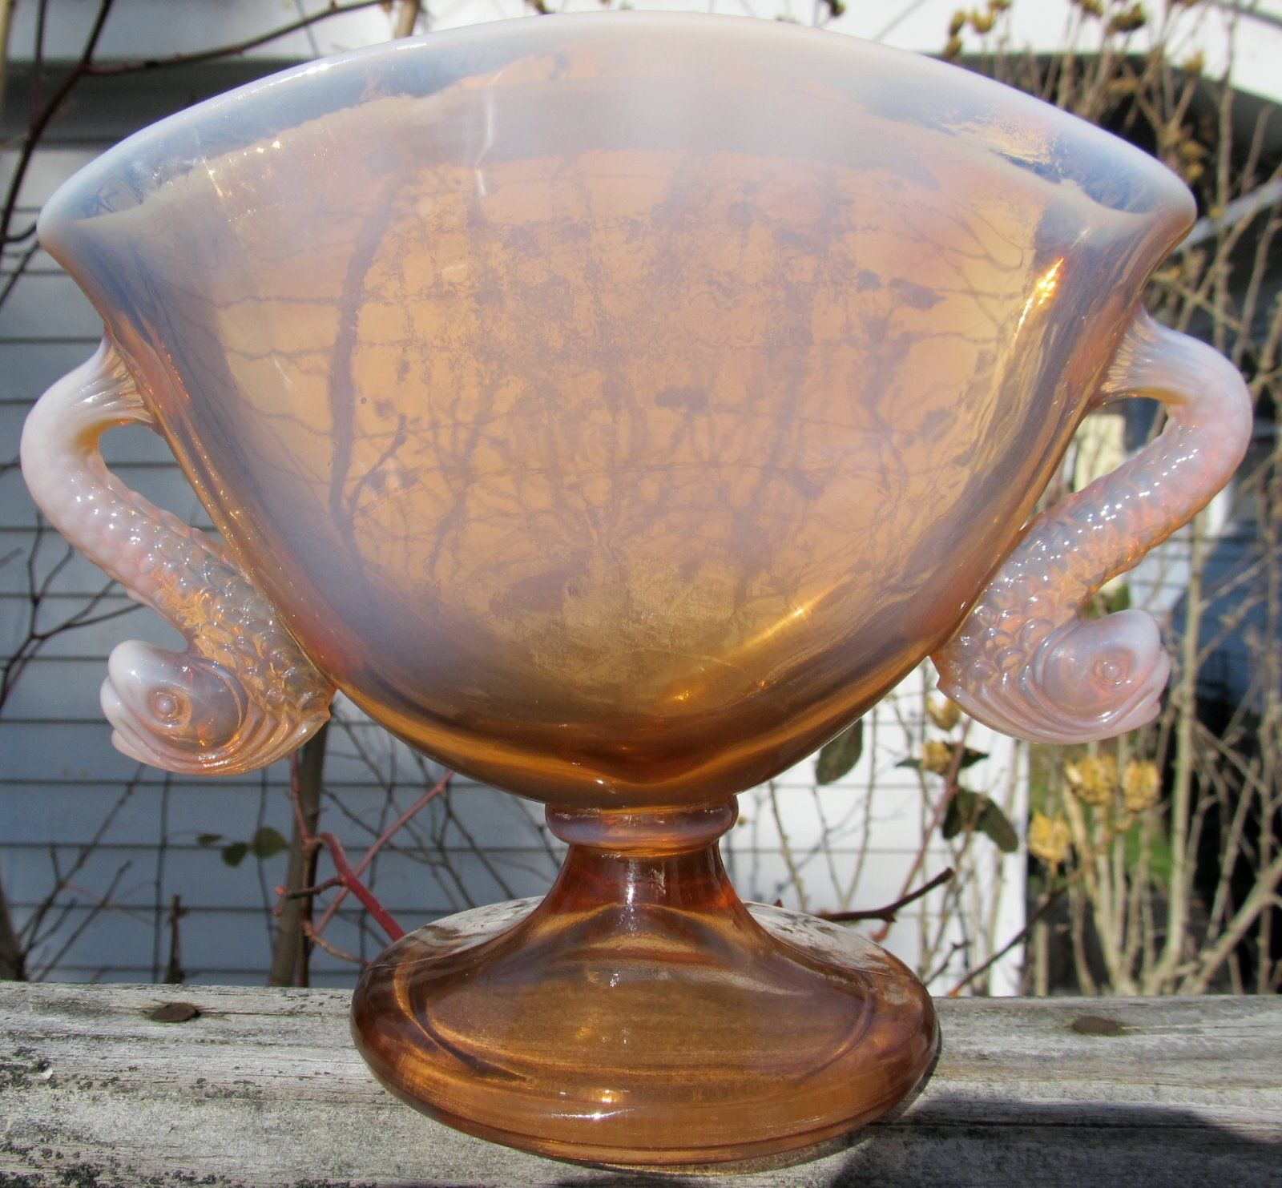

Slide 22
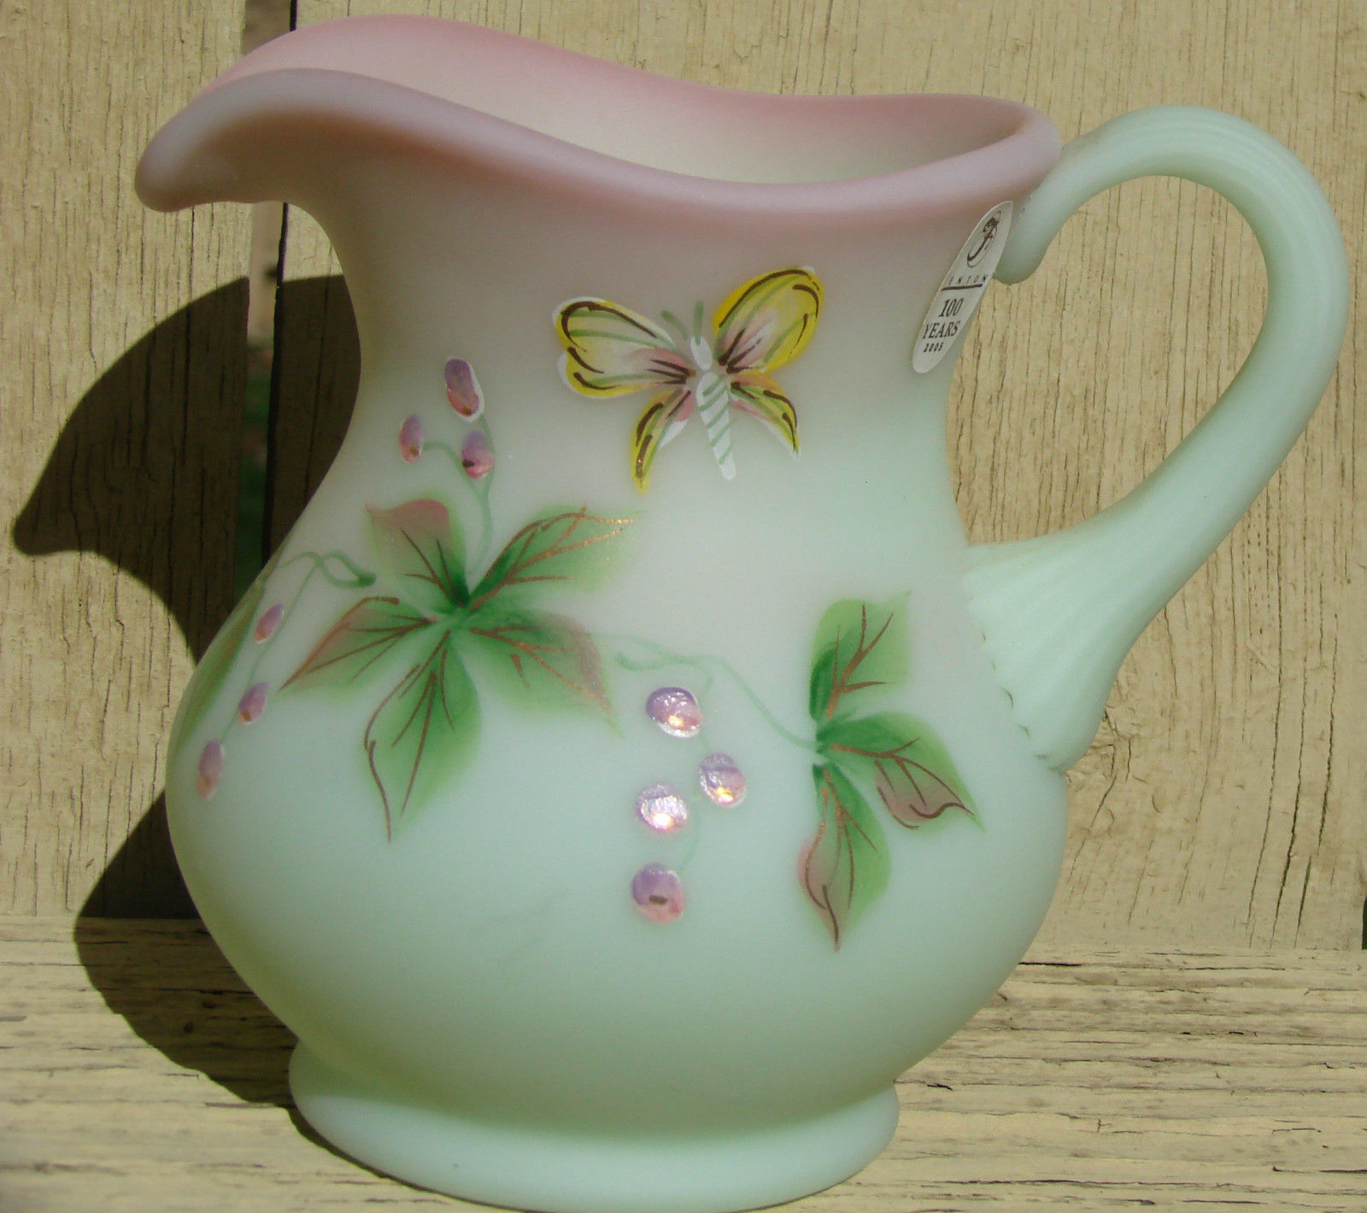

Slide 23
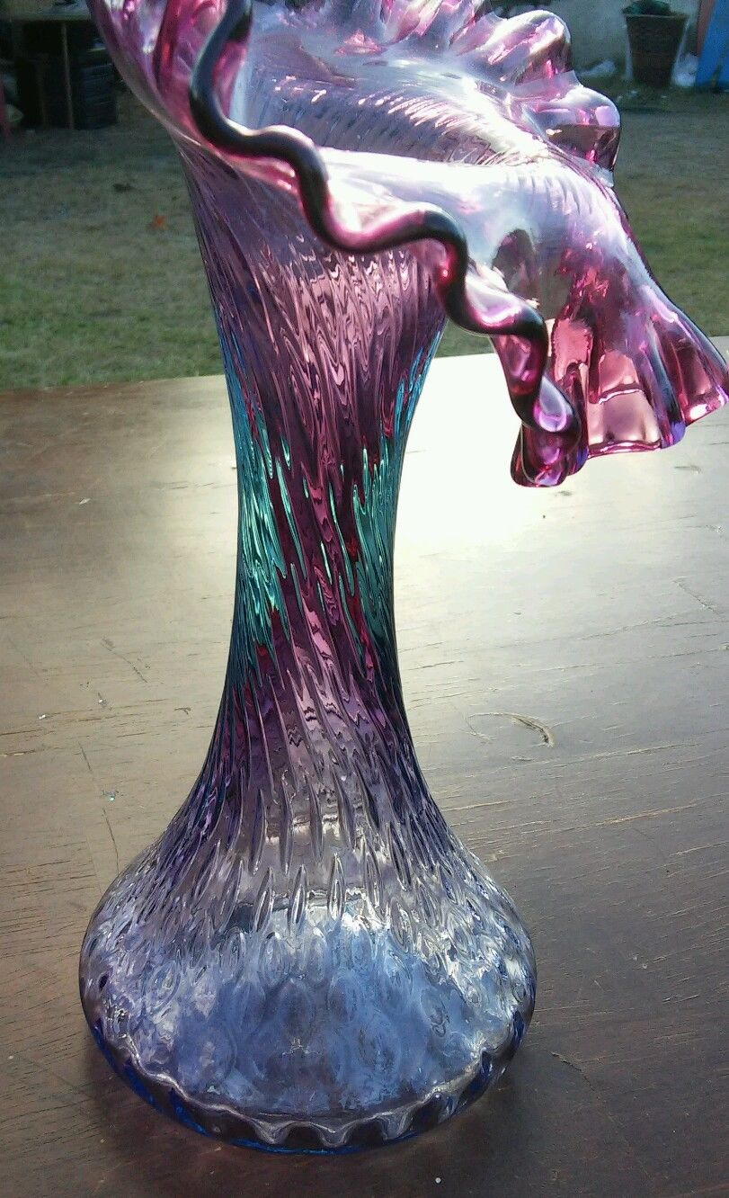


Slide 24
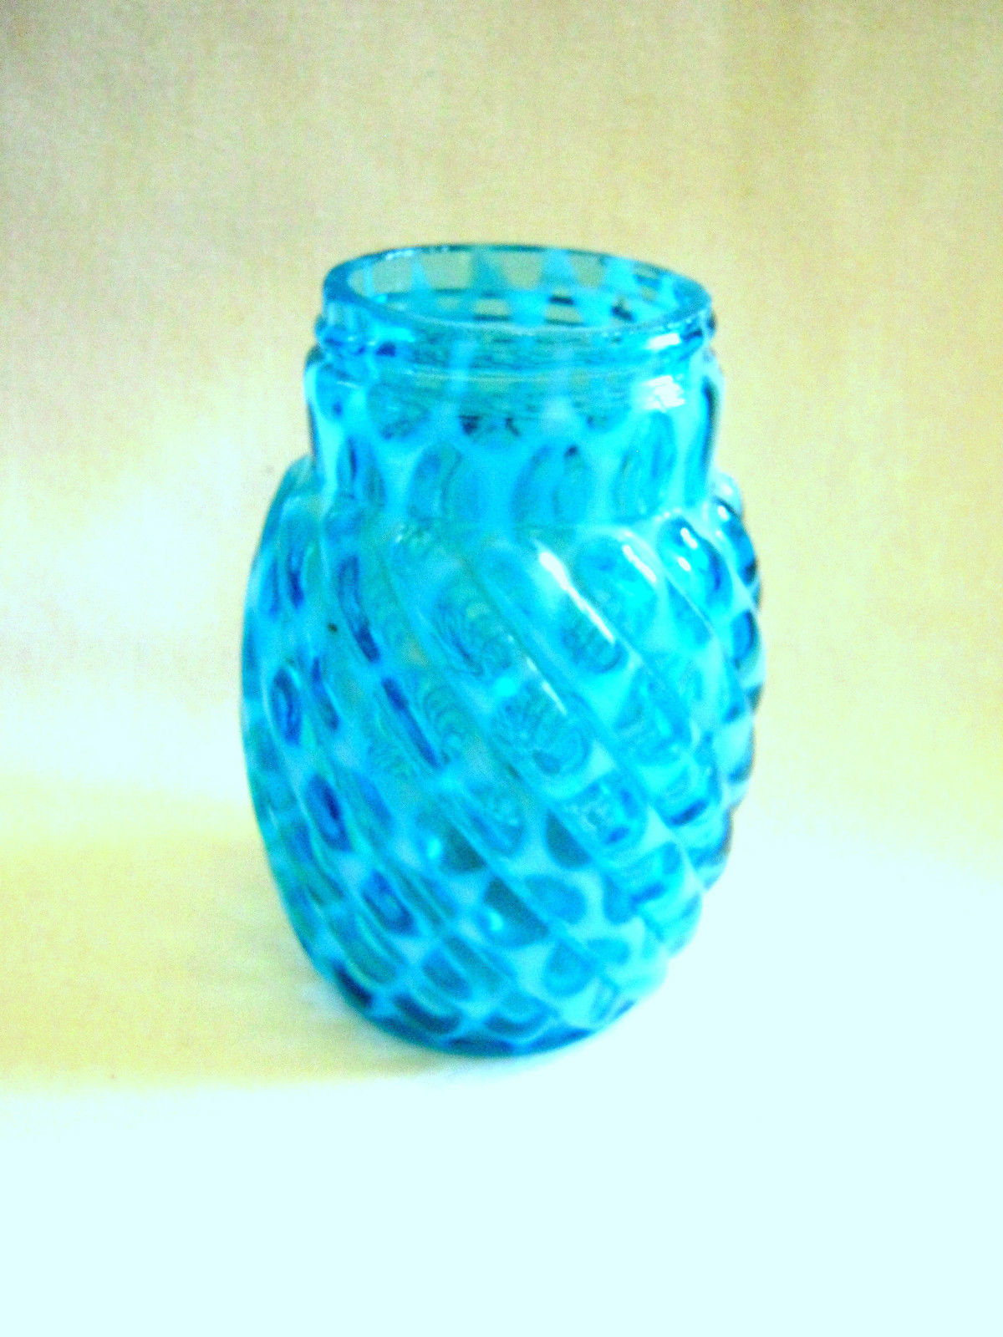

Slide 25
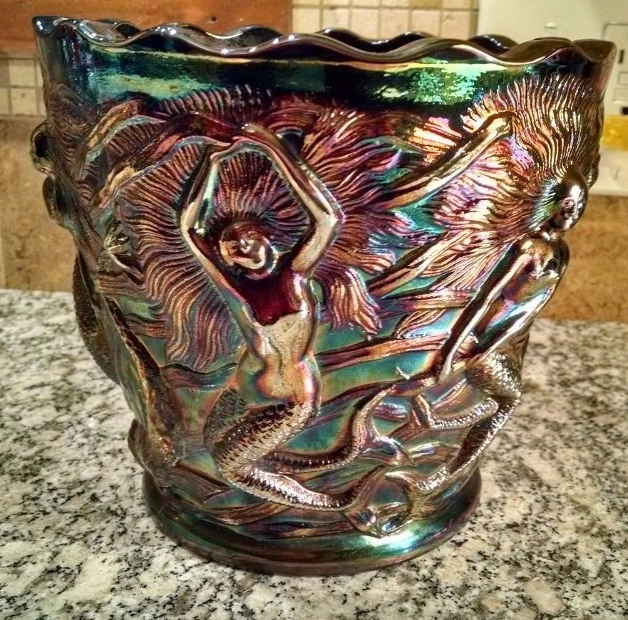

Slide 26
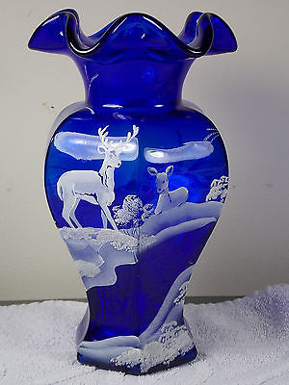
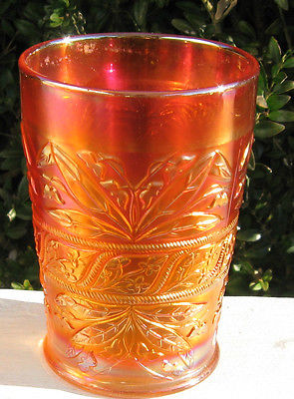

Slide 27
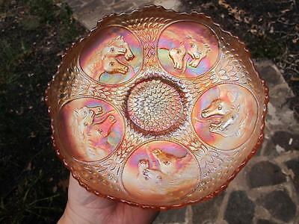

Slide 28
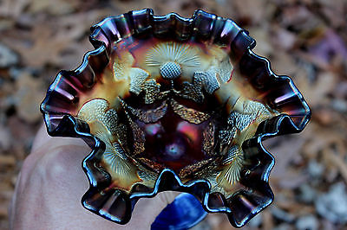

Slide 29
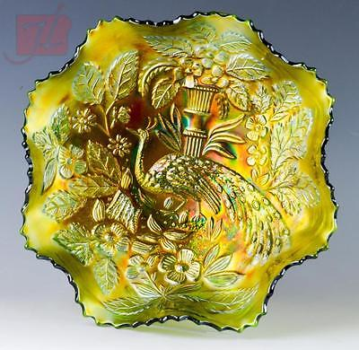

Slide 30
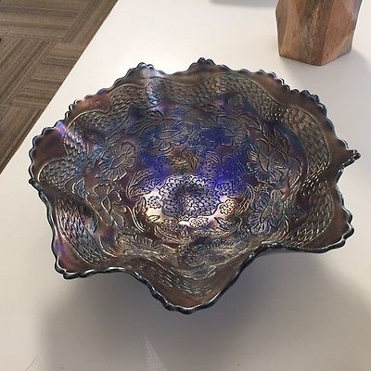

Slide 31
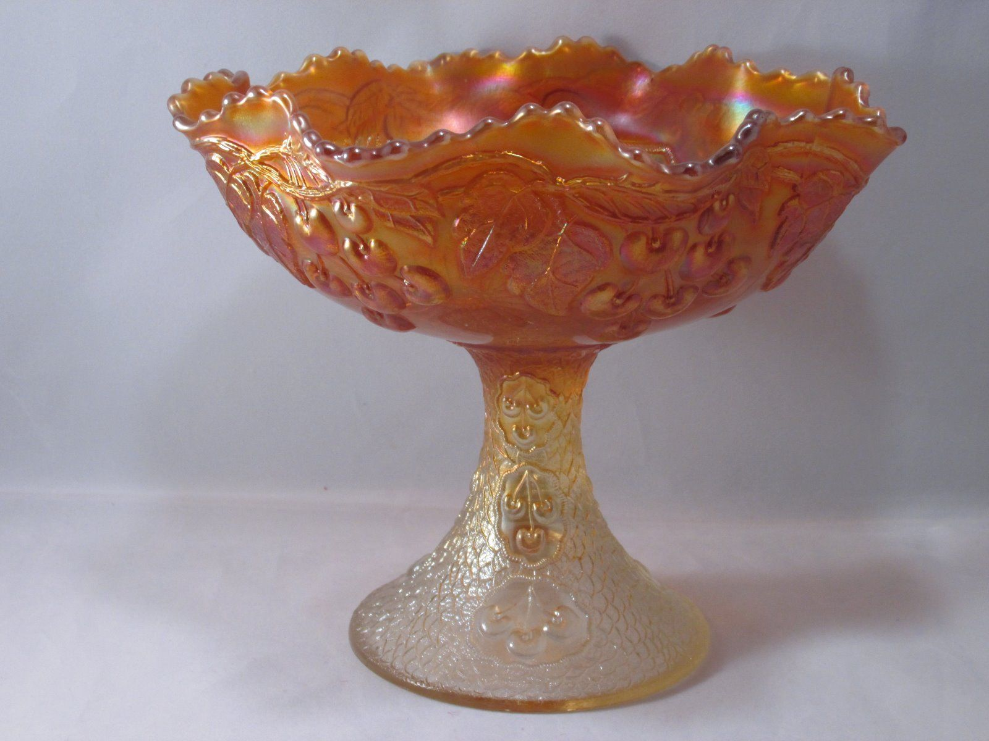

Slide 32
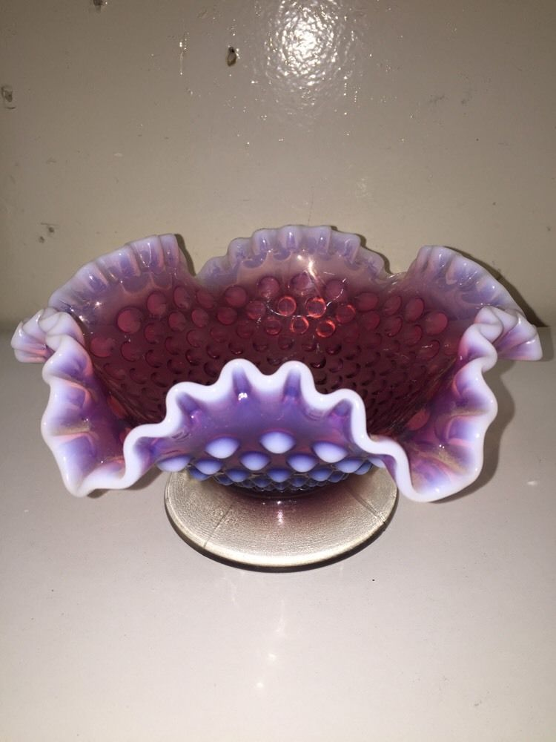
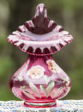

Slide 33
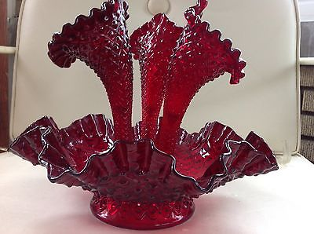

Slide 34
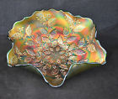

Slide 35
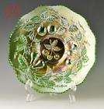

Slide 36
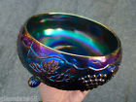

Slide 37
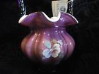

Slide 38
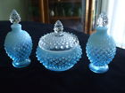

Slide 40
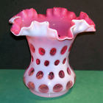

Slide 41
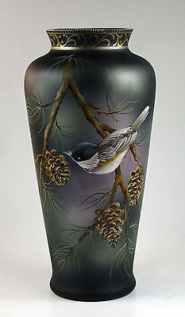

Slide 42
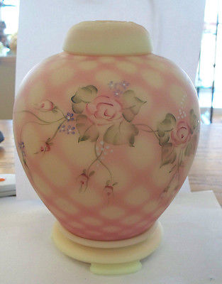

Slide 43
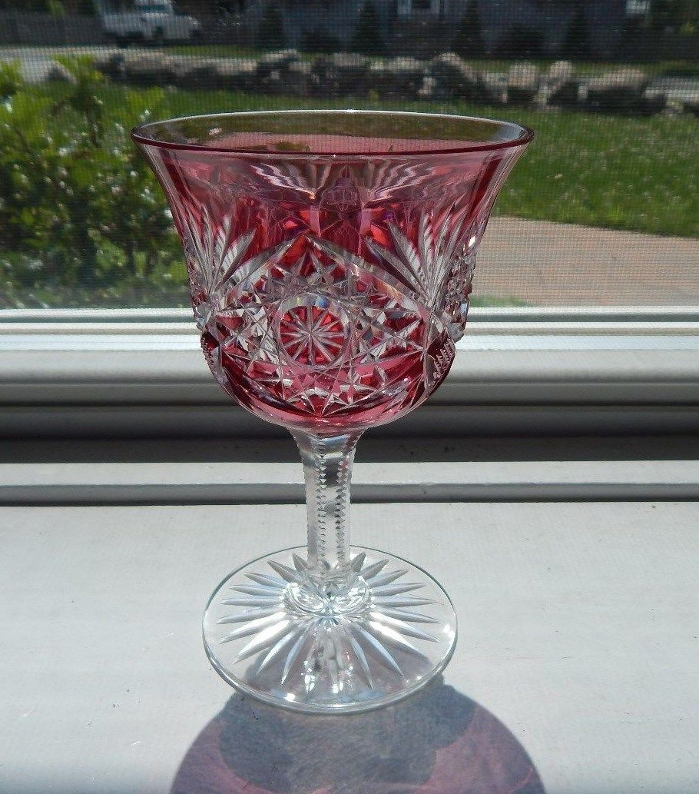

Slide 44
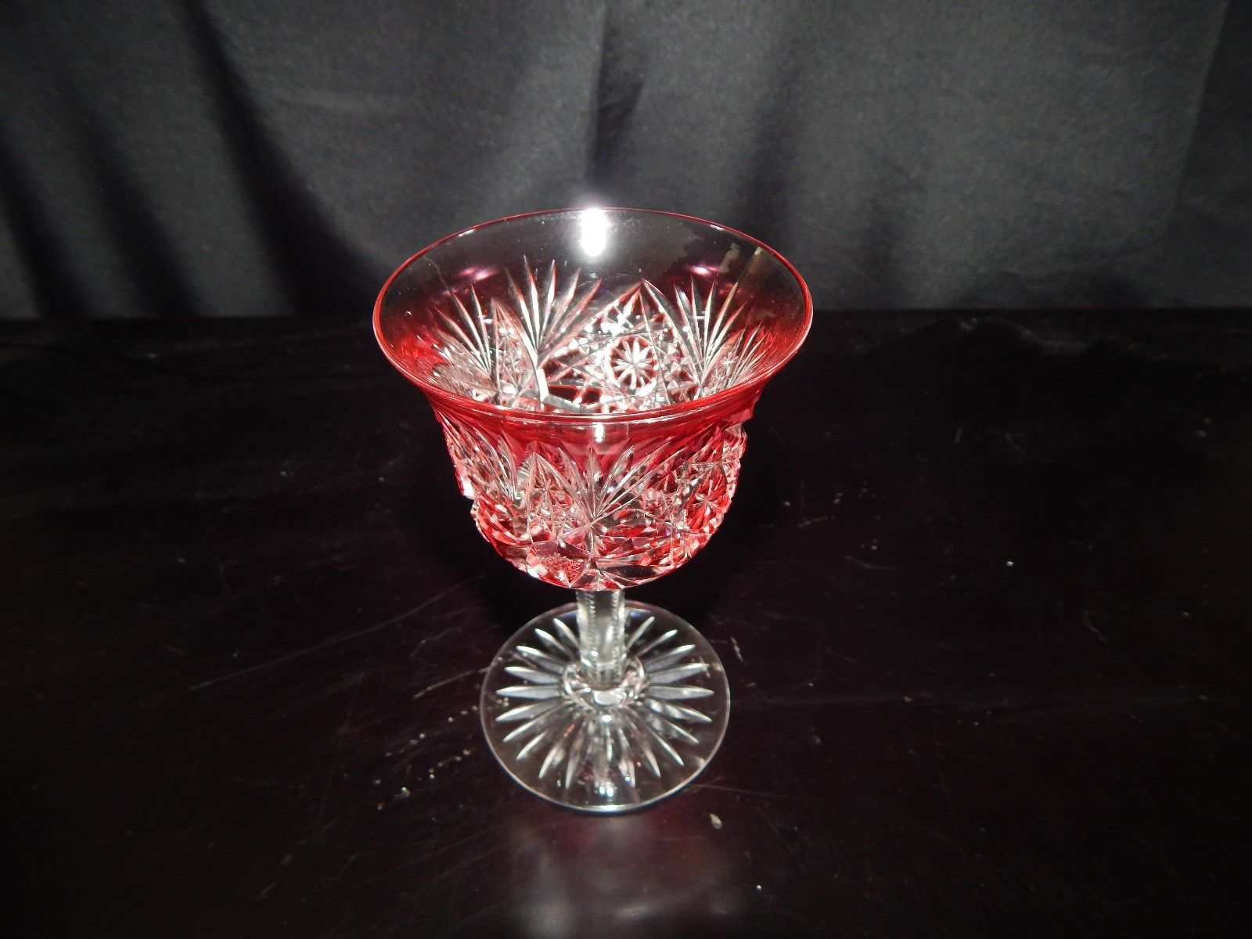

Slide 45
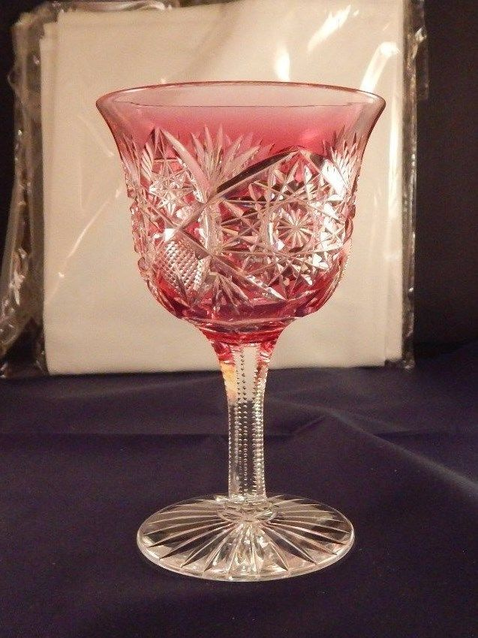

Slide 46
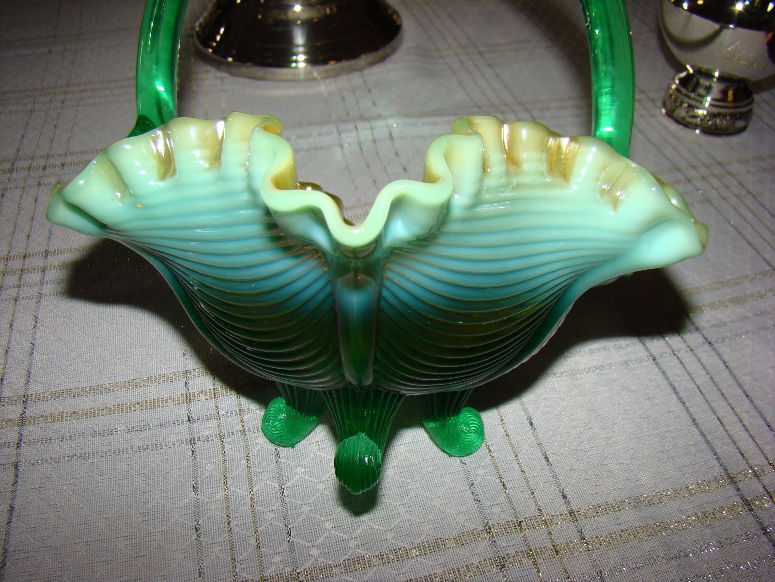

Slide 47
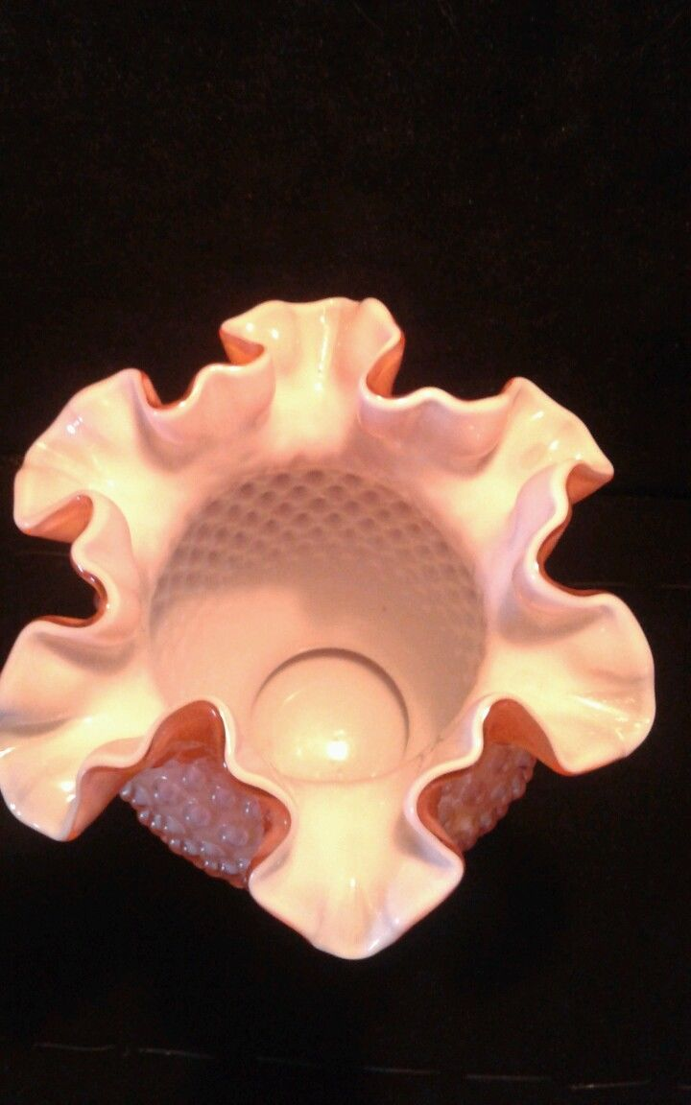

Slide 48
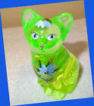

Slide 49
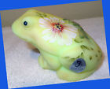

Slide 50
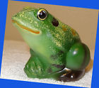

Slide 51


Slide 52


Slide 53


Slide 54


Slide 55


Slide 56


Slide 57


Slide 58


Slide 59
Carnival glass ware

Slide 60


Slide 61


Slide 62


Slide 63


Slide 64


Slide 65


Slide 66


Slide 67


Slide 68


Slide 69


Slide 70


Slide 71


Slide 72


Slide 73


Slide 74


Slide 75


Slide 76


Slide 77


Slide 78


Slide 79


Slide 80


Slide 81


Slide 86


Slide 87


Slide 88


Slide 89


Slide 90


Slide 91



Slide 92



Slide 93



Slide 94


Slide 95


Slide 96


Slide 97


Slide 98



Slide 99


Slide 100


Slide 101


Slide 102



Slide 103


Slide 104



Slide 105


Slide 106



Slide 107


Slide 108


Slide 109


Slide 110


Slide 111



Slide 112



Slide 113


Slide 114


Slide 115



Slide 116


Slide 117


Slide 118



Slide 119




Slide 120


Slide 121


Slide 122


Slide 123


Slide 124


Slide 125


Slide 126


Slide 127


Slide 128


Slide 129



Slide 130


Slide 131



Slide 132



Slide 133
Fostoria glass ware

Slide 134



Slide 135


Slide 136


Slide 137


Slide 138



Slide 139


Slide 140


Slide 141


Slide 142



Slide 143


Slide 144


Slide 145


Slide 146


Slide 147


Slide 148


Slide 149


Slide 150


Slide 151



Slide 152


Slide 153


Slide 154


Slide 155


Slide 156


Slide 157


Slide 158


Slide 159


Slide 160



Slide 161


Slide 162


Slide 164


Slide 165


Slide 166


Slide 167


Slide 168


Slide 169


Slide 170


Slide 171



Slide 172


Slide 173


Slide 174


Slide 175


Slide 176


Slide 179


Slide 180


Slide 181


Slide 182


Slide 183


Slide 184


Slide 185
Heisey glassware

Slide 186


Slide 187


Slide 188


Slide 189


Slide 190


Slide 191


Slide 192



Slide 193


Slide 194


Slide 195


Slide 196


Slide 197


Slide 198



Slide 199



Slide 200


Slide 201


Slide 204


Slide 205


Slide 206


Slide 207


Slide 208


Slide 209


Slide 210



Slide 211
Anchor Hawking glassware

Slide 212


Slide 213


Slide 214


Slide 215


Slide 217


Slide 218


Slide 219


Slide 220


Slide 221


Slide 222


Slide 223


Slide 224


Slide 225


Slide 226


Slide 227


Slide 228


Slide 229


Slide 230



Slide 231


Slide 232




Slide 233



Slide 234


Slide 235


Slide 236


Slide 237


Slide 238


Slide 239


Slide 240


Slide 241


Slide 242


Slide 243


Slide 244


Slide 245


Slide 247


Slide 248


Slide 249


Slide 250


