Slide 1
Ellora caves
The Ellora Caves are an impressive complex of Buddhist, Hindu and Jain cave temples built between the 6th and 10th centuries AD near the ancient Indian village of Ellora near Aurangabad. The caves have a slightly less dramatic setting than those at Ajanta , but more exquisite sculptures. Ellora is a World Heritage Site and the most visited ancient monument in Maharashtra State.

Slide 2
Editor’s note
The Ellora caves , 34 in total include Hindu, Buddhist and Jain shrines as well as monasteries , cut from solid rock on the side of the mountain just like in Ajanta but more ornate and massive like the Kailash temple. Some caves are joined with each other through tunnels and stairs.
The Ajanta caves predate Christ while Ellora caves are of much later date. Ellora symbolizes the harmony that still prevails among the three great religions.
AKC/December 2015

Slide 3
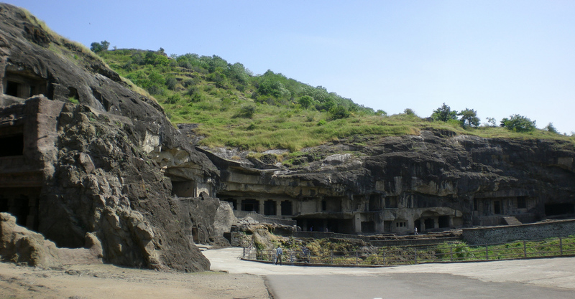

Slide 4
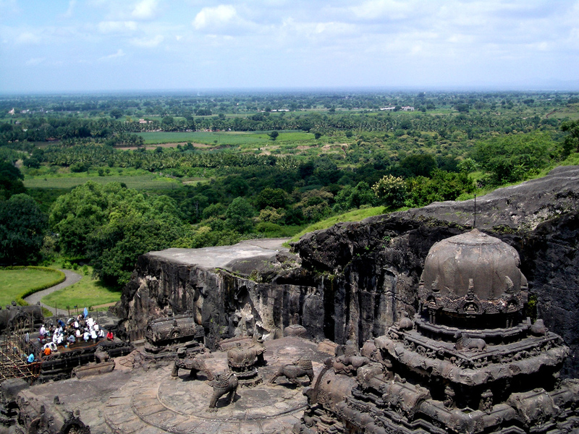

Slide 5
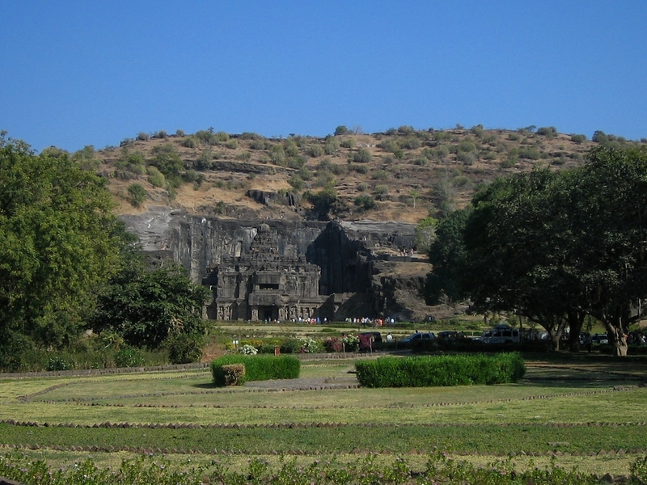

Slide 6
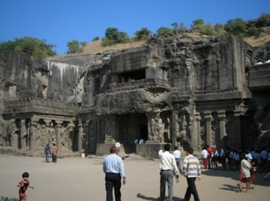

Slide 7
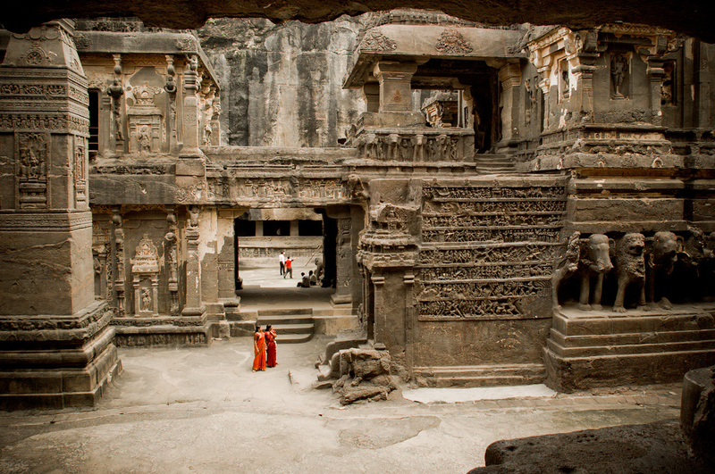
Kailash temple

Slide 8
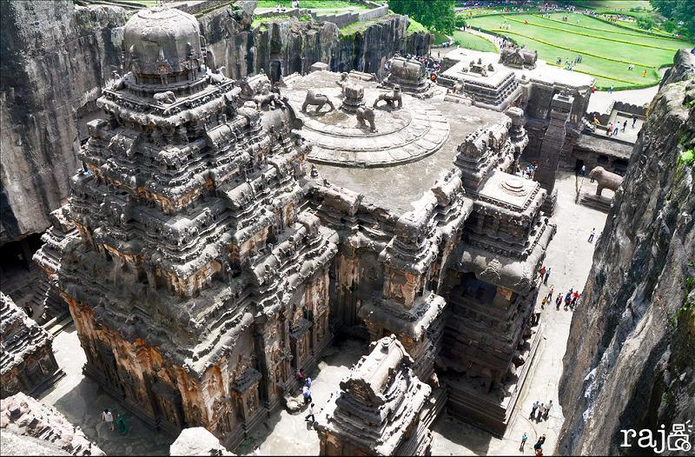

Slide 9
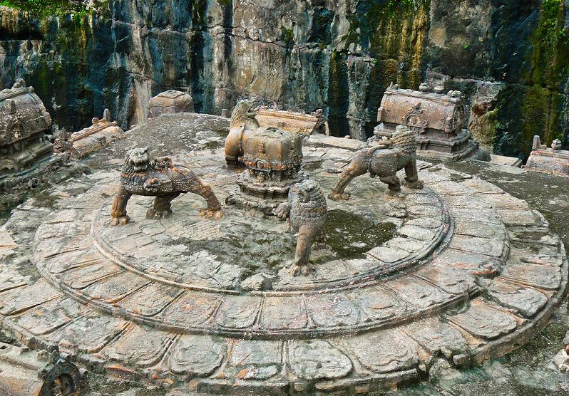

Slide 10
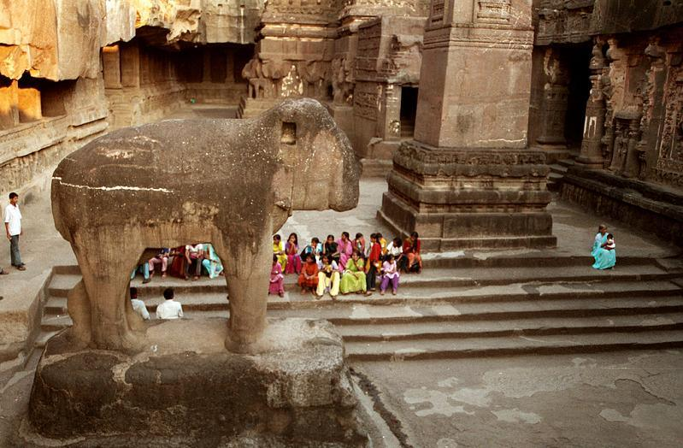

Slide 11
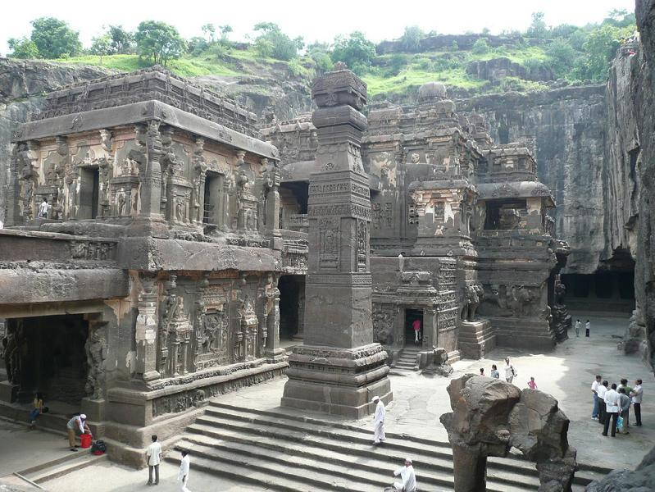

Slide 12
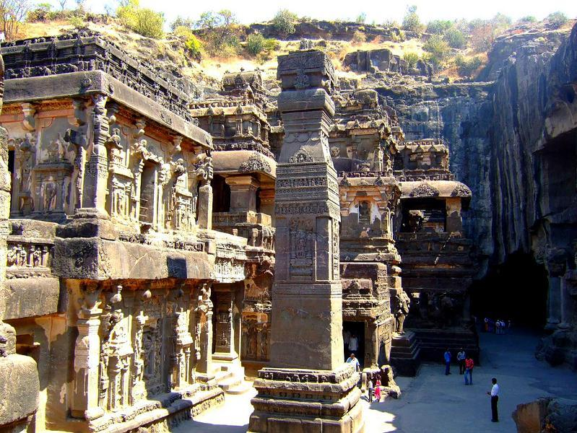

Slide 13
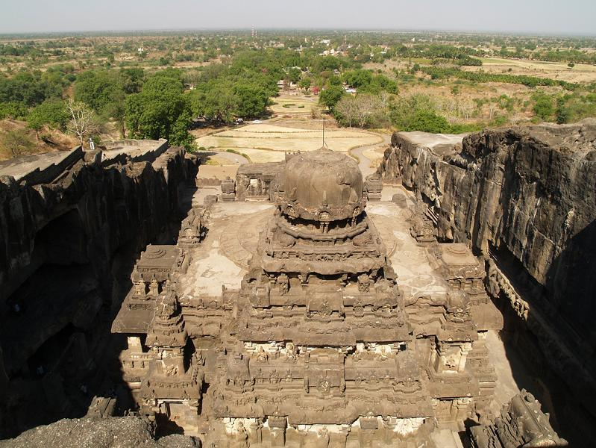

Slide 14
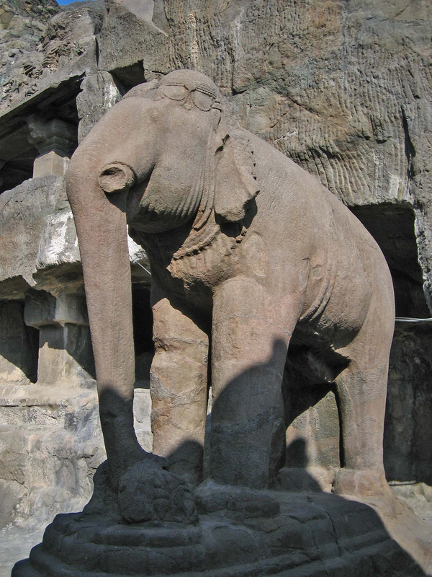

Slide 15
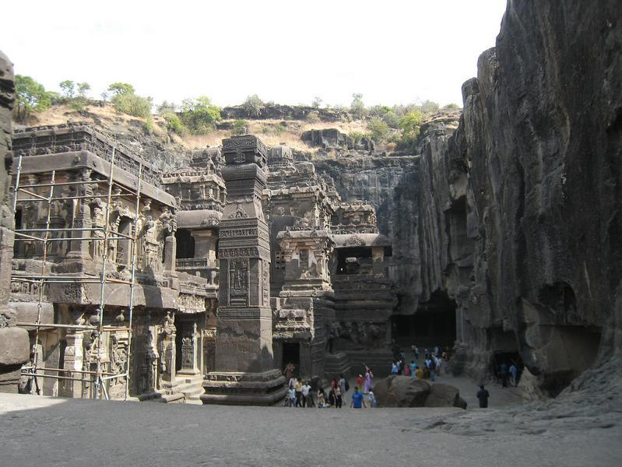

Slide 16
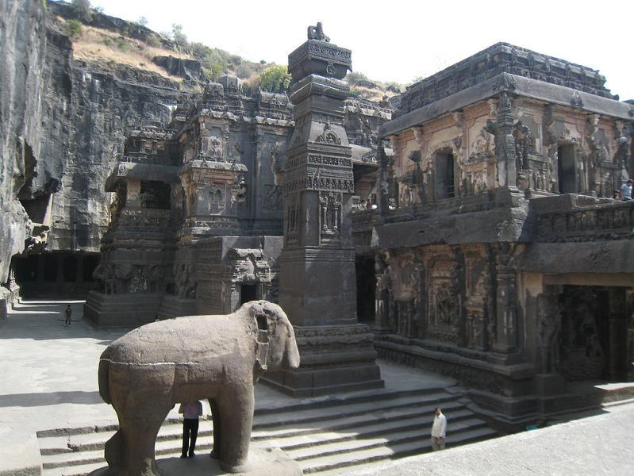

Slide 17
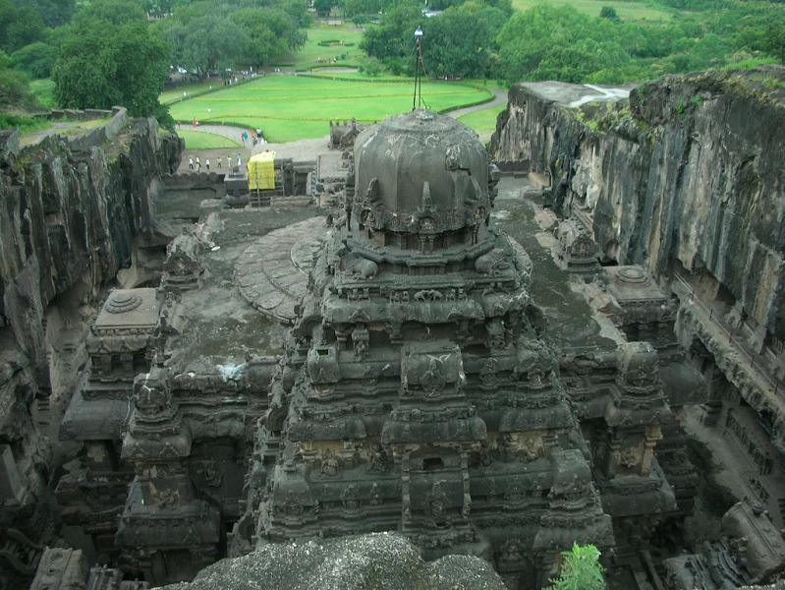

Slide 18
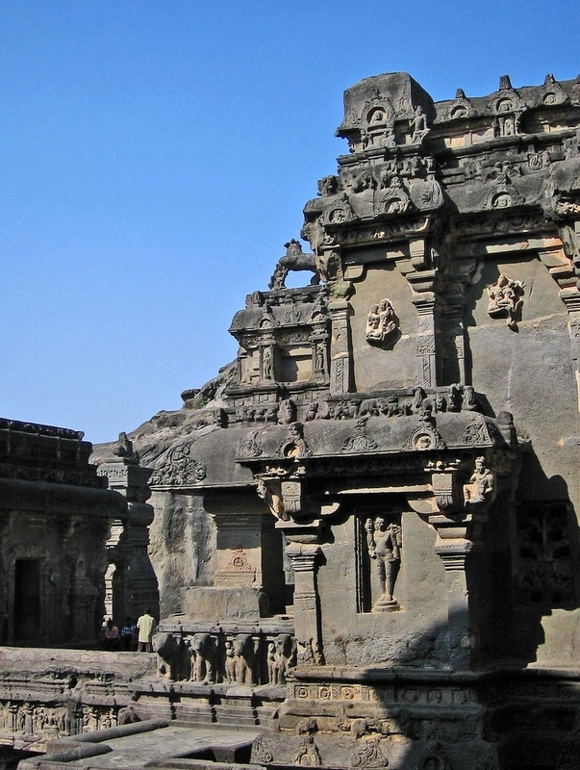

Slide 19
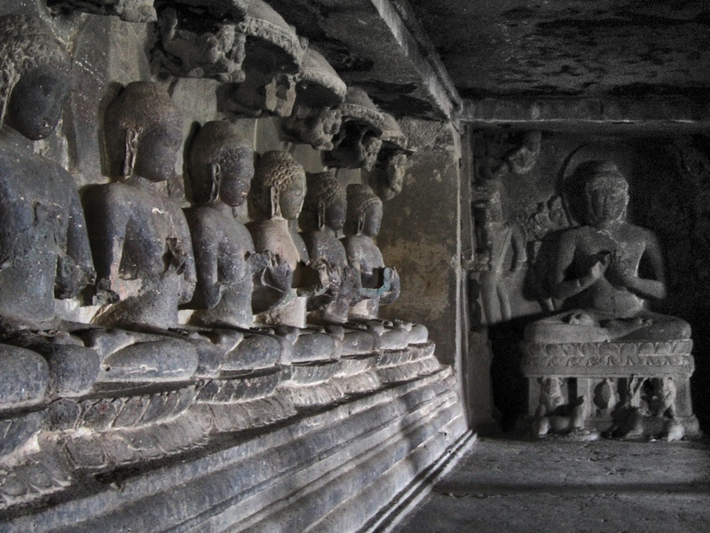

Slide 20
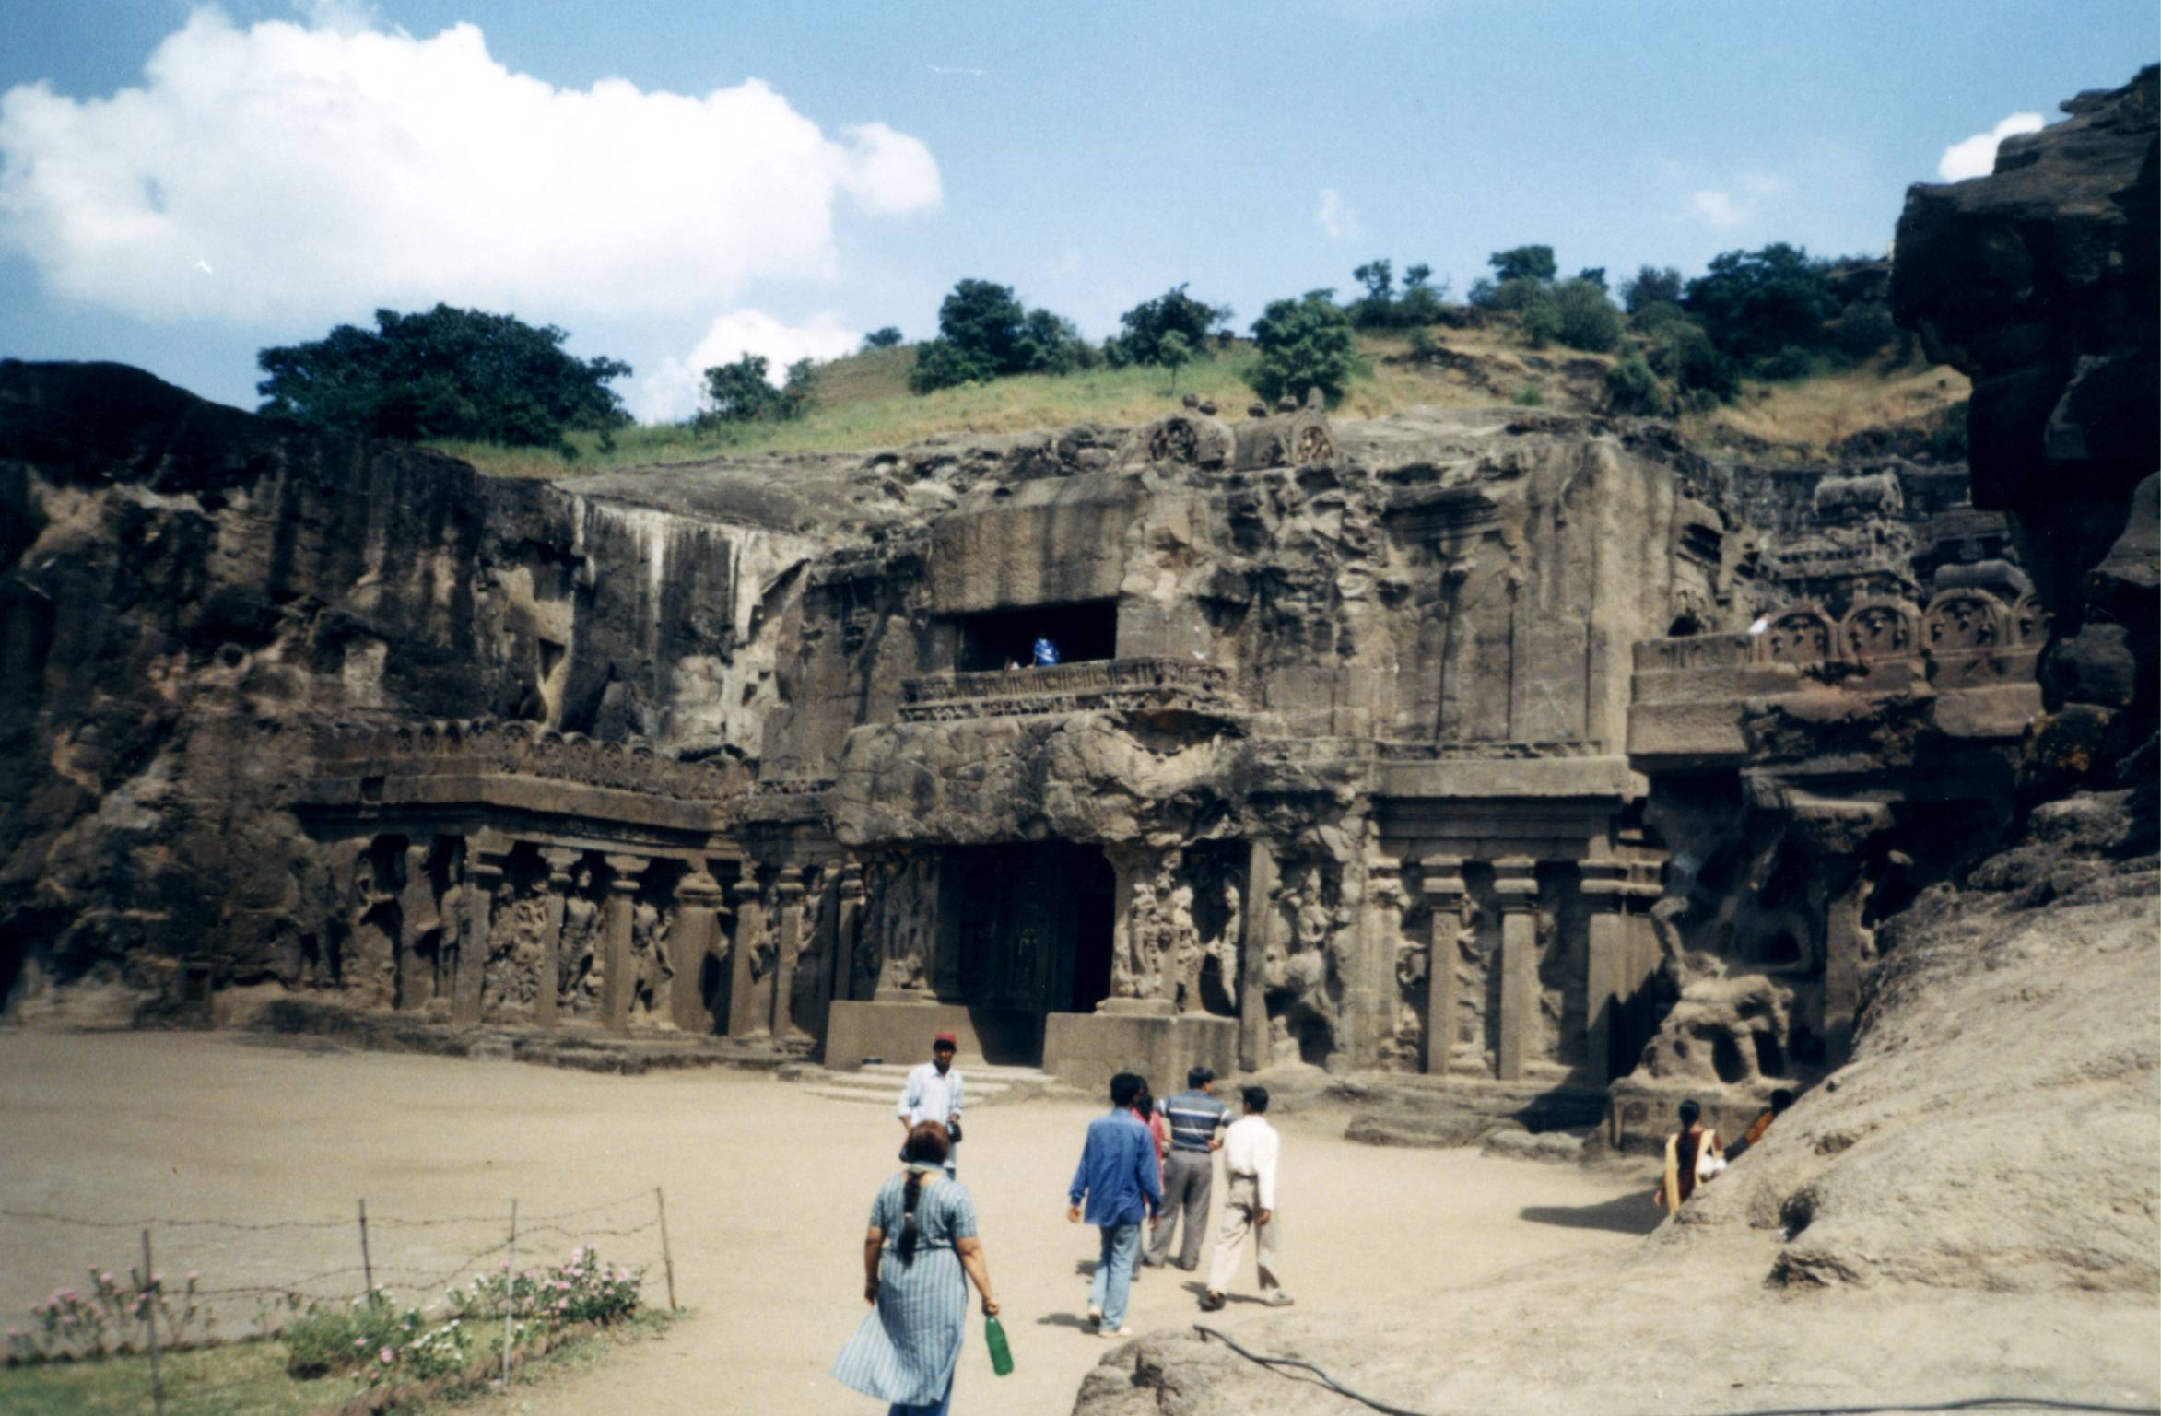

Slide 21
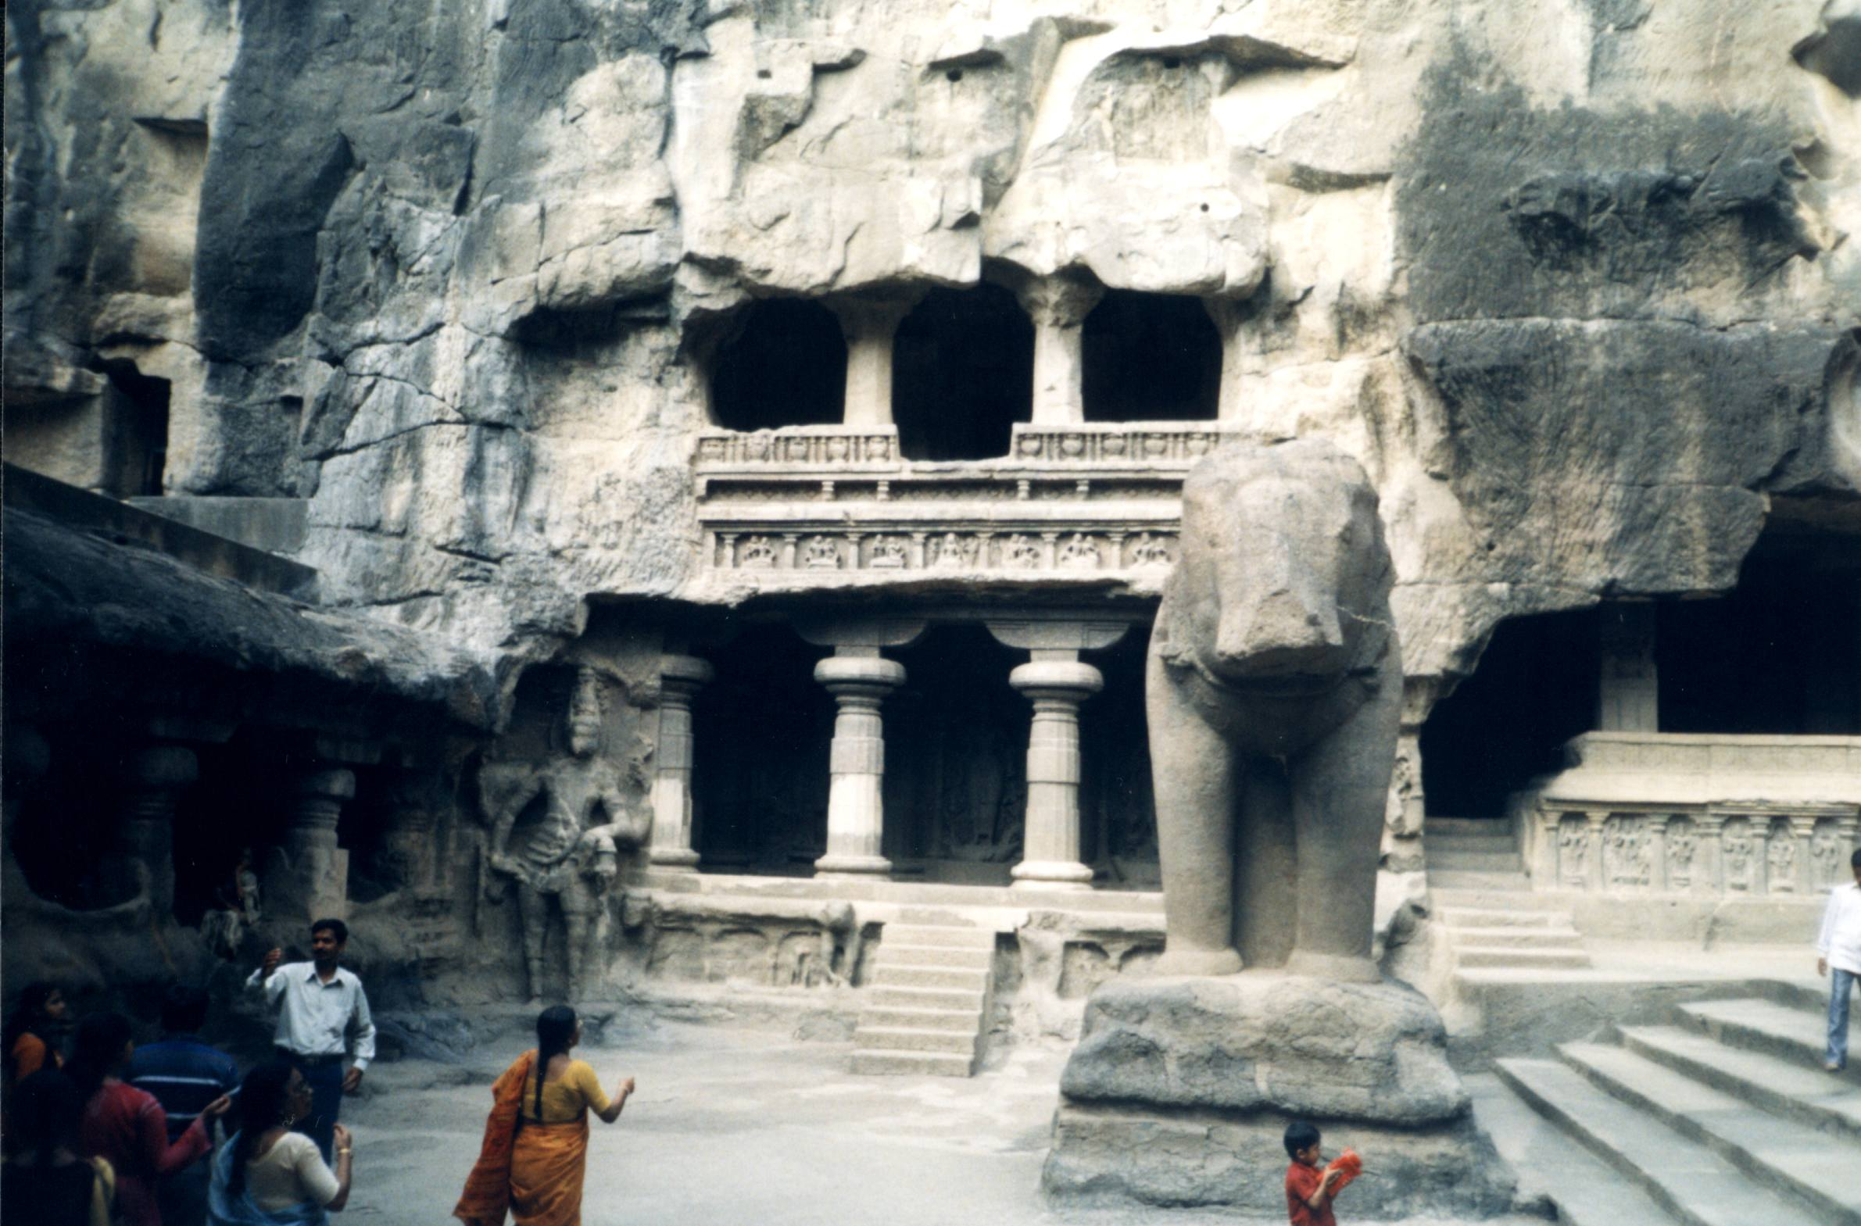

Slide 22
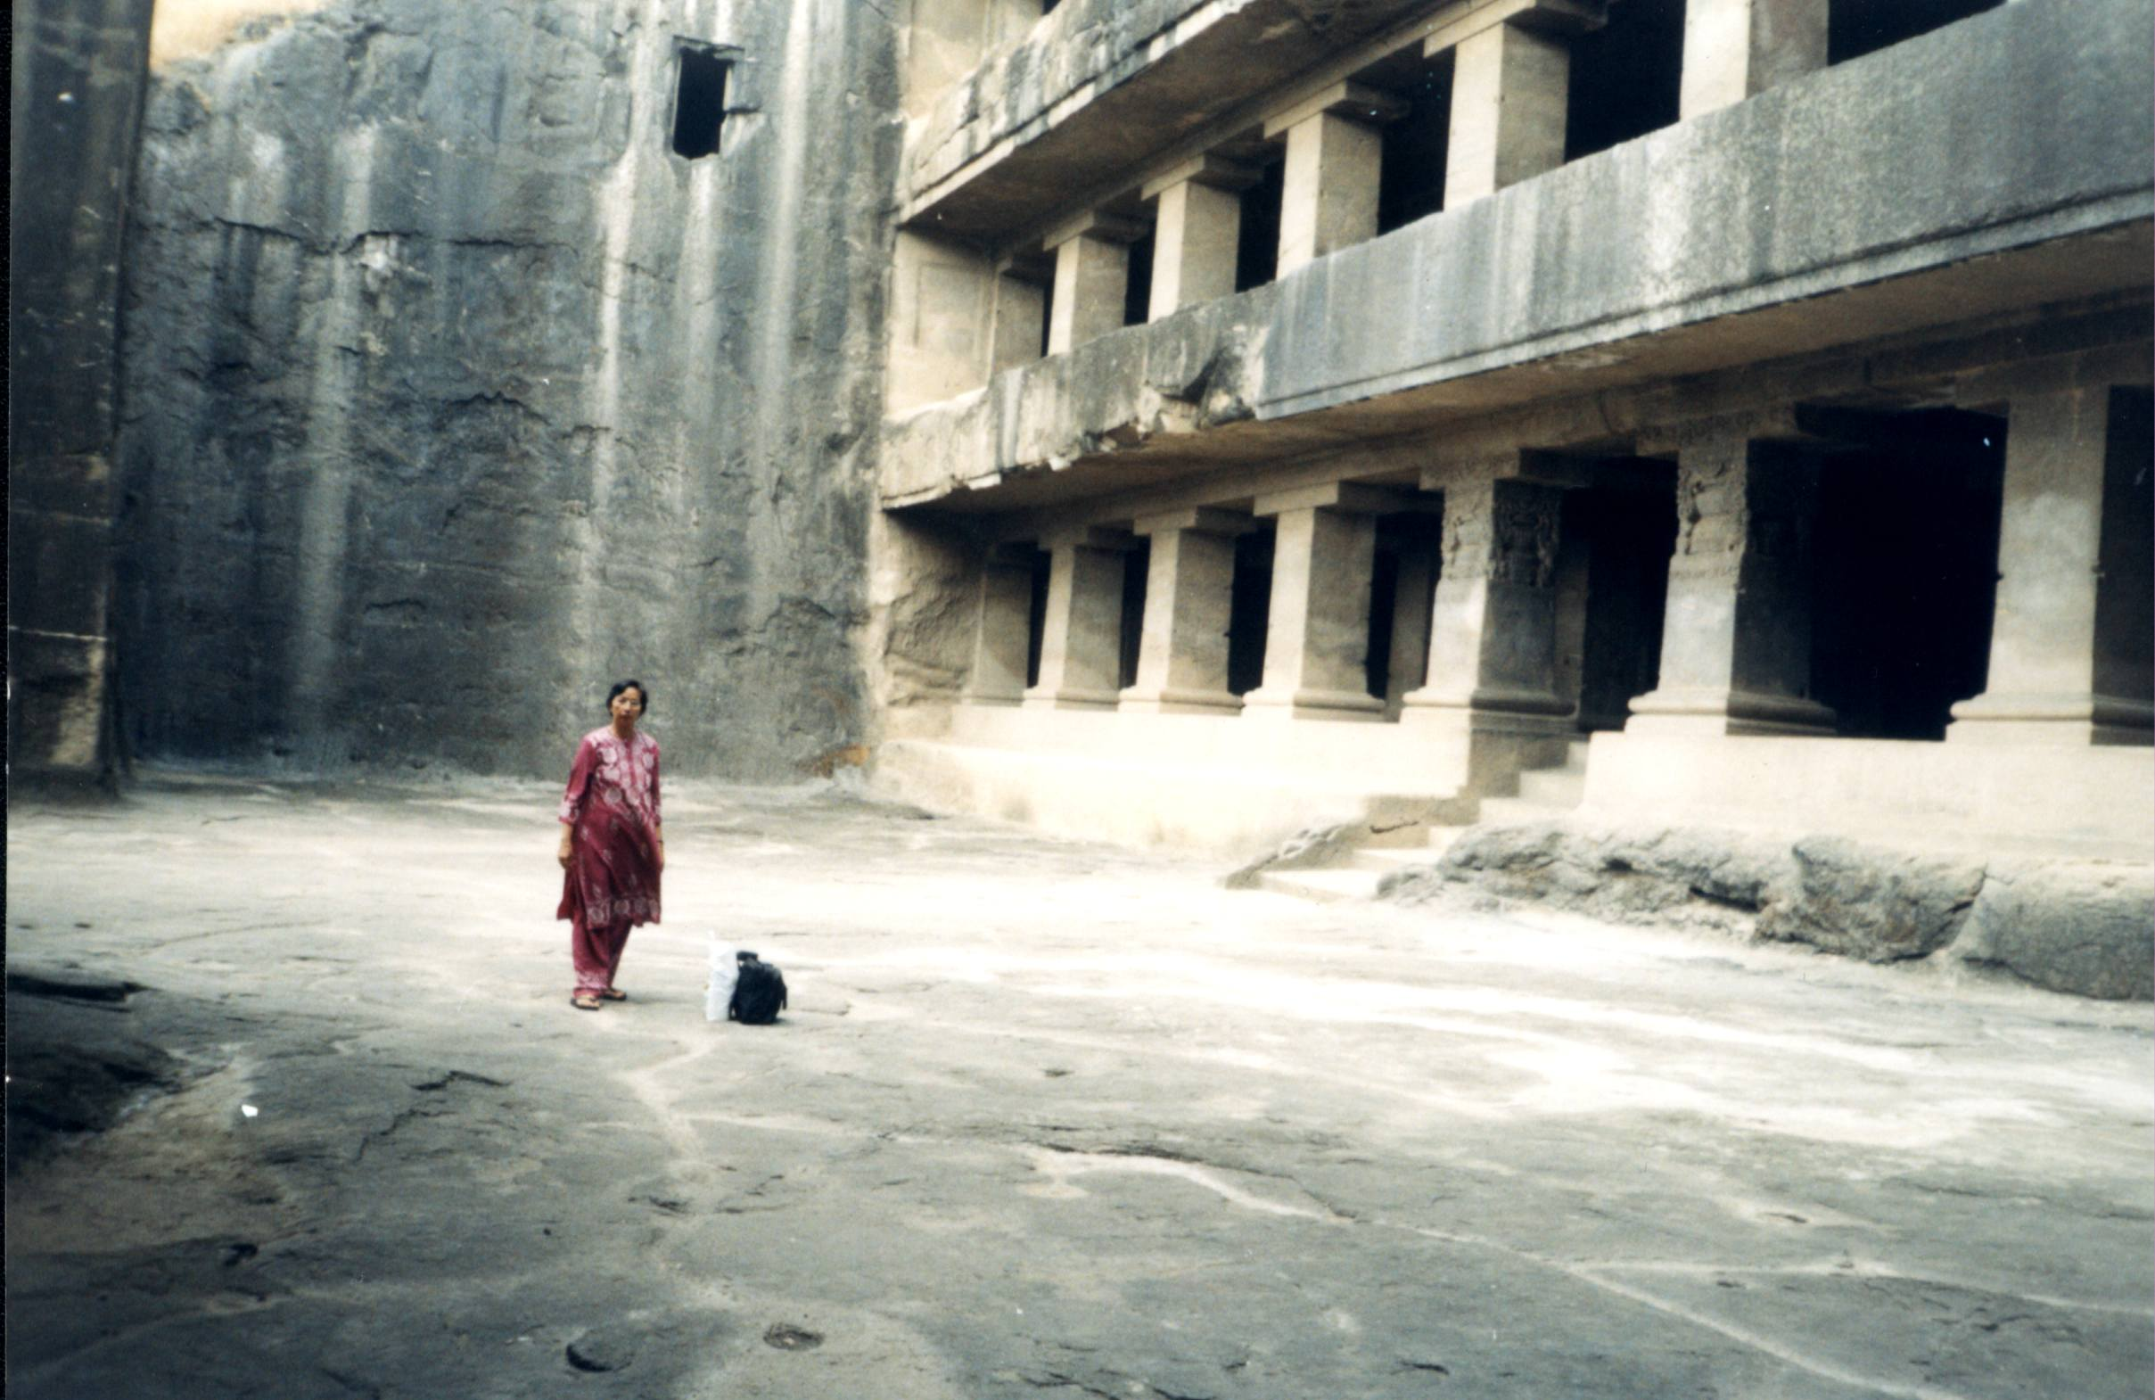
Monasteries

Slide 23
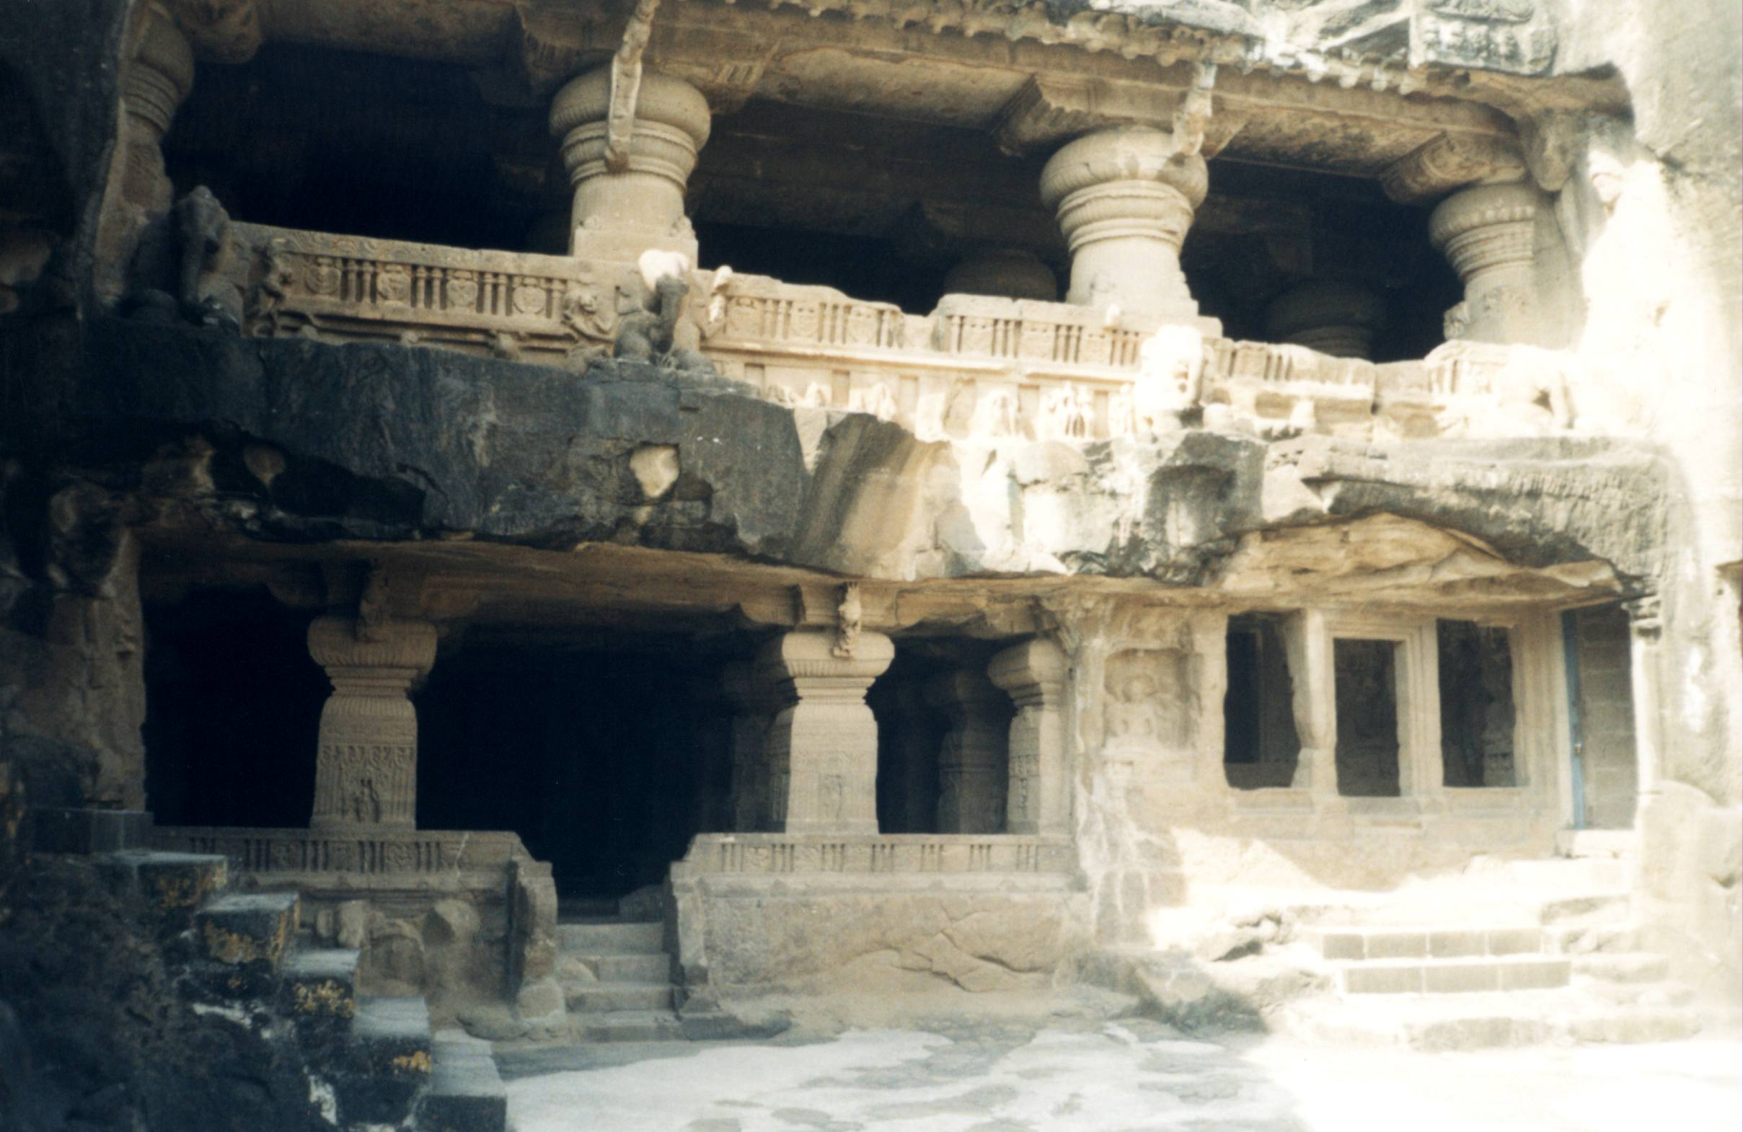

Slide 24
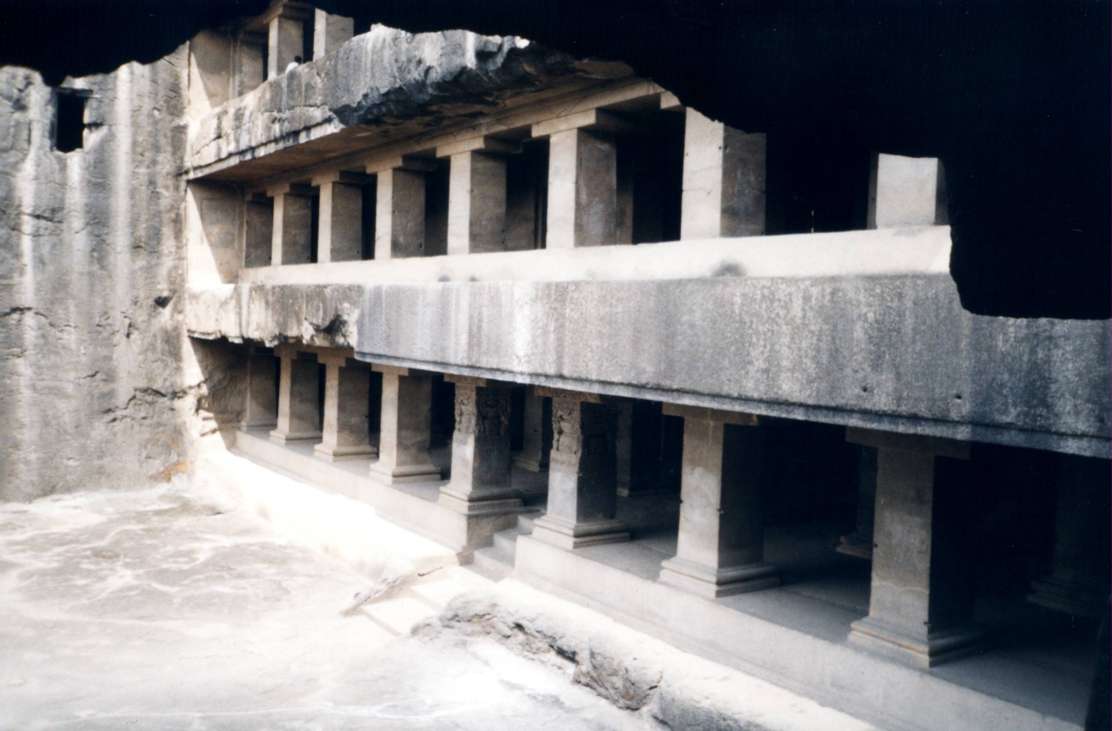

Slide 25
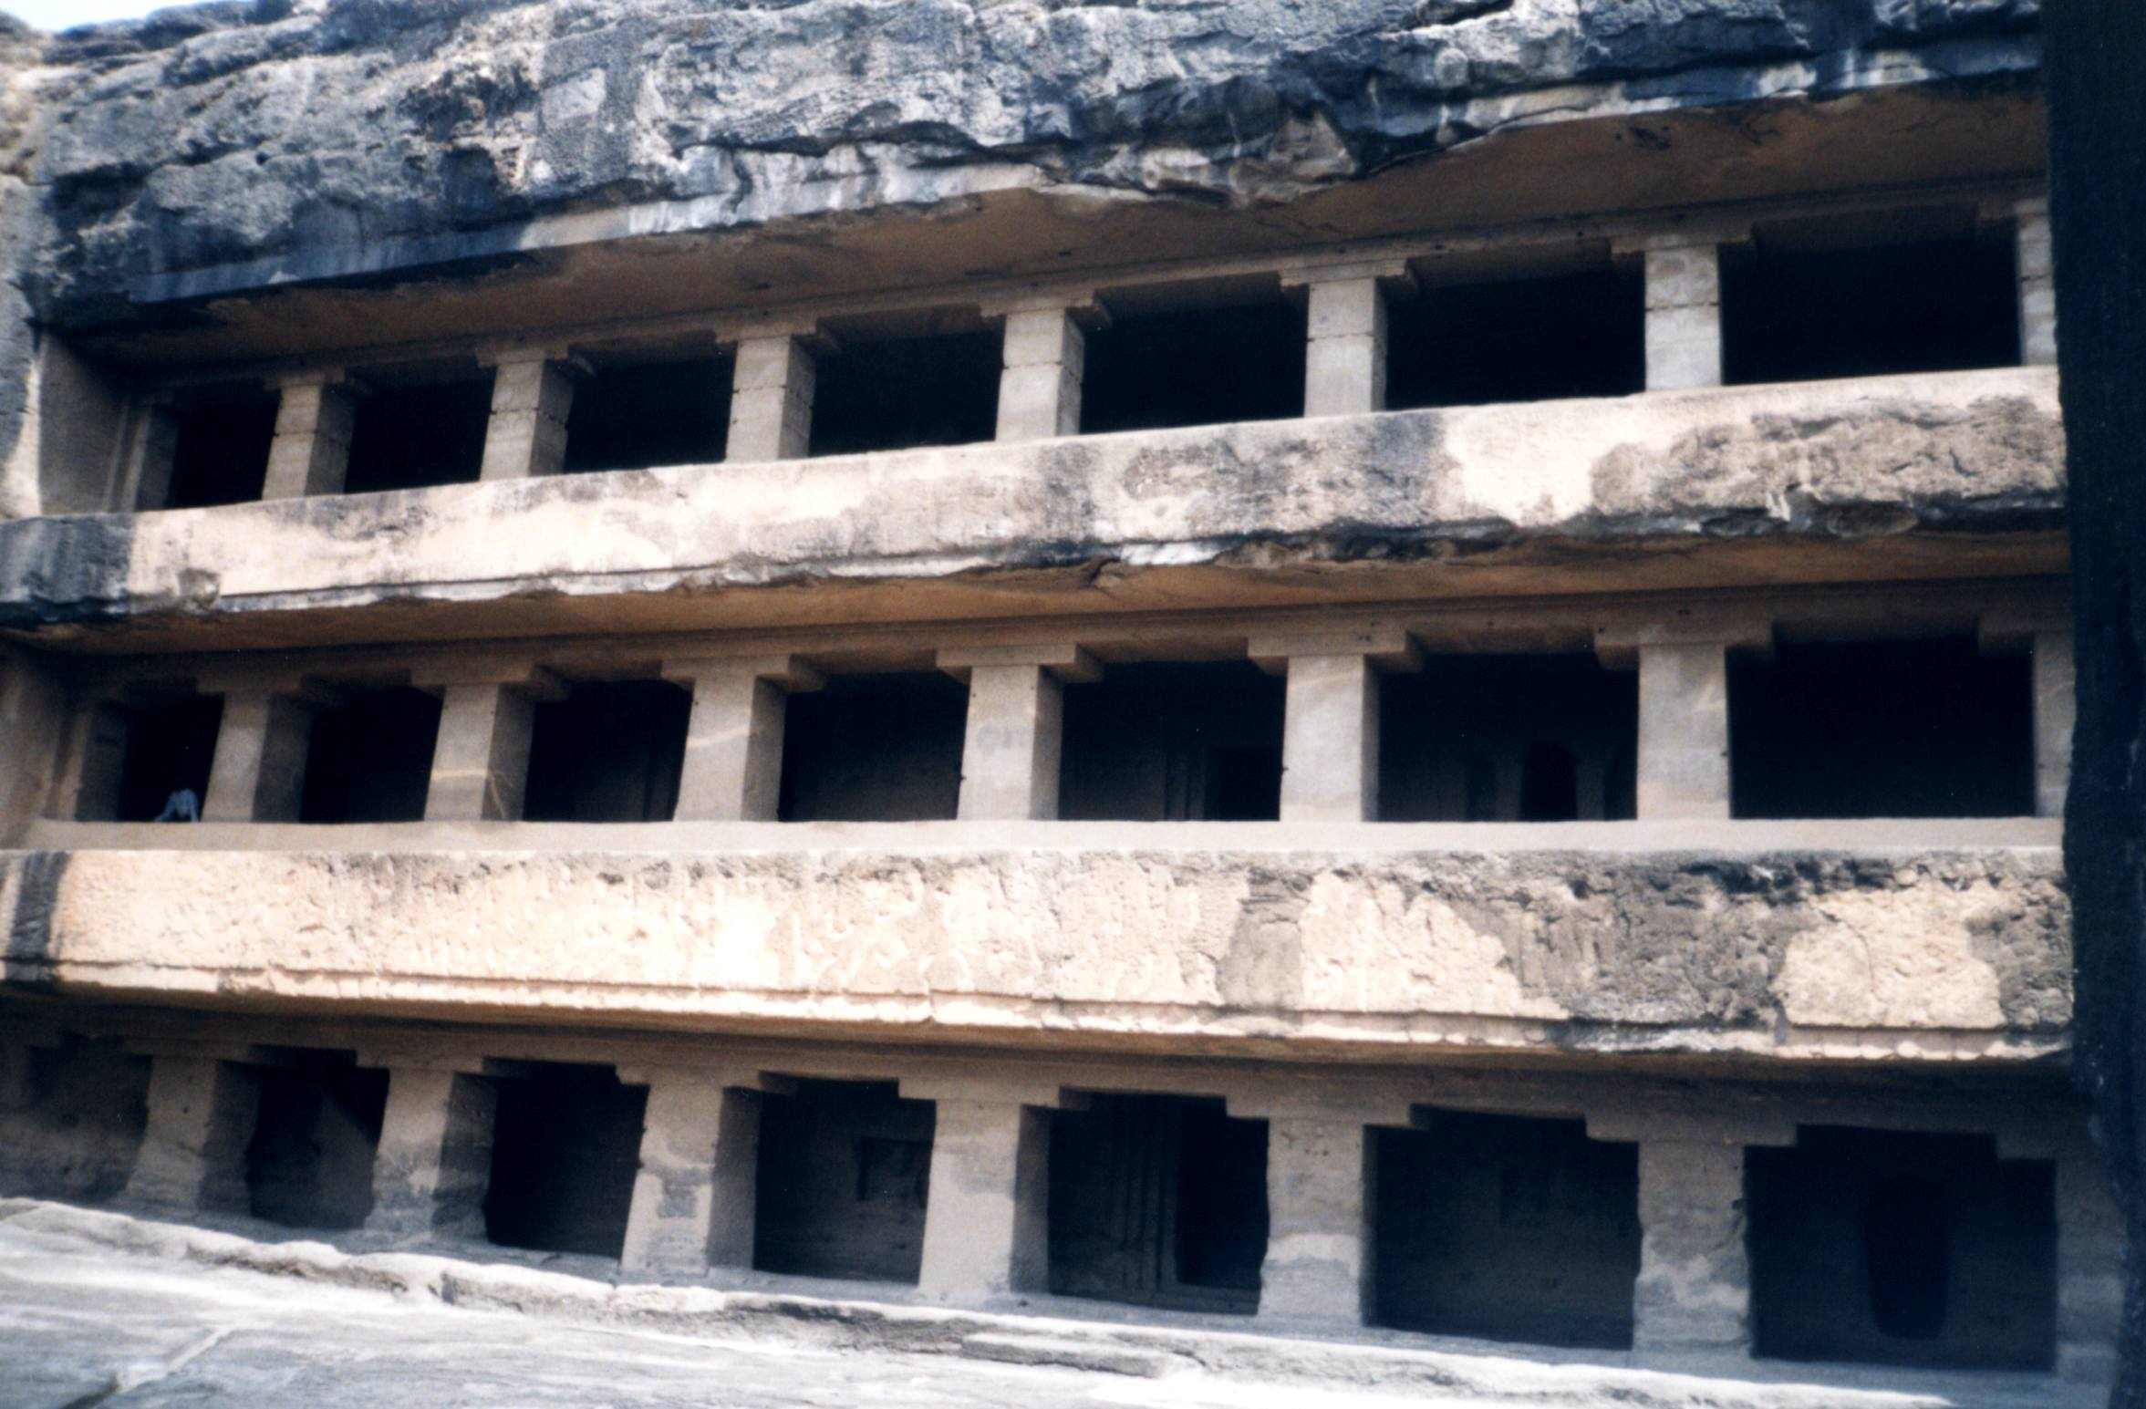

Slide 26
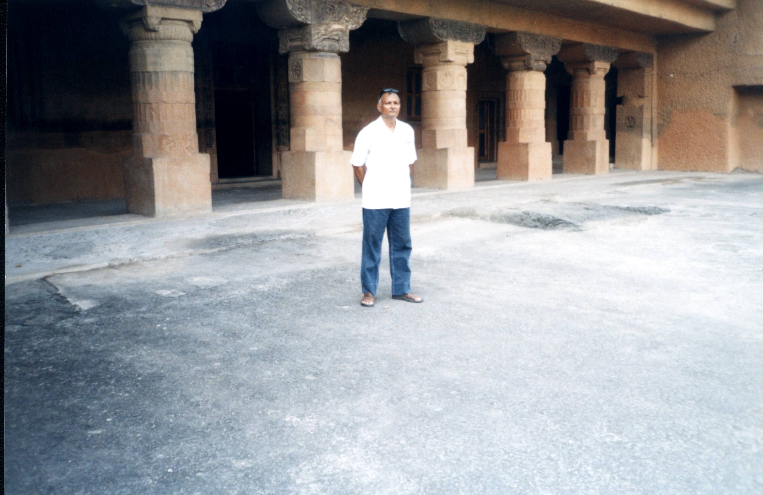

Slide 27
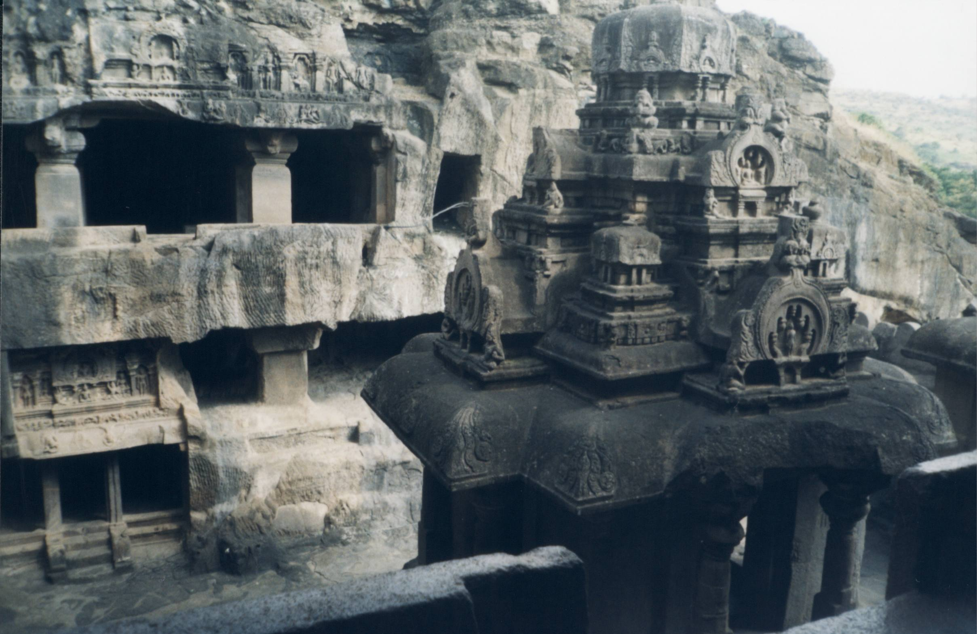

Slide 28
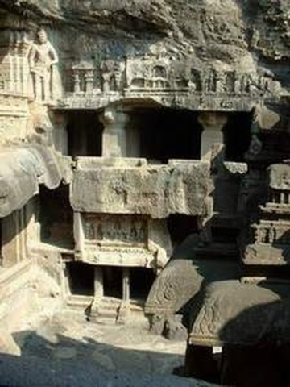

Slide 29
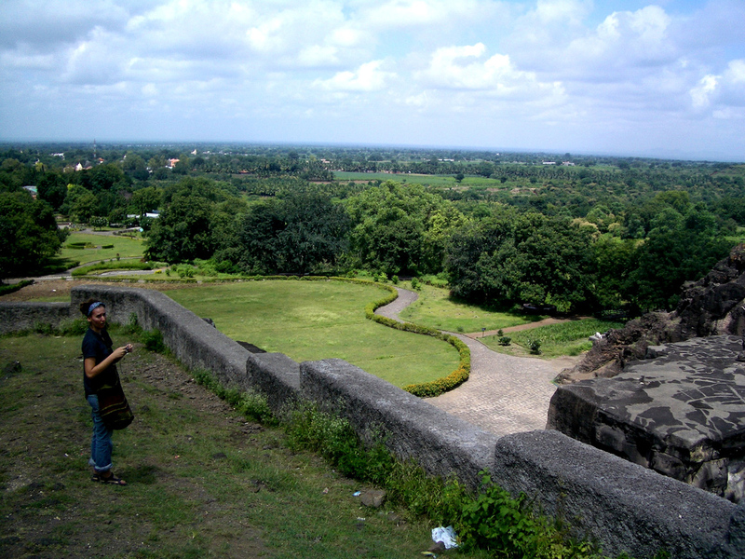

Slide 30
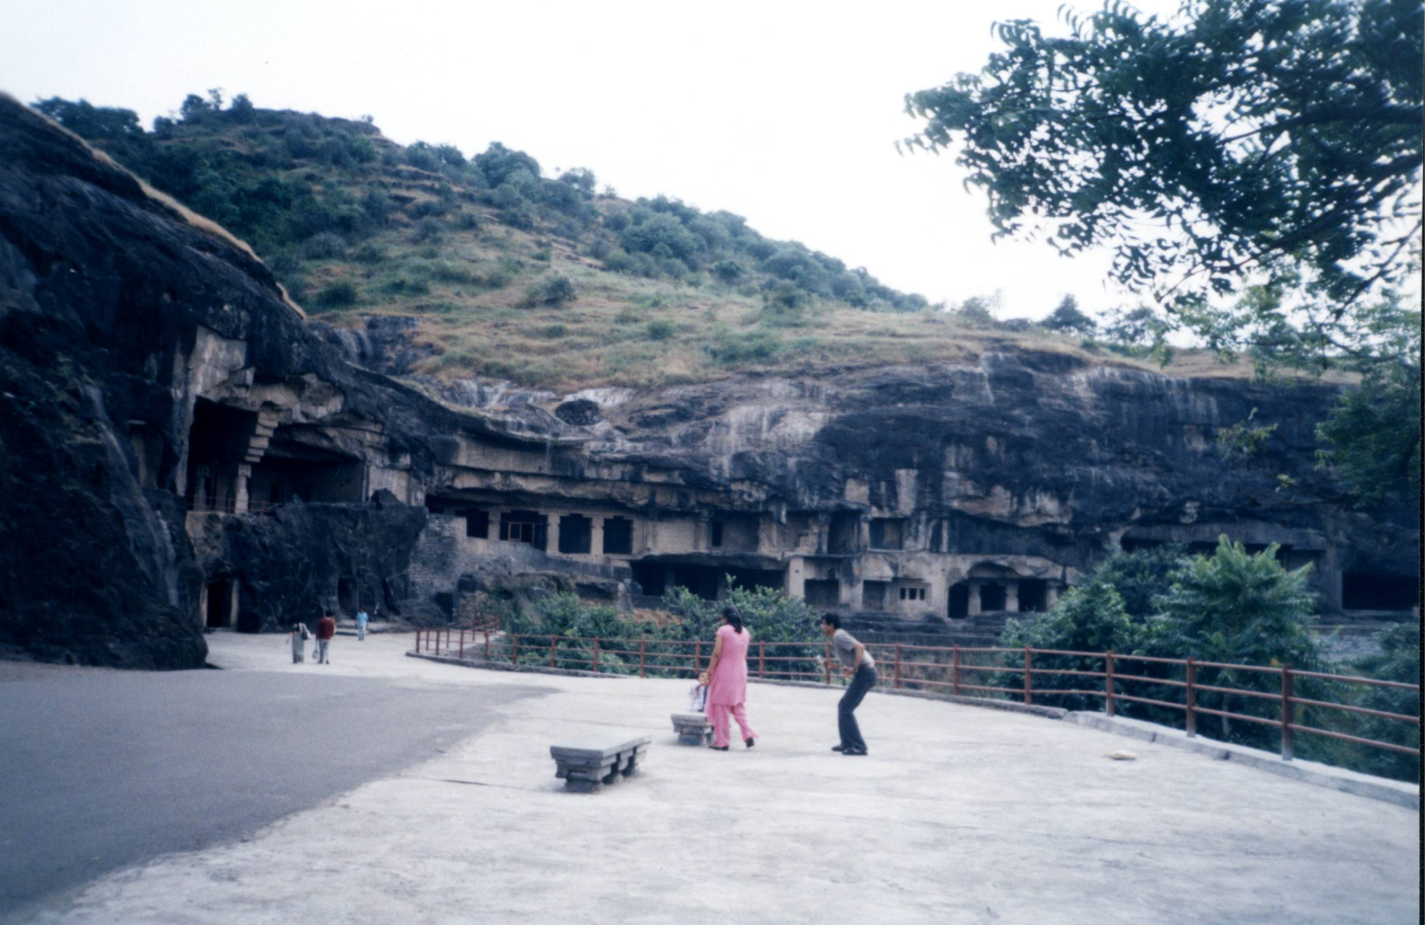

Slide 31
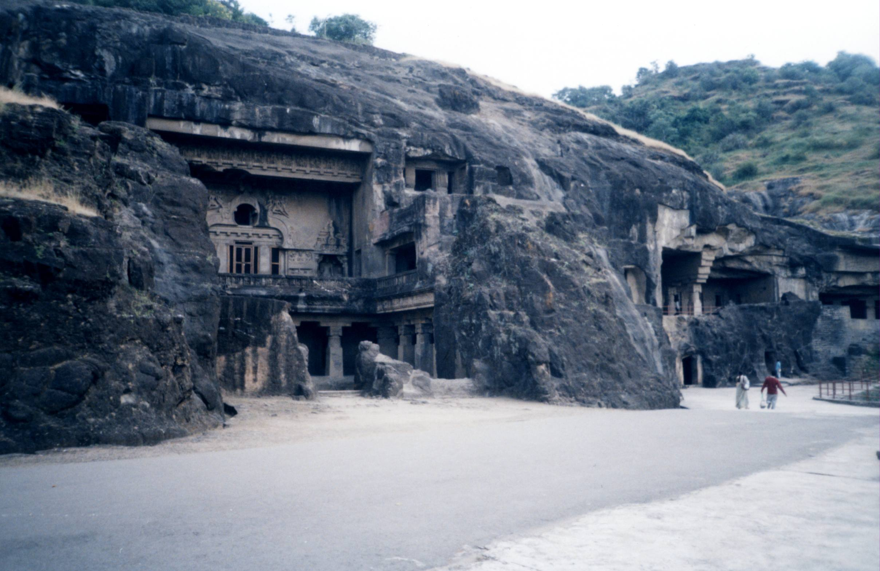

Slide 32
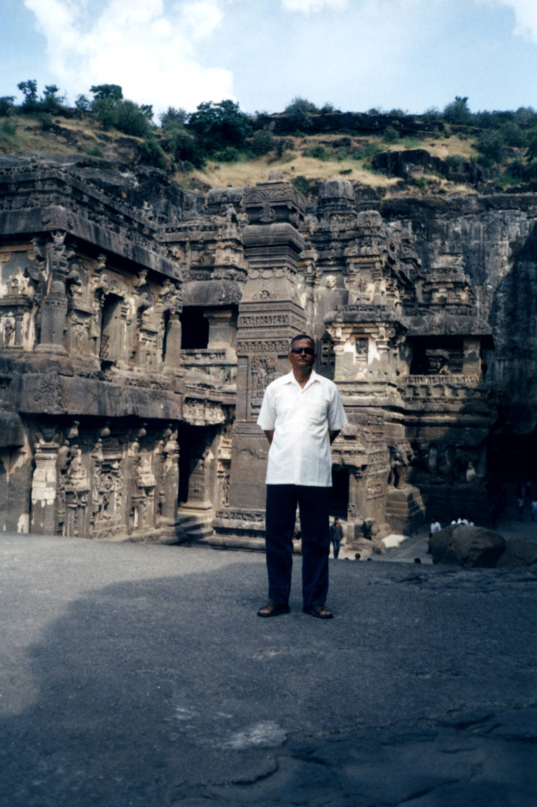

Slide 33
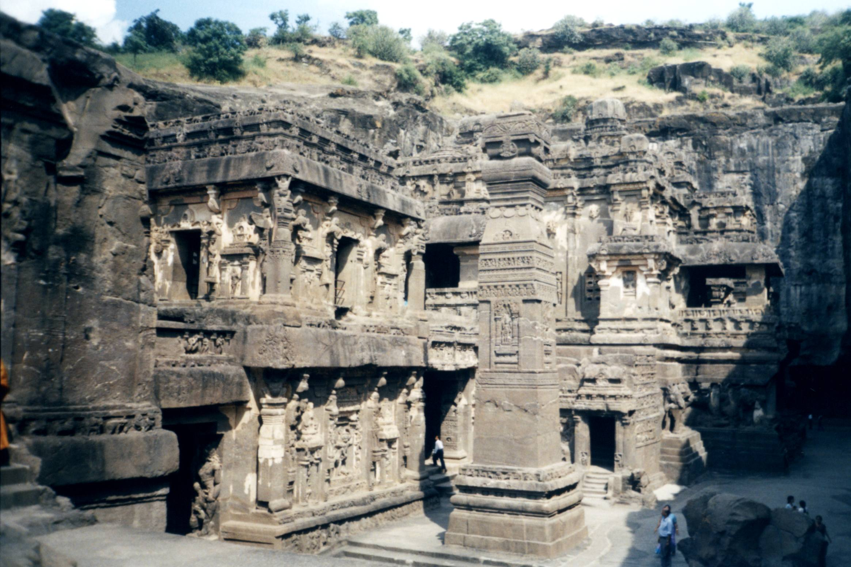

Slide 34
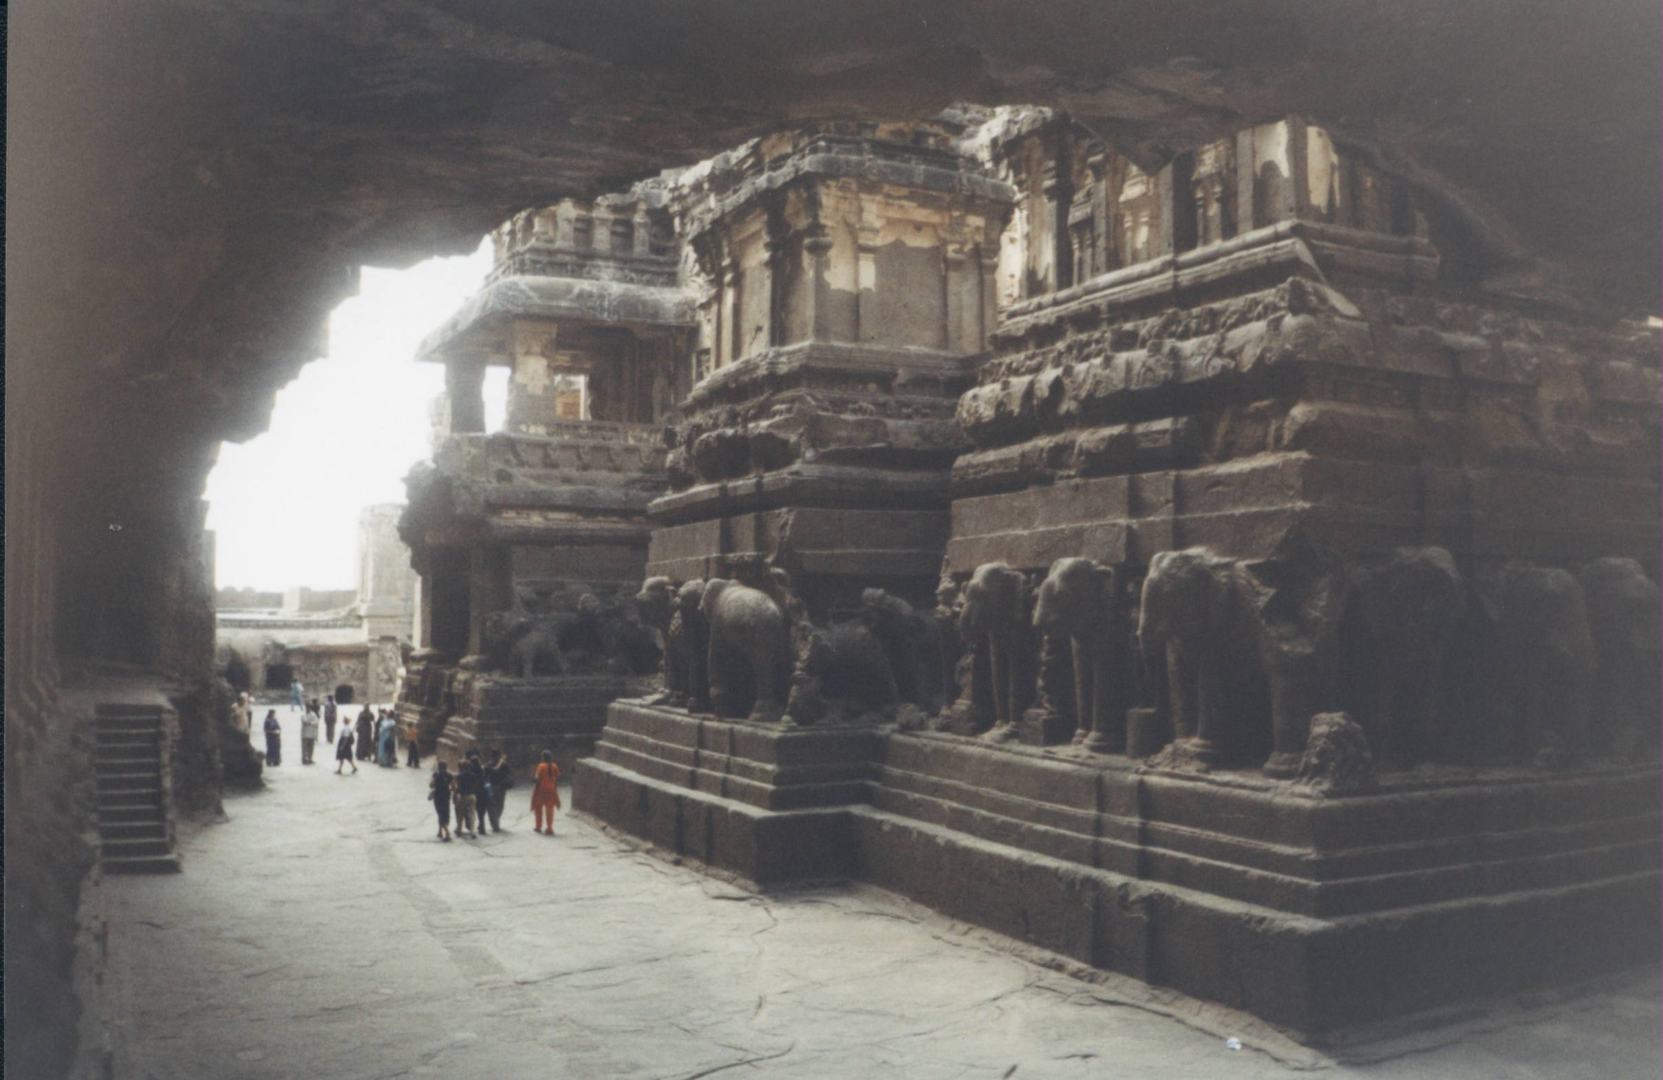

Slide 35
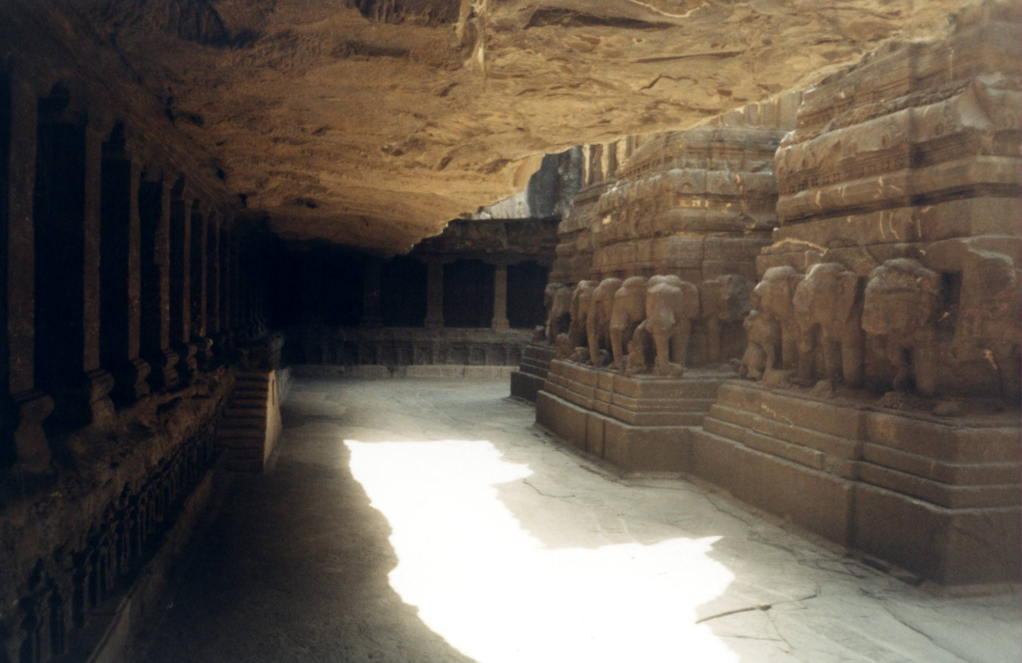

Slide 36
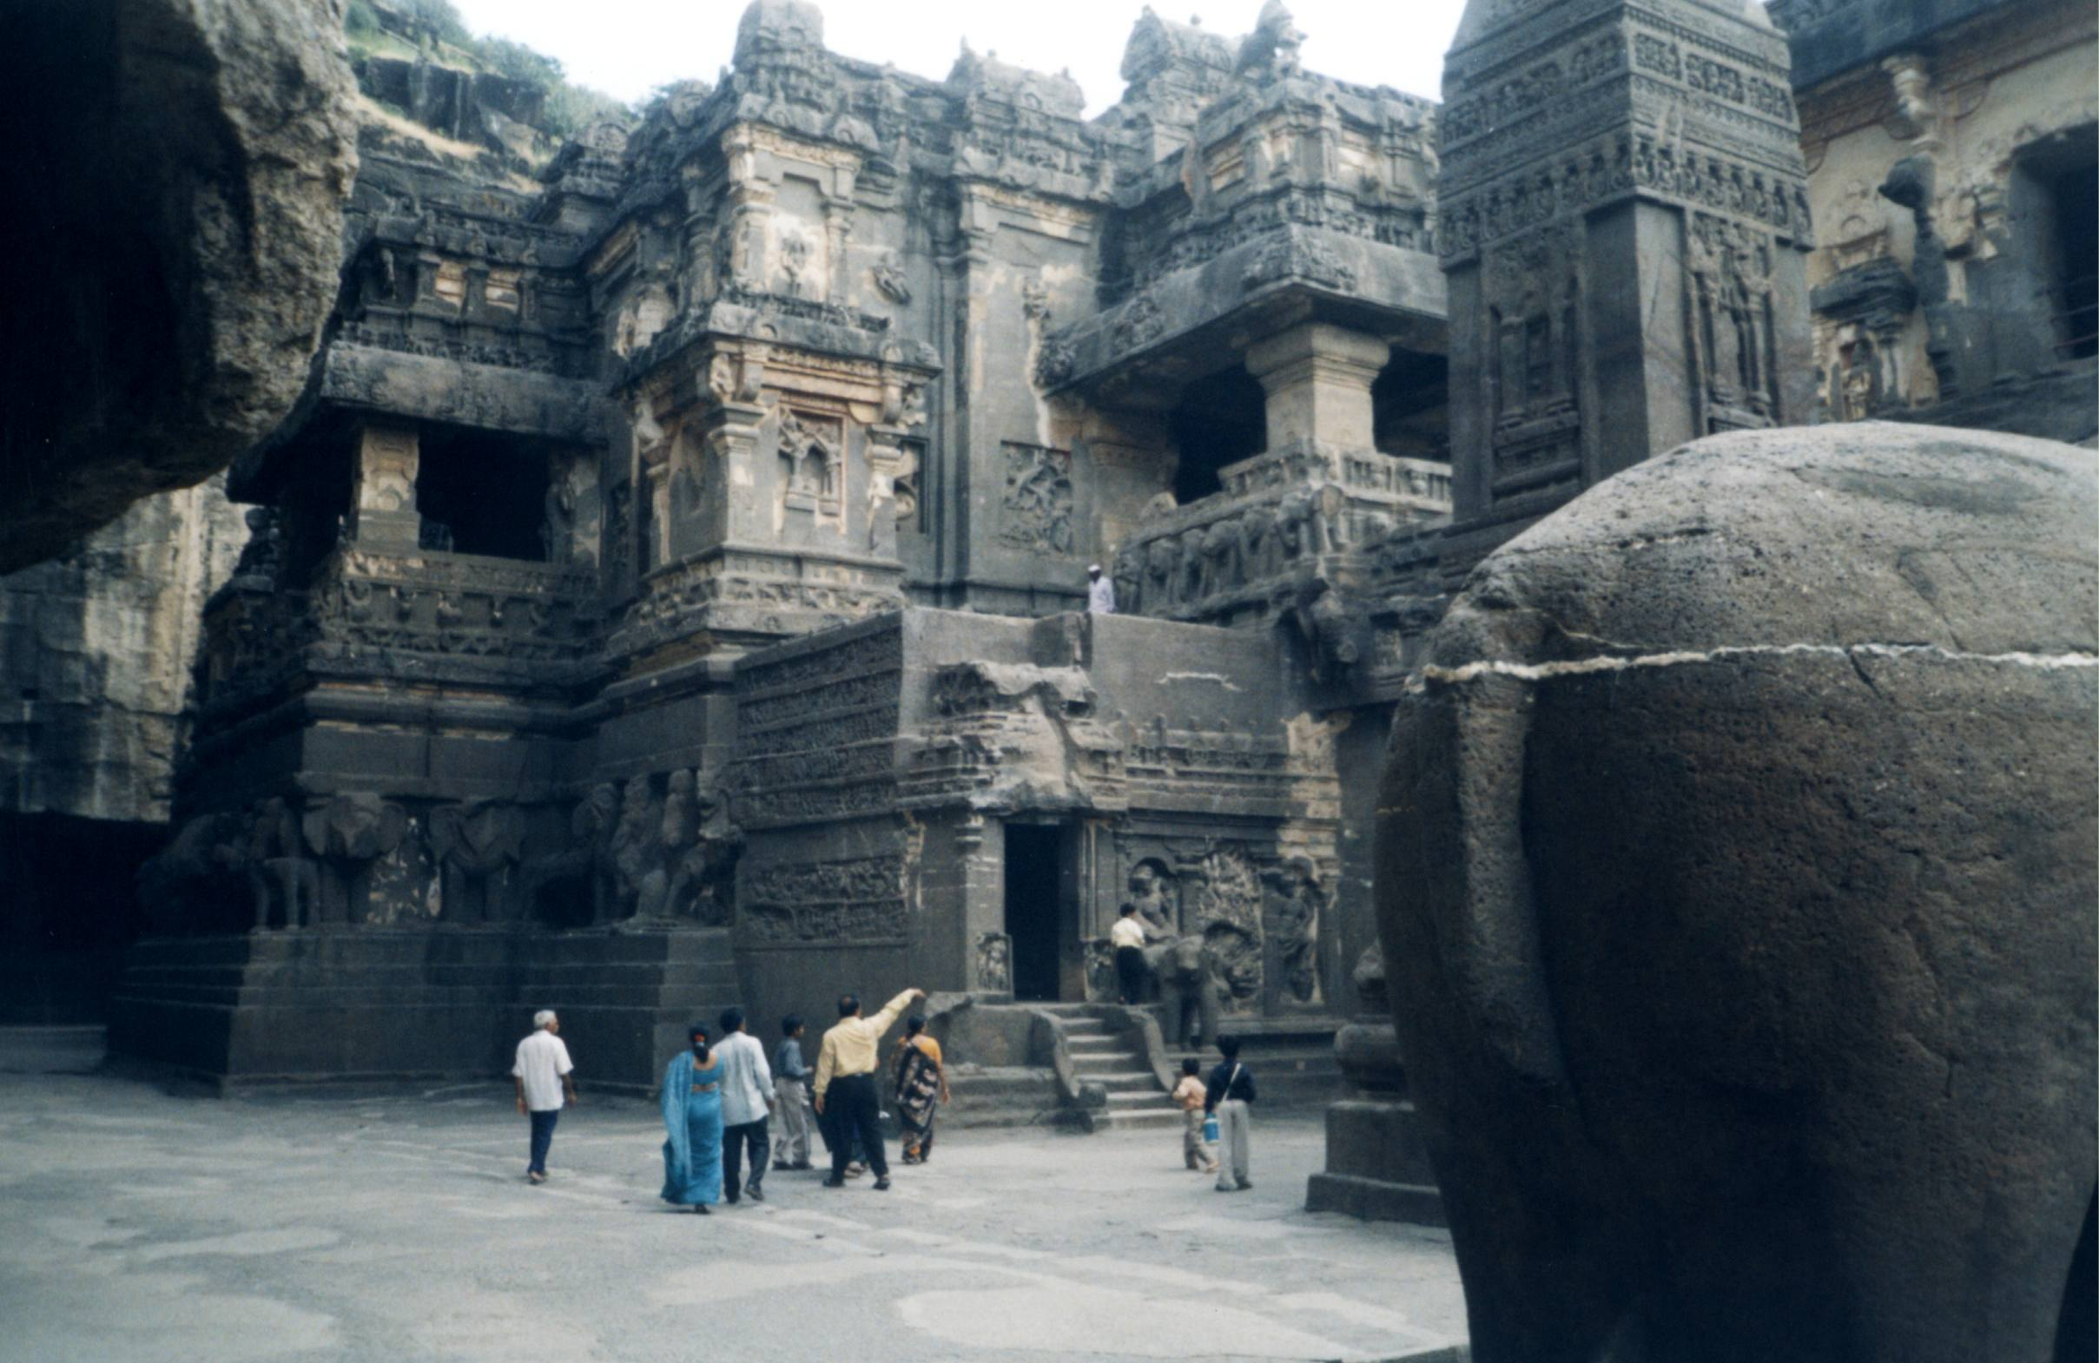
Kailash temple

Slide 37
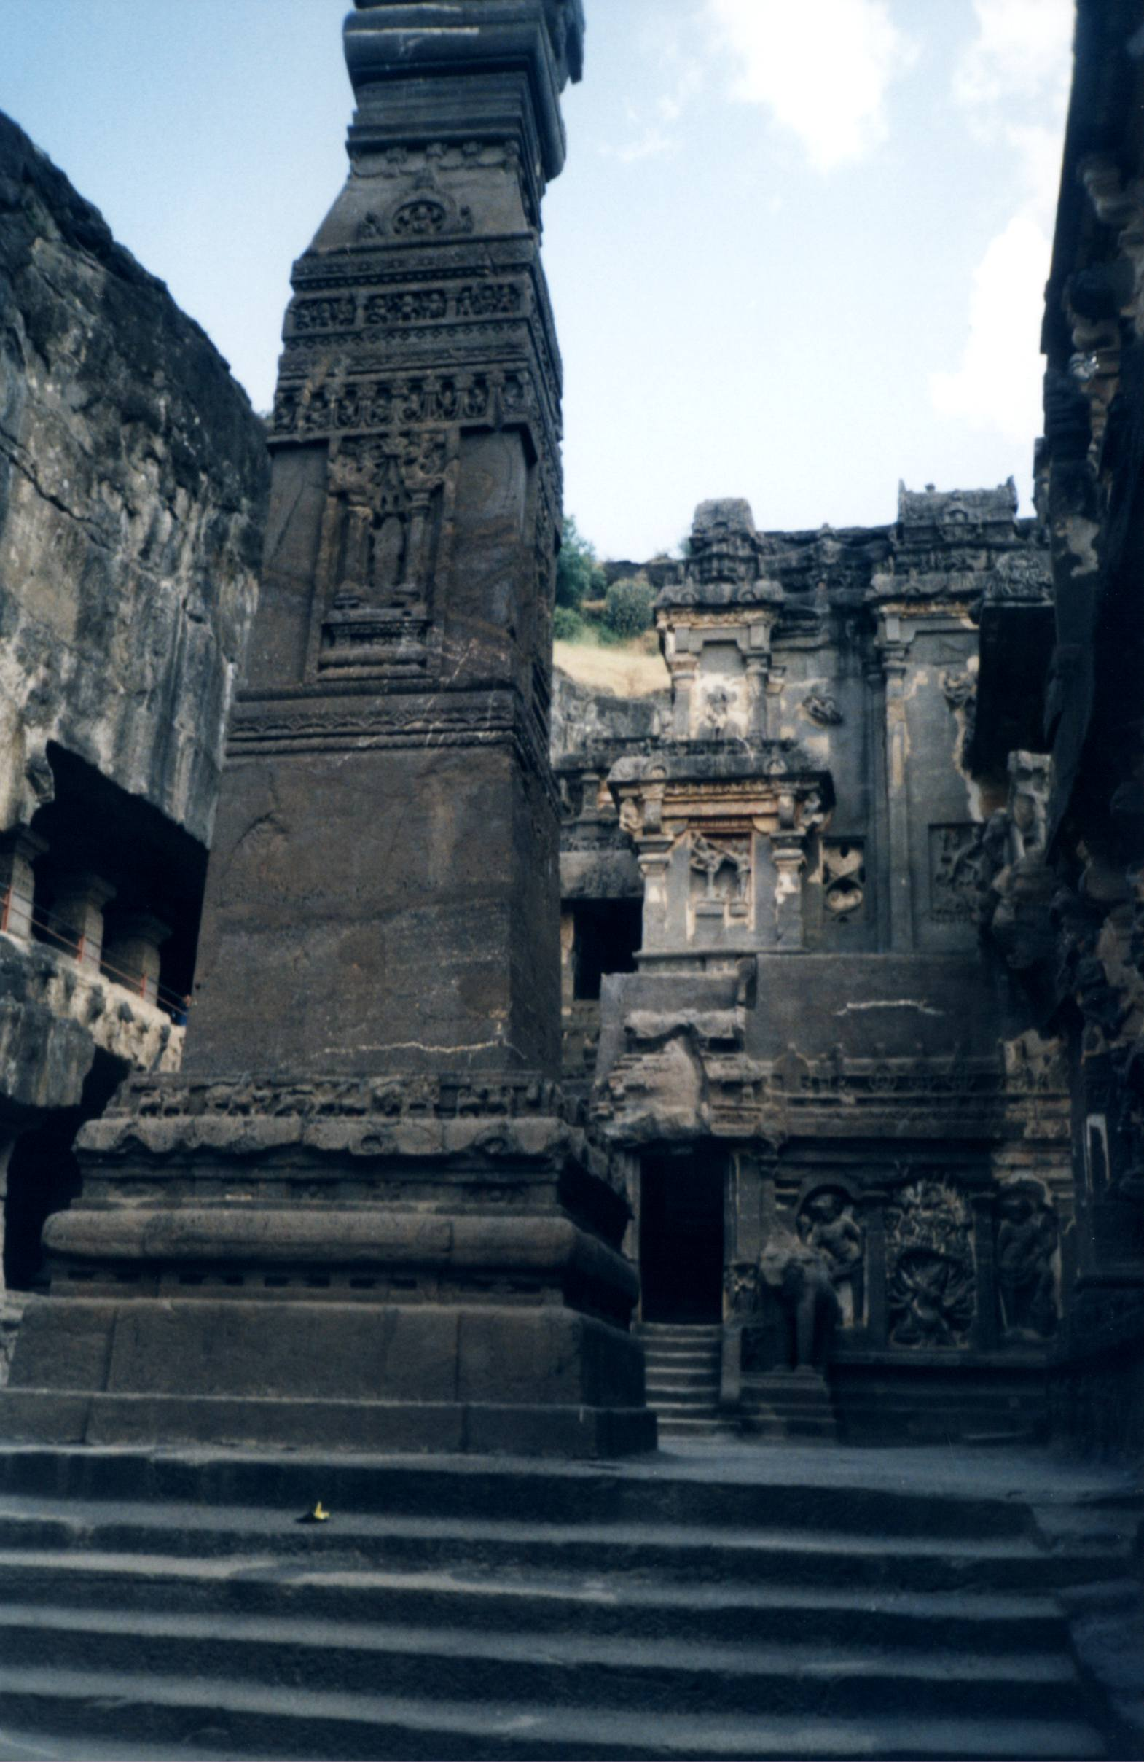

Slide 38
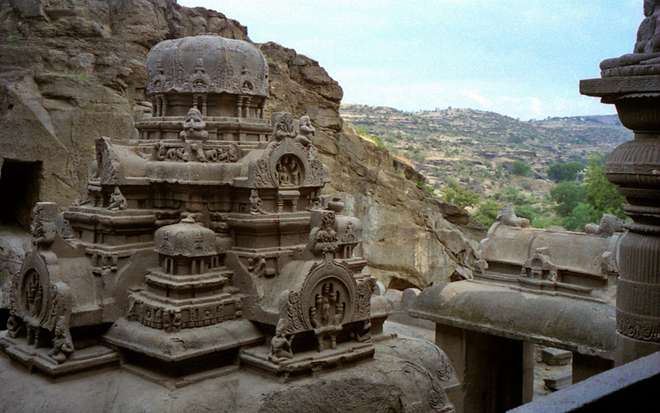

Slide 39
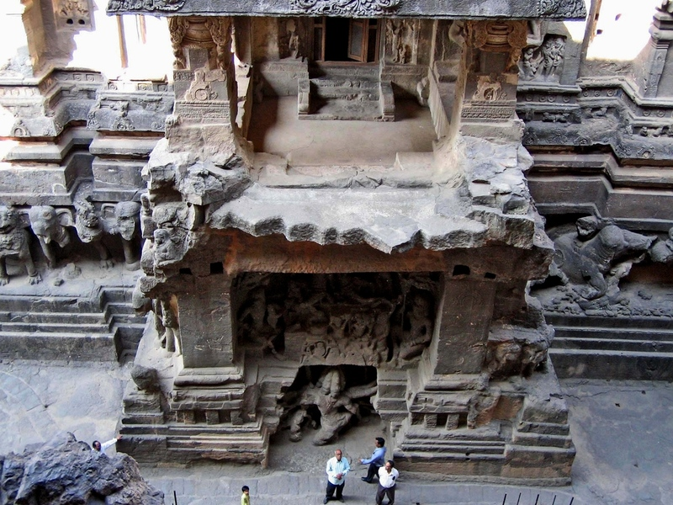

Slide 40
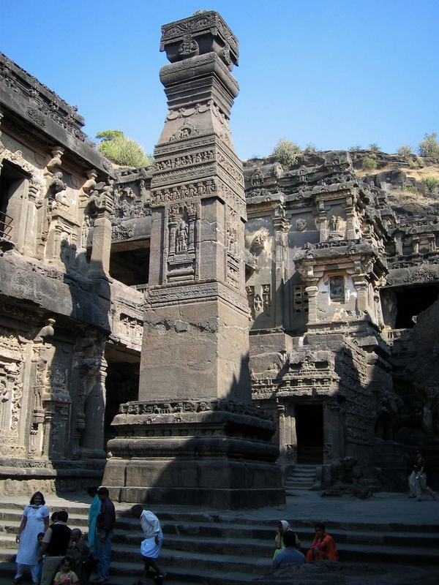

Slide 41
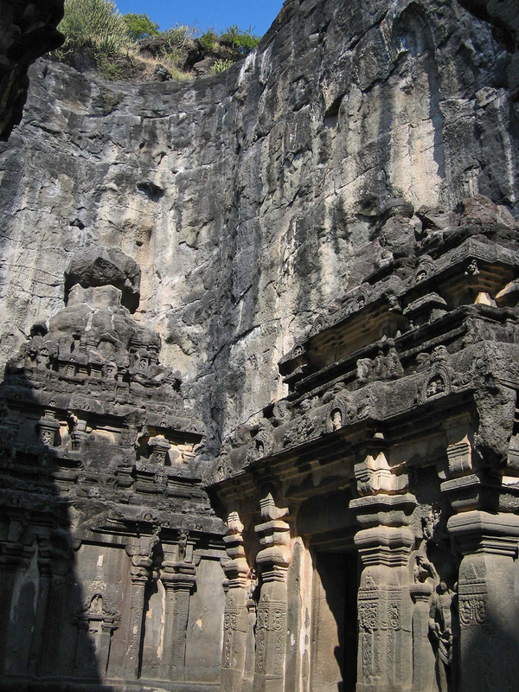

Slide 42
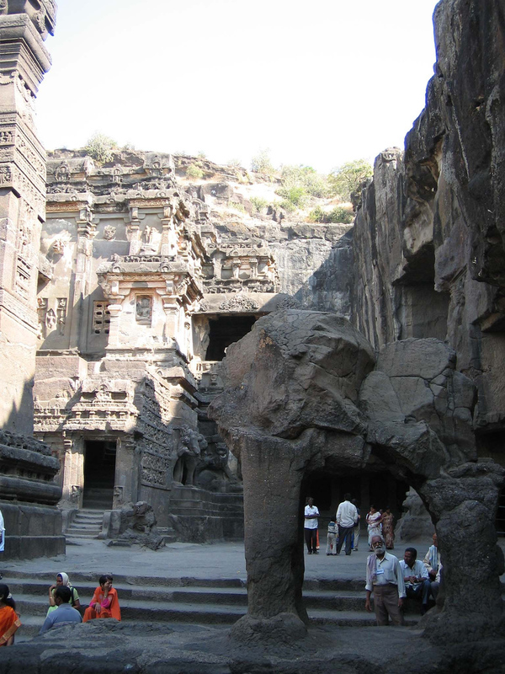

Slide 44
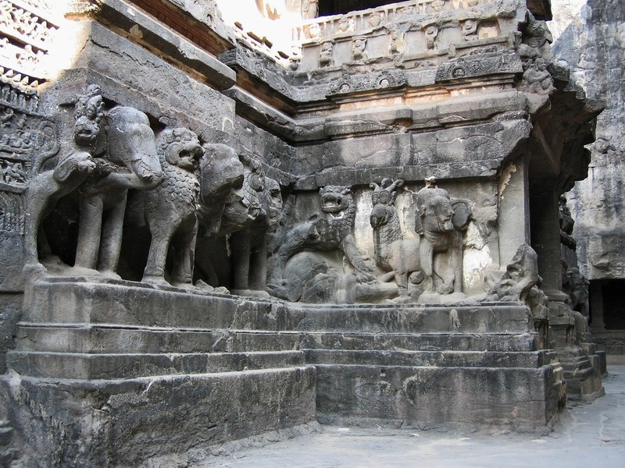

Slide 45
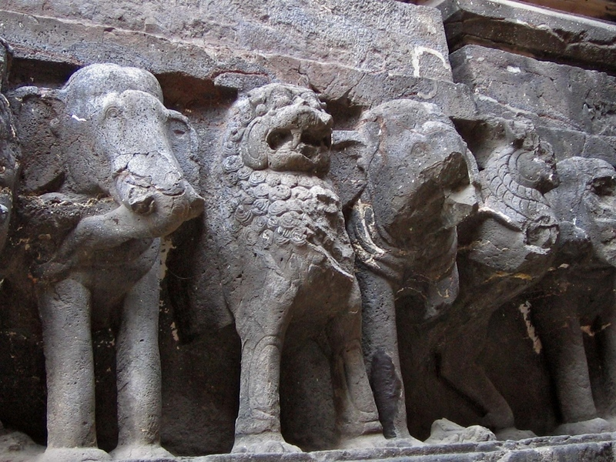

Slide 46
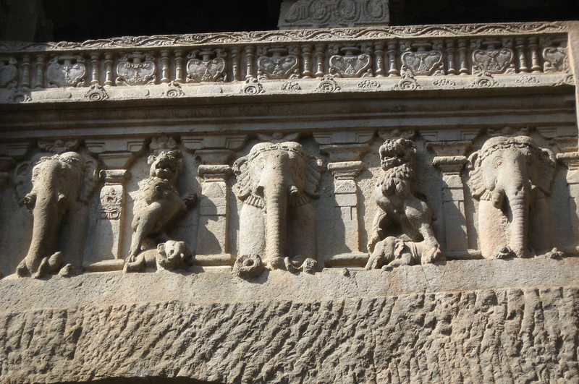

Slide 47
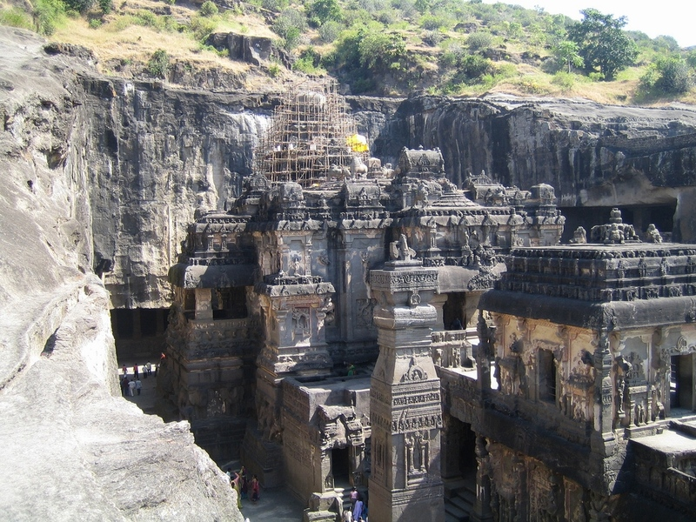

Slide 48
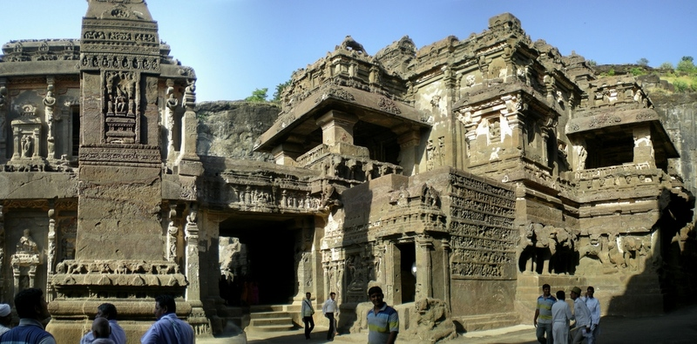

Slide 49
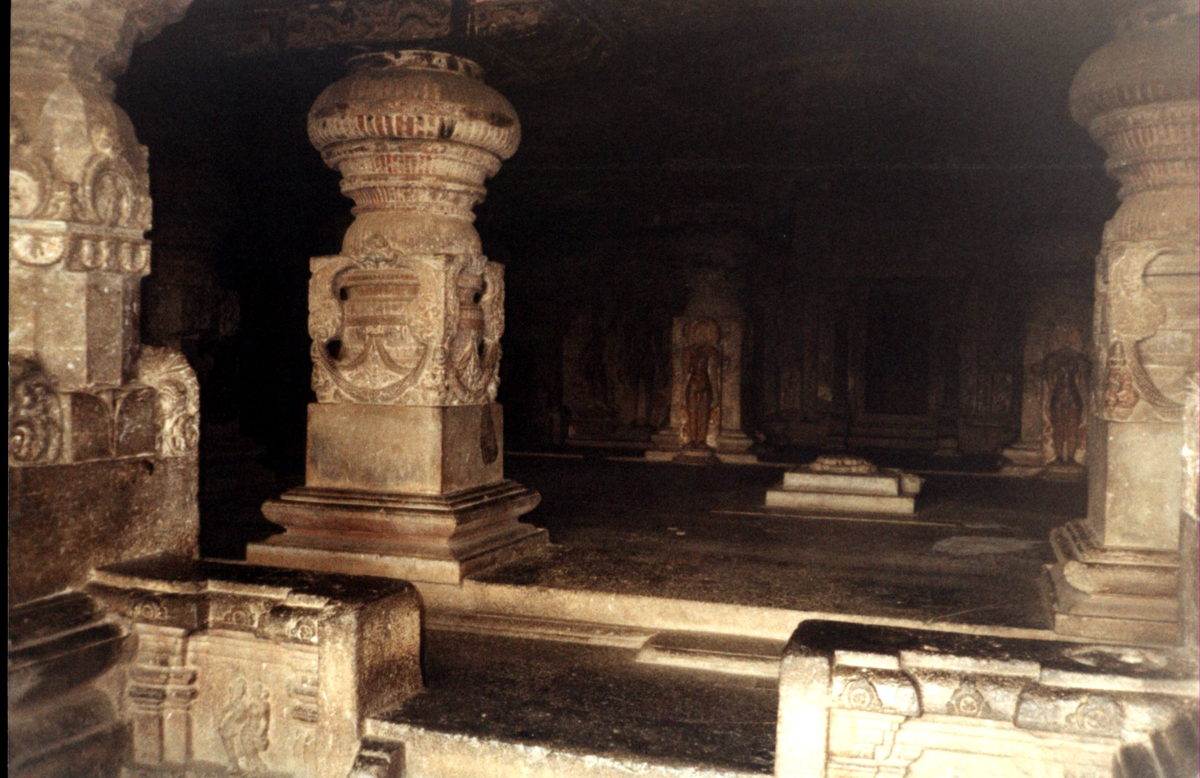

Slide 50


Slide 51
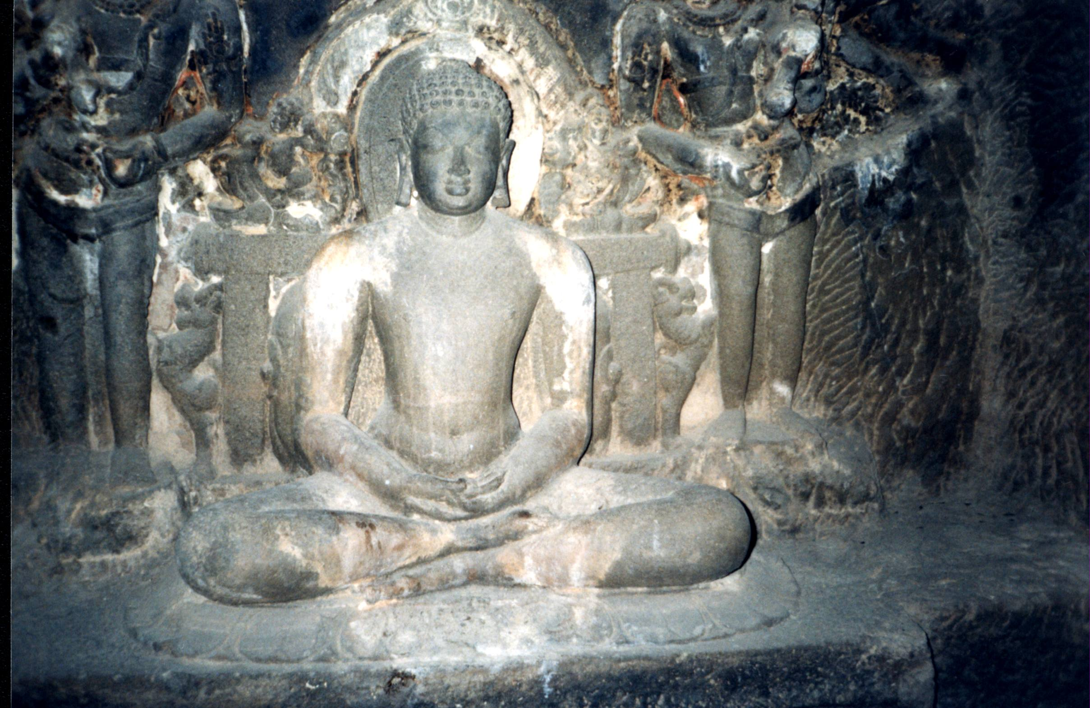

Slide 52
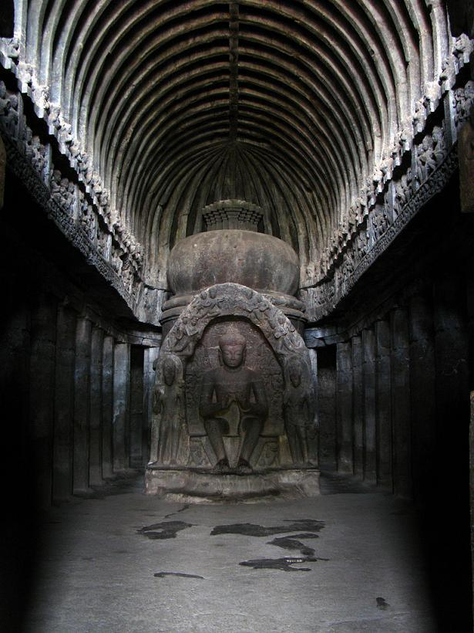

Slide 53


Slide 54
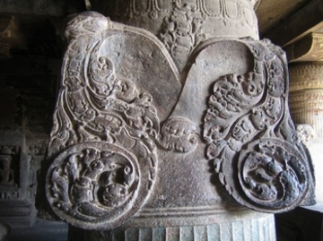

Slide 55
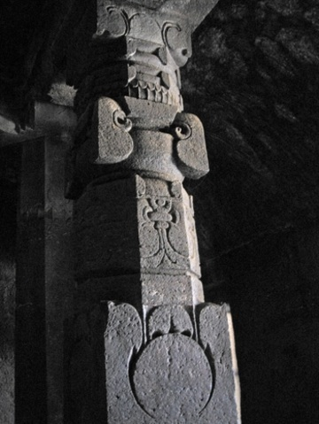

Slide 56


Slide 57


Slide 58


Slide 59


Slide 60


Slide 61


Slide 62


Slide 63


Slide 64


Slide 65


Slide 66


Slide 67


Slide 68


Slide 69


Slide 71


Slide 72


Slide 74


Slide 75


Slide 76


Slide 77


Slide 78


Slide 79


Slide 80


Slide 81


Slide 82


Slide 83


Slide 84


Slide 85


Slide 86


Slide 87


Slide 88


Slide 89


Slide 90


Slide 91


Slide 92


Slide 93


Slide 94


Slide 95


Slide 96


Slide 97


Slide 98


Slide 99


Slide 100


Slide 101


