Slide 1
Edvard Munch
(1863-1944)
Modernist in his context, Munch could be also considered the first expressionist painter in history. Works like "The Scream" are vital to understanding the twentieth century painting.

Slide 2
Editor’s note
Edvard Munch , a modernist and expressionist
artist is well known for his feelings as expressed in his painting like “Screams” where the subject speaks for itself loud and clear even if presented in a crude manner. But not all his works are crude as you will see in this presentation that is for your private viewing only.
AKC
September 2015

Slide 3
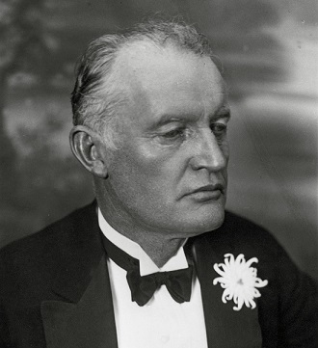
Edvard Munch

Slide 4
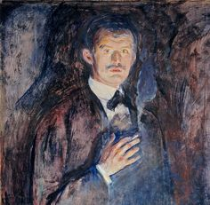

Slide 5
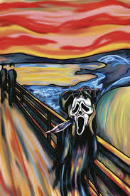
Screams

Slide 6
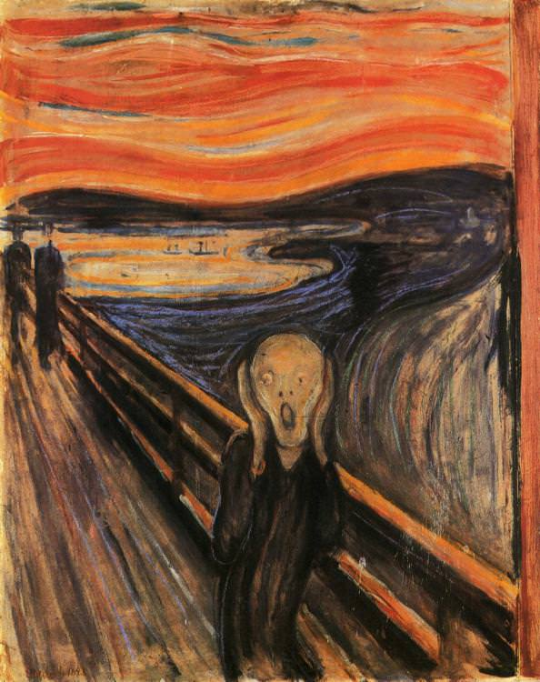
The scream

Slide 7
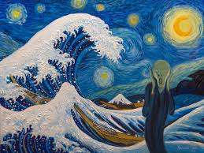

Slide 8
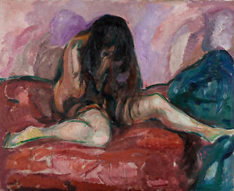

Slide 9
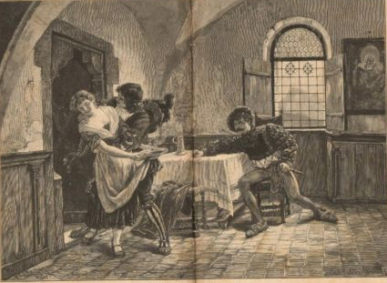

Slide 10
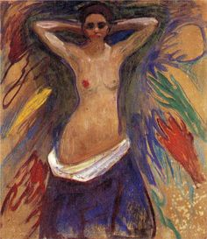

Slide 11
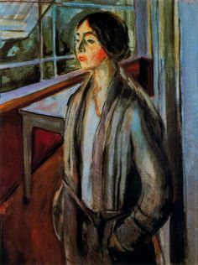

Slide 12
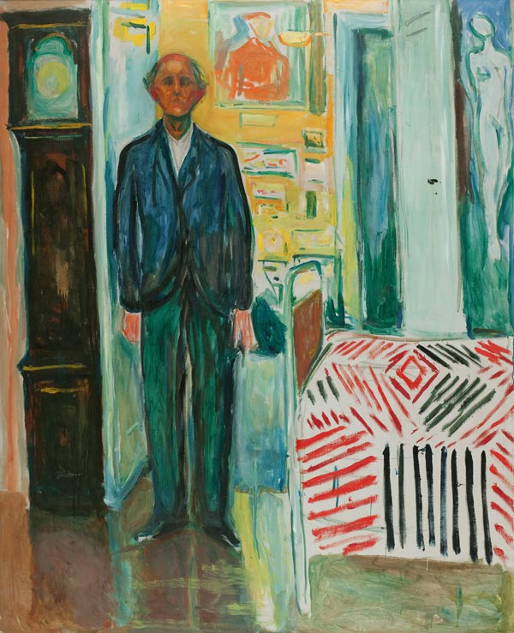

Slide 13
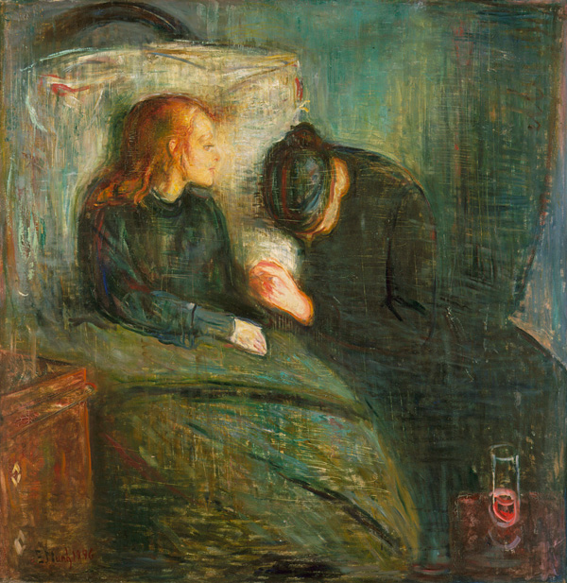

Slide 14
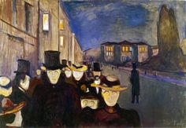

Slide 15
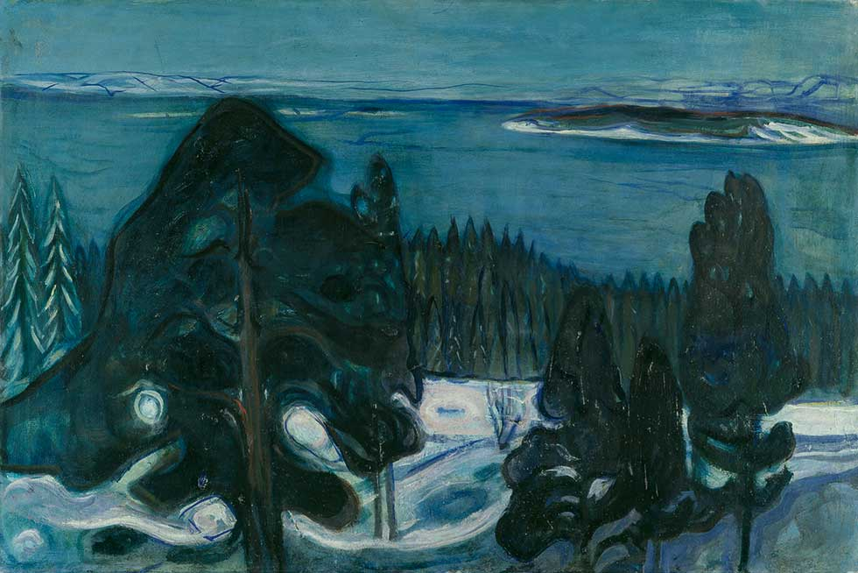

Slide 16
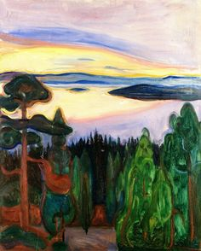

Slide 17
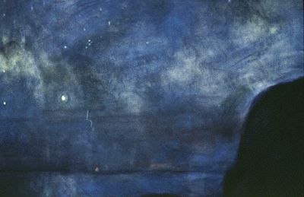

Slide 18
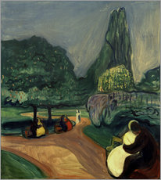

Slide 19
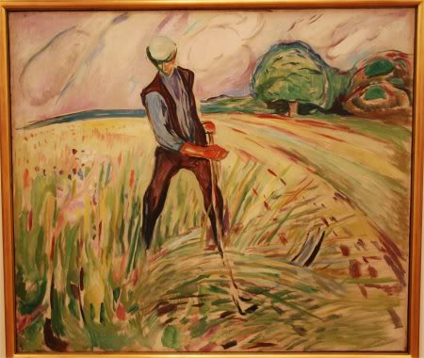
Haymaker

Slide 20
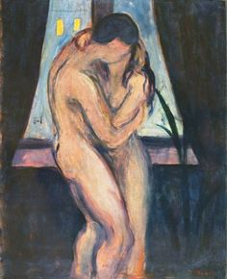

Slide 21
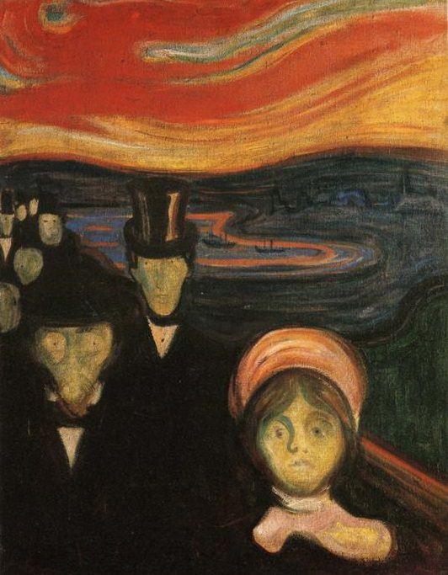
Anxiety

Slide 22
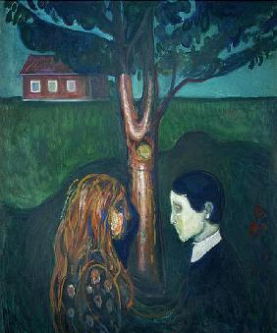

Slide 23
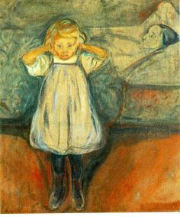

Slide 24
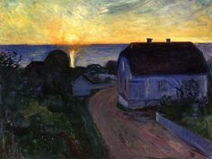

Slide 25
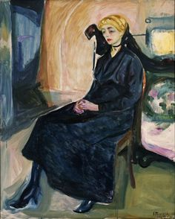

Slide 26
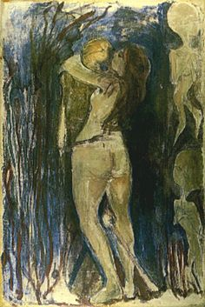

Slide 27
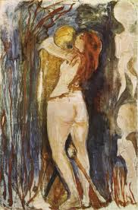
s

Slide 28
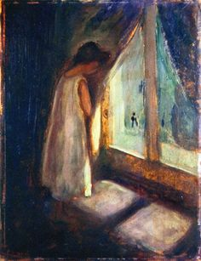

Slide 29
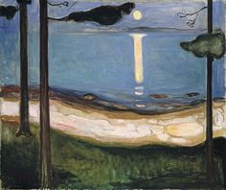

Slide 30
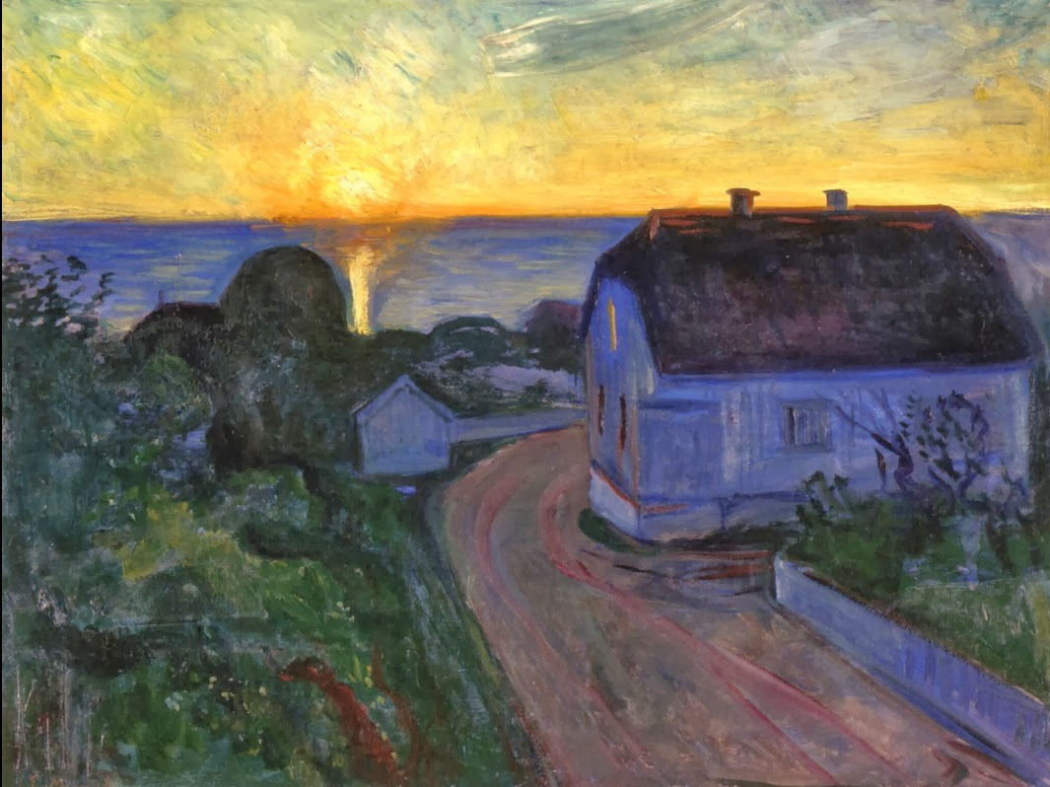

Slide 31
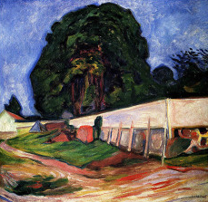

Slide 32
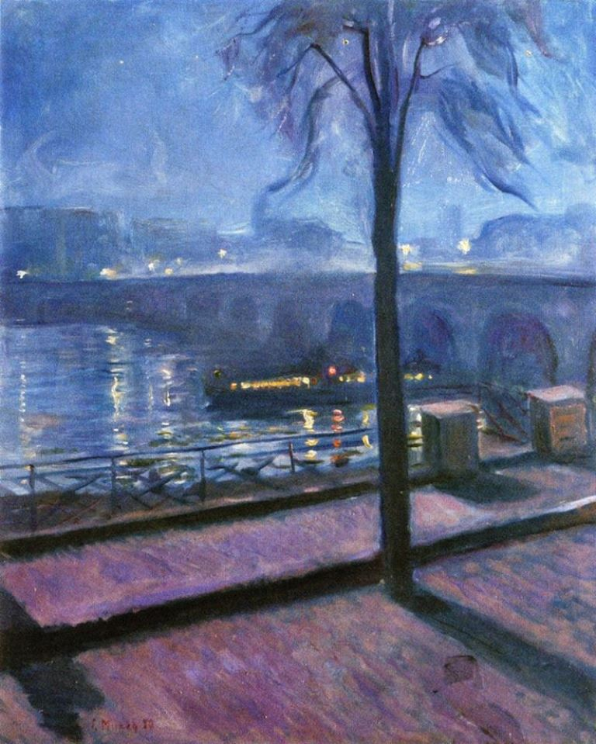

Slide 33
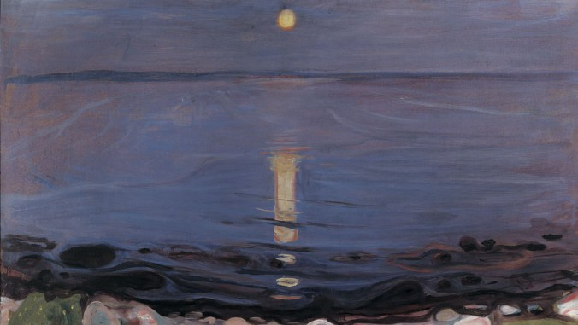
Summer night

Slide 34
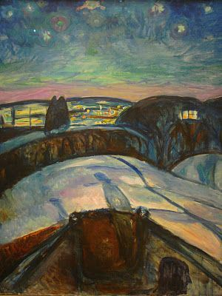
Starry night

Slide 35
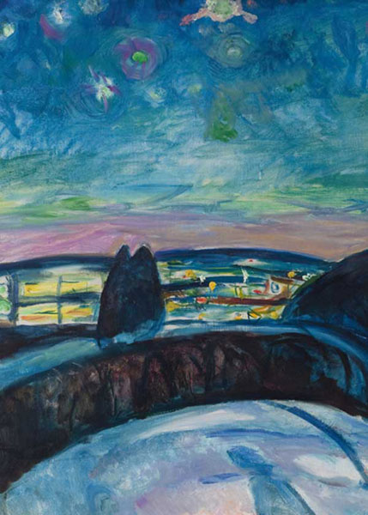

Slide 36
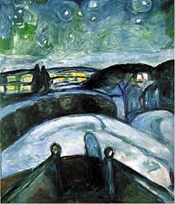

Slide 37
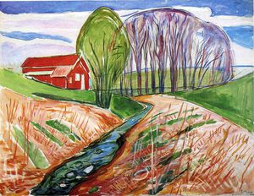

Slide 38
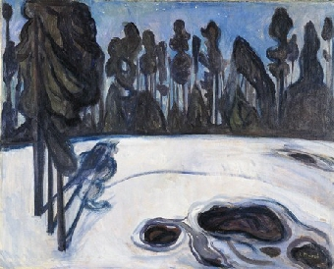

Slide 39
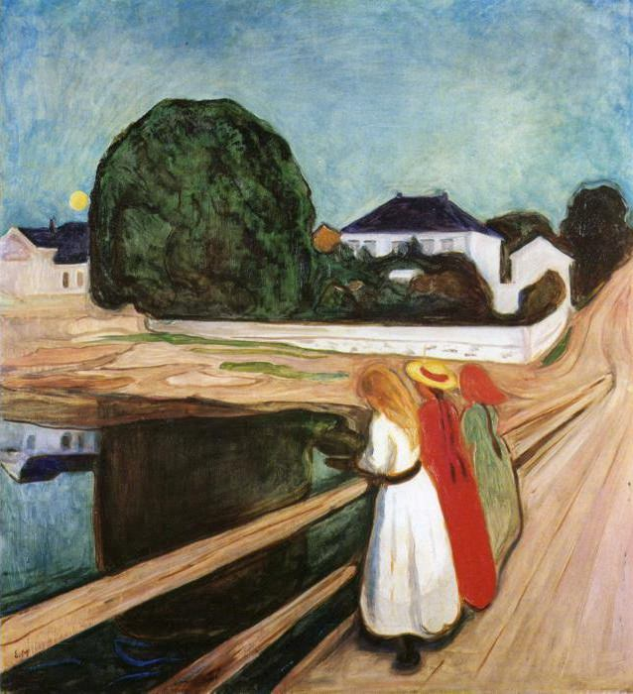
Girls on the bridge

Slide 40
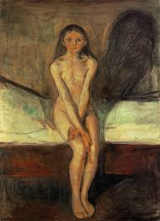

Slide 41
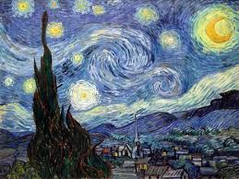

Slide 42
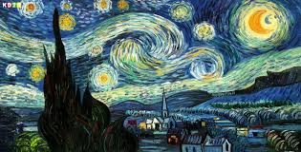
s

Slide 43
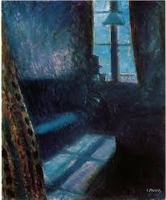

Slide 44
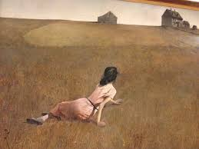

Slide 45
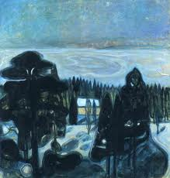

Slide 46
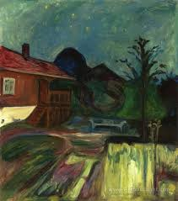

Slide 47
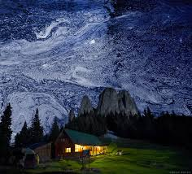

Slide 48
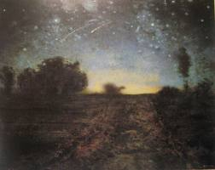

Slide 49
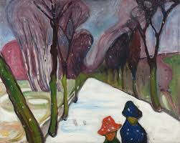

Slide 50
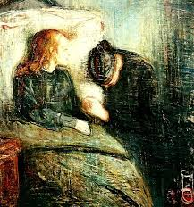
s

Slide 51
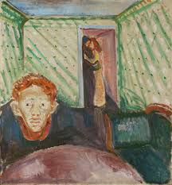
s

Slide 52
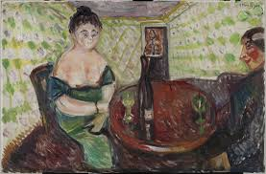
s

Slide 53

s

Slide 54

s

Slide 55

s

Slide 56

s

Slide 57

s

Slide 58

s

Slide 59

s

Slide 60

s

Slide 61

s

Slide 62

s

Slide 63

s

Slide 64

s

Slide 65

s

Slide 66

s

Slide 67

s

Slide 68

s

Slide 69

s

Slide 70

s

Slide 71

s

Slide 72

s

Slide 73

s

Slide 74

s

Slide 75

s

Slide 76

s

Slide 77

s

Slide 78

La muerte de Marat
s

Slide 79

s
Madonna

Slide 80

s
Starry night over Rhone

Slide 81

Hell
s

Slide 82

s
Summer night

Slide 83

s
Sun

Slide 84

s
The dance of life

Slide 85

The day after
s

Slide 86

s
Storm

Slide 87

s

Slide 88

s

Slide 89

s
Vampire

Slide 90

Vampire
s

Slide 91

Vampire
s

Slide 92

s
Woman in three stages

Slide 93

s
Young woman on the beach

Slide 94

s

