Slide 1
Dog breeds of the world
Part two
They are grouped as follows
Sporting dogs
Toy dogs
Best 30 breeds in the world
AKC/November 2015

Slide 2
Sporting dogs

Slide 3
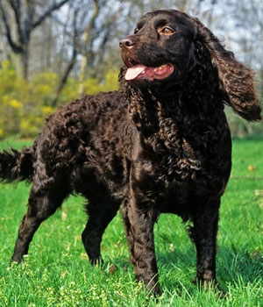
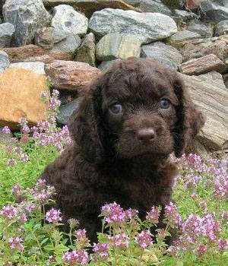
American water spaniel
Puppy

Slide 4
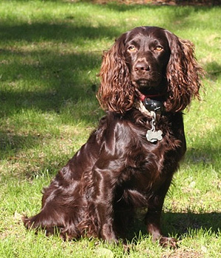
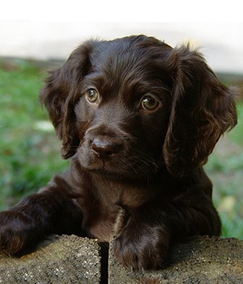
Boykin spaniel
Puppy

Slide 5
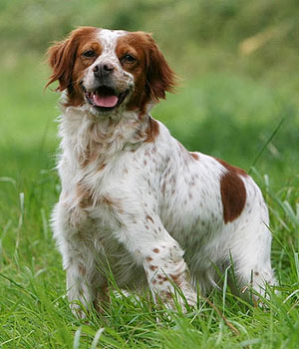
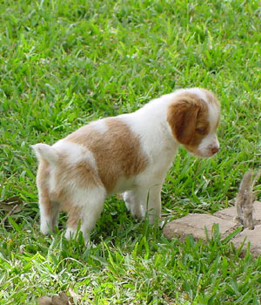
Brittany
Puppy

Slide 6
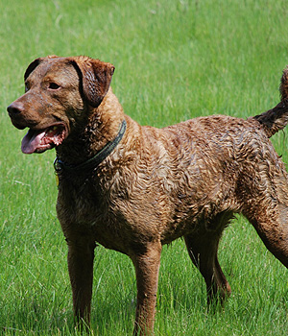
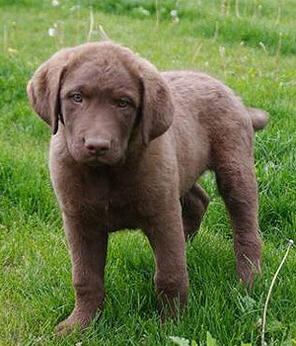
Chesapeake bay retriever
Puppy

Slide 7
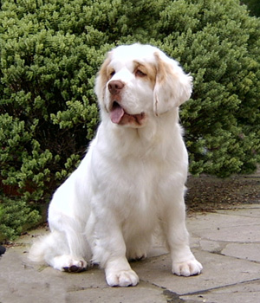
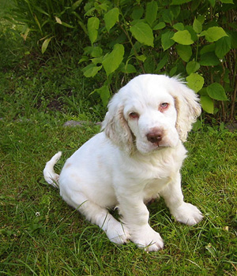
Clumber spaniel
Puppy

Slide 8
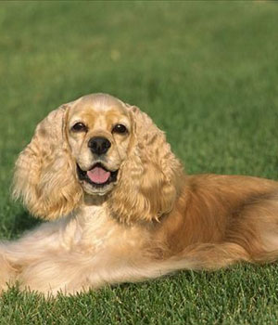
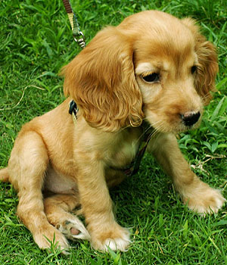
Cocker spaniel
Puppy

Slide 9
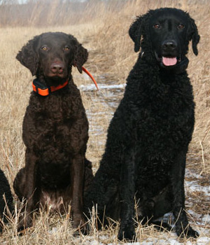
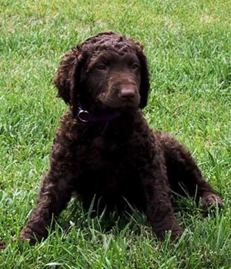
Curly coated retriever
Puppy

Slide 10
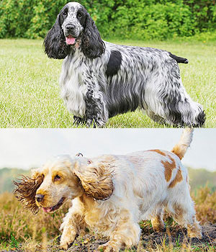
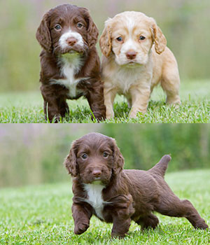
English cocker spaniel
Puppies

Slide 11
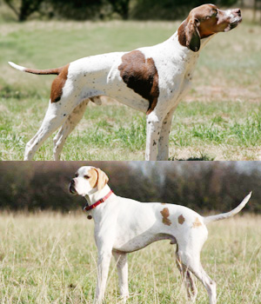
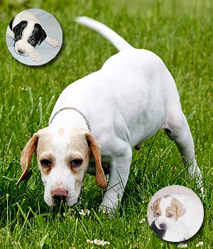
English pointer
Puppy

Slide 12
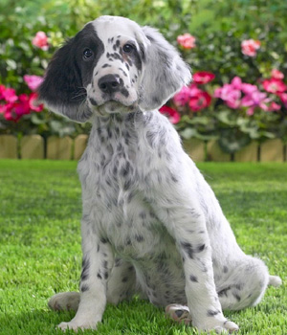
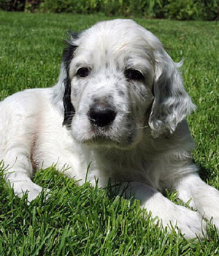
English setter
Puppy

Slide 13
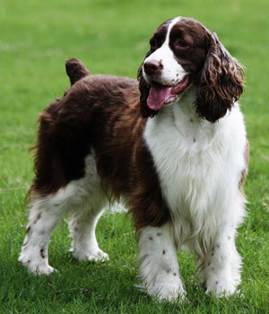
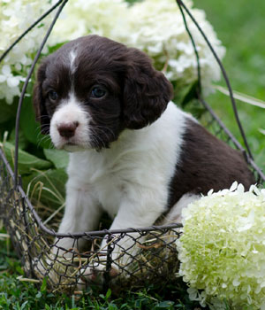
English springer spaniel
Puppy

Slide 14
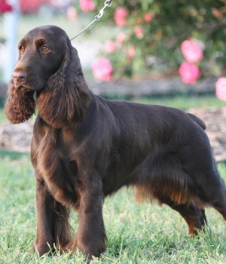
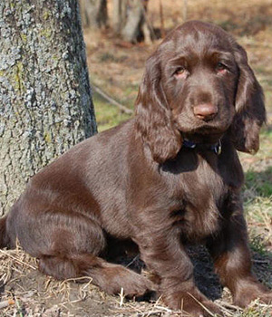
Field spaniel
Puppy

Slide 15
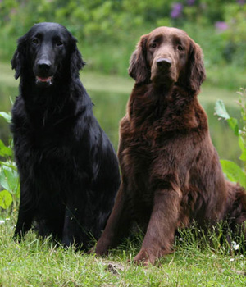
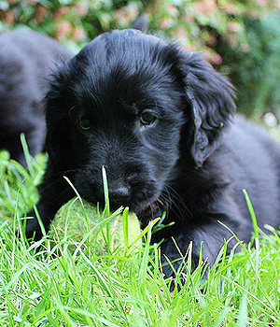
Flat coated retriever
Puppy

Slide 16
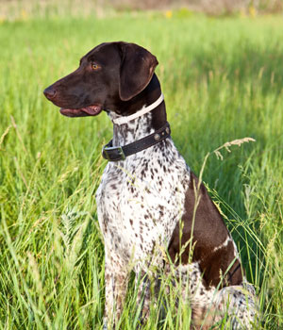
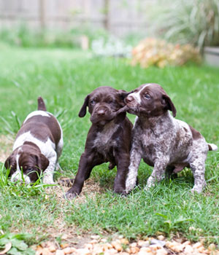
German short haired pointer
Puppies

Slide 17
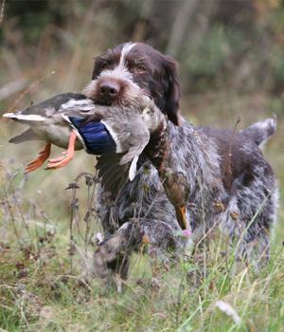
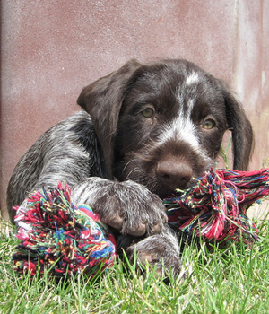
German wirehaired pointer
Puppy

Slide 18
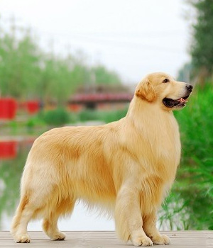
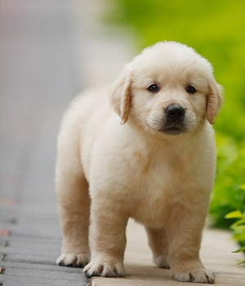
Golden retriever
Puppy

Slide 19
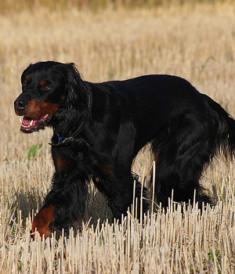
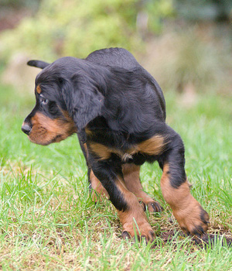
Gordon setter
Puppy

Slide 20
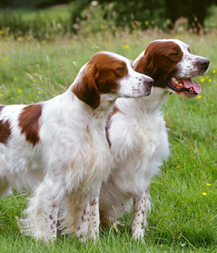
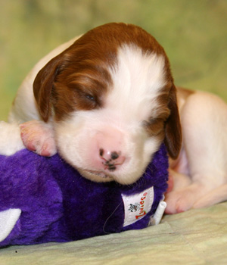
Irish red and white setter
Puppy

Slide 21
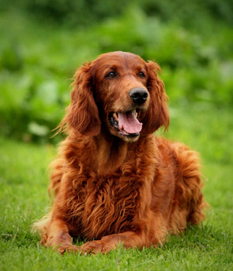
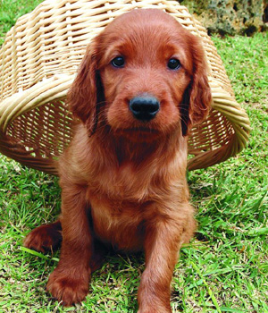
Irish setter
Puppy

Slide 22
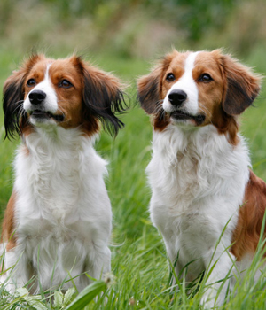
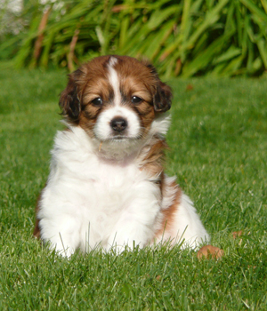
Kooikerhondje
Puppy

Slide 23
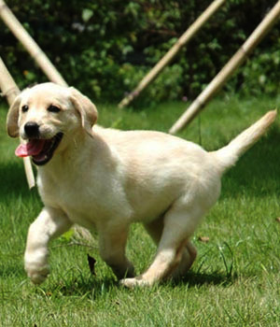
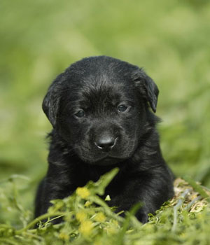
Labrador retriever
Puppy

Slide 24
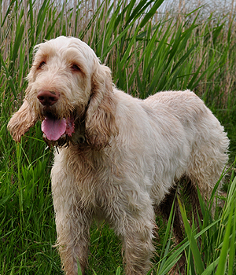
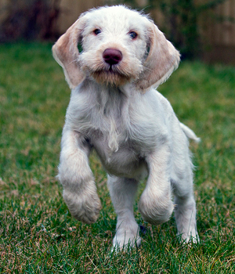
Spinone Italiano
Puppy

Slide 25
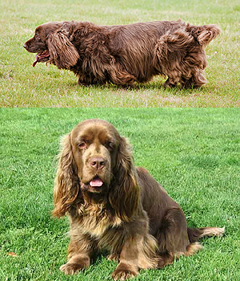
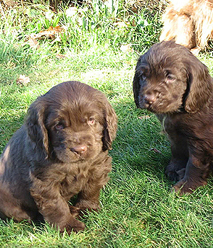
Sussex spaniel
Puppies

Slide 26
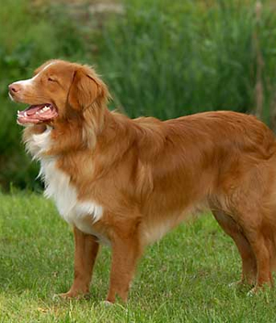
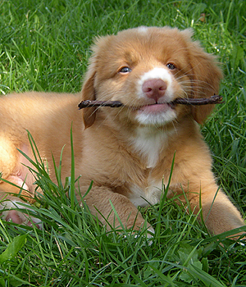
Tolling retriever
Puppy

Slide 27
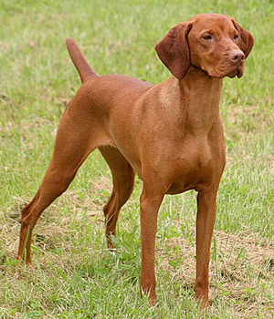
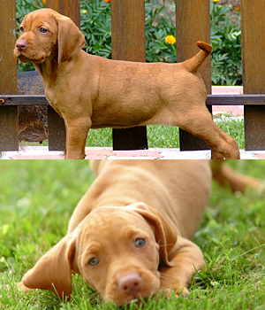
Vizsla
Puppies

Slide 28


Weimaraner
Puppy

Slide 29


Welsh springer spaniel
Puppy

Slide 30


Wirehaired pointing griffon
Puppies

Slide 31
Toy dogs

Slide 32


Affenpinscher
Puppy

Slide 33


Australian silky terrier
Puppy

Slide 34


Beaglier
Puppies

Slide 35


Bichon frise
Puppy

Slide 36


Bolognese dog
Puppy

Slide 37


Brussels griffon
Puppy

Slide 38


Cavalier King Charles spaniel
Puppy

Slide 39


Chinese crested
Puppy

Slide 40


Coton de tulear
Puppy

Slide 41


Havanese
Puppies

Slide 42


Italian greyhound
Puppy

Slide 43


Japanese chin
Puppy

Slide 44


Maltese
Puppy

Slide 45


Miniature pinscher
Puppy

Slide 46


Papillon dog
Puppy

Slide 47


Pekingese
Puppy

Slide 48


Pomeranian
Puppy

Slide 49

Poodle

Slide 50


Pug
Puppy

Slide 51


Shih Tzu
Puppy

Slide 52


Toy fox terrier
Puppies

Slide 53


Toy Manchester terrier
Puppies

Slide 54


Yorkshire terrier
Puppy

Slide 55
30 best dog breeds

Slide 56

Australian shepherd

Slide 57

Australian shepherd puppies

Slide 58


Beagle
Puppies

Slide 59


Boston terrier
Puppy

Slide 60


Boxer
Puppy

Slide 61
Brittany
Puppy

Slide 62


Bull dog
Puppy

Slide 63
Cavalier King Charles spaniel
Puppy

Slide 64


Chihuahua
Puppy

Slide 65
Cocker spaniel
Puppy

Slide 66


Dachshund
Puppy

Slide 67


Doberman pinscher
Puppy

Slide 68
English springer spaniel
Puppy

Slide 69


French bull dog
Puppy

Slide 70


German Shepherd dog
Puppy

Slide 71
German short haired pointer
Puppies

Slide 72
Golden retriever
Puppy

Slide 73


Great dane
Puppy

Slide 74
Labrador retriever
Puppy

Slide 75
Maltese
Puppy

Slide 76


Mastiff
Puppy

Slide 77


Miniature Schnauzer
Puppy

Slide 78


Pembroke Welsh corgi
Puppy

Slide 79
Pomeranian
Puppy

Slide 80

Poodle
Puppy

Slide 81
Pug
Puppy

Slide 82


Rottweiler
Puppy

Slide 83


Shetland sheep dog
Puppies

Slide 84
Shih Tzu
Puppy

Slide 85


Siberian husky
Puppies

Slide 86

Yorkshire terrier
Puppy

Slide 87
Giant dogs

Slide 88

Caucasian ovtcharka

Slide 89

Great Pyrenees

Slide 90

Greyhound

Slide 91

Irish wolfhounds

Slide 92

King Shepherd

Slide 93

Kuvasz

Slide 94

Landseer

Slide 95

Leonberger

Slide 96

Majestic tree hound

Slide 97

Newfoundland

Slide 98

Pakistani mastiff

Slide 99

Scottish deer hound

Slide 100

Shiloh shepherd dog

Slide 101

Spanish mastiff

Slide 102

St.Bernard

