Slide 1
Dog breeds of the world
Part One
They are grouped as follows :
Hound dogs
Herding dogs
Terrier dogs
Working dogs
AKC/ November 2015

Slide 2
Hound dogs

Slide 3
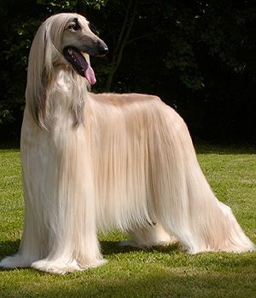
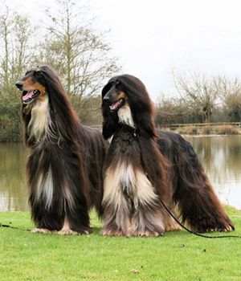
Afghan hound
Puppies

Slide 4
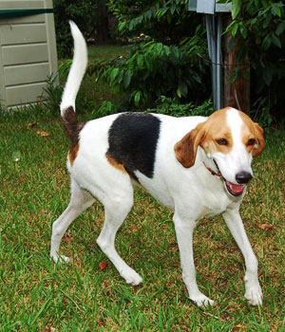
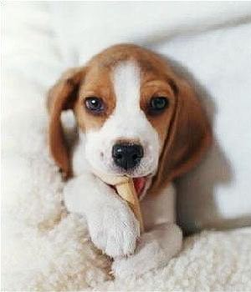
American fox hound
Puppies

Slide 5
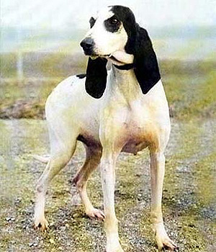
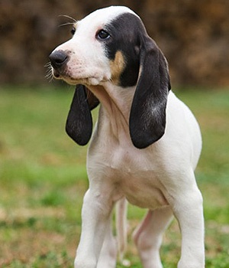
Ariegeois
Puppy

Slide 6
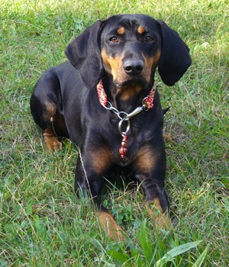
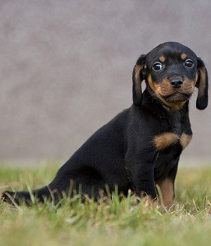
Austrian black and tan hound
Puppy

Slide 7
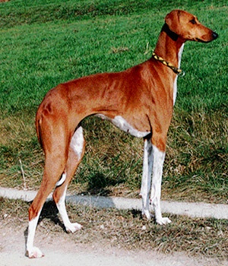
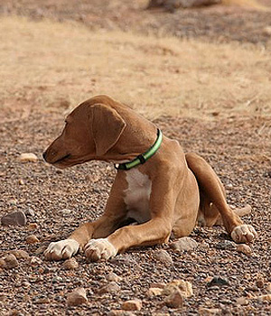
Azawakh
Puppy

Slide 8
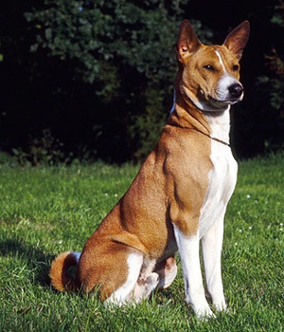
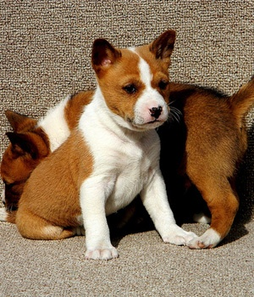
Basenji
Puppies

Slide 9
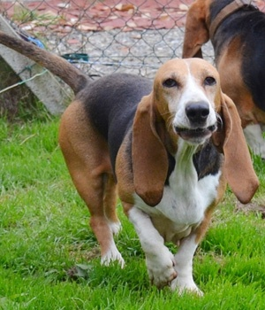
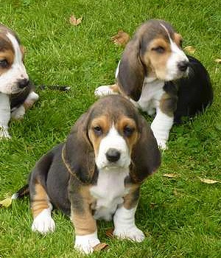
Basset artesien normand
Puppies

Slide 10
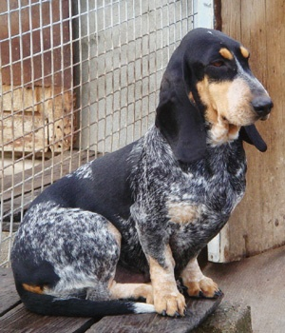
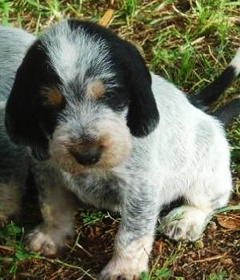
Basset bleu de Gascogne
Puppy

Slide 11
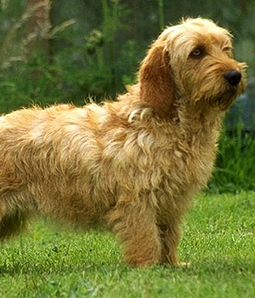
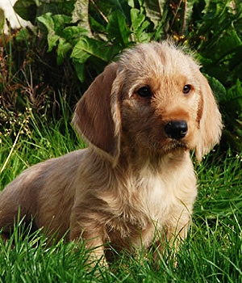
Basset fauve de Bretagne
Puppy

Slide 12
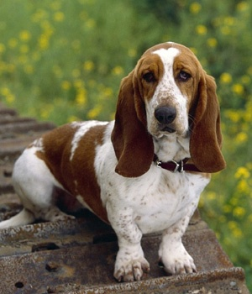
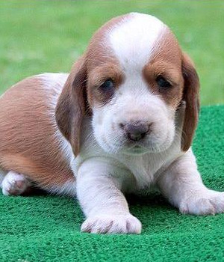
Basset hound
Puppy

Slide 13
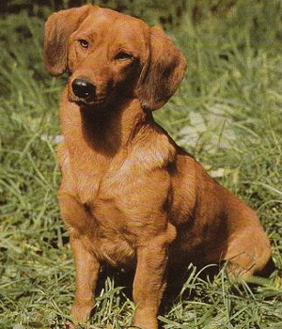
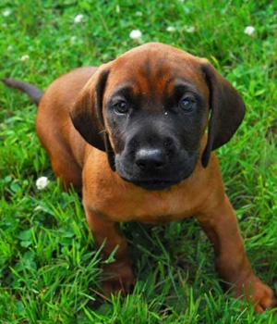
Bavarian mountain hound
Puppy

Slide 14
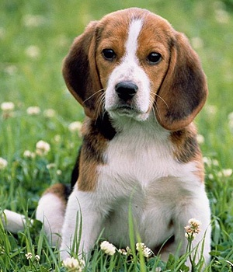
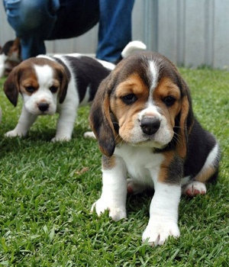
Beagle
Puppies

Slide 15
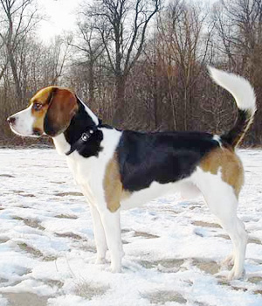
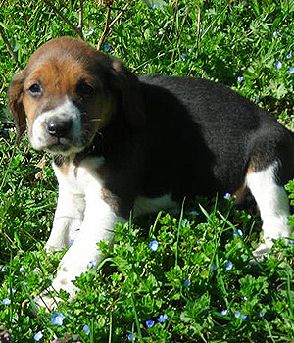
Beagle harrier
Puppy

Slide 16
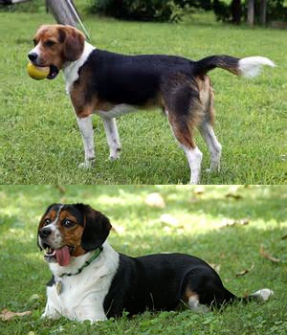
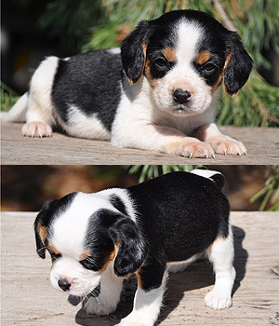
Beaglier
Puppies

Slide 17
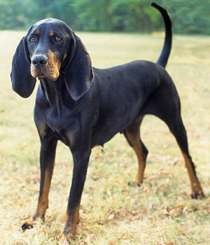
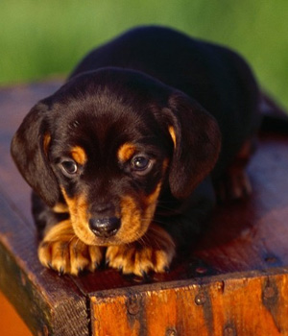
Black and tan coon hound
Puppy

Slide 18
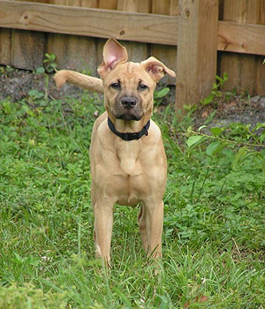
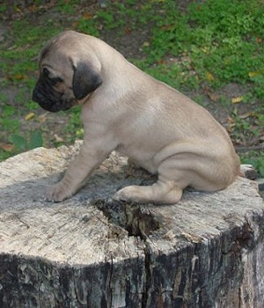
Blackmouth cur
Puppy

Slide 19
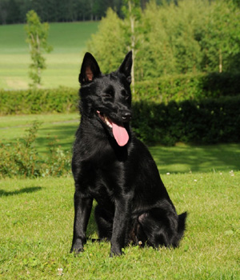
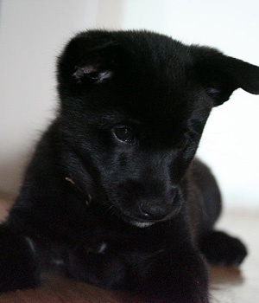
Black Norwegian elk hound
Puppy

Slide 20
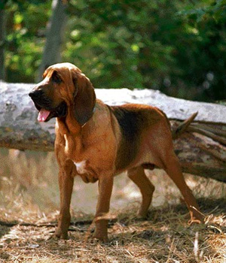
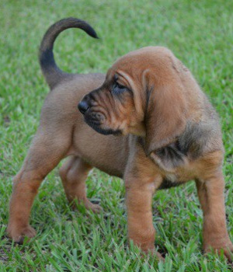
Blood hound
Puppy

Slide 21
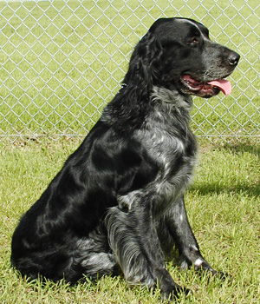
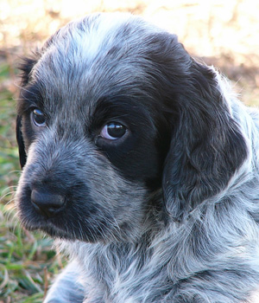
Blue picardy spaniel
Puppy

Slide 22
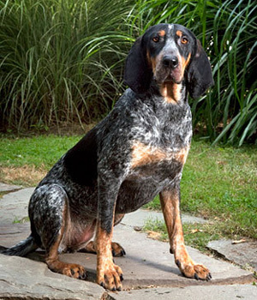
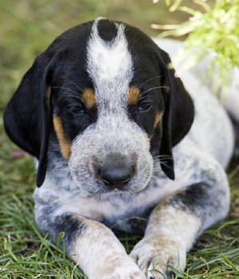
Blue tick coonhound
Puppy

Slide 23
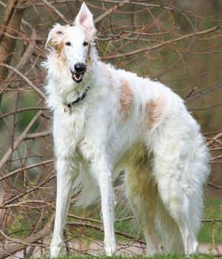
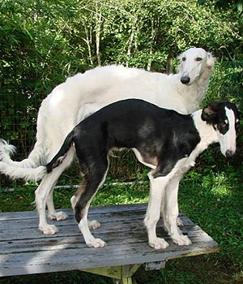
Borzoi
Puppies

Slide 24
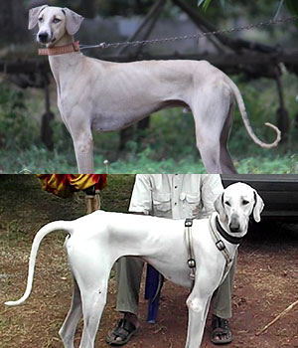
Chippiparai

Slide 25
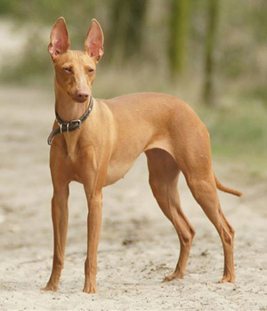
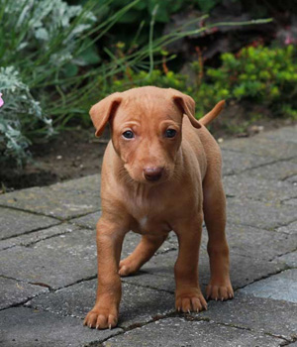
Cirneco dell etna
Puppy

Slide 26
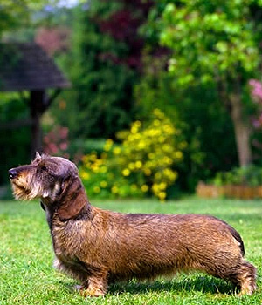
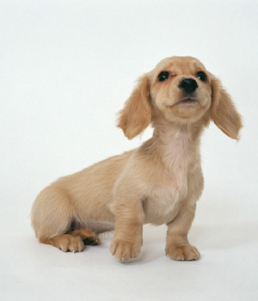
Dachshund
Puppy

Slide 27
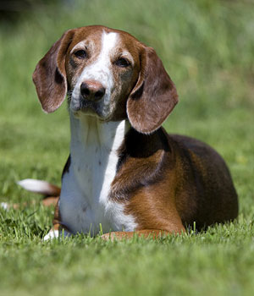
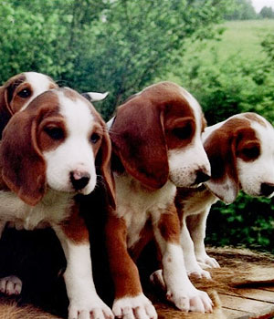
Deutsche bracke
Puppies

Slide 28
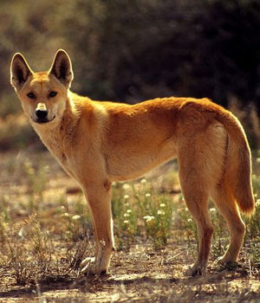

Dingo
Puppies

Slide 29


Drever
Puppy

Slide 30


Dunker
Puppy

Slide 31


East Siberian laika
Puppy

Slide 32


English coon hound
Puppies

Slide 33


English fox hound
Puppies

Slide 34


Finnish hound
Puppy

Slide 35


Finnish spitz
Puppy

Slide 36


Francais blanc et noir

Slide 37


French spaniel
Puppy

Slide 38


Grand basset griffon vendeen
Puppy

Slide 39


Greyhound
Puppies

Slide 40


Hamilton hound
Puppy

Slide 41


Harrier dog
Puppy

Slide 42


Ibizan hound
Puppies

Slide 43


Irish wolf hound
Puppies

Slide 44


Long haired whippet
Puppy

Slide 45


Norrbottenspets
Puppy

Slide 46


Norwegian elk hound
Puppy

Slide 47


Otter hound
Puppy

Slide 48


PVGV
Puppy

Slide 49


Peruvian Inca orchid
Puppy

Slide 50


Pharaoh hound
Puppy

Slide 51


Plott hound
Puppy

Slide 52


Polish hunting dog
Puppy

Slide 53


Portuguese podengo
Puppy

Slide 54


Rajapalyam dog
Puppies

Slide 55


Red bone coon hound
Puppies

Slide 56


Rhodesian ridgeback
Puppy

Slide 57


Saluki
Puppies

Slide 58


Scottish deer hound
Puppy

Slide 59


Whippet
Puppy

Slide 60
Herding dogs

Slide 61


Australian cattle dog
Puppy

Slide 62


Australian kelpie
Puppy

Slide 63


Australian shepherd
Puppies

Slide 64


Australian stumpy tail cattle dog
Puppy

Slide 65


Bearded collie
Puppy

Slide 66


Beauceron
Puppies

Slide 67


Belgian shepherd laekenois
Puppies

Slide 68


Belgian shepherd malinois
Puppy

Slide 69


Belgian shepherd tervuren
Puppy

Slide 70


Bergamasco
Puppy

Slide 71


Berger picard
Puppy

Slide 72


Border collie
Puppy

Slide 73


Bouvier de Ardennes
Puppy

Slide 74


Bouvier de Flanders
Puppy

Slide 75


Briard
Puppy

Slide 76


Canaan dog
Puppies

Slide 77


Cao da serra de aires
Puppies

Slide 78


Cardigan Welsh corgi
Puppies

Slide 79


Catahoula cur
Puppy

Slide 80


Catahoula leopard dog
Puppy

Slide 81


Catalan sheep dog
Puppy

Slide 82


Croatian sheep dog
Puppy

Slide 83


Czechoslovakian wolf dog
Puppies

Slide 84


Dutch shepherd dog
Puppy

Slide 85


English shepherd
Puppies

Slide 86


Entlebucher mountain dog
Puppy

Slide 87


German shepherd
Puppy

Slide 88


Groenendael
Puppy

Slide 89


Icelandic sheep dog
Puppy

Slide 90


Lancashire heeler
Puppy

Slide 91


Lapponian herder
Puppy

Slide 92


McNab
Puppies

Slide 93


Miniature American shepherd
Puppy

Slide 94


Mudi
Puppy

Slide 95


Norwegian Buhund
Puppy

Slide 96


Pembroke Welsh corgi
Puppy

Slide 97


Polish lowland sheep dog
Puppy

Slide 98


Puli
Puppy

Slide 99


Pumi
Puppies

Slide 100


Pyrenean shepherd
Puppy

Slide 101


Rough collie
Puppies

Slide 102


Saarloos wolf dog
Puppies

Slide 103


Schapendoes
Puppy

Slide 104


Shetland sheep dog
Puppies

Slide 105


Puppies
Smooth collie

Slide 106


Swedish vallhun
Puppies

Slide 107
Terrier dogs

Slide 108


Airedale terrier
Puppy

Slide 109


American hairless terrier
Puppy

Slide 110


American pit bull terrier
Puppy

Slide 111


American staffordshire terrier
Puppy

Slide 112


Australian terrier
Puppy

Slide 113


Austrian pinscher

Slide 114


Bedlington terrier
Puppy

Slide 115


Border terrier
Puppy

Slide 116


Braque du Bourbonnais
Puppy

Slide 117


Brazilian terrier
Puppies

Slide 118


Bull terrier
Puppies

Slide 119


Miniature bull terrier
Puppy

Slide 120


Cairn terrier
Puppy

Slide 121


Cesky terrier
Puppies

Slide 122


Dandie dinmont terrier
Puppy

Slide 123


Dutch smoushond
Puppy

Slide 124


Fox terrier
Puppy

Slide 125


Glen of Imaal terrier
Puppy

Slide 126


Irish terrier
Puppy

Slide 127


Jack Russell terrier
Puppy

Slide 128


Jagd terrier
Puppy

Slide 129


Japanese terrier
Puppies

Slide 130


Kerry blue terrier
Puppy

Slide 131


Kromfohrlander
Puppy

Slide 132


Lakeland terrier
Puppies

Slide 133


Manchester terrier
Puppy

Slide 134


Miniature schnauzer
Puppy

Slide 135


Mountain feist
Puppies

Slide 136


Norfolk terrier
Puppy

Slide 137


Norwich terrier
Puppy

Slide 138


Parson Russell terrier
Puppy

Slide 139


Patterdale terrier
Puppies

Slide 140


Rat terrier
Puppies

Slide 141


Scottish terrier
Puppy

Slide 142


Sealyham terrier
Puppy

Slide 143


Skye terrier
Puppies

Slide 144


Smooth fox terrier
Puppy

Slide 145


Staff terrier
Puppy

Slide 146


Welsh terrier
Puppy

Slide 147


West highland white terrier
Puppies

Slide 148


Wheaten terrier
Puppies

Slide 149
Working dogs

Slide 150


Alano espaniol
Puppy

Slide 151


Alapaha blue blood bull dog
Puppy

Slide 152


Alaskan malamute
Puppy

Slide 153


Alopekis
Puppies

Slide 154


American Akita
Puppy

Slide 155


American mastiff
Puppy

Slide 156


Anatolian shepherd dog
Puppy

Slide 157


Argentine dogo
Puppy

Slide 158


Bernese mountain dog
Puppy

Slide 159


Black Russian terrier
Puppy

Slide 160


Blue lacy
Puppies

Slide 161


Boxer
Puppy

Slide 162


Bull Mastiff
Puppy

Slide 163


Canadian eskimo dog
Puppy

Slide 164


Cane corso Italiano
Puppy

Slide 165


Chinook dog
Puppies

Slide 166


Doberman pinscher
Puppy

Slide 167


Dogue de Bordeaux
Puppies

Slide 168


Fila Brasileiro
Puppies

Slide 169


German pinscher
Puppy

Slide 170


Giant schnauzer
Puppies

Slide 171


Great Dane
Puppy

Slide 172


Greater Swiss mountain dog
Puppies

Slide 173


Great Pyrenees
Puppy

Slide 174


Komondor
Puppy

Slide 175


Kuvasz
Puppy

Slide 176


Leonburger
Puppy

Slide 177


Mastiff
Puppy

Slide 178


Neapolitan Mastiff
Puppy

Slide 179


Newfoundland
Puppy

Slide 180


Old English sheep dog
Puppy

Slide 181


Perro de pressa canario
Puppy

Slide 182


Plummer terrier
Puppy

Slide 183


Portuguese water dog
Puppy

Slide 184


Puppy
Rottweiler

Slide 185


Samoyed
Puppy

Slide 186


Seppala Siberian sled dog
Puppies

Slide 187


Siberian husky
Puppies

Slide 188


Standard schnauzer
Puppies

Slide 189



St.Bernard
Puppy

Slide 190

Tibetan mastiff
Puppies

