Slide 1
Dilwara Jain temple
Mt.Abu, Rajasthan

Slide 2
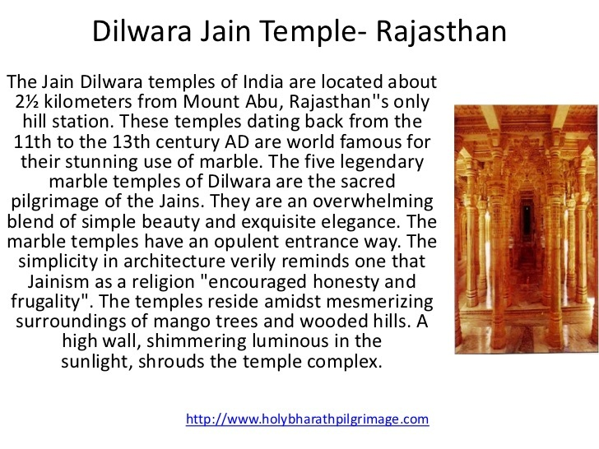

Slide 3
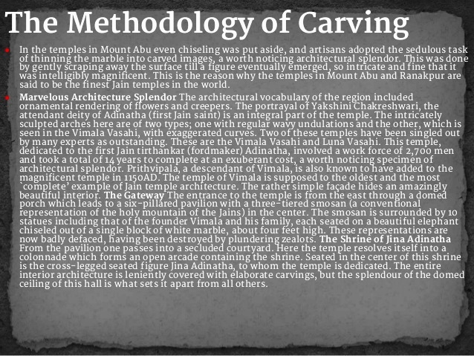

Slide 4
The Jain religion was born in India on the fundamental principle of non violence or Ahimsa and shares this doctrine with Buddhism .It originates with the first of 24 Tirthankaras or teachers the most famous of which is Mahavira whose statue is seen here. While the rest of the world may not be aware of Jain as an ancient religion, it nevertheless has millions of followers in India and elsewhere.
Jainism (/ˈdʒeɪnɪzəm/ or /ˈdʒaɪnɪzəm/), traditionally known as Jain dharma, is an ancient Indian religion belonging to the śramaṇa tradition. The central tenet is non-violence and love towards all living beings. Parasparopagraho Jivanam ("the function of souls is to help one another") is the motto of Jainism.
Dilwara temple in Mt. Abu, Rajasthan is the most famous Jain temple in India.

Slide 5
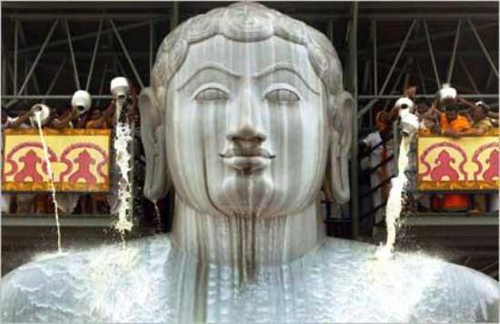
Mahavira being bathed in milk

Slide 6
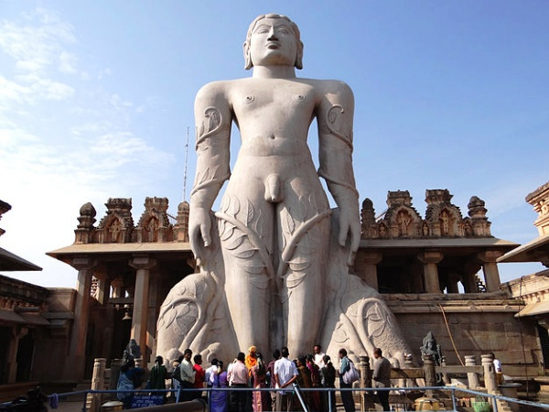

Slide 7
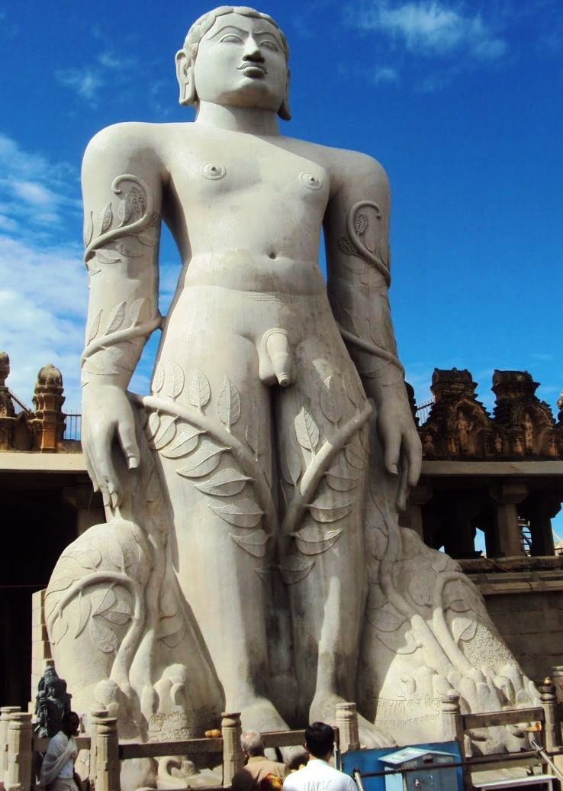

Slide 8
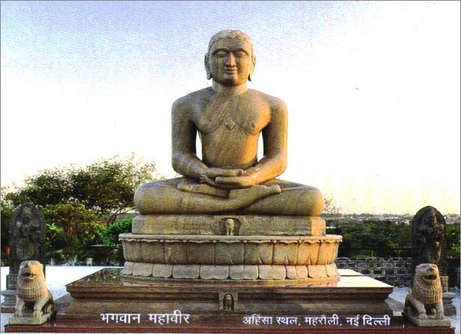
Mahavira statue in Delhi

Slide 9
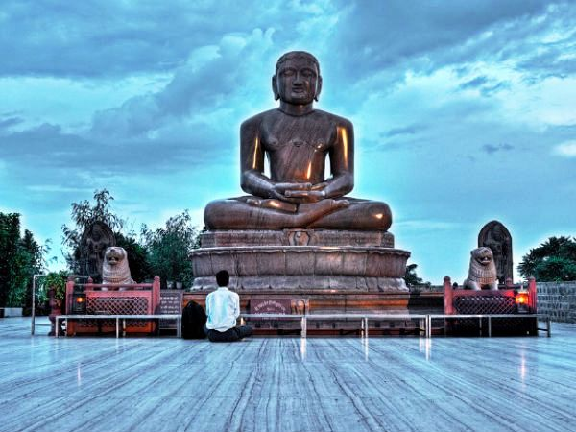

Slide 10
The three main principles of Jainism are ahimsa (non-violence), anekantavada (non-absolutism), and aparigraha(non-possessiveness). Followers of Jainism take five main vows: ahimsa (non-violence),satya (not lying), asteya (not stealing), brahmacharya (chastity), and aparigraha (non-attachment). Jain monks and nuns observe these vows absolutely whereas householders (śrāvakas) observe them within their practical limitations.
Jains trace their history through a succession of twenty-four teachers and revivers of the Jain path known as Tirthankaras. In the current era, this started with Rishabhdeva and concluded with Mahavira. Jains believe that Jainism is eternal and while it may be forgotten, it will be revived from time to time.

Slide 11
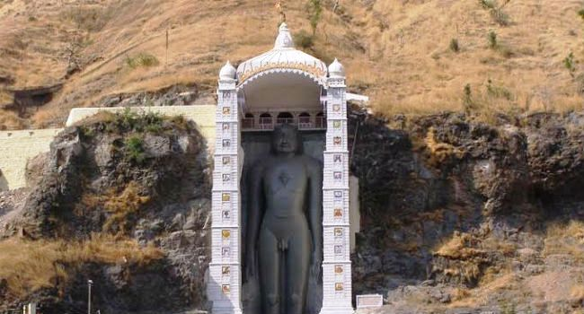

Slide 12
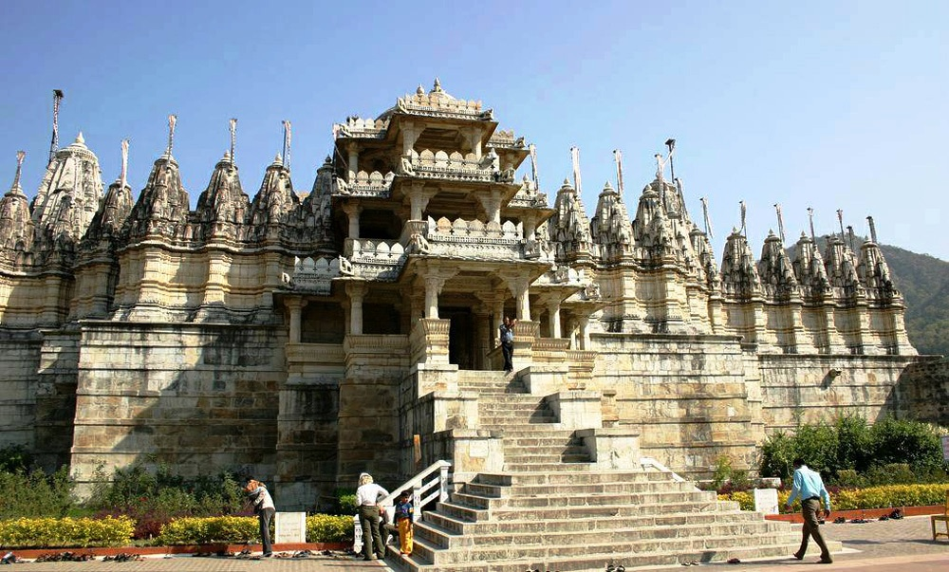
Dilwara Jain temple in Mt. Abu, Rajasthan

Slide 13
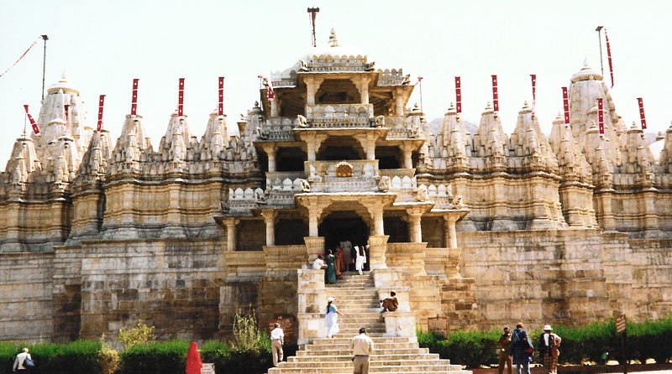

Slide 14
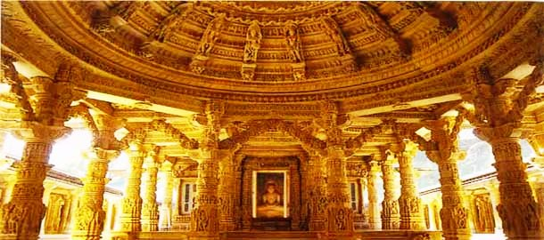

Slide 15
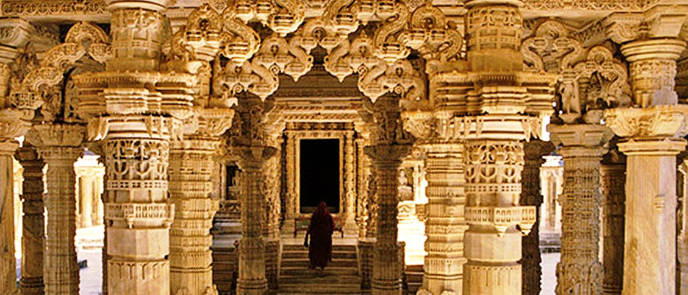

Slide 16
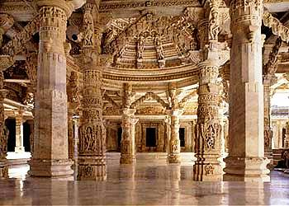

Slide 17
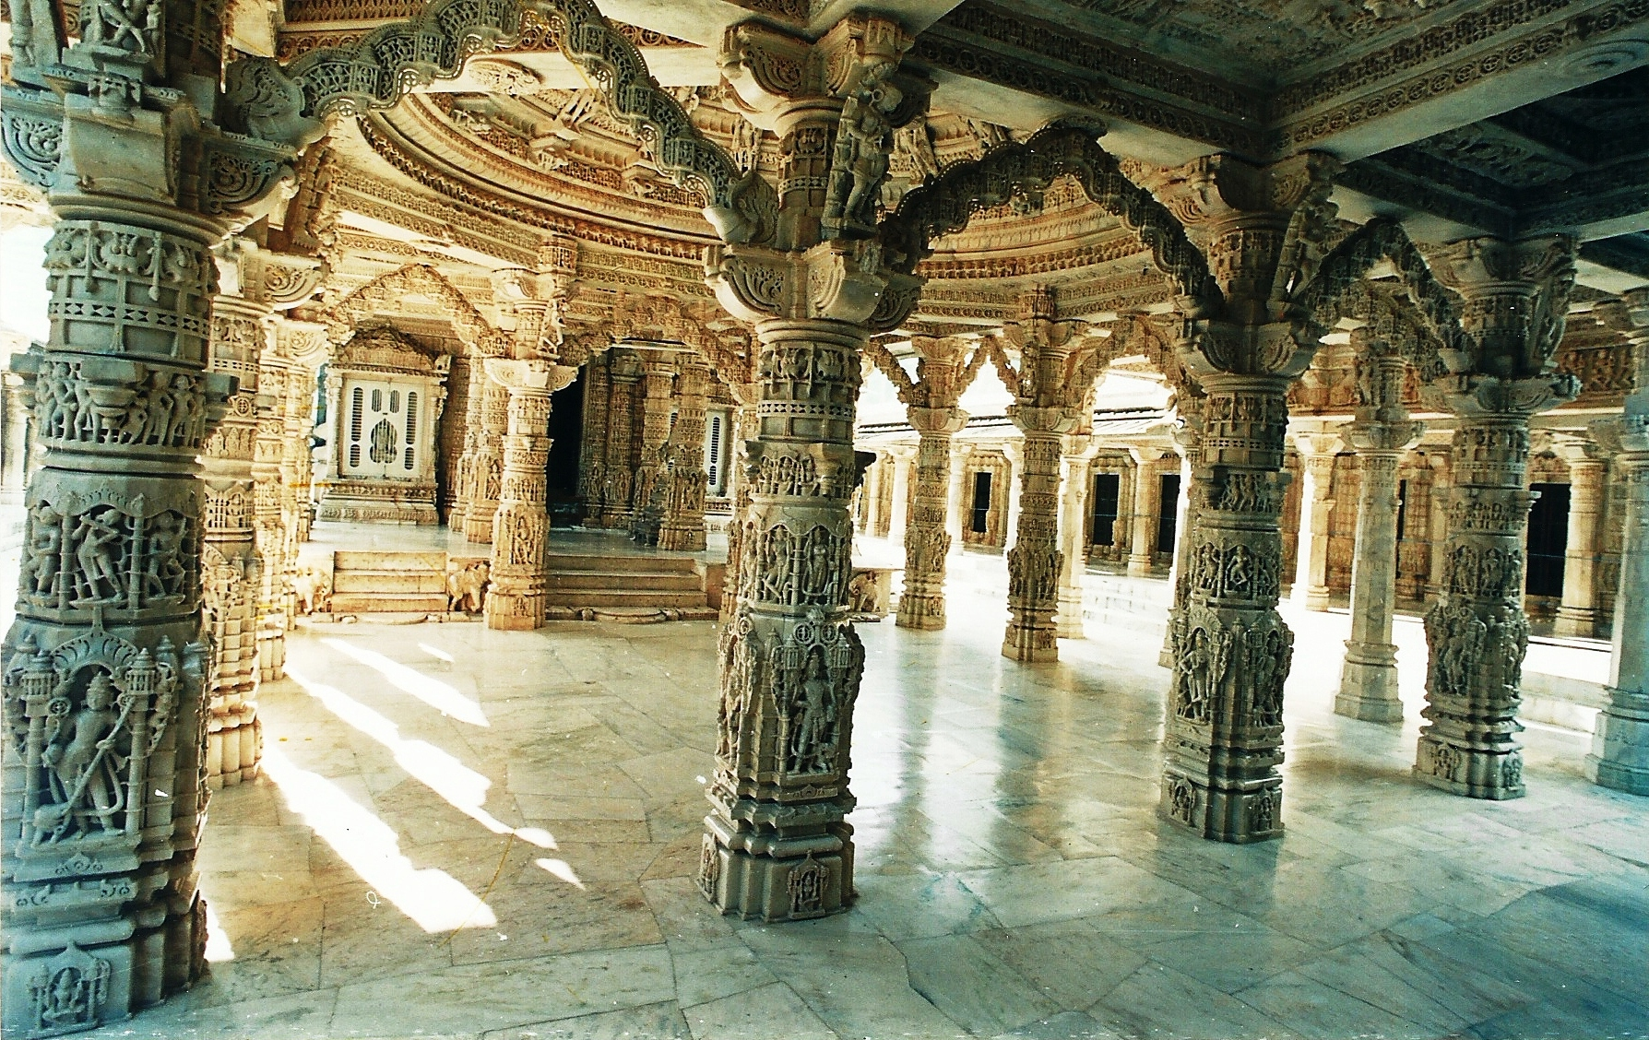

Slide 18
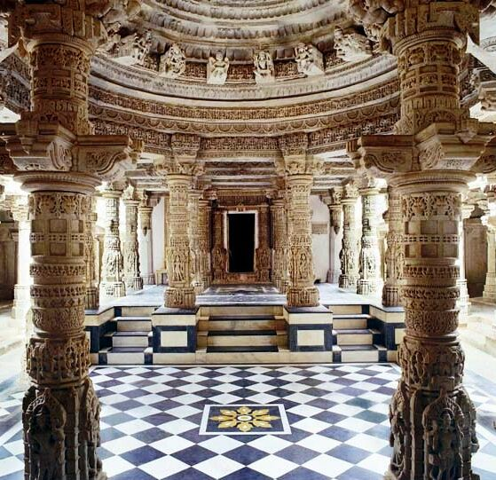

Slide 19
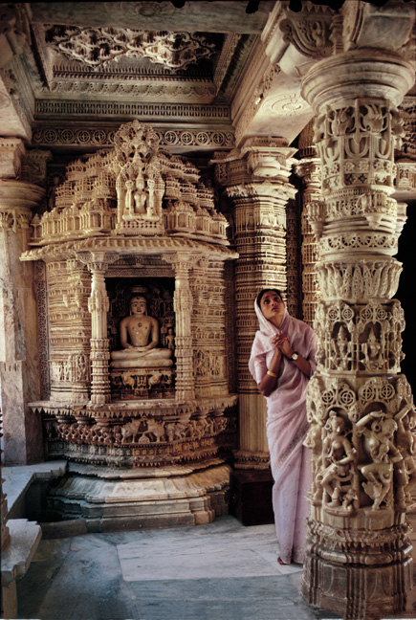

Slide 20
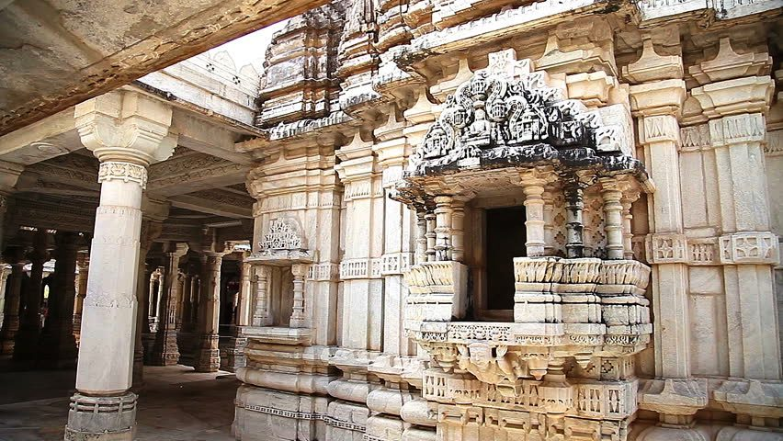

Slide 21
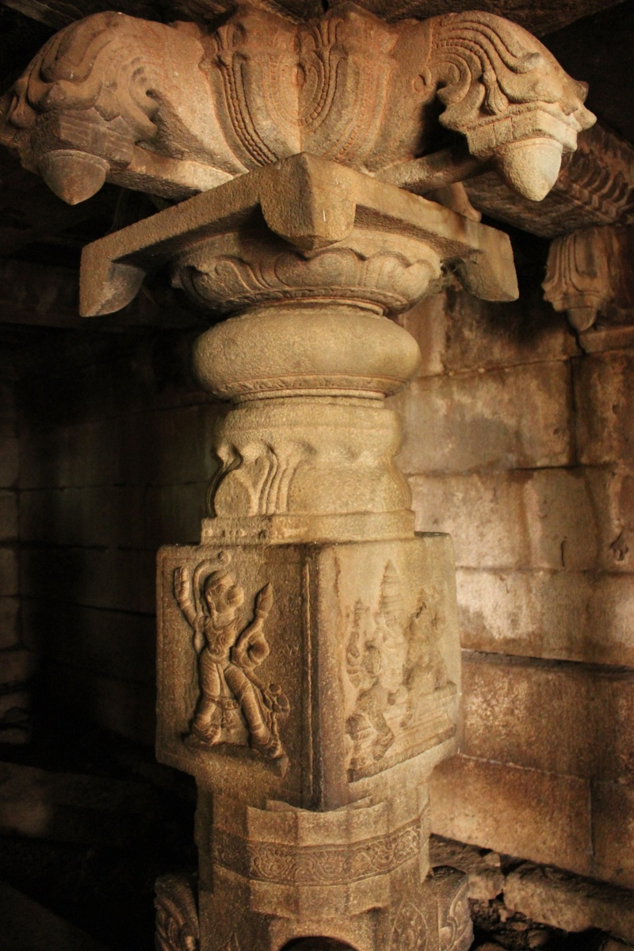

Slide 22
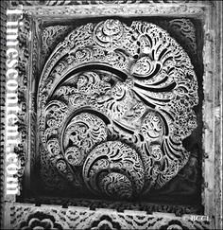

Slide 23
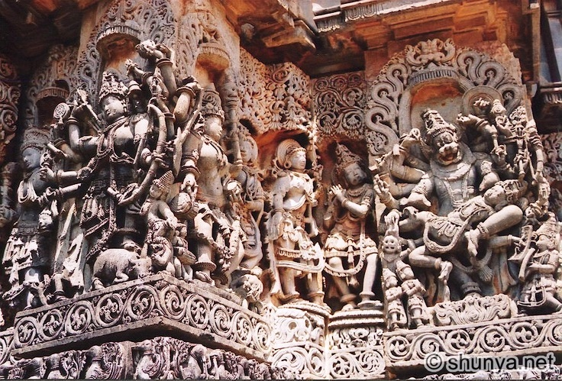

Slide 24
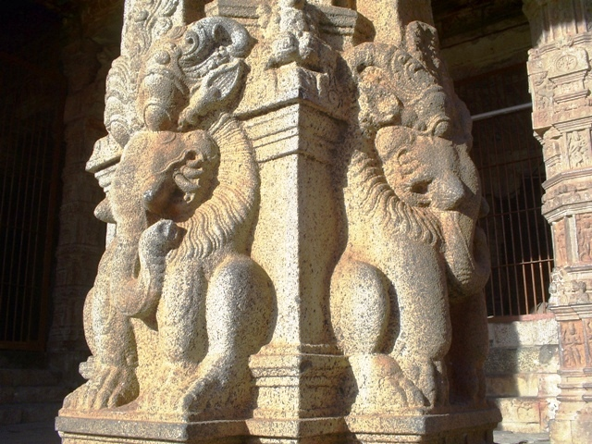

Slide 25
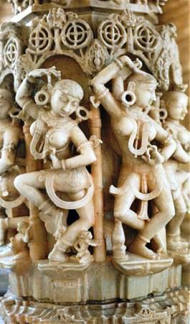

Slide 26
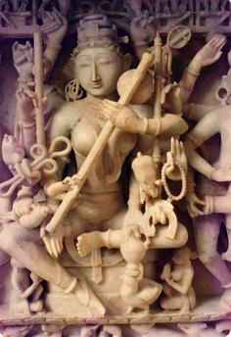

Slide 27
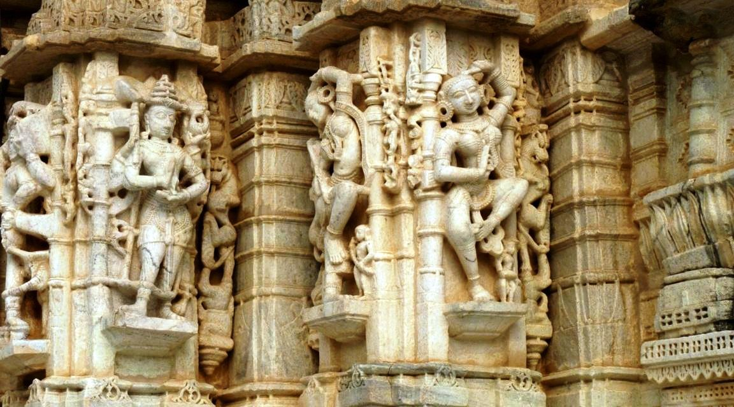

Slide 28
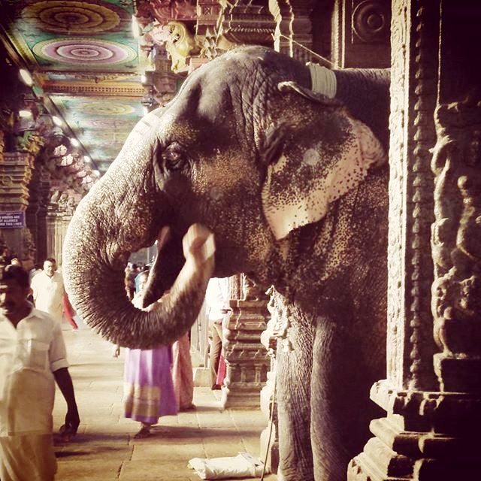

Slide 29
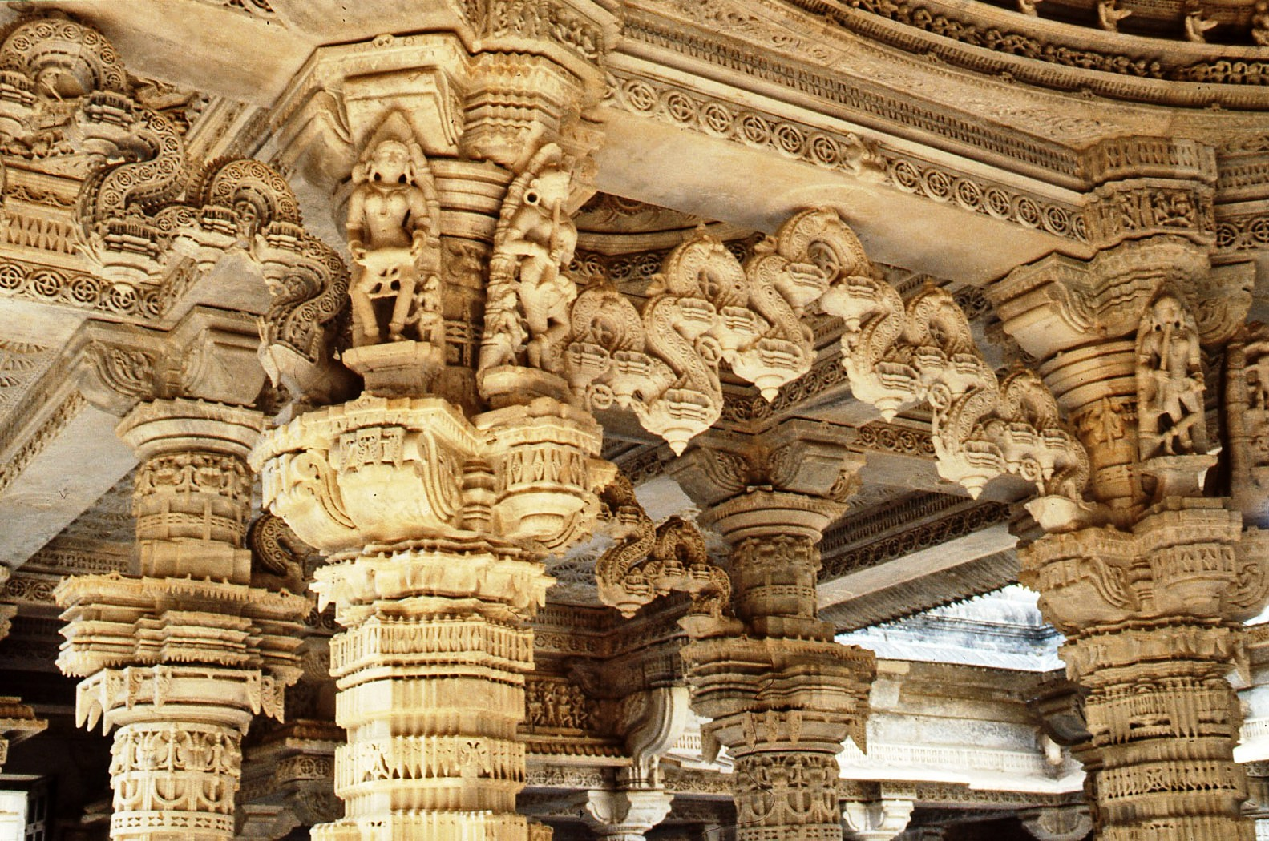

Slide 31
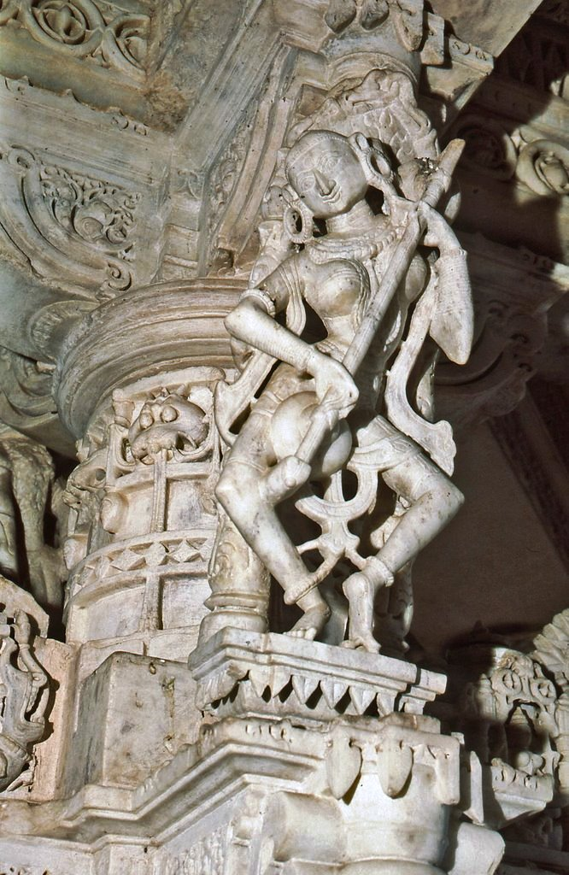

Slide 32
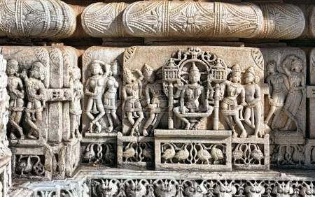

Slide 33
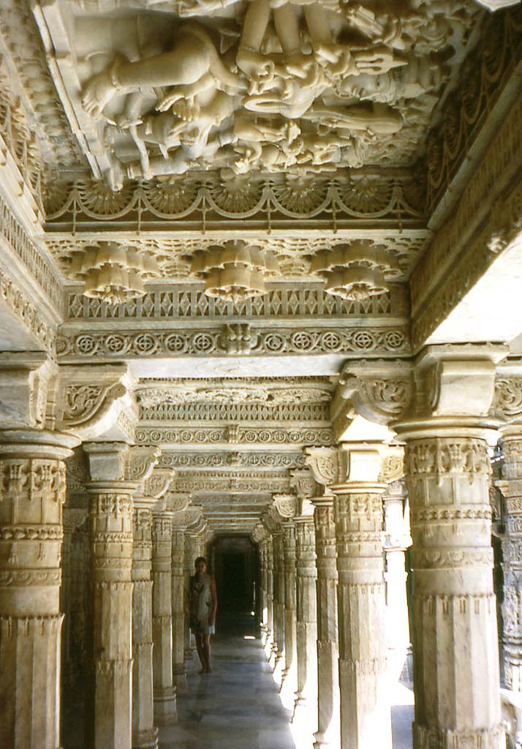

Slide 34
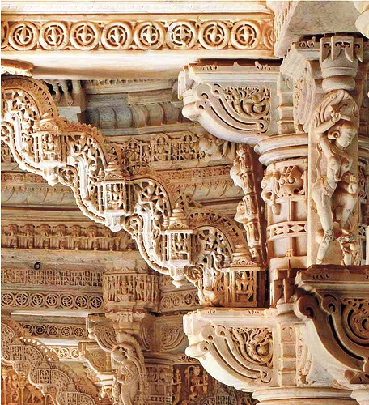

Slide 35
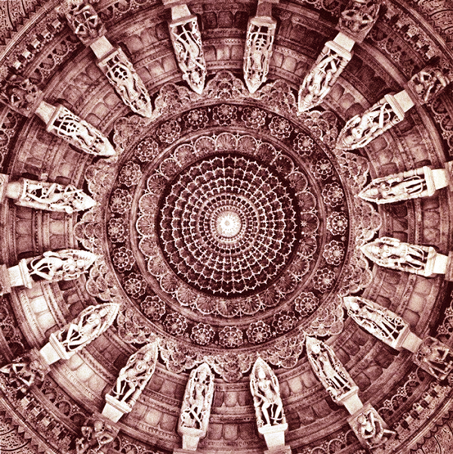

Slide 36
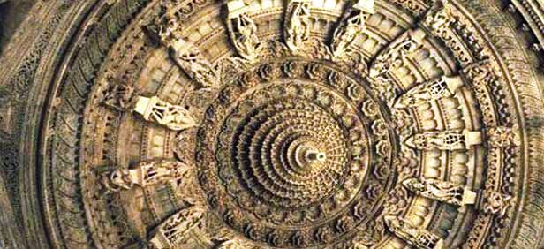

Slide 37
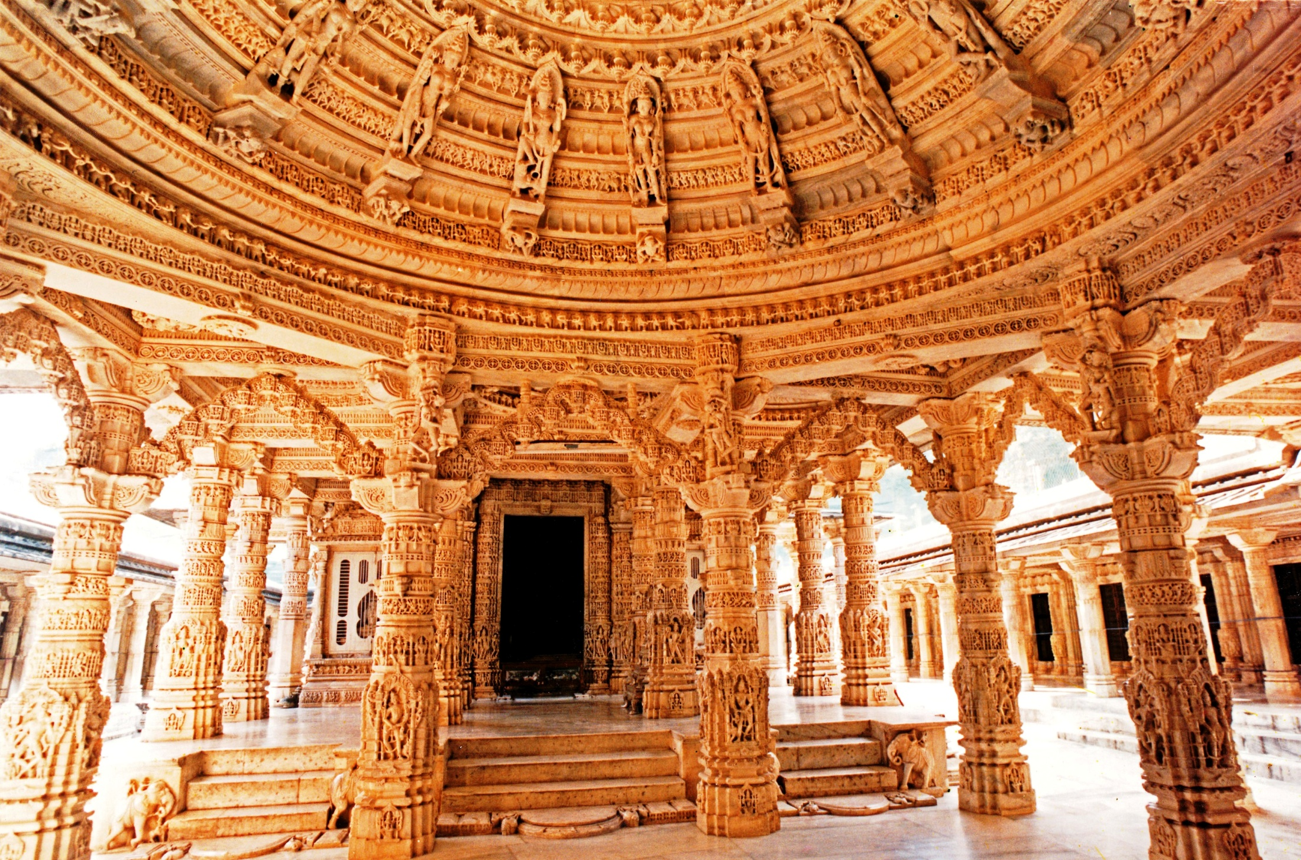

Slide 38
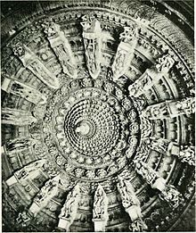

Slide 39
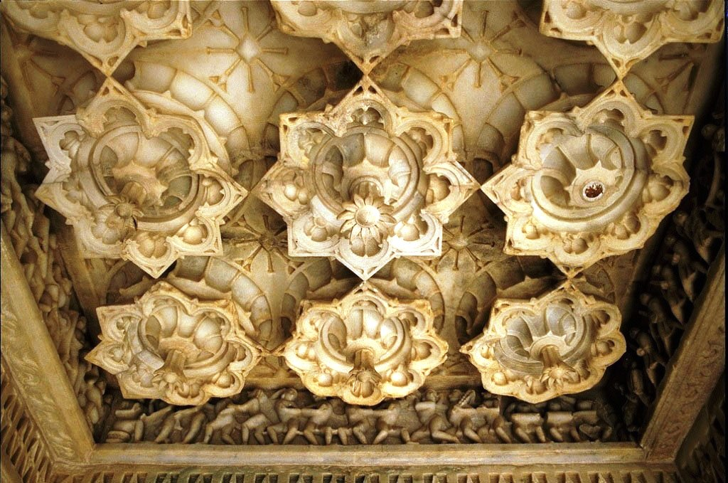

Slide 40
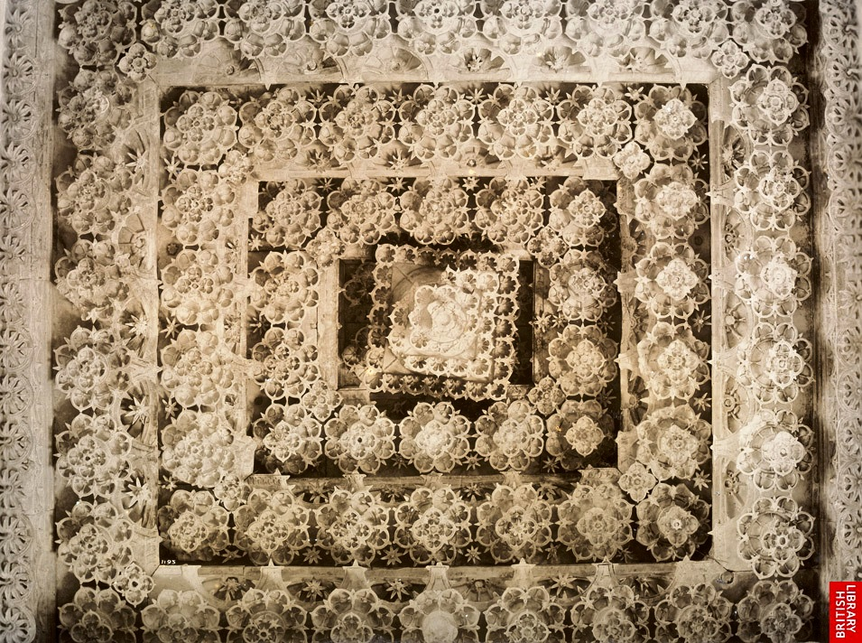

Slide 41
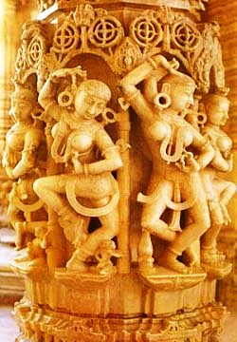

Slide 42
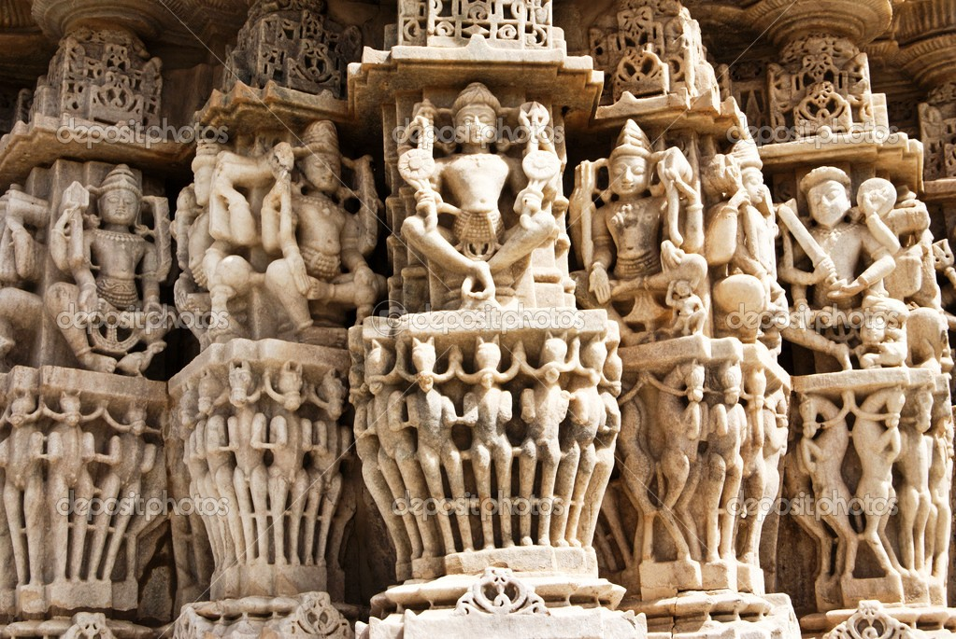

Slide 43
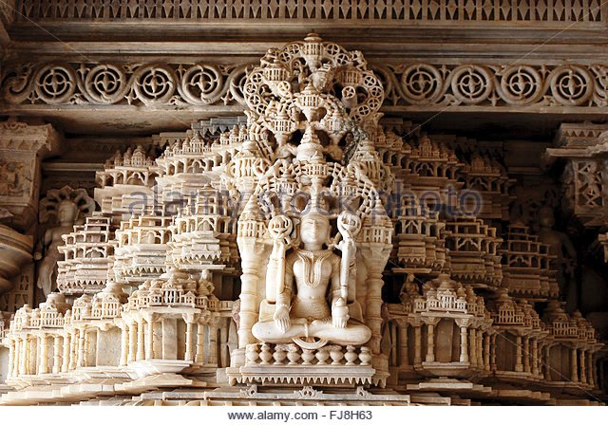

Slide 44
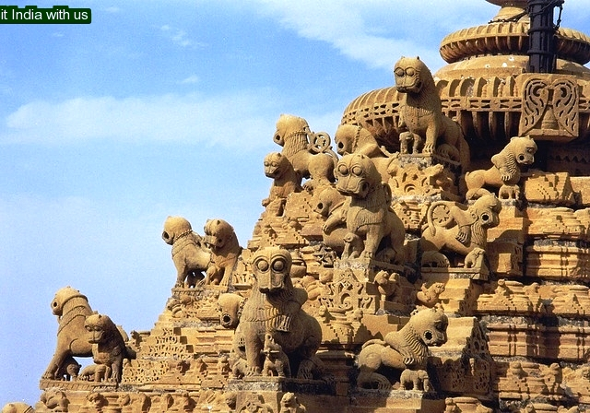

Slide 45
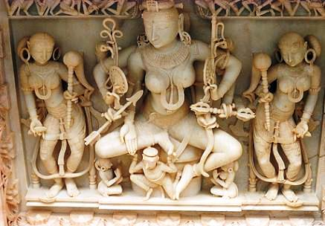

Slide 46
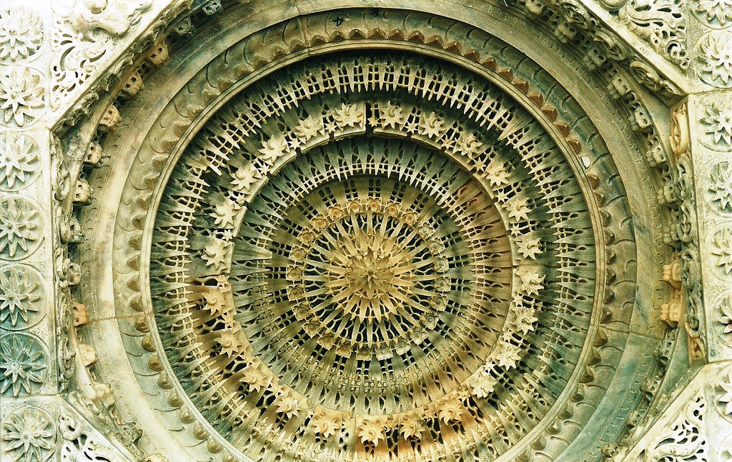

Slide 47
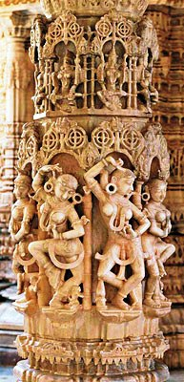
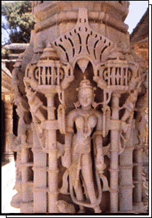

Slide 48
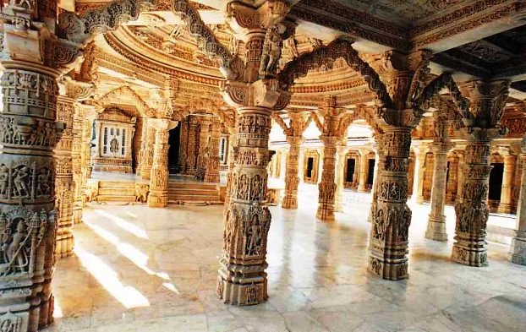

Slide 49
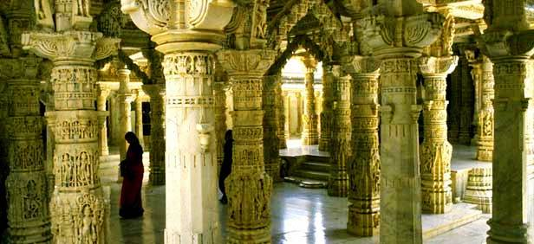

Slide 50
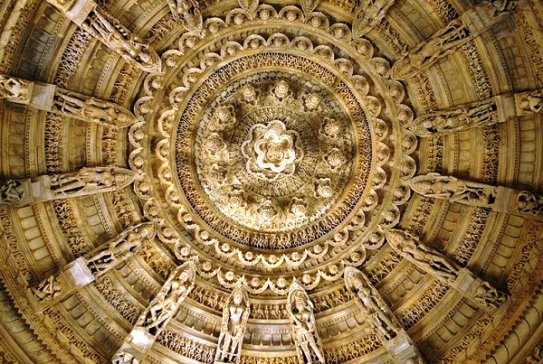

Slide 51
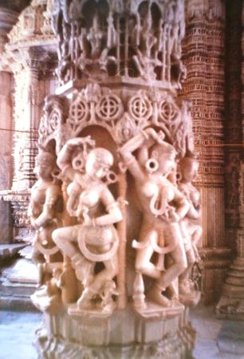

Slide 52
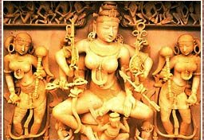

Slide 53
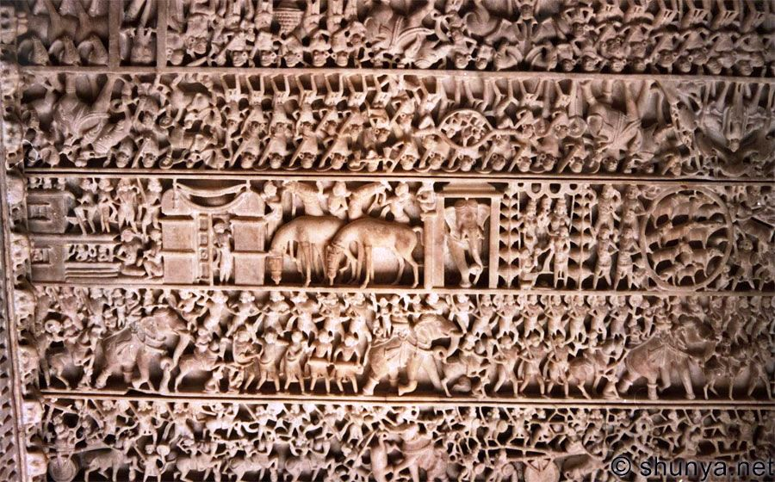

Slide 54


Slide 55


Slide 56


Slide 57


Slide 58


Slide 59


Slide 60


Slide 61


Slide 62


Slide 63


Slide 64


Slide 65


Slide 66


Slide 67


Slide 68


Slide 69


Slide 70


Slide 71


Slide 72


Slide 73


Slide 74


Slide 75


Slide 76


Slide 77


Slide 78


Slide 79


Slide 80


Slide 81


Slide 82


Slide 83


Slide 84


Slide 85


Slide 86


Slide 87


Slide 88


Slide 89

Jain temple in Jaisalmer

Slide 90


Slide 91
Ranakpur Jain temple

Slide 92

Pali Jain temple

Slide 93

Ranakpur Jain temple

Slide 94


Slide 95


Slide 96

Rajasthani women dancing

Slide 97
The end

