Slide 1
Cat breeds of the world
The cat breeds are grouped as follows
Smallest cats
Small cats
Medium cats
Large cats
Largest cats
Best 30 breeds
AKC/November 2015

Slide 2
Smallest cats

Slide 3

Singapura cats

Slide 4
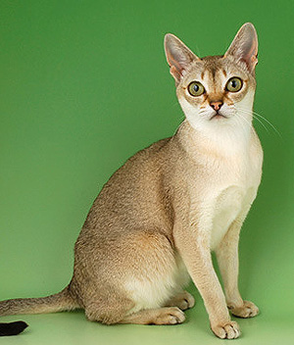
Singapura

Slide 5
Small cats

Slide 6
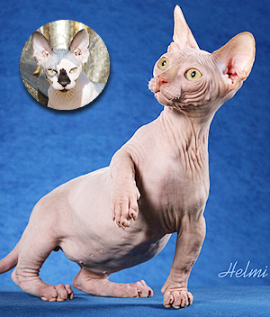
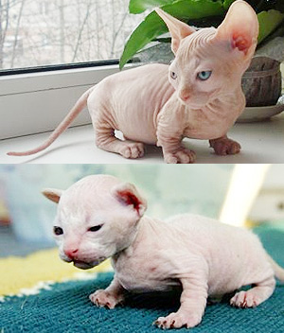
Bambino
Kittens

Slide 7
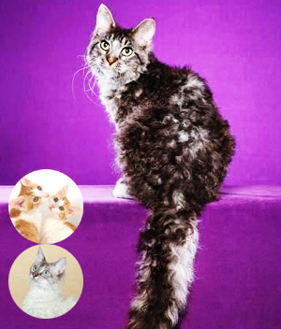
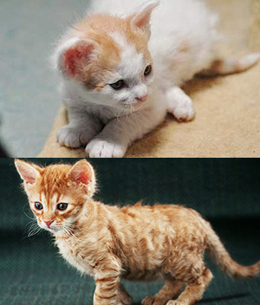
La perm
Kittens

Slide 8
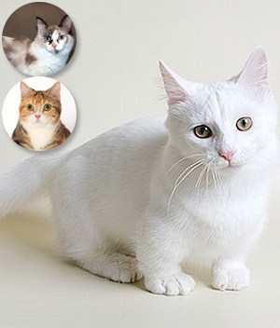
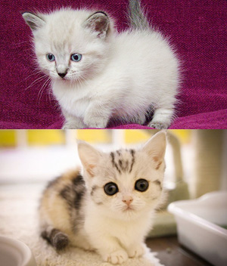
Munchkin cat
Kittens

Slide 9
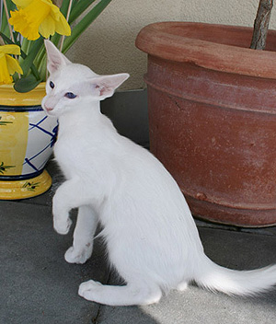
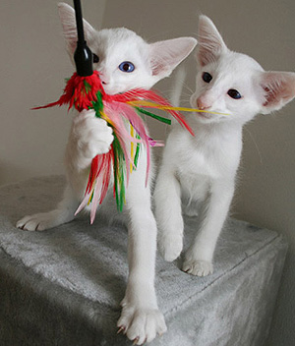
Oriental shorthair
Kittens

Slide 10
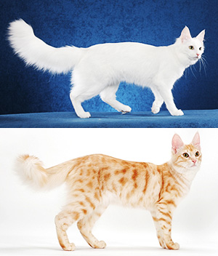
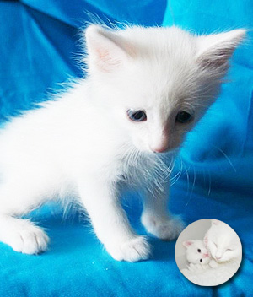
Turkish Angora
Kitten

Slide 11
Medium cats

Slide 12
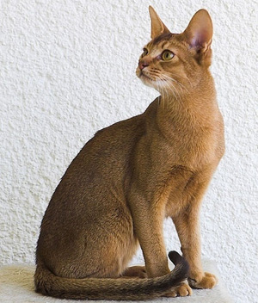
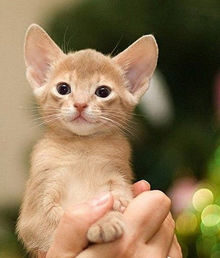
Abyssinian cat
Kitten

Slide 13
Munchkin cat
Kittens

Slide 14
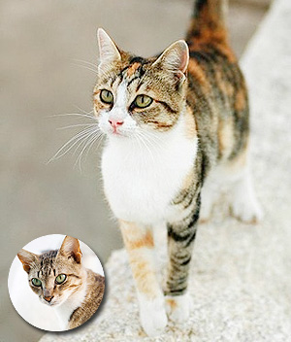
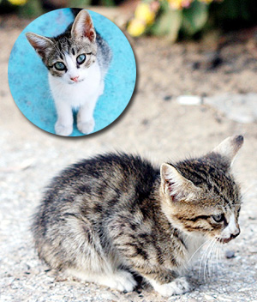
Aegean cat
Kittens

Slide 15
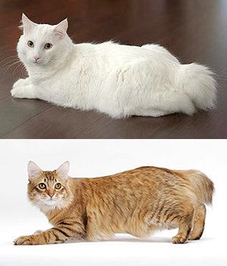
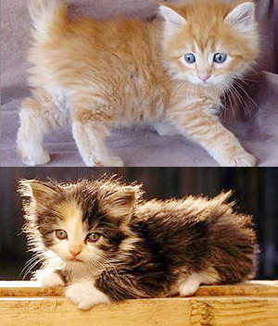
American bob tail
Kittens

Slide 16
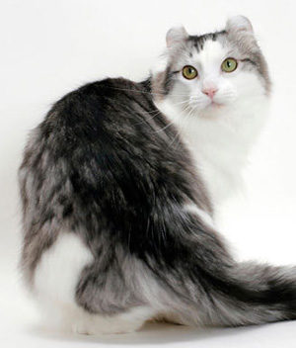
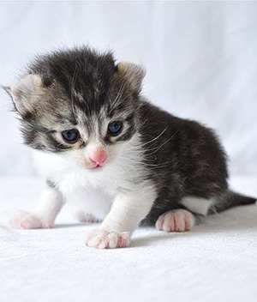
American curl
Kitten

Slide 17
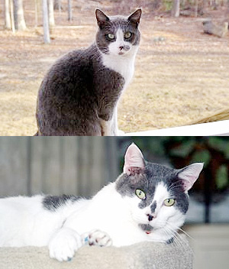
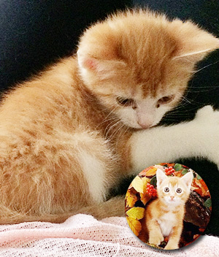
American polydactyl
Kitten

Slide 18
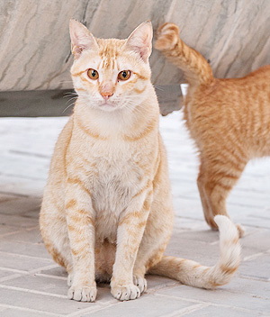
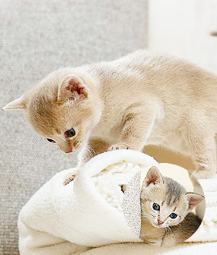
Arabian mau
Kittens

Slide 19
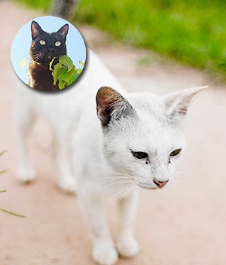
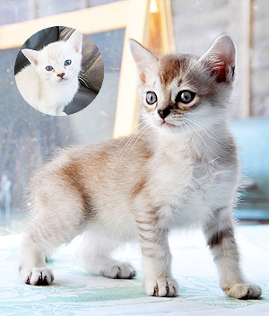
Asian cat
Kitten

Slide 20
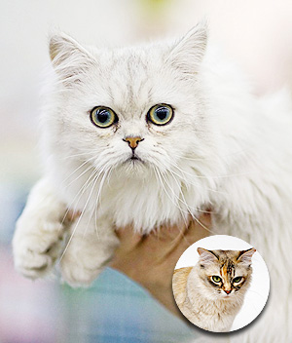
Asian semi long hair

Slide 21
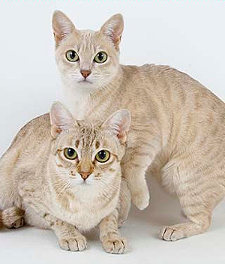
Australian mist

Slide 22
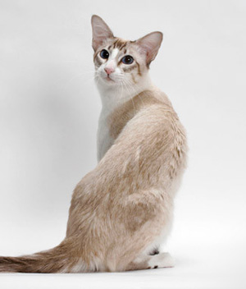
Balinese

Slide 23
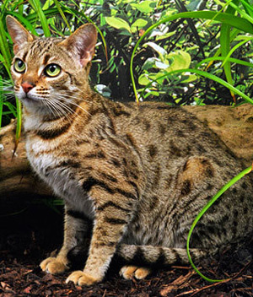
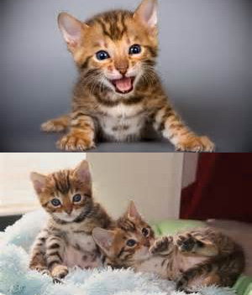
Bengal cat
Kittens

Slide 24
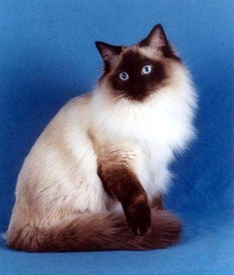
Birman

Slide 25
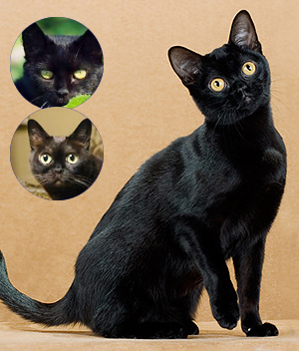
Bombay cat

Slide 26
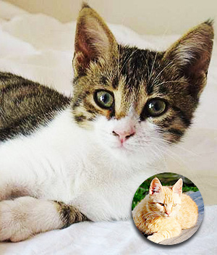
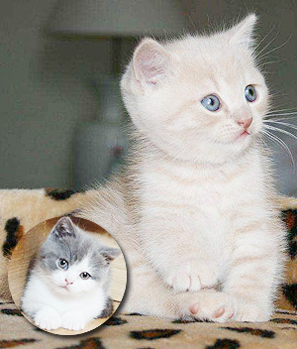
Brazilian short hair
Kitten

Slide 27
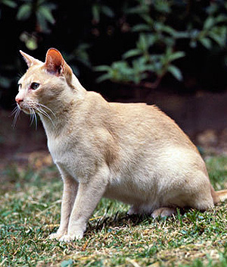
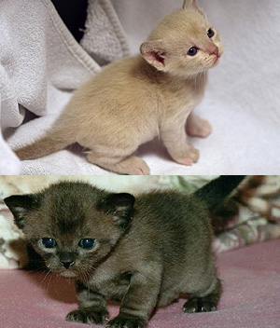
Burmese
Kittens

Slide 28
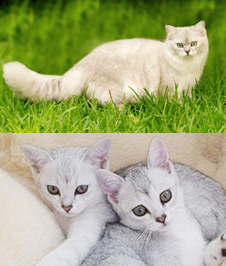
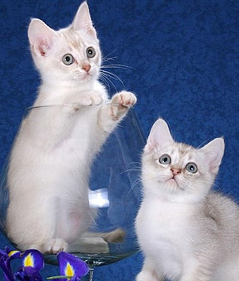
Burmilla
Kittens

Slide 29
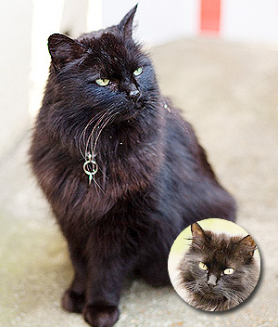
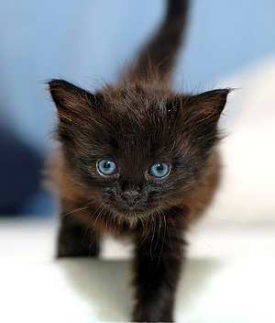
Chantilly
Kitten

Slide 30
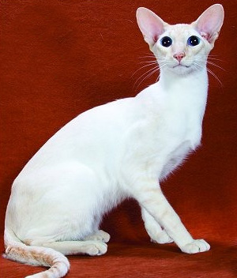
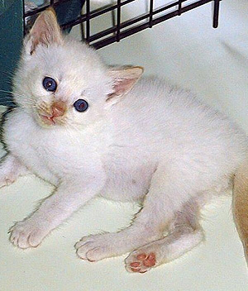
Colorpoint shorthair
Kitten

Slide 31
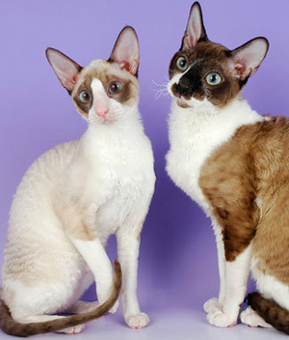
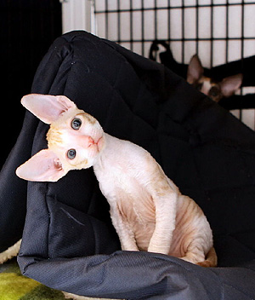
Cornish rex
Kitten

Slide 32
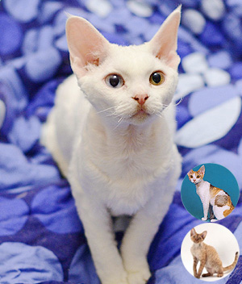
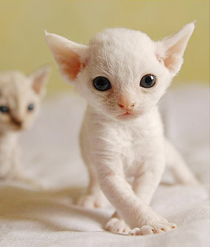
Devon rex
Kitten

Slide 33
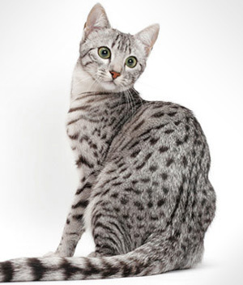
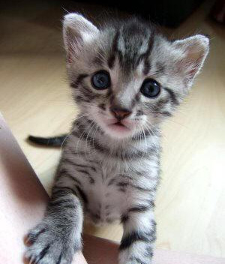
Egyptian mau
Kitten

Slide 34
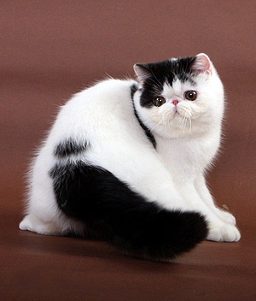
Exotic short hair

Slide 35
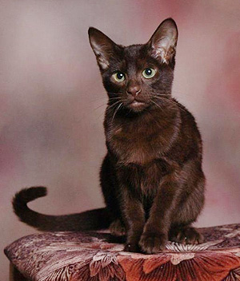

Havana brown
Kitten

Slide 36


Himalayan cat
Kitten

Slide 37


Japanese bob tail
Kittens

Slide 38


Korat
Kitten

Slide 39


Norwegian forest cat
Kittens

Slide 40

Persian cat

Slide 41


Ragamuffin cat
Kittens

Slide 42


Russian blue
Kittens

Slide 43

Savannah cat

Slide 44


Scottish fold
Kittens

Slide 45


Selkirk rex
Kitten

Slide 46


Siamese
Kittens

Slide 47


Snowshoe cat
Kittens

Slide 48


Somali
Kittens

Slide 49


Sphynx cat
Kitten

Slide 50


Tonkinese
Kittens

Slide 51


Toyger
Kittens

Slide 52
Turkish angora
Kitten

Slide 53

York chocolate

Slide 54
Large cats

Slide 55
American bob tail
Kittens

Slide 56


American shorthair
Kitten

Slide 57


American wirehair
Kittten

Slide 58


British semi long hair
Kittens

Slide 59


British short hair
Kitten

Slide 60


Chartreux
Kitten

Slide 61
Himalayan cat
Kitten

Slide 62


Ocicat
Kittens

Slide 63


Pixie bob
Kittens

Slide 64
Ragamuffin cat
Kittens

Slide 65

Savannah cat
Kitten

Slide 66
Selkirk rex
Kitten

Slide 67


Turkish van
Kittens

Slide 68
Largest cats

Slide 69


California spangled cat
Kitten

Slide 70


Maine coon
Kitten

Slide 71
Pixie bob
Kittens

Slide 72


Ragdoll
Kittens

Slide 73


Siberian cat
Kitten

Slide 74
Best 30 cat breeds

Slide 75
Abyssinian
Kitten

Slide 76
American curl
Kitten

Slide 77
American short hair
Kitten

Slide 78
American wire hair
Kitten

Slide 79

Asian semi long hair

Slide 80

Australian mist

Slide 81

Balinese
Kitten

Slide 82
Bengal
Kittens

Slide 83

Birman
Kittens

Slide 84

Bombay cat

Slide 85
British shorthair
Kitten

Slide 86
Burmese
Kittens

Slide 87
Chartreux
Kitten

Slide 88
Colorpoint shorthair
Kitten

Slide 89
Cornish rex
Kitten

Slide 90


Cymric cat
Kittens

Slide 91
Egyptian mau
Kitten

Slide 92


Exotic shorthair

Slide 93
Japanese bobtail
Kittens

Slide 94
Korat
Kitten

Slide 95
Maine coon
Kitten

Slide 96


Manx
Kitten

Slide 97
Munchkin cat

Slide 98


Nebelung
Kitten

Slide 99
Norwegian forest cat
Kittens

Slide 100
Ocicat
Kittens

Slide 101
Oriental short hair

Slide 102


Persian cat
Kitten

Slide 103
Ragdoll
Kittens

Slide 104
Russian blue
Kittens

Slide 105
Savannah

Slide 106
Selkirk rex
Kittens

Slide 107
Siamese
Kittens

Slide 108
Siberian
Kitten

Slide 109

Singapura

Slide 110
Somali
Kittens

Slide 111
Sphynx
Kitten

Slide 112
Tonkenese
Kittens

Slide 113
Turkish angora
Kitten

Slide 114
Turkish van
Kittens

Slide 115

York chocolate

