Slide 1
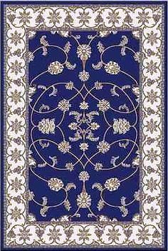
Beauty of Persian carpets
The beauty and intricate designs of the Persian carpets is well known throughout the world. It is an ancient tradition that continues to pass on to the next generation without the loss of originality. The Moghul kings invited them to India to teach their skills to the local artisans like in Bhadohi . But there is a darker side to their story. Children as young as 8 are used to make these wonderful carpets although this practice may be in decline. A small sample of the numerous designs are presented here for your private viewing pleasure.
AKC/ September 2016

Slide 2
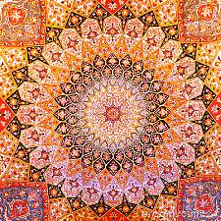

Slide 3
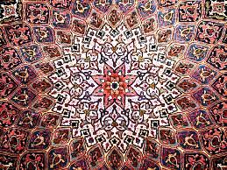

Slide 5
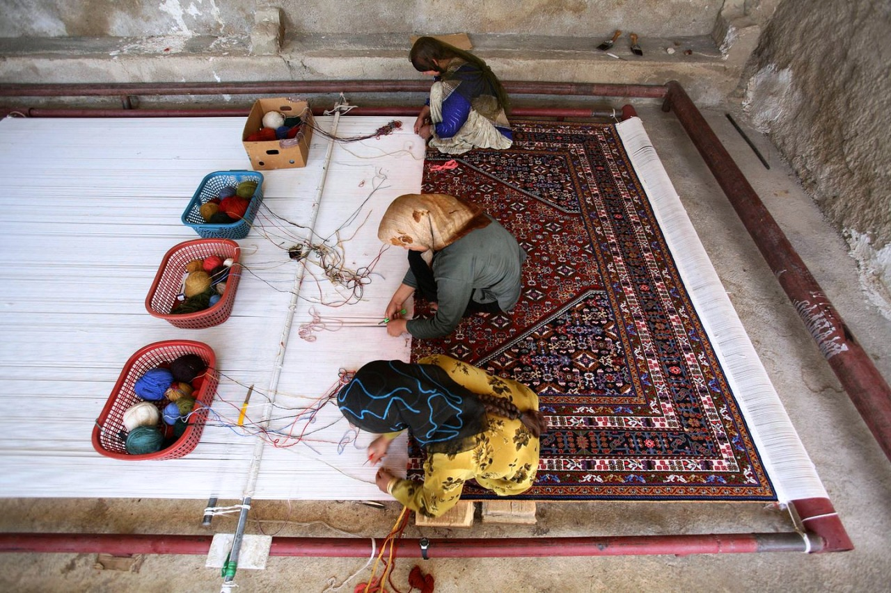

Slide 6
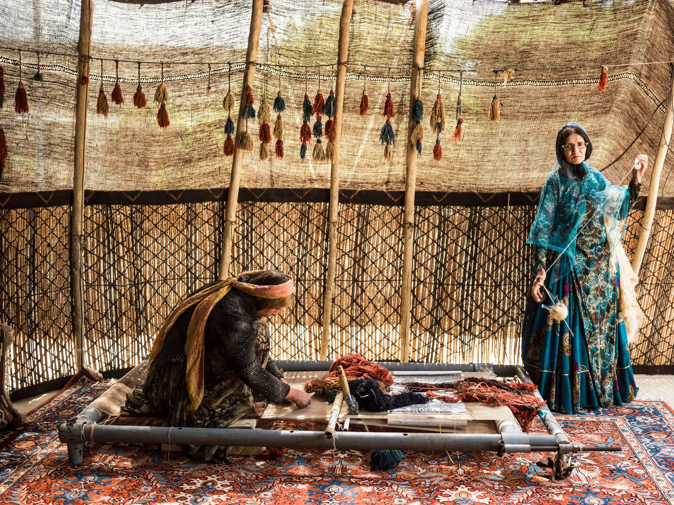

Slide 7
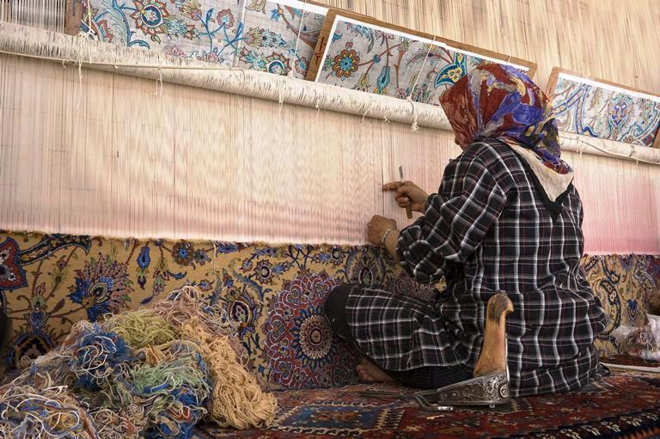

Slide 8
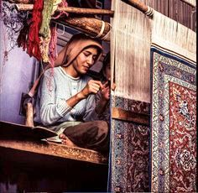

Slide 9
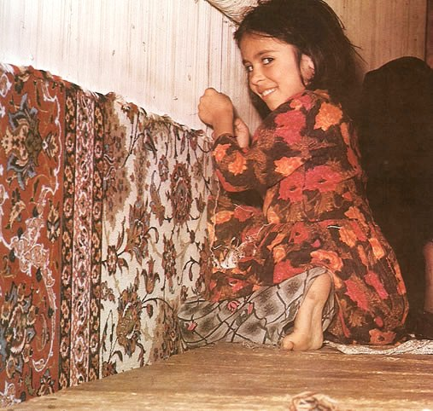

Slide 10
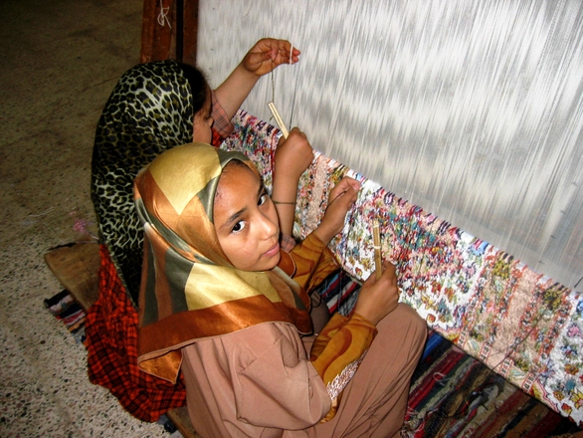

Slide 11
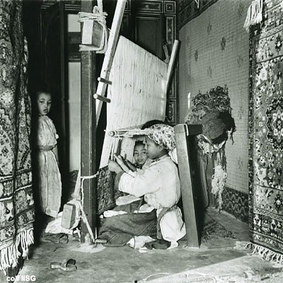

Slide 12
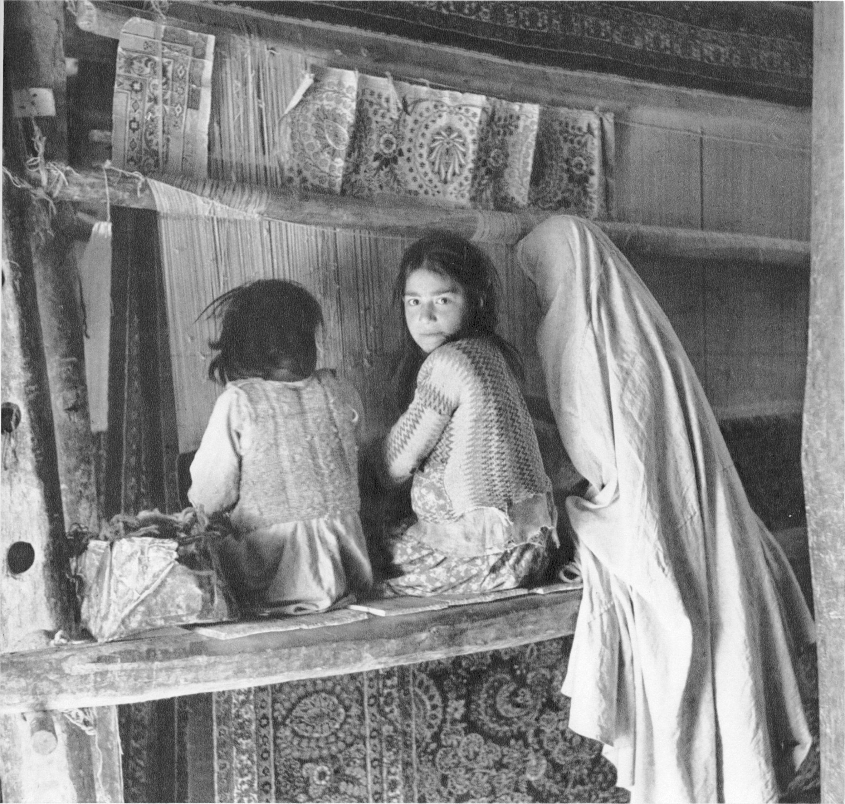

Slide 13
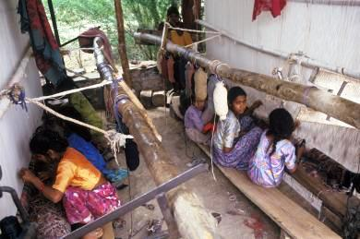

Slide 14
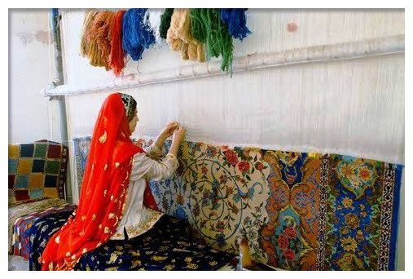

Slide 15
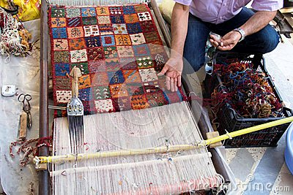

Slide 16
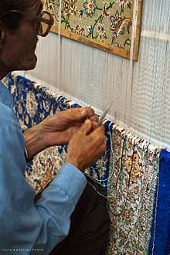

Slide 17
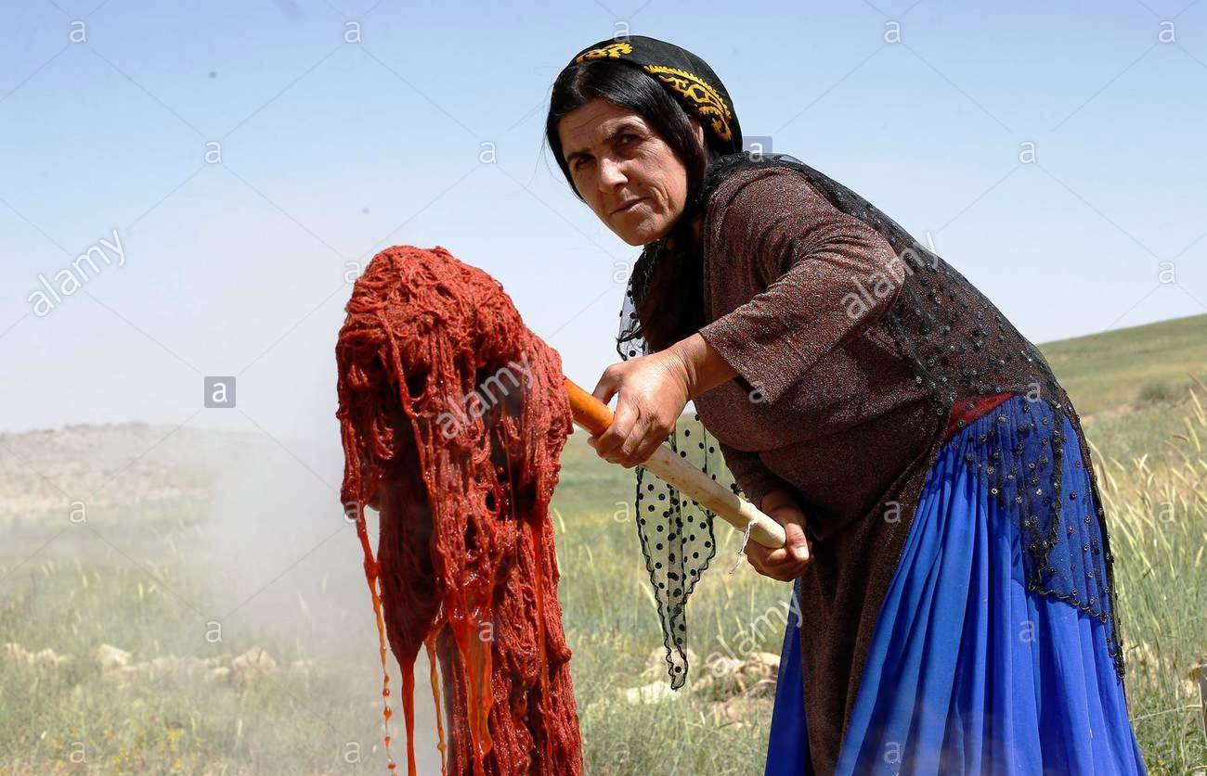

Slide 18
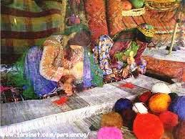

Slide 19
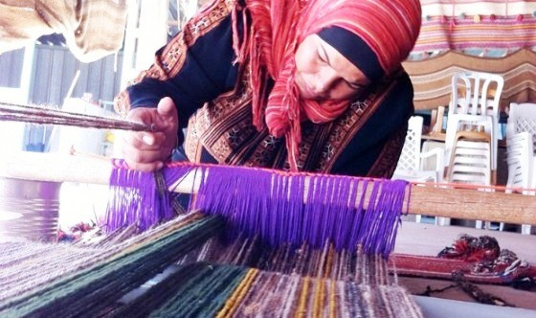

Slide 20
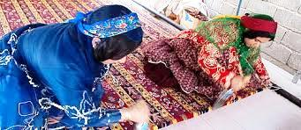

Slide 21
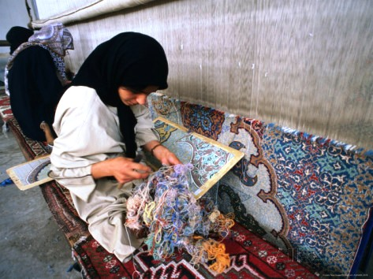

Slide 22
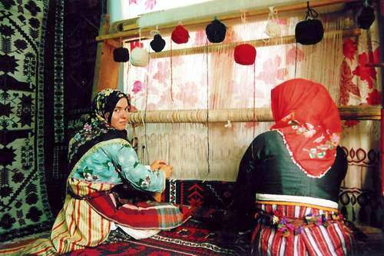

Slide 23
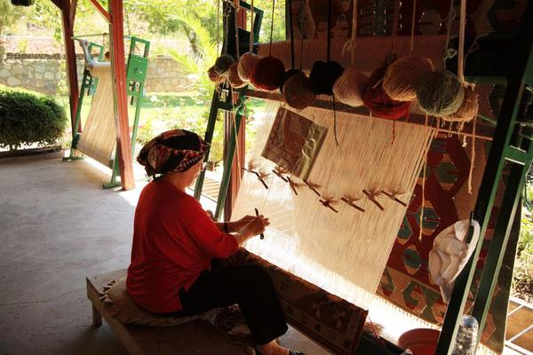

Slide 24
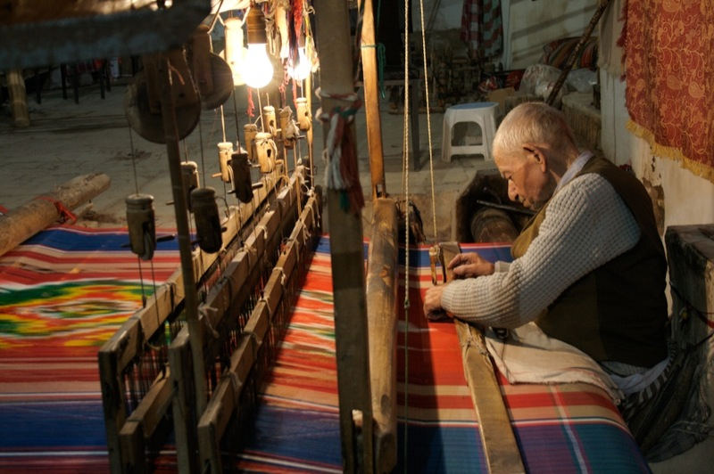

Slide 25
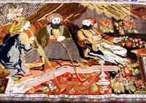

Slide 26
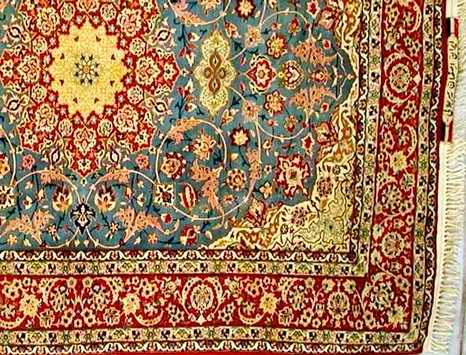

Slide 27
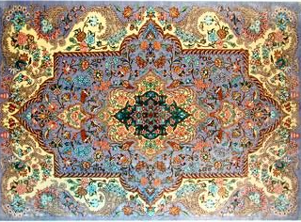

Slide 28
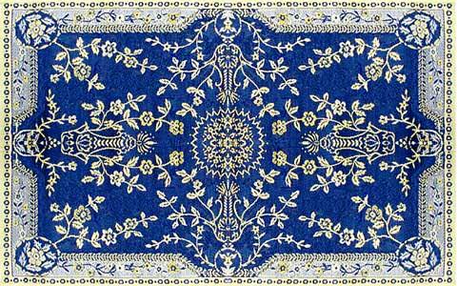

Slide 29
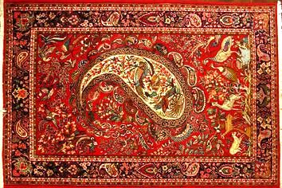

Slide 30
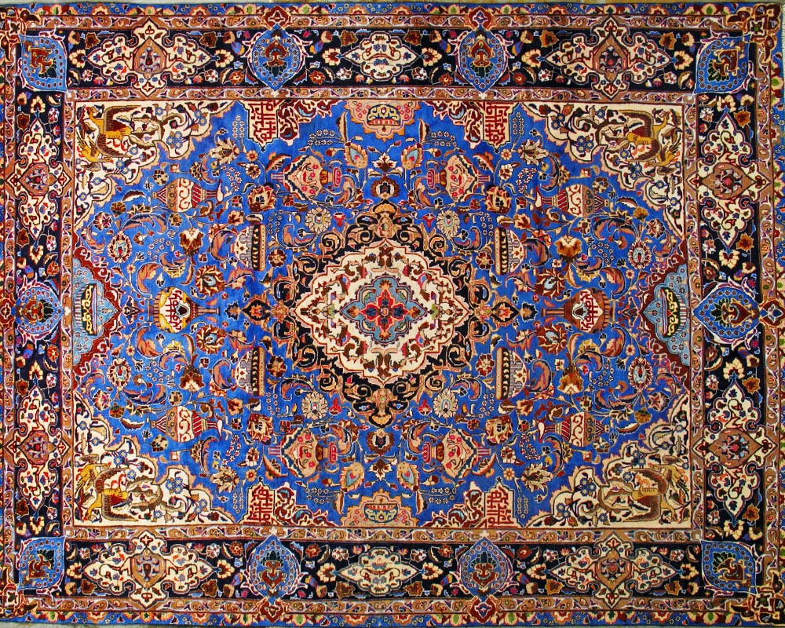

Slide 31
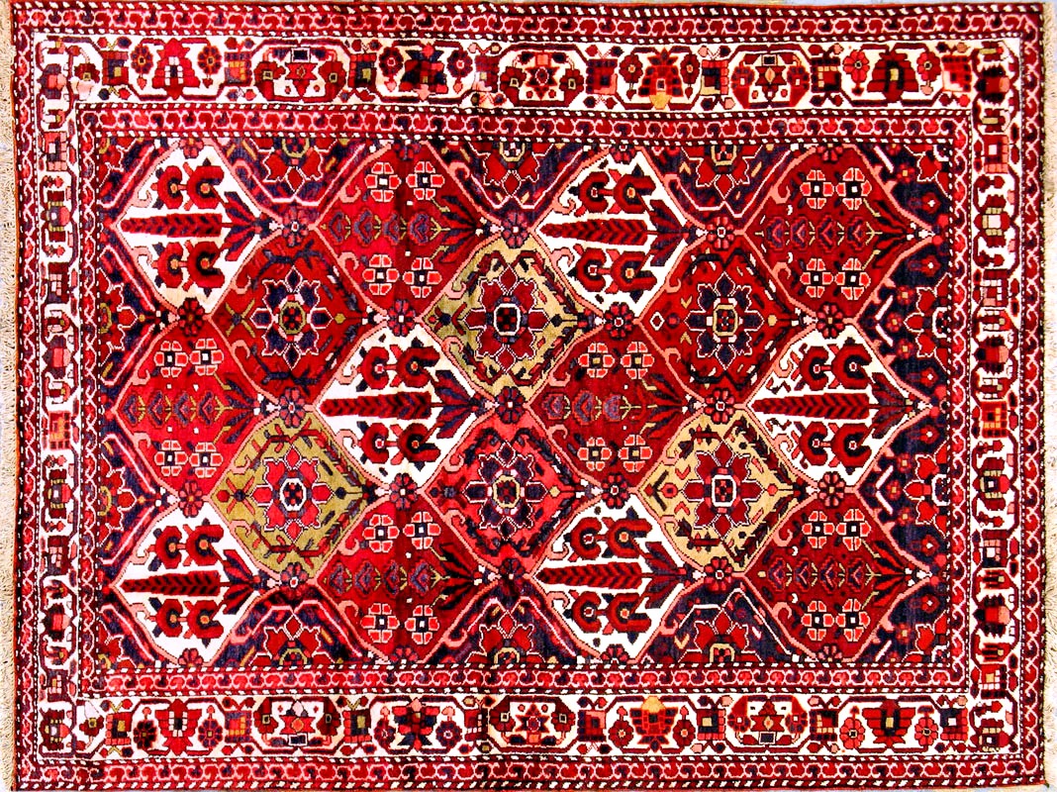

Slide 32
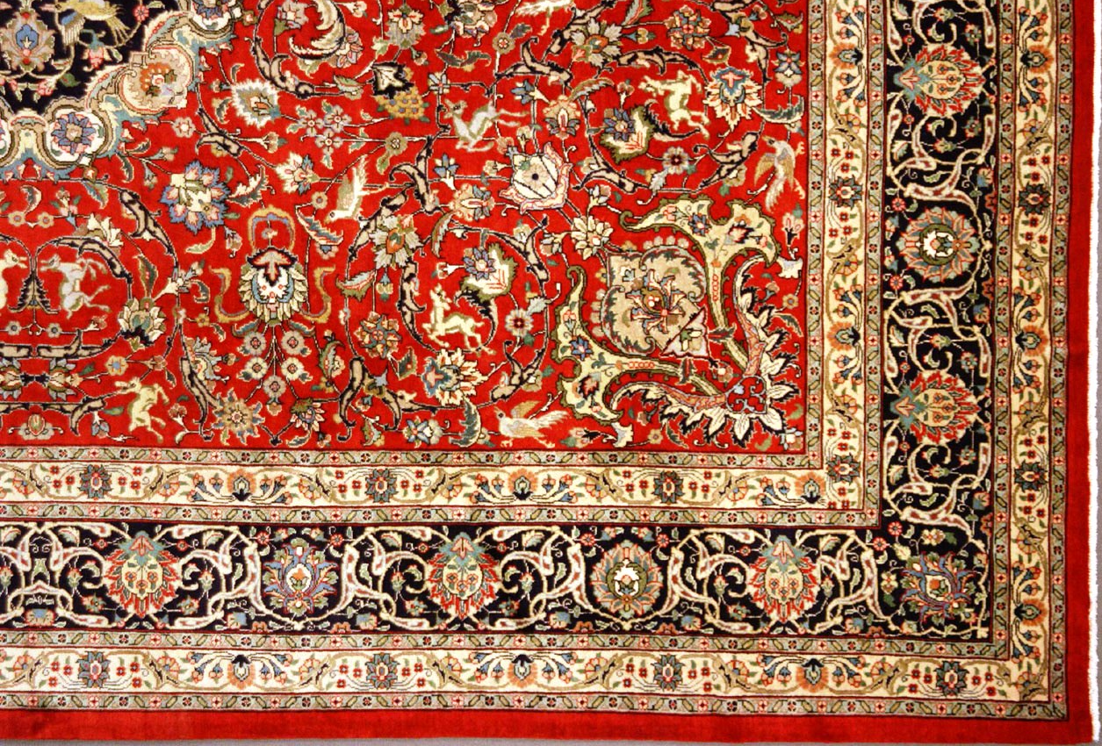

Slide 33
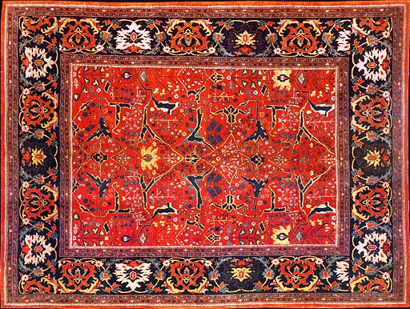

Slide 34
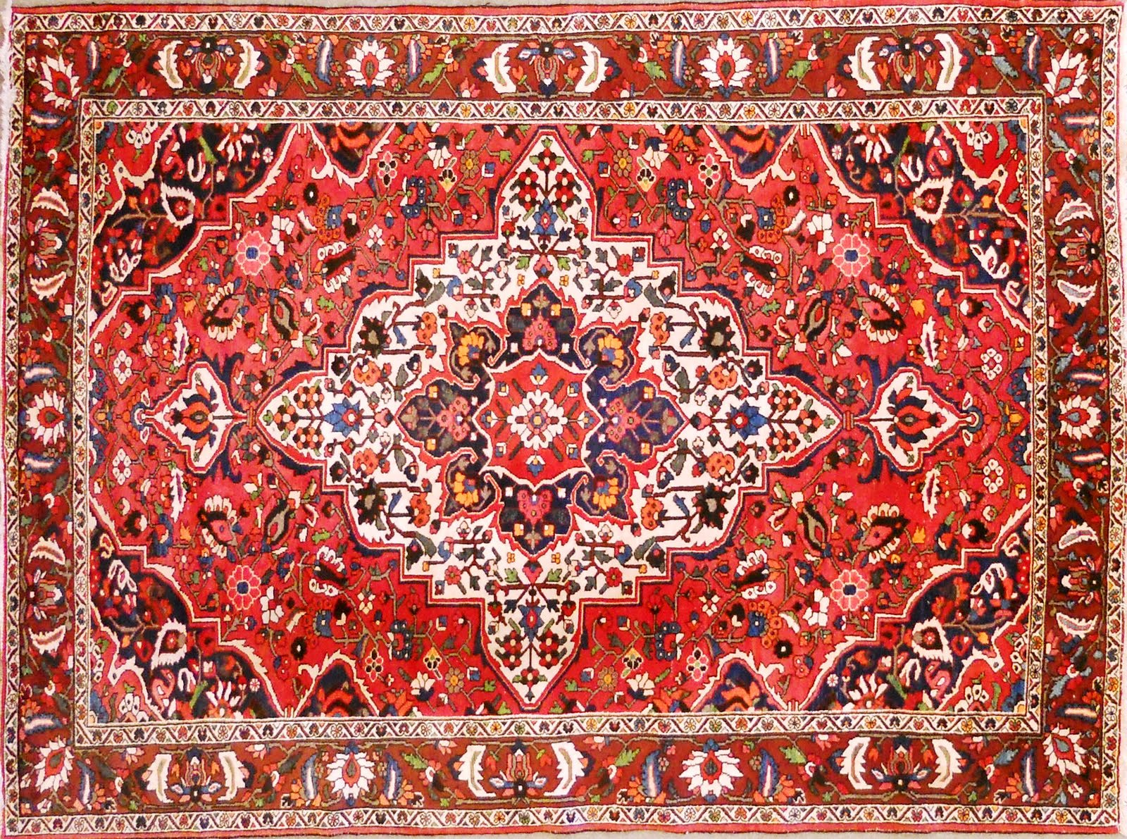

Slide 35
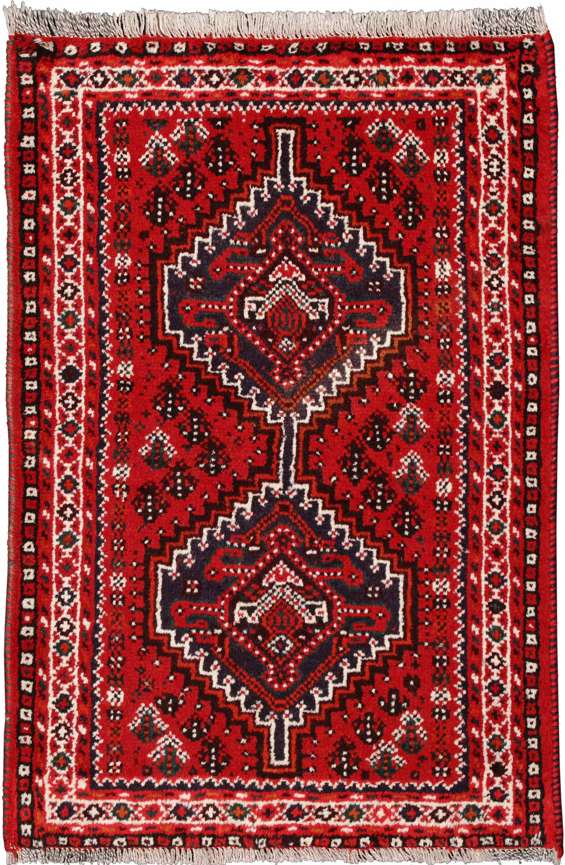

Slide 36
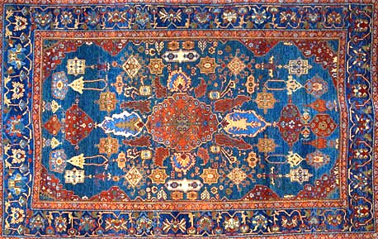

Slide 37
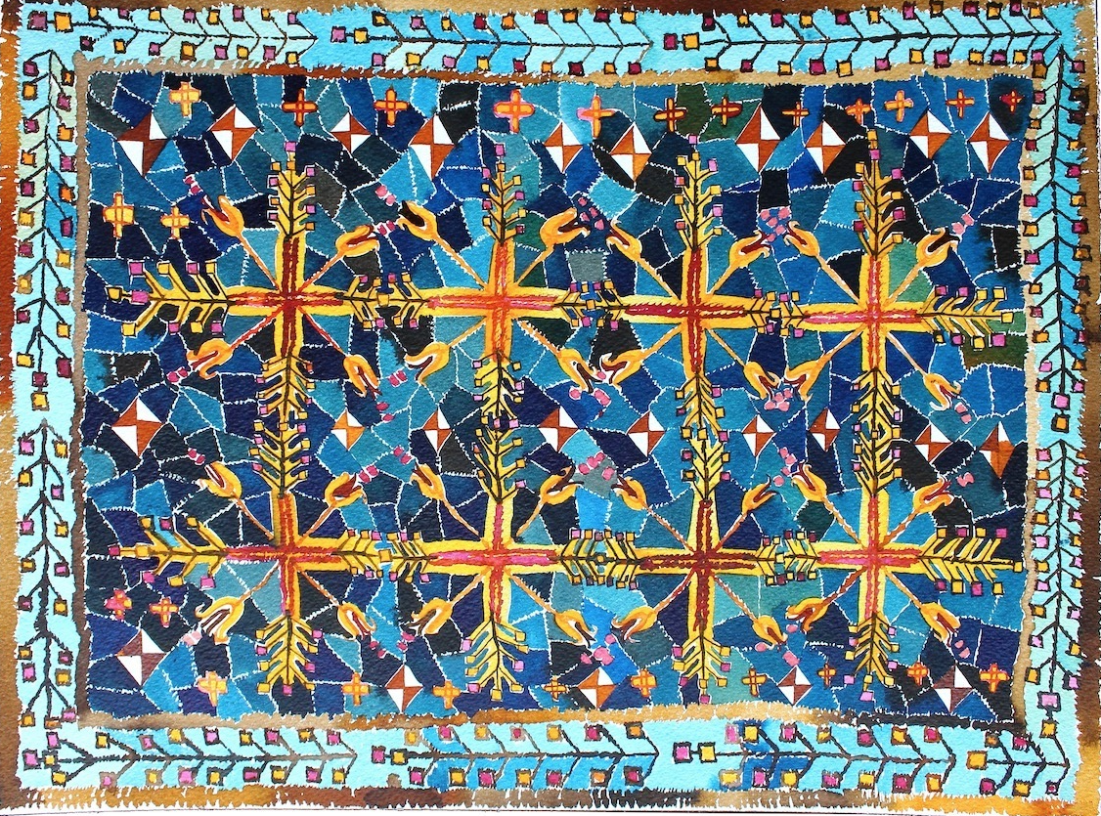

Slide 38
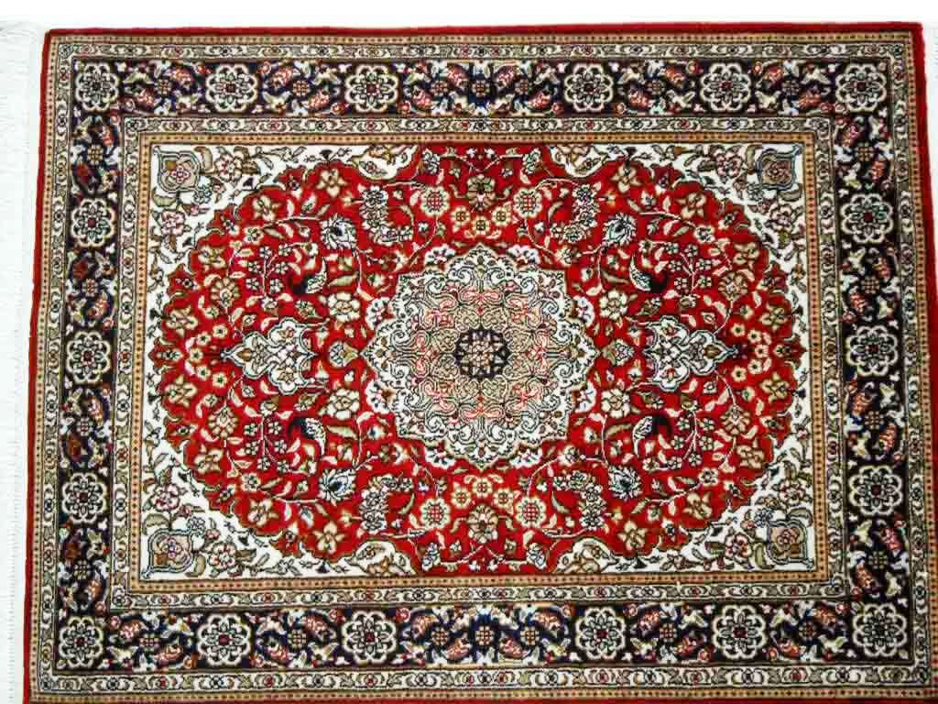

Slide 39
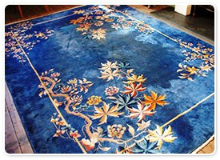

Slide 40
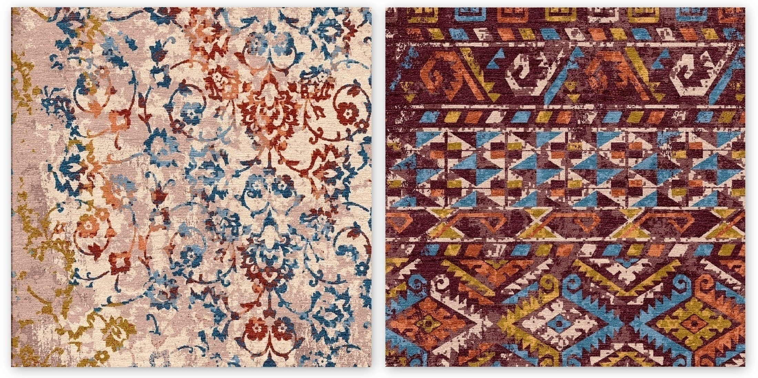

Slide 41
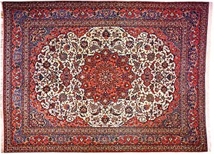

Slide 42
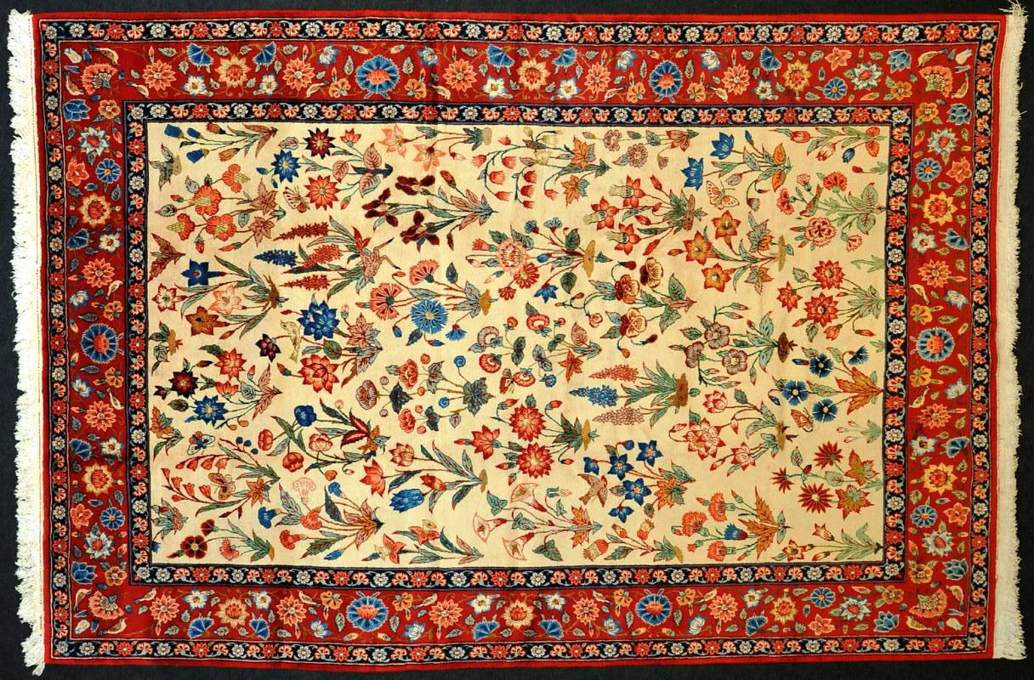

Slide 43
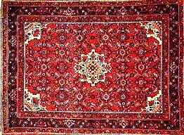

Slide 44
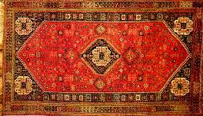

Slide 45
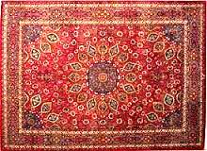

Slide 46
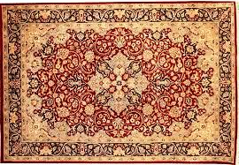

Slide 47
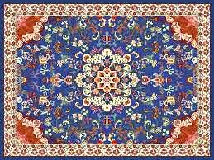

Slide 49
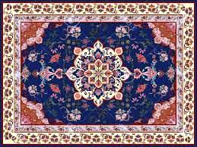

Slide 50
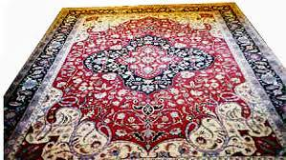

Slide 51
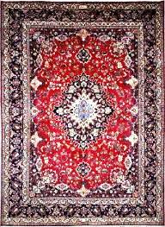
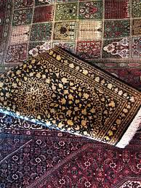

Slide 52



Slide 53



Slide 54



Slide 55



Slide 56



Slide 57



Slide 58



Slide 59


Slide 60


Slide 61



Slide 62



Slide 63



Slide 64



Slide 65



Slide 66



Slide 67



Slide 68



Slide 73


Slide 74


Slide 75


Slide 76


Slide 77


Slide 78


Slide 80


Slide 81


Slide 82


Slide 83


Slide 84


Slide 85


Slide 86


Slide 87


Slide 88


Slide 89


Slide 90


Slide 91


Slide 92


Slide 93


Slide 94


Slide 95


Slide 96


Slide 97


Slide 98


Slide 99


Slide 100


Slide 101


Slide 102


Slide 103


Slide 104


Slide 105


Slide 106


Slide 107


Slide 108


Slide 109


Slide 110


Slide 111


Slide 112


Slide 113


Slide 114


Slide 115


Slide 116


Slide 117


Slide 118


Slide 119


Slide 120


Slide 121


Slide 122


Slide 123


Slide 124


Slide 126


Slide 127


Slide 130


Slide 131
The end

