Slide 1
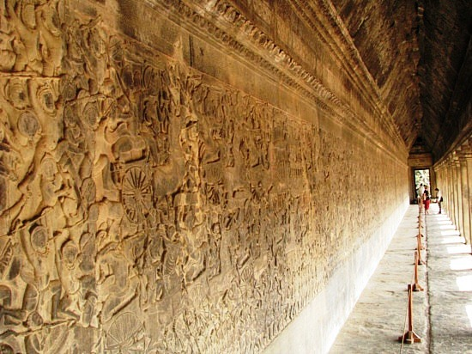
Bas relief of Angkor

Slide 2
Suryavarman II established Angkor in 1152 as a Vishnu temple.
The bas reliefs presented here are the best examples of history of the battle of Mahabharata etched in stone in the long gallery that surrounds the temple. It is interesting to note that the story of Mahabharata only exists in scriptures in India but King Suryavarman II preserved it in stone for eternity . It is noted in Mahabharata that the Khmer kings of the period sent a huge contingent of warriors to fight in the battle on the side of Pandavas who won the fight.

Slide 3
The Hindu empire of Khmer that established itself in Cambodia long before the Angkor complex was built in 1181 – 1219 period but Jayavarman II is known to have started the construction of various temple complexes in 802 to 850 . It is known that there were links between the Khmer kings and the Indian empire that existed 3000 years ago so it is not surprising that the Hindus spread throughout SE Asia and beyond that included Sri Lanka,Burma,Cambodia,Thailand and Indonesia .Later the spread of Buddhism in these parts supplanted the Hinduism including in India but Hinduism proved to be more resilient in India and Bali so the Buddhism was assimilated into it.

Slide 4
The magnificence and splendor of Angkor Wat complex that was engulfed in forest over a long period of time but re discovered has not diminished its place as the shining example of human achievement in the annals of history and rightfully deserves to be called a gem and a world heritage site.
No such monument to past glory preserved this way exists anywhere in the world including the motherland of Hinduism called India. Today there is a massive international effort to rebuild some temple complexes stone by stone but hundreds remain in ruins and completely overtaken by forest and planted with land mines by the Khmer Rouge regime

Slide 5
Editor’s note
It is not possible to show in its entirety the bas reliefs of Angkor so a few splendid examples are included here for your private viewing. Hope it will inspire you to someday visit Angkor in order to fully appreciate what a special place it really is.
AKC /December 2015

Slide 6
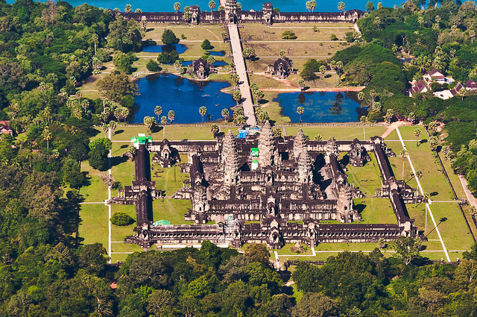

Slide 7
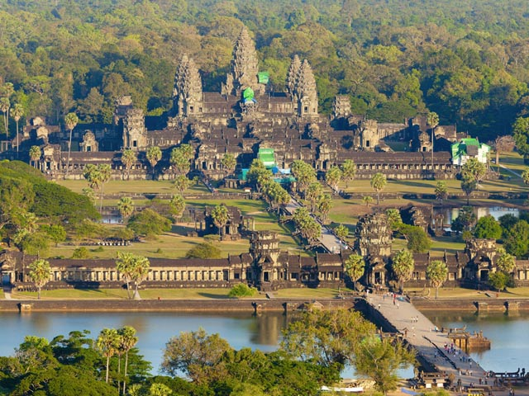

Slide 8
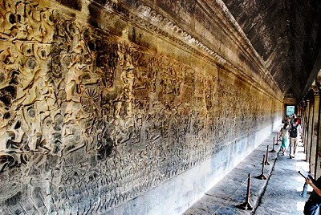

Slide 9
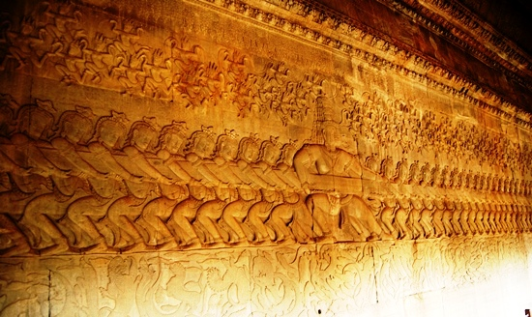

Slide 10
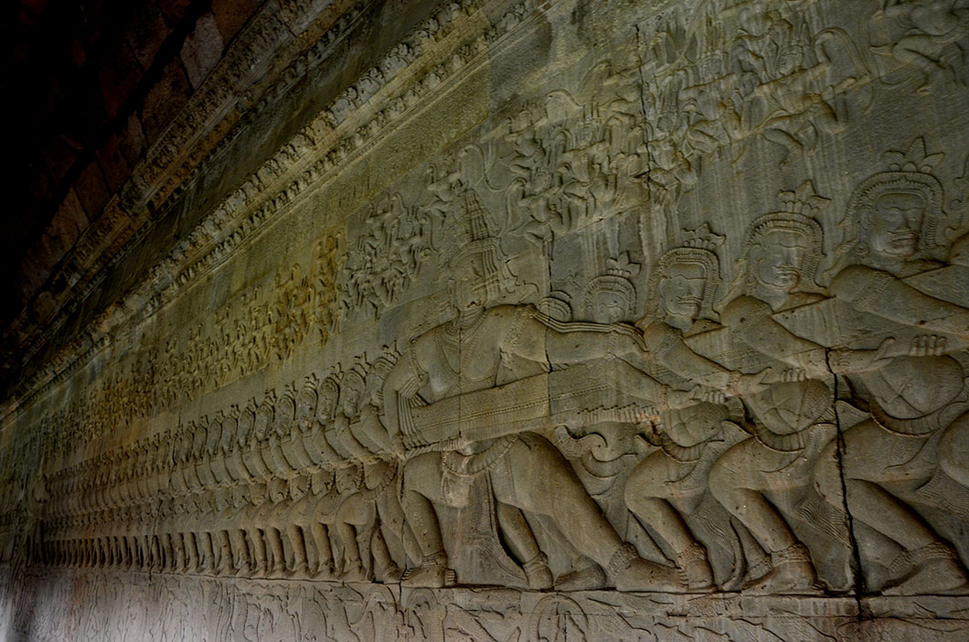

Slide 11
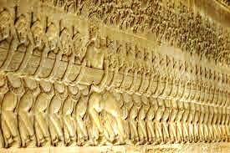

Slide 12
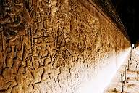

Slide 13
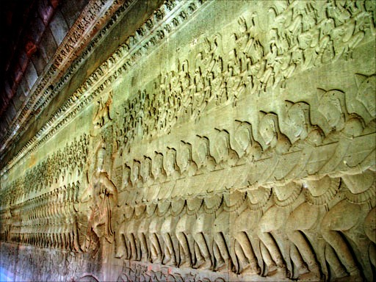

Slide 14
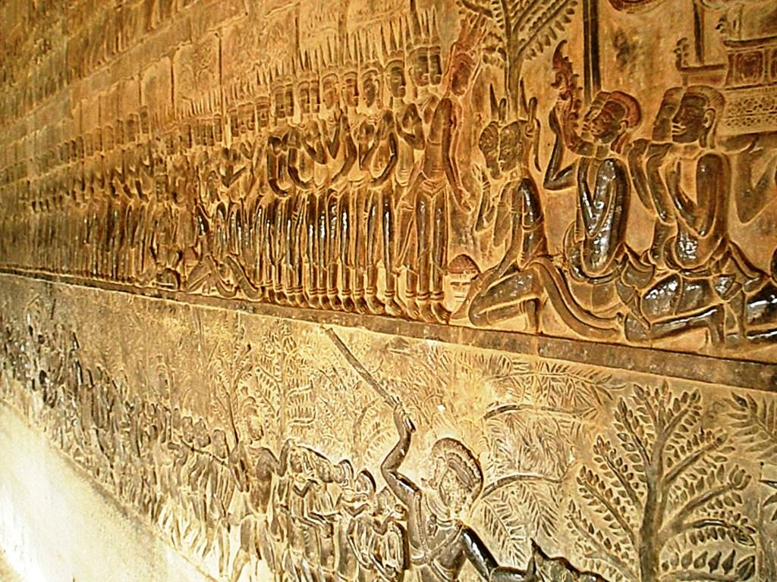

Slide 15
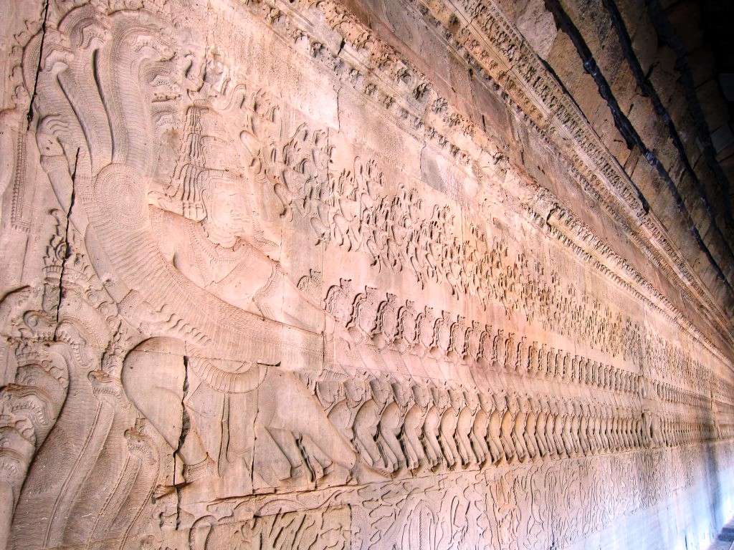

Slide 16
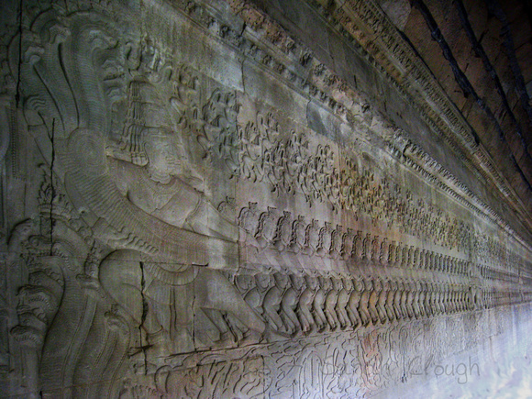

Slide 17
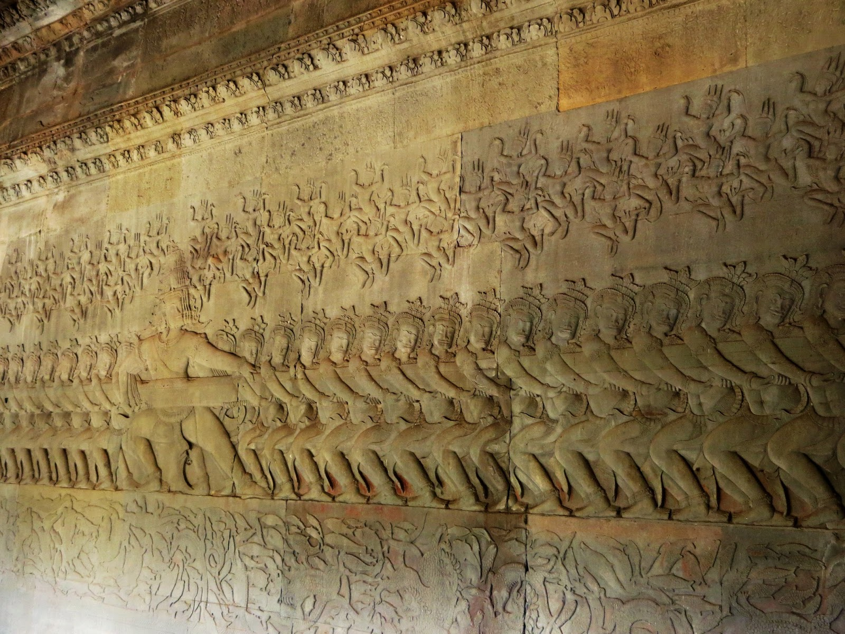

Slide 18
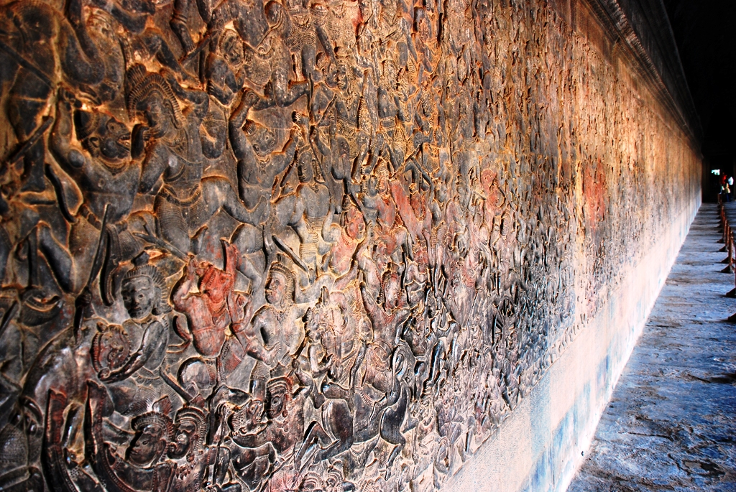

Slide 19
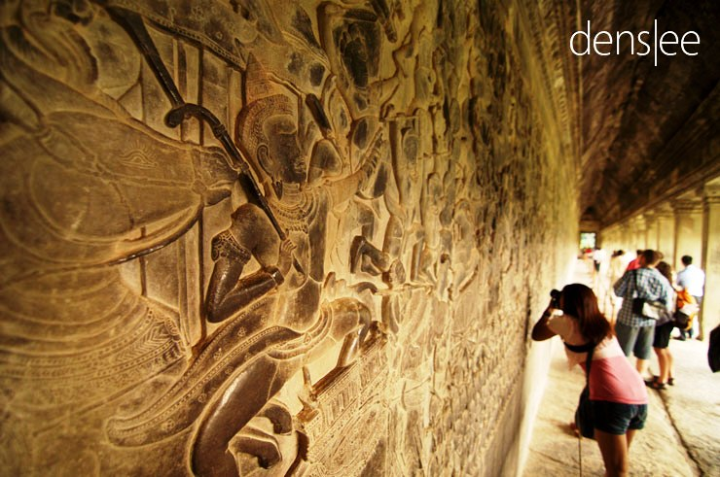

Slide 20
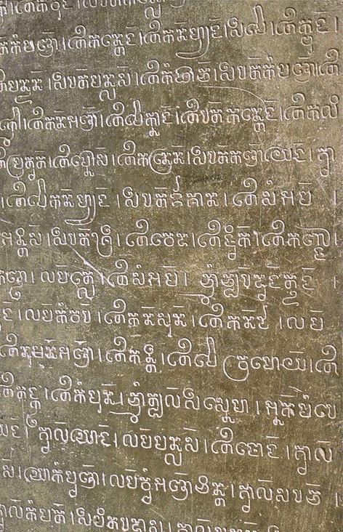

Slide 21
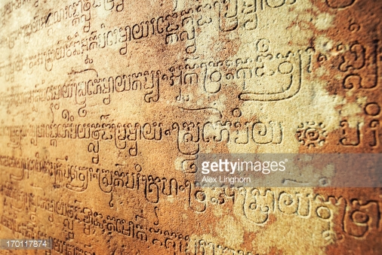

Slide 22
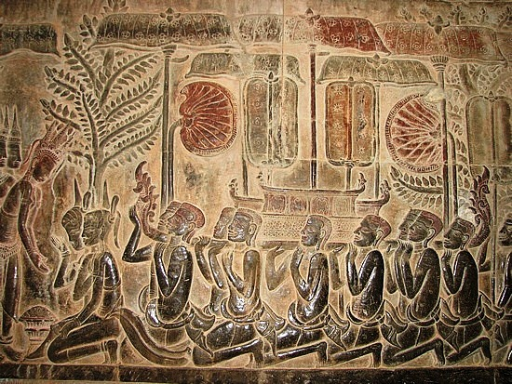

Slide 23
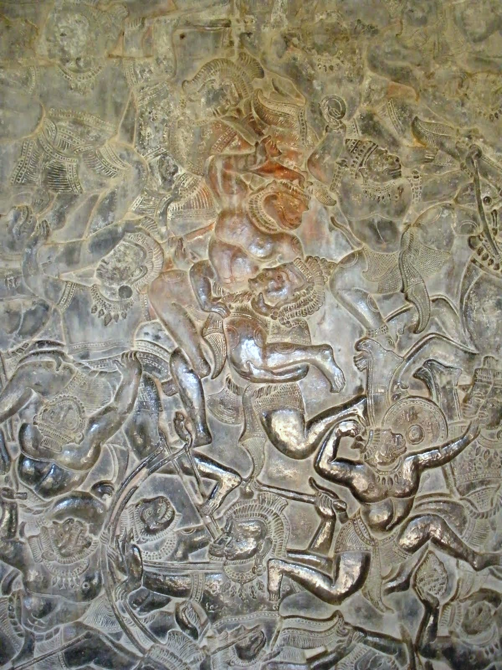

Slide 24
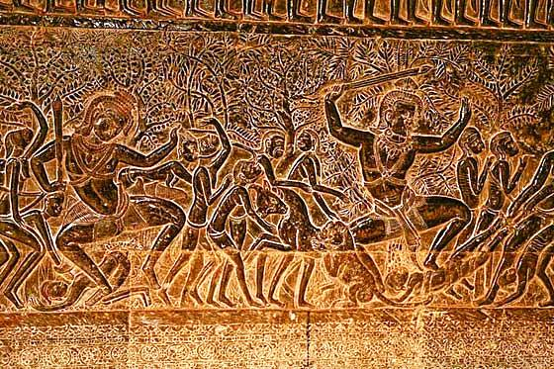

Slide 25
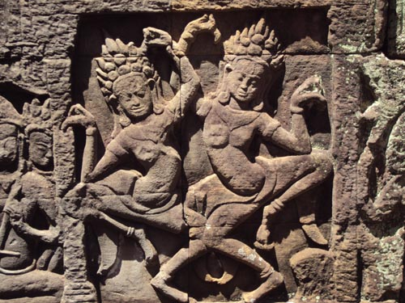

Slide 26
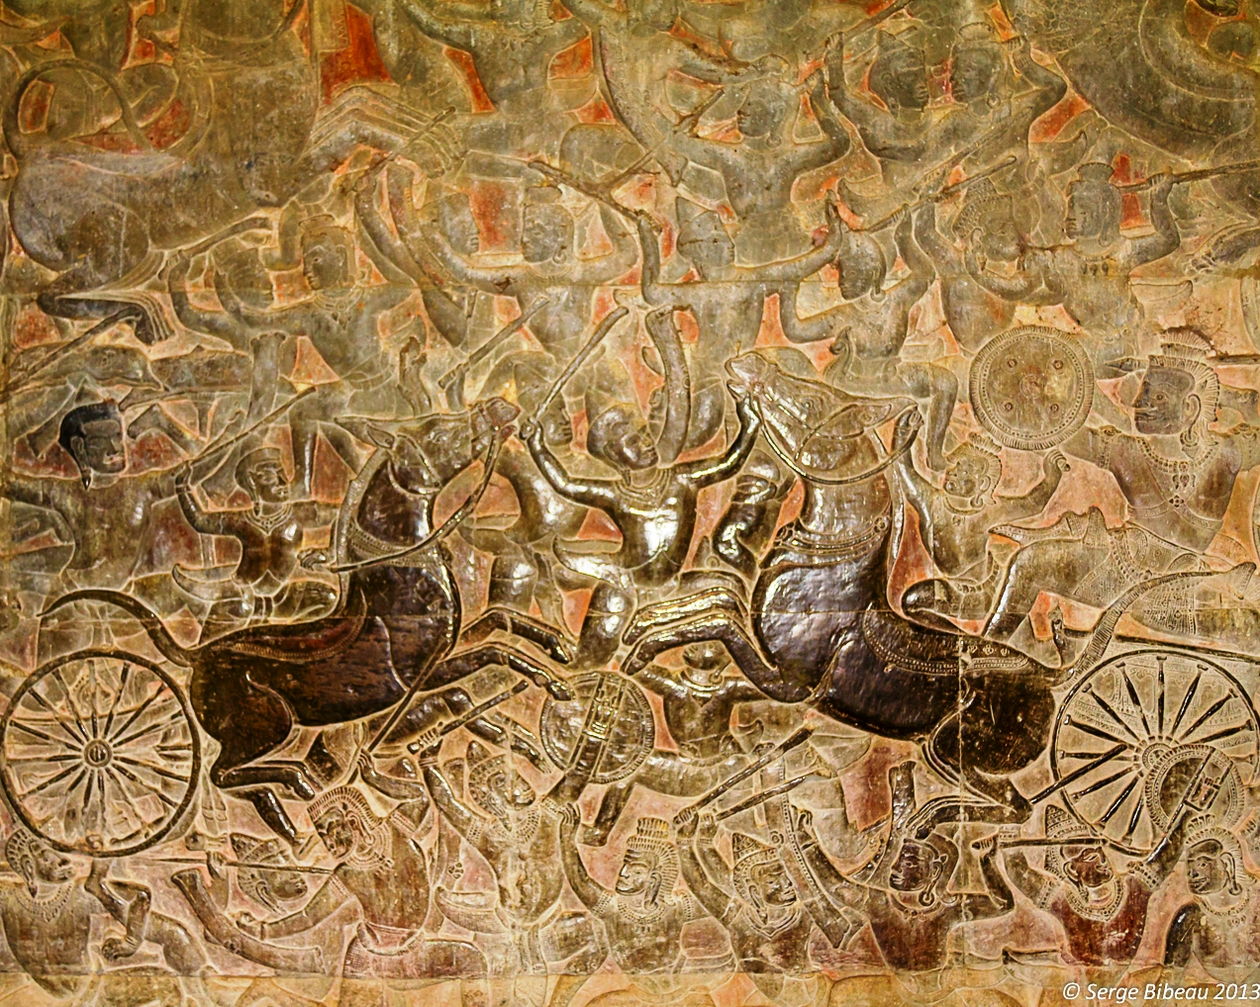

Slide 27
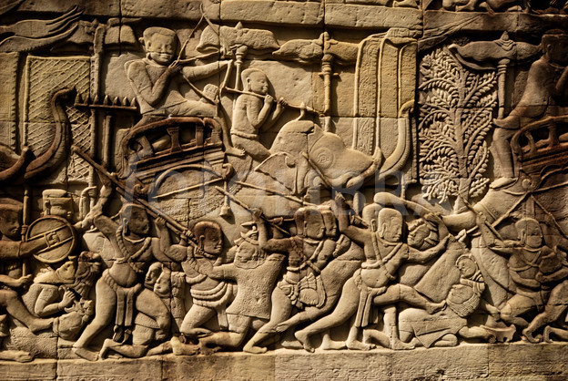

Slide 28
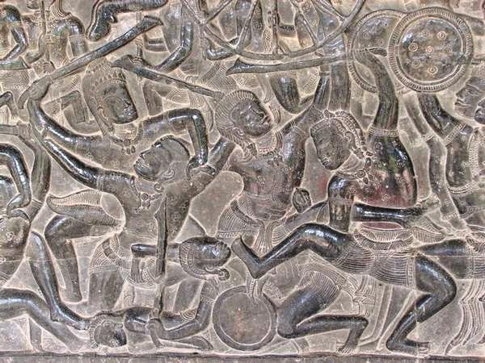

Slide 29
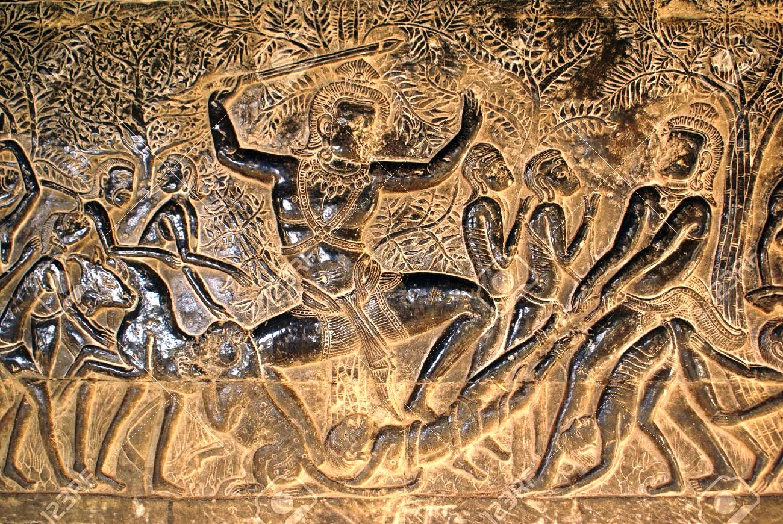

Slide 30
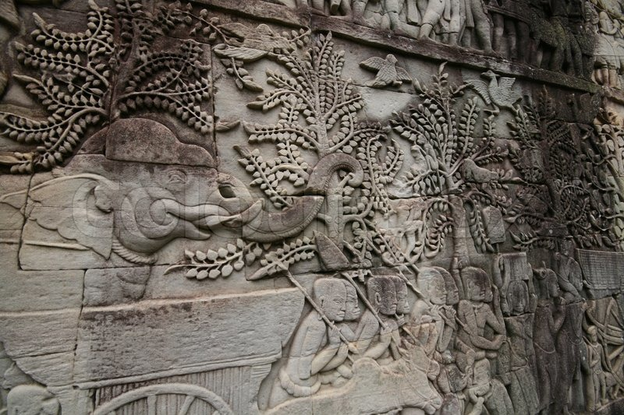

Slide 31
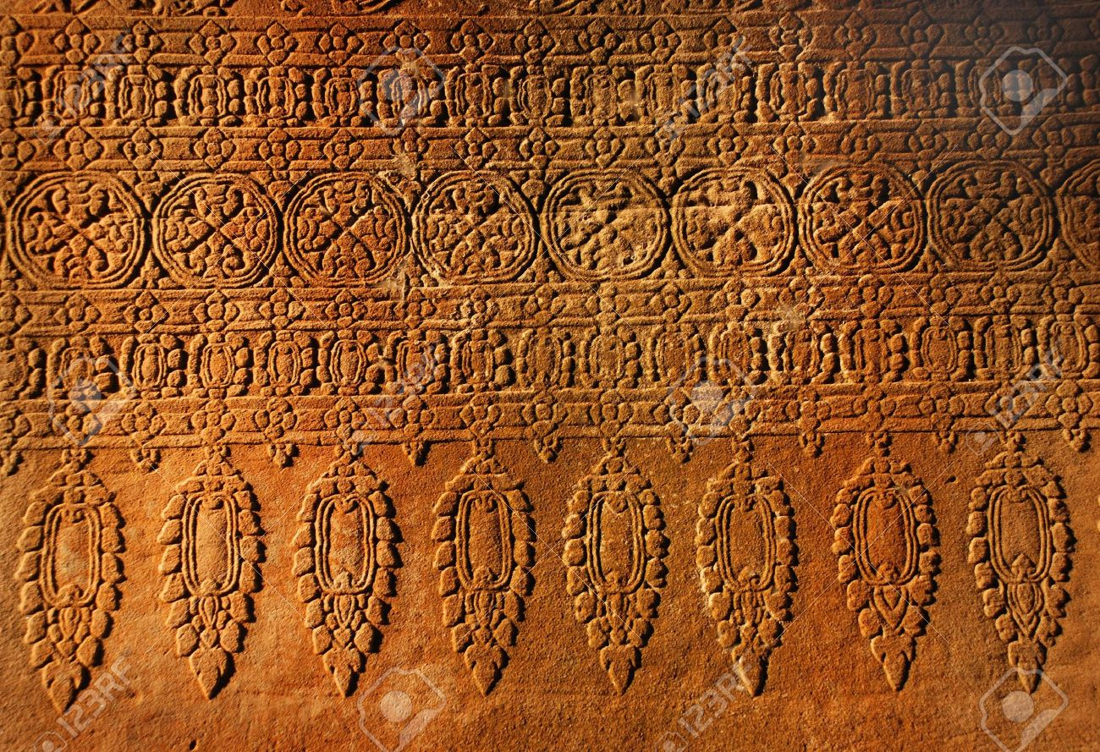

Slide 32
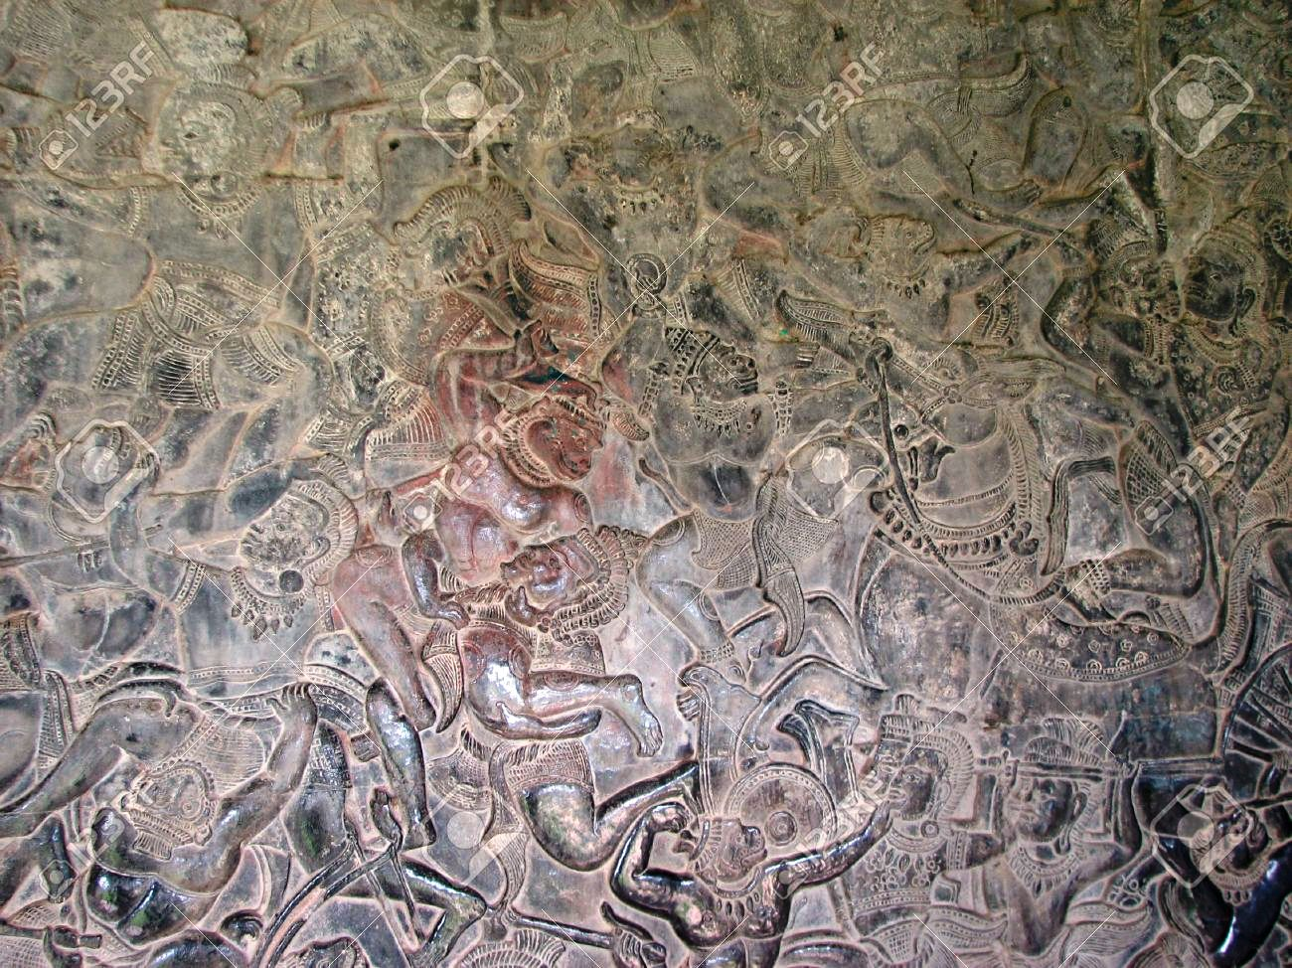

Slide 33
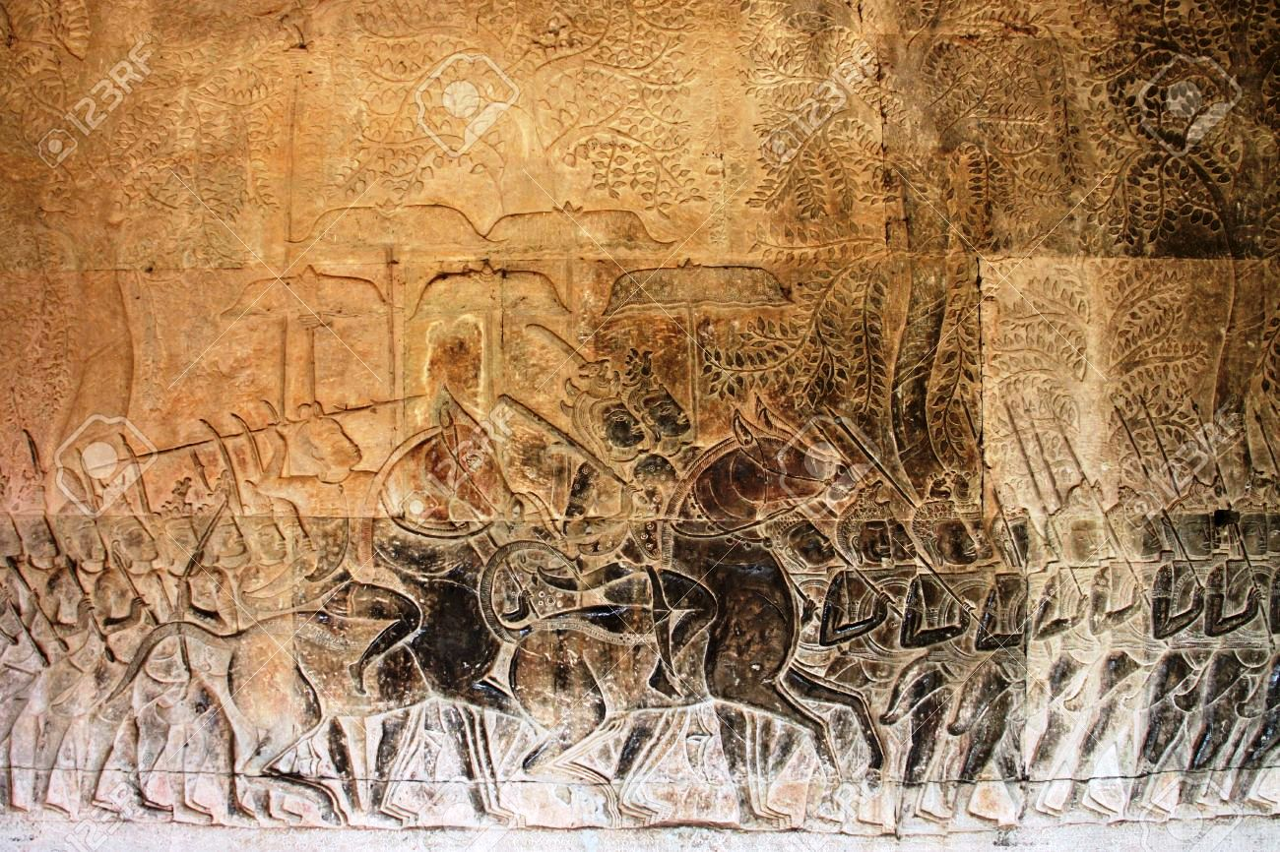

Slide 34
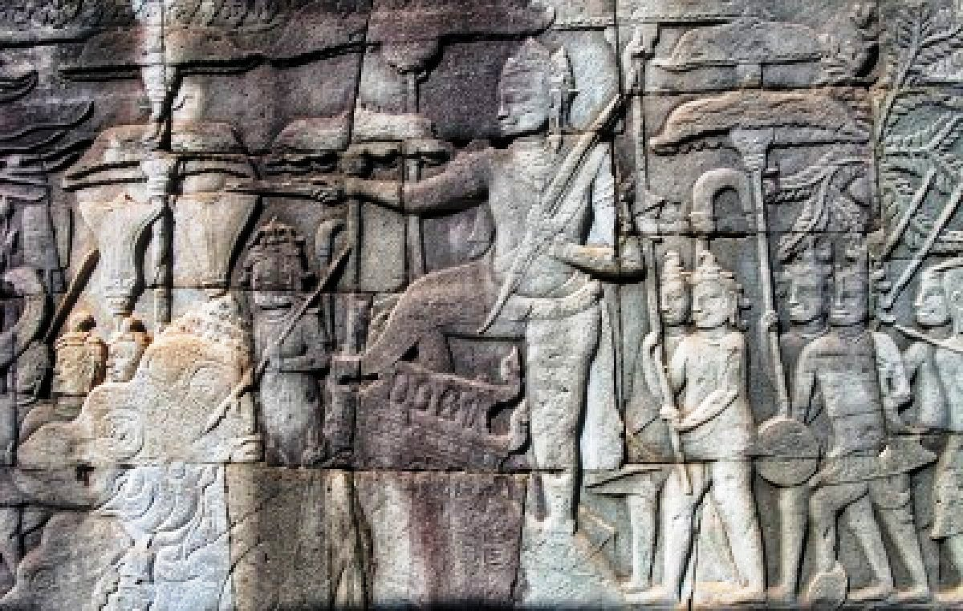

Slide 35
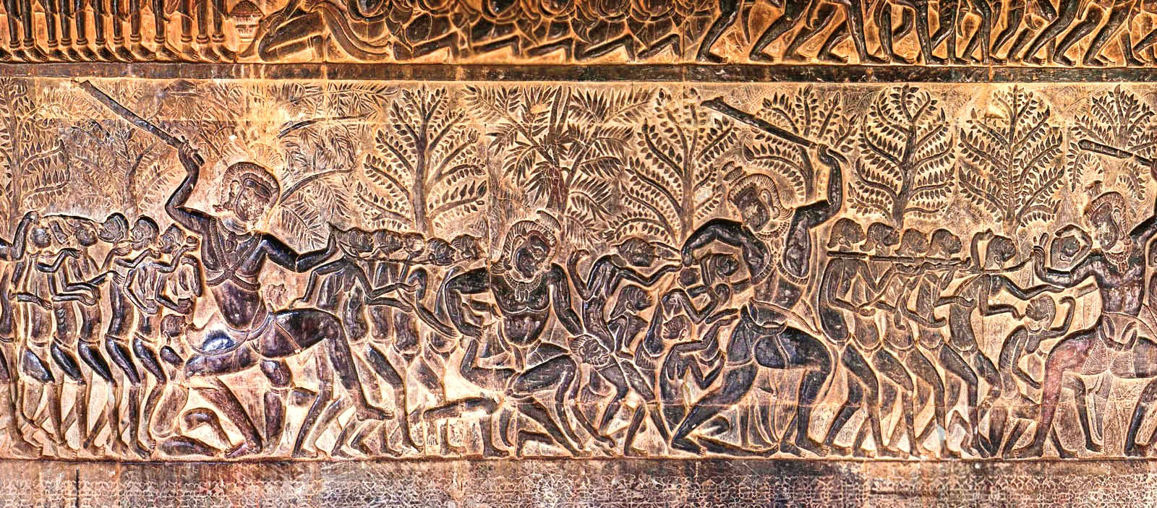

Slide 36
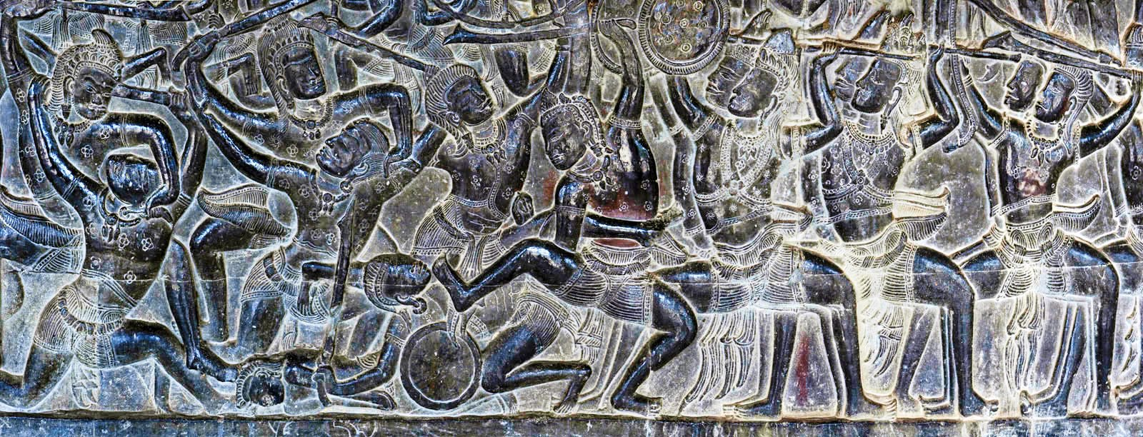

Slide 37
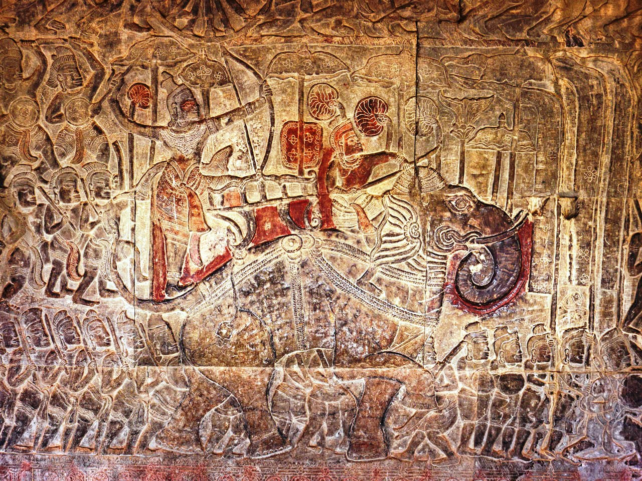

Slide 38
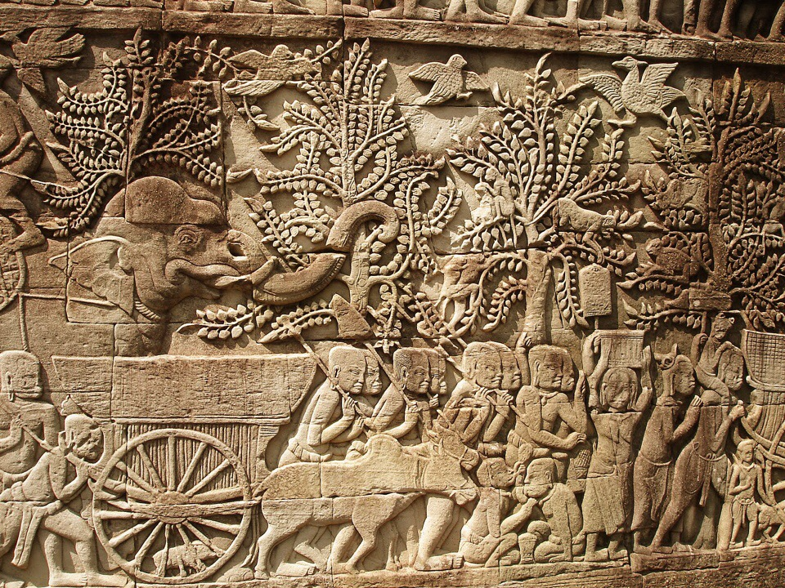

Slide 39
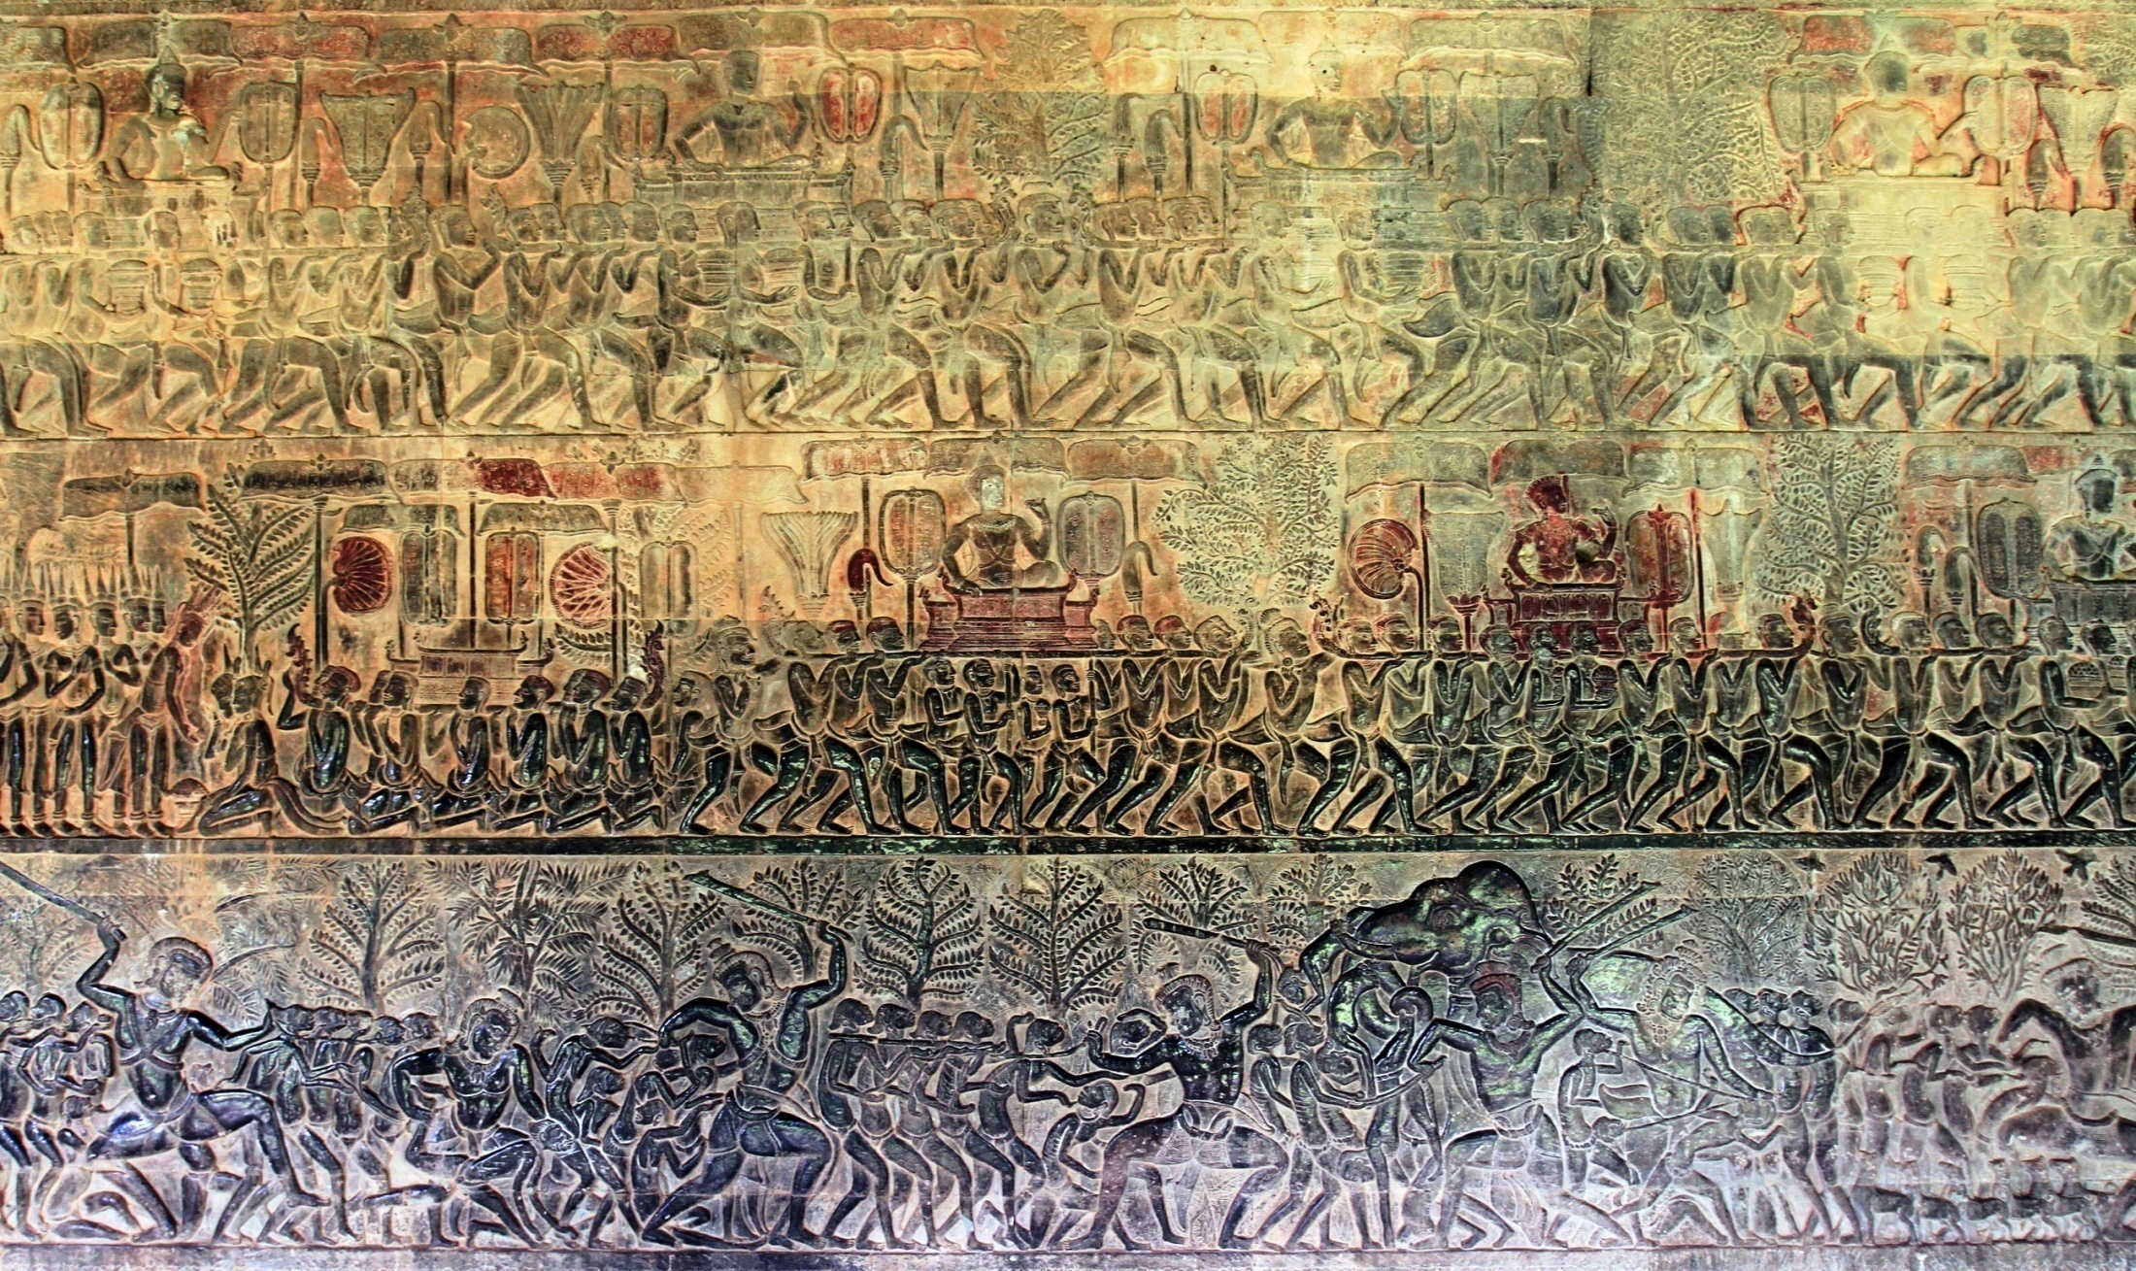

Slide 40
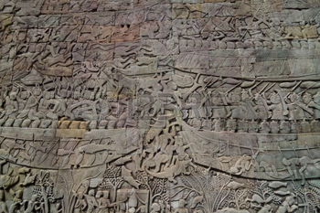

Slide 41
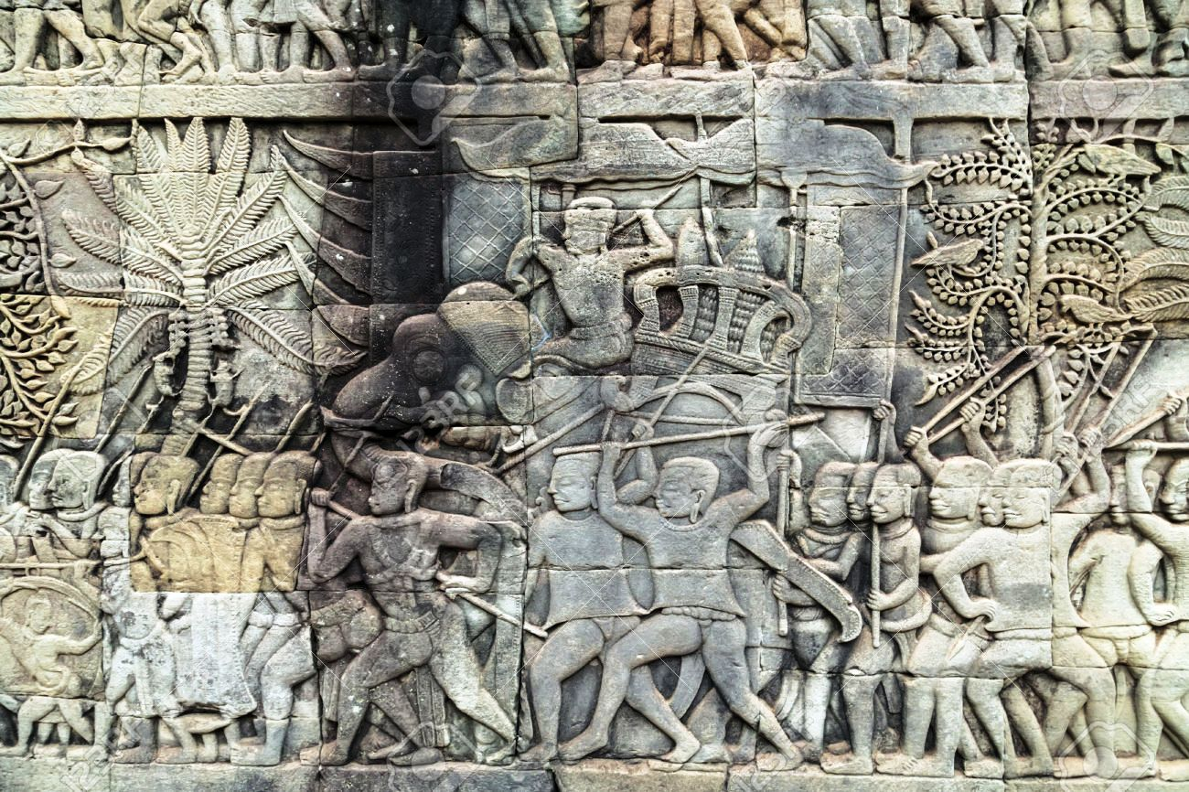

Slide 42
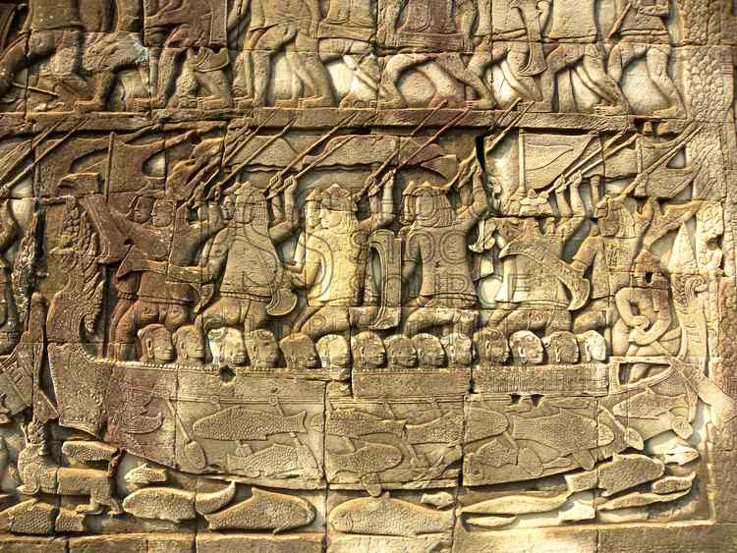

Slide 43
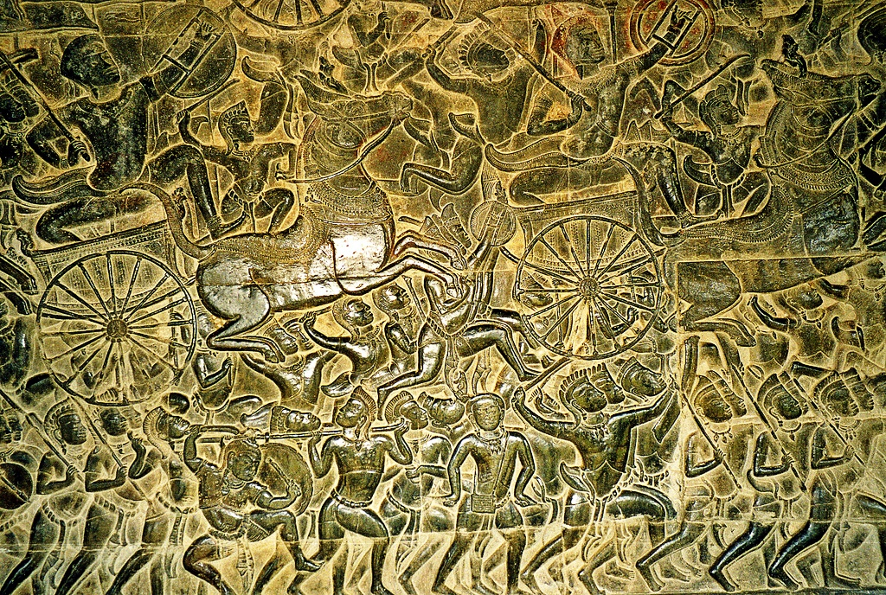

Slide 45
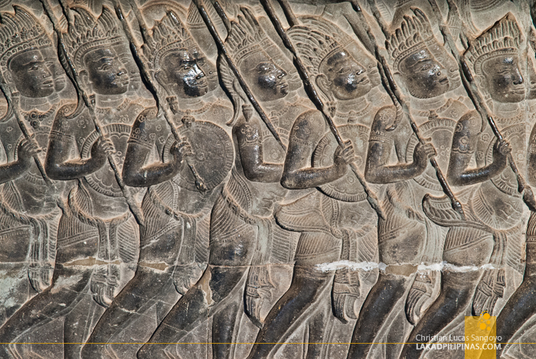

Slide 46
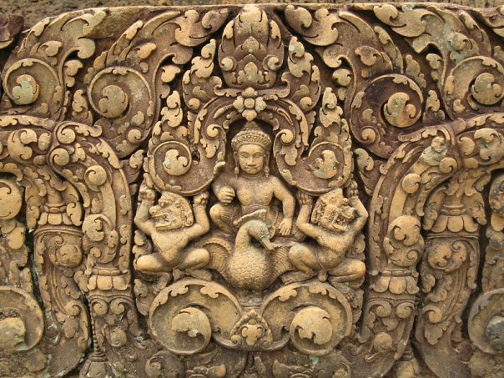

Slide 48
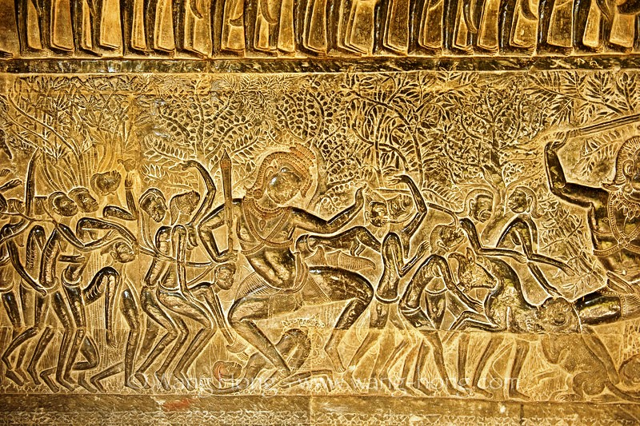

Slide 49
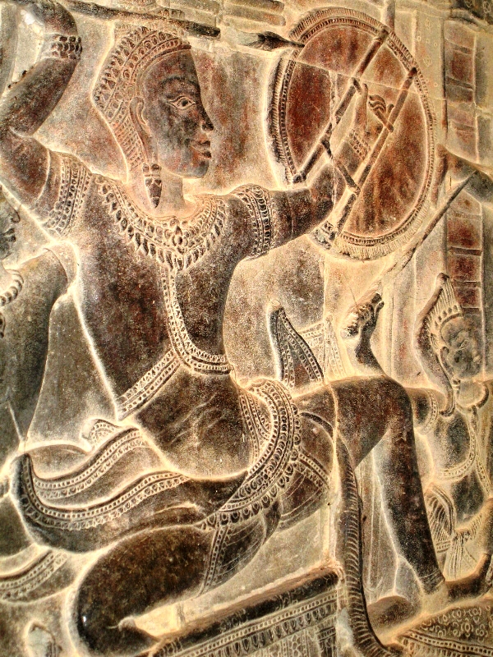

Slide 50
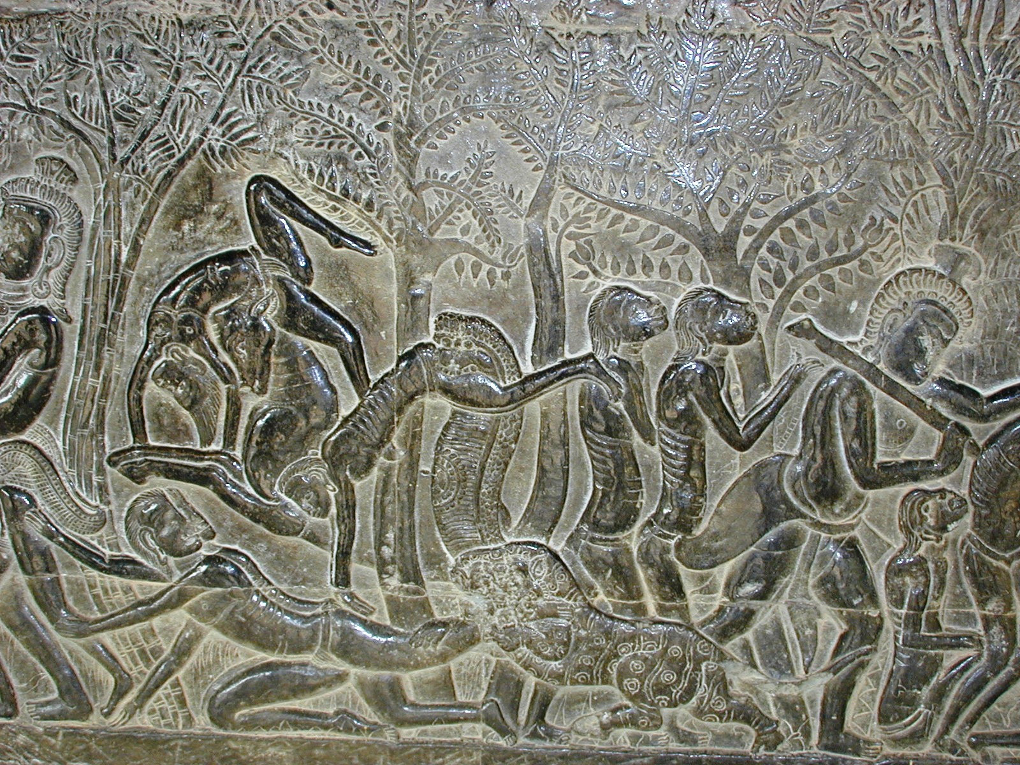

Slide 51
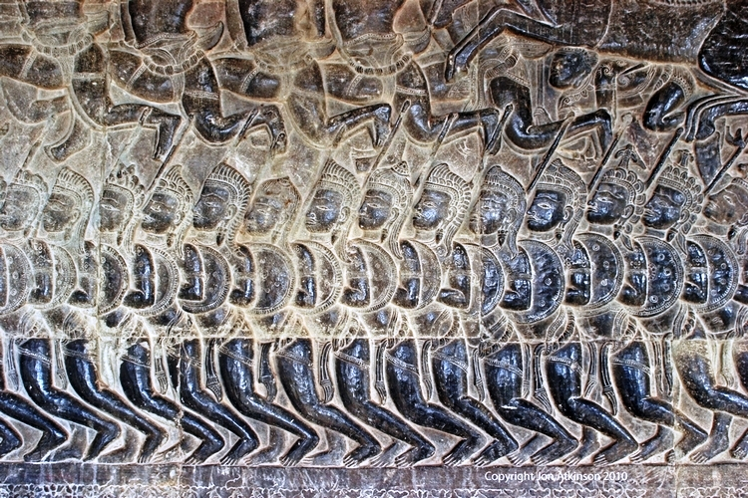

Slide 52
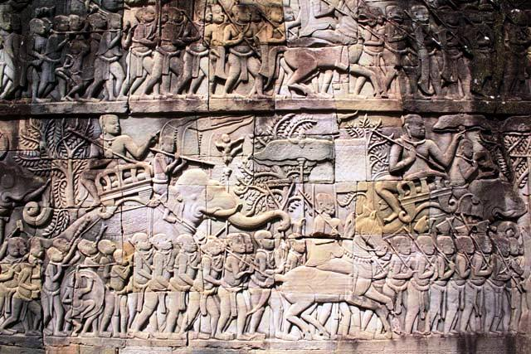

Slide 53
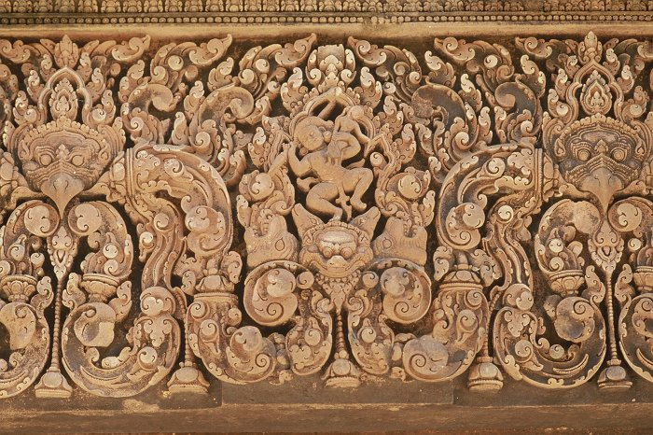

Slide 54
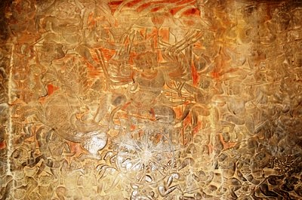

Slide 55
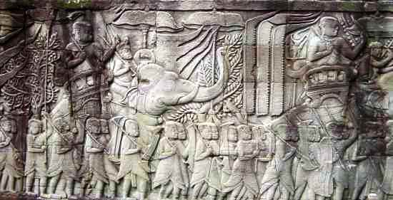

Slide 56
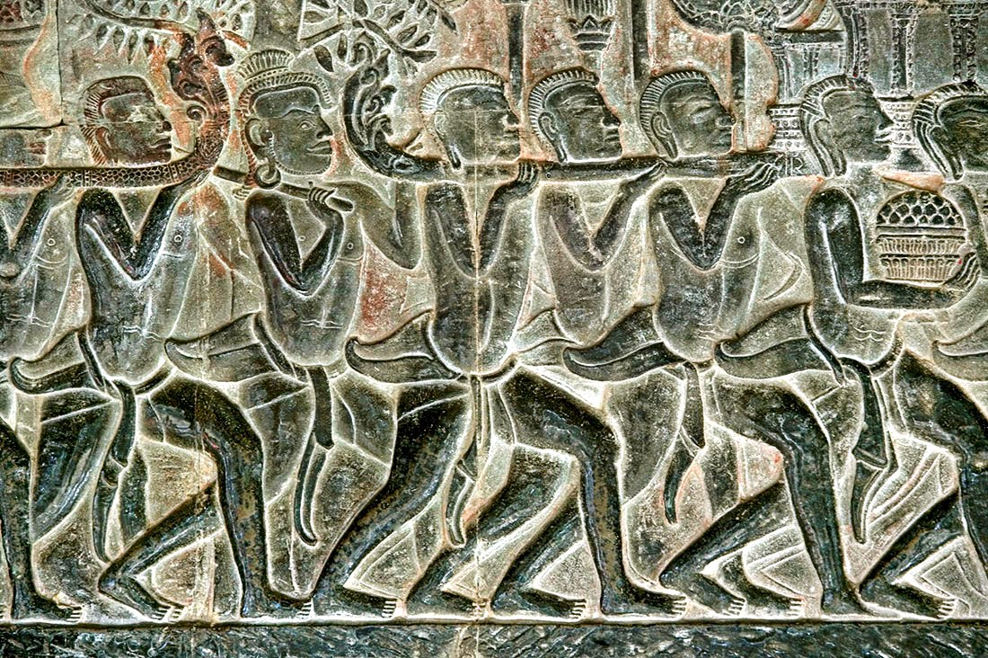

Slide 57


Slide 58


Slide 59


Slide 60


Slide 61


Slide 62


Slide 63


Slide 64


Slide 65


Slide 66


Slide 67


Slide 68


Slide 69


Slide 70


Slide 71


Slide 72


Slide 73

Apsaras or celestial nymphs are everywhere

Slide 74


Slide 75


Slide 76


Slide 77


Slide 78


Slide 79


Slide 80


Slide 81


Slide 82


Slide 83


Slide 84


Slide 85


Slide 86


Slide 87


Slide 88


Slide 89


Slide 90


Slide 91


Slide 92


Slide 93


Slide 94


Slide 95


Slide 96


Slide 97


Slide 98


Slide 99


Slide 100


Slide 101


Slide 102


Slide 103


Slide 104


Slide 105


Slide 107


Slide 108


Slide 109


Slide 110


Slide 111


Slide 112


Slide 113


Slide 114


Slide 115


Slide 116


Slide 117


Slide 118


Slide 119


Slide 120


Slide 121


Slide 122


Slide 123


Slide 124


Slide 125


Slide 126


Slide 127


Slide 128


Slide 129


Slide 130


Slide 131


Slide 132


Slide 133


Slide 134


Slide 135


Slide 137


Slide 138


Slide 139


Slide 140


Slide 142


Slide 143


Slide 144


Slide 145


Slide 146


Slide 147


Slide 148


Slide 149


Slide 150


Slide 151


Slide 152


Slide 153


Slide 154


Slide 155


Slide 156


Slide 157


Slide 158


Slide 159


Slide 160


Slide 161


Slide 162


Slide 163


Slide 164
It should be noted that the craftsmen and artists who built and decorated the Angkor Wat with bas relief to immortalize the story of Mahabharata did so with the help of the script only although it is not improbable that Hindu priests or learned people from India lent a helping hand in the depiction of the story on the walls of the gallery and keep it true . However, the style of the bas relief is uniquely Khmer of which they are justly proud.

