Slide 1
Art and craft of Bengal
The unique art and craft of Bengal that have made a place in the heritage of India are presented here in only a shortened form to high light the variety and diversity. The paintings, leather craft, kantha embroidery, masks, dolls , metal craft, potteries, ceramics etc. are presented for your pleasure only.
AKC/November 2015

Slide 2
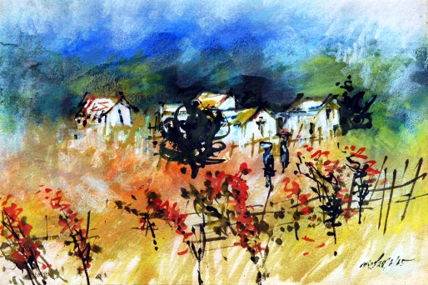
The prominent artists of Bengal
Artists like Jamini Roy, Abanindranath Thakur, Gopal Ghosh, Sukanta Das, Basudeb Pal Majumdar , Falguni Das Gupta , Kamalakhsha Ganguly , Haldar etc. are presented here but there are many others who deserve praise.

Slide 3
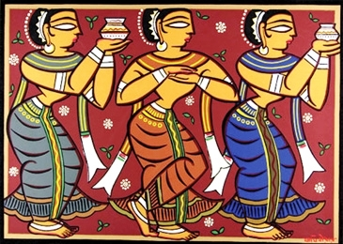
Jamini Roy

Slide 4
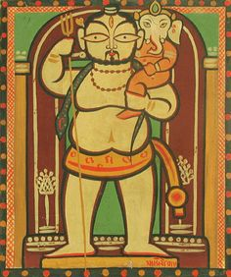

Slide 5
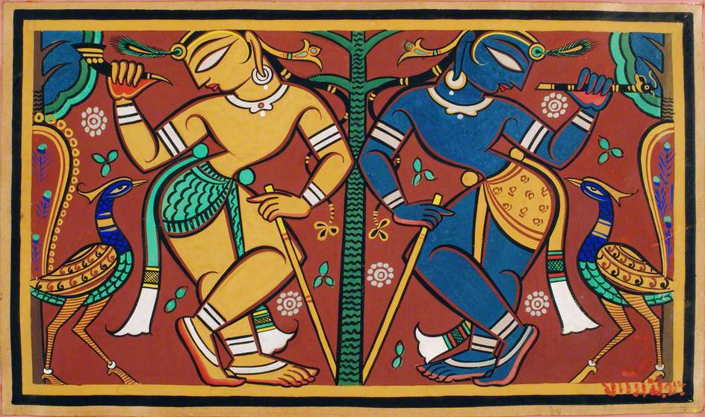

Slide 6
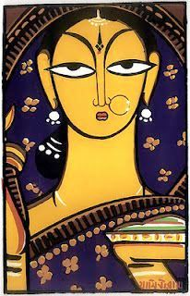

Slide 7
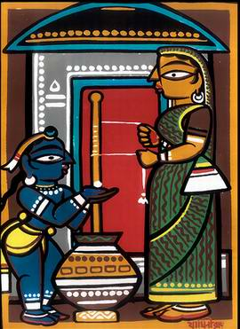

Slide 8
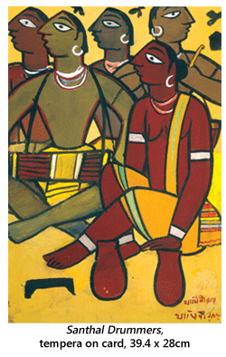

Slide 9
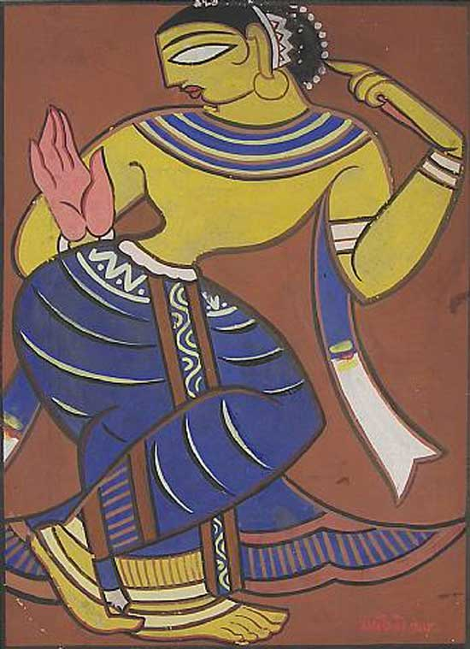

Slide 10
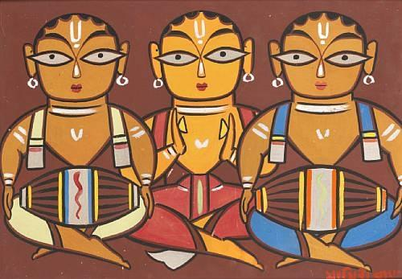

Slide 12
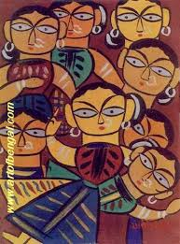

Slide 13
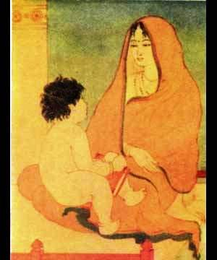
Abanindranath Thakur

Slide 14
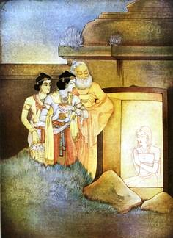

Slide 15
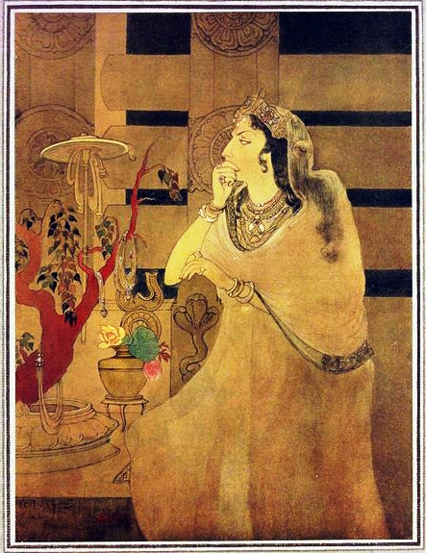

Slide 16
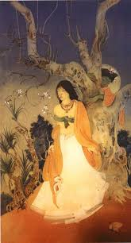

Slide 17
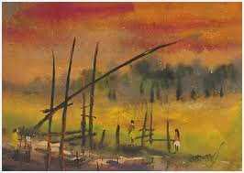

Slide 18
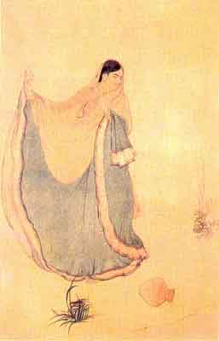

Slide 19
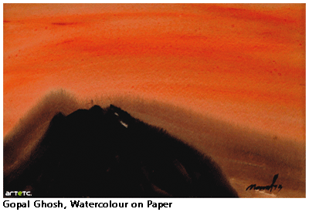

Slide 20
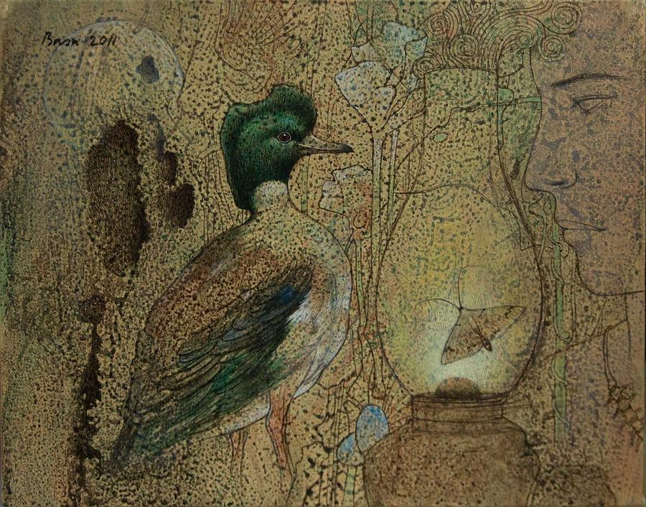
Basudeb Pal Majumdar

Slide 21
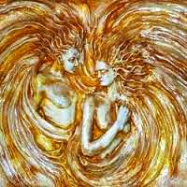

Slide 22
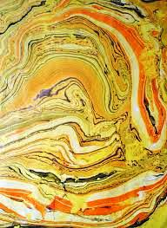

Slide 23
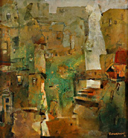

Slide 24
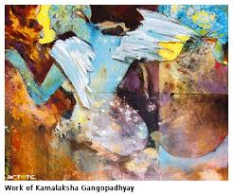

Slide 25
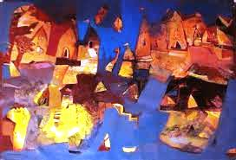

Slide 26
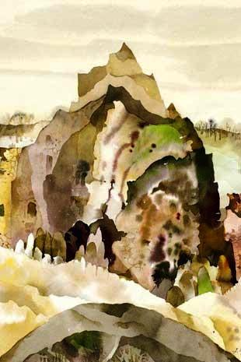

Slide 28
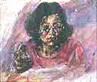

Slide 29
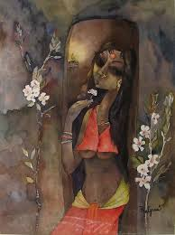

Slide 30
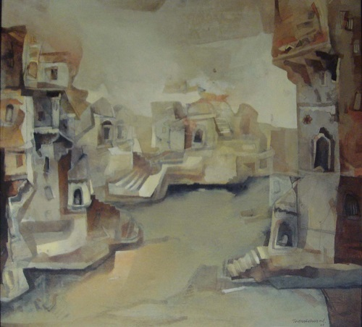
Tapas Ghosal

Slide 31
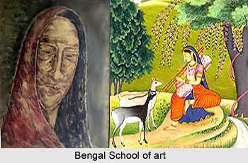

Slide 32
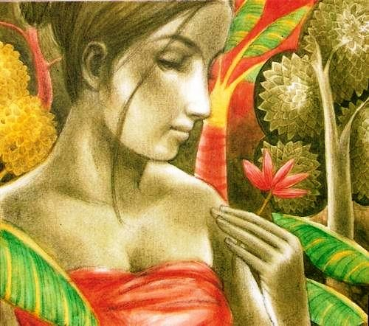
Sukanta Das

Slide 33
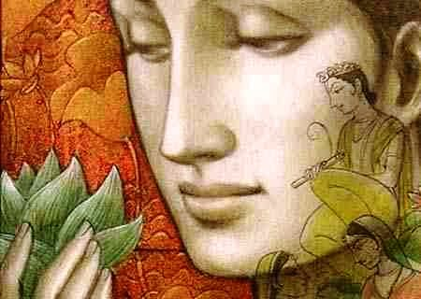

Slide 34
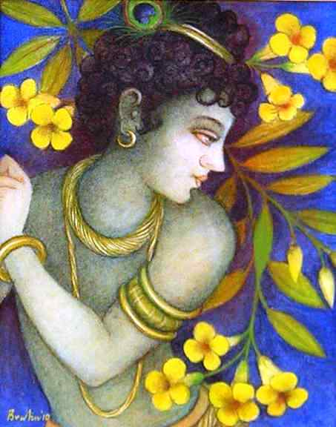

Slide 35
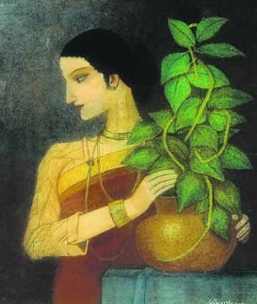

Slide 36
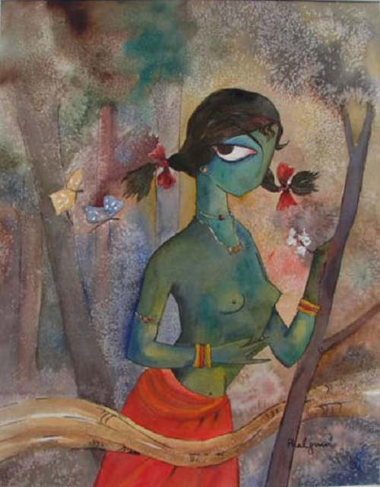
Falguni Das Gupta

Slide 37
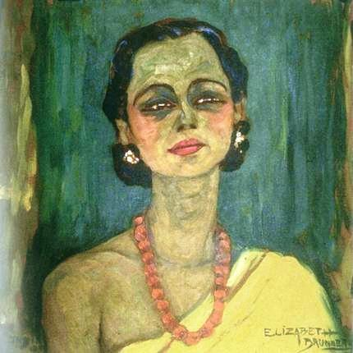
Elizabeth Brunner

Slide 38
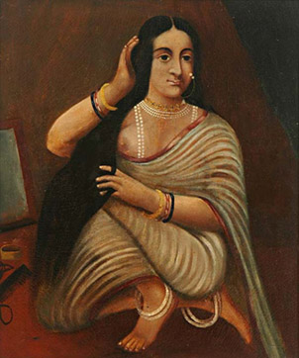
Old school

Slide 39
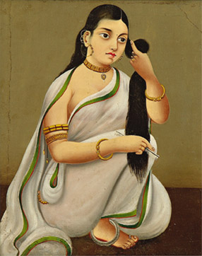

Slide 40
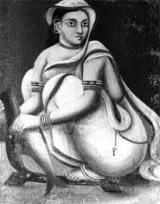

Slide 41
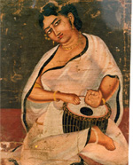

Slide 42
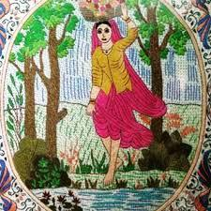

Slide 43
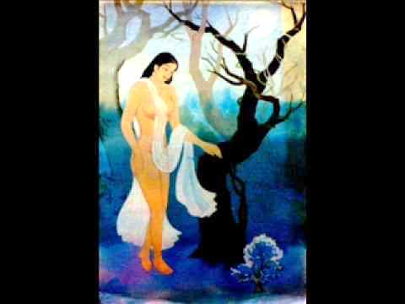

Slide 44
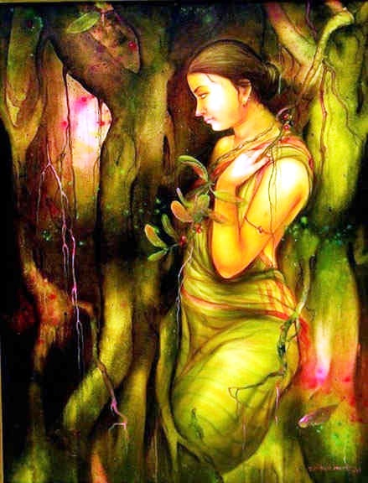

Slide 45
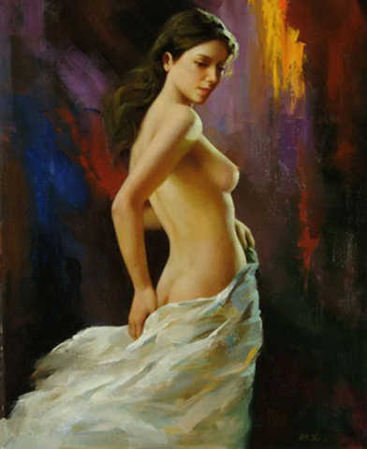

Slide 46
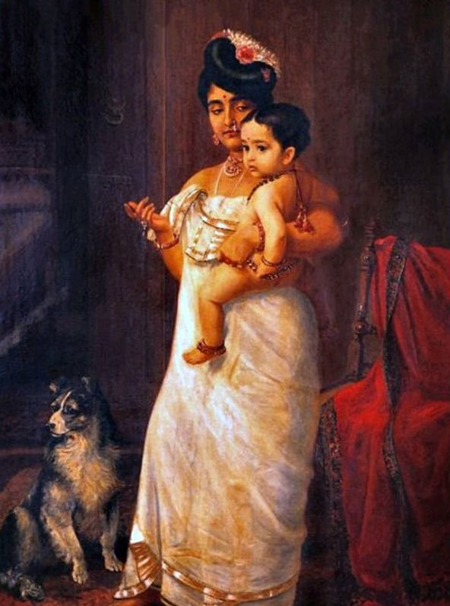

Slide 47
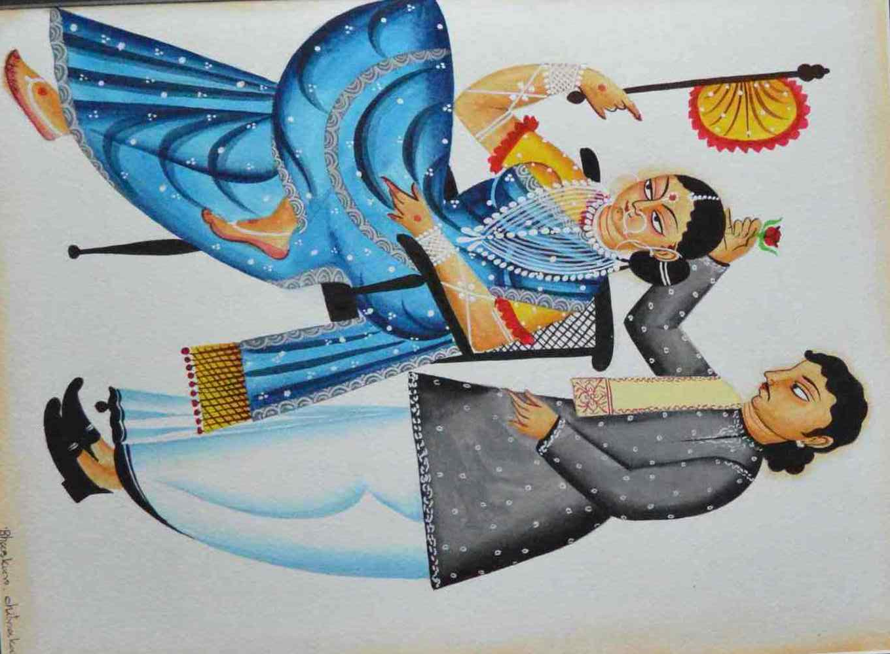

Slide 48
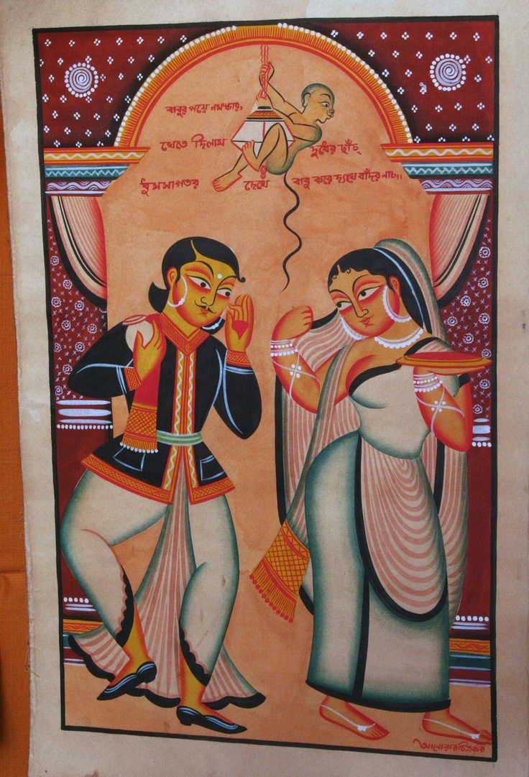

Slide 49
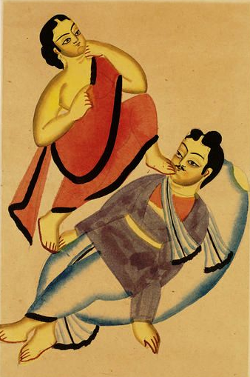

Slide 50
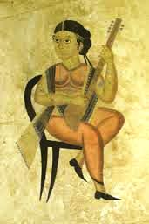

Slide 51
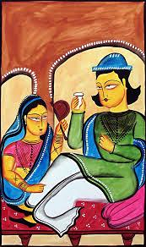

Slide 52
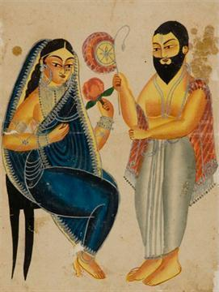

Slide 53
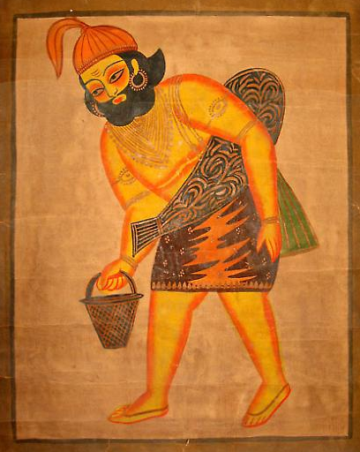
Kalighat painting

Slide 54


Slide 55


Slide 56


Slide 57

Patua tribal art

Slide 58


Slide 59


Slide 60


Slide 61


Slide 62


Slide 63


Slide 64


Slide 65


Slide 66


Slide 67


Slide 68


Slide 69


Slide 70


Slide 71


Slide 72


Slide 73


Slide 74


Slide 75


Slide 76


Slide 77


Slide 78


Slide 79


Slide 80


Slide 81


Slide 82


Slide 83


Slide 84


Slide 85


Slide 86


Slide 87


Slide 88


Slide 89


Slide 90


Slide 91


Slide 92


Slide 93


Slide 94
Shantiniketan leather craft

Slide 95


Slide 96


Slide 97


Slide 98


Slide 99


Slide 100


Slide 101


Slide 102


Slide 103

Batik

Slide 104


Slide 105


Slide 106


Slide 107


Slide 108


Slide 109


Slide 110


Slide 111


Slide 112


Slide 113


Slide 114


Slide 117
Kantha embroidery
Kantha is a traditional cotton quilt/wrap which the village women embroider. No two are alike and its unique character has tremendous variations.

Slide 118


Slide 119

Kantha embroidery

Slide 120


Slide 121


Slide 122


Slide 123


Slide 124


Slide 125


Slide 126


Slide 127


Slide 129


Slide 130


Slide 131


Slide 132


Slide 133


Slide 134


Slide 135


Slide 136


Slide 137


Slide 138


Slide 139


Slide 140


Slide 141


Slide 142


Slide 143


Slide 144


Slide 145


Slide 146


Slide 147


Slide 148


Slide 149


Slide 150
Dolls

Slide 151


Slide 152


Slide 153


Slide 155


Slide 156


Slide 157


Slide 158


Slide 159


Slide 160


Slide 161


Slide 162


Slide 163


Slide 164


Slide 165


Slide 166


Slide 167


Slide 168


Slide 169


Slide 170
Pottery , clay figurines and terra cota art

Slide 171


Slide 172


Slide 173


Slide 174


Slide 175


Slide 176


Slide 177


Slide 178


Slide 179


Slide 180


Slide 181


Slide 182


Slide 183


Slide 184


Slide 185


Slide 186


Slide 187


Slide 188


Slide 189


Slide 190


Slide 191


Slide 192


Slide 193


Slide 194


Slide 195


Slide 196


Slide 197


Slide 198


Slide 199


Slide 200


Slide 201


Slide 202


Slide 203

Terracota arches

Slide 204


Slide 205


Slide 206


Slide 207


Slide 208


Slide 209


Slide 210


Slide 211


Slide 212


Slide 213


Slide 214


Slide 215


Slide 216


Slide 217


Slide 218


Slide 219


Slide 220


Slide 221


Slide 222


Slide 223


Slide 224


Slide 225


Slide 226


Slide 227


Slide 228


Slide 229


Slide 230


Slide 231


Slide 232

Masks and metal craft

Slide 233


Slide 234


Slide 236


Slide 237


Slide 238


Slide 239


Slide 240


Slide 241


Slide 242


Slide 243

Mask

Slide 244


Slide 245

Metal craft

Slide 246


Slide 247


Slide 248


Slide 249


Slide 250


Slide 251


Slide 252


Slide 253


Slide 254


Slide 255

Bamboo craft

Slide 256


Slide 257


Slide 258

Silk printing

Slide 259

Haldi saree

Slide 260


Slide 261


Slide 263

Malkha swirl saree

Slide 264

Mehendi saree

Slide 265


Slide 266


Slide 267

Shalwar kurta

Slide 268

Gold bracelet

Slide 269


Slide 270

Gold ornament

Slide 271

Ornaments

Slide 272

Powder rice painting

Slide 273


Slide 274

Scroll painting

Slide 275


Slide 276


Slide 277


Slide 278


Slide 279


Slide 280


Slide 281


Slide 282


Slide 283


Slide 284

Wall art

Slide 285

Wall art

Slide 286

Panel art

Slide 287

Ceiling decorations

Slide 288


Slide 289

Tribal design

Slide 290

Tree painting

Slide 291


Slide 292

Sea shell art

Slide 293

Conch

Slide 294


Slide 295


Slide 296


Slide 297

Bengali food

Slide 298


Slide 299


Slide 300


