Slide 1

Angkor Wat
https://www.youtube.com/watch?v=IxCOrfS_NY0
A world heritage site

Slide 2
Editor’s note
This is the most complete power point on Angkor Wat and other temples in Siem Reap . It is worth mention that Angkor Wat is the only religious shrine where the complete story of Mahabharata is shown in bas relief that was the subject of a separate power point. In India where the Mahabharata battle took place thousands of years ago has no such monument or archeological site.
Angkor Wat shows light on a glittering past civilization called Khmer like no other and leaves a lasting impression on anyone visiting. Hope it will encourage you to visit some day.
AKC/December 2015

Slide 3
Angkor Wat is the largest religious complex in the world and was constructed in the early 12th century by King Suryavarman II
https://www.youtube.com/watch?v=IxCOrfS_NY0
From Yasovarman to the 12th century,Angkor developed as the most significant religious,military and social civilization covering Cambodia,part of Vietnam,China and accross Bay of Bengal as the Khmer empire that lasted over 6 centuries. It was king Jayavarman II who was declared universal king of Khmer in 8th or early 9th century. His son Indravarman built the complex irrigation system that sustained Angkor. His son Yasovarman chose Angkor as his capital and built Phnom Bakheng and Lolei temple complexes. Originally Hindu ,Angkor became Theravada Buddhist in 14-15th century. Although rediscovered by French expedition led by Henri Mouhot in 1860, Angkor Wat was never abandoned.

Slide 4
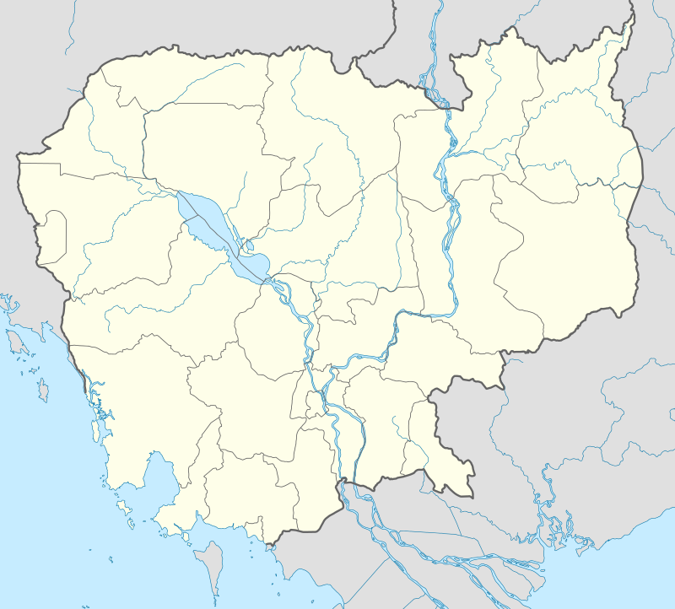
Angkor Wat
PhnomPenh
Cambodia

Slide 5
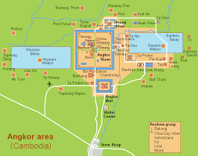
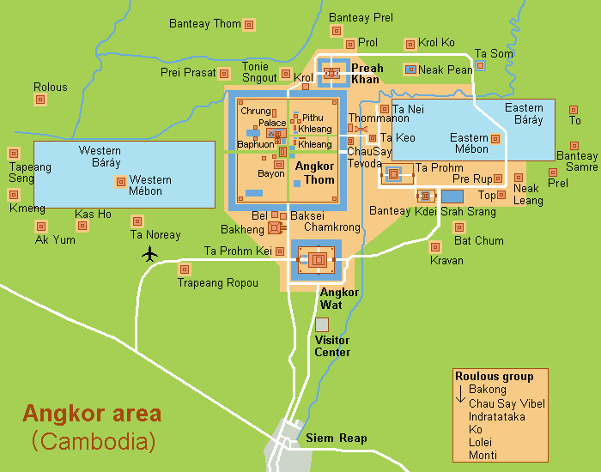

Slide 6
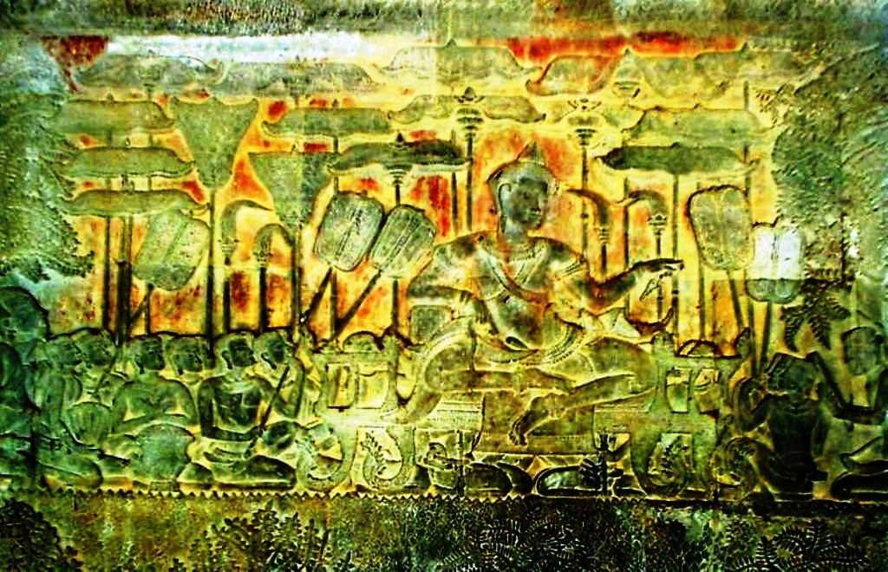
Suryavarman II built Angkor Wat in the 12th century

Slide 7
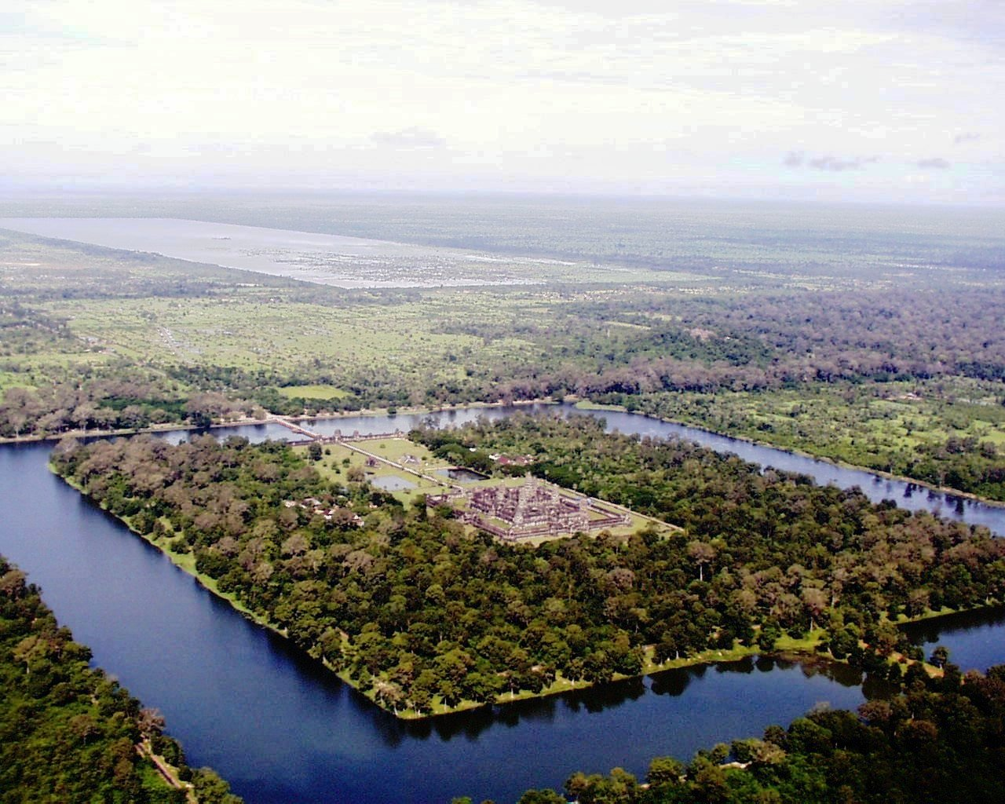
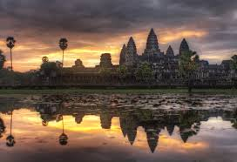
https://www.youtube.com/watch?v=IxCOrfS_NY0
Aerial view of Angkor Wat

Slide 8
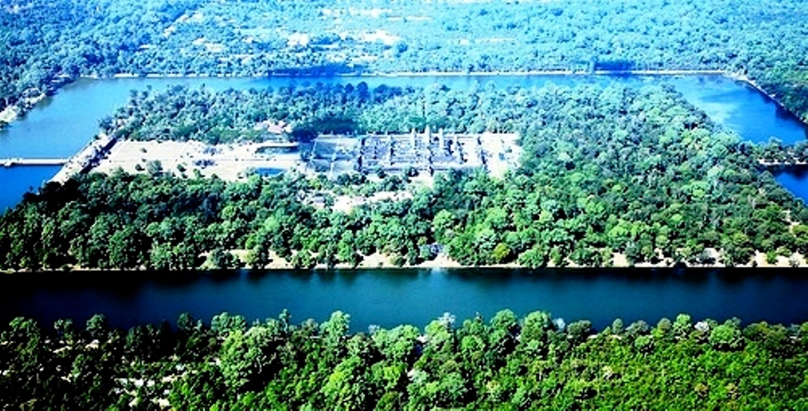
https://www.youtube.com/watch?v=IxCOrfS_NY0

Slide 9
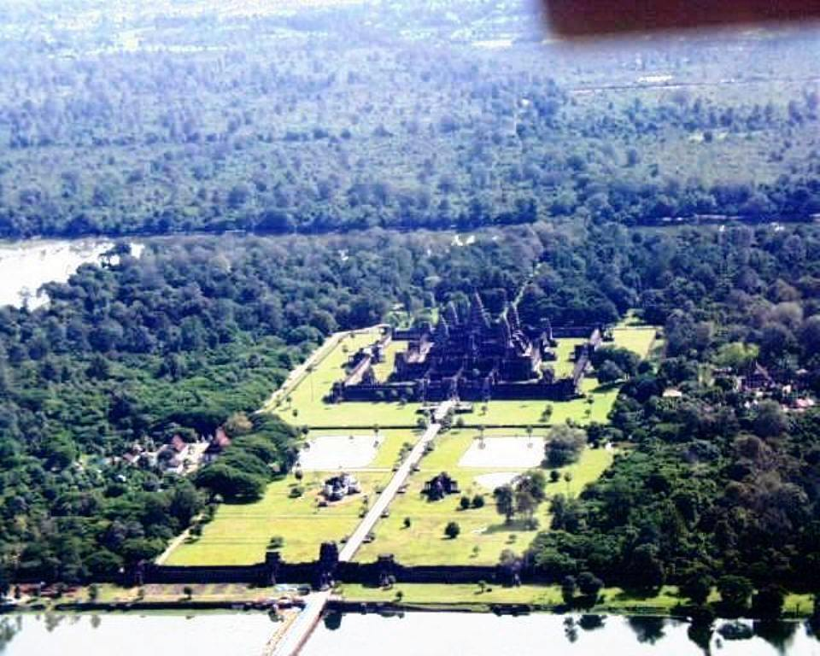
https://www.youtube.com/watch?v=IxCOrfS_NY0

Slide 10
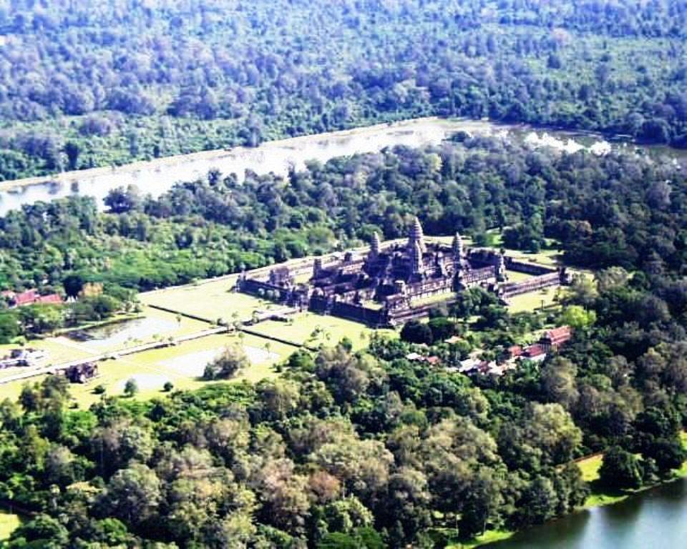
https://www.youtube.com/watch?v=IxCOrfS_NY0

Slide 11
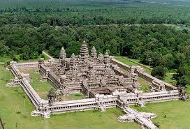
https://www.youtube.com/watch?v=IxCOrfS_NY0

Slide 12
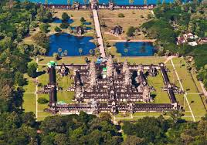
https://www.youtube.com/watch?v=IxCOrfS_NY0

Slide 13
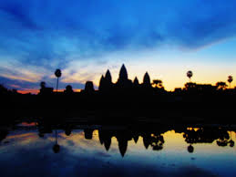
Angkor Wat at dawn

Slide 14
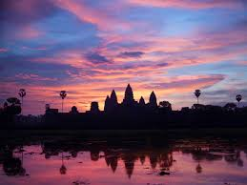

Slide 15
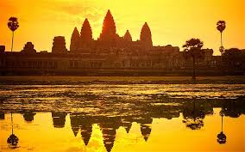
Angkor Wat at sunset

Slide 16
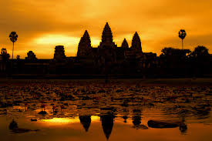

Slide 18
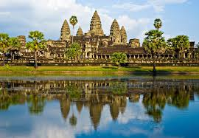

Slide 19
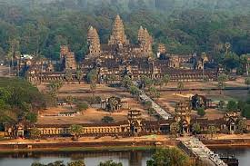

Slide 20
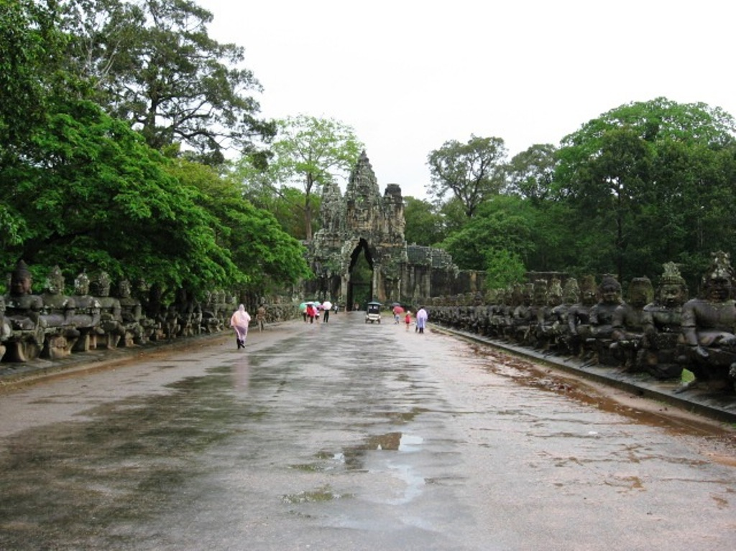
On the way to Angkor Wat with Devas and Asura on both sides churning ocean

Slide 21
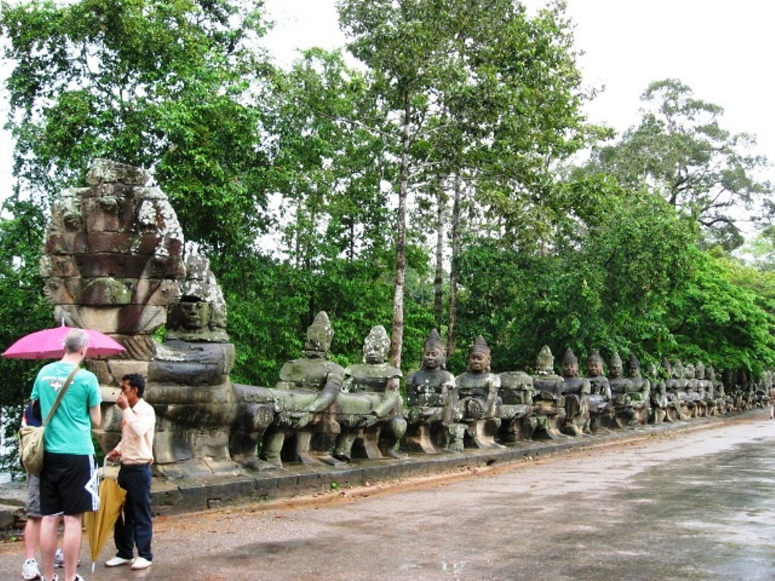
Devas on one side

Slide 22
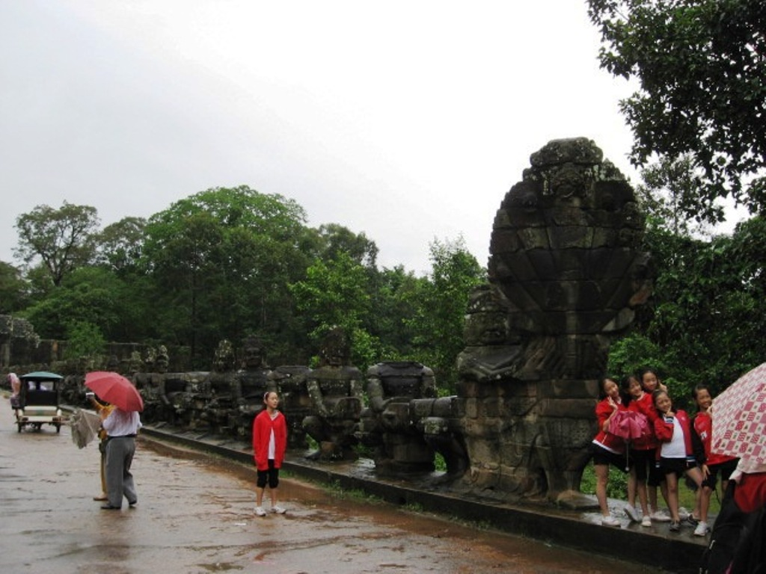
Asuras on the other side

Slide 23
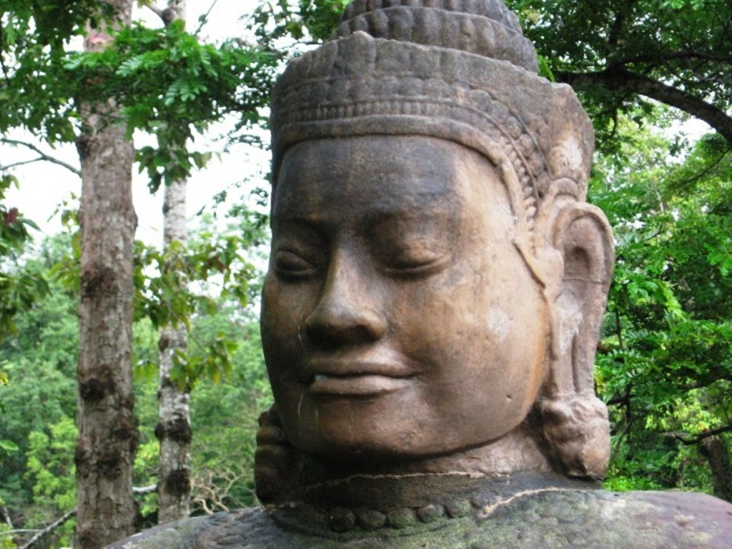
Devas

Slide 24
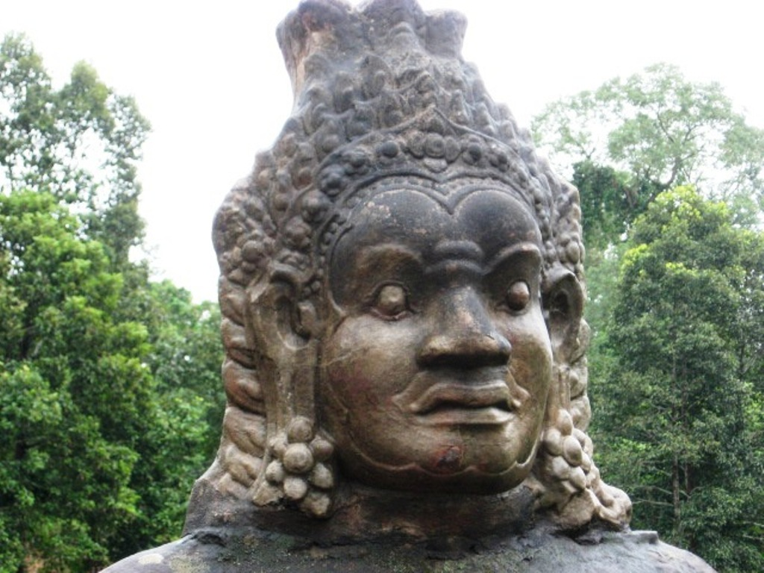
Asuras

Slide 25
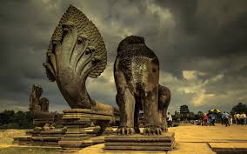
Naga and the guardian on the causeway

Slide 26
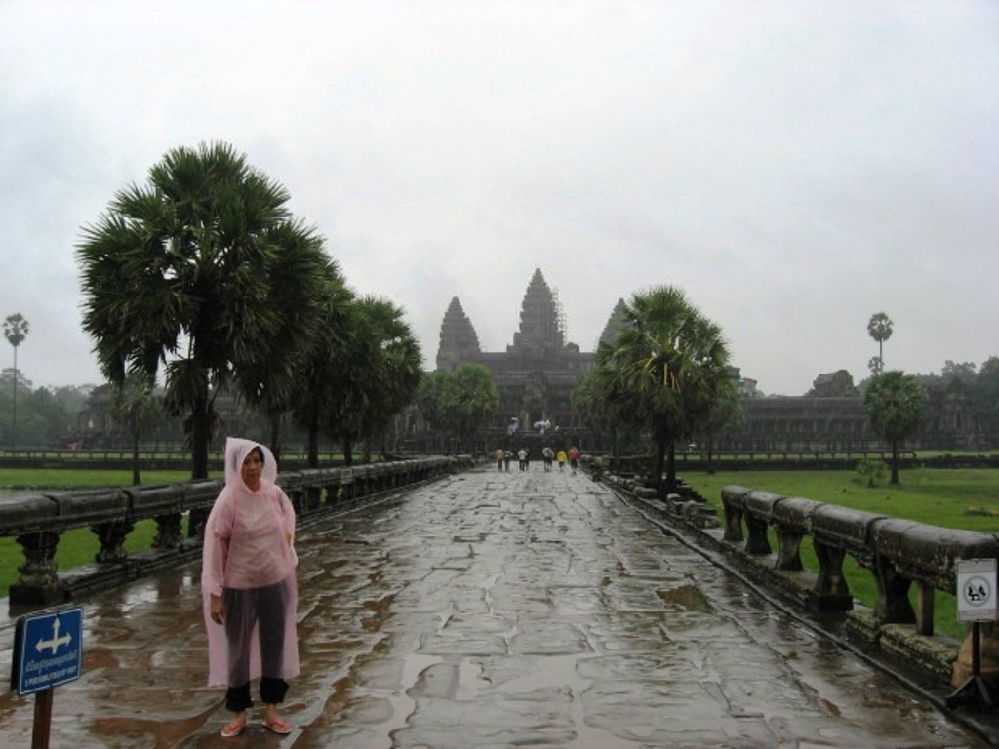
Tipin on the causeway to the temple

Slide 27
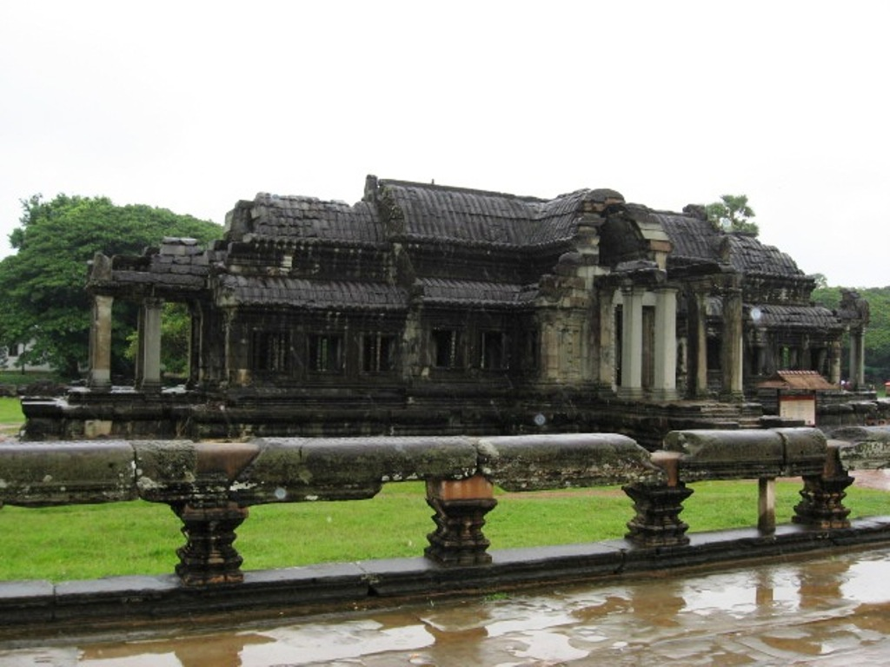
Snake along the causeway and the library in the background

Slide 28
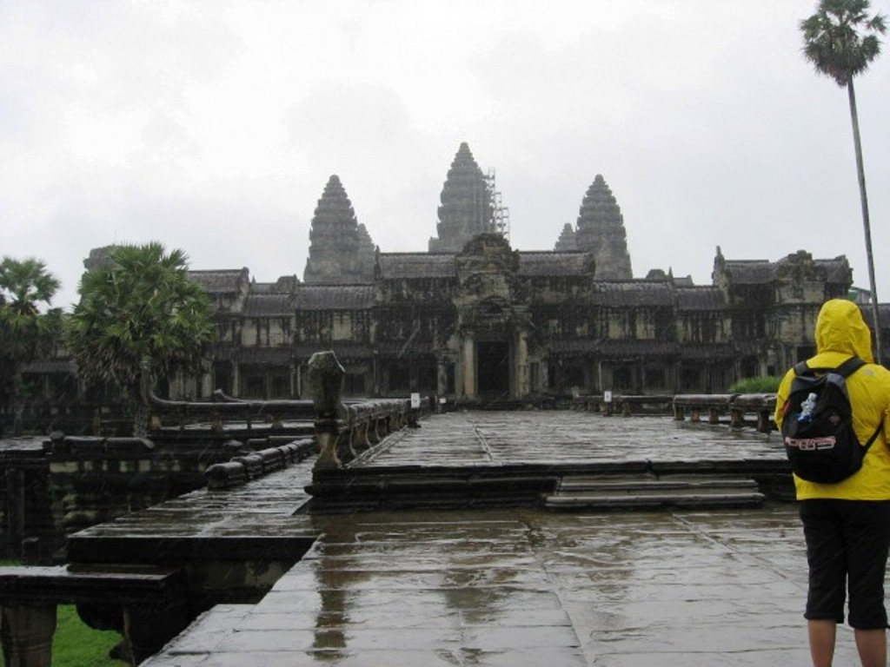
End of causeway

Slide 29
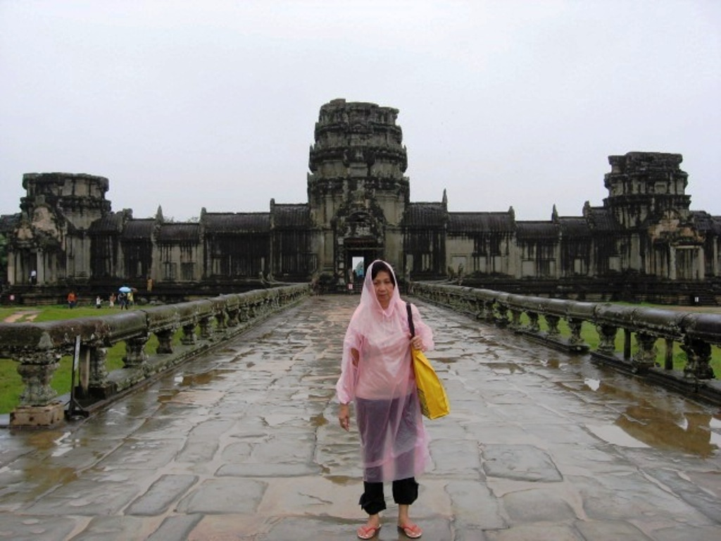
Entry to Angkor through the outer gate

Slide 30
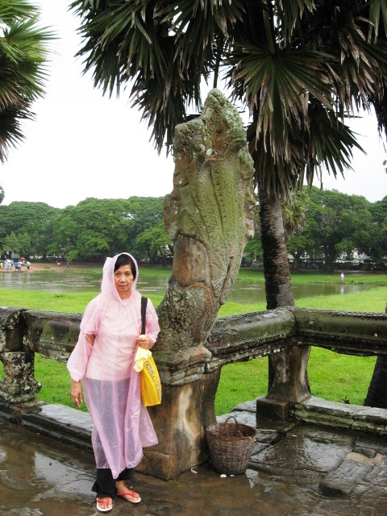
Tipin with Snake at Angkor Wat

Slide 31
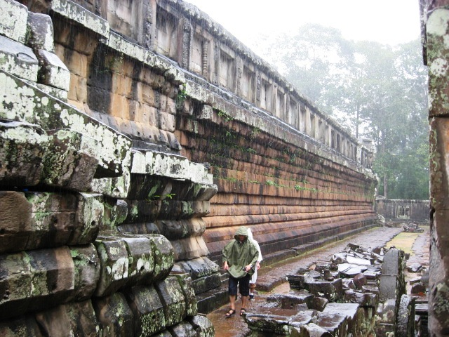
Foundation

Slide 32
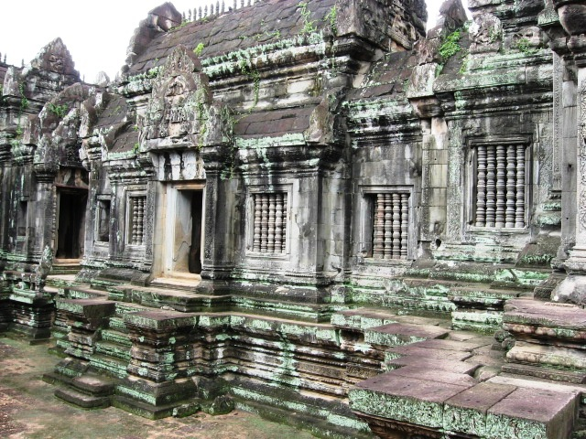

Slide 33
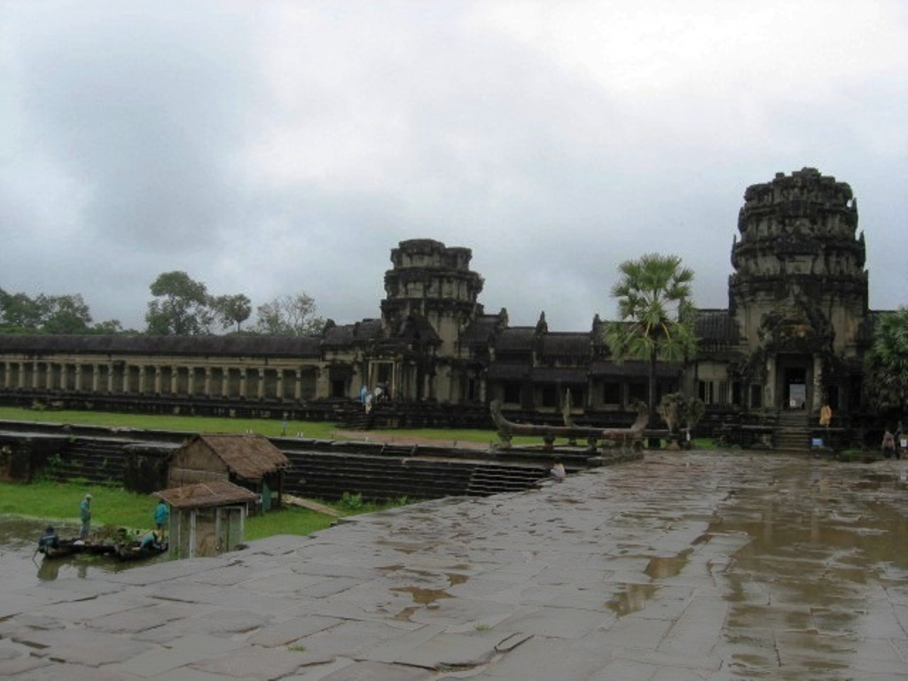
Outer wall

Slide 34
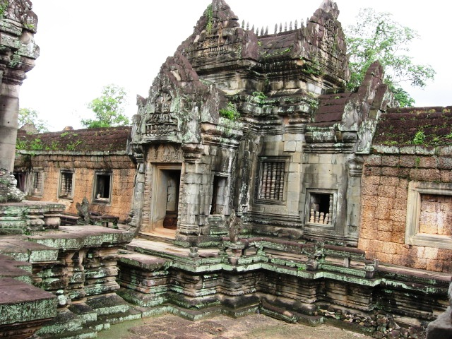

Slide 35
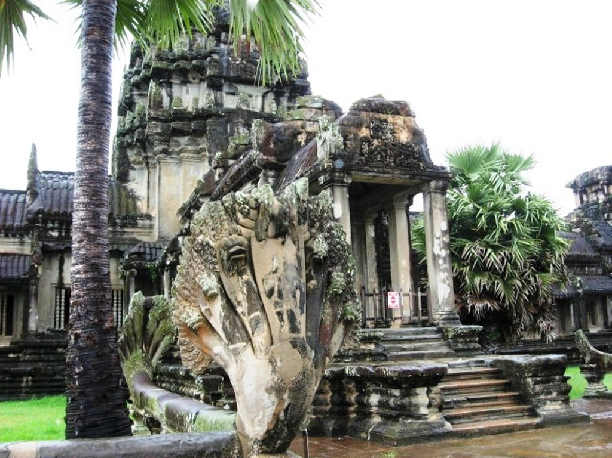
Entrance to the inner court

Slide 36
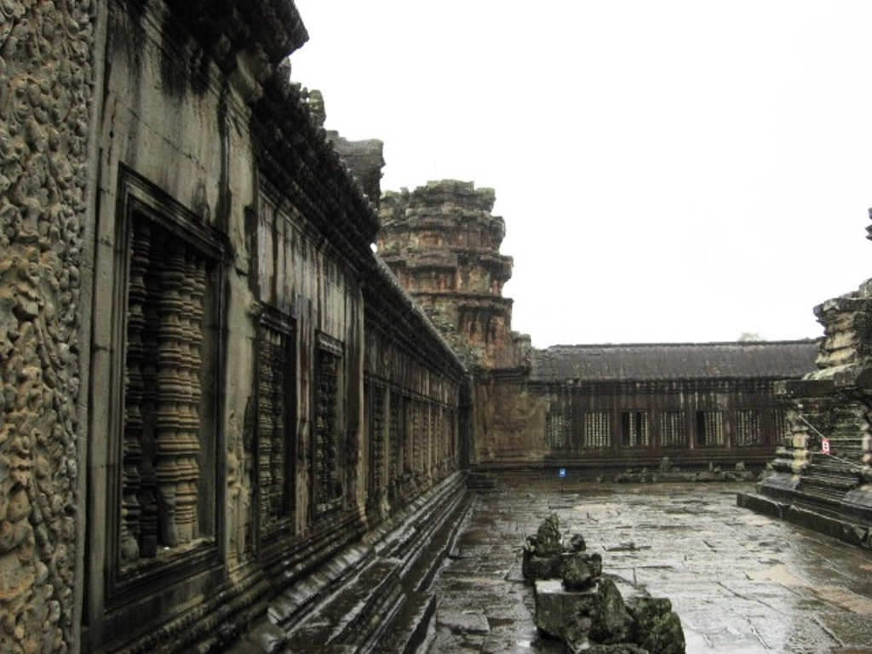
Inner courtyard

Slide 37
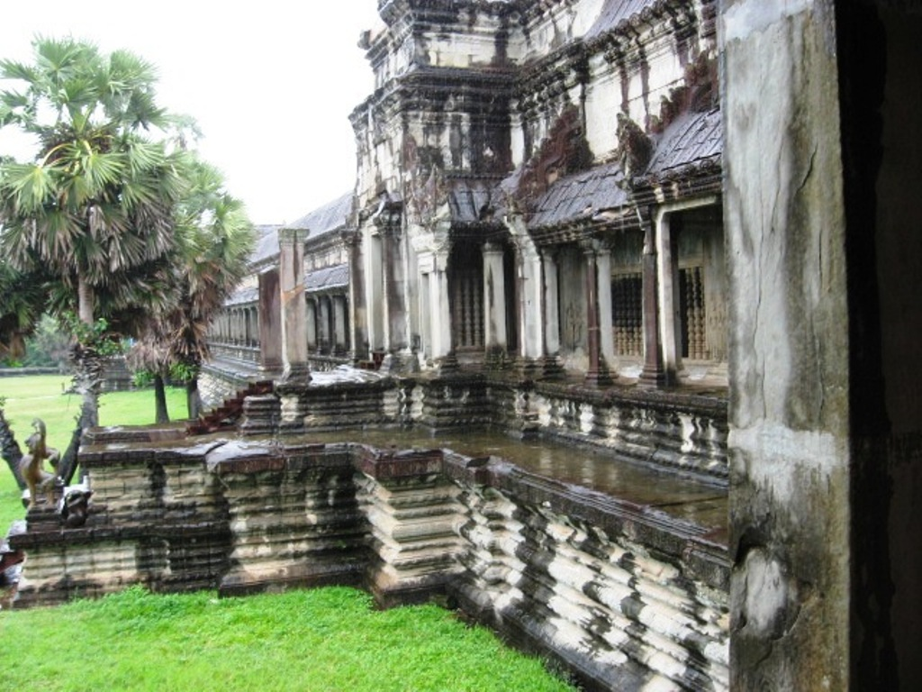
High foundation

Slide 38
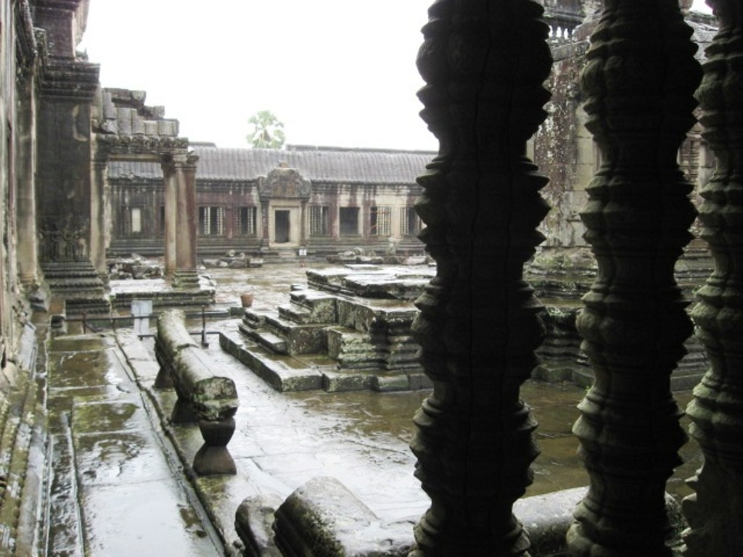
Galleries surround the courtyard

Slide 39
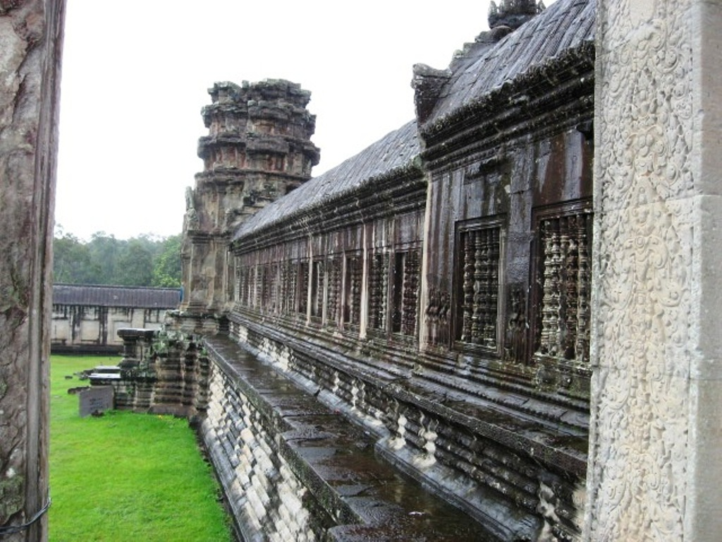
Galleries where bas reliefs are found

Slide 40
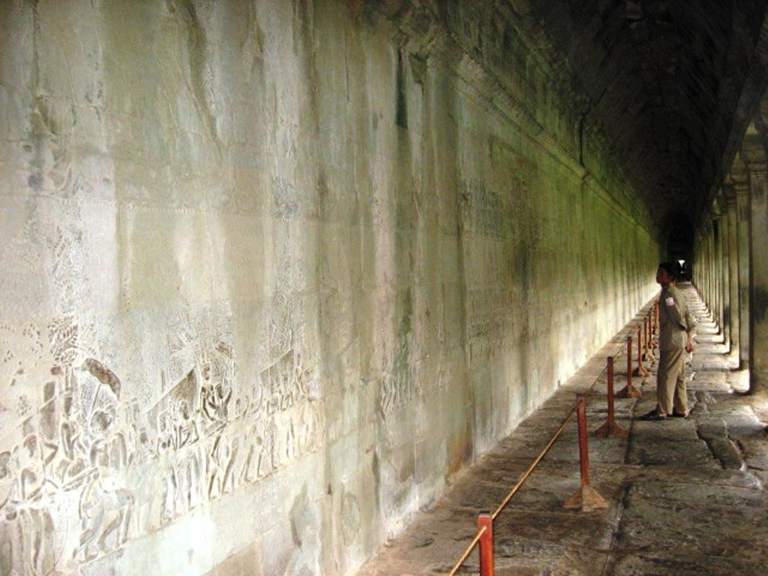
800 meter long( each) gallery on all four sides

Slide 41
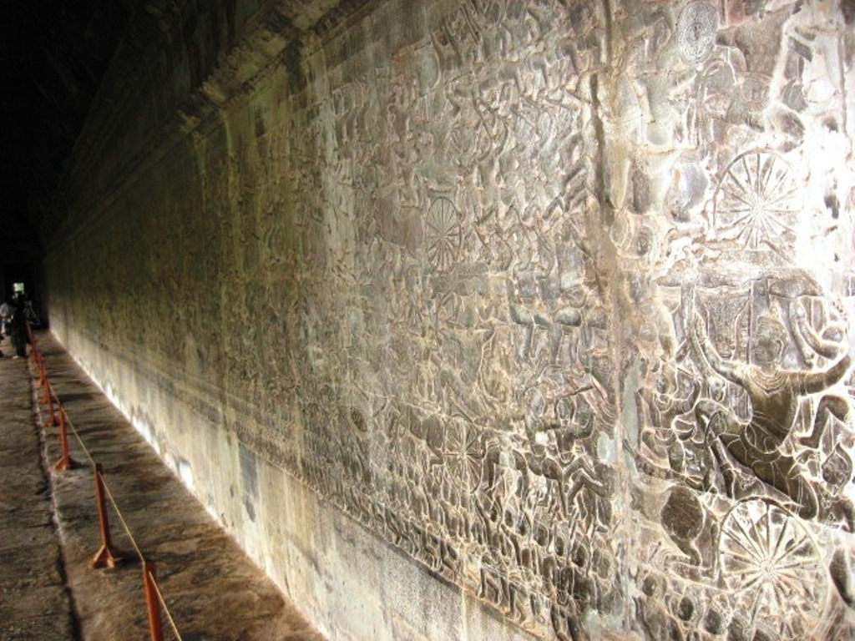

Slide 42
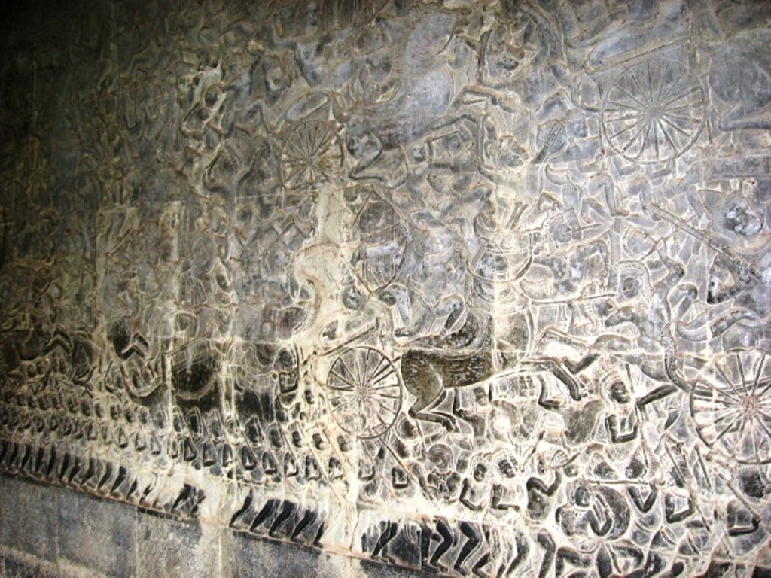
Battle of Mahabharata

Slide 43
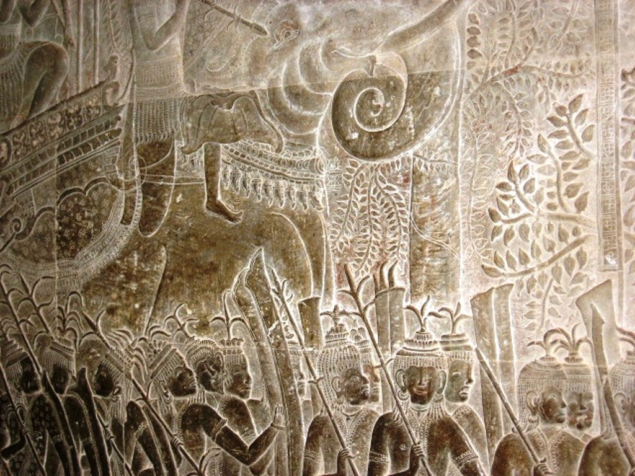
Bas relief depicting battle of Mahabharata

Slide 44
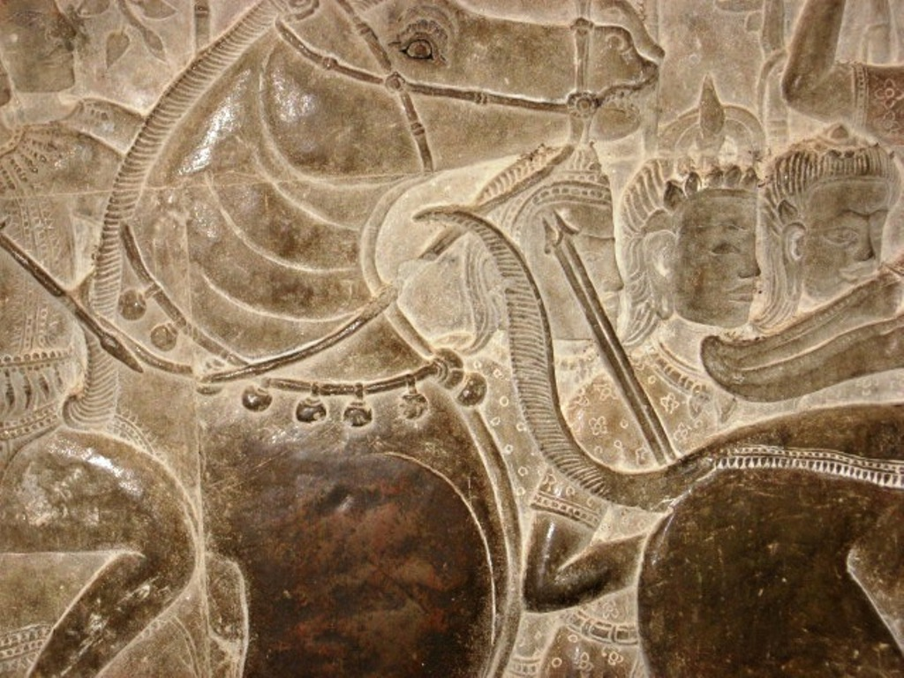

Slide 45
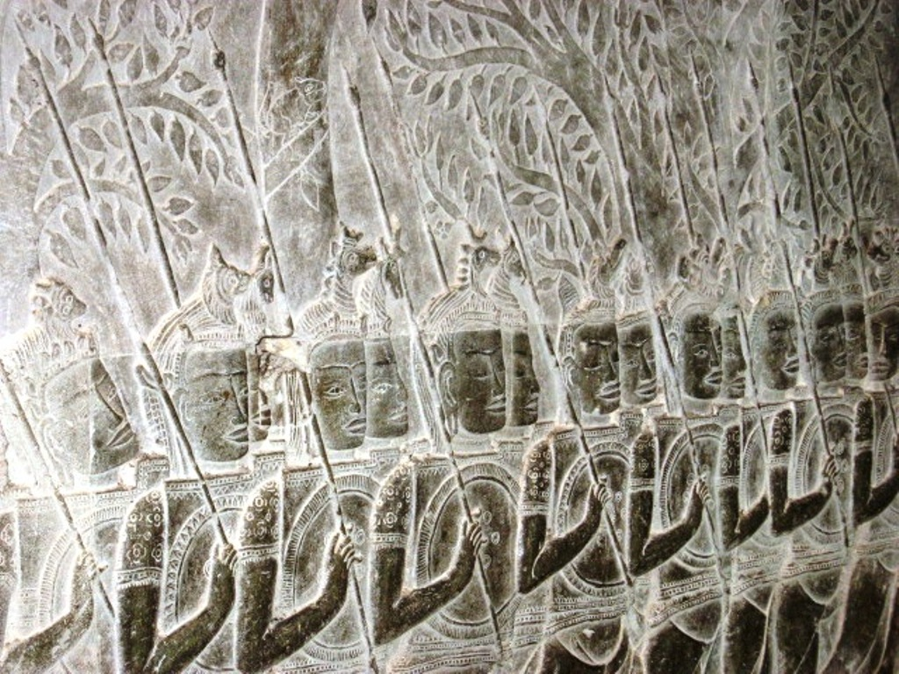

Slide 46
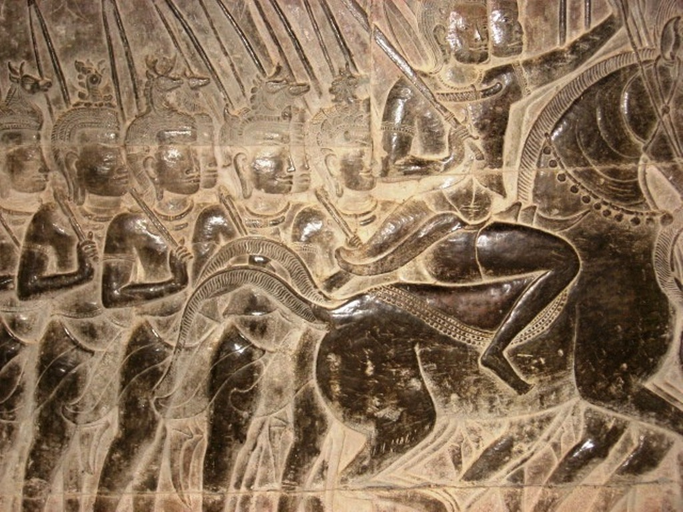

Slide 47
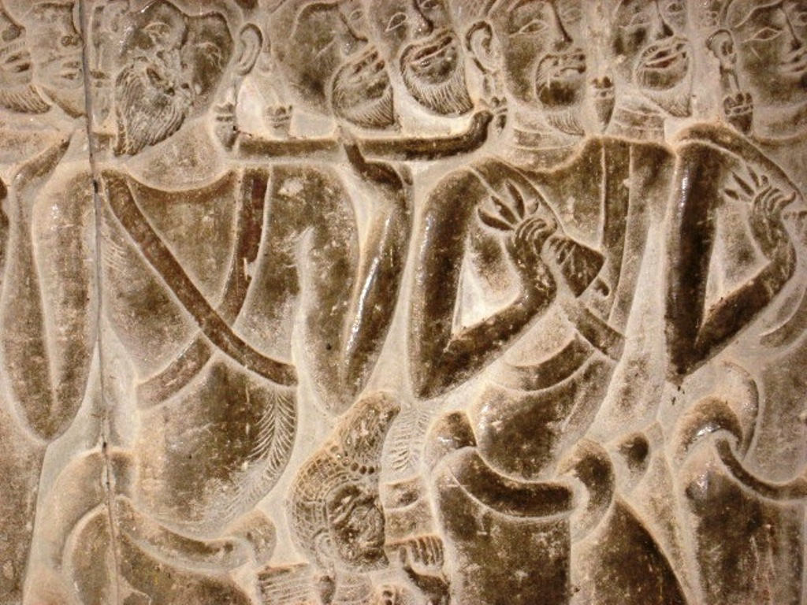

Slide 48
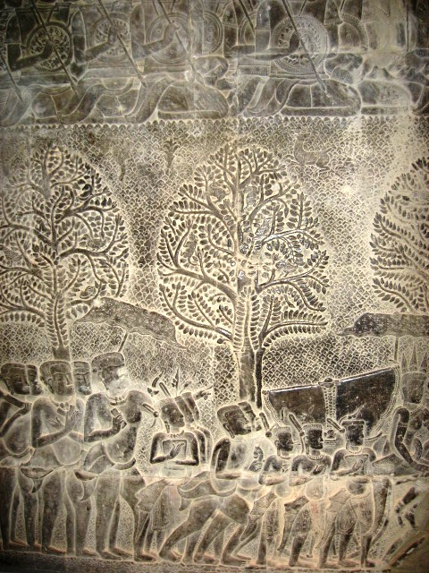

Slide 49
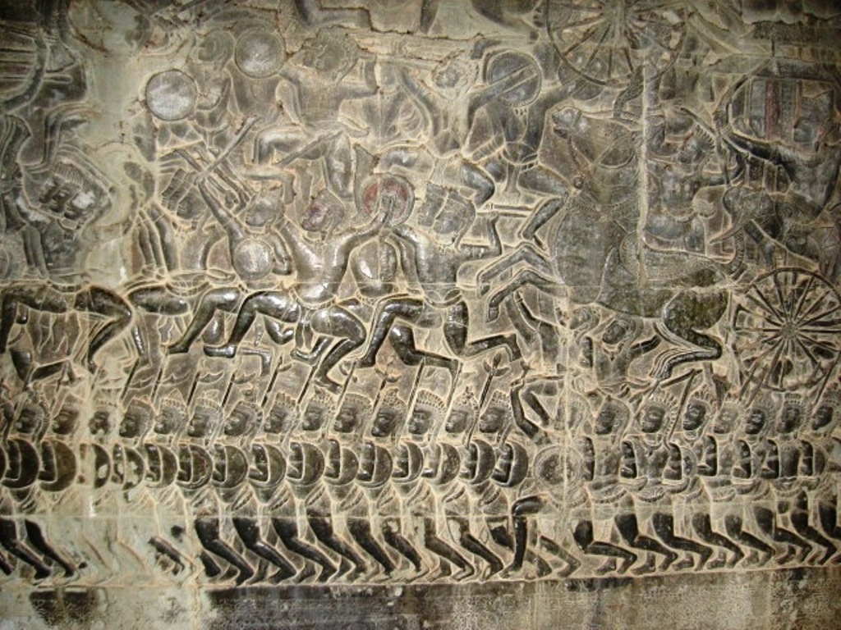

Slide 50
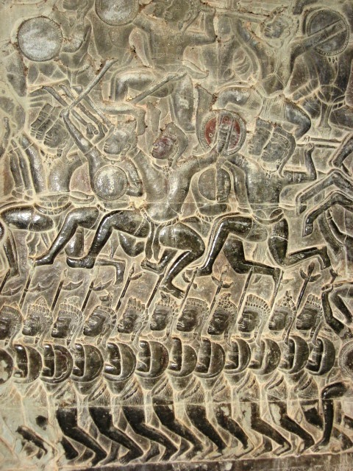

Slide 51
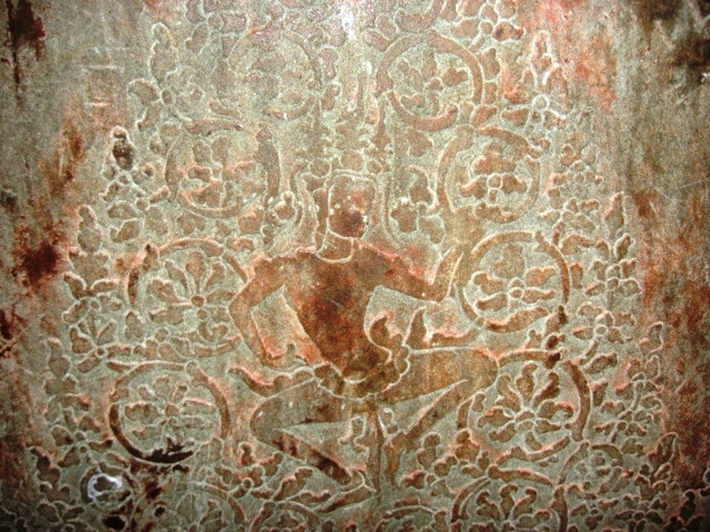

Slide 52
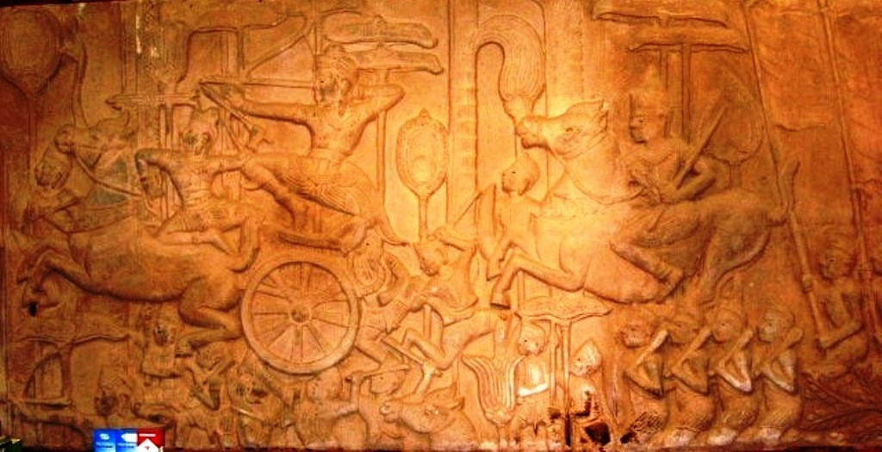

Slide 53


Inscriptions on the wall

Slide 54


Slide 55


Slide 56


Slide 57


Slide 58


Slide 60

Crenalated arch

Slide 61

Looted Apsaras

Slide 62


Slide 63


Slide 64


Slide 65


Slide 66


Slide 67

Apsaras that survived

Slide 68


Slide 69


Slide 70


Slide 71

Inner moat

Slide 72

Inner court

Slide 73

Outer moat

Slide 74

The other end of the moat

Slide 75


Slide 76


Slide 77


Slide 78


Slide 79

Inner tank

Slide 80


Slide 81

Steps to the next level

Slide 82

Steps to the higher level

Slide 83

Highest level with Vishnu temple on top

Slide 84

Another view

Slide 85

Final ascent

Slide 86

Lotus bud shaped Vishnu temple

Slide 87

Main temple at Angkor Wat

Slide 88

Steep steps to main temple

Slide 89

Inner lateritic core

Slide 90


Slide 91

Vishnu

Slide 92

Hinduism gave way to Buddhism later at Angkor

Slide 93

Worship at Angkor Wat

Slide 94

Buddha is worshipped here

Slide 95

Devotees

Slide 96

Approach to Banteay Srei

Slide 97


Slide 98

Entrance to Banteay Srei

Slide 99


Slide 100


Slide 101


Slide 102


Slide 103


Slide 104


Slide 105


Slide 106


Slide 107


Slide 108


Slide 109


Slide 110


Slide 111


Slide 112

Banteay Samre

Slide 113


Slide 114


Slide 115

Restoration work

Slide 116

Elephant terrace

Slide 117


Slide 118


Slide 119

Lake near elephant terrace

Slide 120

Takeo

Slide 121


Slide 122


Slide 123


Slide 125


Slide 126


Slide 127


Slide 128

Tipin and Nandi bull

Slide 129

Tipin and the Snake

Slide 130

Artificial lake lined with steps

Slide 131

Kids playing in Takeo

Slide 132


Slide 133


Slide 134


Slide 135


Slide 136


Slide 137


Slide 138

Mebon lake

Slide 139

Ta Phrom
It is the most dilapidated of all sites

Slide 140

But India is helping restoration

Slide 141


Slide 142


Slide 143


Slide 144


Slide 145


Slide 146


Slide 147


Slide 148


Slide 149


Slide 150


Slide 151


Slide 152

Restoration going on

Slide 153


Slide 154


Slide 155


Slide 156


Slide 157

Ta Phrom

Slide 158


Slide 159


Slide 160


Slide 162


Slide 163


Slide 164


Slide 166

King Jayavarman built Bayon

Slide 167


Slide 168


Slide 169


Slide 170


Slide 171


Slide 172


Slide 173


Slide 174


Slide 175


Slide 176


Slide 177


Slide 178


Slide 179


Slide 180


Slide 181


Slide 182


Slide 183

A gate

Slide 184


Slide 185


Slide 186


Slide 187


Slide 188


Slide 189


Slide 190

Prasat Baphoun

Slide 191


Slide 192


Slide 193


Slide 194


Slide 195


Slide 196


Slide 197


Slide 198


Slide 199

Victims of Khmer Rouge war sing near Angkor

Slide 200

Apsara carvings for sale

Slide 201


Slide 202


Slide 203


Slide 204

The sculptor

